Slide 1

ESA Cosmic Vision MF ASICs and IPs Development
June 12-16, 2016
AMICSA & DSP DAY 2016
Notes:
1

Slide 2
Agenda
Introduction
ASICs Architecture
Radiation Hardening Techniques
Verification
Validation
Conclusions

Slide 3
Introduction
ESA funded activity to create radiation tolerant high-performance mixed-signal IPs.
Two ASICs have been developed:
  CVB001: ADC composed of four different ∑Δ modulators.
  CVC001: Rad-hard analogue front-end chip which contains a Bessel Filter, a Digital to Analogue Converter, a Low Noise Amplifier and a Power amplifier.
  All the IPs were designed to be compatible for interconnection.
  All IPs are configurable

Slide 4




The team
ARQUIMEA:Coordination, design of the general purpose IPs, CVB001 and CVC001 system design, system integration, system verification and system validation.
CNM-IMB-CSIC: Sigma Delta modulators.
UC3M: Digital design
UPC: Amplifiers
USE: Filter design.

Slide 5
List of general purpose IPs
3.3/1.8V power supply regulator for analogue circuitry (REGA)
3.3/1.8V power supply regulator for digital circuitry (REGD)
SPI/APB communication blocks (SPI)
High accuracy bandgap voltage reference (BGR)
Analogue test bus (ATBUS) with 16 channels
Digital test bus (DTBUS) with 16 channels

Slide 6
IPs included in CVB001
Low-speed single-bit (LSSB) ΣΔ modulator designed for the [50; 150] kHz signal frequency range.
High-speed single-bit (HSSB) ΣΔ modulator designed for the [150; 500] kHz signal frequency range.
Low-speed multi-bit (LSMB) ΣΔ modulator designed for the [0.5; 2] MHz signal frequency range.
High-speed multi-bit (HSMB) ΣΔ modulator designed for the [2; 5] MHz frequency range.

Slide 7
IPs included in CVC001
Bessel filter (BF) with configurable bandwidth (1 and 5 MHz options)
Low-speed DAC (LSDAC) Low-noise amplifier (LNA) with voltage and trans-impedance programmable amplification modes.
Power amplifier (PA) with voltage, current, trans-impedance and trans-conductance amplification modes.

Slide 8
Main specs
Parameter | Value | Unit
Operational range | [-10; 85] | °C
Functional range | [-55; 125] | °C
TID | 300 | Krad
SEL | 80 | MeV·cm2/mg
SER | 1e-10 | errors/bit/day
Supply voltage | [2; 3.6] | V
Supply current | <27 | mA

Slide 9
IP Specs
ADC Main specs
Parameter | Value | Unit
Signal bandwidth | [0,05; 5] | MHz
Effective resolution | [13; 19] | bits
Consumption | [1; 20] | mA
LNA Main specs
Parameter | Value | Unit
Signal bandwidth | [0,05; 5] | MHz
Analogue inputs | [0; 4] / [-0.7; 0.7] | V / mA
THD | [80; 114] | dB
Consumption | 4 | mA
PA Main specs
Parameter | Value | Unit
Signal bandwidth | [0,05; 5] | MHz
Analogue outputs | [0; 4] / [0; 80] | V / mA
Consumption | 45 | mA

Slide 10
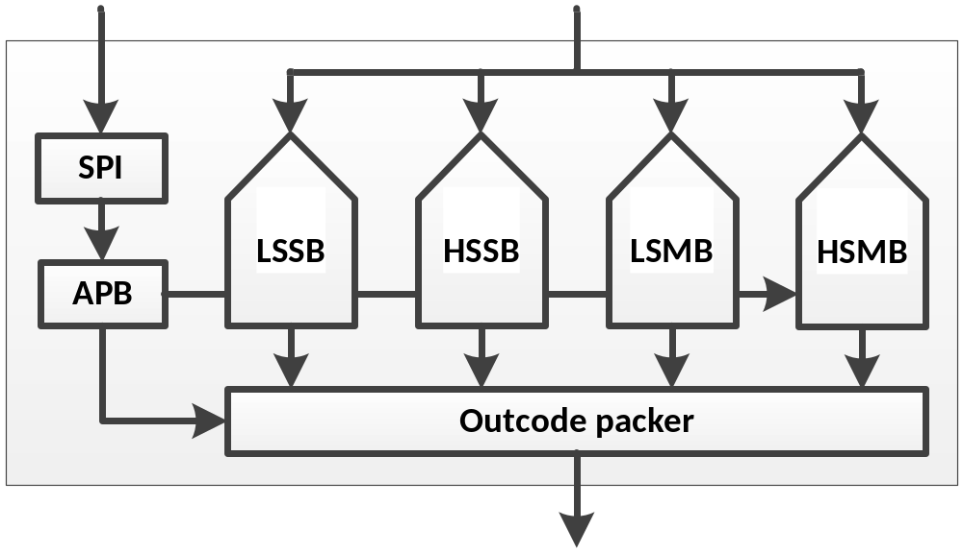
ASICs Architecture – CVB001
CVB001 ASIC is composed by four ΣΔ modulators: LSSB, HSSB, LSMB and HSMB.
Each one is designed to operate in a non-overlapped signal frequency range: LSSB for [50; 150] kHz, HSSB for [150; 500] kHz, LSMB for [0.5; 2] MHz and HSMB for [2; 5] MHz.
Modulators for the two lowest frequency ranges have single-bit output.
Modulators for the highest frequency ranges have a 5-bit multi-bit output.
Only one modulator can operate at a time. 20-bit out-code

Slide 11
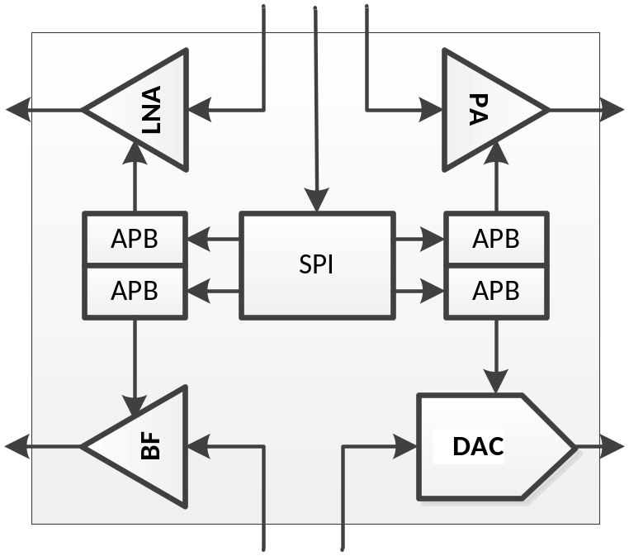
CVC001 Architecture
CVC001 is composed by a Bessel filter a digital-to-analogue converter, a low-noise programmable amplifier and a power amplifier.
All the blocks can operate independently and powered-down if their use is not required. CVC001 is controlled and configured through SPI

Slide 12
CVC001 Architecture
CVC001 is composed by a Bessel filter a digital-to-analogue converter, a low-noise programmable amplifier and a power amplifier.
All the blocks can operate independently and powered-down if their use is not required. CVC001 is controlled and configured through SPI

Slide 13
Radiation hardening
The technology used for the development of these IPs is DARE/UMC180 Mix-mode. The DARE digital library was used to implement the digital configuration logic and the modulator output data packers.
IMEC support and services where also used for digital backend
For the analogue part and a few full custom digital cells directly placed on the ΣΔMs dedicated radiation hardening by design techniques were followed

Slide 14
Verification
Together with the power consumption, a single key parameter has been selected to represent the performance of each IP for convenience
LSSB ΣΔM verification results
Parameter | Core | Chip | Unit
Effective resolution | 18 | 15.5 | bits
Consumption | 11 | 15 | mA
LNA verification results
Parameter | Core | Chip | Unit
THD | 88 | 80 | dB
Consumption | 24 | 25 | mA
LNA verification results
Parameter | Core | Chip | Unit
THD | 74 | 68 | dB
Consumption | 100 | 110 | mA

Slide 15
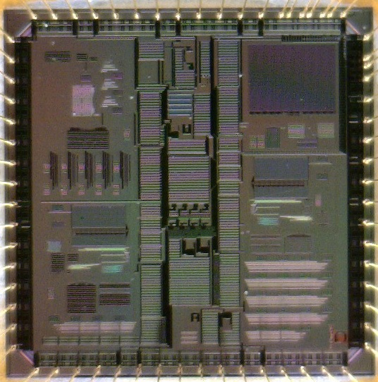
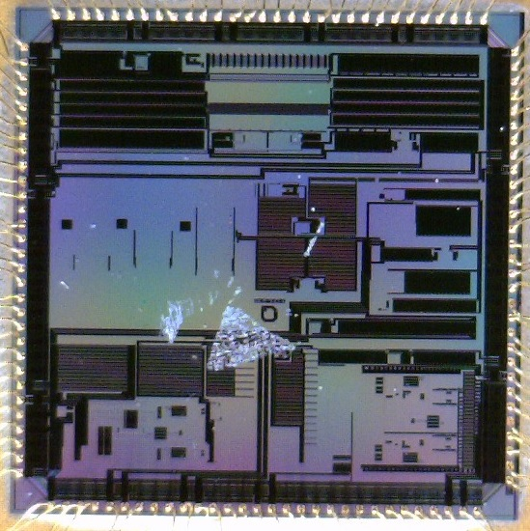
Validation – Tested silicon and packaging
The CVB and CVC chips were fabricated under the IMEC-Europractice service using a MPW run. The die area of both devices is 5x5 mm²
In addition to these two dies an additional one fabricated under the same service in a mini-ASIC run and ordered directly by IMB-CSIC was also fabricated. This additional die contains an isolated version of the LLSB ΣΔM and was also packaged in the frame of the project.
The CVB chip was packaged using a plastic QFN64 and the CVC a plastic LQFP120
CVB001
CVC001

Slide 16
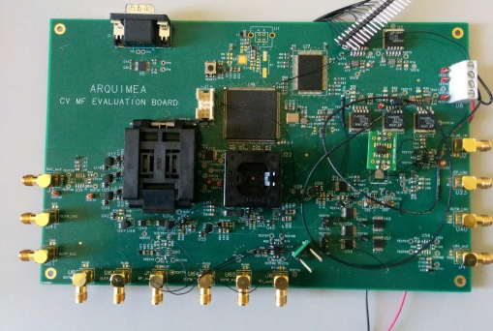
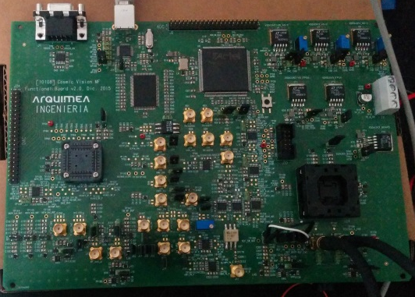
Measurement boards (1)
4 boards designed, fabricated and mounted.
CVB&CVC board 1: to allow functional validation of the ASICs and perform preliminary measurements on each of the IPs.
CVB&CVC board 2. The main objective of the second board was to extend the functional validation capabilities of the setup, to allow the connection of high precision signal sources and to reduce the overall noise floor.
CVB&CVC Board 1
CVB&CVC Board 1

Slide 17
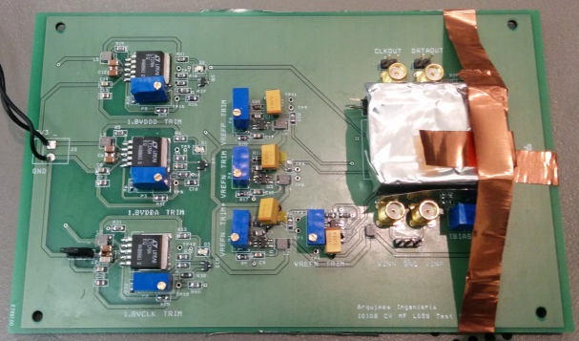
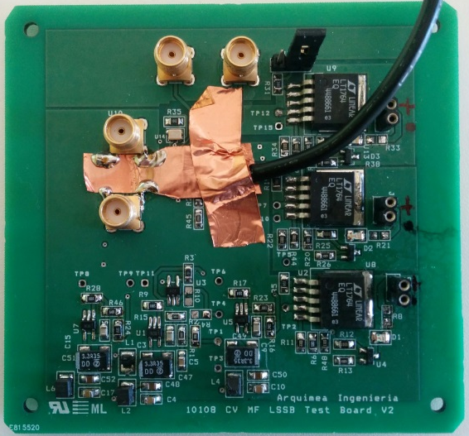
Measurement boards (2)
LLSB board 1: to be able to measure the high performance of the modulator. After mounting and debugging, the noise floor measured was around 20dB higher than was required and the distortion 10dB.
LLSB board 2: upgrade to further improve the overall noise and distortion figures.
LSSB Board 1
LSSB Board 2

Slide 18
Signal source and measurement equipment
For the [0; 200] kHz range, the analogue input signal was generated with DS360 Standard Research Systems high quality source. It can achieve 100dB of SNDR but can only go up to 200 kHz
For the [0.2; 5] MHz range, BK PRECISION 4064 source was used. It can reach higher frequencies but only achieves 80dB of SNDR.
Keysight DSOS204A oscilloscope was used to monitor time domain signal and to perform a quick but moderate accuracy frequency analysis (up to 60dB of SNDR).
Analogue Devices boards were used to perform high accuracy frequency analysis (up to 90dB of SNDR).

Slide 19
Results
Together with the power consumption, a single key parameter has been selected to represent the performance of each IP for convenience
LSSB ΣΔM in CVB results LSSB ΣΔM standalone
Parameter | Value | Unit
Effective resolution | 14 | bits
Area | 1.325 x 1.485 | mm²
Consumption | 16 | mA
Parameter | Value | Unit
Effective resolution | 15.5 | Bits
Area | 1.325 x 1.485 | mm²
Consumption | 15 | mA
LNA validation results
Parameter | Value | Unit
THD | 63 | dB
Area | 0.995 x 1.07 | mm²
Consumption | 25 | mA
PA validation results
Parameter | Value | Unit
THD | 73 | dB
Area | 0.61 x 1520 | mm²
Consumption | 110 | mA

Slide 20
Conclusions
A set of high performance and highly configurable IPs have been designed, verified and electrically validated in the frame of ESA’s Cosmic Vision MF activity showing promising results.
A single silicon run was used to implement the designs showing a very good correlation between verification and validation.
Further work on the IPs could tune or adapt performances for particular applications and further testing of the ASICs would allow additional data on all possible configuration modes.

Slide 21



dgonzalez@arquimea.com
jlopez@arquimea.com
arquimea_012
arquimea_026

