Slide 1

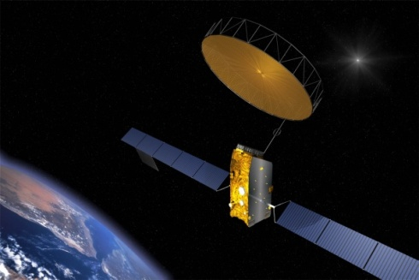
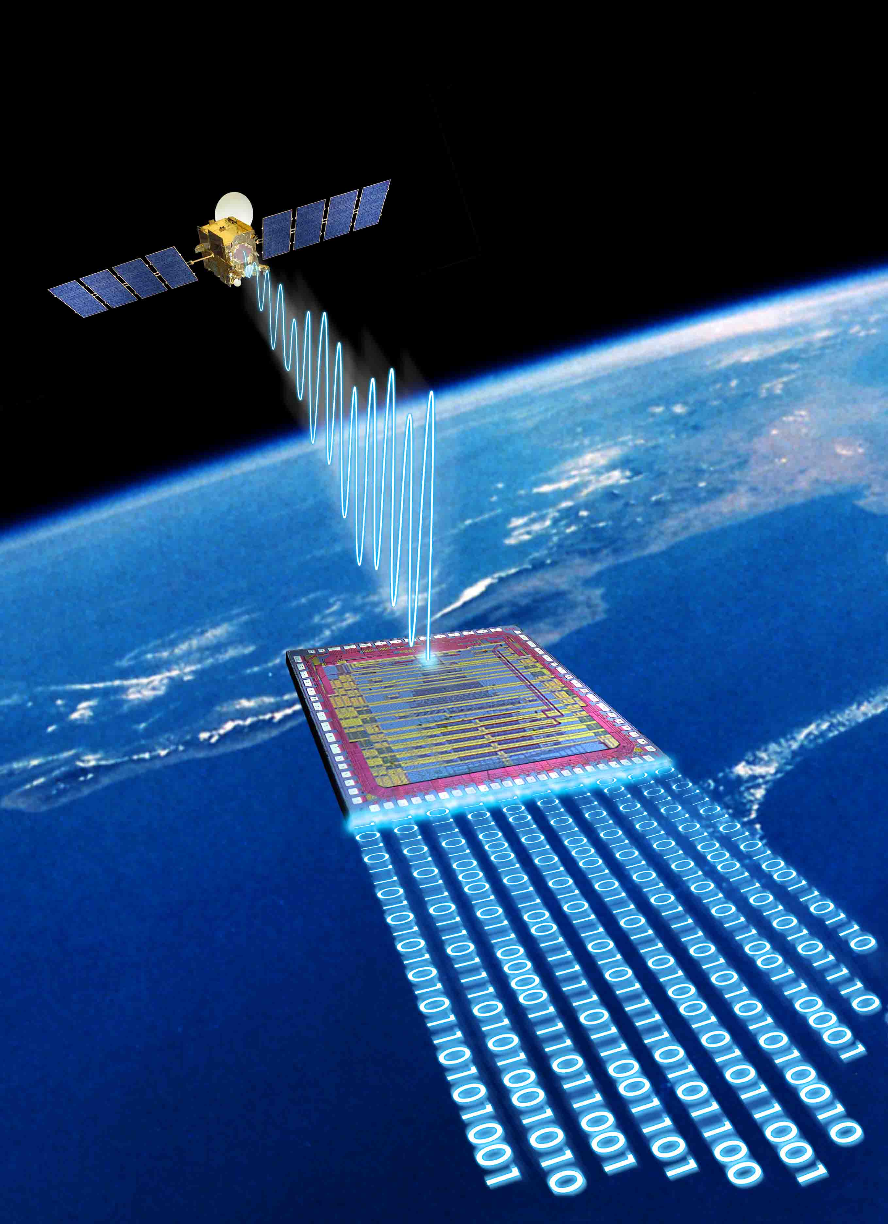
Serial I/O ADCs/DACs : The Next Giant Leap in Mixed-Signal for Space
Dr. Rajan Bedi
CEO Spacechips Ltd.
Notes:
Same cost and schedule issues from the mobile phone basestation industry

Slide 2
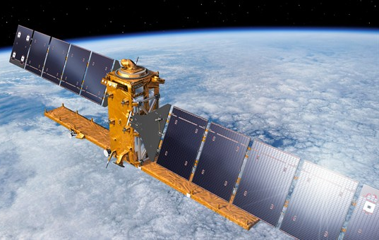
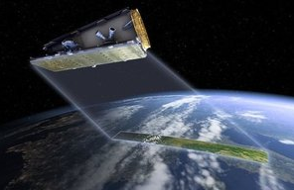
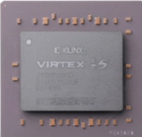
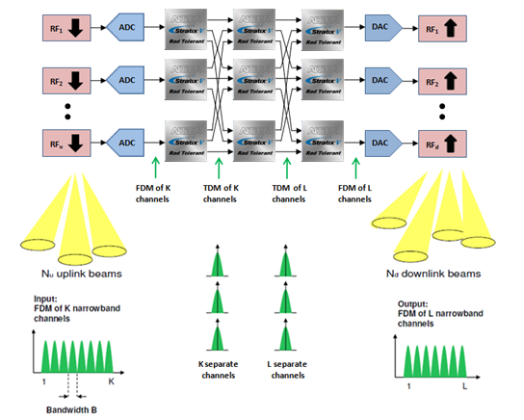
Sentinel 1 vs. NovaSAR

Slide 3
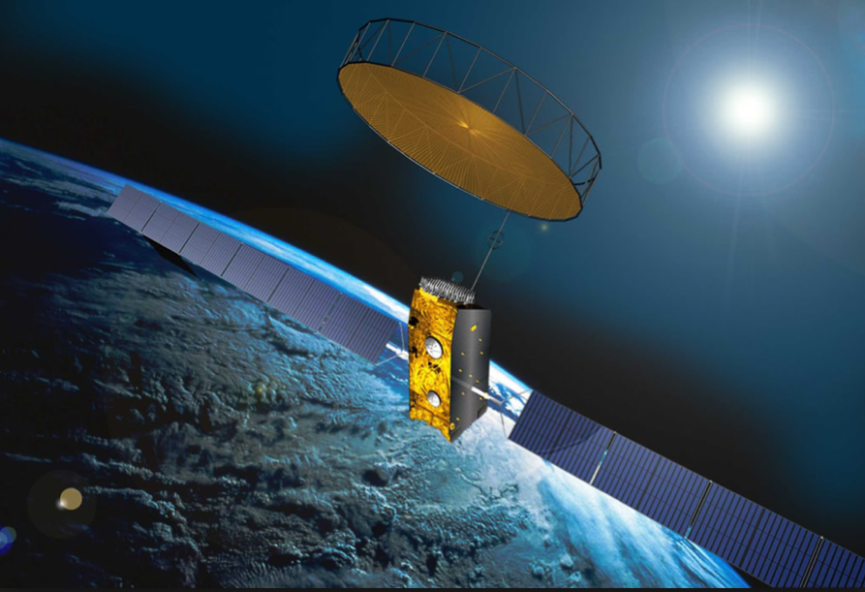
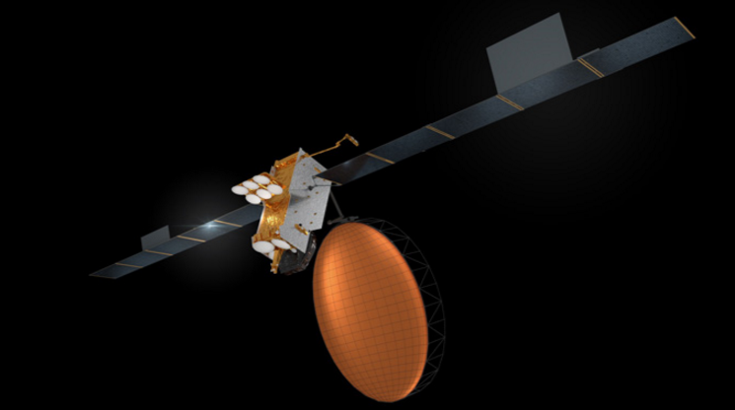
Alphasat vs. Inmarsat 6

Slide 5
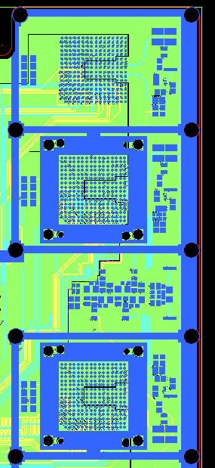
Parallel-I/O ADCs/DACs
Each parallel ADC requires over 50 pins to connect the digital outputs to the
FPGA – over 200 I/O pins!
Complex routing, expensive 20-layer PCBs, large ADC/DAC packages

Slide 6
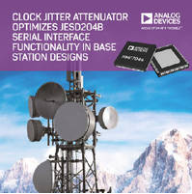
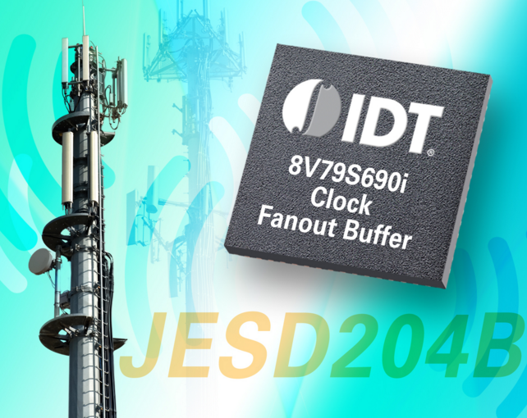
Demand for data services has increased base station capacity

Slide 7
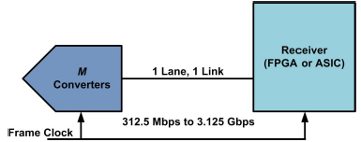
JESD204
To accommodate higher sampling rates and resolutions, JEDEC founded the JESD204 working group in 2006 publishing the first standard for serial I-O ADCs/DACs.
JESD204 (2006) – Serial data link defined for a single lane

Slide 8
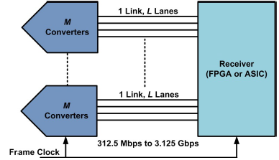
JESD204A
JEDEC released revision A in 2008 supporting 3.125 Gbps.
JESD204A (2008) Multiple-aligned serial lanes

Slide 9
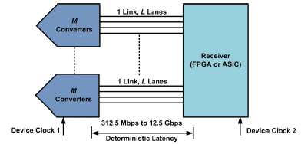
JESD204B
JEDEC released revision B in 2011 supporting 12.5 Gbps and deterministic latency.
JESD204B (2011), Multiple-aligned serial lanes,
repeatable latency from power-up

Slide 10






JESD204
Major suppliers of mixed-signal convertors now offering JESD204B ADCs/DACs.
JESD204 has been used in cellular base stations since 2007.
In Europe, NXP developed some of the leading parts in The Netherlands and in France.
Notes:
Supported by providers of space-grade FPGAs

Slide 11
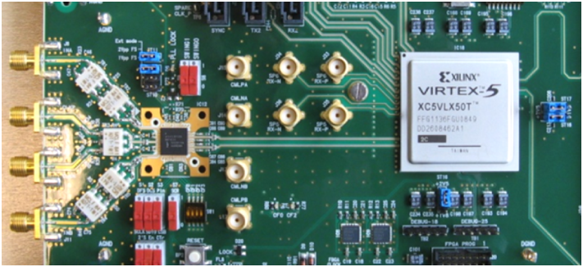
JESD204 ADCs/DACs
An Opportunity to Eliminate Hardware NRE!
Notes:
Must ensure their 90 nm ASIC technology is compatable
I’m on the jedec committee and can help you ensure your asic serdes i/p is jesd204 compatable
Use example of three people

Slide 12
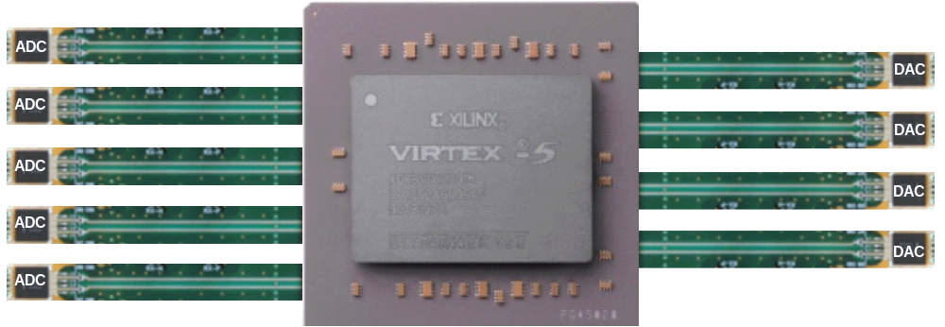
Mixed-Signal Serialisation Concept
18 ADCs/DACs connected to one space-grade FPGA

Slide 13
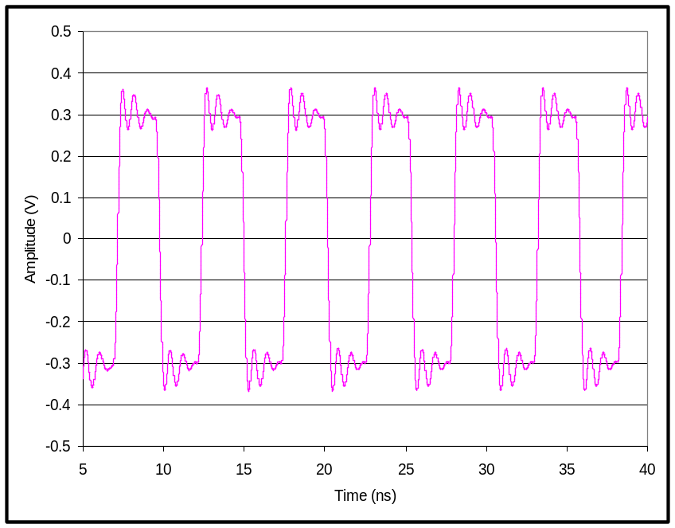
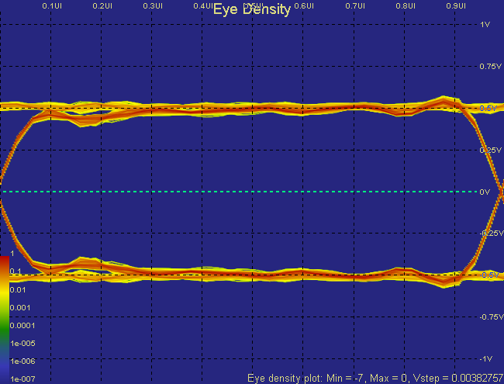

Slide 14
What Can JESD204B Offer The Space Industry?
Allow OEMs to offer different operators bespoke levels of performance without having to re-engineer the hardware avionics – it’s reusable and scalable!
The ability to eliminate hardware, NRE costs
Only have to re-program/configure the arithmetic processing length within FPGAs
Simpler, smaller, less expensive PCB costs
Allow OEMs to deliver hardware right-first-time, to cost and schedule
Allow operators to receive less expensive spacecraft sooner – from contract to launch quicker!
A proven, mature standard from JEDEC, now 3rd generation, supported by major ADC/DAC suppliers

Slide 15


Slide 16

www.courses-for-rocket-scientists.com

Slide 17
ADC, DACs & Mixed-Signal Processing Techniques for Rocket Scientists : A Comparison of Space-Grade Devices
Day 1
Module 1 : Designing with ADCs - Understanding the ADC output spectrum
Understanding aliasing, folding, the level of the noise floor, the effects of FFT processing gain and coherent sampling.
Understanding the real meaning of ADC dynamic performance metrics such as SNR, SINAD, SFDR, ENOB, THD, NPR and IMD.
Understanding the effects of clock jitter, thermal noise and clumping on ADC performance.
Module 2 : Designing with DACs - Understanding the DAC output spectrum
Module 3 : Dynamic Testing of ADCs and DACs
Module 4 : Mixed-Signal Processing Techniques
Day 2
Module 5 : A Comparison of Space-Grade ADCs & DACs : Part 1
A comparison of broadband, GSPS, space-grade ADCs
A comparison of broadband, GSPS, space-grade DACs
Module 6 : A Comparison of Space-Grade ADCs & DACs : Part 2
A comparison of MSPS, space-grade ADCs
A comparison of MSPS, space-grade DACs
Module 7 : Analogue Front-End and Back-End Design
Module 8 : Mixed-Signal System & Hardware Design Considerations
www.courses-for-rocket-scientists.com

Slide 18
FPGAs for Rocket Scientists :
A Comparison of Space-Grade Devices
Day 1
Module 1 : Space-Grade FPGA Technologies
One-Time Programmable FPGAs
Flash FPGAs
SRAM FPGAs
A comparison of FPGA technologies and SEE mitigation
Module 2 : Space-Grade FPGA Fabrics & Resources
One-Time Programmable fabrics & resources
Flash fabrics & resources
SRAM fabrics & resources
A comparison of FPGA fabrics and SEE mitigation
Module 3 : A Comparison of Space-Grade FPGAs Implementing Spacecraft IP
A comparison of devices, specifications and resources
A comparison of devices implementing spacecraft IP
A comparison of design software
A comparison of hardware debug features
Day 2
Module 4 : FPGA System Architecture Design
How to power, sequence and clock your FPGAs, high-speed serial links
Space-grade, low-voltage, high-current DC-DC converters
Space-grade oscillators
Module 5 : Hardware Design-In of Space-Grade FPGAs
Signal Integrity, PDN design & power-estimation spreadsheets and high-speed serial links
Right-first-time PCB design
Design-for-EMC stack-up design and using your PCB as the heatsink
Module 6 : HDL Coding Techniques for High-Reliability Applications
Best practice coding techniques for space applications
www.courses-for-rocket-scientists.com

