Slide 1
CAN Lab and SavoirSAT testbed
Alberto Valverde & Tiago Hekkert
10/03/2016

Slide 2
ESTEC Avionics lab
Wide experience in CAN bus and ECSS-E-ST-50-15C in particular
We can support you in the complete CAN network development cycle
Last year ad-hoc “Introduction to CAN ECSS” workshops were organized for the primes of ELECTRA and SAT-AIS
Plenty of available SW and HW tools and development environments. Simulation, prototyping, testing…

Slide 3
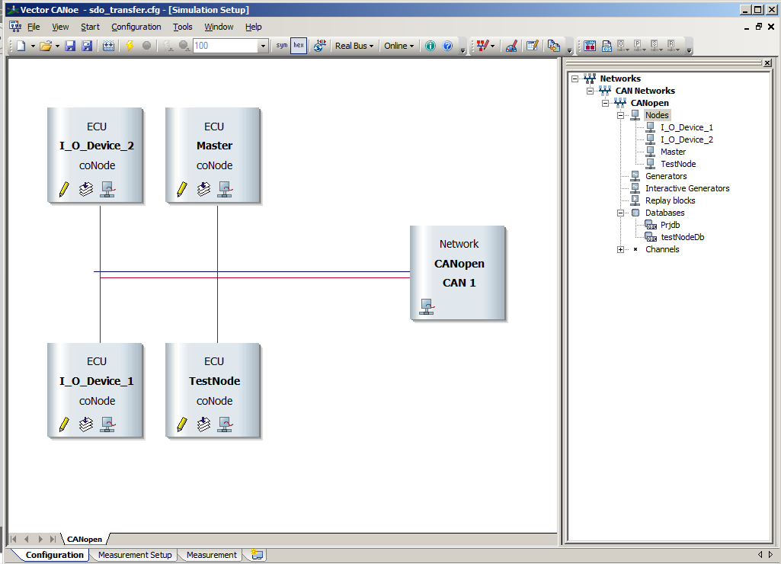
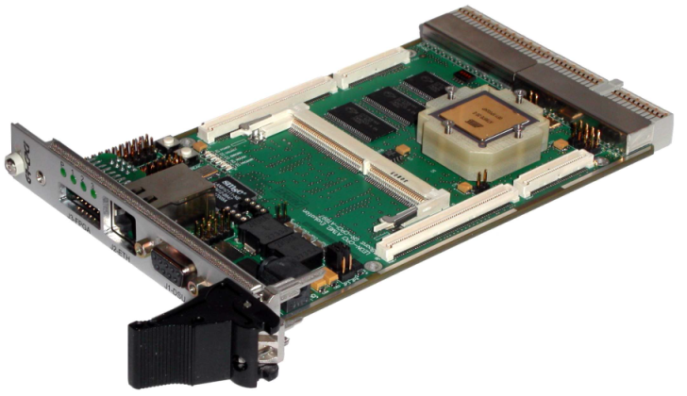
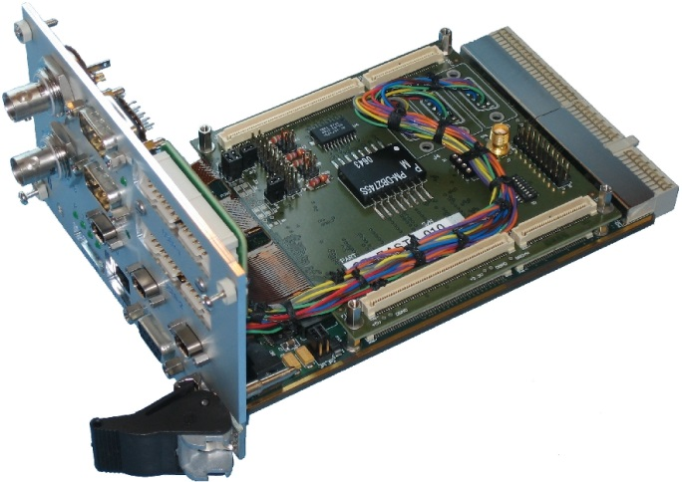
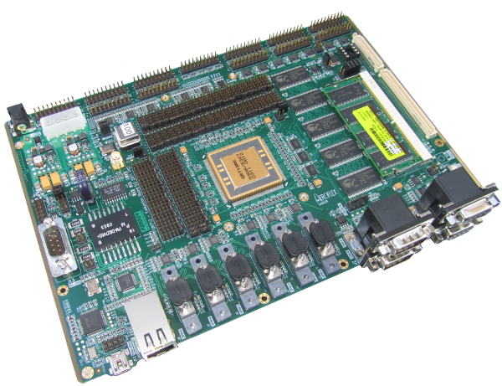
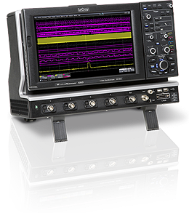
ESTEC Avionics lab (2)

Slide 4
CANOpen SW stacks analysis
Source code analysis of Vector CANOpen and CANFestival (open source)
Project Metrics | Vector | CAN Festival
Files | 50 | 50
Program Units | 105 | 115
Code Lines | 4735 | 3735
Statements | 2240 | 1774
Program Unit Complexity | Vector | CAN Festival
WC unit | CanCom | proceedSDO
Mod. Cyclomat | 42 | 167
Nesting | 9 | 6
Path Count | 2040 | 169325

Slide 5
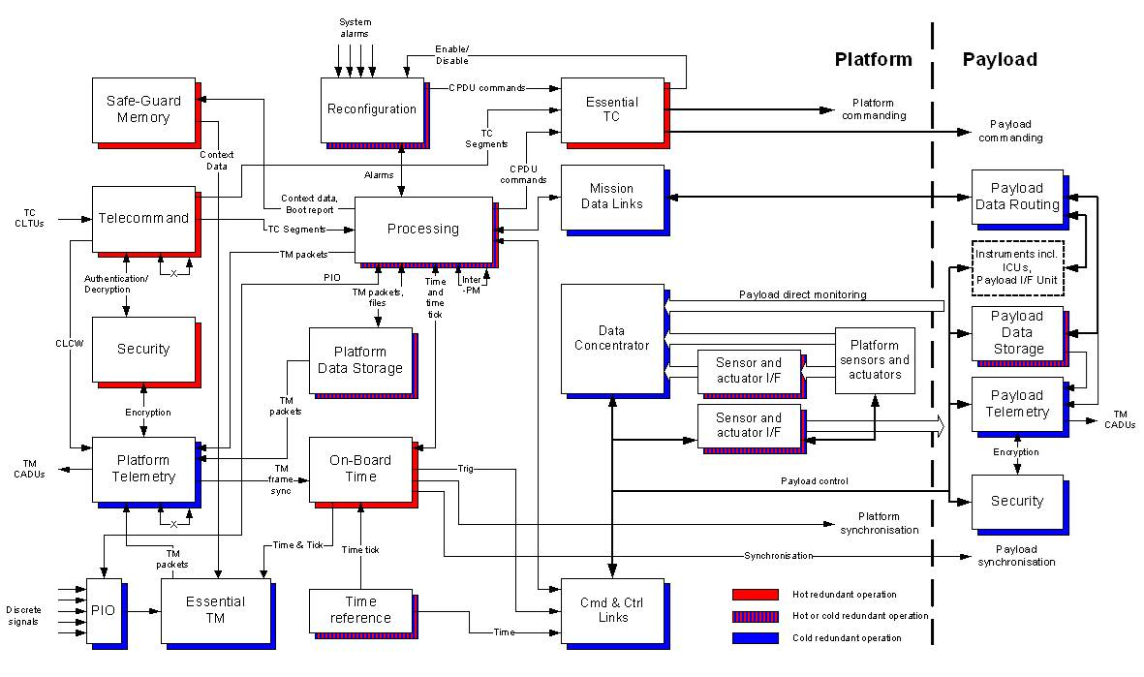
What’s next? Savoir Sat

Slide 6
Panel discussion

Slide 7
Future for CAN in Space
In which areas does it have a bigger potential?
Will it ever replace traditional C&C bus such as MIL-1553?
Will it be cannibalized by newer, higher speed alternatives? TTEthernet, Deterministic SpW…
What are its weakpoints? Galvanic isolation?? Speed??

Slide 8
Multi-master/Distributed intelligence
CAN is a multi-master bus. Enabler for distributed intelligence architectures
Availability of microcontrollers from major vendors
Everybody is using it like MIL-1553
IOs
IOs
OBC
TMTC
PCDU
IOs
IOs

Slide 9


Use of industrial standards
Large user community, examples, lessons learned, bibliography, documentation...
Large pool of development environments and tools.
Availability of components (HW and SW)
Delta-qualifications of components (HW and SW)
Re-developments
Increased complexity?? Many people pushing to use simpler ad-hoc implementations

