Slide 1
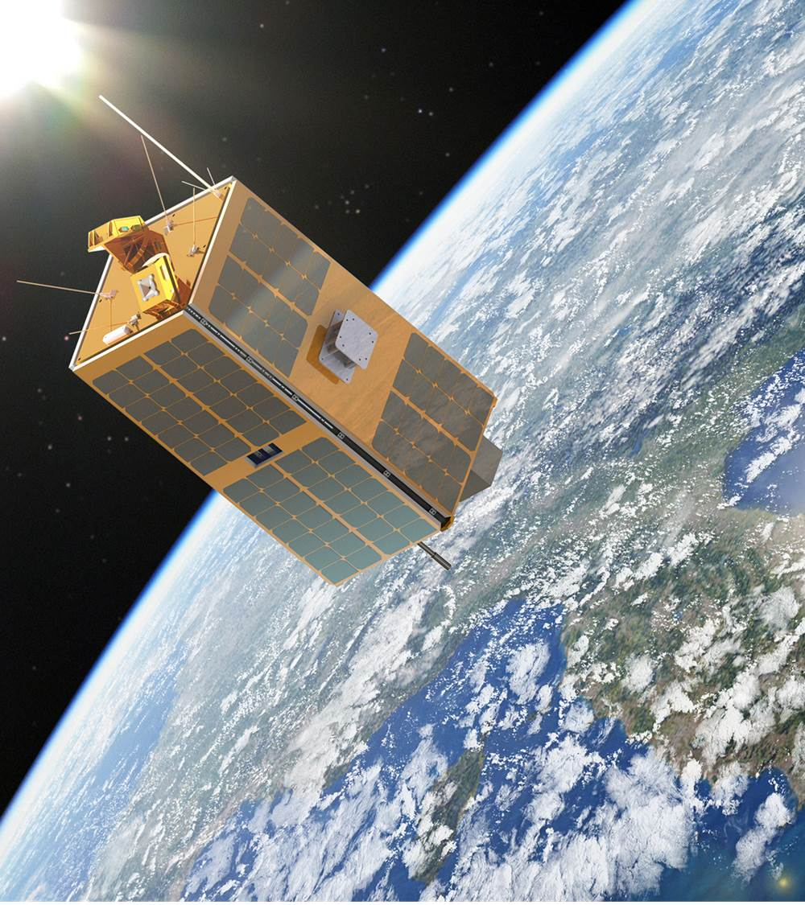
CANopen IP Core evolutions
Pietro Tosi
CAN In Space Workshop, 14-26 June 2017 Mola di Bari

Slide 2
Outline
CANopen IP Cores Status
CANopen Overview
CCIPC Architecture
  Refresh of ESA release
  New developments on SITAEL release
CCIPC future developments
CAN IP developments : proposed ideas

Slide 3
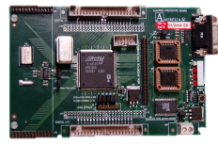
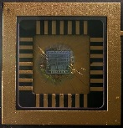
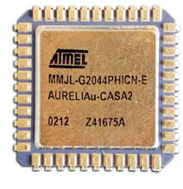
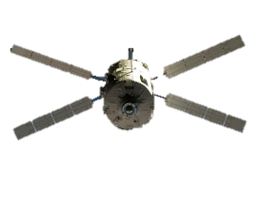
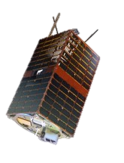
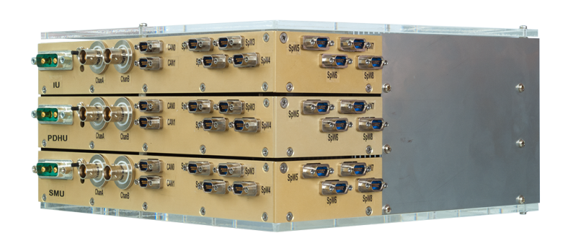
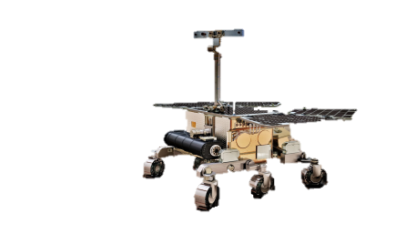
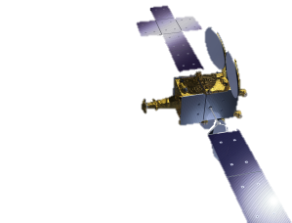
SITAEL CAN Bus Experience at a glance
1999
2000
2002
2004
2007
HurriCANe ALPHA version is provided by ESA for completion and verification against BOSCH testbenches
The new CAN bus Controller (HurriCANe core version 5.0) is delivered to ESA
  CANTRAN ASIC and AmCAN IP Core are developed and tested in the frame of an ASI contract.
First ASIC prototypes in DMILL CMOS 0.8um process
  CASA2 is licensed to ATMEL and manufactured with MG2RTP Rad-hard Sea of Gate (P/N AT7908E).
Collaboration with Alenia Spazio and Roscosmos to develop a new CAN bus controller with 3 mailboxes and uCU I/F (CASA2) for ATV fully compliant with CAN 2.0B protocol
HurriCANe core IP update (version 5.2.3) - last by SITAEL
2009
2012
2013
2015
2016
Final Presentation of IPPM with a Demo session in ESTEC
ESEO Phase C0/C1/D/E1 development
start.
CANopen Controller IP Core (CCIPC) is delivered to Thales Alenia Space in the
frame of
an ExoMars
Contract
CCIPC improvement
for SATCOM
Payload
and
Platform
Management
Release of a new CCIPC implementation with improved performances and wider usability.
3

Slide 4
CANopen IP Cores Status (CCIPC)
CCIPC DB ver. 3.7 (03/12/2013) : cited on ESA website and used by Exomars contractors
CCIPC DB ver. 3.9 (12/06/2015) : released to TASI
  Minor fixing on CCIPC configuration tool
  Adjusted proper updating of single error counter on EDAC register
CCIPC DB ver. 4.0 (15/12/2016) : SITAEL release
  Supports HurriCANe and SITCAN (based on VHDL CAN Controller by OpenCores)
  New hardware architecture
  Additional functionalities
  Removed CCIPC Configuration tool from Database to be distributed separately

Slide 5
CANopen IP Cores Status (CCIPC)
CCIPC DB ver. 3.7 (03/12/2013) : cited on ESA website and used by Exomars contractors
CCIPC DB ver. 3.9 (12/06/2015) : released to TASI
  Minor fixing on CCIPC configuration tool
  Adjusted proper updating of single error counter on EDAC register
CCIPC DB ver. 4.0 (15/12/2016) : SITAEL release
  Supports HurriCANe and SITCAN (based on VHDL CAN Controller by OpenCores)
  New hardware architecture
  Additional functionalities
  Removed CCIPC Configuration tool from Database to be distributed separately
FLIGHT PROVEN

Slide 6
CANopen IP Cores Status (RCCIPC)
RCCIPC DB ver. 2.3 (03/12/2013) : cited on ESA website and used by Exomars contractors
RCCIPC DB ver. 2.4 (03/02/2015) : released to TAS
  Minor fixing on CCIPC configuration tool
  adjusted minor bug could occur at “bus switch”

Slide 7
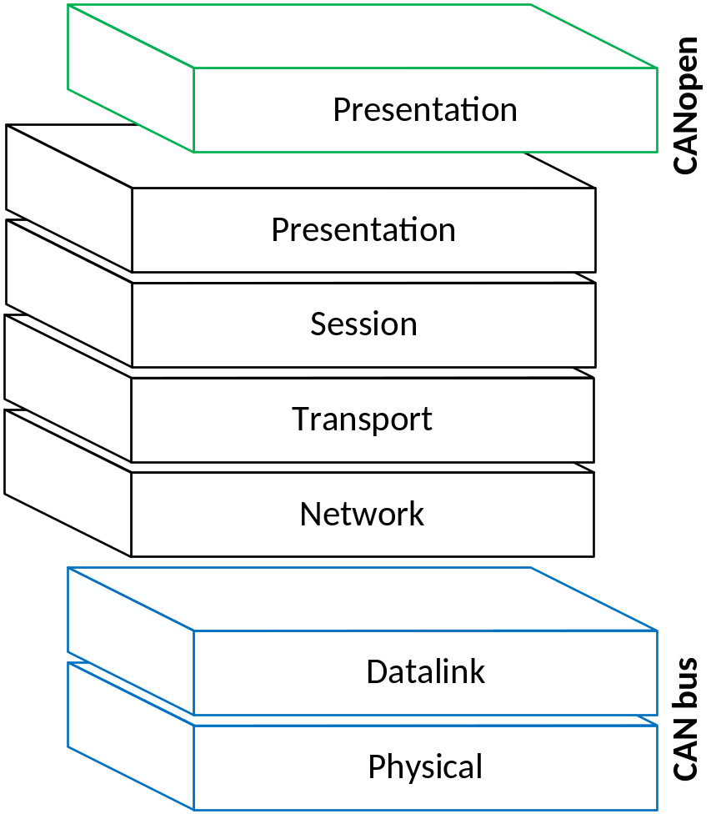
CANopen Overview : ISO/OSI
Application Layer
  Encoding/Decoding messages
Data Link Layer :
  Data Encapsulation
  Frame Coding
  Error Detection/Signaling
  Acknowledge
  Overload
  Recovery Management
Physical Layer :
  Bit Encoding/Decoding
  Bit Timing
  Synchronization
Application

Slide 8
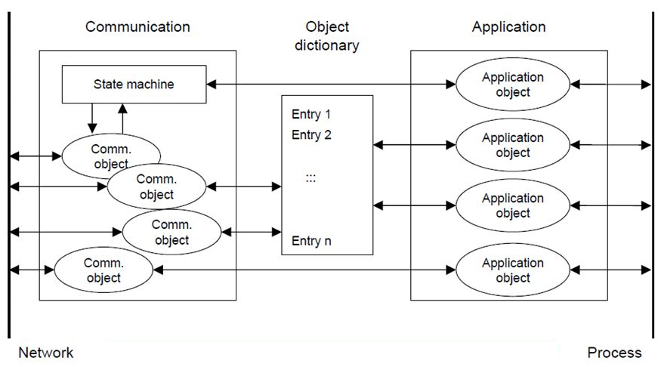
CANopen Overview : Device Model
Communication : define the characteristics and functionalities of the device
Application : define the objects (“variables”) shared with the Process Environment
Object Dictionary : define the link between Communication and Application

Slide 9
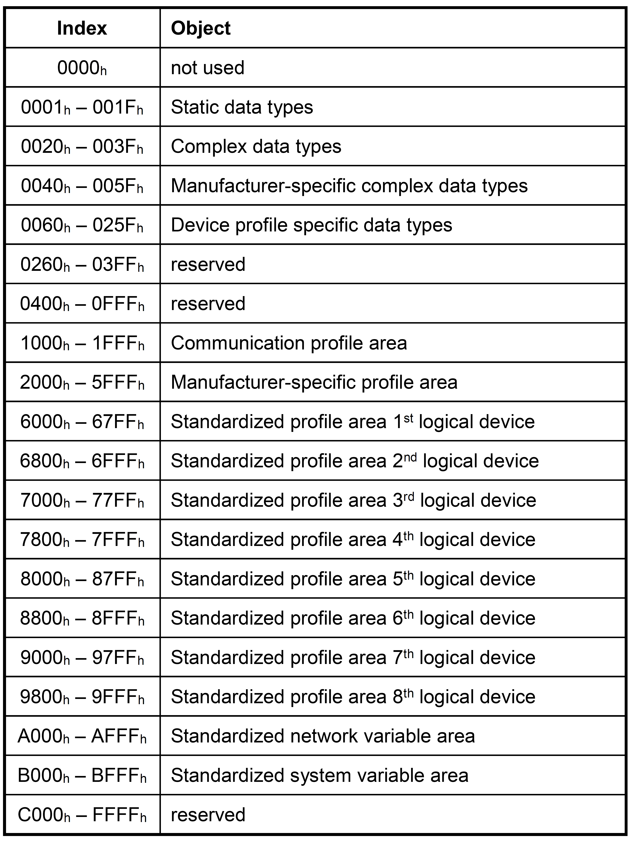
CANopen Overview : Object Dictionary
Object Dictionary
  ordered LUT containing the definition of all the objects
  characterize a CANopen node
It is addressed by
  16-bit Index → Up to 65536 objects
  8-bit Sub-Index → Up to 256 sub-indices per object

Slide 10
CANopen Overview : Communication Objects (1)
Network Management
  Node control services: NMT master controls the NMT slave state by:
    Initialise Node
    Start/Stop Node
    Reset Node
  Error Control service: used to detect failures within the CAN net.
    Based on Heartbeat mechanism:
    Heartbeat producers cyclically transmit message on the net
    Heartbeat consumers listen for this message
  Bootup service
    NMT slave indicates that it is initialized

Slide 11
CANopen Overview : Communication Objects (2)
Process Data Object (PDO)
  Used to perform real-time data transfer
  Two types of PDO:
    Receive PDO → RPDO
    Transmit PDO → TPDO
  PDOs are described by
    Communication Parameters: describe the characteristics of PDO:
      COB-ID
      Transfer Mode (Synchronous, Asycnhronous)
      Triggering Mode (Event Driven, Timer Driven)
    Mapping Parameters: contains information about the content (Application Objects) of PDO

Slide 12
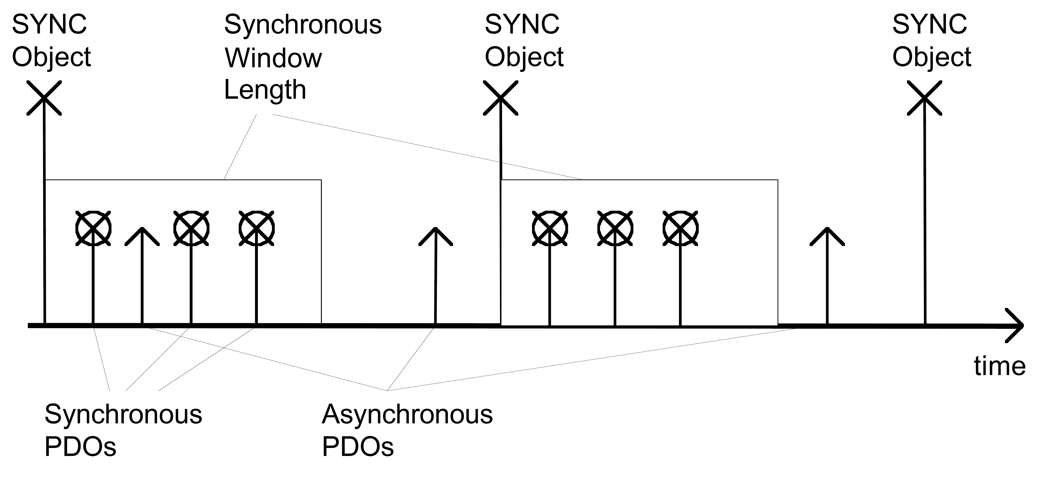
CANopen Overview : Communication Objects (3)
Process Data Object (PDO) : Transmission Mode
  Synchronous: PDO are transmitted after SYNC reception within SWL (if defined)
  Asynchronous : PDO are transmitted without relation to SYNC and dependent of:
    Event trigger : transmission triggered by the occurrence of an application-specific event
    Timer Trigger : Transmission triggered by timer expiration

Slide 13
CANopen Overview : Communication Objects (4)
Process Data Object (PDO) : Reception Mode
  Synchronous: RPDO is elaborated at SYNC reception
  Asynchronous: RPDO is elaborated as soon as it is received
SYNC
SYNC RDPOs
SYNC
ASYNC

Slide 14
CANopen Overview : Communication Objects (5)
Service Data Object (SDO)
  Used to perform access on the Object Dictionary entries
  Used to transfer multiple data sets
  Basically an SDO is transferred as a sequence of segments. Prior to transferring the segments there is an initialization phase where client and server prepare themselves for transferring the segments
    Expedited: Up to 4 bytes are transferred during initialization
    Segmented: Data are transferred as a sequence of segments after initialization
    Block : Data are transferred as a set of blocks. Each block may consist of up to 127 messages
  Basic Services:
    Download : Client transfers data to Server
    Upload : Client requests data from server
    Abort: Client or Server signals protocol error

Slide 15
CANopen Overview : Implementation
Software
  Flexibility in Object Dictionary definition and protocol implementation
  No additional Hardware components
  Detailed CANopen Protocol understanding
  High Computational load (messages encoding/decoding)
  Heavy Code Debugging
Hardware
  uC/uP free of computational task (working only on “variables”)
  Basic knowledge of CANopen protocol
  System Integration debugging
  Ready to play
  Dependent on architectural restrictions
  HW resource occupation:

Slide 16
CCIPC Architecture : Main Characteristics (1)
Supported CANopen functionalities
  Slave Node;
  PDO (TPDOs and RPDOs) objects
  SDO server services (expedited, segmented and Block)
  Network Management;
  SYNC consumer;
  Heartbeat producer and consumer;
Additional Features
  Redundancy Manager
  EDAC protection on memories
CCIPC configuration
  Node-Id & Node-Mask
  Host Interface (Generic I/O, AMBA, Direct)
  CAN bit Rate (125k, 250k, 500k, 1M)

Slide 17
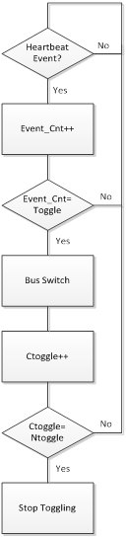
CCIPC Architecture : Main Characteristics (2)
Redundancy Manager
  Heartbeat Consumer Time: time window within which CCIPC is waiting for Master Heartbeat.
  Heartbeat Event : missing Heartbeat from Master
  Ttoggle : Maximum number of Heartbeat Event before bus switch
  Ntoggle : Maximum Number of Bus switch
  Ctoggle : current number of bus switch

Slide 18
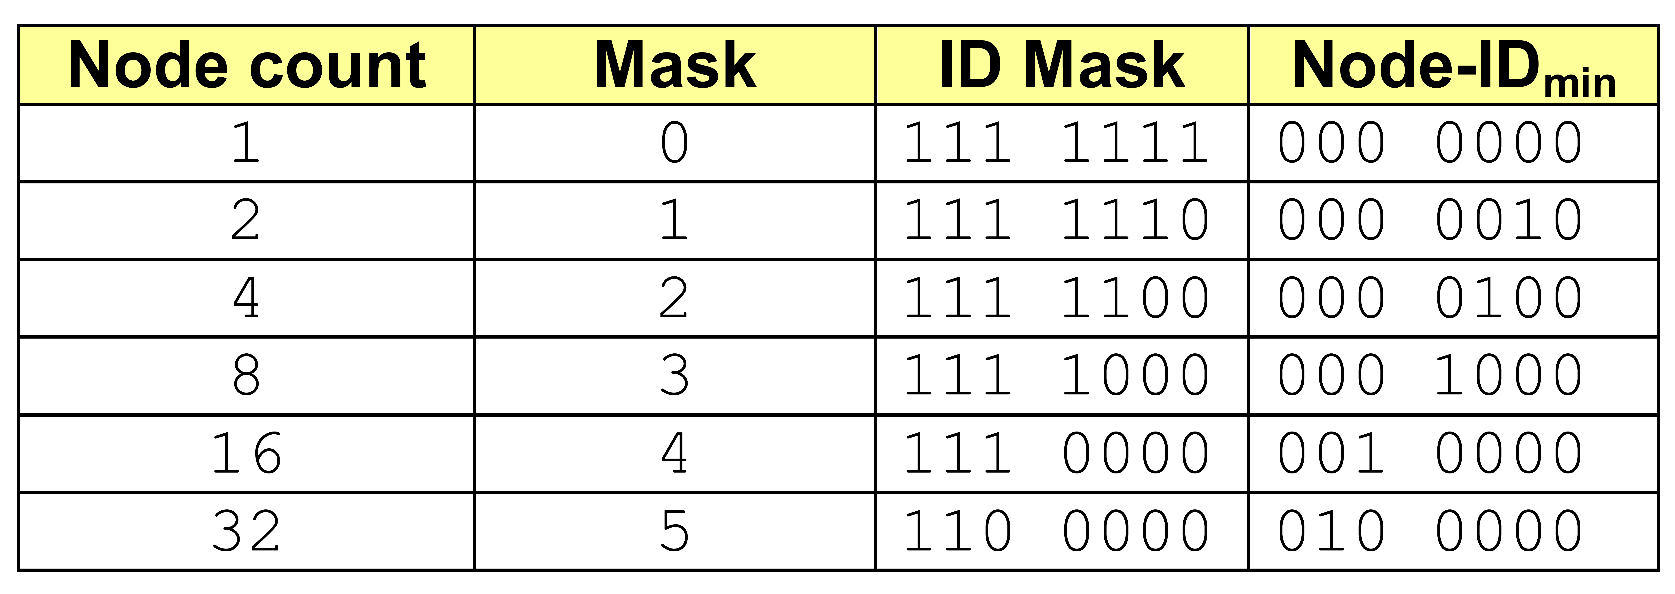
CCIPC Architecture : Main Characteristics (3)
Node-ID & Node-Mask
  CCIPC can occupy one or more Node-ID
  Each Node includes up to 4 RPDOs and 4 TPDOs
  If more PDOs are necessary → CCIPC can use consecutive CAN IDs.
  The Node-Mask determines how many Node CCIPC occupies
    Mask=2 (ID MASK = 1111100)→ Node Count=4 → #TPDO=#RPDO=16

Slide 19
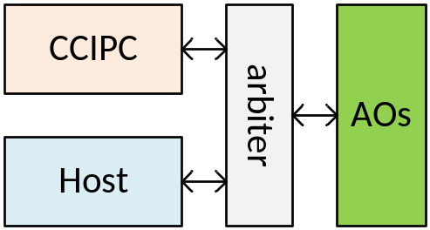
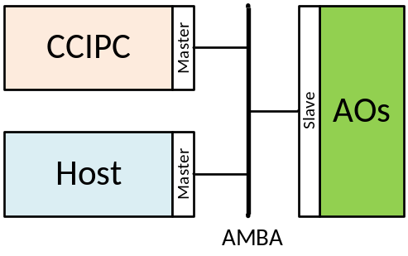
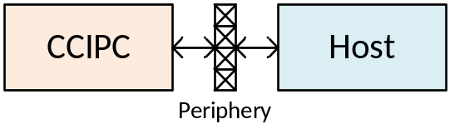
CCIPC Architecture : Main Characteristics (4)
HOST Interface
  Generic I/O : Simple Memory Interface.
  Arbiter allows Host and CCIPC memory sharing
  AMBA : oriented for Complex SoC
  Direct : Simple Architecture where AOs are directly
  connected to external device
Generic I/O
Interface
AMBA
Interface
Direct
Interface

Slide 20
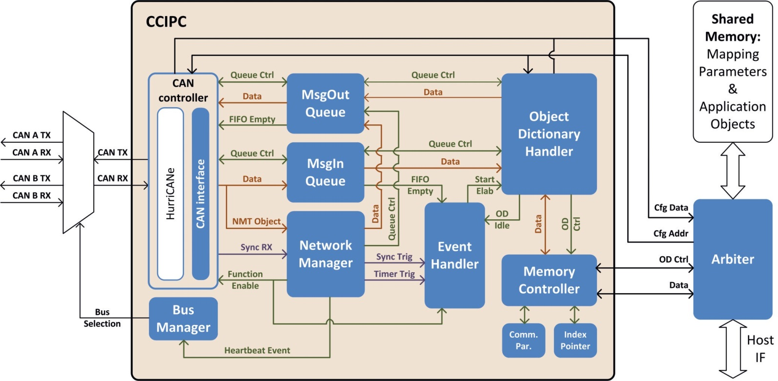
CCIPC Architecture : ESA release
Single Clock (up to 16 MHz)
CAN : ESA HurryCANe 5.2.4
Building Blocks
  BUS Manager
  CAN Controller
  Network Manager (NMT)
  Message Queues (PDO,SDO)
  Event Handler + OD Handler
  Memory Controller
    Communication Parameter
    Index Pointer (for AOs addressing)
    Shared Memory (Mapping Parameter & Application Objects)

Slide 21
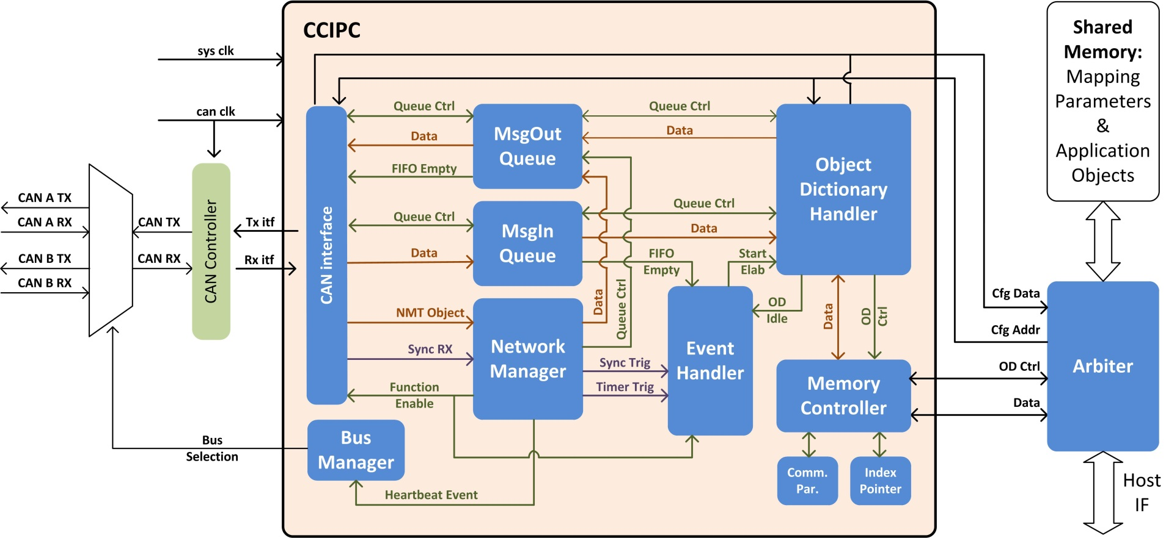
CCIPC Architecture : SITAEL release (1)
Same Architecture as previous CCIPC
Double clocking
CAN Controller independent

Slide 22
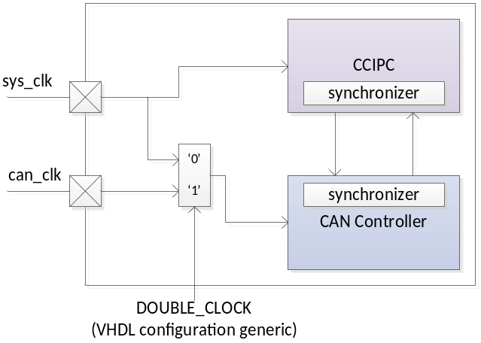
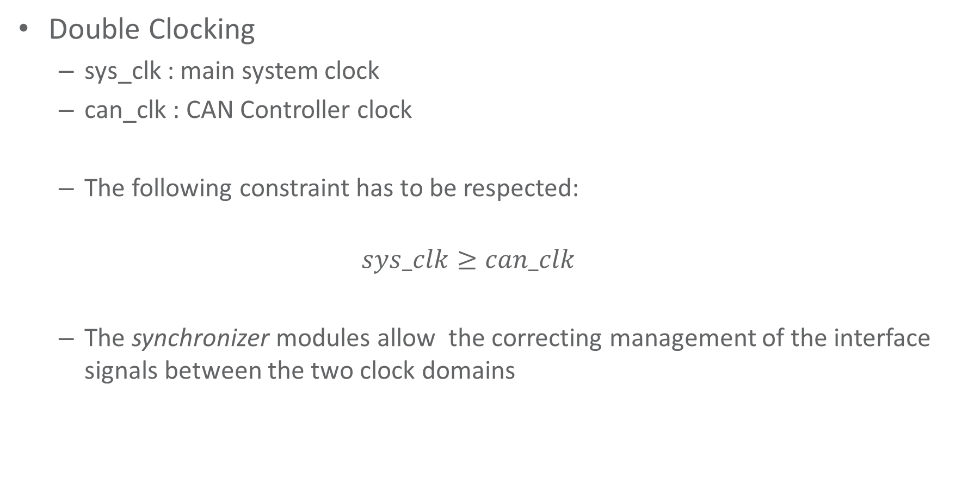
CCIPC Architecture : SITAEL release (2)
Double Clocking
  sys_clk : main system clock
  can_clk : CAN Controller clock
  The following constraint has to be respected:
  $$sys_clk≥can_clk$$
  The synchronizer modules allow the correcting management of the interface signals between the two clock domains
Not critical path because clock selection is done by a VHDL generic

Slide 23
CCIPC Architecture : SITAEL release (3)
CAN Controller independent
  CAN Controller has been moved out of CCIPC core
  A generic interface has been designed to interface CCIPC to the CAN Controller
RX Interface | Dir | Type | Description
msg_rx | In | bit | CAN Controller informs CCIPC that a CAN msg is ready
rx_ready | Out | bit | CCIPC ready to accept the message (‘1’ – ready , ‘0’ – busy)
rx_data[10:0] | In | byte | Message content
TX Interface | Dir | Type | Description
tx_request | Out | bit | CCIPC request msg transmission to the CAN Controller
tx_data [10:0] | Out | byte | Message content
tx_gnt | In | bit | CAN Controller informs CCIPC that msg has been accepted
tx_completed | In | bit | CAN Controller informs CCIPC that msg has been transmitted

Slide 24
CCIPC Architecture : SITAEL release (4)
  Transfer of the CAN Controller outside CCIPC architecture
  Development of a generic interface to exchange CAN messages
  User can utilize any CAN Controller to implement the CCIPC core
SITCAN
  SITAEL decided to use the VHDL CAN Protocol Controller from OpenCores (www.opencores.org) as reference CAN Controller (distributed under LGPL license)
  The last CCIPC release (ver. 4.0) contains all the files needed to use the CCIPC with the SITCAN core

Slide 25
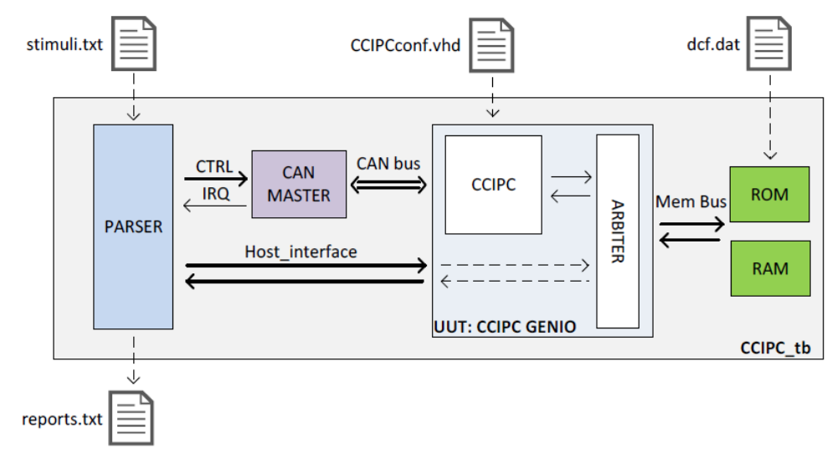
CCIPC Architecture : SITAEL release (5)
New Functionalities
  Broadcast RPDO : particular type of PDO with COB-ID=180h and 8 bytes length that is simultaneously received by all CCIPC nodes connected in the CAN network
  Infinite Toggling : Redundancy algorithm always active allowing an infinite toggling between Nominal and Redundant bus
New Test bench
  A set of Perl scripts developed to interface
  with the CAN Controller utilized allow
    generating the input stimuli.txt file
    translating the output reports.txt

Slide 26
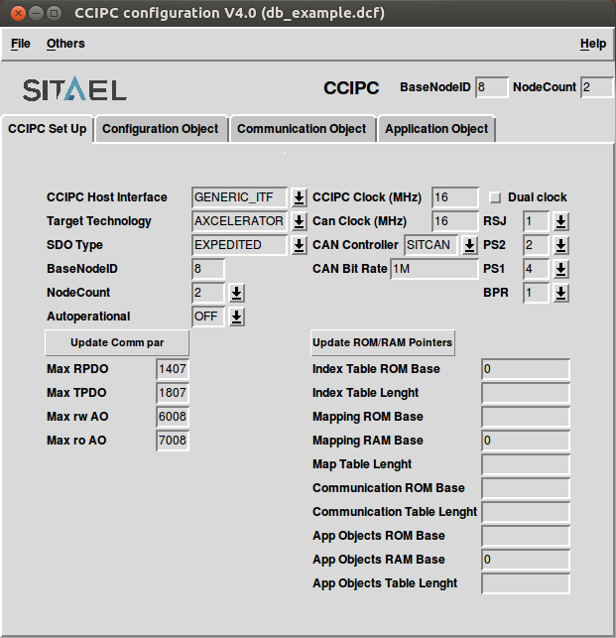
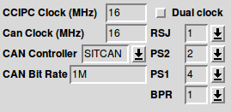
CCIPC Architecture : SITAEL release (6)
Updated Configuration Tool

Slide 27
CCIPC Architecture : SITAEL release (7)
Resource Budget
Generic I/O interface with SDO Block (Single Clock configuration)
Family | Device | Cells |  |  | RAM | Utilization | Fmax (MHz) | CAN Fmax (MHz)
 |  | Combinational | Sequential | Total
Axcelerator | RTAX1000S | 7745 | 2029 | 9774 | 17 | 53.87% | 30.4 | ---
ProAsic | A3PE3000 | 13563 | 2096 | 15659 | 17 | 20.81% | 28.3 | ---
Xilinx | XC4VLX25 | 7412 | 1889 | 9301 | 17 | 28.83% | 105 | ---
CCIPC DB ver. 4.0
(SITCAN)
Family | Device | Cells |  |  | RAM | Utilization | Fmax (MHz)
 |  | Combinational | Sequential | Total
Axcelerator | RTAX1000S | 7823 | 1785 | 9608 | 17 | 52.95% | 19
ProAsic | A3PE3000 | 13216 | 1772 | 14988 | 17 | 19.91% | 20.7
Xilinx | XC4VLX25 | 7203 | 1702 | 8905 | 17 | 28% | 31.8
CCIPC DB ver. 3.9
(HurriCANe)
Added registers barrier to relax timing of a critical path within the Object Dictionary Handler module

Slide 28
CCIPC Architecture : SITAEL release (8)
Resource Budget
Generic I/O interface with SDO Segment (Dual Clock configuration)
Family | Device | Cells |  |  | RAM | Utilization | Fmax (MHz) | CAN Fmax (MHz)
 |  | Combinational | Sequential | Total
Axcelerator | RTAX1000S | 7590 | 2027 | 9617 | 17 | 53.00% | 32.3 | 42.8
ProAsic | A3PE3000 | 12697 | 2071 | 14768 | 17 | 19.62% | 31.6 | 34.5
Xilinx | XC4VLX25 | 7355 | 1895 | 9250 | 17 | 28.68% | 109 | 137
CCIPC DB ver. 4.0
(SITCAN)

Slide 29
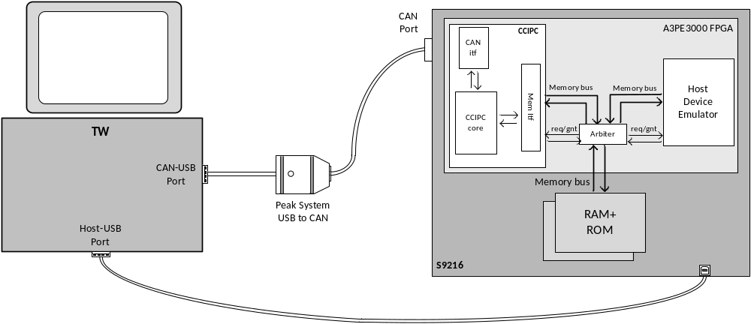
CCIPC Architecture : SITAEL release (8)
Verification
  The new CCIPC (based on the SITCAN controller) has been verified running the same Hardware tests performed on CCIPC with HurriCANe and currently used on the ESA Exomars mission.
Test WorkStation (TW) as
  CAN Master;
  Host Device
Peak System “PCAN-USB” adapter in charge of managing CAN bus link;
S9216 CANopen Development Module with CCIPC and USB Host Interface controller.

Slide 30
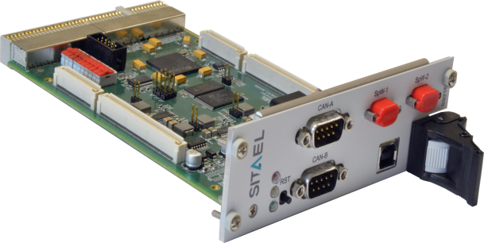
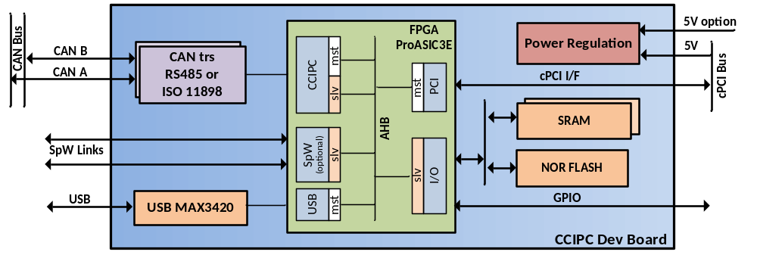
SITAEL CANopen Development Module S9216
Powerful tool for CANopen node design, test, configuration and analysis, based on SITAEL CANopen Controller IP Core (CCIPC).
Microsemi ProAsic3E FPGA
Volatile and non-volatile memory on-board (FLASH, SRAM)
Two CANbus links (with ISO11898 or RS485 physical layer)
USB 2.0 link for Host communications
Two SpaceWire links (optional)
Standard cPCI format
Bench-top usage with external power supply
Basic Software Package

Slide 31
Future Developments on CCIPC
Acyclic Synchronous TPDO
Enable/Disable SDO service (currently at least Expedited is mandatory)
  Multiplexed PDO?
SDO greater than 128Kbytes
Scrubbing Unit for internal memories
Selectable Endianness (current Little Endian)
Memory Initialization to enable EDAC also during start-up
Investigation on possibility to develop a VHDL CANopen Master

Slide 32
Future Developments on CAN IP (1)
Hardware Filtering
  uC/uP: Smart Transceiver
  uC/uP and FPGA or stand-alone FPGA: CAN Controller with Filtering function
CAN Controller Implementations
  Basic CAN : limited buffers (3/4) for TX/RX messages (no filtering)
  Full CAN : TX/RX buffer for each message objects ID (8/16 objects)
  FIFOs : only filtered messages are stored in FIFO:
    Good solution but high priority messages could be stored after low priority messages
  Enhanced FIFO :
    FIFO for each message object
    Single RAM split in slices with configurable length, each one associated to a message object

Slide 33
Future Developments on CAN IP (2)
CAN Controller Interface
  SPI, I2C , 8-bit parallel
CAN I/O Extender
  Able to directly interface with DAC/ADC or sensors without CPU
  Automatically Bit Timing identification
Implementation of CAN-FD Controller
Predictable communication
  Time-Triggered CAN (TTCAN) ISO 11898-4

Slide 34

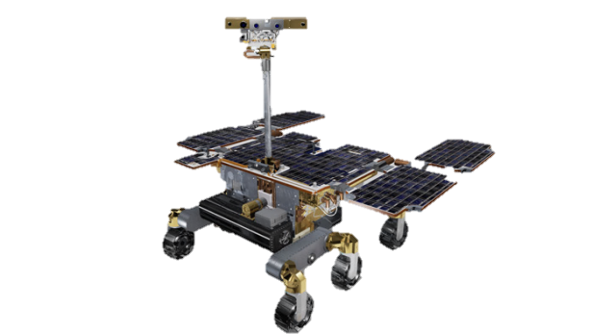


SITAEL S.p.A.
Via San Sabino, 21
70042 Mola di Bari (BA) – ITALY
Tel: +39 080 5321796
Fax: +39 080 5355048
www.sitael.com

