Slide 2

INDUSTRIALISATION & QUALIFICATION OF 80 um CTJ30 SOLAR CELL (CTJ30-80)
Space Power and EMC workshop
R. Campesato, M. Casale, G. Gabetta M. Ficcadenti,
CESI SpA Via Rubattino, 54 20134 Milano - Italy

Slide 3
Agenda
CESI space products & thin solar cells benefits
Project Breakdown Structure and activities performed
  2.1 Manufacturing process Industrialization
  2.2 Qualification at bare level
  2.3 Results at SCA and bent configuration (first trials of sub M)
Conclusion

Slide 4



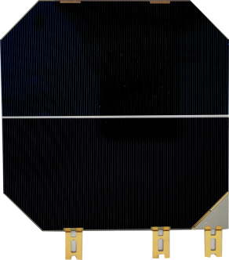
CESI produces high performance space Multi Junction cells and has contributed to more than 60 satellite for over than 25 countries worldwide
1
Algeria
Argentina
Belgium
Brazil
China
France
Germany
India
Italy
Japan
Korea
Malaysia
Netherlands
Nigeria
Poland
Russia
South Africa
Spain
Switzerland
Taiwan
Turkey
Ukraine
United Kingdom
USA
Solar Cell Assembly
(SCA /CIC)
CESI
Bare solar cells
Industrialisation and qualification of 80 micron CTJ30 solar cell (CTJ30-80)
ESA Contract No. 4000114125/15/NL/CBi/fk

Slide 5

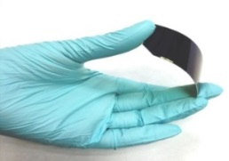



CESI currently produces high performance MJ solar cells qualified for space GEO and LEO satellites
1
Name | Application Field | Technology | Efficiency (BOL AM0, 25C) | Note | Application
CTJ30 | Space | InGaP/ InGaAs/Ge | 29.5% | GEO and LEO ECSS Qualified
CTJ30-Thin | Space Flexible/bendable New Generation Solar Arrays | InGaP/InGaAs/Ge 80 um Thin | 29% | Qualification completed
CTJ-LC | Space Minisat/Cubesat Mega constellations | InGaP/InGaAs/Ge Low Cost | 28% 27% | Qualification in progress LC2 ver. advanced development (up to 80 cm^2)
CTJ-LA | Space New Generation Solar Arrays | InGaP/InGaAs/Ge Large Area ca 70 cm^2 | 29% | Advanced progress
3J & 4J on Dilute Nitride | Space New Generation Solar Arrays | InGaP/GaAs/InGaNAs InGaP/InGaAs/InGaNAs/Ge | 31% (to date) | Advanced progress Industrial R&D
Industrialisation and qualification of 80 micron CTJ30 solar cell (CTJ30-80)
ESA Contract No. 4000114125/15/NL/CBi/fk

Slide 6
Why thin solar cells ?
1
Thin III-V solar cells will be mainly beneficial for the following space applications:
Large satellites for which it is important to maximize the power-to-mass ratio at solar generator level, maintaining high efficiency and reliability of solar panels
Satellites with non-planar surfaces and/or stratospheric aircraft or drones where the PVAs are "body mounted” on body/wings or fuselage that can take advantage of bendability of thin solar cells.
Specific power 0.7 W/g
Specific power 0.47 W/g
150 um thick cell
80 um thick cell
Industrialisation and qualification of 80 micron CTJ30 solar cell (CTJ30-80)
ESA Contract No. 4000114125/15/NL/CBi/fk

Slide 7
Agenda
CESI space products & thin solar cells benefits
Project Breakdown Structure and activities performed
  2.1 Manufacturing process Industrialization
  2.2 Qualification at bare level
  2.3 Results at SCA and bent configuration (first trials of sub M)
Conclusion

Slide 8
Work Breakdown Structure
2
CESI had already carried out R&D activities on solar cells where the germanium thickness was decreased down to 80 μm and had proved that the resulting prototype triple junction efficiency had 29% efficiency in AM0 conditions, and allowed a bending radius as low as 30 mm
Industrialization & Qualification of 80 μm CTJ30 solar cells (CTJ30-80
Upgrade of the manufacturing line
Preliminary test at SCA level
GEO and LEO Qualification at bare level of CTJ30-80
Industrialisation and qualification of 80 micron CTJ30 solar cell (CTJ30-80)
ESA Contract No. 4000114125/15/NL/CBi/fk

Slide 9
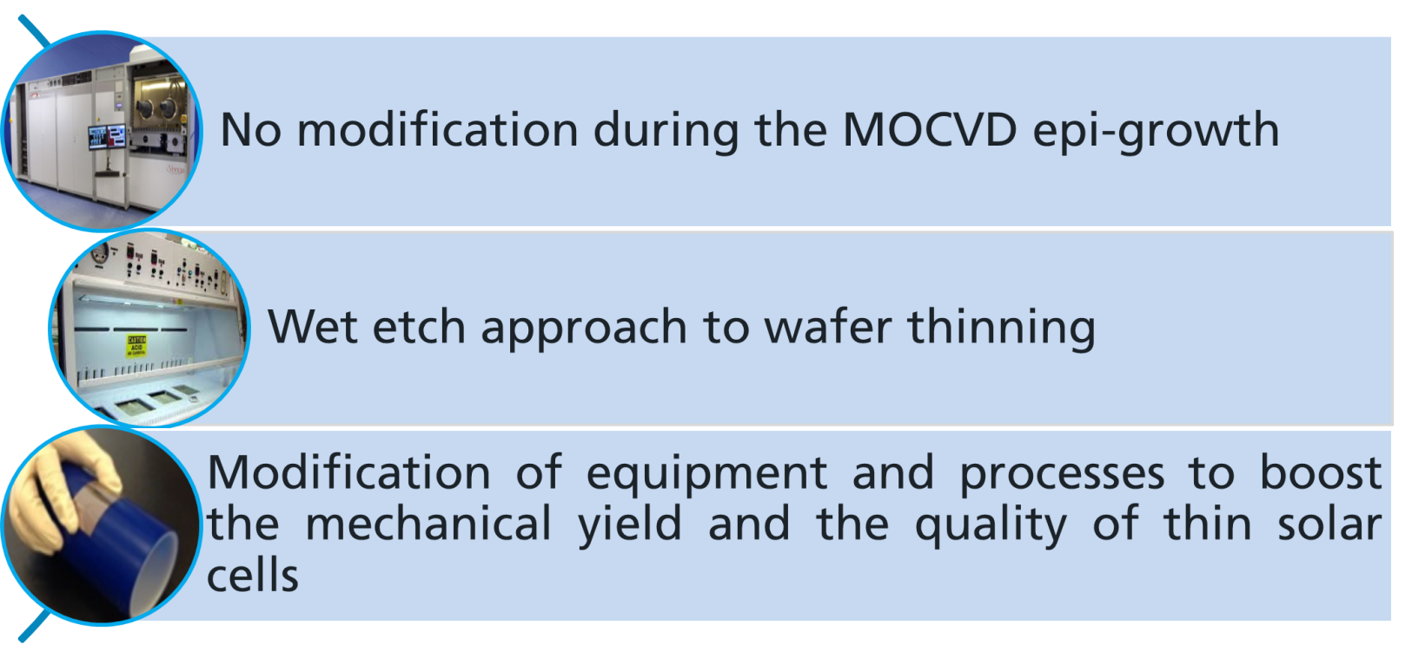
2.1
Industrialization process:
Upgrade of the manufacturing process
No signficant modification in the MOCVD epi- growth
Industrialisation and qualification of 80 micron CTJ30 solar cell (CTJ30-80)
ESA Contract No. 4000114125/15/NL/CBi/fk

Slide 10
Industrialization process: Upgrade of the manufacturing process
2.1
Two different approaches were at first considered for the manufacturing of the 80 μm thick solar cells :
APPROACH A : involved the use of standard germanium wafers (thickness 150 μm) during the MOCVD epi-growth and the consequent substrate thinning down to 80 μm
APPROACH B implied the use of thin germanium wafers thickness 100 μm) during the MOCVD epi-growth and further substrate thinning of additional 20 μm of germanium of the wafer rear side.
To select the best approach the following features were considered:
  Complexity of the manufacturing process steps
  Mechanical yield
  BOL and EOL electrical performance
  Manufacturing cost
Industrialisation and qualification of 80 micron CTJ30 solar cell (CTJ30-80)
ESA Contract No. 4000114125/15/NL/CBi/fk

Slide 11
Industrialization process: Upgrade of the manufacturing process
2.1
CTJ30-80 solar cells were manufactured with approches A and B to select the best procedure
Approach A
No significant modification in the MOCVD growth
Advantage to perform some process steps with 150um thick wafers
No problems evidenced due to the long etching process.
Longer process times to thin the Ge substrate down to 80 μm
Only Few modification required respect to the standard CTJ30 process
Approach B
No significant modification in the MOCVD growth
100 μm wafers require optimized tools for the handling
High mechanical breakages during the process
After the thinning, the100 um wafer resulted more fragile
Fast etching process
.
Industrialisation and qualification of 80 micron CTJ30 solar cell (CTJ30-80)
ESA Contract No. 4000114125/15/NL/CBi/fk

Slide 12
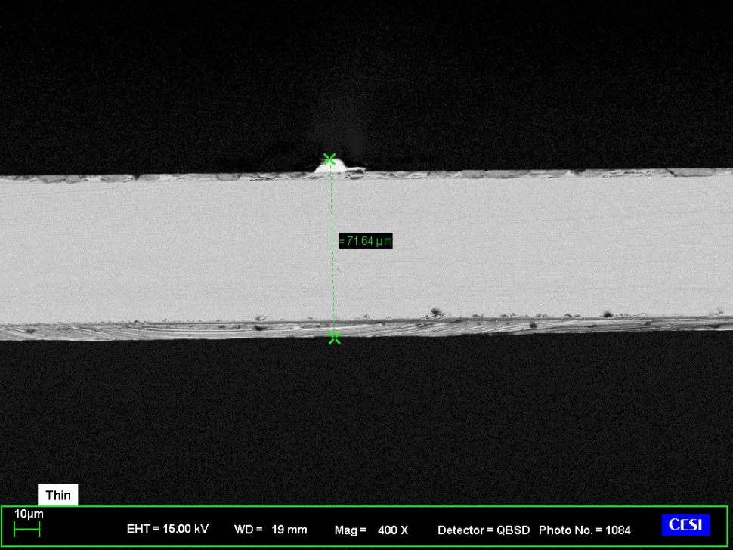
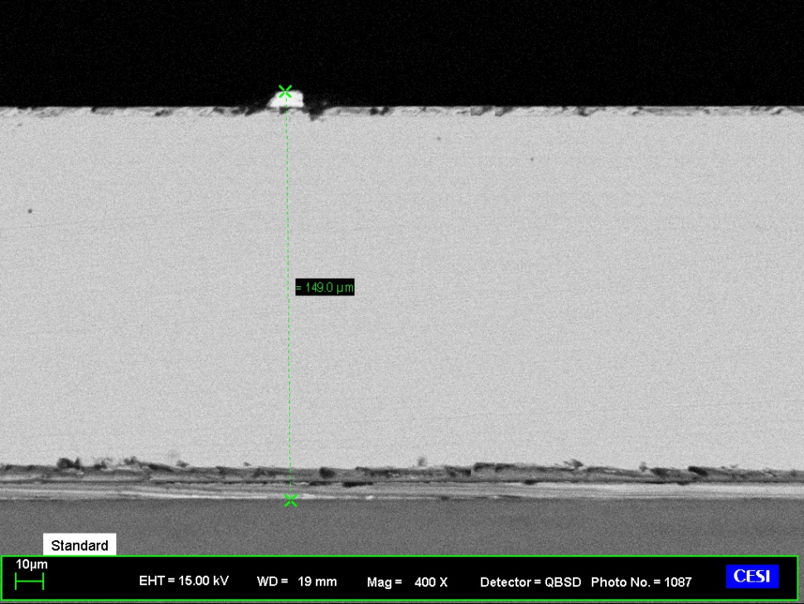
Thinning by wet etch technology is satisfactory in terms of replicability
2.1
Wafer thinning has been properly optimised to get the desired thickness, uniformity and process yield
CTJ30-thin solar cell (bare) | Thickness (μm) | Weight (g) | Power-to-mass ratio (W/g) | thickness uniformity (%)
Average CTJ30-80, area 26.5cm² | 83 | 1.31 | 0.79 | > 96%
149.0 μm
71.6 μm
CTJ30-Thin (80 μm)
Standard CTJ30
Industrialisation and qualification of 80 micron CTJ30 solar cell (CTJ30-80)
ESA Contract No. 4000114125/15/NL/CBi/fk

Slide 13
Industrialization process: Upgrade of the manufacturing process
1
Mechanical yeld:
Best performance were reached with Approach A
(2% higher)
Electrical perfomance
(BOL and EOL 5E14 e⁻/cm² 1 MeV):
The two approaches were comparable
Manufacturing Cost
Lower cost with approach A
- 100 µm Ge substrate cost
- Ge reclaim from etching
solution
Approach A was selected for the manufacturing of the CTJ30-80 cells
.
Industrialisation and qualification of 80 micron CTJ30 solar cell (CTJ30-80)
ESA Contract No. 4000114125/15/NL/CBi/fk

Slide 14
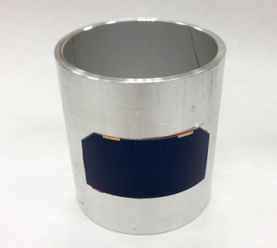
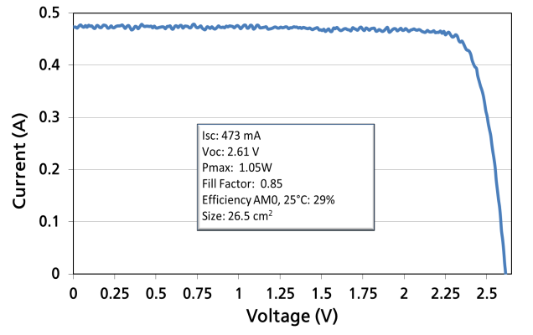
Industrialization process: Upgrade of the manufacturing process
2.1
Manufacturing of 430 CTJ30-80 thin solar cells with size 26.5 cm² to be used for the qualification campaign and for the SCA prototype fabrication
@AM0, 1367 W/m² T=25°C | Area (cm²) | Isc (mA) | Voc (V) | FF | P_{max}[W] | Eff (%)
Typical Avg (BOL, bare) | 26.5 | 463 | 2.64 | 0.85 | 1.03 | 28.6
EOL (1MeV, 5e14 e/cm²) | 26.5 | 445 | 2.51 | 0.84 | 0.94 | 26
30 mm radius
I-V @AM0, 1367 W/m² ,T=25°C (BOL)
Glued by wacker RTV 691 silicone, no coverglass

Slide 15
Agenda
CESI space products & thin solar cells benefits
Project Breakdown Structure and activities performed
  2.1 Manufacturing process Industrialization
  2.2 Qualification at bare level
  2.3 Results at SCA and bent configuration (first trials of sub M)
Conclusion

Slide 16
Qualification Test campaign
(start : end June 2016 - completed February 2017)
2.2
Test | Symbol | Chapter ref. | Bare cells (115 +20)
 |  |  | A 20 +3 | B 20+3 | C1 25+5 | O 20+3 | P 30+6
Interconnect Welding | IW | 6.1.1 | 6
Visual Inspection (*) | VI | 6.1.2 | 1,7,9 | 1,11 | 1,6,13 | 1,5,8,11 | 1,6,11
Dimensions and Weight | DW | 6.1.3 | 2 | 2 | 2 | 2 | 2
Electrical Performance | EP | 6.1.4 | 3 | 4,6,10 | 3,8,11 | 3,6,9 | 3,8
Temperature Coefficients | TC | 6.1.5 |  | 7 | 9 |  | 9
Spectral Response | SR | 6.1.6 |  |  | 4,12 |  | 4,10
Optical Properties | OP | 6.1.7 |  | 8 | 14 |  | 12
Humidity & Temperature 1 | HT1 | 6.1.8.1 |  |  |  | 4
Humidity & Temperature 2 | HT2 | 6.1.8.2 | 8
Coating Adherence | CA | 6.1.9 |  |  |  | 10
Contact Uniformity | CU | 6.1.10 | 4
Surface Finish | SF | 6.1.10 | 5
Pull Test | PT | 6.1.11 | 10
Electron Irradiation | EI | 6.1.12 |  |  | 5
Proton Irradiation | PI | 6.1.13 |  |  |  |  | 5
Photon Irradiation | PH | 6.1.14 |  | 5 | 7 |  | 7
Solar cell reverse bias test | RB | 6.1.15 |  | 9 | 10
Thermal cycling | CY | 6.1.16 |  |  |  | 7
Flatness | FT | 6.1.17 |  | 3
(*)also including electroluminescence characterization at 1.5 magnification
Industrialisation and qualification of 80 micron CTJ30 solar cell (CTJ30-80)
ESA Contract No. 4000114125/15/NL/CBi/fk

Slide 17

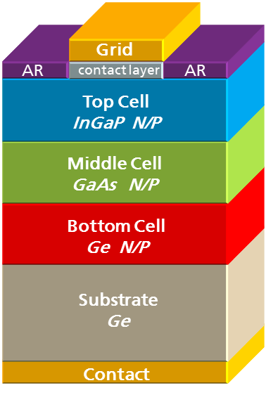
2.2
New CTJ30-Thin (80μm case) solar cell has successfully passed the qualification according to the ECSS standard at bare level
Features & Characteristics (bare)
Efficiency 29%
Triple Junction Solar Cells InGaP/GaAs/Ge for Space Applications
Thickness 80 μm ± 20 μm
Polarity N on P
Very low solar cell mass (< 50 mg/cm²)
Fully qualified according to the ECSS E ST20-08C rev.1 Standard for LEO orbit
External By-pass diode for reverse bias protection
Weldable Contacts, Front and Back, based on gold coated silver layers.
Standard sizes available 26.5 cm² , 27.5 cm² and 30.15 cm²
High Radiation Resistance
Good mechanical strength (Thermal Cycling degradation < 1%)
Industrialisation and qualification of 80 micron CTJ30 solar cell (CTJ30-80)
ESA Contract No. 4000114125/15/NL/CBi/fk

Slide 18
Qualification Campaign: Group A
2.2
 |  | SUB GROUP A (20+3 cells)
TEST |  | Requirement | Results
Visual Inspection | 1 | In SCD | test passed
Dimensions and Weight | 2 | <1.45 g | average weight 1.31 g
Electrical Performance | 3 | I_{L_MIN}= 430 mA | Average IL= 453 mA
Contact Uniformity | 4 | In SCD | passed
Surface Finish | 5 | In SCD | passed
Interconnect Welding | 6 | Invar Au/Ag coated | No shunt at interconnects welds
Visual Inspection | 7 | In SCD | passed
Humidity & Temperature 2 | 8 | None, environmental test only
Visual Inspection | 9 | In SCD | No degradation observed
Pull Test | 10 | Ultimate Pull strength >1000g at 0° or cell breakage value | *
 | Tab 1 (front) |  | Tab2 (front) |  | Tab3 (back) |  | Tab4 (back)
Type of breaks | N° of cells | Average pull strength (gr) | N° of cells | Average pull strength(gr) | N° of cells | Average pull strength(gr) | N° of cells | Average pull strength (gr)
Cell break | 15 | 1700 | 15 | 1905 | 11 | 1560 | 12 | 1425
Interconnects Breaks | 3 | 1700 | 2 | 1973 | 0 |  | 0
weld breaks | 5 | 1451 | 6 | 1591 | 12 | 1580 | 11 | 1520
Industrialisation and qualification of 80 micron CTJ30 solar cell (CTJ30-80)
ESA Contract No. 4000114125/15/NL/CBi/fk

Slide 19
Qualification Campaign Group B
2.2
SUB GROUP B (20+3 cells)
TEST |  | Requirement | Results
Visual Inspection | 1 |  | test passed
Dimensions and Weight | 2 | <1.45 g | average weight 1.31 g
Flatness | 3 | characterization | 40 μm long axis, 500 μm short axis
Electrical Performance | 4 | I_{L_MIN}= 430 mA | Average IL= 454 mA
Photon Irradiation | 5 | None, environmental test only | No degradation
Electrical Performance | 6 | characterization | Average IL= 454 mA
Temperature Coefficients | 7 | characterization
Optical Properties | 8 | characterization | average solar absorptance = 0.89
Solar cell reverse bias test | 9 | Current degradation at the cell’s operating point < 3% (ΔI_{L} <3%).
Electrical Performance | 10 | characterization | ΔI_{L} <-0.16%
Visual Inspection | 11 | characterization | No degradation
 | dIsc/dT | dVoc/dT | dP_{max}/dT | dI_{mp}/dT | dV_{mp}/dT | dFF/dT | dEff/dT
15-140 °C | mA/cm²/°C | V/°C | mW/cm²/°C | mA/cm²/°C | V/°C | 1/°C | 1/°C
Average | 0.014 | -0.006 | -0.098 | 0.007 | -0.006 | -0.001 | -0.072

Slide 20
Qualification Campaign Group C1 Electron Irradiation (1 MeV)
2.2
Electron irradiation performed at TU DELFT
Radiation Degradation (Remaining Factors)
Electron Energy | Fluence | I_{sc} | V_{oc} | P_{m} | I_{m} | V_{m} | TOP/MID lim
 | (e-/cm²)
1MeV | 1.00E+13 | 0.99 | 0.98 | 0.97 | 0.99 | 0.98 | top
1MeV | 1.00E+14 | 0.99 | 0.97 | 0.96 | 0.99 | 0.97 | top
1MeV | 5.00E+14 | 0.98 | 0.95 | 0.91 | 0.96 | 0.94 | top
1MeV | 1.00E+15 | 0.93 | 0.93 | 0.84 | 0.89 | 0.94 | mid
1 MeV | 3.00E+15 | 0.84 | 0.9 | 0.72 | 0.79 | 0.9 | mid

Slide 21
Qualification Campaign Group C1 Electron Irradiation (1 MeV)
2.2
The temperature coefficients (15°C-140°C)
Electron Energy | Fluence | ΔIsc/dT | ΔVoc/dT | ΔPmax | ΔImp | ΔVmp | ΔFF | ΔEff
 | (e-/cm²) | mA/cm²/°C | mV/°C | mW/cm²/°C | mA/cm²/°C | V/°C | 1/°C | %abs/°C
1MeV | 1.00E+13 | 0.015 | -6.49 | -0.099 | 0.008 | -6.58 | -0.001 | -0.072
1MeV | 1.00E+14 | 0.015 | -6.56 | -0.099 | 0.008 | -6.74 | -0.001 | -0.072
1MeV | 5.00E+14 | 0.016 | -6.8 | -0.098 | 0.009 | -6.99 | -0.001 | -0.071
1MeV | 1.00E+15 | 0.014 | -6.86 | -0.092 | 0.009 | -6.99 | -0.001 | -0.067
1 MeV | 3.00E+15 | 0.012 | -7.07 | -0.083 | 0.01 | -7.2 | -0.001 | -0.06
Absorpt EOL=0.907

Slide 22
Qualification Campaign Group P Proton Irradiation (1-2 MeV)
2.2
  Proton irradiation performed at Centre de Sciences Nucléaire et de Sciences de la Matière (CSNSM) Paris:
  36 samples of group P
  6 different energy-dose pair
Radiation Degradation (Remaining Factors)
Proton Energy | Fluence | ΔIsc/dT | ΔVoc/dT | ΔPmax | ΔImp | ΔVmp
 | (p+/cm²) | mA/cm²/°C | mV/°C | mW/cm²/°C | mA/cm²/°C | V/°C
1MeV | 1.00E+10 | 1.00 | 0.98 | 0.97 | 1.00 | 0.97
1MeV | 2.00E+10 | 0.99 | 0.97 | 0.95 | 0.99 | 0.95
1MeV | 5.00E+10 | 0.99 | 0.95 | 0.90 | 0.97 | 0.93
1MeV | 1.00E+11 | 0.97 | 0.92 | 0.85 | 0.95 | 0.90
1MeV | 3.00E+11 | 0.90 | 0.88 | 0.73 | 0.86 | 0.85
2MeV | 1.50E+11 | 0.98 | 0.94 | 0.88 | 0.96 | 0.92
Industrialisation and qualification of 80 micron CTJ30 solar cell (CTJ30-80)
ESA Contract No. 4000114125/15/NL/CBi/fk

Slide 23
Qualification Campaign Group P Proton Irradiation (1-2 MeV)
2.2
The temperature coefficients (15°C-140°C)
Proton Energy | Fluence | ΔIsc/dT | ΔVoc/dT | ΔPmax | ΔImp | ΔVmp | ΔFF | ΔEff
 | (p+/cm²) | mA/cm²/°C | mV/°C | mW/cm²/°C | mA/cm²/°C | V/°C | 1/°C | %abs/°C
1MeV | 1.00E+10 | 0.015 | -6.633 | -0.102 | 0.007 | -6.743 | -0.001 | -0.074
1MeV | 2.00E+10 | 0.015 | -6.679 | -0.099 | 0.007 | -6.675 | -0.001 | -0.073
1MeV | 5.00E+10 | 0.015 | -6.873 | -0.102 | 0.008 | -6.839 | -0.001 | -0.074
1MeV | 1.00E+11 | 0.015 | -7.045 | -0.101 | 0.007 | -6.934 | -0.001 | -0.074
1MeV | 3.00E+11 | 0.016 | -7.332 | -0.091 | 0.009 | -7.017 | -0.001 | -0.066
2MeV | 1.50E+11 | 0.015 | -6.908 | -0.103 | 0.007 | -6.947 | -0.001 | -0.076
Absorpt EOL=0.89
Absorpt EOL=0.89 @ 1MeV 3.00E+11 p+/cm²
Industrialisation and qualification of 80 micron CTJ30 solar cell (CTJ30-80)
ESA Contract No. 4000114125/15/NL/CBi/fk

Slide 24
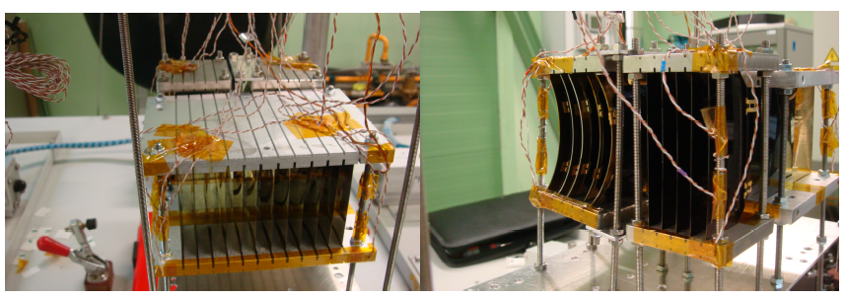
Qualification Campaign Group O Thermal Cycling
2.2
Thermal Cycling has been performed by INTA/Spasolab
The following samples have been tested:
  20+3 CTJ30-80 bare solar cells (for qualification at bare level)
  1 CTJ30-80-SCA (solar cell assembly) using standard CMG100 coverglass
  4 CTJ30-80-SCA (solar cell assembly) using flexible QOptic coverglass
  5 CTJ30-80 in bent configuration on a 6 cm diameter cylinder
Number of cycles | Temp. Range | Cycle Duration (*) | Environment
 | [°C] | [min]
6000 | -130 (-5;0) / +150 (0;+5) | 30 °C/min. max temperature grade | Inert atmosphere
Industrialisation and qualification of 80 micron CTJ30 solar cell (CTJ30-80)
ESA Contract No. 4000114125/15/NL/CBi/fk

Slide 25
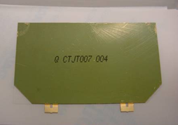
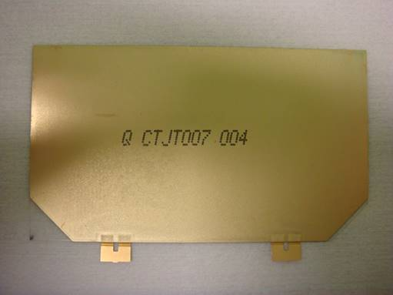
Qualification Campaign Group O –Bare cells
2.2
Bare solar cells: no variation of the electrical performance after Thermal Cycling
 | ΔIsc (%) | ΔVoc(%) | ΔPm (%) | ΔIL (%)
Average | -0.4% | -0.1% | -0.4% | -0.4%
Max | 0.3% | 0.8% | 1.4% | 0.5%
Min | -0.9% | -0.3% | -1.0% | -1.2%
Bending radius higher (from 3 to 5 cm)
Pull strength unchanged
Back side metal opaque
Industrialisation and qualification of 80 micron CTJ30 solar cell (CTJ30-80)
ESA Contract No. 4000114125/15/NL/CBi/fk

Slide 26
Agenda
CESI space products & thin solar cells benefits
Project Breakdown Structure and activities performed
  2.1 Manufacturing process Industrialization
  2.2 Qualification at bare level
  2.3 Results at SCA and bent configuration (first trials of sub M)
Conclusion

Slide 27
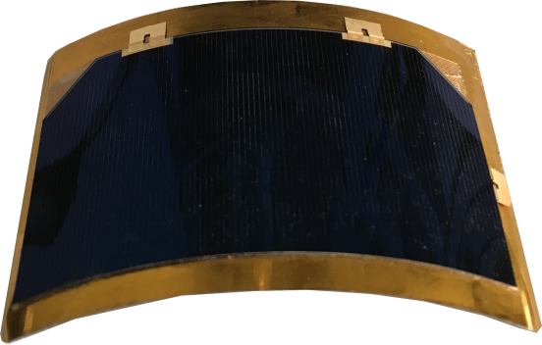
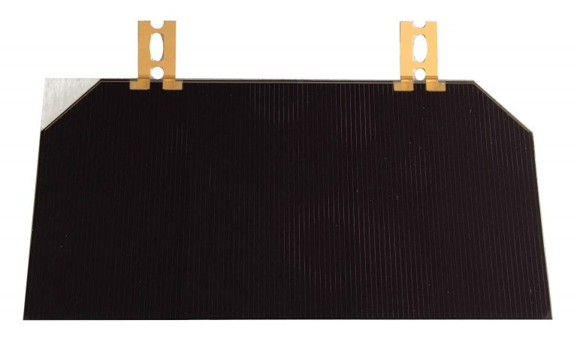
Bent thin cells and SCAs using std rigid CMG coverglass and new flexible coverglass were also successfully submitted to thermal cycling
2.3
  SCAs with rigid cover glass ( without bypass diode)
  SCAs with flexible coverglass ( without bypass diode)
  5 bare cells in bent configuration (glued by Nusil CV2680-12 onto a stainless steel support with a bending radius of 60 mm, no coverglass, no bypass diode)
60 mm radius
SCA with flexible coverglass (plane position)
Also these additional samples survived to thermal cycling
Preliminary results suggest that the cell in bent configuration didn’t experience any mechanical / electrical degradation
Industrialisation and qualification of 80 micron CTJ30 solar cell (CTJ30-80)
ESA Contract No. 4000114125/15/NL/CBi/fk

Slide 28
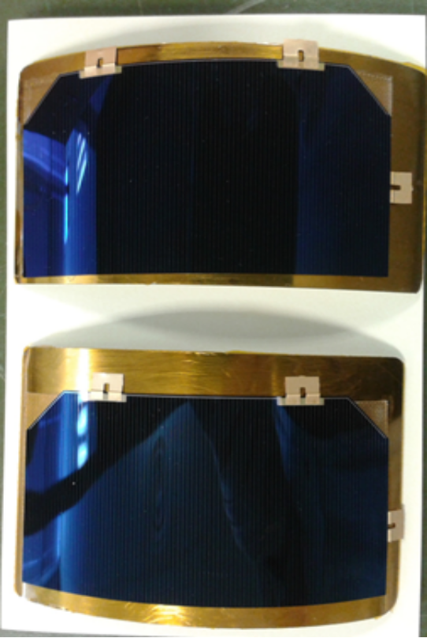
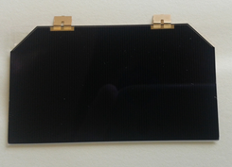
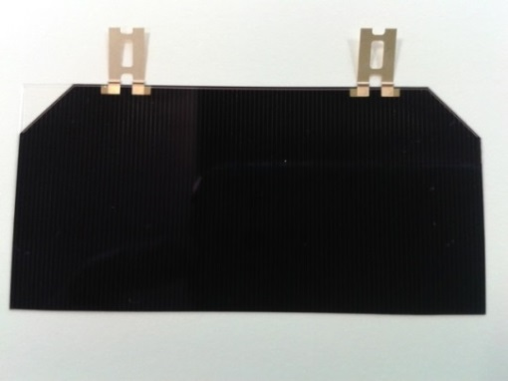
SCA and bent solar cells CY results
2.3
CIC with standard CMG 100 coverglass
Bare cells in bent configuration
 | Isc[A] | Voc[V] | Pmax[W] | Ipmax[A] | Vpmax[V]
before Thermal Cycling | 0.457 | 2.64 | 1.02 | 0.443 | 2.31
After thermal cycling | 0.458 | 2.64 | 1.02 | 0.444 | 2.31
Size 26.5 cm²
CIC with flexible coverglass
Before thermal cycling |  | After thermal cycling
Isc(mA) | Voc(V) | Isc (mA) | Voc(V)
438 | 2.61 | 440 | 2.57
 | Isc[A] | Voc[V] | Pmax[W] | Ipmax[A] | Vpmax[V]
before Thermal Cycling | 0.479 | 2.65 | 1.071 | 0.463 | 2.31
After thermal cycling | 0.479 | 2.65 | 1.072 | 0.463 | 2.31
By-pass diode for flexible array:
Silicon thin?? (SIBJ not compatible)
GaAs/Ge: higher Vd
Size 27.5 cm²

Slide 29
Thermal shock and Long duration bending (in progress)
2.3
Thermal shock with bare and SCA (std CMG100 free to shrink: 100 cycles -193/+150°C, 2 minutes per cycle
 | Delta Isc [%] | Delta Voc [%] | Delta Pm [%]
 | after Thermal Shock
CTJ30-80 | 0.3% | -0.1% | 0.1%
SCA | 0.2% | -0.1% | -0.4%
Long duration test in bent configuration: 3 bare cells, start 27/01/2017:
no degradation at now
Data | Isc[A] | Voc[V] | Pmax[W] | Ipmax[A] | Vpmax[V] | F.F. | Eff.[%]
27/01/2017 | 0.464 | 2.622 | 1.029 | 0.447 | 2.301 | 0.846 | 28.4
27/02/2017 | 0.465 | 2.617 | 1.026 | 0.447 | 2.295 | 0.843 | 28.3
27/03/2017 | 0.467 | 2.622 | 1.033 | 0.451 | 2.291 | 0.843 | 28.5
27/04/2017 | 0.464 | 2.625 | 1.034 | 0.451 | 2.295 | 0.849 | 28.5
29/05/2017 | 0.466 | 2.622 | 1.030 | 0.448 | 2.300 | 0.844 | 28.4
28/07/2017 | 0.467 | 2.621 | 1.028 | 0.450 | 2.285 | 0.840 | 28.4
Industrialisation and qualification of 80 micron CTJ30 solar cell (CTJ30-80)
ESA Contract No. 4000114125/15/NL/CBi/fk

Slide 30
Conclusion and future work
3
At the end of this project CESI successfully completed the industrialization and qualification of the CTJ30_80 solar cells :
The CTJ30 _80 cell exhibits a BOL efficiency of about 29.0% (AM0, 1367 W/m², T=25°C)
EOL Remaining Power Factor after proton and electron irradiation are comparable with standard CTJ_30 solar cells (e.g. 0.91 at 5E14 electron/cm² 1 MeV electron).
Applicability of the etching process to the other CESI products like low cost and large area solar cells
Suitability of the standard assembly technology on 80 um thick cells proved
First demonstration of bendable SCA reliability on flexible/ curved substrate
The future activities for completing the CTJ30-80 product are:
Qualification of CTJ30_80 SCA with flexible cover glass and thin by pass diode
Industrialisation and qualification of 80 micron CTJ30 solar cell (CTJ30-80)
ESA Contract No. 4000114125/15/NL/CBi/fk

Slide 31

Thank you for your attention
Thank you for your attention
Thank you for your attention
Milan • Berlin • Mannheim • Dubai • Abu Dhabi • Rio de Janeiro • Washington DC

