Slide 1
OPTIMIZED TRANSFERS BETWEEN EARTH-MOON INVARIANT MANIFOLDS
Speaker: Laurent Beauregard laurent.beauregard@isae-supaero.fr
Co-authors: Emmanuel Blazquez
Dr. Stéphanie Lizy-Destrez

Slide 2
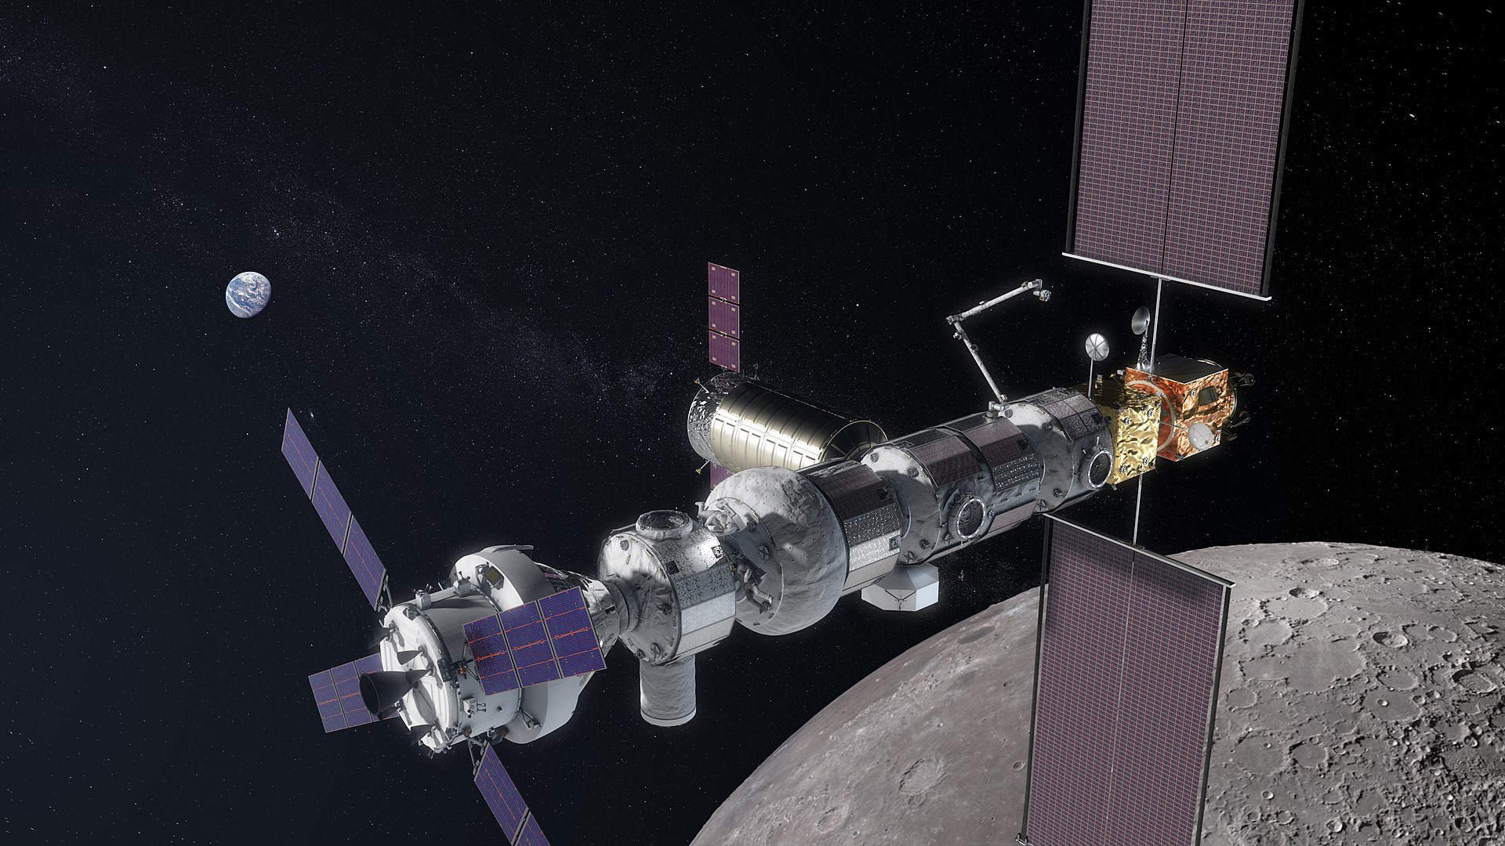
Context
Lunar orbital platform-Gateway (LOP-G)
Successor to the International Space Station will be the LOP-G (2022)
Allow easy surface access
Constant communication with Earth, few eclipses
On a L2 southern Near Rectilinear Halo orbit
Period: 6.56 days
Periapsis: 1500 km
Apoapsis: 70 000 km

Slide 3
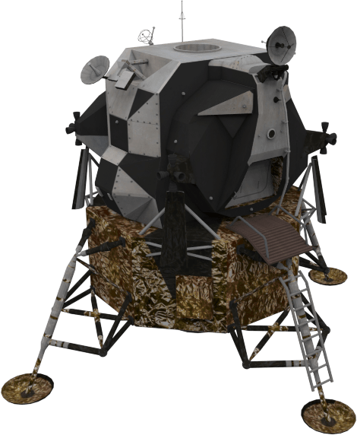
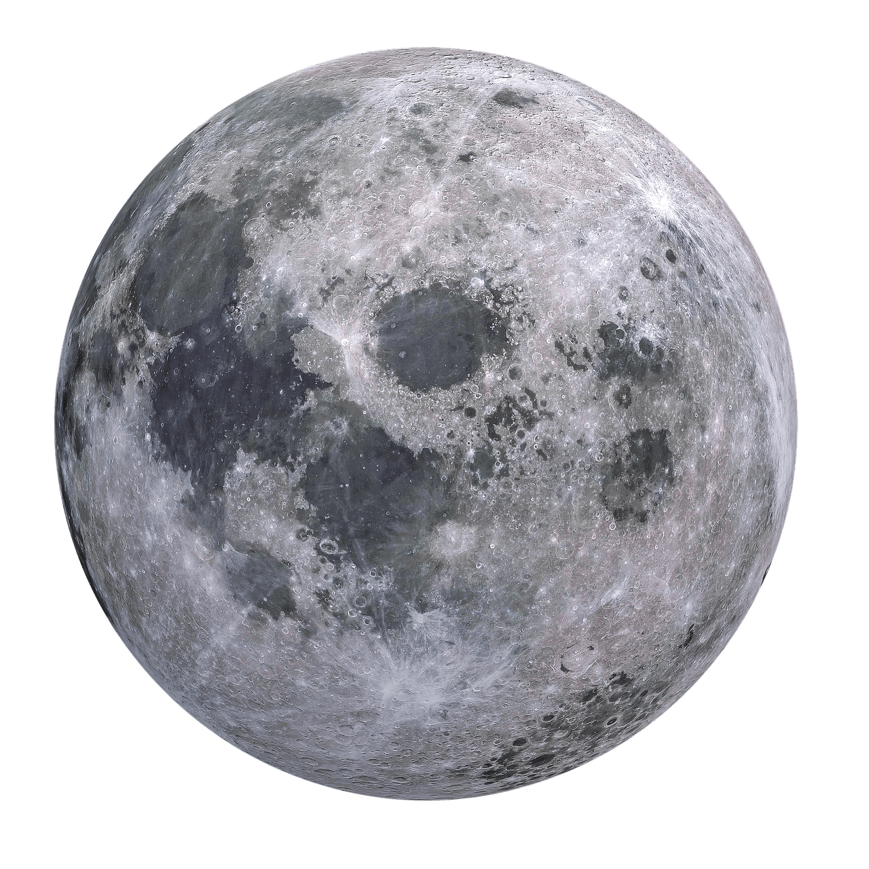
Circular restricted three body problem
Only massive bodies
Earth and Moon
Moon’s orbit is circular
Third body is masslesss
$$\ddot{r}=−\frac{μ_{M}\left(r−r_{M}\right)}{{\left|r−r_{M}\right|}^{3}}−\frac{μ_{E}\left(r−r_{E}\right)}{{\left|r−r_{E}\right|}^{3}}$$
$$−ω×\left(ω×r\right)−2 ω×\dot{r}$$
Moon’s gravity
Earth’s gravity
y
Centrifugal acceleration
Coriolis acceleration
x
z
Center of mass

Slide 4
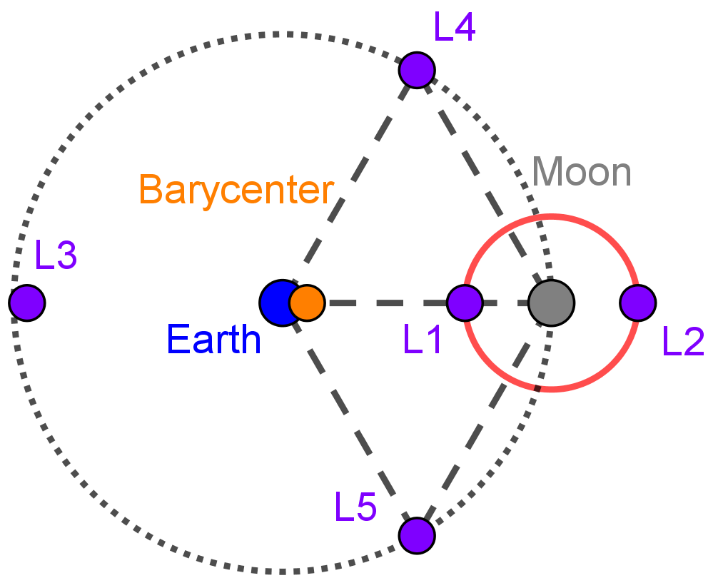
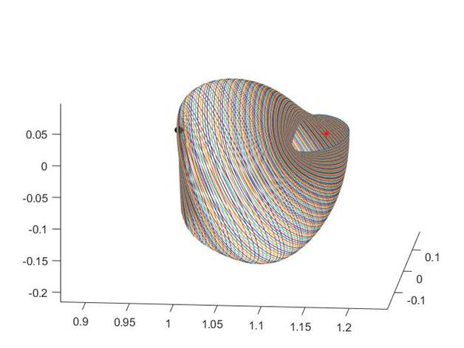
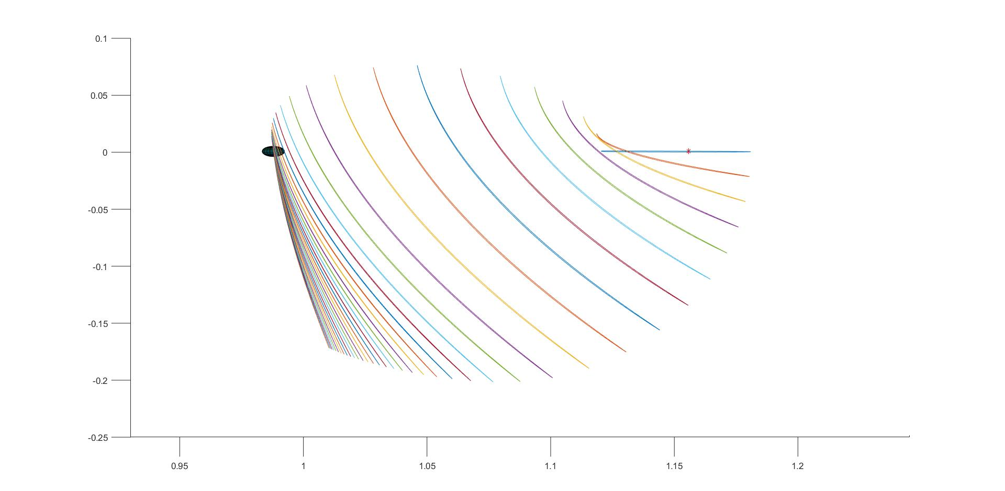
Halo orbits
Fixed point of the CR3PB exists
Lagrange points
Closed orbit of the CR3PB exists
Halo orbits are 3 dimensional trajectories

Slide 5
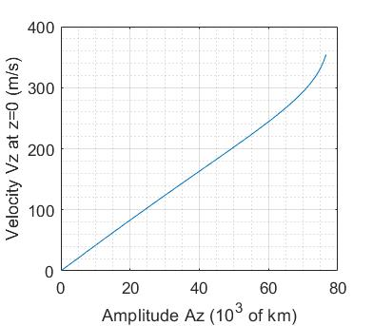
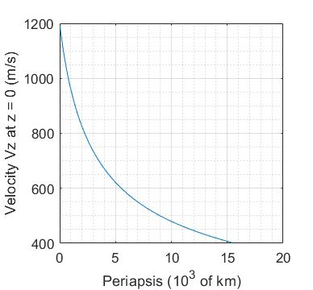
Parametrization
Several parametrizations exist
Amplitude of Halo $A_{z}$
Periapsis $P_{e}$
Velocity $V_{z}$ at $z=0$
$V_{z}\sim \frac{4 m/s}{1000 km}A_{z}$

Slide 6
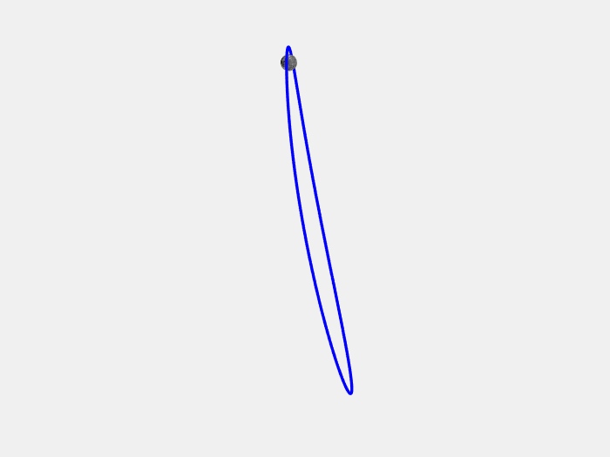
Objective
Comparison of far approach rendez-vous methods
Low thrust (Orbit hopping)
Lambert arcs
Manifold methods
Orbit of the LOP-G

Slide 7
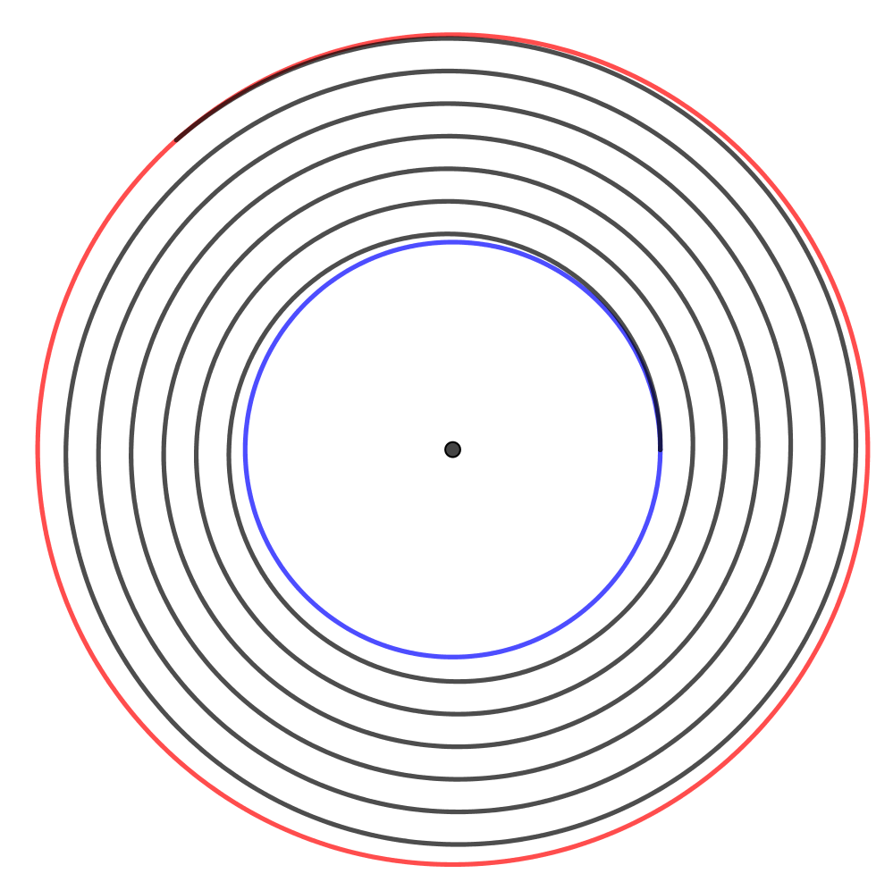
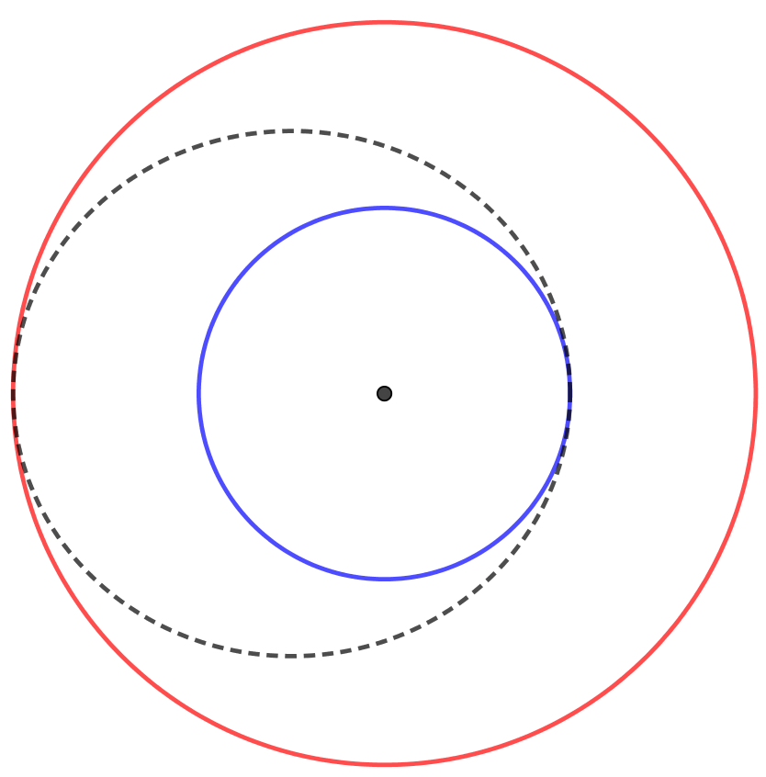
Quasi-static method
Two body
Hohmann transfer
(Limit ∞ thrust)
Low thrust trajectory
(Limit 0 thrust)
$$Δv_{Hoh}=\left(\sqrt{2μ\left(\frac{1}{a_{1}}−\frac{1}{a_{1}+a_{2}}\right)}−\sqrt{\frac{μ}{a_{1}}}\right)$$
$$+\left(\sqrt{\frac{μ}{a_{2}}}−\sqrt{2μ\left(\frac{1}{a_{2}}−\frac{1}{a_{1}+a_{2}}\right)}\right)$$
$$Δv_{Low}=\sqrt{\frac{μ}{a_{1}}}−\sqrt{\frac{μ}{a_{2}}}$$
$$Δv_{Low}−Δv_{Hoh}\sim \frac{1}{32}\sqrt{\frac{μ}{a_{1}}}\frac{{\left(a_{2}−a_{1}\right)}^{3}}{a_{1}^{3}}$$

Slide 8
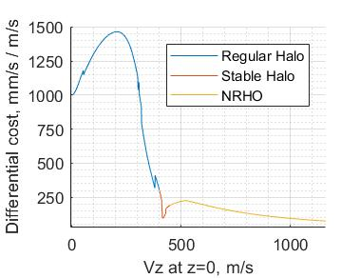
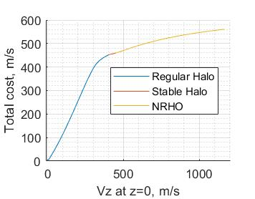
Quasi-static method
Orbit hopping
Orbit hopping ~ Low thrust trajectory
Gives an upper bound on the cost between any two Halo orbits
Each intermediate stage is a closed orbit
Up to an $A_{z}\sim 60 000 km$
Covering all NRHOs ~ 100 m/s
$$Δv<\frac{6 m/s}{1000 km} {ΔA}_{z}$$

Slide 9
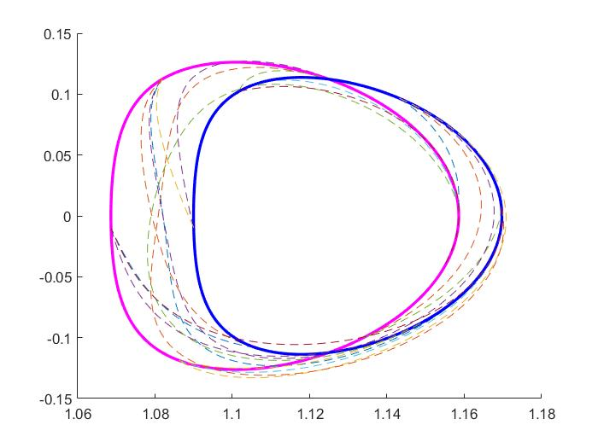
Lambert arcs
Two impulse maneuvers
Minimize $Δv$ over
Departure point
Arrival point
Time of flight

Slide 10
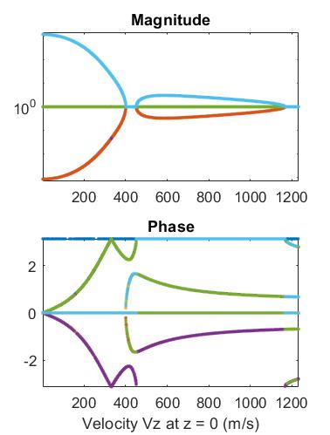
Manifolds
Most Halo orbits are unstable
The eigenvalues of the differential of the Poincaré map encodes this information
Except for a narrow range of Halos
Continuation direction: $λ=1$
Unstable direction: $\left|λ\right|>1$
Stable direction: $\left|λ\right|<1$
Center: $λ=e^{±iφ}$
Propagate
forward
Unstable direction: Diverges
Stable direction: Converges
Propagate
backward
Unstable direction: Converges
Stable direction: Diverges

Slide 11
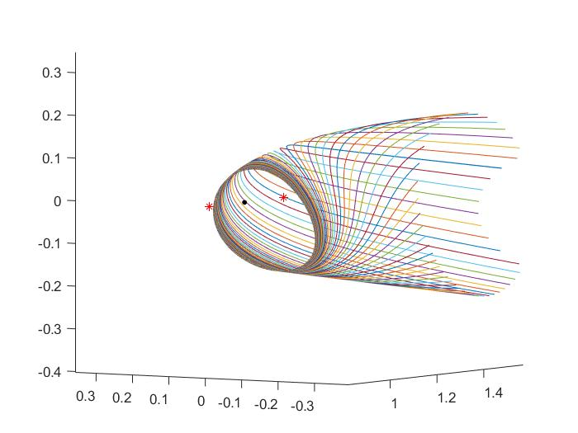
Manifolds generation
Eigenvector corresponding to the unstable direction $w_{u}$
Apply a perturbation $α=ε_{0}λ^{k/N}$, $k∈\{0,1,…,N−1\}$
Manifolds are parametrized by $\left(α,t\right)→\left(r_{u},v_{u}\right)$
Unstable trajectories

Slide 12
Manifolds method
Departure orbit A
Unstable manifold of A
Stable manifold of
B
Arrival orbit B
Low $Δv$
Intersection + $Δv$
Low $Δv$
Intersection of two surfaces: Find $α_{u},t_{u},α_{s},t_{s}$ such that $r_{u}=r_{s}$

Slide 13
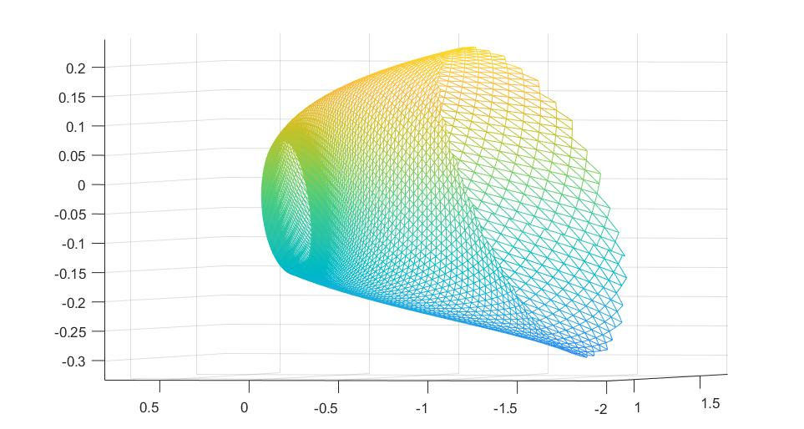
Manifolds method
Triangulation of $\left(α,t\right)$

Slide 14
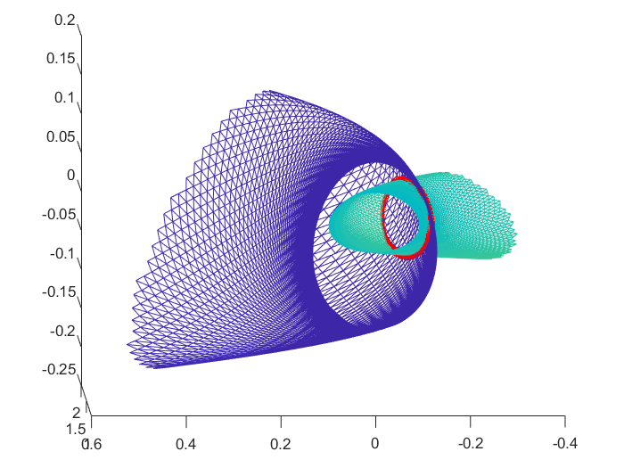
Manifolds intersection
Intersections of two triangulated surface can be done efficiently
By linear interpolation and refinement, the states can be recovered $\left(r_{u},v_{u}\right) \& \left(r_{s},v_{s}\right)$
Find the intersection that has lowest $Δv=\left|v_{u}−v_{s}\right|$

Slide 15
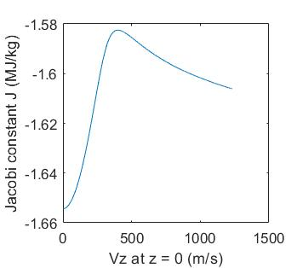
Jacobi constant
The CR3PB has a conservation of “Energy”; the Jacobi constant
$$J=\frac{1}{2}v^{2}−\frac{μ_{E}}{\left|r−r_{E}\right|}−\frac{μ_{M}}{\left|r−r_{M}\right|}−\frac{1}{2}{\left(ω×r\right)}^{2}$$
$L_{2}$ Halo orbits

Slide 16
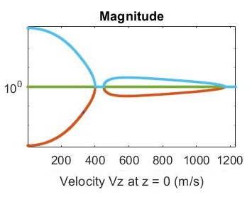
Cases considered
Stability
LOP-G
LOP-G
14 different cases considered
Close orbits
Far orbits, two directions
Same Jacobi constant

Slide 17
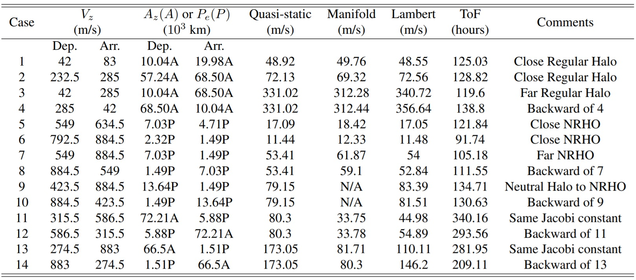
Results
The three methods are compared
If the orbits are close, then the three methods cost the same $Δv$ (within 10%)
For far orbit, the manifold is better for regular halo, worse for NRHO
For orbits of same energy, saving of 25%-45% is observed compared to Lambert arc

Slide 18
Results
The three methods are compared
If the orbits are close, then the three methods cost the same $Δv$ (within 10%)
For far orbit, the manifold is better for regular halo, worse for NRHO
For orbits of same energy, saving of 25%-45% is observed compared to Lambert arc

Slide 19
Results
The three methods are compared
If the orbits are close, then the three methods cost the same $Δv$ (within 10%)
For far orbit, the manifold is better for regular halo, worse for NRHO
For orbits of same energy, saving of 25%-45% is observed compared to Lambert arc

Slide 20
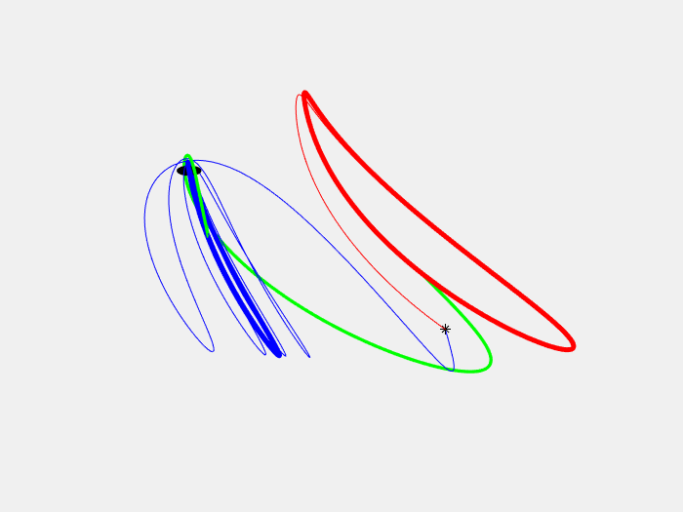
Example: Same energy, LOP-G -> Halo
Low thrust
173.05 m/s
Lambert arc (Green)
146.2 m/s
Manifold
80.3 m/s

Slide 21
Conclusion
For close orbits: No substantial savings
Manifold method can provide substantial saving in the $Δv$ for far orbits, especially for same energy level (up to 45%)
Next steps
Increase the number of search variables
Check the robustness of the trajectory in an ephemeris model

Slide 22
Thank you
Thank you for your attention

Slide 23
Bibliography
[1] “Lunar outpost sustaining human space exploration by utilizing in-situ resources with a focus on propellant production,” International Astronautical Congress 2018, IAC-18,A5,1,5,x46282.
[2] S. Lizy-Destrez, “Rendezvous optimization with an inhabited space station at EML2,” 25th International Symposium on Space Flight Dynamics, ISSFD, 2015.
[3] G. Gomez, A. Jorba, J. Masdemont, and C. Simo, “Study of the transfer from the earth to a halo orbit around the equilibrium pointl1,” Celestial Mechanics and Dynamical Astronomy, vol. 56, no. 4, pp. 541–562, Aug 1993.
[4] G. Gomez et al, “Connecting orbits and invariant manifolds in the spatial restricted three-body problem,” Caltech, 2004.
[5] V. Szebehely, “Theory of orbits. the restricted problem of three bodies,” Academic Press, New York, 1967.
[6] NASA, “General mission analysis tool (GMAT),” 2016.
[7] S. K. Wang et al., “Dynamical systems, the three-body problem and space mission design,” Caltech, 2000.
[8] Norman R. Lebovitz, “Ordinary differential equations, chapter 9 stability ii: maps and periodic orbits,” http://people.cs.uchicago.edu/ lebovitz/odes.html.
[9] D. Torre Sangra, E. Fantino, “Review of lambert’s problem,” 25th International Symposium on Space Flight Dynamics ISSFD, 2015.
[10] T. Moeller, “A fast triangle-triangle intersection test,” Stanford University, 1992.

