Slide 1
Rendezvous in non-keplerian orbits with Low-Thrust
Rubén Vega-Astorga
Manuel Sanjurjo-Rivo
David Morante
Universidad Carlos III de Madrid
Notes:
Trabajo fin de master

Slide 2
MOLTO
(Multi-Objective Low-Thrust Optimizer
OR
(ORBIT RAISING)
IT
(INTERPLANETARY TRAJECTORIES)
MB
(MULTI-BODY)
…
OR-STEP 1
Genetic Algorithm
+
Q-law
IT-STEP 1
Genetic Algorithm
+
Shape-based method
MB-STEP 1
¿?
…
STEP 2
Direct Transcription + Gradient Based solver

Slide 3
OUTLINE
Introduction
Solution approach
Test case
Conclusions

Slide 4
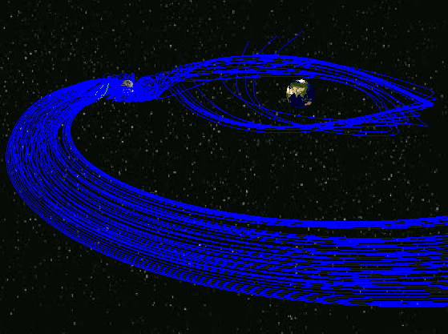
INTRODUCTION

Slide 5
1. INTRODUCTION
The goal is to design a low-thrust trajectory
to rendezvous at a non-keplerian orbit with minimum cost
Earth-Moon System trajectories
  Applications:
    Support Lunar surface activities
    Deep space Gateway
  Requirements:
    Earth accessibility
    Lunar accessibility
    Station keeping
    Communication
    Thermal Environment

Slide 6
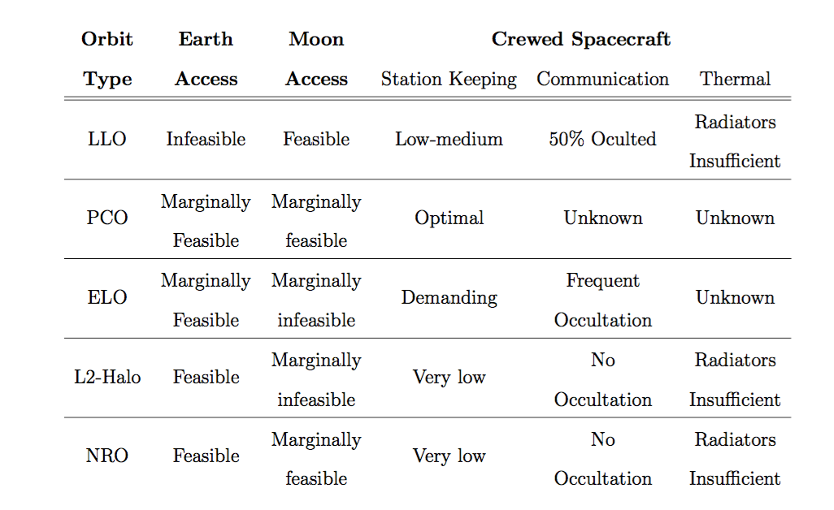
1. INTRODUCTION
Requirement Analysis for different orbits:
We select a rendezvous mission to L2-Halo orbit
Robust computational schemes that converges rapidly are necessary
Notes:
During the preliminary design phase and or during operations: for example in response to contingencies if an abort maneuver have to be computed instantanously

Slide 7

METHODOLOGY

Slide 8
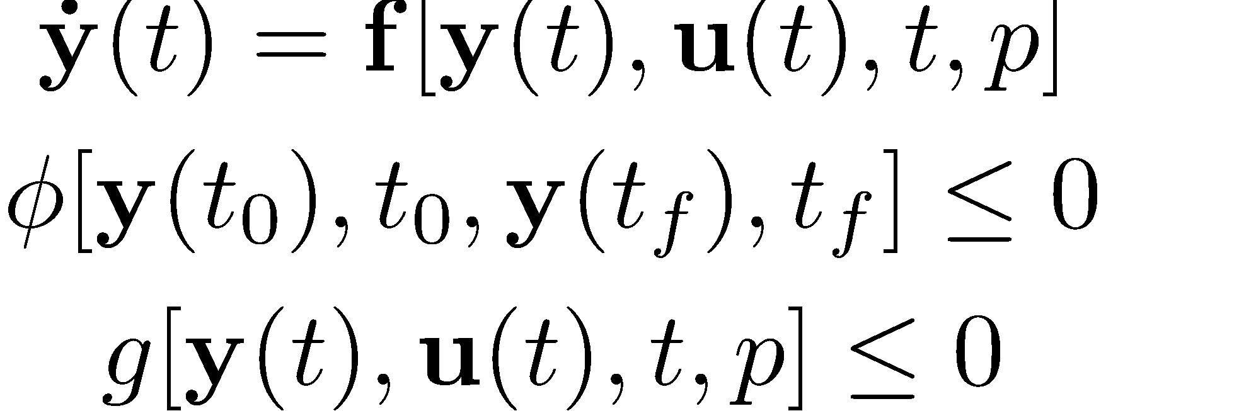
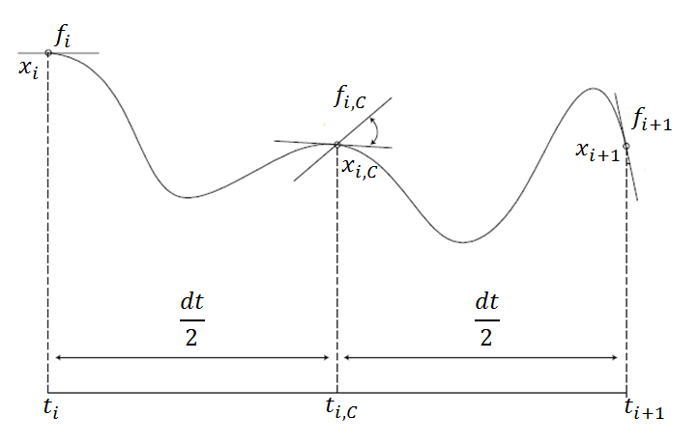
2. METHODOLOGY
Step2: Solution Approach
Find the control law u*(t) that:
Maximize →
Subject to:
Dynamical constraints→
Boundary constraints →
Path constraints →
CONTINUOUS OPTIMAL CONTROL PROBLEM
DISCRETIZATION
NONLINEAR PROGRAMMING PROBLEM
IPOPT

Slide 9
2. METHODOLOGY
Step 1: Initial Guess generation
Summary of implemented tools:
ANALYTICAL TOOL
HALO ORBIT GENERATION
NUMERICAL TOOL
MANIFOLDS GENERATION
MANIFOLDS GENERATION

Slide 10
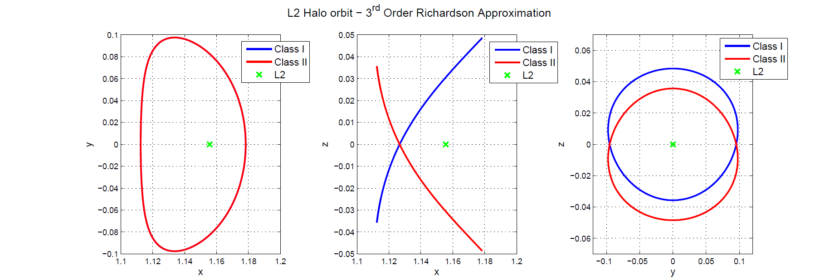
2. METHODOLOGY
Step 1: HALO ORBITS GENERATION
Analytical solution: 3rd Order Richardson Approximation
Analytical approximation for halo type periodic orbits about the collinear points of the circular restricted three body problem

Slide 11
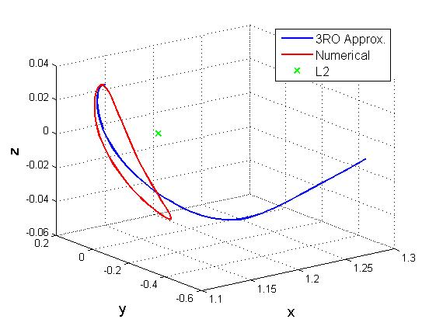
2. METHODOLOGY
Step1: HALO ORBITS GENERATION
Numerical Generation: Shooting method + differential corrections
Iteration process until periodicity is reached
 | 3 ^{rd} O.R. Approx. | Numerical Computation
x₀ | 1.11245500 | 1.11073363
y₀ | 0 | 0
z₀ | 0.03568033 | 0.035698470
v_{x,0} | 0.00016773 | 0
v_{y,0} | 0.20156709 | 0.20366491
 | -0.00102173 | 0

Slide 12
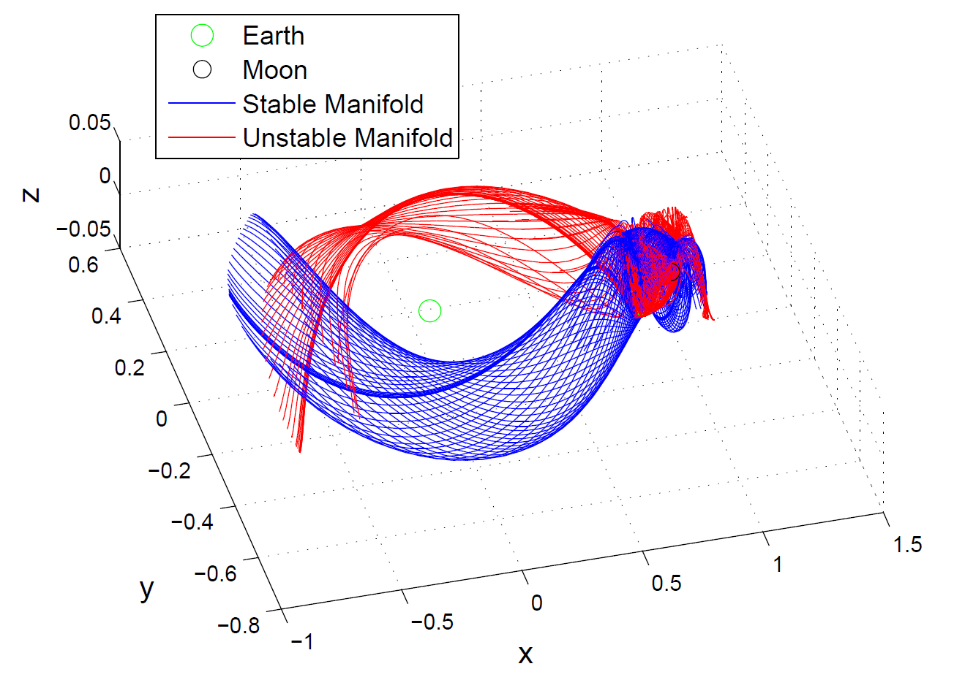
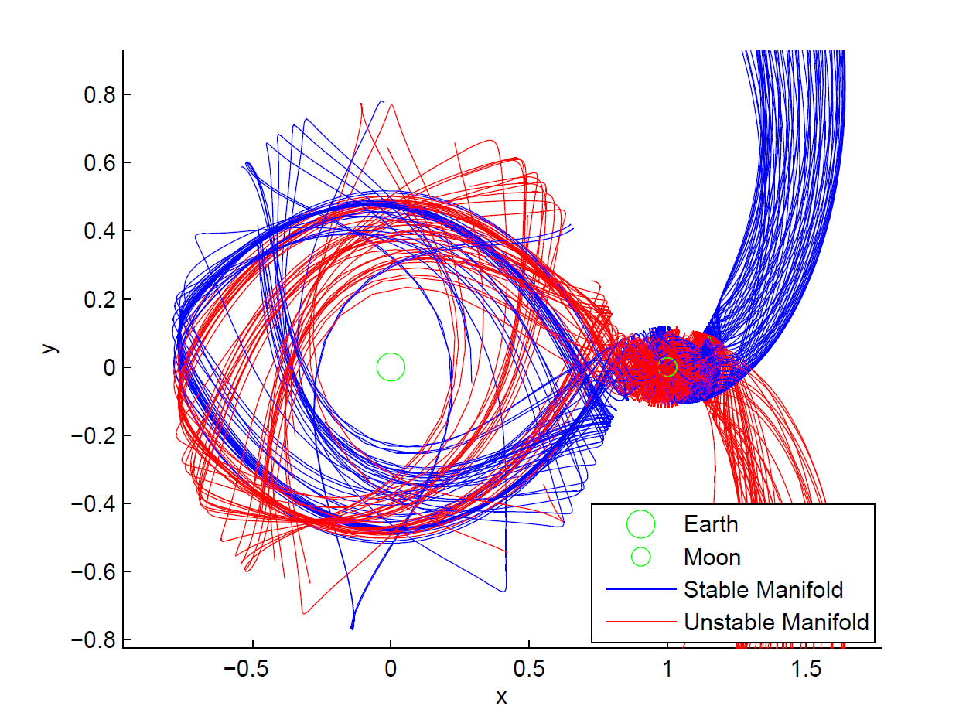
2. METHODOLOGY
Step 1: HALO MANIFOLDS GENERATION
From the eigenvectors of the Monodromy matrix at a point.
Propagation the EoM with shift the manifolds are obtainedd
Backward propagation-> stable manifolds
Forward propagation -> unstable manifolds
L1 Halo manifolds.
L2 Halo manifolds.

Slide 13
TEST CASES

Slide 14
3. TEST CASE
PROBLEM DESCRIPTION
The rendezvous problem
Goal: meeting the target spacecraft.
Optimize the rendezvous manoeuvre with the direct collocation method.
Target: L2 Halo orbit
Assumptions:
  Initial parking orbit connects with a manifold trajectory of halo close to the target
  The Halo manifold do not lead directly to the target L2
PROBLEM 1 :
  Transfer between Halo orbits
  Rendezvous in the target Halo
PROBLEM 2 : General rendezvous problem
14
Notes:
Three different stages for a deeper analysis

Slide 15
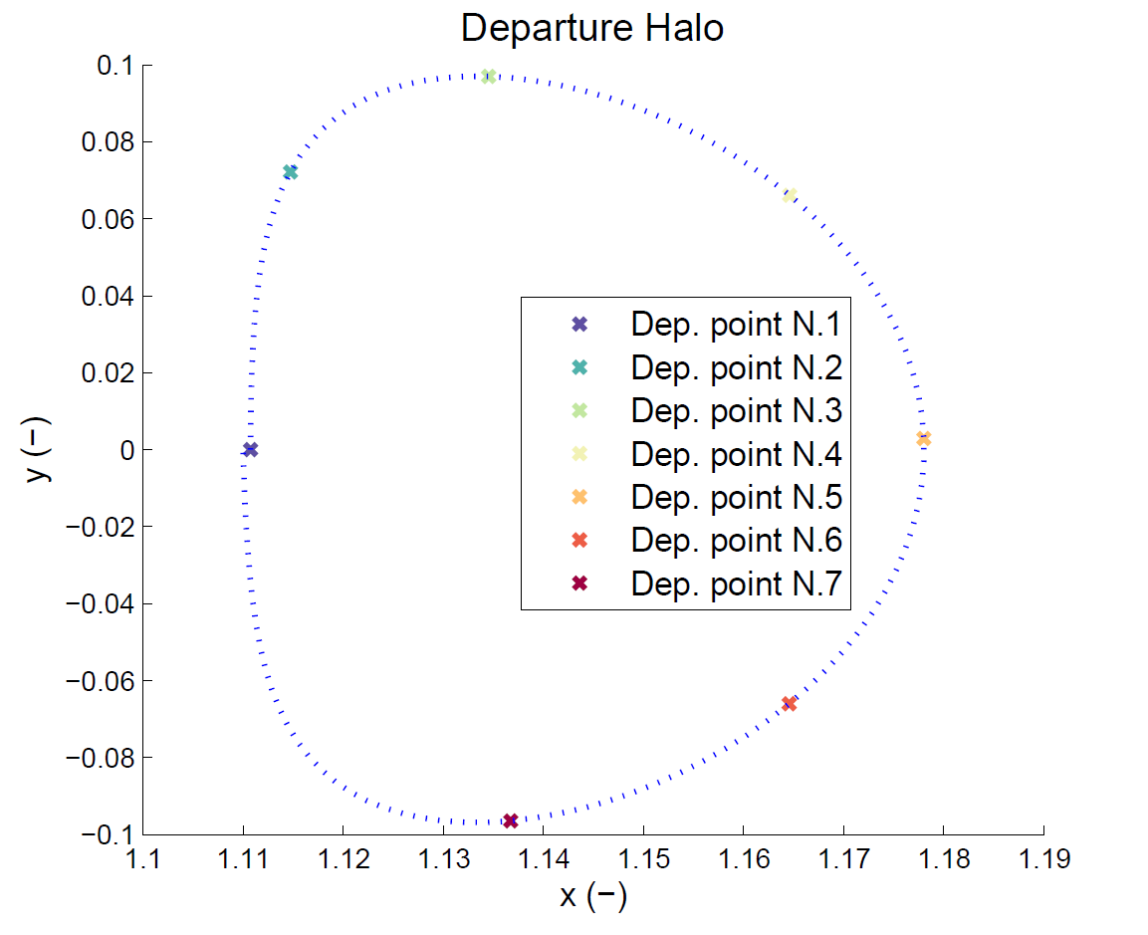
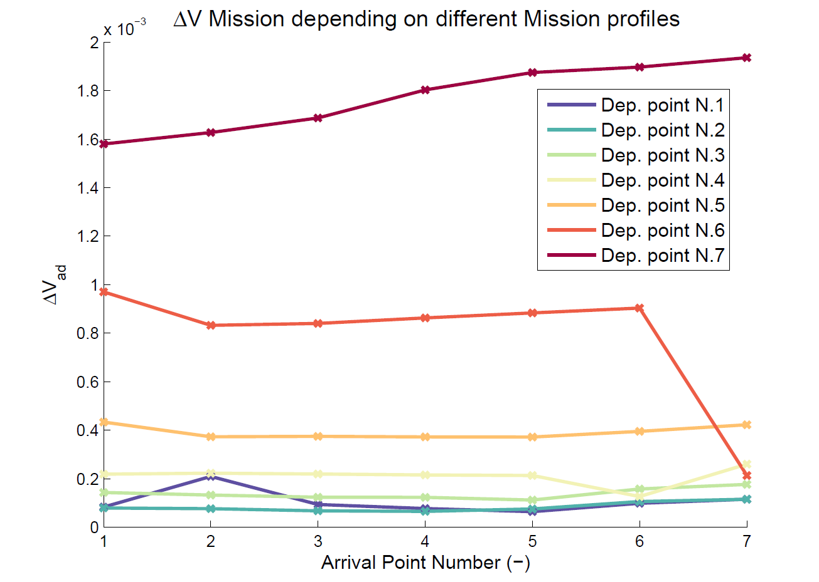
3. TEST CASE
CASE 1: TRANSFER BETWEEN HALO ORBITS
Notes:
¿por qué estos puntos?

Slide 16
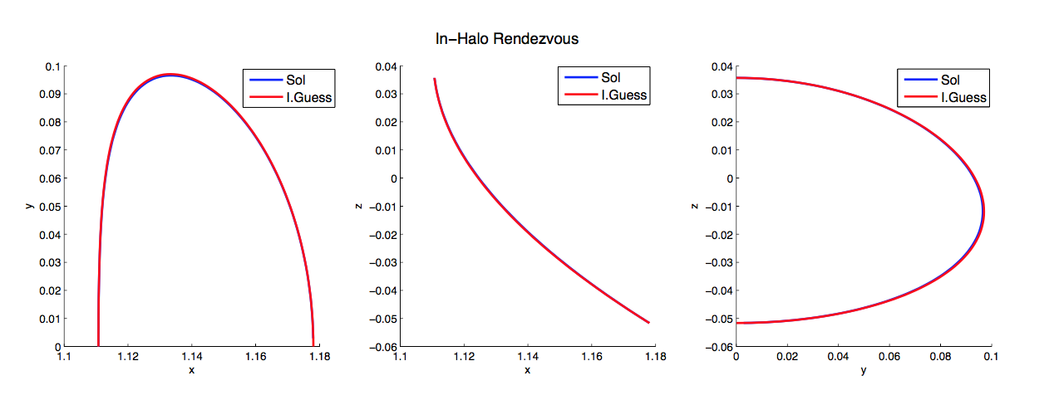
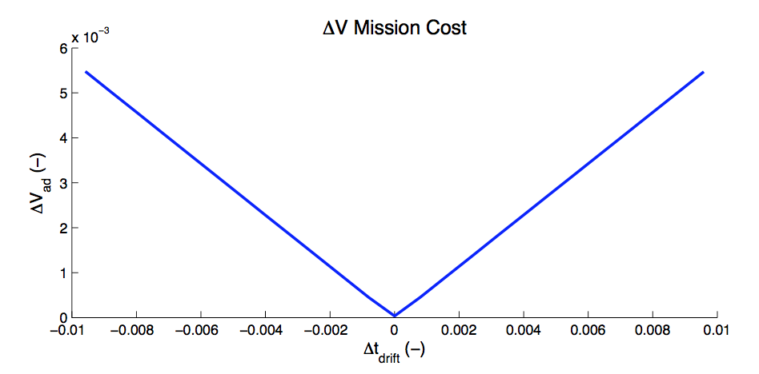
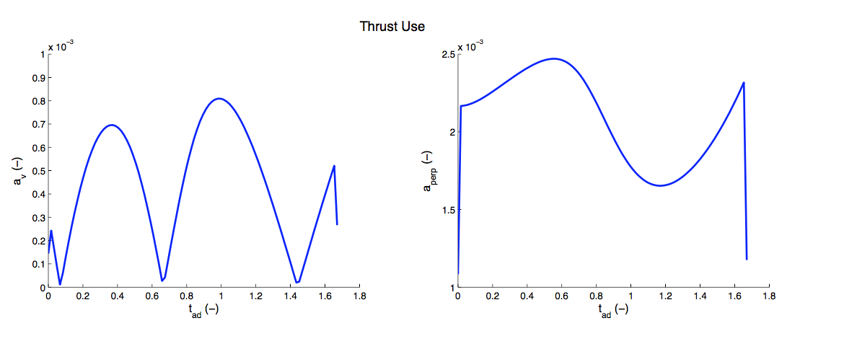
3. TEST CASE
CASE 2: RENDEZVOUS IN THE TARGET HALO
Notes:
Half of the orbit in less or more time: Initial guess> natural HALO trajectory

Slide 17
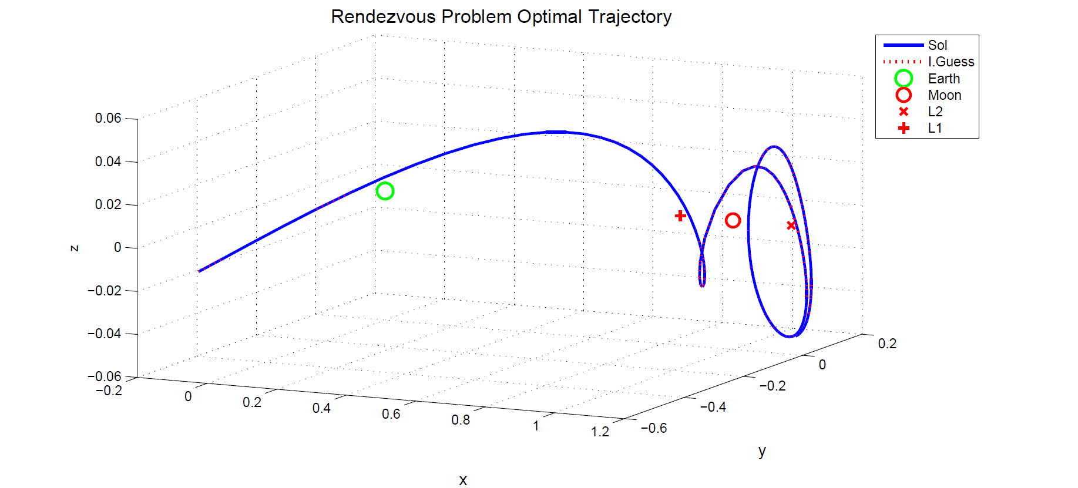
3. TEST CASE
GENERAL RENDEZVOUS PROBLEM
Fixed initial and final state (position and velocity)
Notes:
¿cómo genera esta initial guess?

Slide 18
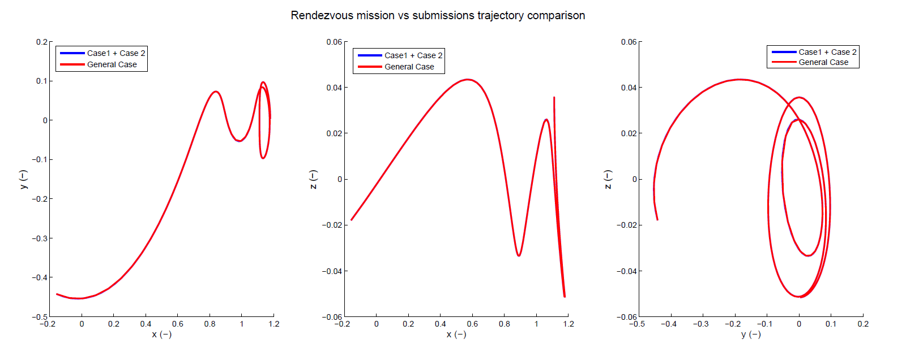
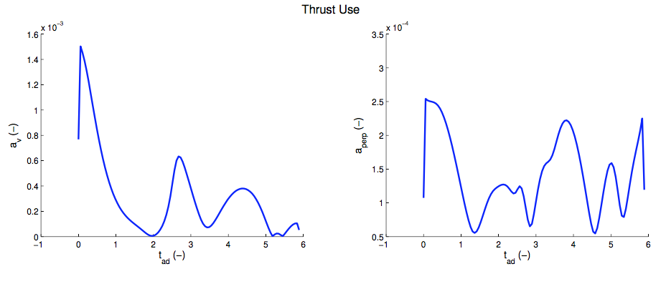
3. TEST CASE

Slide 19

CONCLUSIONS

Slide 20
4. CONCLUSIONS
An initial step for the design of Multi-Body module for MOLTO has been tested
An numerical model for solving the rendezvous optimal control problem has been implemented within a direct transcription scheme.
A more sophisticated initial guess generator is demanded

Slide 21
Thank you for your
attention.
Questions?

