Slide 1
Astrodynamics techniques for missions towards Earth-Trailing or Earth-Leading Heliocentric Orbits
Eric Joffre, Valerio Moro (Airbus)
Florian Renk, Waldemar Martens (ESA)
7th International Conference on Astrodynamics Tools and Techniques
6-9 November 2018, DLR Oberpfaffenhofen, Germany

Slide 2
Outline of the presentation
Introduction and motivations
Reference frames
Problem statement
Solution space analysis for direct injection
  Preliminary Keplerian analyses
  Transfer opportunities with Deep Space Manoeuvres and injection into the ecliptic
Alternative transfer strategies
  Orbit raising from LEO or HEO
  Low energy escape via SEL1/SEL2
  Use of Lunar Gravity Assists
  Transfers augmented with Solar Electric Propulsion
Conclusion

Slide 3
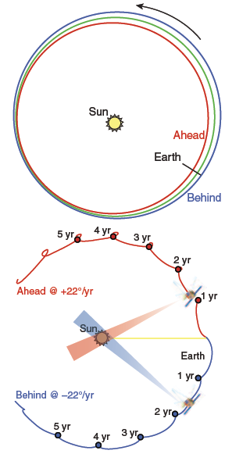
1. Introduction and motivations
Focus on mission design techniques towards Earth Displaced Heliocentric Orbits:
  Earth-Trailing Heliocentric Orbits (ETHOs)
  Earth-Leading Heliocentric Orbits (ELHOs)
Examples of past missions
  NASA’s Spitzer Space Telescope: launched in 2003, retired in 2009
  NASA’s Space Interferometry Mission (SIM): cancelled in 2010
  NASA’s Kepler space observatory: launched in 2009, retired on 30 October 2018
  NASA’s Solar TErrestrial RElations Observatory (STEREO): launched in 2006
Drift-away orbits – principle:
  Increase (for trailing) / decrease (for leading) heliocentric semi-major axis wrt Earth (1 AU)
  Different orbital period around the Sun
  → heliocentric mean motion is faster (ELHOs) or slower (for trailing ETHOs) than Earth
Figure credits: D.W. Dunham, J.J. Guzman, and P.J. Sharer
“Stereo trajectory and maneuver design.,” Johns Hopkins APL Technical Digest, vol. 28, no. 2, pp. 104 – 125, 2009.
Notes:
Spitzer: Delta II + DA
Kepler: Delta II + LGA
STEREO: Delta II + LGA

Slide 4
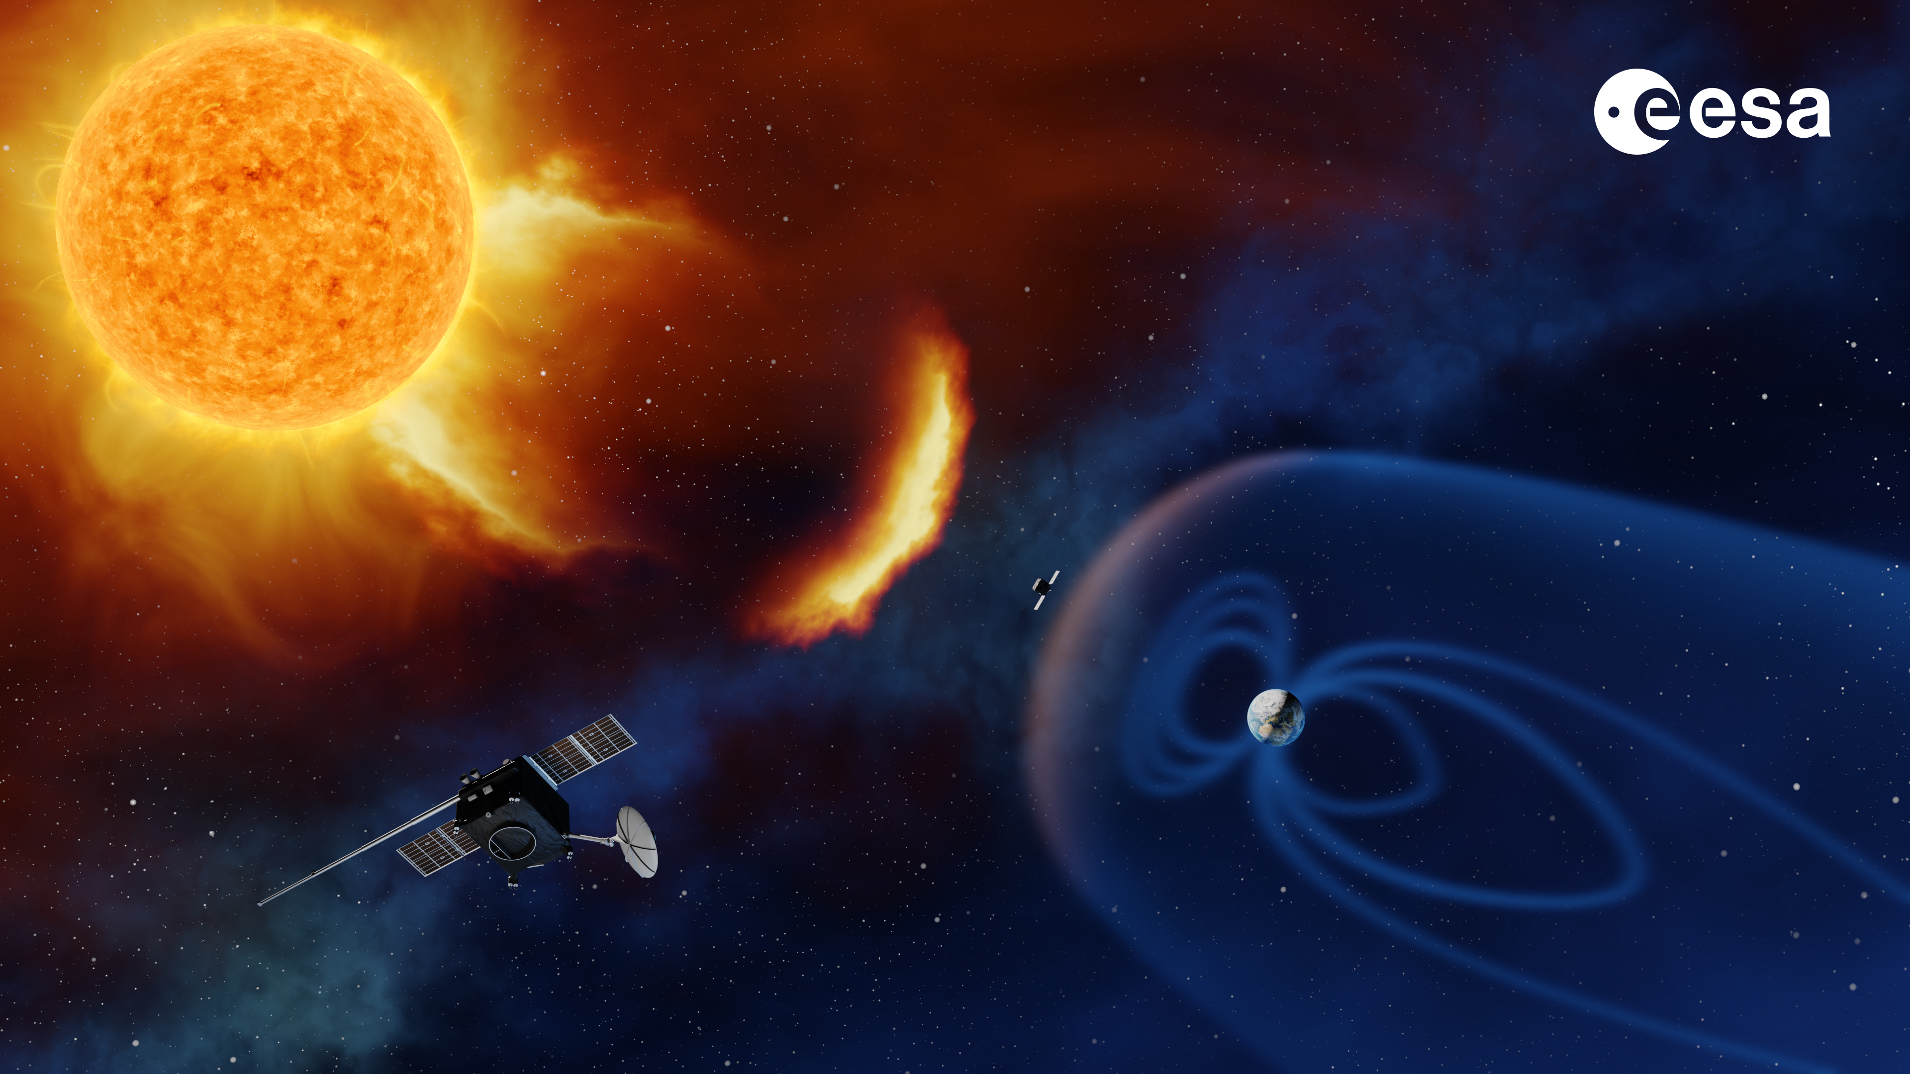
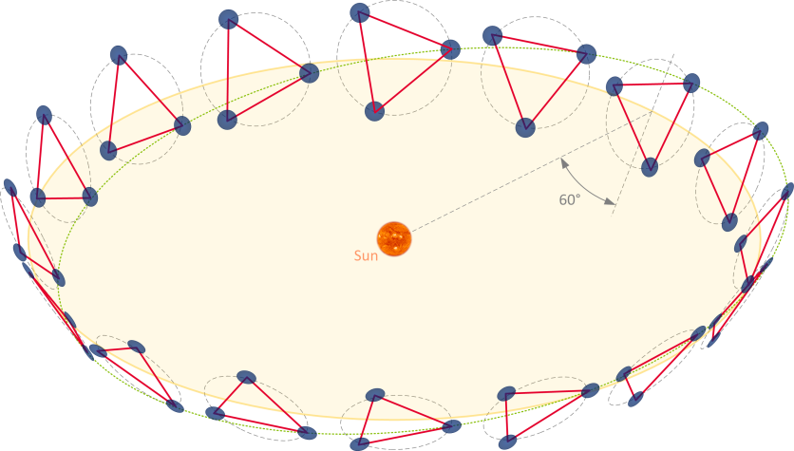
1. Introduction and motivations
Focus of the presentation:
  Earth-Displaced Heliocentric Orbits (trailing or leading) in a 1:1 resonance with Earth → semi-major axis differential cancelled upon insertion
Examples of future ESA missions:
  ESA’s Lagrange Missions (Space Weather):
  Airbus -led Phase A completed, Phase B1 ongoing
  ESA’s Laser Space Interferometer Space Antenna (LISA):
  Airbus-led Phase A ongoing
  … ?
Benefits of such orbits:
Near-constant distance and geometry with respect to the Sun and the Earth, thus potentially simplifying the spacecraft design for:
  Power generation: e.g. fixed Solar Array,
  Communications: e.g. non-steerable antennas
  Thermal design: stable and eclipse-free thermal environment
  Low (orbit dynamics) perturbation environment , etc.
→ Candidate alternative operational/science orbits for future missions
ESA Lagrange missions to SEL1/SEL5 (top)
ESA LISA mission (bottom)
Heliocentric
orbital motion
Formation rotating
clockwise
as seen from Sun
Outwards / clockwise formation
(Credits: ESA)
Oriented normal pointing
away from Sun (outwards)

Slide 5
2. Reference frames
Sun-Earth rotating frame:
  X-axis: pointing from Sun to Earth (true of epoch)
  Z-axis: towards the orbital momentum vector of the
  Sun-Earth system, perpendicular to the plane of the
  Earth’s orbit around the Sun (ecliptic North of epoch)
  Y-axis: completing the right-handed trihedron
Commonly used to describe transfers to the Sun-Earth Lagrange Points, but also to visualise lighting conditions, such as the Sun Aspect Angle (SAA), eclipses from Earth during LEOP, operational angles, etc
Example of a two-revolution transfer to Sun-Earth L5 point, trailing Earth at about -60 deg from the Sun-Earth line, illustrated in the Sun-Earth rotating frame
Sample two-revolution transfer to SEL5 in
the Sun-Earth rotating frame
(Lagrange Missions)

Slide 6
2. Reference frames
Earth-Moon Barycentre (EMB)
    Always under Earth’s surface: radius between 4,300 km and 5,000 km from the Earth’s Centre of Mass
Mean Earth-Moon Barycentre (MEMB)
    Mean orbit derived from the heliocentric osculating orbit of the EMB: same orbital plane (inclination, RAAN), same period (semi-major axis), but circular (eccentricity = 0)
    Substituting the mean anomaly, derived from the true anomaly and eccentricity, to the true anomaly: EMB and MEMB anomalies / heliocentric longitudes coincide at perihelion and aphelion
Sun-MEMB rotating frame: constructed as the Sun-Earth rotating frame, replacing Earth (true of epoch) by MEMB
Orbit of (true) Earth and (true) Moon illustrated on figure
  Earth: typical formation-flying like trajectory around circular fictitious centre caused by eccentricity (0.0167)
  Relative velocity: ~500 m/s (radial pro/anti Sun) in April/October,
  ~1 km/s (tangential prograde/retrograde) at perihelion (January) and aphelion (July)
Sun-Mean Earth-Moon Barycentre rotating frame and trajectories of the true of epoch Earth and Moon
Notes:
Orders of magnitude for Earth’s motion in Sun-MEMB frame

Slide 7
3. Problem statement
Sample single revolution transfer (March 2030 launch) towards -30 deg ETHO
Advantages of Sun-[Mean-Earth-Moon Barycentre]
(Sun-MEMB) rotating frame
    More appropriate to describe heliocentric trailing/leading orbits at 1 AU than the Sun-(true) Earth rotating frame
    Heliocentric 1 au circular orbit is a fixed point in this frame
    Departure (launch) date directly visible on trajectory plots
Problem statement
    Target EDHO (trailing ETHO or leading ELHO) assumed to be on a perfectly circular in-(ecliptic) plane heliocentric orbit at 1 AU
    Depart Earth to rendezvous with fixed point in Sun-MEMB rotating frame
    Target displacement angle from the Sun-MEMB called MEDA (Mean EMB Displacement Angle)
Sun-Earth rotating frame
Sun-MEMB rotating frame

Slide 8
4. Preliminary Keplerian analysis (from MEMB)
Simplified transfer problem – Assumptions:
  Departing a fictitious point at 1 AU (MEMB)
  Keplerian motion of a Sun-centred two-body problem, not accounting for any perturbation and in particular the Earth’s gravity
  Initial (MEMB) and final (EDHO) orbits both heliocentric circular (at 1 AU) and coplanar (ecliptic)
  Initial velocity (inertial, before departure Delta-V), is that of the MEMB under the above assumptions
  Final manoeuvre (arrival/insertion Delta-V) cancelling the velocity differential between the spacecraft and the EDHO target
  Only ballistic transfers sought, no Deep Space Manoeuvre (DSM)
Simplified transfer problem (from MEMB) – Main results:
  Time-invariant problem, and symmetric in departure/arrival: same Delta-V to depart MEMB and to insert into the EDHO
  Theoretical solutions exist for all transfer durations
  Clear local minima for integer number of heliocentric revolutions: basic Hohmann transfers
  Relatively linear behaviour in terms of (optimal) transfer Delta-V and duration as a function of the target MEDA (absolute value)
Optimal
1-rev transfers
(Sun-Earth rotating frame)
Notes:
To Leading orbits: slightly shorter / but also more Delta-V

Slide 9
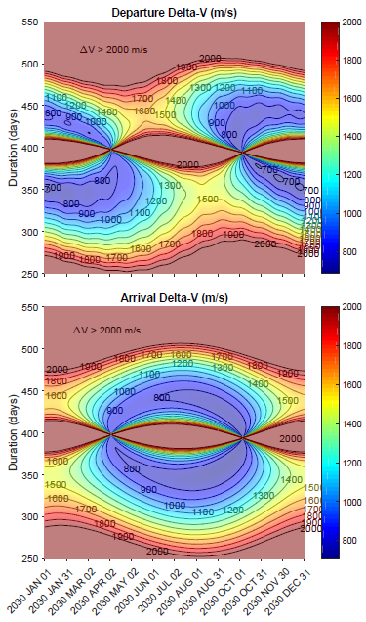
4. Preliminary Keplerian analysis (from Earth)
Departing true (ephemeris) Earth – Assumptions:
  Departing Earth true of epoch
  Keplerian motion of a Sun-centred two-body problem, not accounting for any perturbation and in particular the Earth’s gravity
  Initial velocity is that of the Earth on its heliocentric orbit
  Final manoeuvre (arrival/insertion Delta-V) cancelling the velocity differential between the spacecraft and the EDHO target
  Only ballistic transfers sought, no Deep Space Manoeuvre (DSM)
Opportunity maps derived for full (sample) year 2030 towards -30 deg ETHO
Keplerian transfer problem (from Earth) – Main results:
  Problem no longer time-invariant, but 1-year periodic
  Seasonal variation: low departure Delta-V periods (~ October to April, when Earth closer to perihelion at departure) corresponding to high arrival Delta-V periods (high heliocentric eccentricity) for transfers to ETHOs
  Situation mirrored for transfers to ELHOs
  Singularity near previous Delta-V optimum durations: because the departure and arrival radii are different except for two very specific dates
  Highly undesirable from a mission design point of view (LV launch programs, S/C propellant sizing)
Notes:
Second order short-term variation visible on the departure Delta-V maps: indirect effect of the Moon

Slide 10
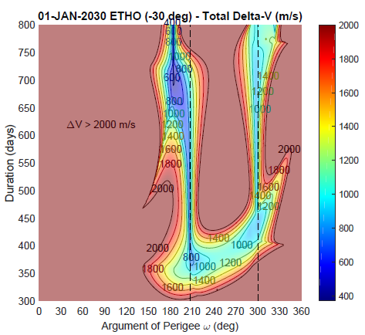
4. Transfer opportunities with DSM and injection into the ecliptic
AoP/duration opportunity map (January 2030 launch) towards -30 deg ETHO
Updated assumptions:
  Actual injection conditions considered, departing Earth from a given escape (hyperbolic) orbit, accounting for Earth’s gravity
  Injection state given by osculating geocentric orbital elements at perigee
  Launch into the ecliptic assumed (inclination and RAAN tuning)
  Single launch program (C3) considered throughout the year
  Introduction of a Deep Space Manoeuvre (DSM) during cruise
  Minimum duration of 30 days between DSM and orbit insertion
  Optimisation problem: Minimising sum of DSM + insertion Delta-V
  Optimisation parameters include: Argument of Perigee (ω), date, direction and magnitude of both the DSM and the insertion manoeuvres
  Example opportunity map: X-axis = Argument of Perigee, Y-axis = total transfer duration – for each point, the manoeuvres scenario is optimised
  Reveals a challenging optimisation problem for an NLP solver: ill-conditioned objective function with multiple local minima
  A good initial guess for the Argument of Perigee can be obtained
  Continuum of low Delta-V solutions for various transfer durations, no clear distinction between single and two-revolution transfers → well posed optimisation problem requires a maximum duration constraint
Dashed lines: Heliocentric semi-major axis at SOI equal to value required to complete a full Keplerian revolution around the Sun before reaching the target MEDA

Slide 11
4. Transfer opportunities with DSM and injection into the ecliptic
Sample optimal transfer illustrations (-30 deg trailing orbit) for launch in January, May and September 2030
  Maximum transfer duration constrained to 540 days → saturated for May and September cases
Injection and escape
Heliocentric transfer
Insertion

Slide 12
4. Transfer opportunities with DSM and injection into the ecliptic
Results for each month of the year 2030 – Targeting -30 deg trailing orbit
  Strong seasonal variation, as observed in previous analysis – low transfer Delta-V from ~May/June to November
  Situation would be mirrored for transfers towards leading orbits (ELHOs)
Launch date | Total DV (m/s) | Total duration (days) | Argument of Perigee AoP (deg) | Duration between DSM and insertion (days)
01-Jan-30 | 945.9 | 369.5 | 319.5 | 221.8
01-Feb-30 | 982.0 | 411.0 | 93.5 | 215.6
01-Mar-30 | 920.6 | 406.0 | 119.5 | 226.8
01-Apr-30 | 834.0 | 400.0 | 146.0 | 196.3
01-May-30 | 801.1 | 540.0 (*) | 175.8 | 141.0
01-Jun-30 | 779.3 | 351.5 | 121.5 | 159.6
01-Jul-30 | 747.0 | 540.0 (*) | 147.8 | 189.8
01-Aug-30 | 720.5 | 540.0 (*) | 175.8 | 181.7
01-Sep-30 | 706.8 | 540.0 (*) | 204.8 | 172.3
01-Oct-30 | 710.1 | 540.0 (*) | 234.2 | 163.0
01-Nov-30 | 785.7 | 378.0 | 262.0 | 227.4
01-Dec-30 | 874.6 | 375.0 | 289.5 | 224.6
(*) Maximum transfer duration constraint saturated

Slide 13
5. Alternative injection and transfer strategies
Alternative transfer strategies are possible, which will lead to increased transfer durations
Possible motivations:
  Improve the mass efficiency of the transfer strategy, i.e. increase the mass delivered on the operational orbit
  Ensure the compatibility with a lighter (lower cost) Launch Vehicle (LV)
  Ensure the compatibility with a dual launch scenario, with some constraints imposed by the passenger spacecraft
First alternative injection strategy: Injection to LEO or HEO followed by Orbit Raising
  Injection by into an Earth-bound LEO or HEO orbit
  Apogee Raising Manoeuvre (ARM) performed by the S/C when the right alignment of the line of apses wrt the Sun line is reached
  Can be performed in a single burn or in a multiple ARMs scenario, such as the one conduced in 2015 by Lisa Pathfinder (LPF)
  → reduction of the gravity losses associated with each individual burn
  → possibility to perform intermediary orbit correction manoeuvres to improve the injection accuracy
  Apogee raising can be performed by means of Electric Propulsion (EOR scenario) to reduce the required propellant mass

Slide 14
5. Alternative injection and transfer strategies
Low energy escape via SEL1/SEL2
  Use Sun gravity perturbation to raise apogee → Weak Stability Boundary-like orbit eventually escaping the Earth-Moon system via SEL1 (→ leading) / SEL2 (→ trailing orbits)
Example provided for launch in January 2030 towards -30 deg ETHO – Main results:
  Apogee altitude ~ 1.3 Mkm (compared to V-infinity = 764 m/s for direct injection)
  Total Delta-V = 811 m/s (compared to Delta-V = 946 m/s)
  Transfer duration ~ 16 months (4 months longer than direct injection)
SEL2
Injection (left: Sun-Earth rotating frame,
middle: Sun-MEMB rotating frame)
Transfer and insertion (top)

Slide 15
5. Alternative injection and transfer strategies
Escaping via SEL1 for a transfer towards trailing orbit
Space Weather SEL1/SEL5 dual launch scenario example:
  Direct trans-SEL1 injection for both spacecraft
  SEL1 spacecraft performs sequence of manoeuvres to reach SEL1 orbit
  Examples of past Space Weather missions at SEL1:
  Advanced Composition Explorer (ACE), Deep Space Climate Observatory (DSCOVR)
  Small DSM for the SEL5 S/C to depart
  Heteroclinic connection towards SEL2 region
  DSM and L5 Orbit Insertion (L5OI)
  Total Delta-V = 821 m/s
  Example provided with two-revolution
  heliocentric transfer to SEL5
  Total transfer duration ~ 3 years
SEL5 escape and
heliocentric transfer
Example of DSCOVR transfer
to SEL1 Lissajous orbit

Slide 16
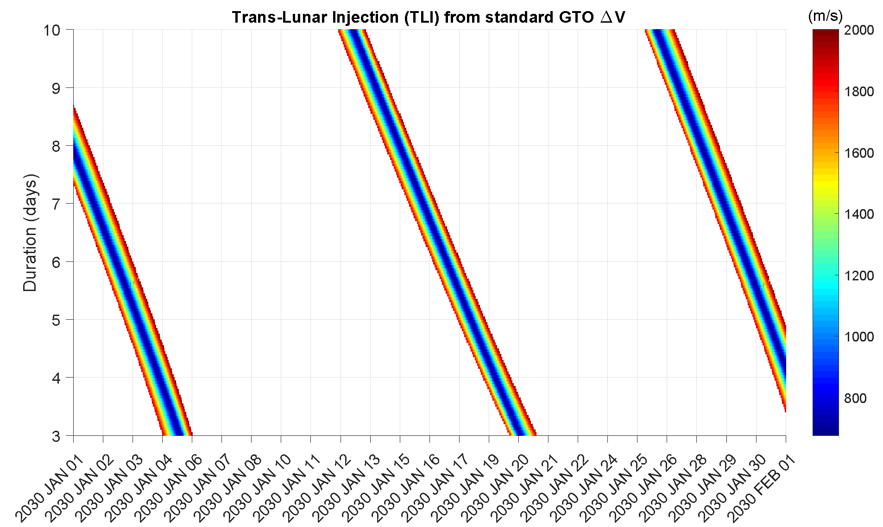
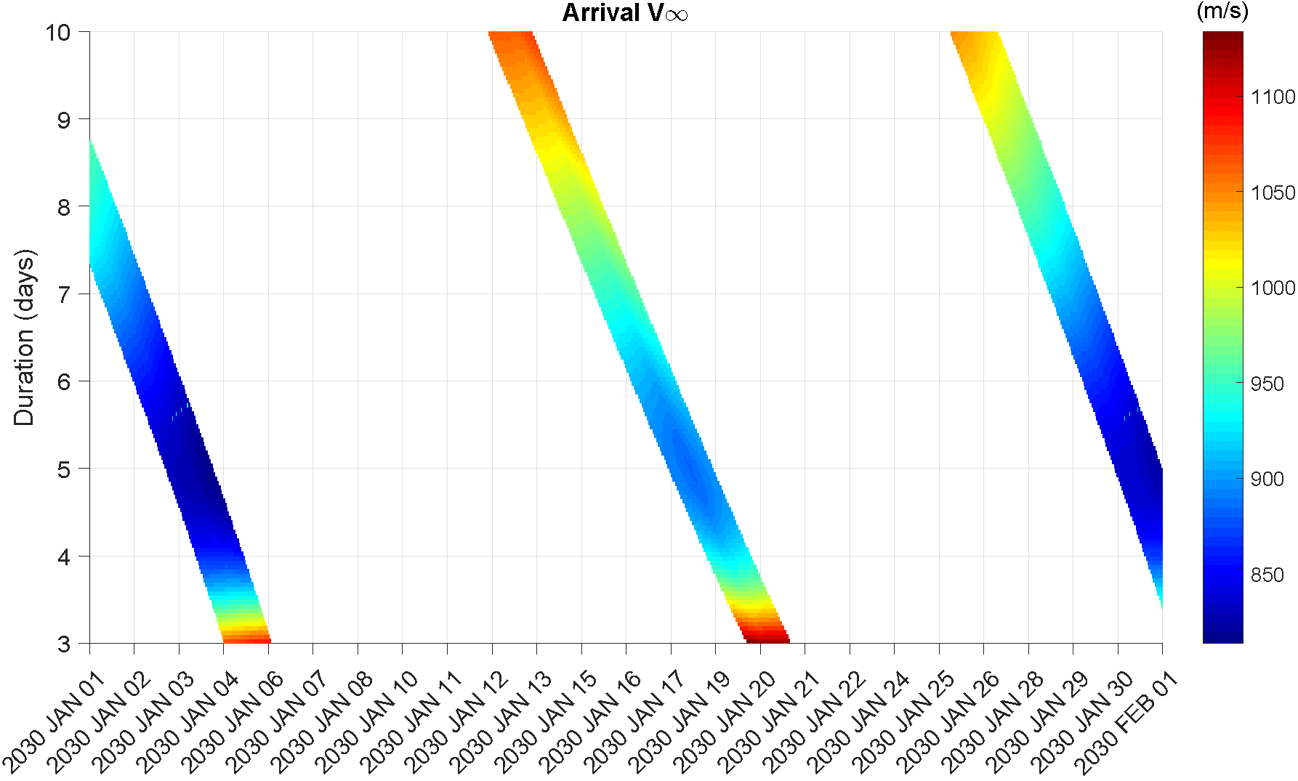
5. Alternative injection and transfer strategies
Lunar Gravity Assist (LGA) scenarios
  Use of another perturbation (gravity of the Moon) to escape from an even lower apogee / less energetic Earth-bound orbit
  Very mass efficient strategy for missions towards EDHOs, but:
    additional operational complexity
    reduced number of launch opportunities, depending on the LV
  Trans-Lunar Injection (TLI) manoeuvre for a typical launch from Kourou / assuming Ariane 6 standard GTO-like injection orbit: inclination = 6 deg, Argument of Perigee = 178 deg
    → only two opportunities per month ~ when the Moon crosses the equatorial plane (cf. opportunity maps)
    Low sensitivity on Lunar transfer duration, enabling to reach a wide range of arrival conditions at the Moon
TLI opportunity maps departing a GTO orbit

Slide 17
5. Alternative injection and transfer strategies
LGA and escape (left: Sun-Earth rotating frame)
Transfer and insertion (right: Sun-MEMB rotating frame)
Lunar Gravity Assist (LGA) scenarios
  End-to-end example (Jan. 2030):
    TLI Delta-V = 681 m/s from GTO
    5 days transfer to the Moon
    (apogee altitude ~386,000 km)
    LGA on ascending Moon
    (periselene altitude ~ 500 km)
    DSM and orbit insertion
    DSM + insertion Delta-V = 841 m/s
    (~ 100 m/s less than direct injection)
    Transfer duration about 14 months

Slide 18
5. Alternative injection and transfer strategies
SEP transfer with T/M = 0.05 N/t
(Sun-MEMB rotating frame)
Use of Solar Electric Propulsion – Potential benefits:
  Reduce the Earth departure V-infinity (C3), thus increasing the available launch mass
  Perform the launch declination corrections that may be required with a lesser mass impact as compared to Chemical Propulsion
  Benefit from the higher specific impulse (Isp) to perform more propellant mass efficient Deep Space Manoeuvres, including EDHO insertion, which does not require high thrust like a planetary insertion manoeuvre would
Main challenges:
  Cost and complexity of the Electric Propulsion System itself
  Concept of operations: navigating a low-thrust interplanetary trajectory requires suboptimal forced coast arcs for Orbit Determination campaigns
  Strong interactions between the spacecraft and the mission design: impact of available power and evolution with the heliocentric distance, choice of the Electric Propulsion System (EPS), degradation etc. → driving the available thrust-to-mass ratio along the interplanetary transfer
Parametric analysis of the impact of the thrust-to-mass ratio
  Similar case of a January launch towards -30 deg trailing orbit (ETHO)
  Thrust to mass ratio varied between 0.5 N/t down to 0.05 N/t

Slide 19
5. Alternative injection and transfer strategies
SEP transfer with T/M = 0.05 N/t
(inertial frame)
SEP transfers – Results of parametric analysis:
  Impact of a reduced thrust-to-mass ratio: increases the
  required SEP Delta-V as well as the transfer duration
  Limit under which the exponential increase in duration and
  Delta-V becomes prohibitive, also saturating the
  interplanetary arcs with thrust
T (mN) | Initial mass (kg) | Final mass (kg) | Thrust-to-mass ratio (N/t) | Delta-V (m/s) | Arrival date | Transfer duration (days)
Inf (CP)* | 2000 | N/A | Inf | 945.95 | 05/01/2031 | 369
1000 | 2000 | 1886.65 | 0.5 | 949.77 | 14/01/2031 | 378
500 | 2000 | 1885.88 | 0.25 | 956.48 | 25/01/2031 | 389
250 | 2000 | 1880.62 | 0.125 | 1001.94 | 18/02/2031 | 413
125 | 2000 | 1864.61 | 0.0625 | 1141.12 | 26/03/2031 | 449
100 | 2000 | 1843.58 | 0.05 | 1325.73 | 04/05/2031 | 488
* CP transfer solution for comparison

Slide 20
6. Conclusion
Several transfer strategies are available to reach Earth-Leading or Earth-Trailing Heliocentric Orbits, as candidate orbits for future operational or science missions, providing some flexibility in the optimisation of a mission architecture
A new frame (Sun-Mean Earth Moon Barycentre rotating frame) has been introduced as a convenient way to describe transfer trajectories to such target destinations
Strong seasonal variations of the required transfer Delta-V have been described for a direct injection scenario into heliocentric transfer orbit
More mass efficient strategies include low energy escape via the Sun-Earth Lagrange Points, as well as Lunar Gravity Assists
However, these alternative options come at the expense of an additional LEOP and/or transfer duration, as well as an increased operational complexity.

Slide 21
Thank you – Questions ?

