Slide 1
Near Rectilinear Orbits around the Moon as Operational Orbit for the future Deep Space Gateway
Carlos Sánchez Lara, Joan Pau Sánchez Cuartielles
7th International Conference on Astrodynamics Tools and Techniques (ICATT)
6 - 9 November 2018

Slide 2
GUIDELINE
Introduction
NRHO
Orbit Maintenance
Transfer Trajectories
Conclusions

Slide 3
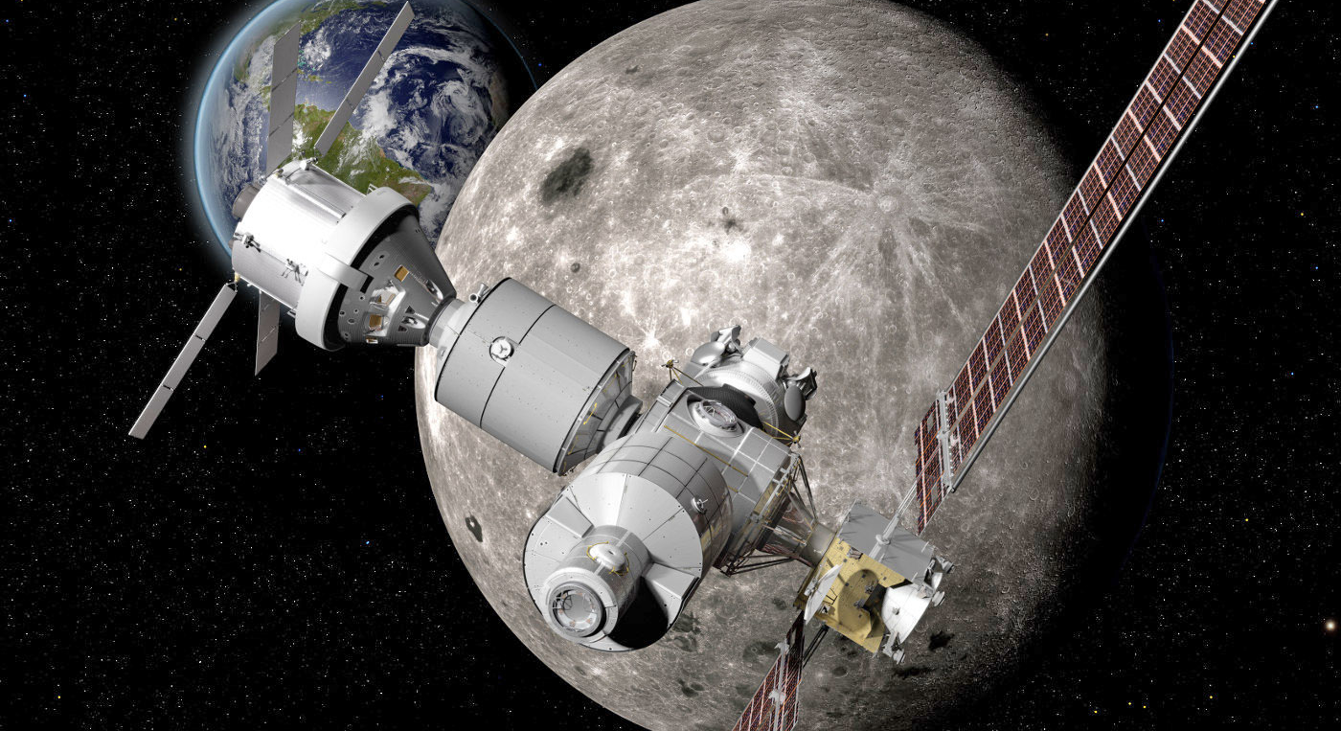
INTRODUCTION
Credits: www.engadget.com
Lunar Poles Exploration (water ice)
Libration Point Orbits ($L_{1}/L_{2}$)
Lunar Orbital Platform-Gateway
(LOP-G)
Deep Space Gateway
(DSG)
Introduction
NRHO
Orbit Maintenance
Transfer Trajectories
Conclusions

Slide 4
INTRODUCTION – LOP-G
Credits: www.engadget.com
Applications
Staging point
Communications
Scientific observations
Orbit Requirements
Lunar poles coverage
Low orbit maintenance risks & costs
Accessibility
Near Rectilinear Halo Orbits
(NRHO)
Introduction
NRHO
Orbit Maintenance
Transfer Trajectories
Conclusions

Slide 5
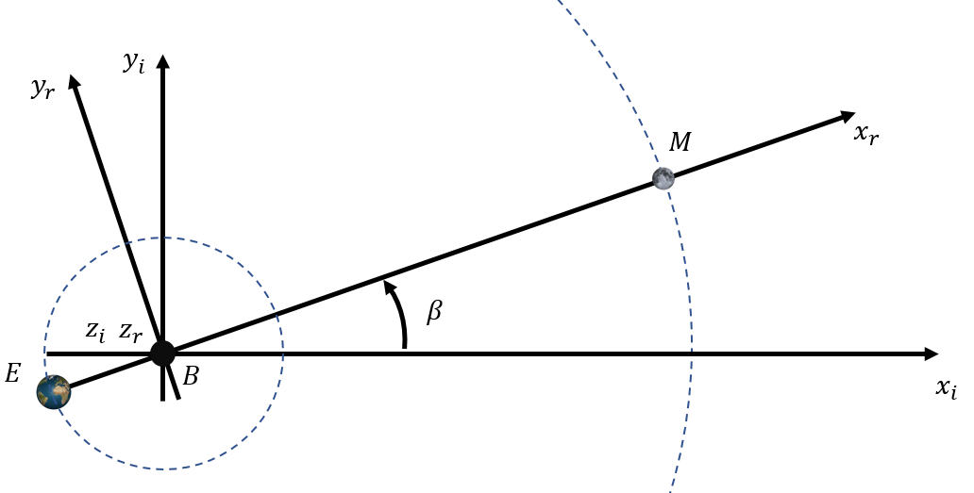
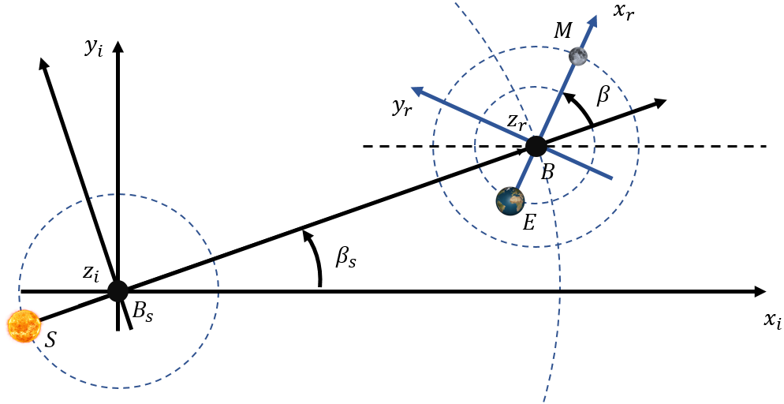
INTRODUCTION – Dynamical Models
Circular Restricted Three Body Problem
(CR3BP)
Bicircular Model
(BCM)
Periodic orbits
Transfer trajectories
Station-keeping analysis
Introduction
NRHO
Orbit Maintenance
Transfer Trajectories
Conclusions

Slide 6
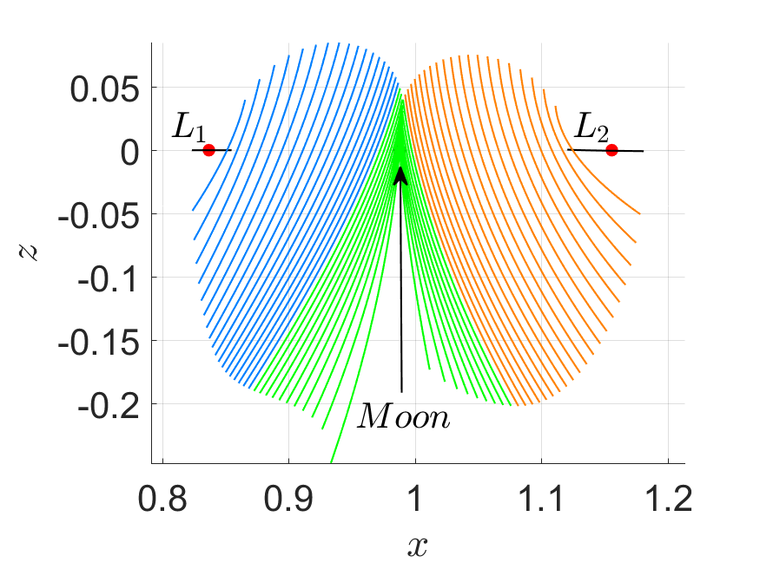
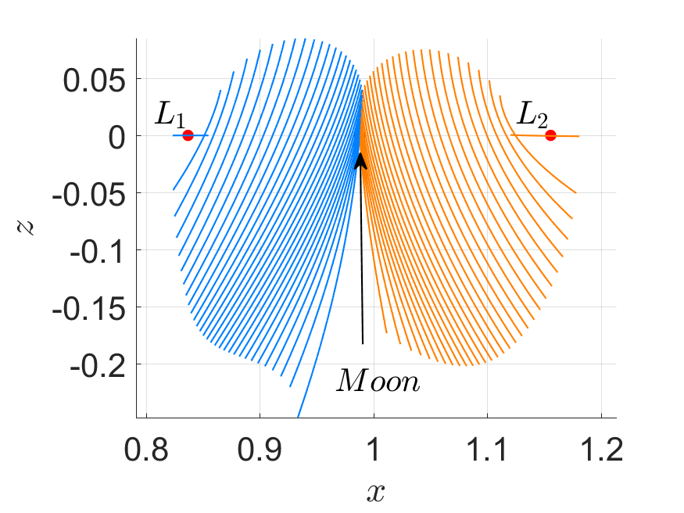
HALO ORBITS
Near-Rectilinear Halo Orbits
Introduction
NRHO
Orbit Maintenance
Transfer Trajectories
Conclusions

Slide 7
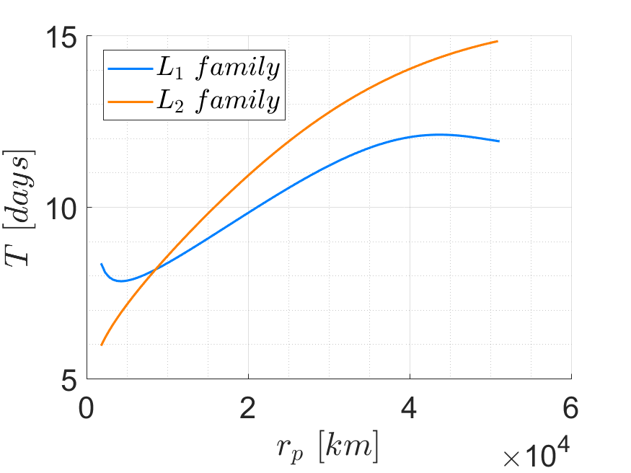
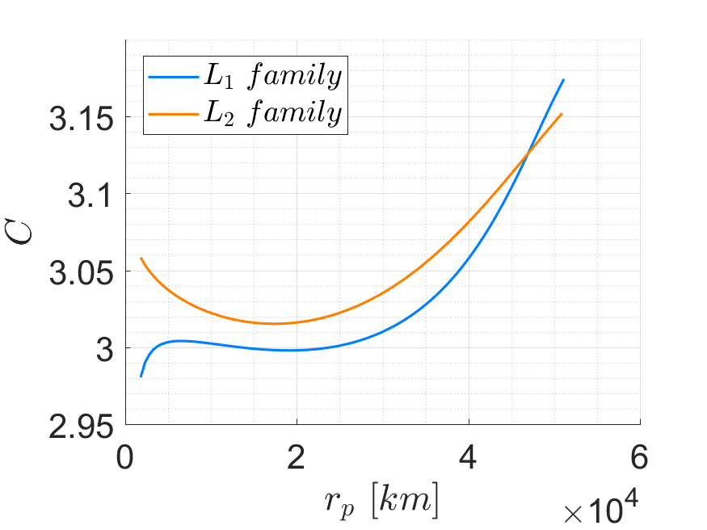
HALO ORBITS
Period
Jacobi Constant
Introduction
NRHO
Orbit Maintenance
Transfer Trajectories
Conclusions

Slide 8
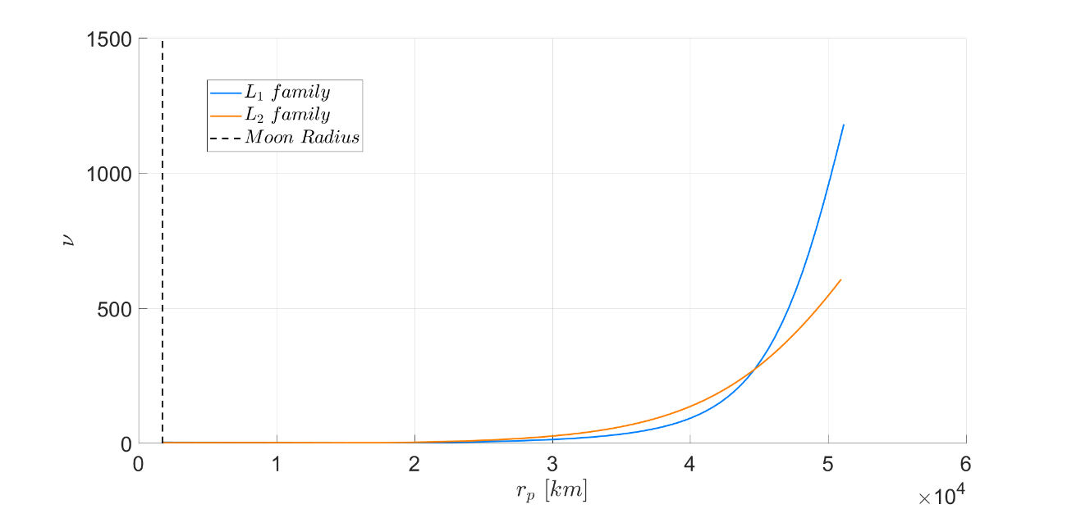
– Near Rectilinear Halo Orbits (NRHO)
HALO ORBITS
Stability index ($ν$)
$$ν=\frac{1}{2}\left(λ_{max}+\frac{1}{λ_{max}}\right)$$
Introduction
NRHO
Orbit Maintenance
Transfer Trajectories
Conclusions

Slide 9
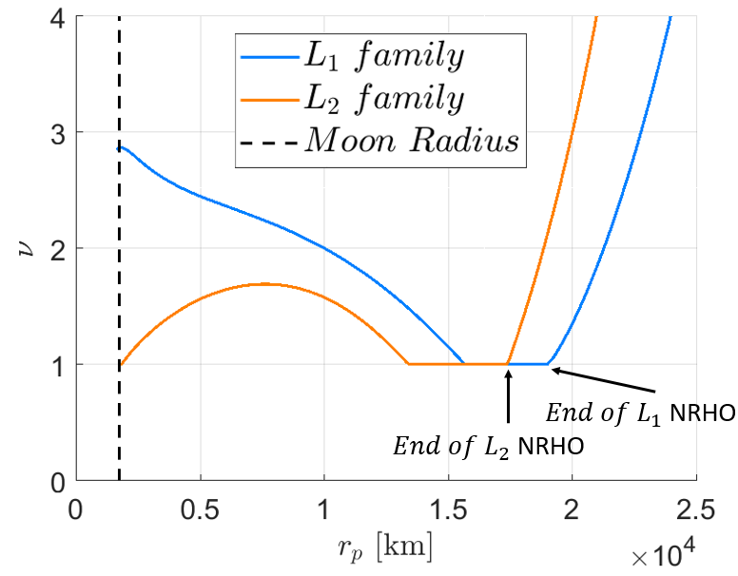
– Near Rectilinear Halo Orbits (NRHO)
HALO ORBITS
Stability index ($ν$)
Introduction
NRHO
Orbit Maintenance
Transfer Trajectories
Conclusions

Slide 10
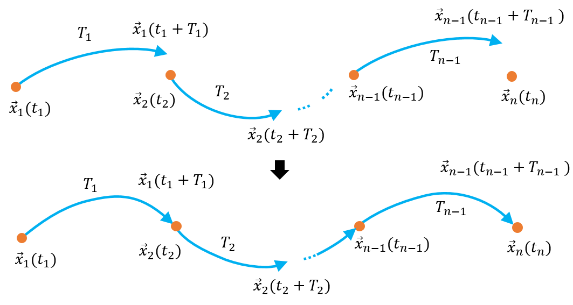
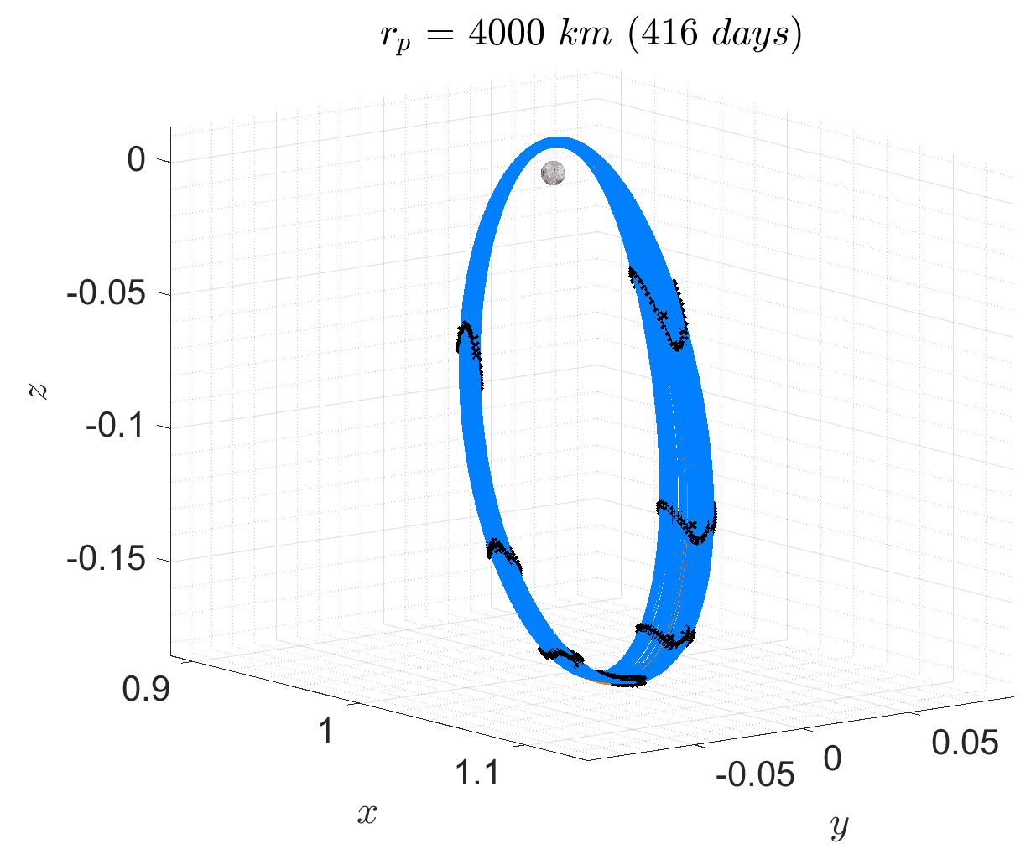
HALO ORBITS – Dynamical Substitutes
$$\vec{X}={\vec{X}}_{0}−DG{\left({\vec{X}}_{0}\right)}^{−1}G\left({\vec{X}}_{0}\right)$$
$$DG\left(\vec{X}\right)=\left[\begin{matrix}Φ_{1} & {\vec{\dot{X}}}_{1} & −I_{6x6} & & & & & \\ & & Φ_{2} & {\vec{\dot{X}}}_{2} & −I_{6x6} & & & \\ & & & & ⋱ & ⋱ & & \\ & & & & & Φ_{n−1} & {\vec{\dot{X}}}_{n−1} & −I_{6x6}\end{matrix}\right]$$
Introduction
NRHO
Orbit Maintenance
Transfer Trajectories
Conclusions

Slide 11
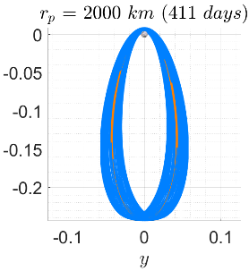
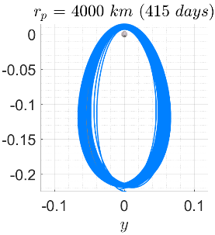
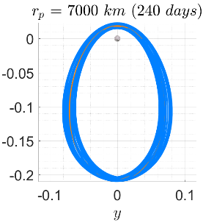
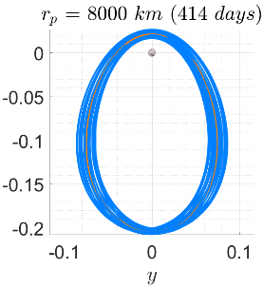
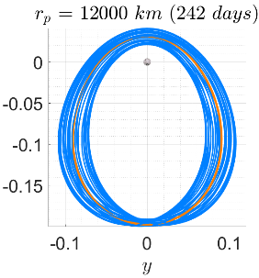
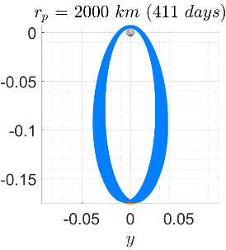
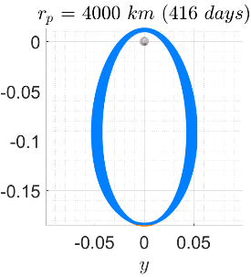
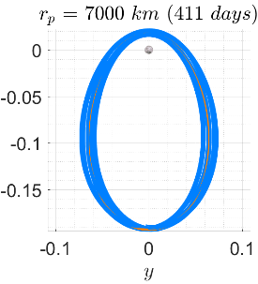
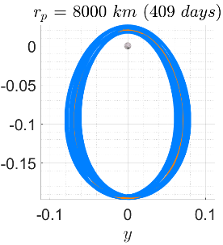
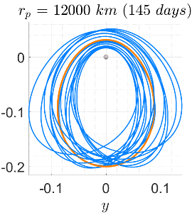
$L_{1}$ family
$L_{2}$ family

Slide 12
STATION-KEEPING
Errors Model
Error | Magnitude | Model
Manoeuvre execution | 1% | 1$σ$ 0 mean Normal
Position | 1 km | $$3σ$$ 0 mean Normal
Velocity | 1 cm/s | $$3σ$$ 0 mean Normal
Minimum manoeuvre | 0.15 cm/s | -
$$Initial error$$
$$Nominal trajectory$$
$$Patch points$$
$$Actual trajectory$$
$$Target points$$
$$Predicted trajectory without errors$$
Introduction
NRHO
Orbit Maintenance
Transfer Trajectories
Conclusions

Slide 13
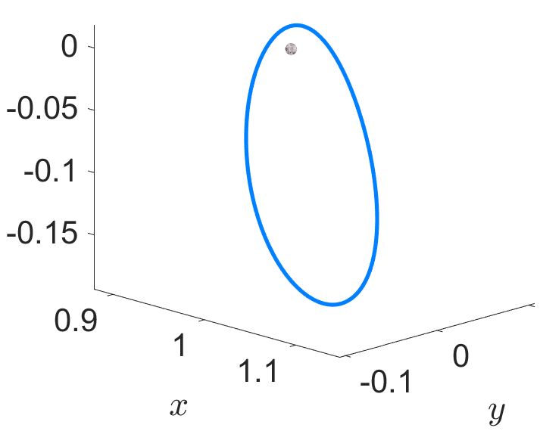
STATION-KEEPING – Strategies
Unstable mode cancellation
Differential Corrections
Cost Function Optimisation
$$CF=ΔV+\sum_{i=1}^{n}{δr_{i}+{δv}_{i}}$$
Introduction
NRHO
Orbit Maintenance
Transfer Trajectories
Conclusions

Slide 14
STATION-KEEPING – Strategies
Unstable mode cancellation
Differential Corrections
Cost Function Optimisation
SKS – 1
SKS – 5 → 1 man/orbit
SKS – 9 → 1 man/orbit
SKS – 2 → 1 man/orbit
SKS – 6 → 2 man/orbit
SKS – 3 → 2 man/orbit
SKS – 7 → 3 man/orbit
SKS – 4 → 3 man/orbit
SKS – 8 → 1 man/orbit
(x-axis crossing method)
Guzzetti, Howell et al., 2017
Introduction
NRHO
Orbit Maintenance
Transfer Trajectories
Conclusions

Slide 15
STATION-KEEPING – Results (CR3BP)
$L_{1}$ family
$ΔV$ NRHOs
$$1 m/s$$
$L_{2}$ family
$ΔV$ NRHOs
$$0.3 m/s$$
Introduction
NRHO
Orbit Maintenance
Transfer Trajectories
Conclusions

Slide 16
STATION-KEEPING – Results (BCM)
$L_{1}$ family
$ΔV$ NRHOs
$$1 m/s$$
$L_{2}$ family
$ΔV$ NRHOs
$$0.5 m/s$$
Introduction
NRHO
Orbit Maintenance
Transfer Trajectories
Conclusions

Slide 17
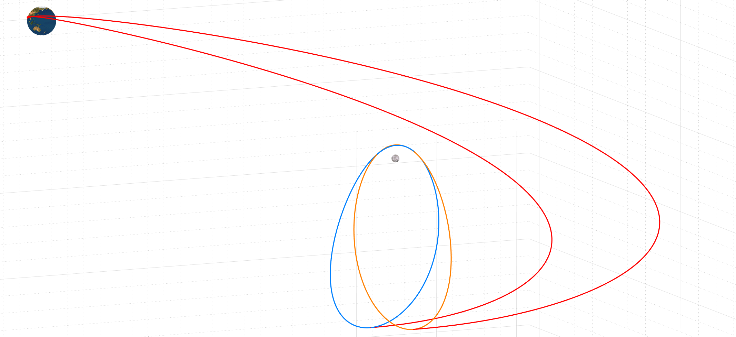
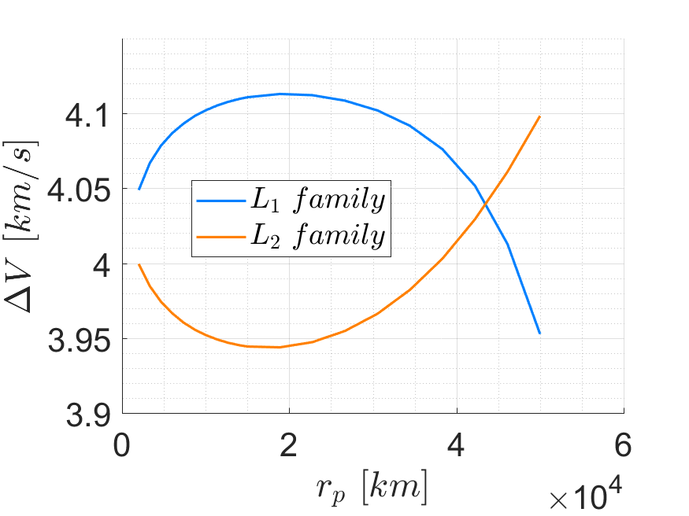
TRANSFER TRAJECTORIES
Direct transfer from Earth to apolune
$$r_{p}=6,000 km$$
Introduction
NRHO
Orbit Maintenance
Transfer Trajectories
Conclusions

Slide 18
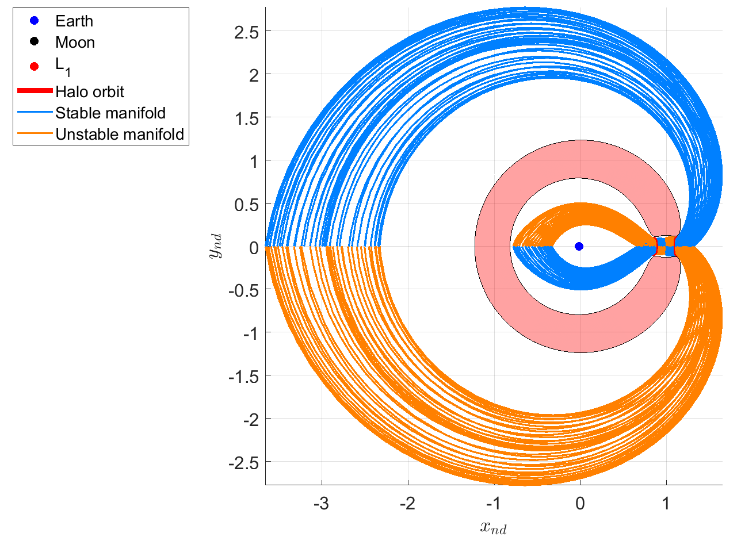
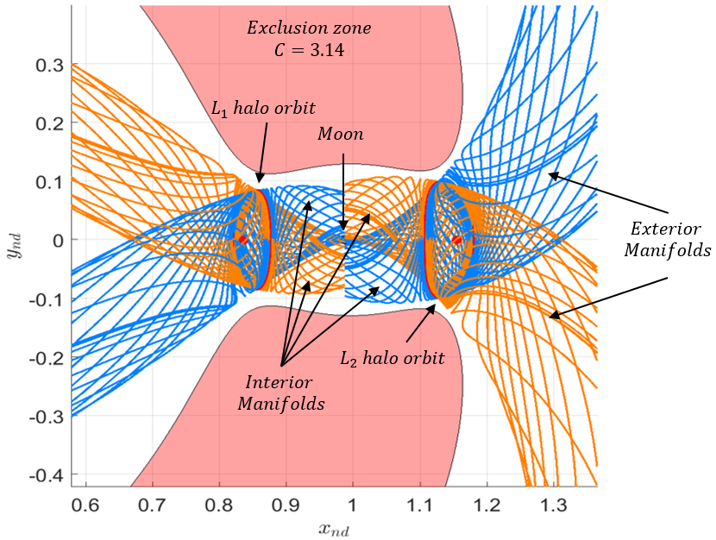
TRANSFER TRAJECTORIES
Transfer from Earth to stable manifold
Introduction
NRHO
Orbit Maintenance
Transfer Trajectories
Conclusions

Slide 19
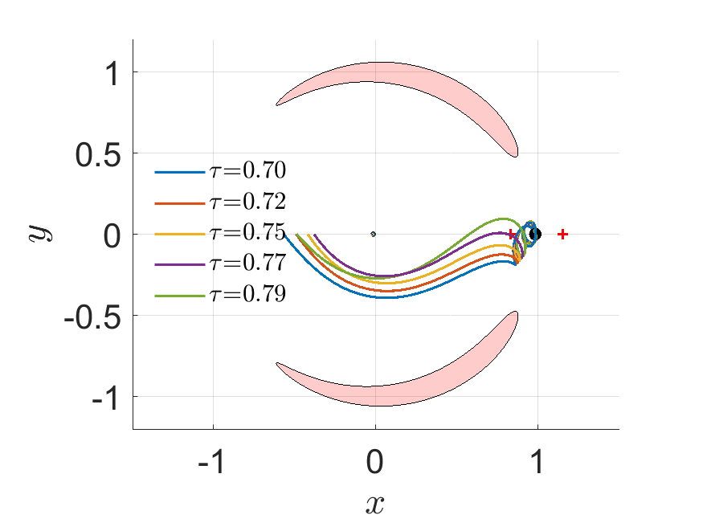
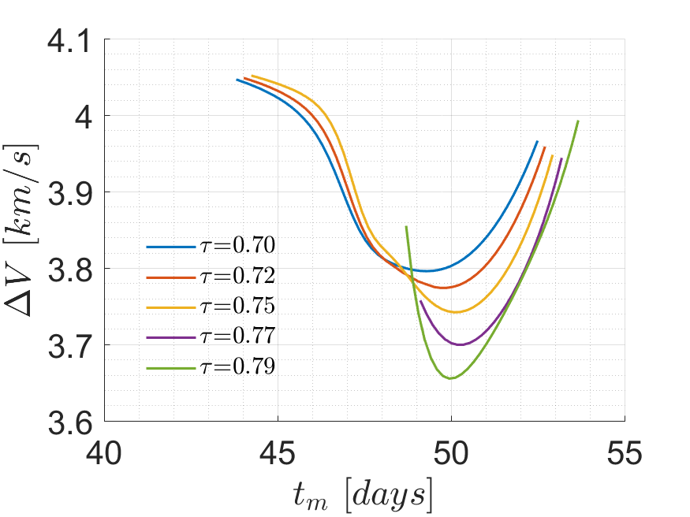
TRANSFER TRAJECTORIES
Transfer from Earth to stable manifold ($L_{1}$)
$$r_{p}=7,000 km$$
$ΔV$ savings ≈ 440 m/s
Introduction
NRHO
Orbit Maintenance
Transfer Trajectories
Conclusions

Slide 20
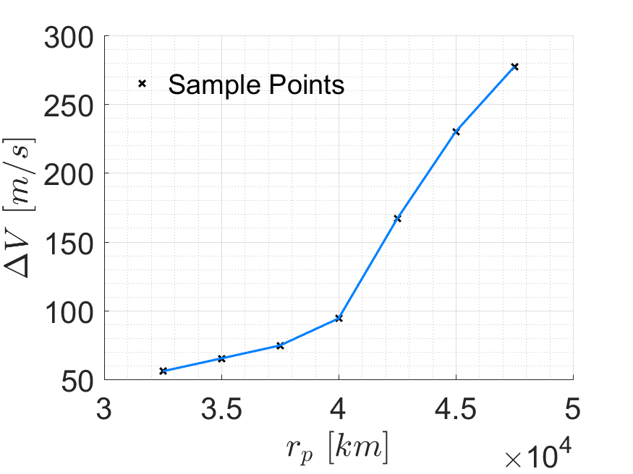
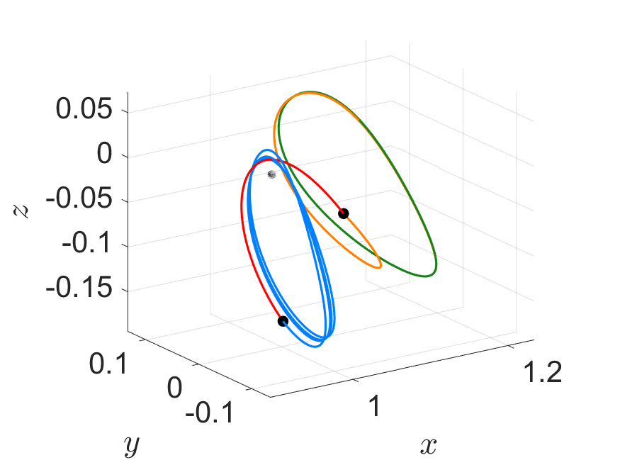
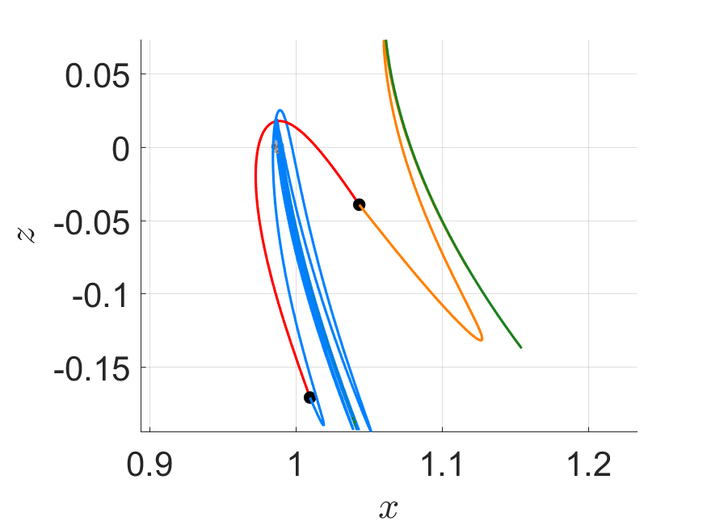
TRANSFER TRAJECTORIES
Transfer from Earth to stable manifold ($L_{2}$)
$r_{p}=40,000 km$ to $r_{p}=7,000 km$
$ΔV$ savings ≈ 250 m/s
Introduction
NRHO
Orbit Maintenance
Transfer Trajectories
Conclusions

Slide 21
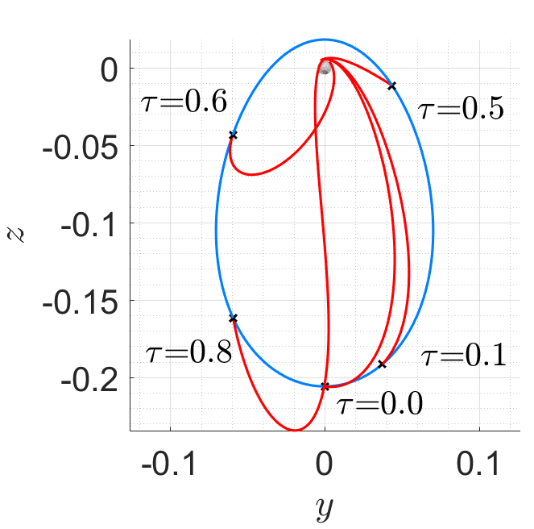
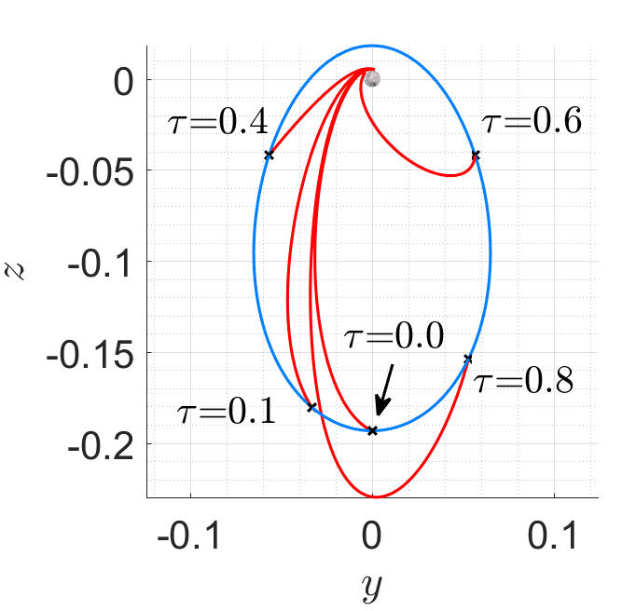
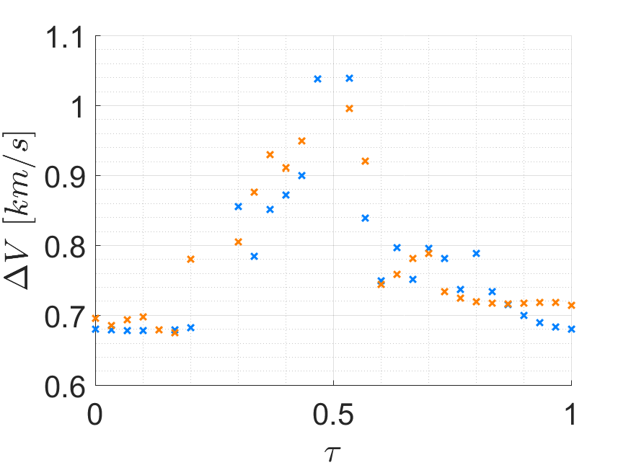
TRANSFER TRAJECTORIES
Transfer from NRHO to polar circular Moon orbit
$$L_{1}$$
$$L_{2}$$
$$r_{p}=7,000 km$$
Orbit | $$ΔV$$
Distant Retrograde Orbit | 830 m/s
$L_{2}$ Halo Orbit | 800 m/s
Credits: Whitley et al., 2016
Introduction
NRHO
Orbit Maintenance
Transfer Trajectories
Conclusions

Slide 22
CONCLUSIONS
Excellent lunar poles coverage
Direct line of sight with the Earth
Low escaping risks
Low maintenance costs
Direct/fast trajectories available at reasonable costs
Efficient transfer trajectories
Good accessibility to the lunar poles
Introduction
NRHO
Orbit Maintenance
Transfer Trajectories
Conclusions

Slide 23
Thank you for your attention!
Any Questions?

Slide 24
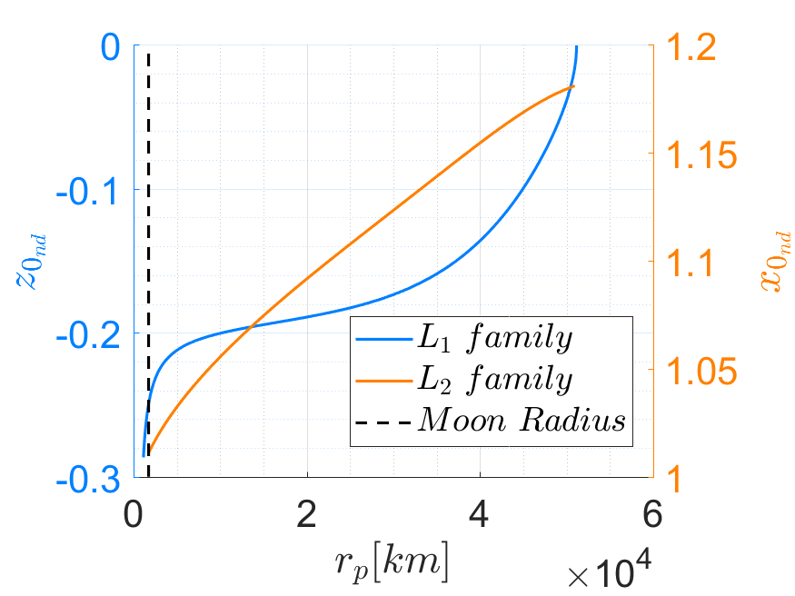
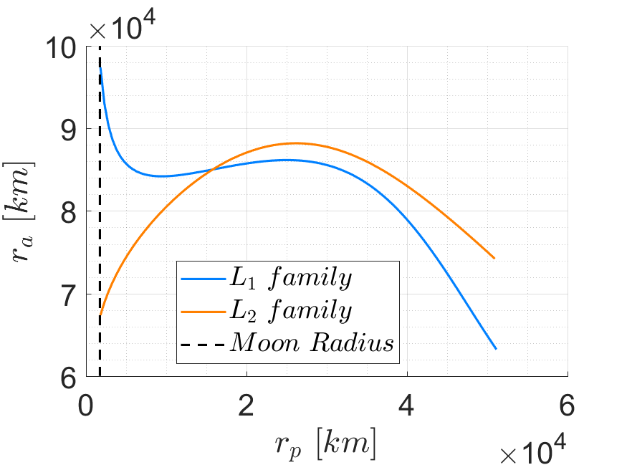

Slide 25
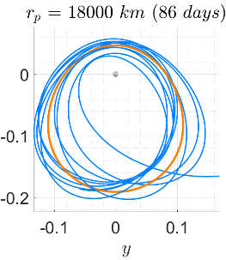
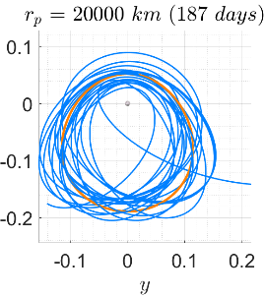
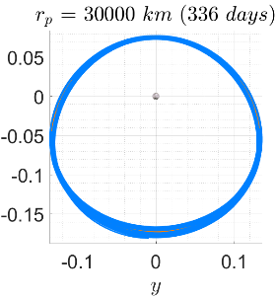
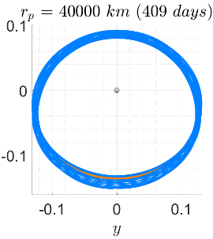
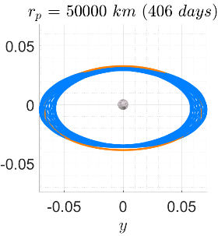
$L_{1}$ family

Slide 26
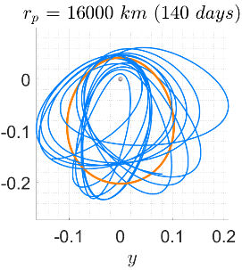
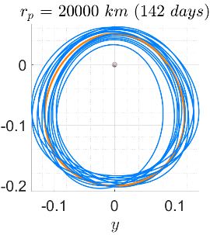
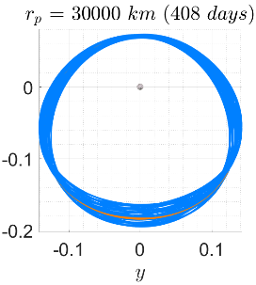
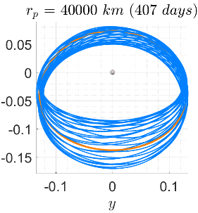
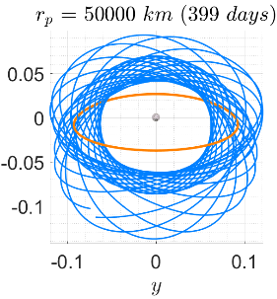
$L_{2}$ family

Slide 27
Unstable mode evolution
$$r_{p}$$
$$40,000 km$$
$$r_{p}$$
$$7,000 km$$

Slide 28
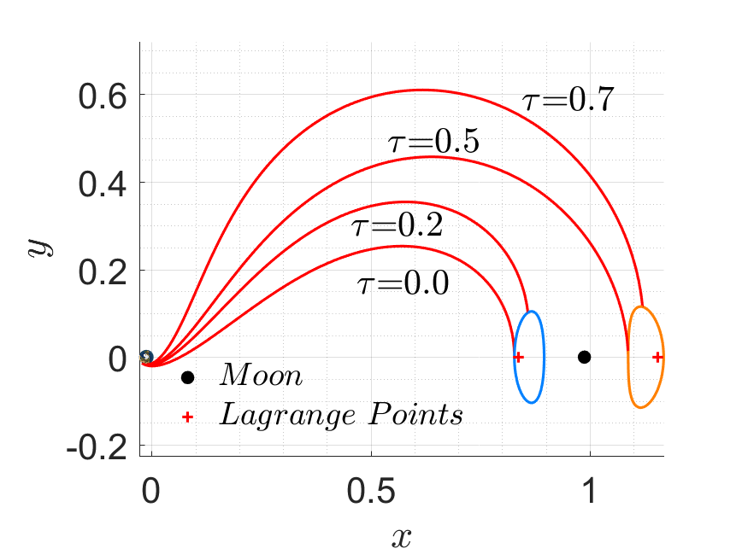
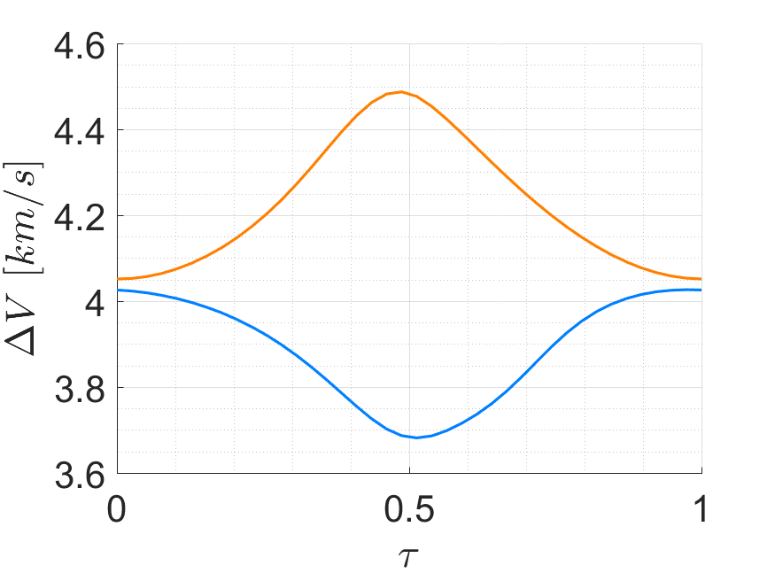
Transfer costs as a function of $τ$

Slide 29
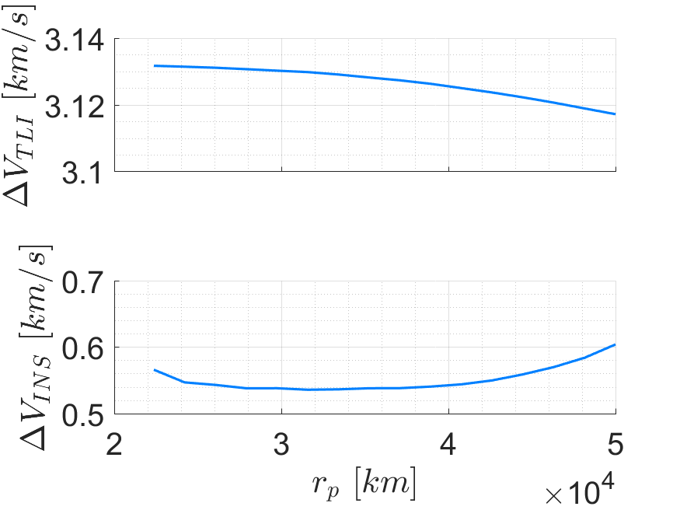
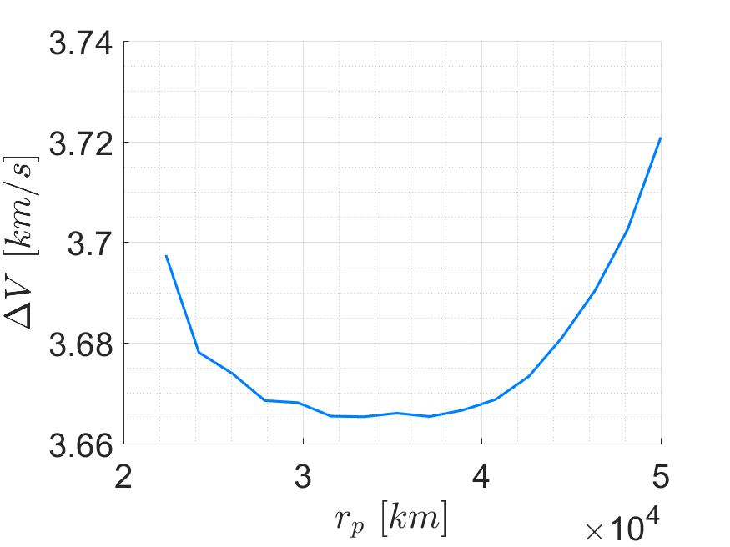
Transfer to the perilune ($L_{1}$ family)

Slide 30
Transfer costs as a function of $t_{m}$
$$2$$
$$3$$

