Slide 1
Mars Sample Return: Mission Analysis for an ESA Earth Return Orbiter
Eric Joffre, Uwe Derz, Marie-Claire Perkinson (Airbus)
Jakob Huesing, Friederike Beyer, and Jose-Manuel Sanchez Perez (ESA)
7th International Conference on Astrodynamics Tools and Techniques
6-9 November 2018, DLR Oberpfaffenhofen, Germany

Slide 2
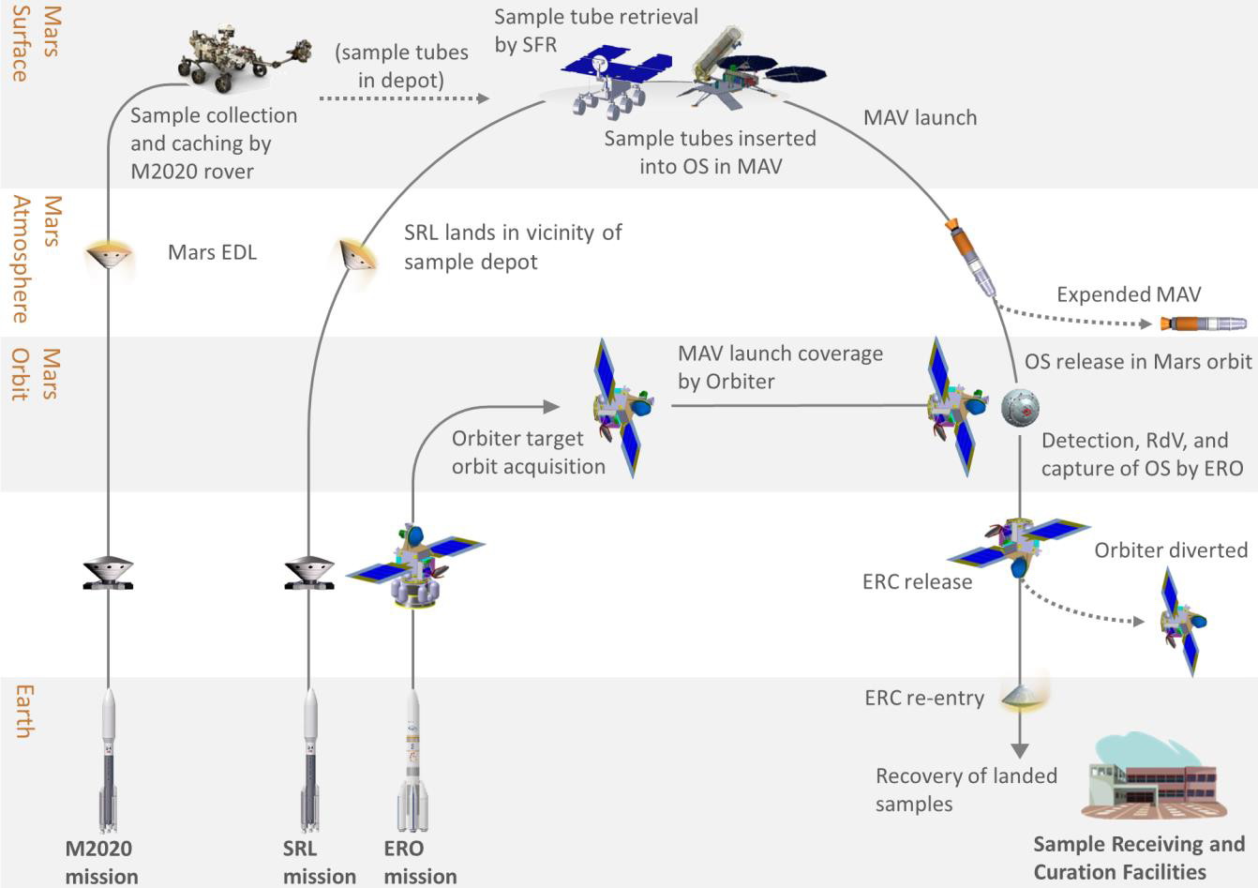
Mars Sample Return (MSR) Campaign Overview
Three missions to be separately launched in the 2020s
  Mars 2020 (M2020) Rover for samples acquisition and caching
  Sample Return Lander (SRL)
  Surface platform, Sample Fetch Rover (SFR), and Mars Ascent Vehicle (MAV)
  Earth Return Orbiter (ERO)
  Rendezvous and capture of the Orbiting Sample (OS), bio-sealing, Earth Re-entry Capsule (ERC)

Slide 3
Mars Sample Return (MSR) Campaign Overview
Three missions to be separately launched in the 2020s
  Mars 2020 (M2020) Rover for samples acquisition and caching
  Sample Return Lander (SRL)
  Surface platform, Sample Fetch Rover (SFR), and Mars Ascent Vehicle (MAV)
  Earth Return Orbiter (ERO)
  Rendezvous and capture of the Orbiting Sample (OS), bio-sealing, Earth Re-entry Capsule (ERC)
Earth Return Orbiter identified as a strong candidate for an ESA contribution to the campaign
Scope of the ESA Mars Sample Return
Architecture Assessment Study

Slide 4
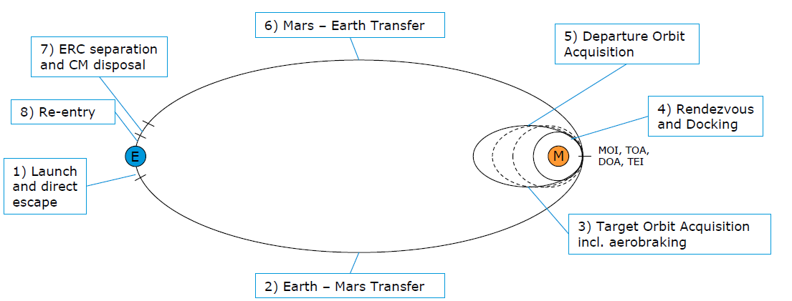
Mission Analysis – Investigated Mission Phases and Key Driving Requirements
Phase | Tasks
Launch | Select Launch Vehicle
Interplanetary transfers: outbound and inbound | Select propulsion type Optional: Select stage separation point
Mars Orbit Insertion (MOI) | Select propulsion type Select insertion orbit Optional: Select stage separation point
Apocentre reduction | Select propulsion type or aerobraking Select aerobraking initial apocentre altitude Assess comms relay performance, including during aerobraking Optional: Select stage separation point
Rendezvous with Orbiting Sample | Select orbit inclination Investigate rendezvous timeline
Apocentre raising and Trans-Earth Injection (TEI) | Select propulsion type
Earth re-entry | Assess Earth re-entry conditions/interface
The mission shall be launched by an Ariane 6 from Kourou (baseline).
The mission shall be designed for a launch in 2026 (2028 backup).
The mission design shall be compatible with an Orbiting Sample (OS) container arrival no earlier than early 2028 (2030 for a 2028 lander launch).
The mission shall provide communications relay functions to the surface mission, covering the Entry, Descent and Landing (EDL) of the SRL, the surface operations until MAV launch and the MAV launch phase. NB The EDL coverage constraint was later reformulated as a mission design goal, rather than a strict requirement.
The mission should return the samples by 2030.

Slide 5
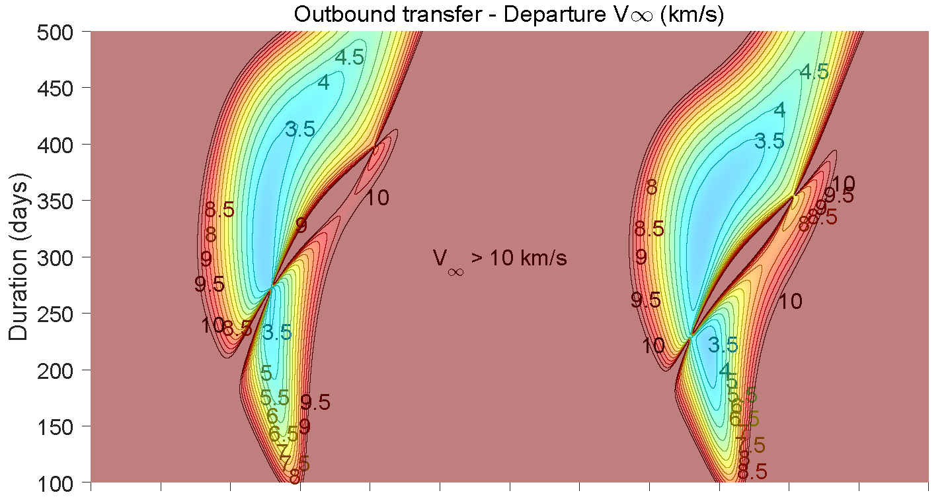
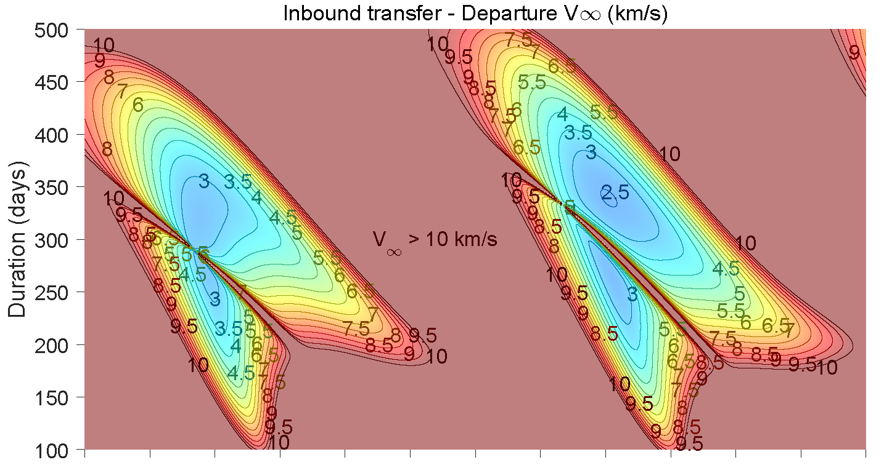
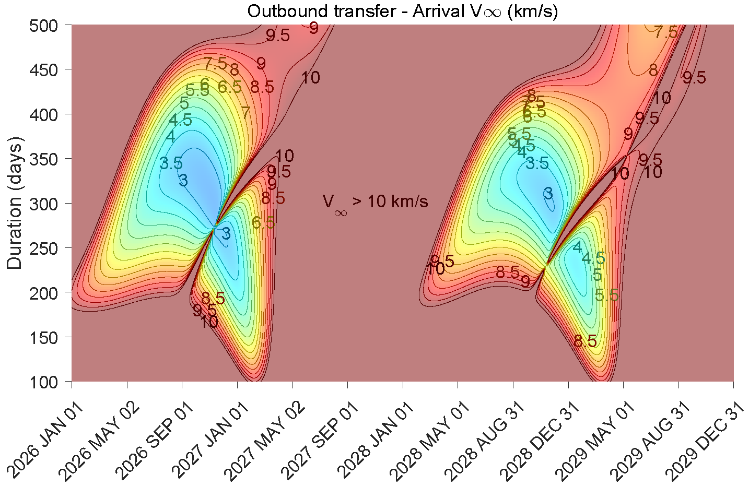
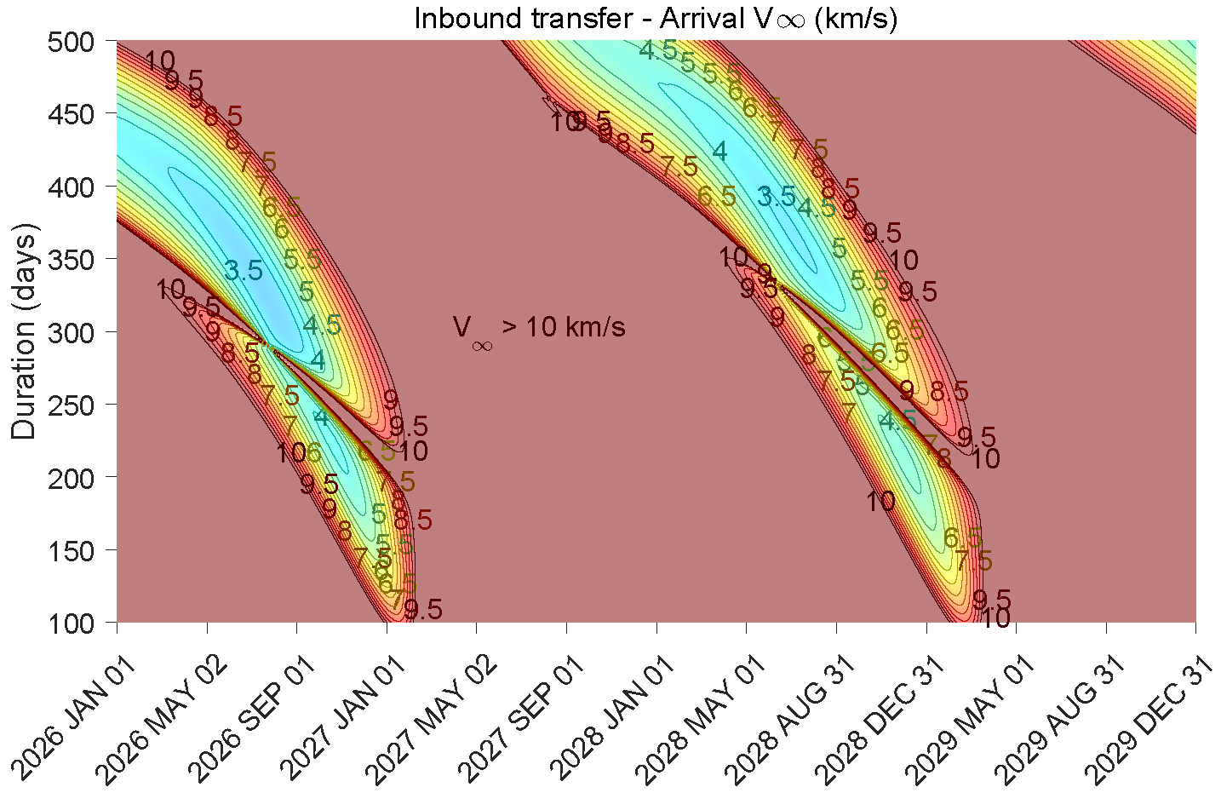
Interplanetary Transfers with Chemical Propulsion (CP)
Outbound and inbound opportunity maps example: short transfers departing between 2026 and 2030
  Solution space for short ballistic transfers well known and documented
  Key design parameters for the evaluation of the architectures are: departure and arrival V-infinity (launcher performance, MOI/TEI Delta-V, Earth entry conditions),
  departure and arrival declination,
  (launcher performance, LMO inclination compatibility, Earth entry conditions)
  departure and arrival dates (timeline)
  Solution space characterised by energy optimal opportunities every ~26 months, with minimum departure/arrival V-infinity typically around 3 km/s

Slide 6
Interplanetary Transfers with Chemical Propulsion (CP)
Declination and Launch Vehicle (LV) considerations:
  Baseline Launch Vehicle is Ariane 64: injection performance not available
  → mass estimates based on Proton
  Nominal performance assumption gives a declination range, possibly extended to
  +/- 35 deg to be confirmed, higher performance expected for near equatorial launch
  Near zero declination launch constraint mandates the use of Deep Space Manoeuvres (DSMs) to compensate
  Alternatively, consider eg Falcon Heavy / Delta IV Heavy: all declinations between +/- 28 deg accessible without significant penalty
“Extra-short” transfers also considered to increase time available at Mars, with slightly suboptimal dates compared to energy optimal solutions
Backup mission (relaxed timeline) architectures can use long transfers (more than one heliocentric revolution) and Earth Gravity Assist (EGA) options
CP transfer dates assessed:
  Outbound transfers: 2026, 2028
  Inbound transfers: 2028, 2030, 2032

Slide 7
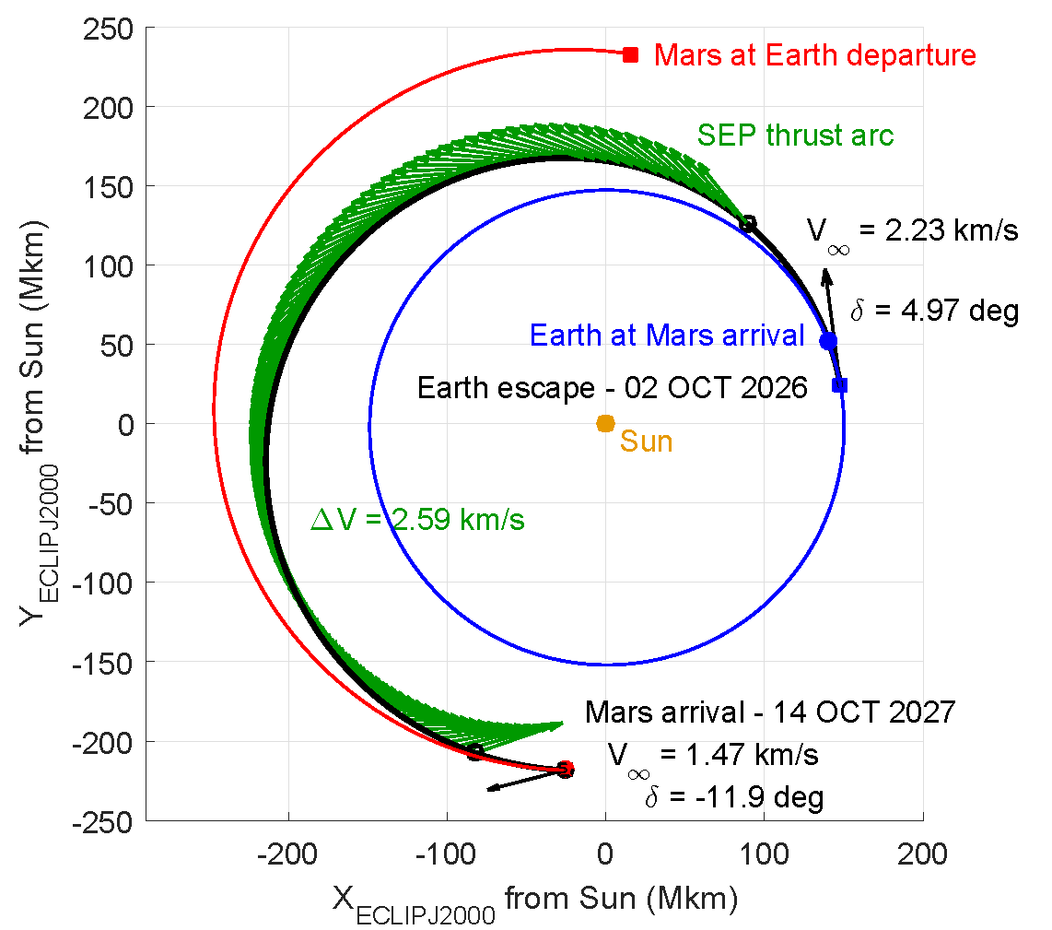
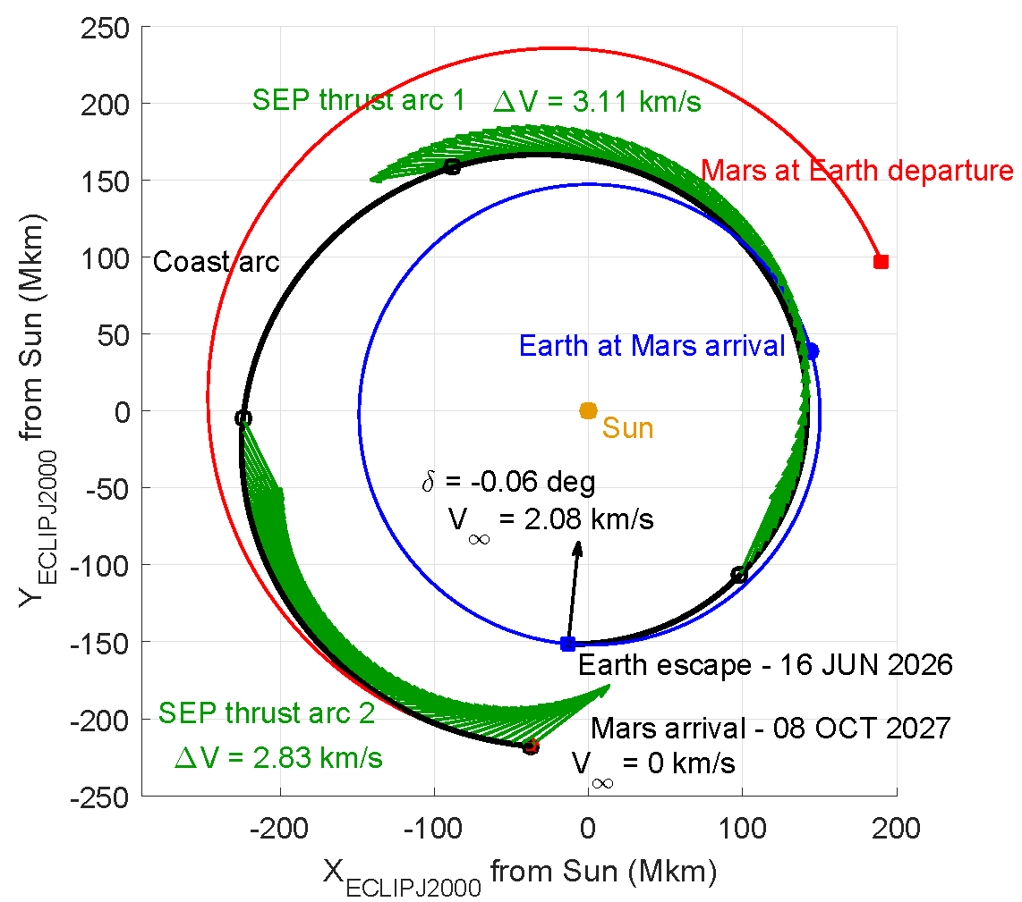
Interplanetary Transfers with Electric Propulsion (EP)
Solar Electric Propulsion (SEP) augmented transfers from Earth to Mars can:
  Reduce Earth departure V-infinity → increase launcher injection mass
  Reduce Mars arrival V-infinity → reduce CP orbit insertion Delta-V
  Perform required Deep Space Manoeuvres (e.g. to compensate for constrained declination) at lesser propellant mass impact
SEP transfers from Mars to Earth can:
  Reduce Mars departure V-infinity → reduce CP planetary escape Delta-V
  Reduce Earth arrival V-infinity → reduce aerothermodynamic loads on ERC
In both cases, additional freedom in the departure and arrival dates
Strong interaction between trajectory and spacecraft design. A key driving parameter is the available thrust to mass ratio at 1 au and the evolution with heliocentric distance:
  Size and technology of the Solar Arrays → maximum available power
  Number and type of thrusters, throttling capability → available thrust to mass ratio
Increased operational complexity, likely to require forced coast arcs for Orbit Determination and operational contingency
Database of SEP transfers with parametric variation on: departure/arrival dates, departure/arrival V-infinity, thrust to mass at 1 au, thrust evolution model

Slide 8
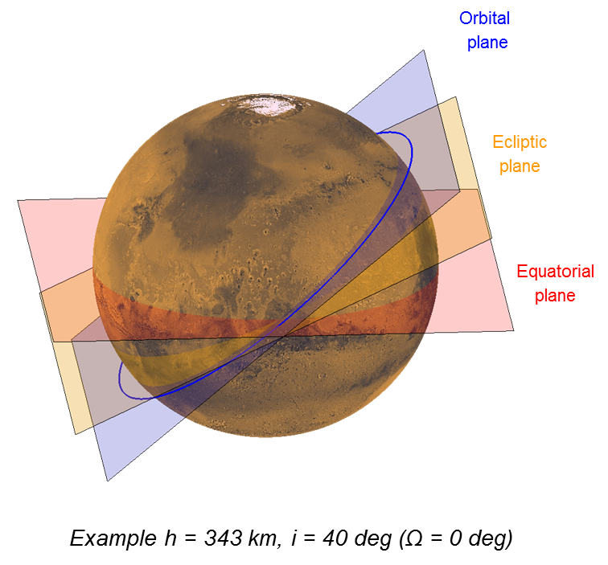
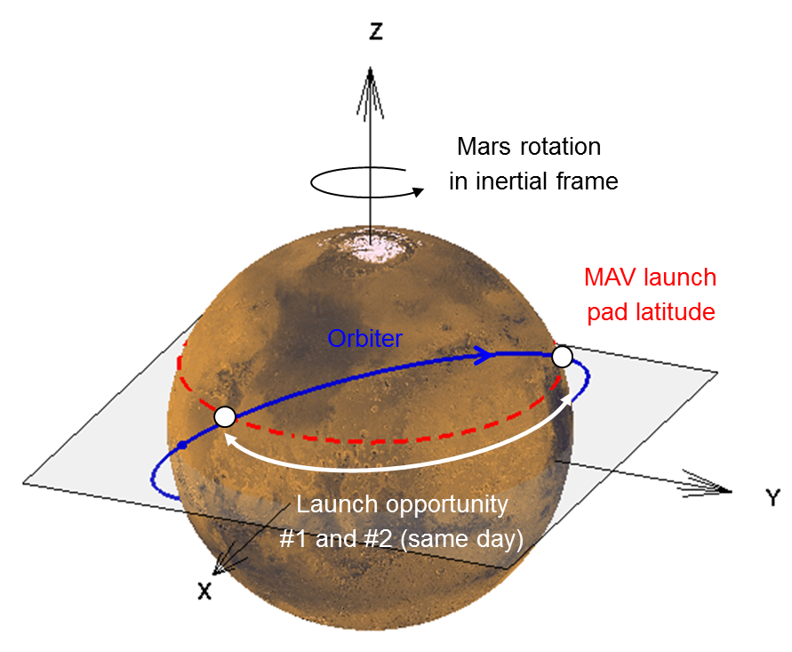
Low Mars Orbit (LMO) Inclination Trade-Off
Mars Orbit not driven by science requirements as was the case for concepts involving a NASA orbiter (e.g. NeMO)
The only orbit parameter open to trade-off is the inclination
Objective: investigate options and relevant trade-off for possible Delta-V / duration reduction
The selection of the LMO inclination is a driver to all mission phases from MOI to DOA
Trade-off conducted, assessing (see summary table):
  Drift of the Right Ascension of the Ascending Node (RAAN) owing to Mars J₂: both absolute (for DOA) and relative (for OS detection, Orbit Matching and rendezvous)
  MAV launch considerations
  Communications with Earth
  Eclipses: range of possible durations
  Compatibility with MAV launch pad latitude and interplanetary transfers (declination)
Proposed LMO inclination baseline of 40 deg
Trade-Off driver | Low inclination (e.g. ~ 20 deg) | High inclination (e.g. ~ 75 deg) | Rationale
RAAN absolute drift rate | Fast | Slow | RAAN phasing for Departure Orbit Acquisition (DOA)
RAAN relative drift rate | Fast | Slow | OS detection & Orbit Matching (w/o MAV LST constraint)
MAV opportunities Right Ascension separation, for given launch pad latitude | Small (0 for i = launch pad latitude) | Large | Orbiter visibility from Earth during MAV ascent
Eclipses minimum duration (minor) | Longer | Shorter | Power / thermal
Limitation wrt MAV launch | Minimum value = launch pad latitude (18.5 deg TBC) | Performance (value TBC) | -
Limitation wrt arrival / departure conditions | Minimum value (declination, transfer dependent) | N/A | -

Slide 9
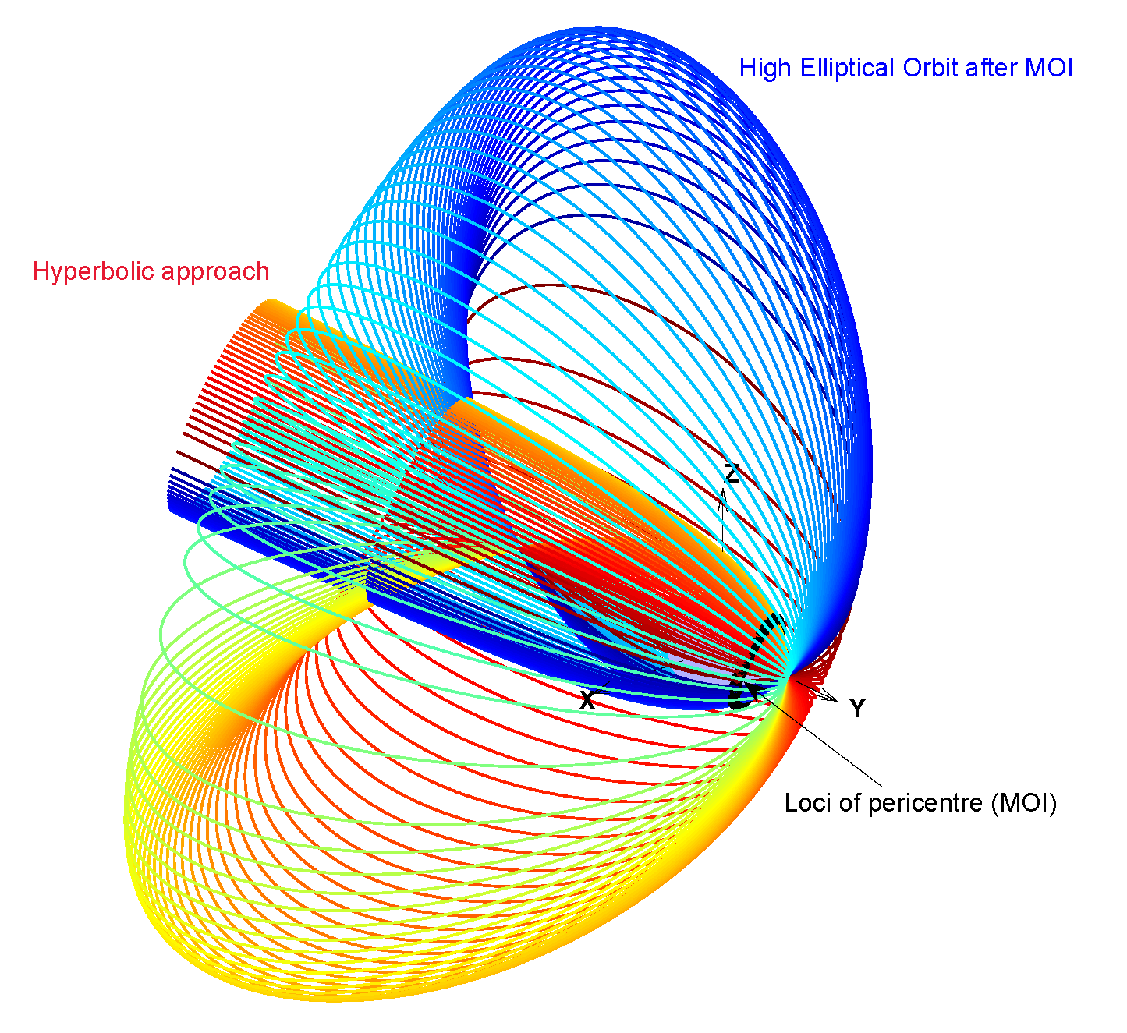
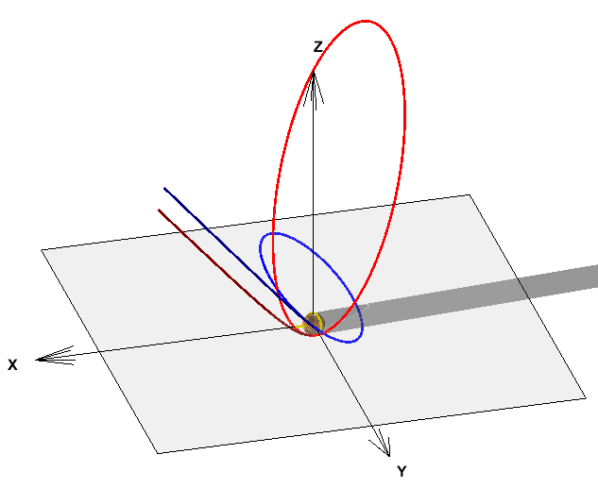
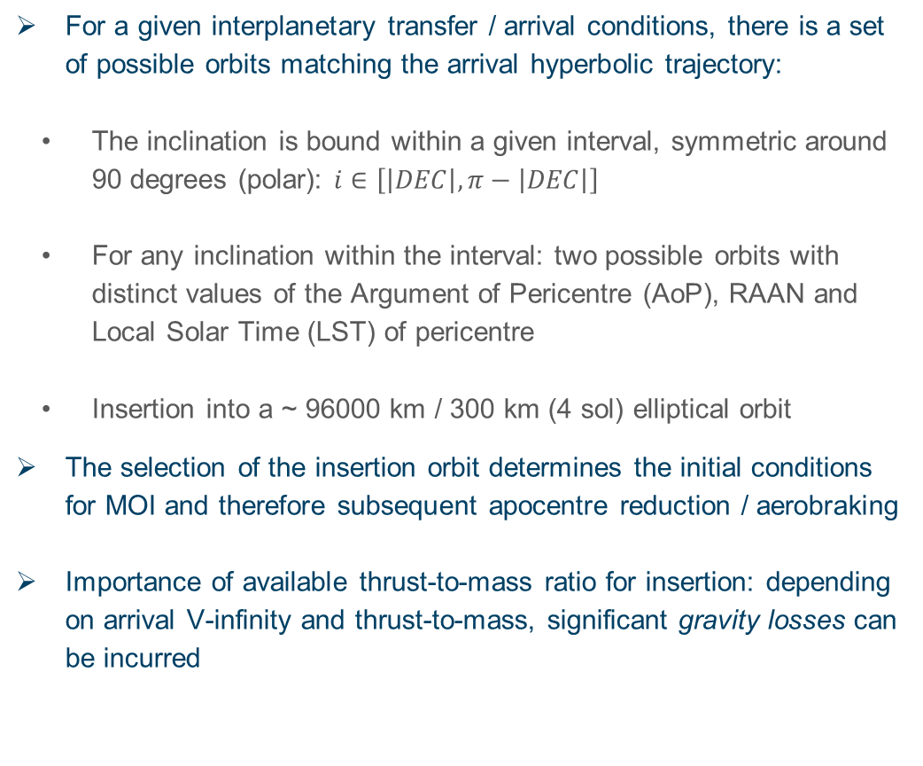
Mars Orbit Insertion (MOI)
All possible pre/post-MOI orbits
For a given interplanetary transfer / arrival conditions, there is a set of possible orbits matching the arrival hyperbolic trajectory:
  The inclination is bound within a given interval, symmetric around 90 degrees (polar): $i∈\left[\left|DEC\right|, π−\left|DEC\right|\right]$
  For any inclination within the interval: two possible orbits with distinct values of the Argument of Pericentre (AoP), RAAN and Local Solar Time (LST) of pericentre
  Insertion into a ~ 96000 km / 300 km (4 sol) elliptical orbit
The selection of the insertion orbit determines the initial conditions for MOI and therefore subsequent apocentre reduction / aerobraking
Importance of available thrust-to-mass ratio for insertion: depending on arrival V-infinity and thrust-to-mass, significant gravity losses can be incurred
Case 1 MOI
orbit
(i = 40 deg,
AoP = -77 deg)
Arrival
hyperbola
Case 2 MOI
orbit (i = 40 deg,
AoP = 155 deg)
40 deg inclination cases
Equator

Slide 10
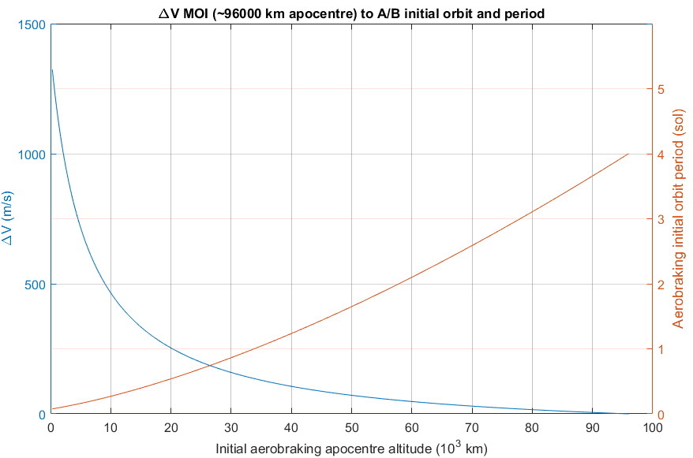
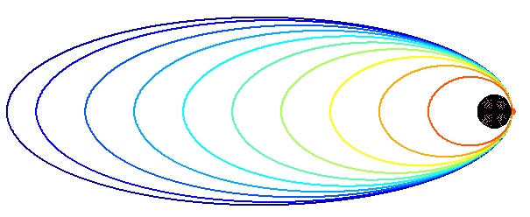
Target Orbit Acquisition: Apocentre Reduction and Aerobraking (A/B)
The default assumption for preliminary budgets is to start aerobraking from a 1 sol orbit, as was done by ExoMars Trace Gas Orbiter (TGO)
This means that the spacecraft needs to perform a manoeuvre (ΔV ~ 140 m/s) to reach the initial A/B altitude from the post-MOI orbit
This baseline can be modified to:
  Decrease the associated Delta-V, by starting A/B with a higher apocentre (increases A/B duration): max Delta-V saving = 137 m/s
  Decrease the duration, by starting the A/B with a lower apocentre: rapid Delta-V increase
ΔV max _{MOI → 300/300 TOA} = 1323 m/s
A/B starting at 1 sol
34000 km apocentre
ΔV _{MOI → A/B} = 137 m/s

Slide 11
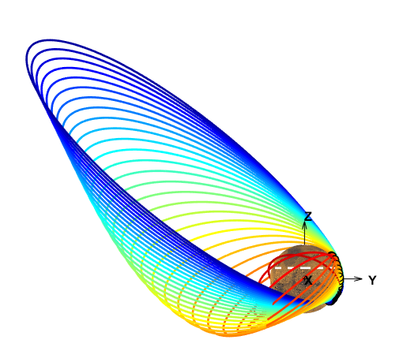
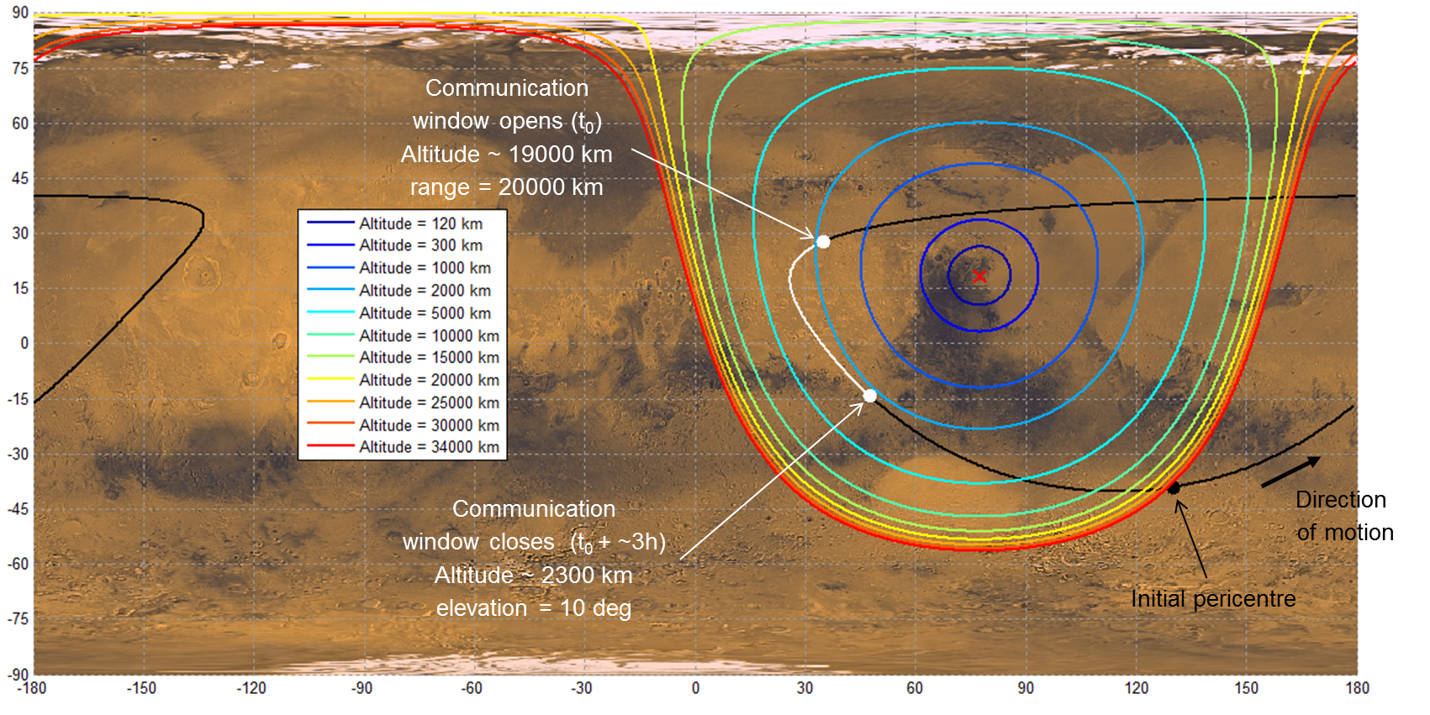
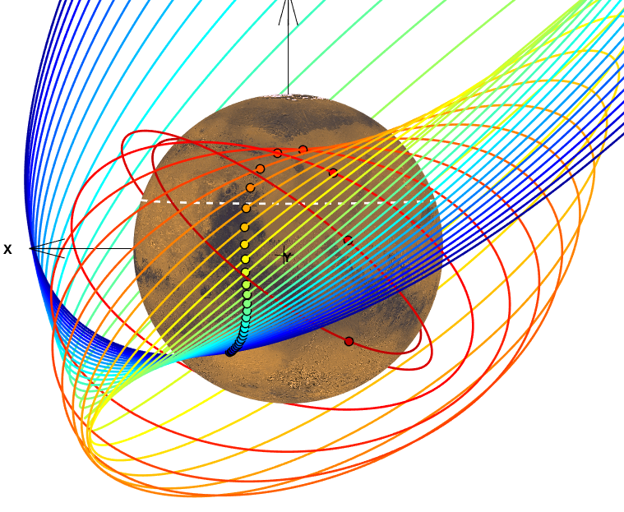
Communications With Lander During Aerobraking
No detailed aerobraking scenario optimisation performed in the context of the study
Simplified semi-analytical orbit propagation model based on parametric description of the apocentre profile, and first-order drift models for RAAN, AoP and anomaly (J₂ only)
Complex orbit evolution: combination of: apocentre decay, AoP drift and RAAN drift
  Quantitative metrics for opportunities of communication links derived for sample arrival transfer case, considering two landing sites: Jezero Crater and Columbia Hills
Jezero Crater
loci of
pericentre

Slide 12
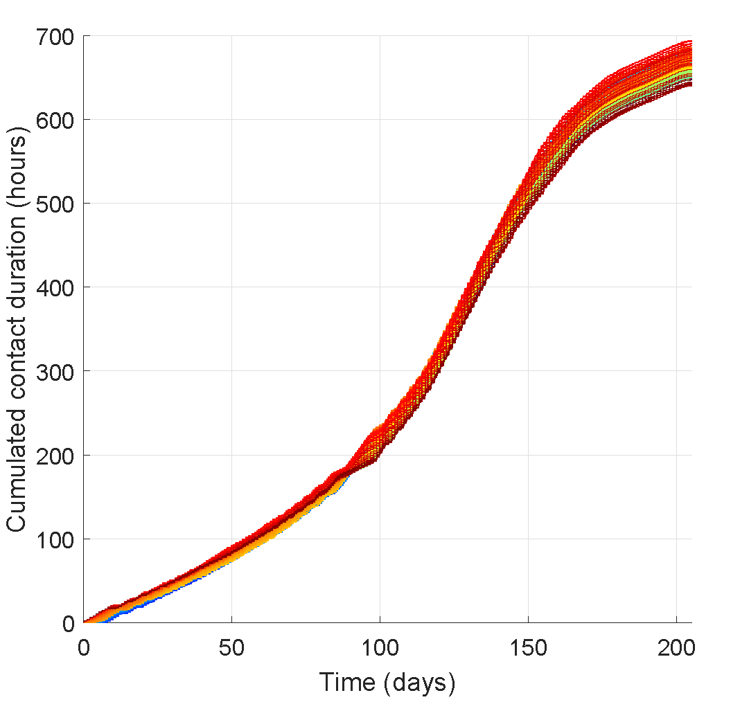
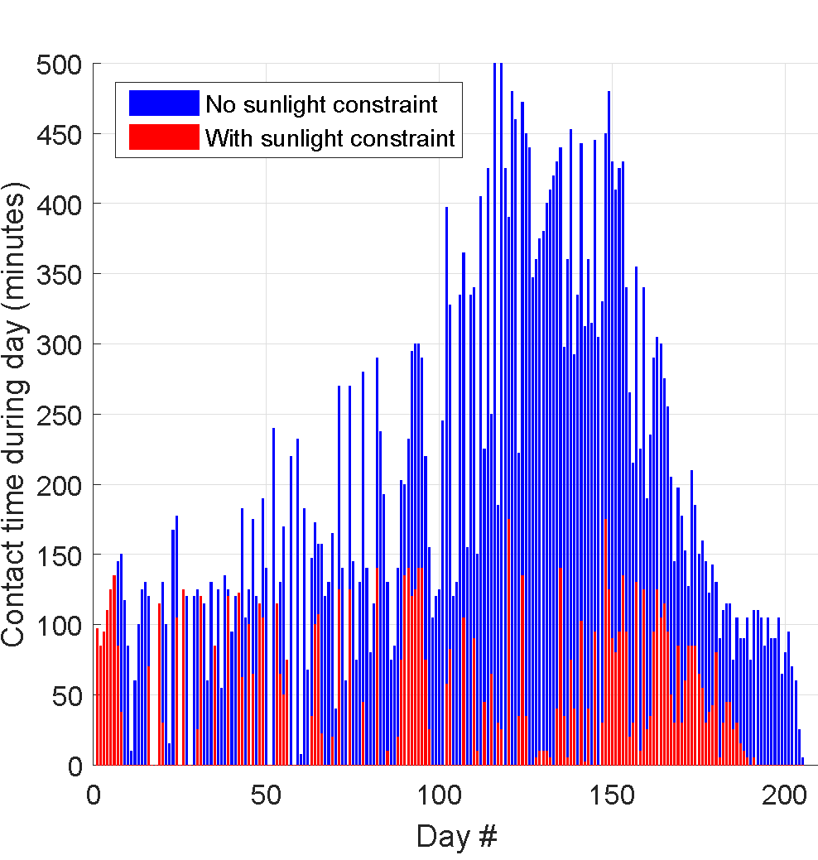
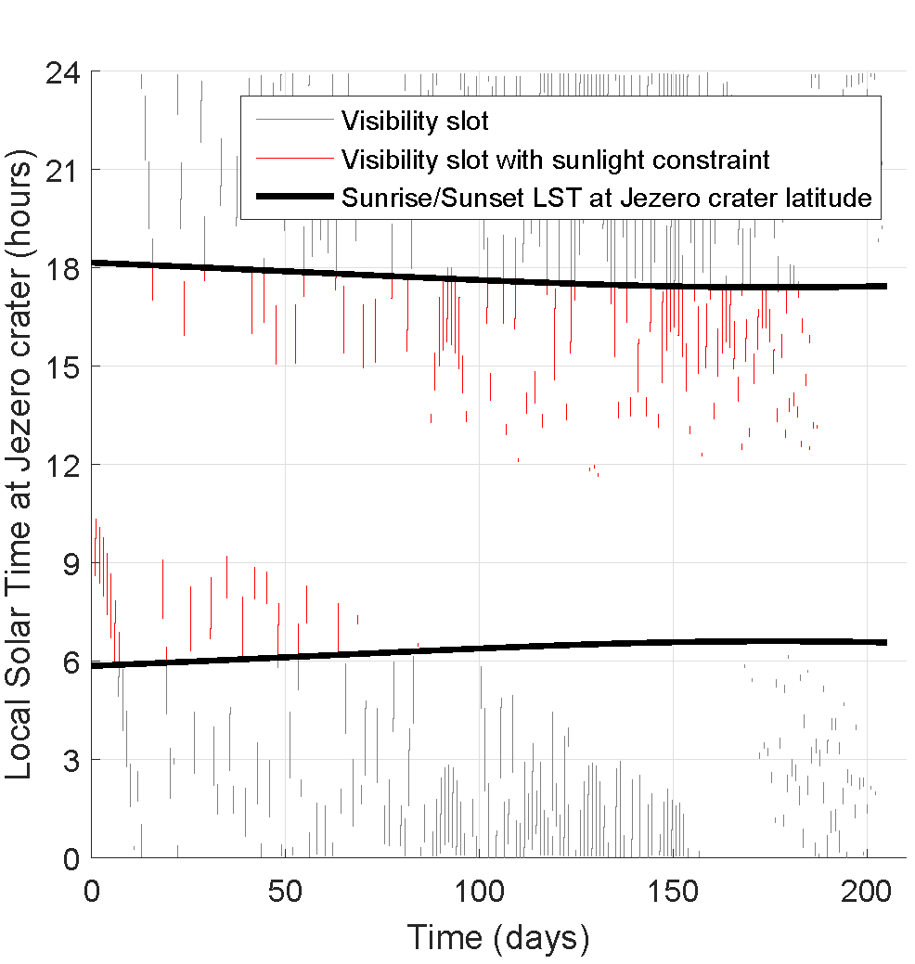
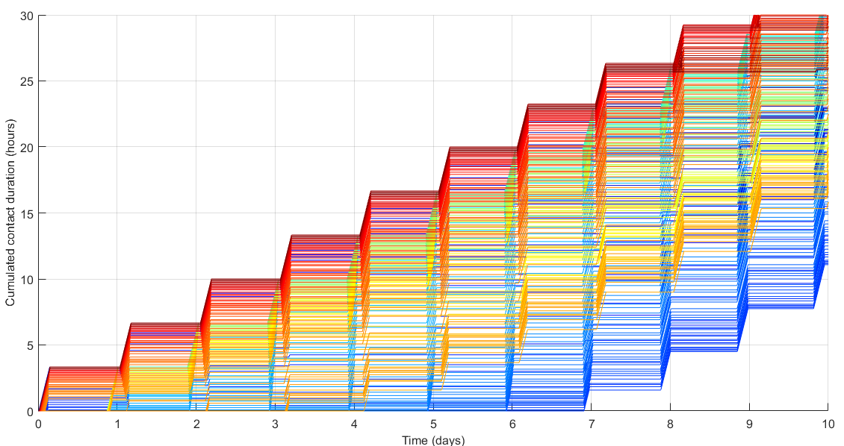
Communications With Lander During Aerobraking
  Assessment of the total (cumulated) and daily contact time between the orbiter (ERO) and the lander (SRL) during aerobraking
  Parametric analysis of the impact of the initial longitude (wrt Martian surface, which can be finely tuned by proper arrival timing)
  Assessment of the impact of the additional constraint to have the lander in sunlight to communicate (power limitation)
  Constraints considered: minimum elevation = 10 deg, minimum altitude = 350 km, maximum range = 20000 km
1 curve/colour = 1 assumption
for initial longitude value

Slide 13
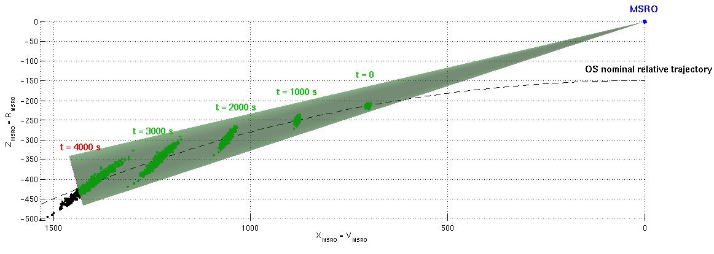
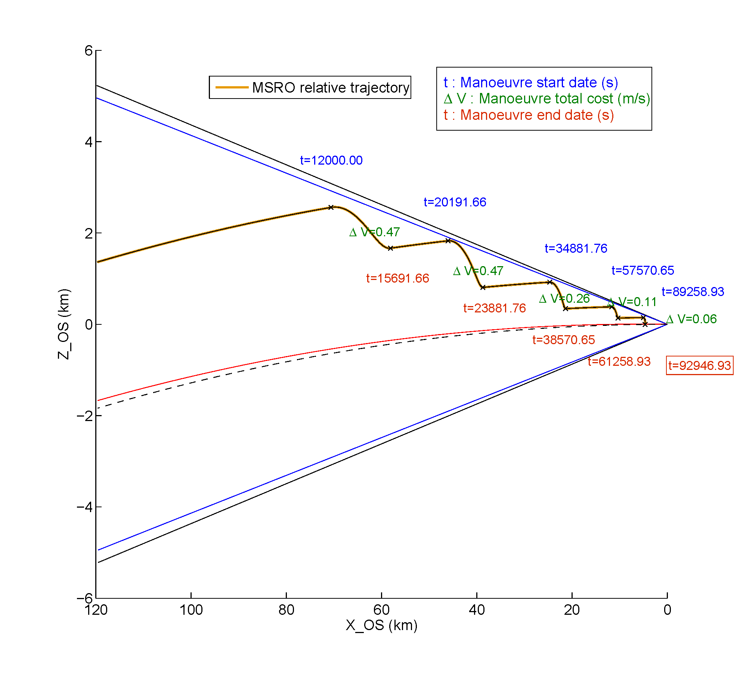
Timeline Between MAV Ascent and TEI
Proposed timeline for nominal operations between MAV ascent and TEI
90 days conservatively assumed for the timelines, in order to account for
possible contingencies e.g. requiring 2 rendezvous attempts
Phase | Events | Duration | Time
MAV ascent |  |  | T0
Orbit Matching | OS detection | 14 days | T0 + 14 days
 | Hohmann transfer / "Homing" | 2 days | T0 + 16 days
Rendezvous and Capture | Co-elliptic approach / Far RdV ~120 km to 5 km | 2 days | T0 + 18 days
 | Final approach / Close RdV ~5 km to 100 m | 2 days | T0 + 20 days
 | Forced translation, capture and bio-sealing | 2 days | T0 + 22 days
Departure Orbit Acquisition | Absolute RAAN phasing (assuming 200 deg) | 24 days | T0 + 46 days
 | Apocentre raising to 4 sols | 14 days | T0 + 60 days
Trans-Earth Injection (TEI) |  |  | T0 + 60 days
OS detection (NAC) (ERO-relative frame)
Co-elliptic approach (OS-relative frame)

Slide 14
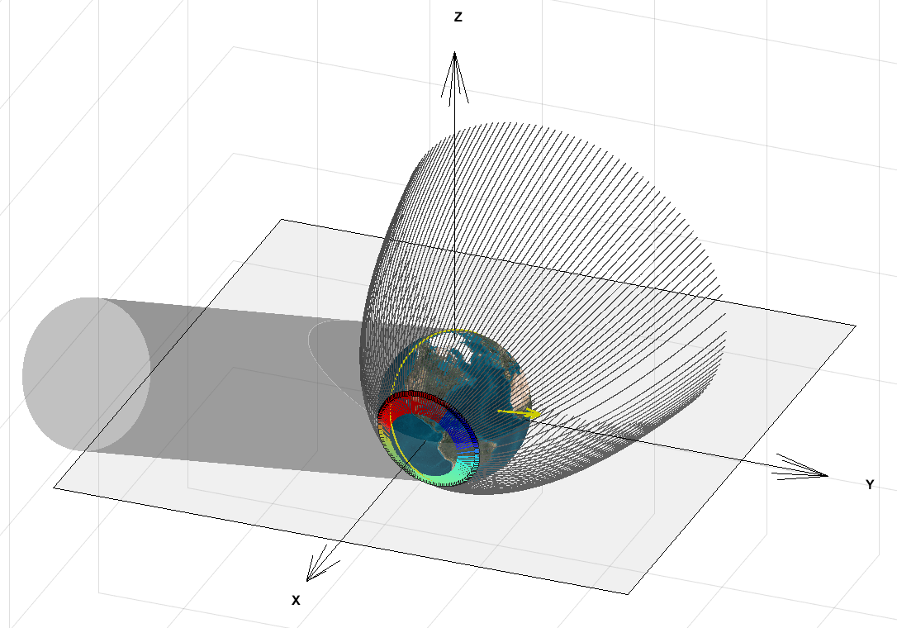
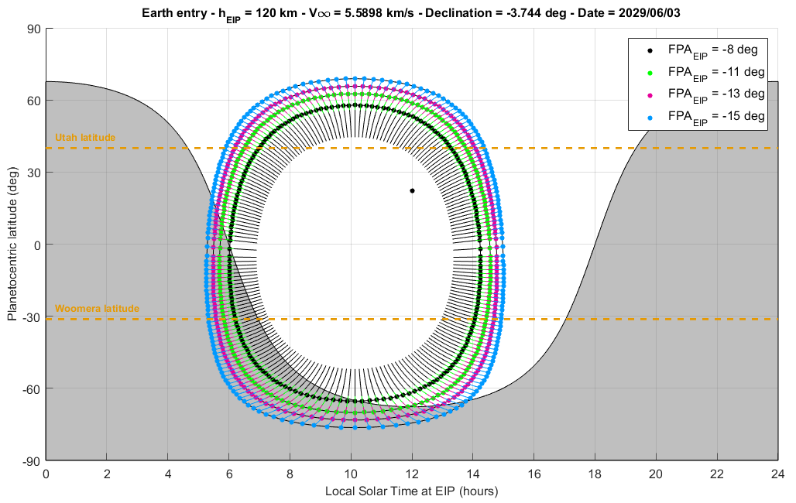
ERC Re-entry Conditions – Overview
Hyperbolic
approach orbits
Entry trajectory characteristics are influenced by the atmospheric velocity and the Flight Path Angle (FPA) at the Entry Interface Point (EIP @ 120 km)
Maximum dynamic pressure and kinetic heating are key driving parameters for the aerothermodynamic loads and therefore the design of the ERC
The FPA can be chosen freely without Delta-V penalty via approach orbit pericentre altitude targeting: entry angles in [8-15] deg typically considered
Key factors are Earth approach V-infinity, declination, and orientation wrt Sun:
  V-infinity determines inertial velocity at EIP, typically required < 13 km/s
  Declination determines the latitude of the centre of the landing locations
  Orientation wrt Sun line determines admissible Local Solar Time at EIP
For a given return trajectory, loci of possible pericentre locations are obtained by sweeping the approach velocity vector in the B plane (B-plane targeting):
  Implications for prograde (atmospheric velocity < inertial velocity) or retrograde (atmospheric velocity > inertial velocity) entry trajectory
  Possibility to target a landing site e.g. Utah (40 deg N), Woomera (31 deg S)
  For a typical tangential Earth approach night or day landings can be chosen
Terminator
Earth shadow
Sun vector
at EIP
Locus of EIP
and entry arcs
Re-entry conditions for 2028-T1
CP return transfer example
Verification of compliance with Earth entry requirements necessary for all candidate transfers

Slide 15
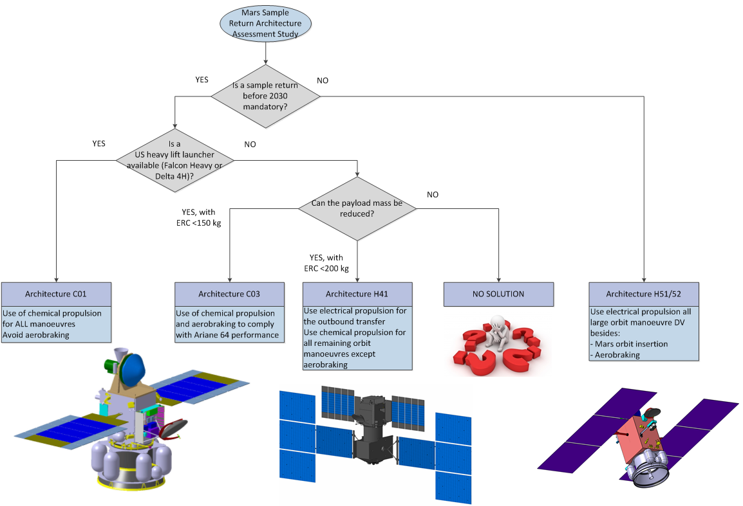
Conclusion and Future Work
Based on the outcomes of the mission analysis, a number of mission architectures investigated: including purely chemical (CP) as well as hybrid (CP and EP stages) options
Most promising down-selected for further analysis, including preliminary spacecraft architecture
Target sample return date found to be incompatible with current assumptions for the baseline Launch Vehicle performance and payload mass
2018: Airbus awarded the Mars Sample Return Earth Return Orbiter (MSR-ERO) Phase A/B1 system study by the ESA, and thus given the opportunity to pursue its contribution to the MSR campaign, working in close collaboration with ESA and NASA JPL
Mission analysis and architecture trade-offs still currently ongoing, looking in particular at higher power options for some EP architectures as well as alternative CP transfer options for the relaxed timeline
Phase A to be completed before end of 2018, and Phase B1 before the ministerial council 2019 (CM19)

Slide 16
Thank you – Any questions ?

Slide 17
Backup slides
MSR-AA Study objectives

Slide 18
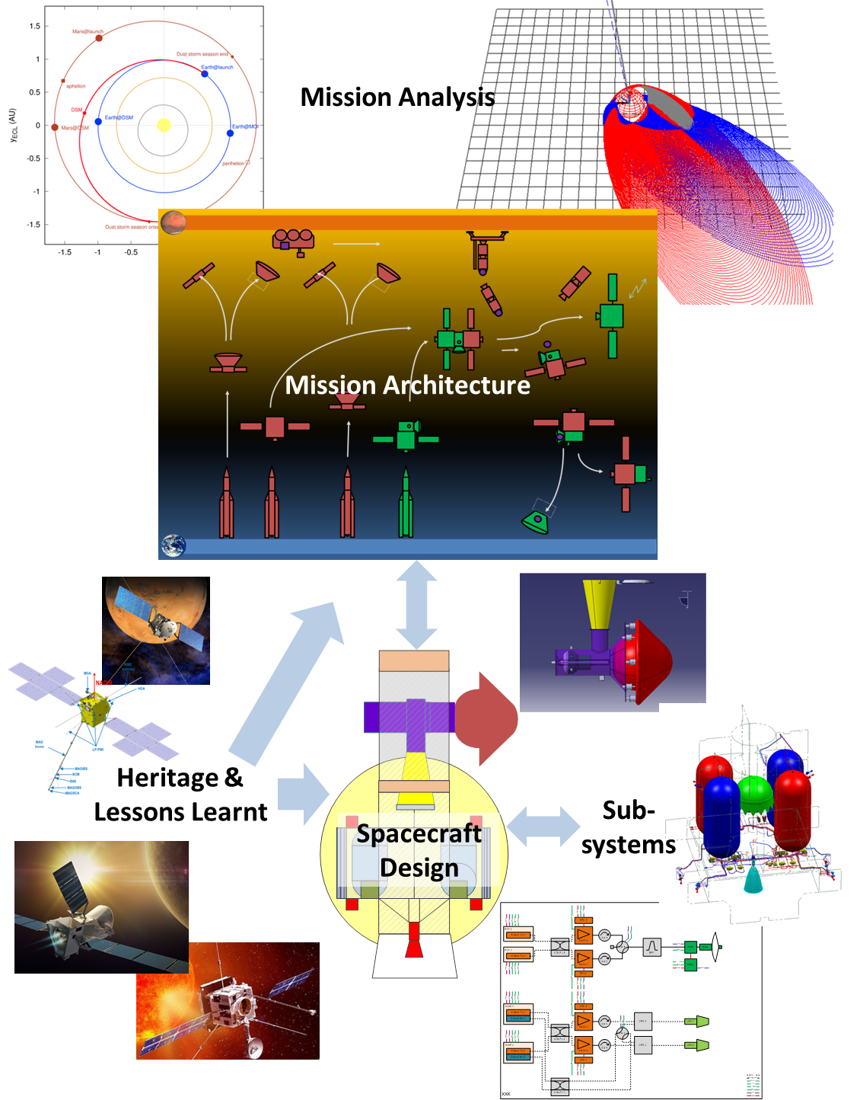
Mars Sample Return Architecture Assessment
Mars Sample Return Architecture Assessment (MSR-AA) study overview
  4 months study conducted by Airbus for the European Agency between July and November 2017
  Airbus strong heritage in designing Sample Return missions and missions to Mars, in particular Airbus conducted the MSRO Phase A in 2011-12 for ESA
Objectives of the study
Quantify different mission architectures of the Mars Sample Return campaign
Support identification and selection of ESA contributions to the campaign
Identify design envelopes and ranges for specific input parameters based on these possible architectures, for the elements that could be contributed by ESA
Provide inputs to the technology development planning
Support ESA’s interactions with NASA on the planning of a joint MSR mission

Slide 19
Backup slides
LMO Inclination trade-off

Slide 20
Introduction and main motivations
Focus on Mars proximity phases in particular:
  Mars Orbit Insertion to Target Orbit Acquisition (TOA)
  MAV/OS launch, Rendezvous (RdV) and OS capture
  Departure Orbit Acquisition (DOA) prior to Mars escape
Challenge:
  Main focus and priority given to the architecture D mission with very tight timeline and ΔV budget
  Objective: investigate options and relevant trade-off for possible ΔV / duration reduction
Durations essentially driven by RAAN drift considerations:
  Relative (OS/SRO) RAAN phasing for rendezvous with the OS after MAV injection
  Absolute RAAN phasing to match the conditions for Mars escape
Main assumptions:
  Mars Orbit Insertion (MOI) into a Highly Elliptical Orbit of period ~ 4 sols: apocentre ~96,000 km and pericentre ~300 km
  Low Mars Orbit (LMO) corresponds to the OS orbit after injection by the MAV: assumed to be ~ 343 km attitude circular orbit
  A priori RAAN can take any arbitrary value at arrival and at Mars departure
  Remaining degree of freedom for the LMO: inclination
The selection of the LMO inclination is a driver to all mission phases from MOI to DOA

Slide 21
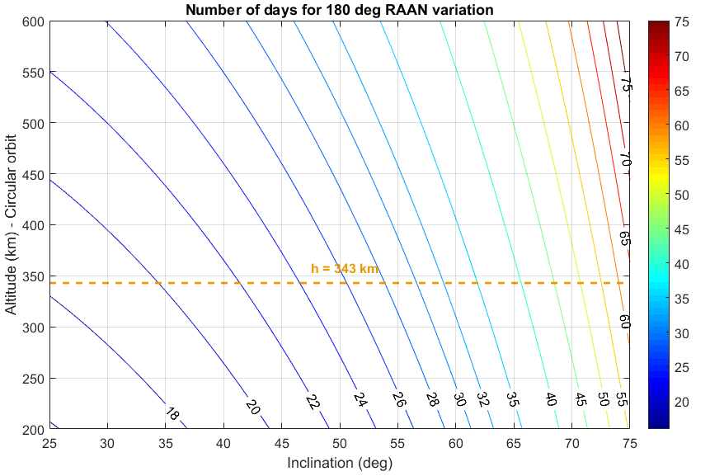
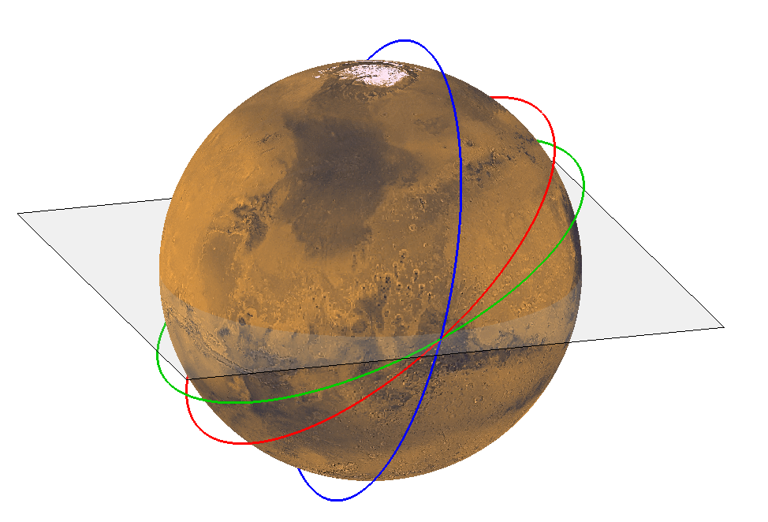
Right Ascension of the Ascending Node (RAAN) drift and drift rate
At a similar altitude, J₂ perturbation in a Low Mars Orbit is stronger than in a Low Earth Orbit
Causes secular drift rate of the Right Ascension of the Ascending Node (RAAN), and Argument of Pericentre (AoP, if elliptical orbit)
Significant variation with (circular orbit) altitude and inclination – initial baseline (MAG) was 343 km / 75 deg leading to -3 deg/ day
For given Mars escape conditions at a given date (V∞ vector), two values of the RAAN are admissible
This typically requires up to ~ 180 degrees absolute rotation of the line of nodes: for a baseline inclination of 75 deg, this could take 2 months, down to ~ 18 days at 25 deg
75 deg
40 deg
25 deg
Altitude = 343 km
Inclination = 75 deg
Duration = 2 months
Example orbits at different inclinations

Slide 22
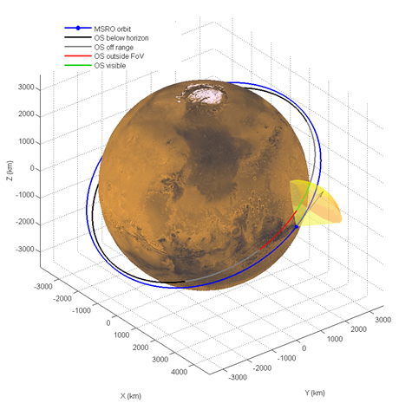
Relative RAAN phasing
Minimum altitude differential between the orbiter (SRO) and the OS after injection by the MAV, driven by:
  MAV injection dispersions
        ∆a = +/- 30 km
        ∆e ≤ 0.02
        (∆i = +/- 0.5 deg)
  Orbit determination performance for the orbiter
→ OS must be launched with a RAAN differential wrt SRO so that it catches up
(Orbit Matching) during the time allocated for RdV operations
RAAN separation must be large enough or RAAN to ensure there is no RAAN “overshoot” during that time → in favour of slow relative RAAN drift / high inclination
Possible conflict with MAV ascent coverage / OS detection issue
Clarification from ESA/JPL:
The SRO will be required to receive the MAV telemetry during and after its ascent. The current design has the MAV transmitting on UHF band to be received by an orbiter with a UHF relay package similar to the one on TGO or MAVEN.
Assessed during MSRO study but unlikely to be a major issue (large range)

Slide 23
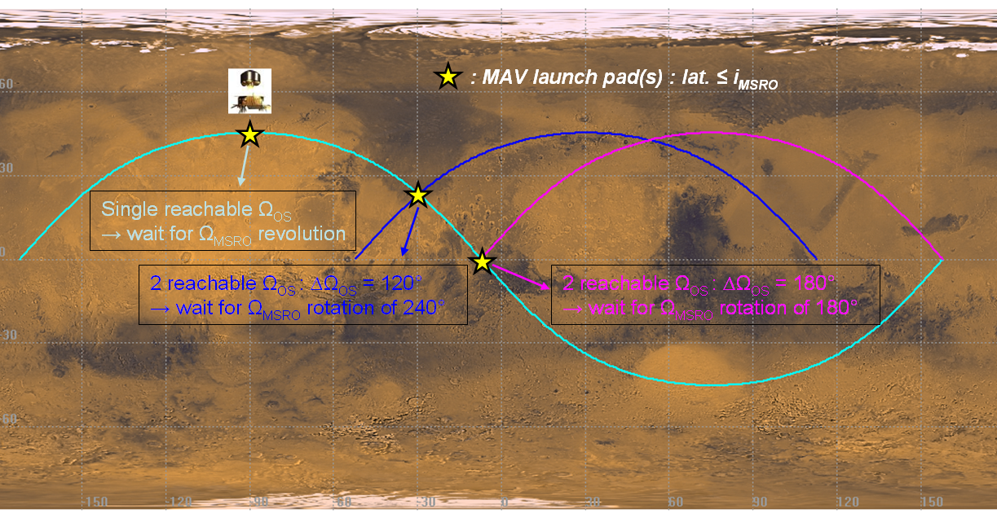
MAV launch considerations wrt RAAN relative phasing
If the MAV launch (solar) time was constrained
  Then the RAAN of the OS would be constrained
    Inclination = latitude of the launch pad
    → 1 value of RAAN imposed for the OS
    → Possible very long relative RAAN phasing
    Inclination > latitude
    → 2 values of OS RAAN possible (North or South launch)
    → worst case RAAN phasing duration reduced
  → Would impact the inclination trade-off
If no constraint is put on the launch time, then the relative RAAN phasing duration can be very short (up to maximum of a few days, depending on orbit determination performance) → Assumed baseline, confirmed by ESA / JPL

Slide 24
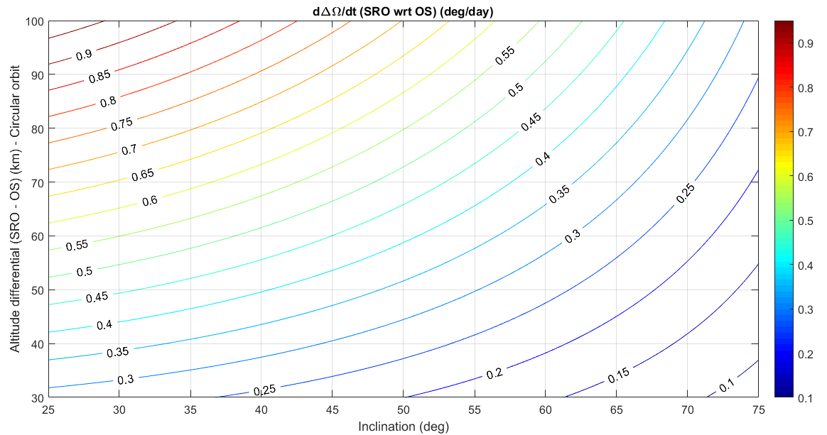
Relative RAAN phasing
Map showing relative RAAN drift rate as a function of (absolute) inclination and OS/SRO altitude differential
(∆e = 0, ∆i = 0 assumed)

Slide 25
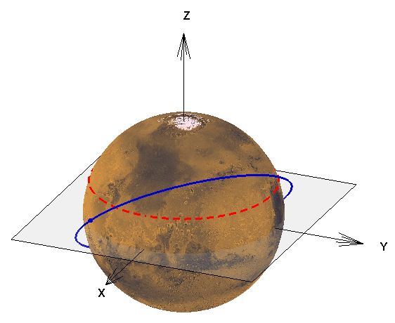
MAV launch considerations wrt inclination
For a given launch pad latitude (Φ):
  The minimum inclination is given by the launch pad latitude: i_{min} = Φ
  For an inclination equal to the latitude of the launch pad latitude
    Only one launch opportunity per sol
    Launch azimuth = 90 deg towards East
  For an inclination greater than the latitude of the launch pad latitude
    Two launch opportunities every sol
    Launch either towards North or towards South
The orbiter needs to be in visibility of Earth during MAV ascent
  If one launch opportunity is not, the other may be if enough separation
  → Higher inclination ensuring larger separation of launch opportunities Right Ascensions / longitudes are favourable
However, this is essentially driven by the latitude of the MAV launch pad
  For example always 180 deg separation in case of an equatorial launch, for all inclinations > 0
Mars rotation
in inertial frame
MAV launch
pad latitude
Orbiter
Launch opportunity
#1 and #2 (same day)
Example with 40 deg inclination
and 20 deg launch pad latitude
X, Y, Z = inertial axes

Slide 26
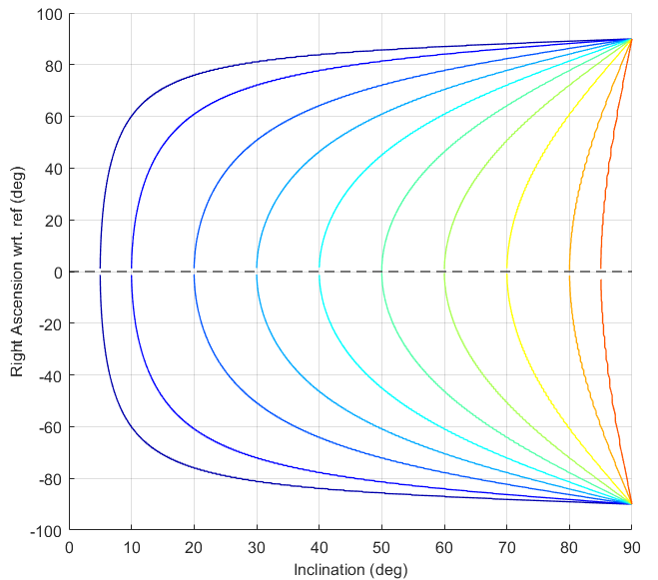
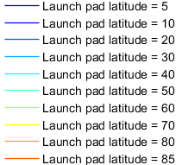
MAV launch considerations wrt inclination
Admissible Launch Right Ascension as a function of latitude and inclination
Mars rotation
in inertial frame
MAV launch
pad latitude
Orbiter
Example South (top)
& North (bottom) opportunities
Launch opportunity
#1 and #2 (same day)
Example with 40 deg inclination
and 20 deg launch pad latitude
X, Y, Z = inertial axes
→ For a given launch pad latitude, higher inclinations lead to larger separation in launch opportunities time / Right Ascension

Slide 27
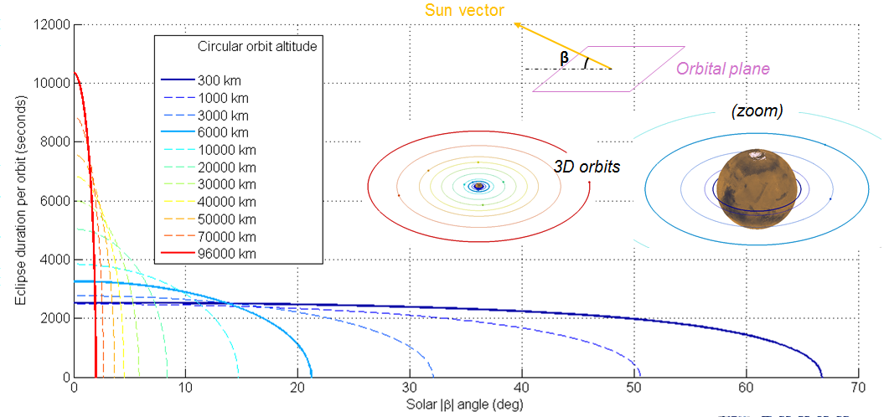
Eclipses
Duration of eclipses around Mars as a function of altitude (circular orbit) and Solar β angle

Slide 28
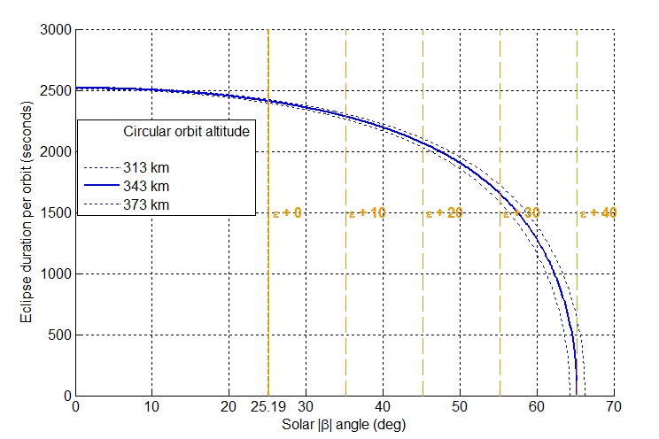
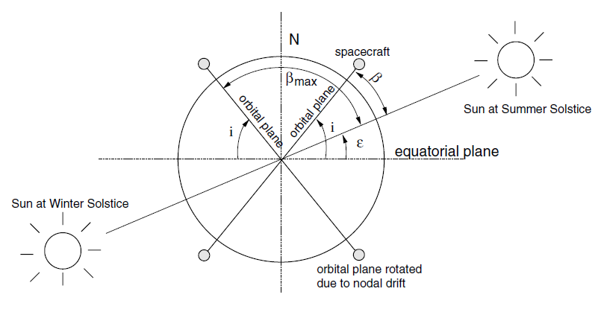
Eclipses
β_{max} for inclination =
0
10
20
30
40
deg
OS orbit assumed to be on a circular orbit at 343 km (+/- 30 km)
  Orbital period ~ 2 hours (~6940 s = 1 hour 56 minutes)
Eclipse duration function of the solar β angle = angle between orbital plane and Sun vector (see top-right figure)
Solar β angle comprised between +/- β_{max} = i + ε (see bottom-right figure)
  i = inclination – subject to trade-off
  ε = angle to the ecliptic = 25.19 deg for Mars
Instantaneous Solar β angle function of the orbit’s inclination, Right Ascension of the Ascending Node, and of the aerocentric Solar Longitude Ls (date / Mars season)
→ There will be eclipses every orbit for i ≤ 40 deg
  Maximum duration 42 minutes (worst case, β_{min} = 0)
  Minimum duration function of the inclination (best case, β_{max})
  The higher the inclination the lower the minimal eclipse duration
  (e.g down to 0 for 40 deg inclination)
Eclipse duration as a function of the solar β angle
Solar β angle extreme values

Slide 29
Summary and LMO / OS inclination trade-off
Trade-Off driver | Low inclination | High inclination | Rationale
RAAN absolute drift rate | Fast | Slow | RAAN phasing for Departure Orbit Acquisition (DOA)
RAAN relative drift rate | Fast | Slow | OS detection & Orbit Matching (w/o MAV LST constraint)
MAV opportunities Right Ascension separation, for a given launch pad latitude | Small (0 for i = launch pad latitude) | Large | Orbiter visibility from Earth during MAV ascent
Eclipses minimum duration (minor) | Longer | Shorter | Power / thermal
Limitation wrt MAV launch | Minimum value = launch pad latitude (18.5 deg TBC) | Performance (value TBC) | -
Limitation wrt arrival / departure conditions | Minimum value (declination, transfer dependent) | N/A | -

Slide 30
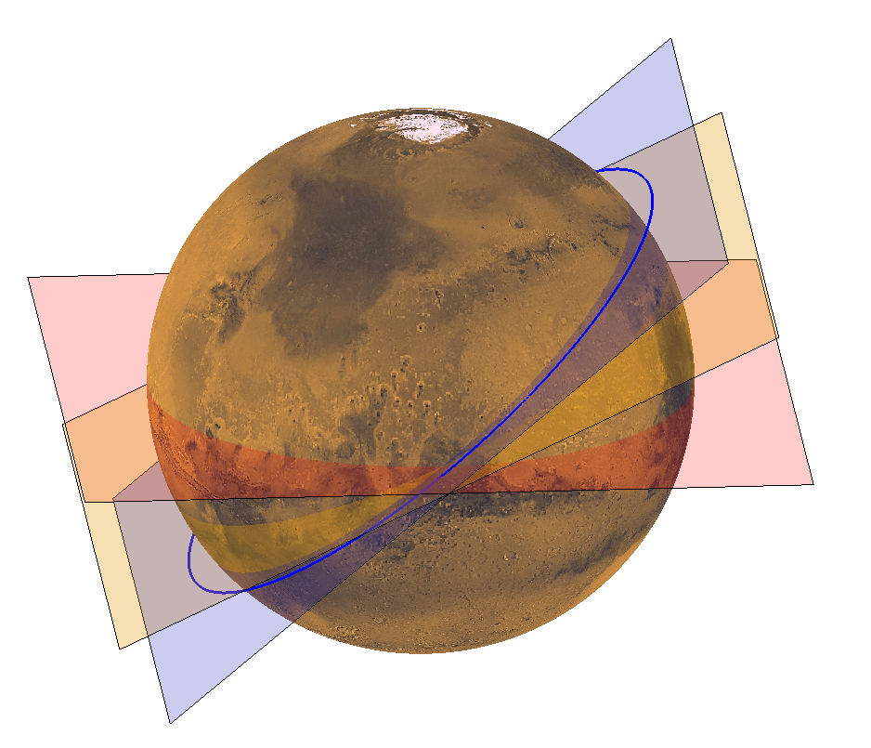
LMO inclination proposed baseline
As a result from this trade-off, an inclination of ~40 deg is proposed as a preliminary baseline for the architecture D mission:
Absolute RAAN drift rate = -8.25 deg / day
Corresponding duration to achieve 200 deg RAAN drift duration = 24 days
(instead of ~ 2 months allocation previously)
Relative RAAN drift rate = 0.4 deg / day (or ~ 24.6 deg per 2 months)
(assuming 50 km altitude differential)
MAV/OS launch opportunities RA separation = 128 deg
(assuming 20 deg launch pad latitude)
MAV/OS launch opportunities time separation = 29 minutes
(assuming 20 deg launch pad latitude)
Solar Beta Angle in [0 - 65.19] deg interval
Eclipses duration in [2 - 42] minutes interval
Orbital
plane
Ecliptic
plane
Equatorial
plane
Example h = 343 km, i = 40 deg (Ω = 0 deg)

Slide 31
Backup slides
Rendezvous operations

Slide 32
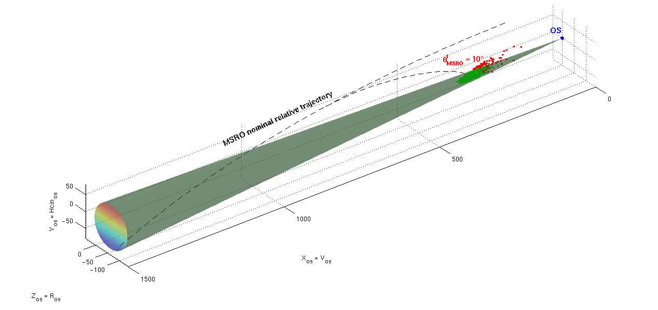
Rendezvous: OS Detection, Homing, Co-elliptic and Final Approach
Earth Return Orbiter (ERO) initially on a higher orbiter than Orbiting Sample (OS) after MAV injection
1. OS detection by means of RF sensor together with Narrow Angle Camera (NAC): data sent to ground for orbits restitution
2. Orbit Matching: Hohmann (“Homing”) transfer to a few km above OS
3. Co-elliptic approach within NAC sensor field of view, Wide Angle Camera (WAC) acquisition (~ 50 km)
4. Final approach, LiDAR acquisition (~ 5 km), forced translation and OS capture
1. OS detection (NAC) (ERO-relative frame)
2. Hohmann transfer to ~ OS altitude
(OS-relative frame)
3. Co-elliptic approach (OS-relative frame)

Slide 33
Timeline Between MAV Ascent and TEI
Proposed timeline for nominal operations between MAV ascent and TEI
90 days conservatively assumed for the timelines, in order to account for possible contingencies e.g. requiring 2 rendezvous attempts
Phase | Events | Duration | Time
MAV ascent |  |  | T0
Orbit Matching | OS detection | 14 days | T0 + 14 days
 | Hohmann transfer / "Homing" | 2 days | T0 + 16 days
Rendezvous and Capture | Co-elliptic approach / Far RdV (~120 km to 5 km) | 2 days | T0 + 18 days
 | Final approach / Close RdV (~5 km to 100 m) | 2 days | T0 + 20 days
 | Forced translation, capture and bio-sealing | 2 days | T0 + 22 days
Departure Orbit Acquisition | Absolute RAAN phasing (assuming 200 deg) | 24 days | T0 + 46 days
 | Apocentre raising to 4 sols | 14 days | T0 + 60 days
Trans-Earth Injection (TEI) |  |  | T0 + 60 days

Slide 34
Backup slides
ERC re-entry conditions

Slide 35
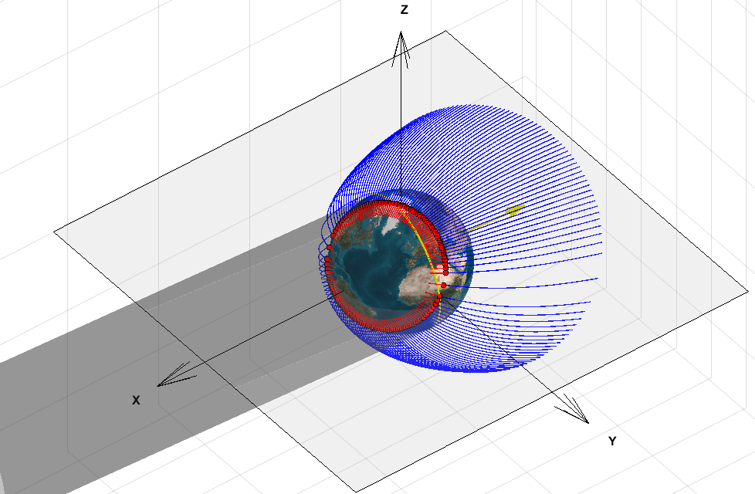
2030-T2 CP return transfer example – Summary
Hyperbolic
approach orbits
Arrival Date | 17/09/2031
Arrival Vinf (EME2000, km/s) | Vx | Vy | Vz
 | 3.958 | 1.923 | 2.708
Arrival Vinf (EME2000, km/s, deg) | V∞ magnitude | Declination | Right Ascension
 | 5.167 | 31.608 | 25.913
Sun vector
at EIP
XXXXX
Entry arcs
Terminator
Earth
shadow
Case | EIP osculating pericentre altitude (km) | Re-entry site | Relative velocity at EIP (km/s) | Local Solar Time at EIP (hours)
Entry FPA - 15 deg | 13.0 | Utah prograde | 11.91 | 20.1
 |  | Utah retrograde | 12.54 | 8.1
 |  | Woomera prograde | 12.03 | 23.9
 |  | Woomera retrograde | 12.42 | 4.3
Entry FPA - 13 deg | -81.7 | Utah prograde | 11.90 | 20.4
 |  | Utah retrograde | 12.55 | 7.8
 |  | Woomera prograde* | 12.07 | 0.4
 |  | Woomera retrograde* | 12.38 | 3.80
Entry FPA - 11 deg | -160.8 | Utah prograde | 11.89 | 20.7
 |  | Utah retrograde | 12.56 | 7.5
 |  | Woomera prograde* | 12.14 | 1.2
 |  | Woomera retrograde* | 12.31 | 3
Entry FPA - 8 deg | -252.5 | Utah prograde | 11.88 | 21.1
 |  | Utah retrograde | 12.57 | 7.1
 |  | Woomera prograde* | N/A | N/A
 |  | Woomera retrograde* | N/A | N/A
Equator
FPA = - 8 deg illustration
Main conclusions:
  High V∞ and high declination approach
  Higher atmospheric velocities
  Woomera landing impossible unless a very steep re-entry is performed, with a near South-North azimuth (polar approach)
  Utah landing possible for all FPA: night prograde entries and day-time retrograde entries
*feasibiliy tbc with more detailed simulations
*Impact at higher latitude than target landing site

Slide 36
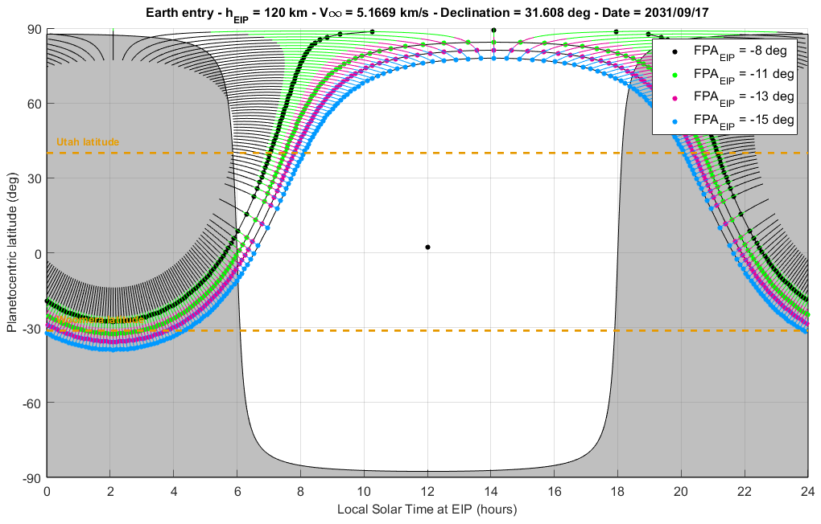
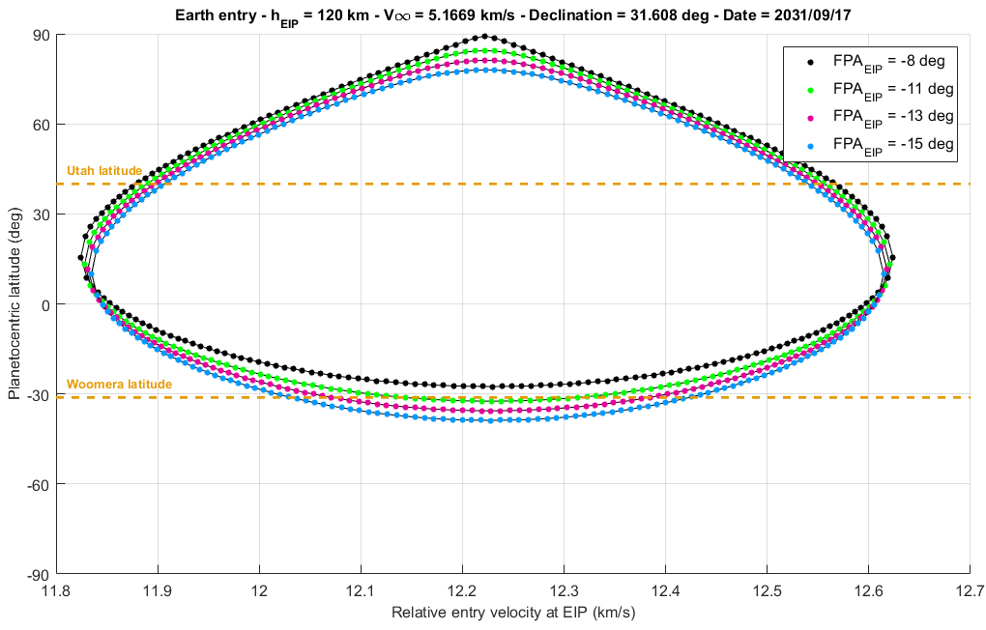
2030-T2 CP return transfer example – Entry plots
Local Solar Time (X axis) vs planetocentric latitude (Y axis)
Relative re-entry velocity (X axis) vs planetocentric latitude (Y axis)

Slide 37
Backup slides
Example timeline

Slide 38
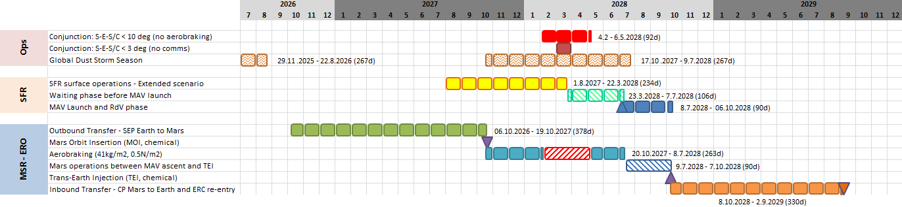
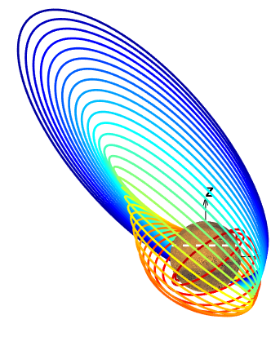
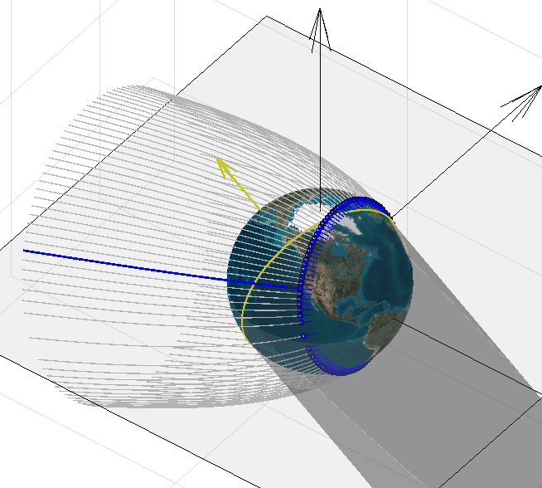
Example Timeline for Hybrid Architecture Mission

