Slide 1

Active Magnetic Shielding to Reduce Dose to Astronauts on an Interplanetary Mission
Kristine Ferrone, MS MS MBA
PhD Candidate
MD Anderson Cancer Center
Systems Engineer
The Aerospace Corporation, Houston, TX
Geant4 Space Users’ Workshop
Space Center Houston
November 28, 2018

Slide 2
Overview
Motivation & Background
Research Summary
Conclusion
Mission Objectives
Identify Risks
Define Hazards
Estimate Risks
Mitigate Risks
Hypothesis & Specific Aims
Research Plan/Design
Experiments
Results & Analysis
Next Steps
2

Slide 3
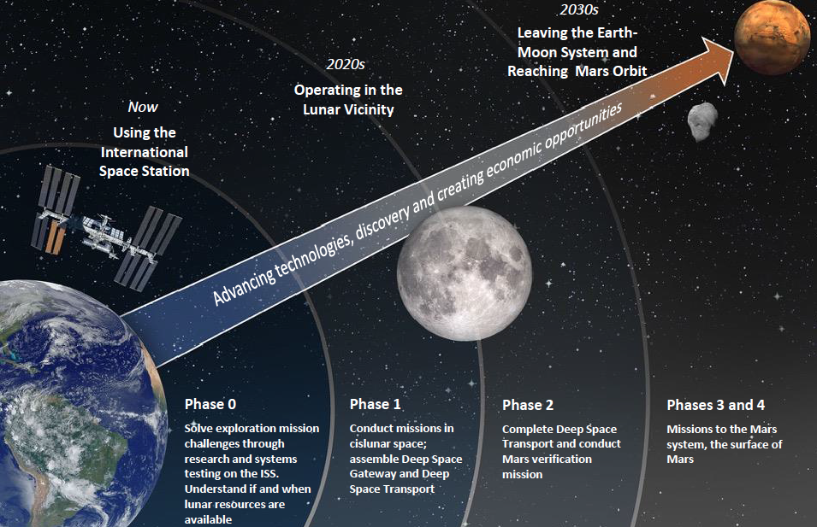
NASA’s Human Space Exploration Strategy
Mission Objectives
L. Simonsen, NASA's Mission and Roadmap, presented to NASA Space Radiation Summer School, Upton, NY (2017).
3

Slide 4
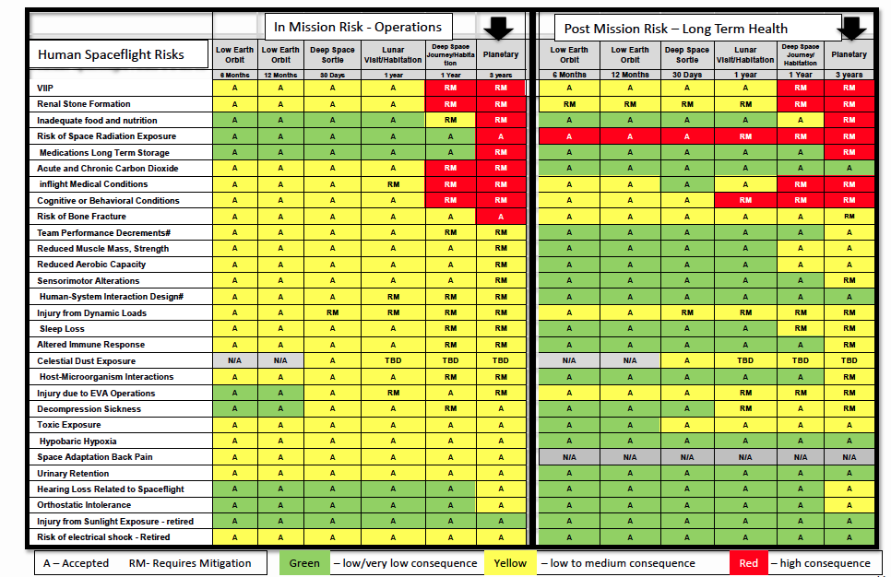
NASA’s Top Human Spaceflight Risks
Identify Risks
Top Human Risks for Planetary Missions (~3 years) | In-Mission Risk | Post-Mission Risk
Visual Impairment and Intracranial Pressure | High Consequence | High Consequence
Renal Stone Formation | High Consequence | High Consequence
Inadequate Food and Nutrition | High Consequence | High Consequence
Space Radiation Exposure | High Consequence | High Consequence
Medications Long-Term Storage | High Consequence | High Consequence
Acute and Chronic Carbon Dioxide | High Consequence | High Consequence
Inflight Medical Conditions | High Consequence | Low Consequence
Cognitive or Behavioral Conditions | High Consequence | High Consequence
Risk of Bone Fracture | High Consequence | High Consequence
Space radiation exposure remains a high consequence risk for planetary human spaceflight and requires further mitigation
4
D. Francisco, Human Risks for Exploration Missions, proceedings Aerospace Medical Association Conference, Orlando, Fla. (2015).

Slide 5
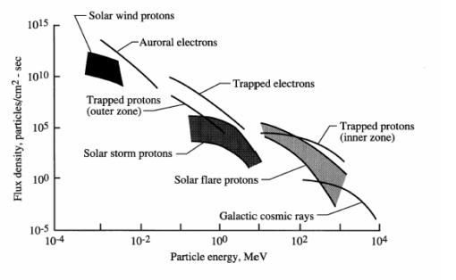
Space Radiation Environment
Define Hazards
Solar wind:
Protons & electrons
0.5 – 2 keV
~10¹⁰ #/cm²-s
Solar flares:
Protons
10 MeV – 1 GeV
10 - 10³ #/cm²-s
Galactic Cosmic Rays (GCR):
Heavy ions
All elements H to Fe
100 MeV – 1 TeV
10⁻⁵ – 1 #/cm²-s
Trapped particles not relevant for planetary missions
F.A. Cucinotta, M.Y. Kim, and L.J. Chappell, Space Radiation Cancer Risk Projections and Uncertainties - 2012, NASA-TP-2013-217375 (2013).
5

Slide 6
Space Radiation Effects
Estimate Risks
Acute Radiation Syndromes
Carcinogenesis
Degenerative Tissue Diseases
Cardiovascular
Cataracts
Respiratory
Digestive
Hematopoietic
Gastrointestinal
Cutaneous
Neurovascular
Acute CNS Risks:
Altered cognitive function
Reduced motor function
Behavioral changes
Late CNS Risks:
Neurological Disorders
Dementia
Premature Aging
Central
Nervous
System
Effects
Dose limits based on BIER VII linear no threshold model
Increased lifetime risk of fatal cancer may not exceed 3% at a 95% CI
Relative size of circles indicates evidence base for each space radiation risk category
NASA Human Research Roadmap Space Radiation Risks: https://humanresearchroadmap.nasa.gov/
6

Slide 7
Space Radiation Risk Mitigation Strategies
Mitigate Risks
Shorten Mission Duration
Radiation Countermeasures
Astronaut
Selection Criteria
Passive Shielding
Active Shielding
Improved Propulsion
Pharmaceuticals
Genetic Predisposition
Aluminum Spacecraft
Electrostatic
Optimize Mission Profile/Trajectory
Chemicals
Male / Female
Water /
Polyethylene
Plasma
Age
Advanced Materials
Magnetic
7

Slide 8
What is Active Magnetic Shielding?
Mitigate Risks
B
Astronauts in a typical cylindrical aluminum spacecraft
Incident space radiation
Space radiation deflected based on rigidity
NASA Astronaut Scott Kelly and Russian Cosmonaut Mikhail Kornienko on the International Space Station during their year in space (image courtesy of NASA)
I
Superconducting solenoid coil with uniform magnetic field
Idealized and simplified case for illustration
8

Slide 9
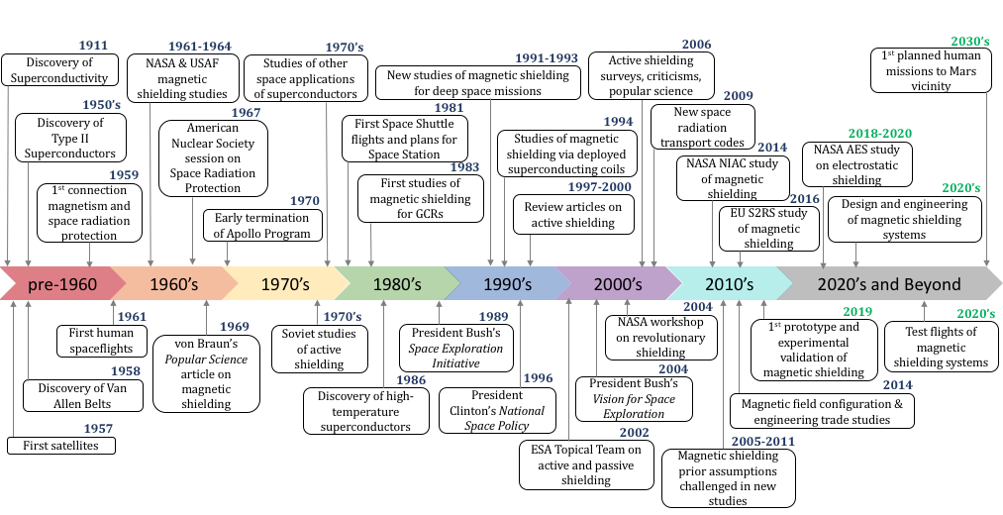
History of Active Magnetic Shielding
Mitigate Risks
9

Slide 10
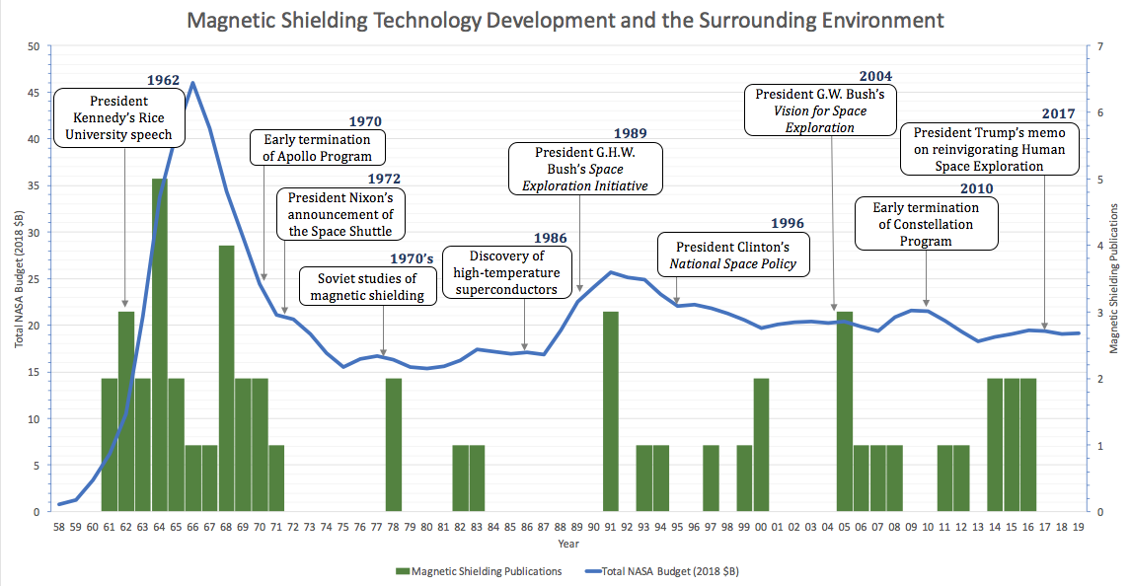
History of Active Magnetic Shielding
Mitigate Risks
10

Slide 11
Overview
Motivation & Background
Research Summary
Conclusion
Mission Objectives
Identify Risks
Define Hazards
Estimate Risks
Mitigate Risks
Hypothesis & Specific Aims
Research Plan/Design
Experiments
Results & Analysis
Next Steps
11

Slide 12
Hypothesis & Specific Aims
Hypothesis & Specific Aims
Hypothesis: Active magnetic shielding reduces effective dose to astronauts on an interplanetary mission by 50% versus no shielding
SA1: Model a spacecraft with superconducting magnetic shielding in a typical Mars mission radiation environment, and determine effective dose to crew members during a simulated Mars flyby mission.
SA2: Perform beam experiments to measure radiation dose behind magnetic shielding in a simulated Mars flyby mission radiation environment.
12

Slide 13
Experiment Design for SA1
Research Plan/Design
Model GCR Environment in Geant4
Model Solar Environment in Geant4
Model Spacecraft in Geant4
Model Shielding in Geant4
Model Astronaut in Geant4
Run Sim
VARIABLES
Solar Cycle
Mission Profile
Collect Dosimetry in GEANT4
Shielding Type
Magnetic Field
Dose to Risk Translation
Crew Gender
13

Slide 14
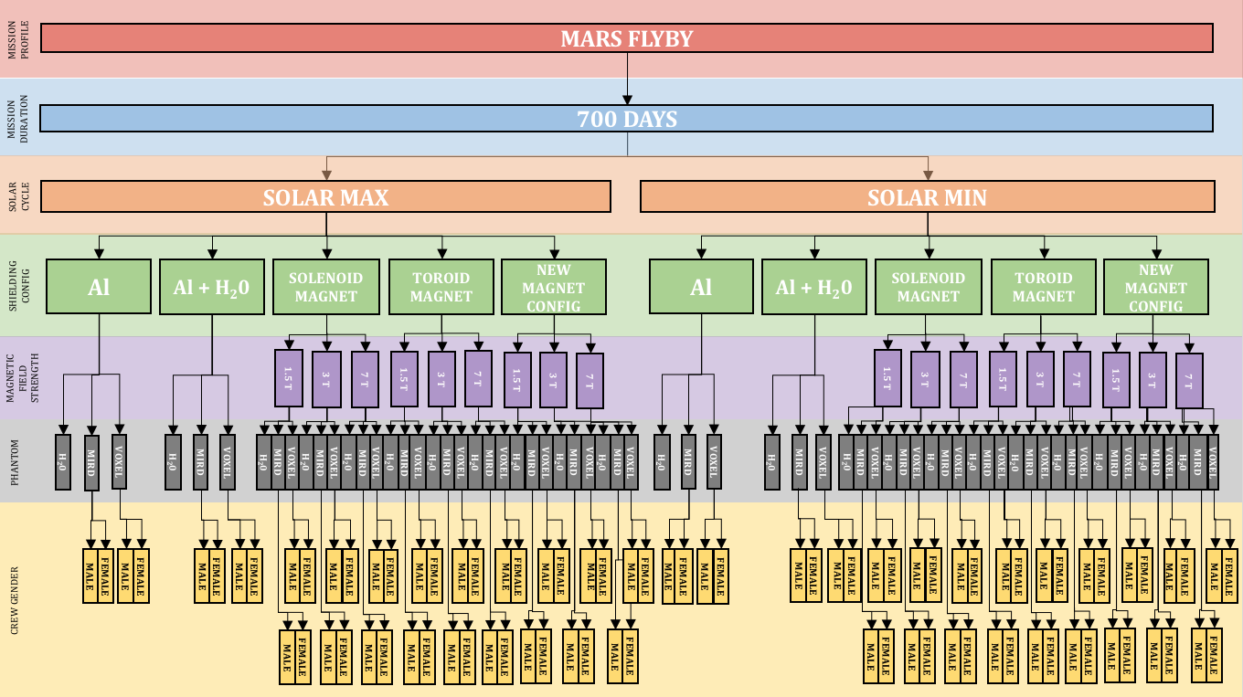
Trade Tree for SA1
Research Plan/Design
14

Slide 15
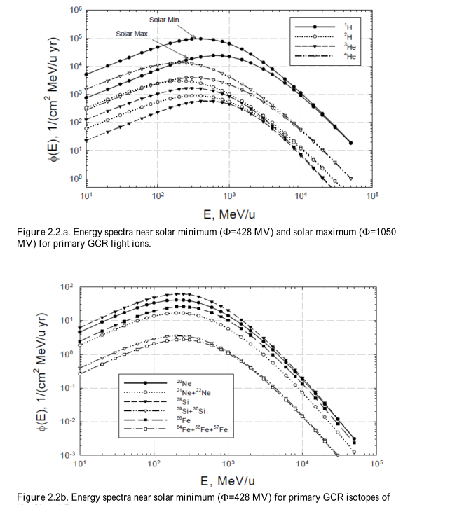
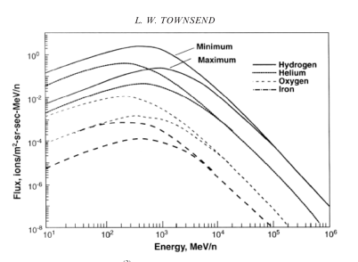
Modeling Space Radiation Environment
Experiments
Use NASA’s Badhwar-O’Neill model to calculate GCR flux at Earth/Mars vicinity
Plot GCR spectra; incorporate Forbush modulation for lower energy particles at solar max
GCR spectra from Cucinotta et al. 2011 (above) and Townsend 2005 (below)
Above: My GCR spectra calculated from NASA’s Badhwar-O’Neill model, with lower energy ions modulated by a factor of 2-10 for Forbush modulation at solar max

Slide 16
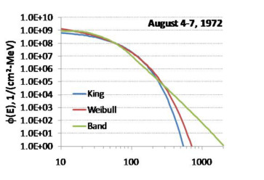
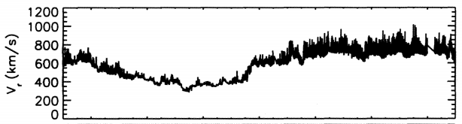

Modeling Space Radiation Environment
Experiments
Use historical solar activity data to calculate solar flare and solar wind flux at Earth/Mars vicinity; plot solar flare and wind spectra
Comparison solar flare spectra from Cucinotta et al. 2011 (above) and comparison solar wind time plot from 1976 from Roberts 2011 (below)
My solar flare spectra (above) and solar wind spectra (right) calculated from historical data and technical references
16

Slide 17
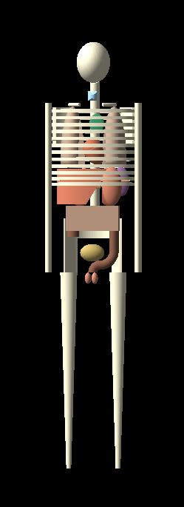
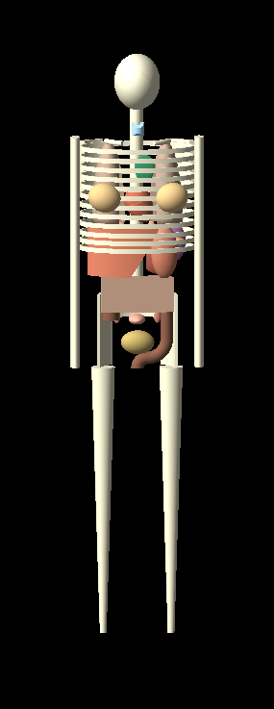
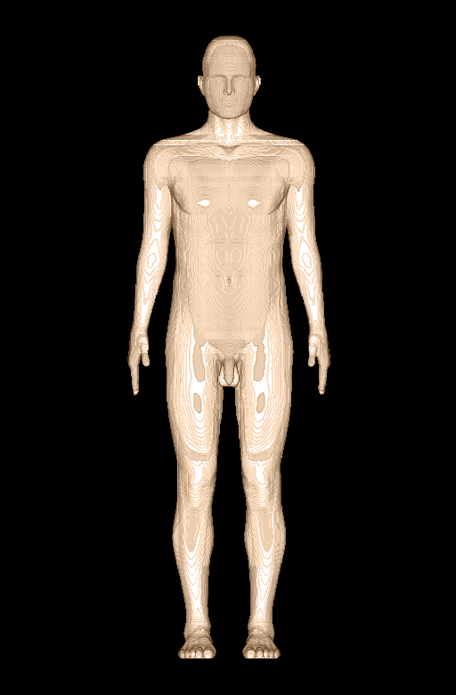
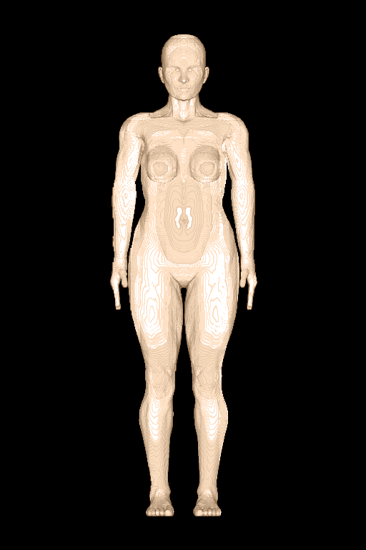
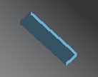
Modeling the Astronaut
Experiments
Compare effective dose in each scenario using three different types of phantoms: water, MIRD, and voxelized mesh.
Above: 70kg water phantom; center: MASH/FASH male and female voxelized phantoms; right: MIRD male and female phantoms
17

Slide 18
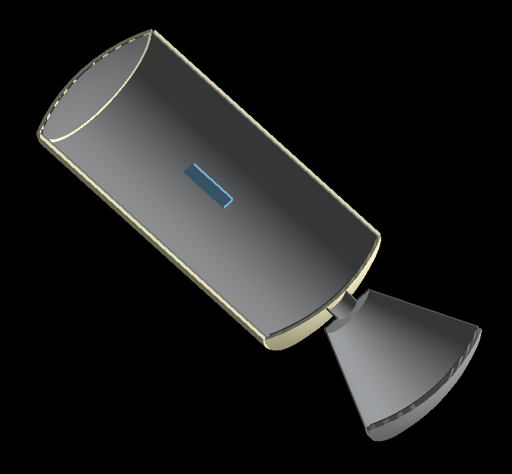
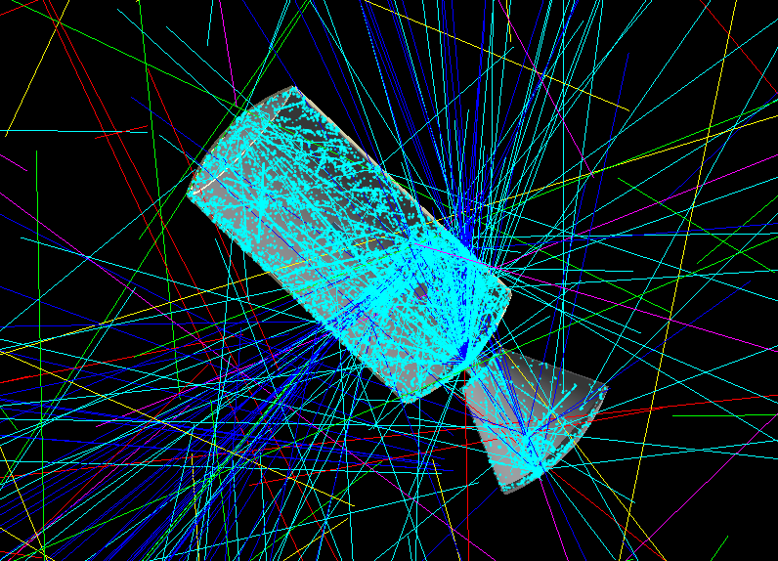
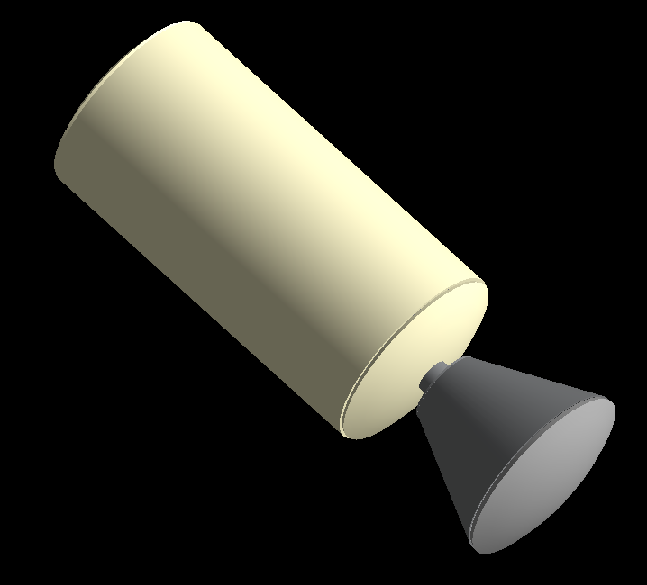
Baseline Geometry
Experiments
18

Slide 19
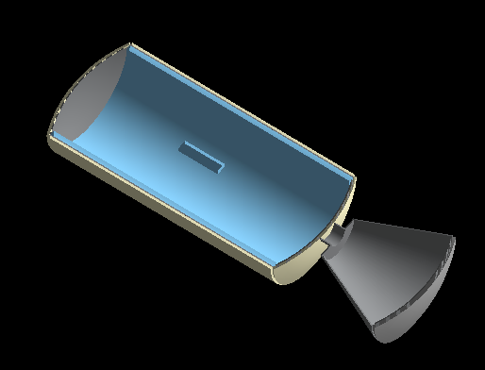
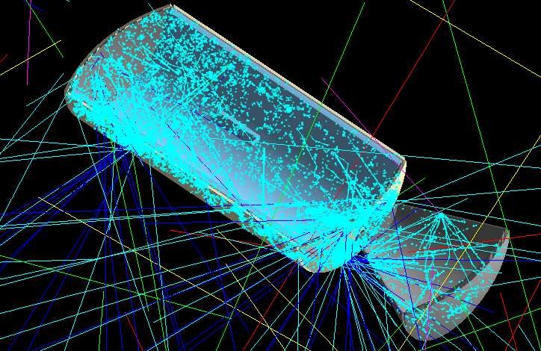
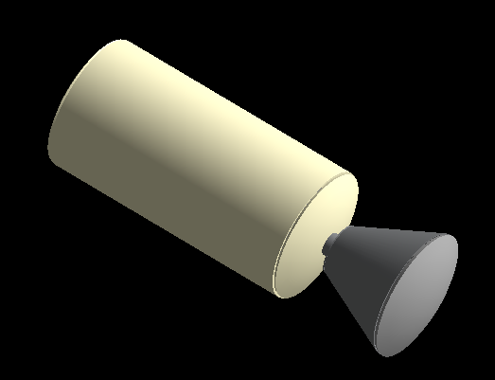
NASA Standard Water Wall Configuration
Experiments
19

Slide 20
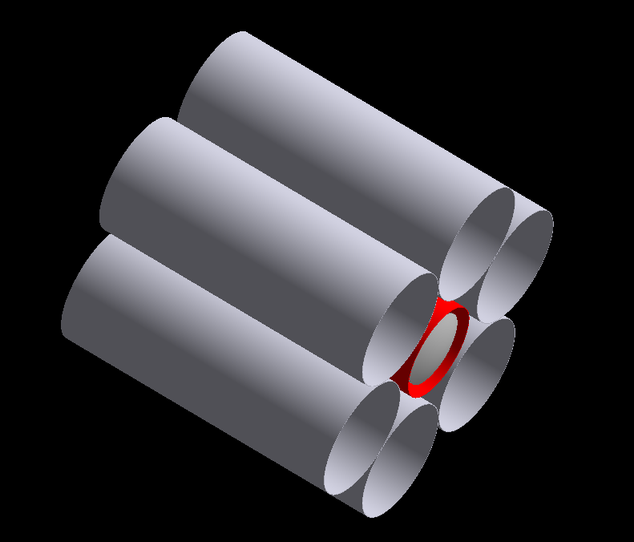
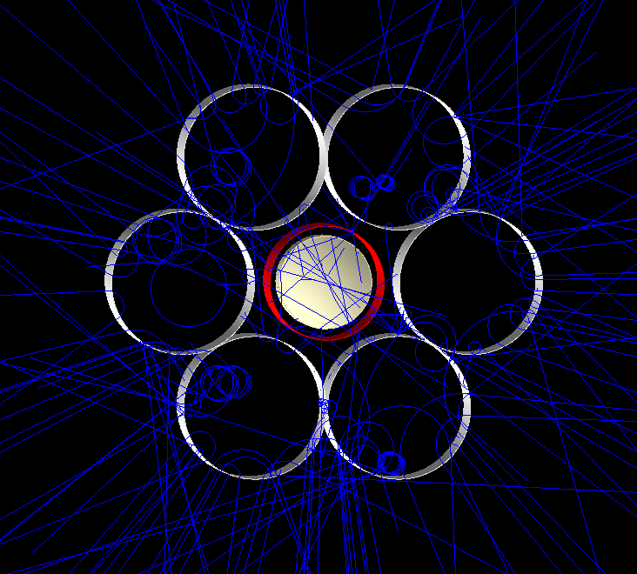
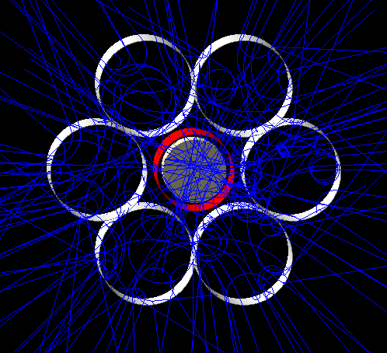
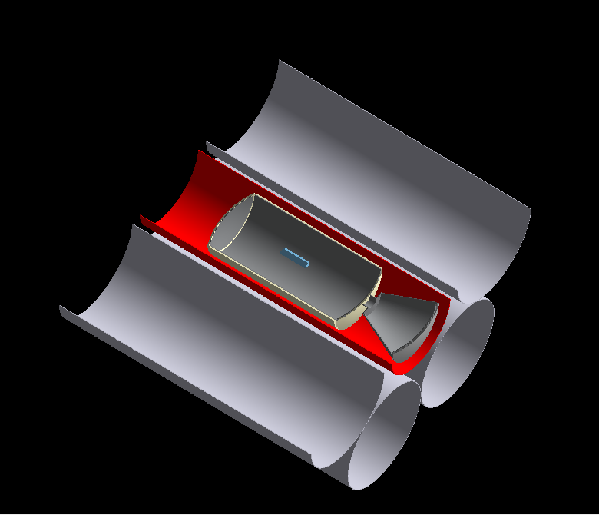
NASA 6+1 Solenoid Configuration
Experiments
20

Slide 21
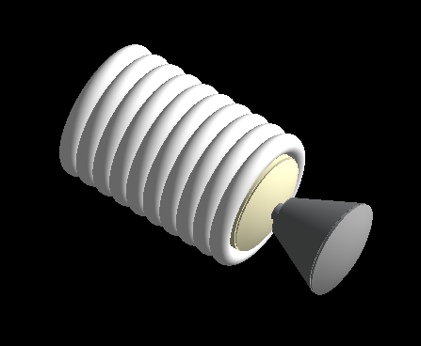
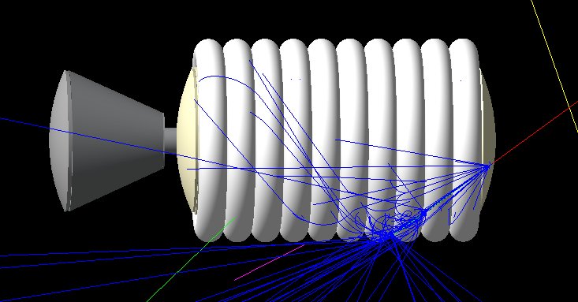
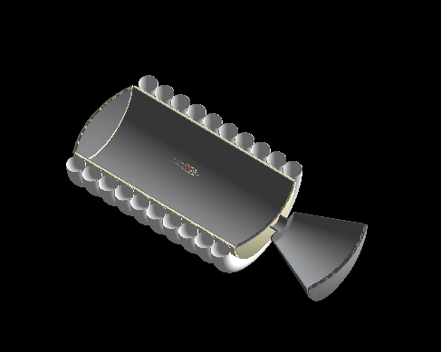
Toroid Configuration
Experiments
21

Slide 22
Model Validation via Beam Experiments
Experiments
GEANT4 SIMULATION
LABORATORY EXPERIMENT
Model PTC Proton Beam in Geant4
Model GMW 3472 Magnet in Geant4
Model Aluminum Shielding in Geant4
Model Zebra and Matrixx Detectors in Geant4
Permission to Use Zebra and/or Matrixx
Permission to Use GMW Magnet
Permission to Conduct Experiment at PTC
Transport Magnet to PTC
Magnet Field Map
Run Sim
Experiment set up including detectors
Schedule Beam Time
Collect Dosimetry in GEANT4
Run Exp
Collect Dosimetry from Detector SW
Compare Results from Geant4 and Beam Experiment
22

Slide 23
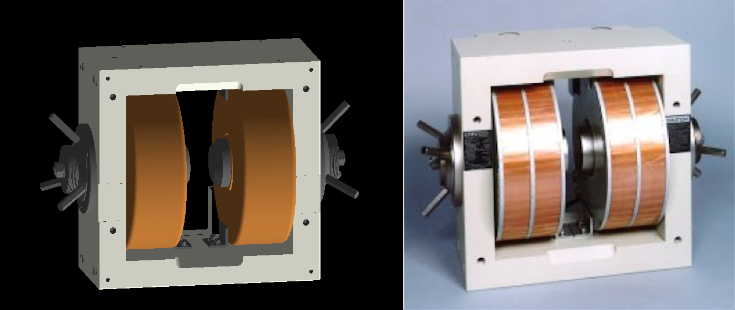
Model Validation via Beam Experiments
Experiments
Obtain 3D CAD Model of GMW-3472 Electromagnet from manufacturer’s website
Convert CAD model (.STEP) to .STL using FreeCAD
Convert .STL to .GDML using InStep (Windows)
Import GDML volumes to Geant4 using GDML schema
Separate volumes to apply individual attributes (e.g. material, color)
Geant4 screenshot of imported GMW-3472 electromagnet (left) and manufacturer’s photo (right)
23

Slide 24
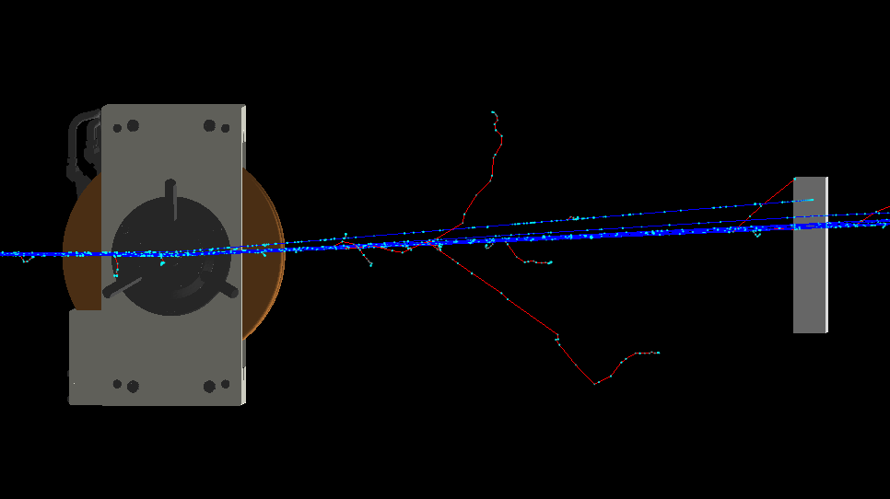
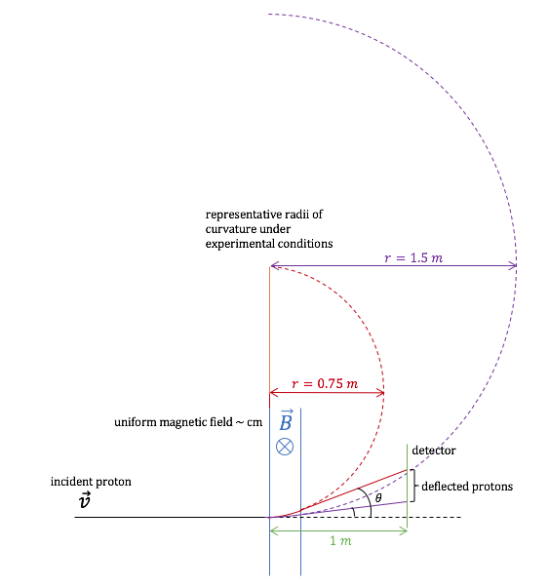
Model Validation via Beam Experiments
Experiments
Apply magnetic field between poles of simulated magnet
Run sim and verify proton deflection
1 m
Geant4 screenshot of 2T GMW3472 magnet deflecting 200 MeV proton beam (left), and first-order calculation of deflection angle of similar conditions in red (right)
24

Slide 25
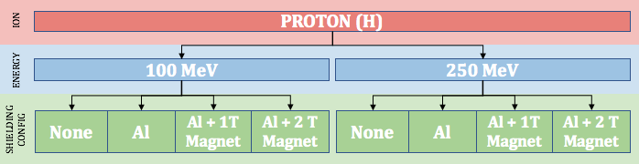
Model Validation via Beam Experiments
Experiments
Tree of experiment configurations for PTC measurements (below)

Slide 26
Initial Results
Results & Analysis
A previous NASA study reported an equivalent dose reduction from GCR and SPE of 50-60% in simulation with magnetic field strengths 1-2.5 T in a solenoid magnetic shield (Westover, 2014).
A recent European Space Agency concept study reported an effective dose reduction from GCR and SPE of approximately 60% in simulation with magnetic field strengths 1-4 T in a toroidal magnetic shield (Vuolo et al., 2016).
Another recent study reported effective dose reduction from SPE of 70-100% and from GCR of 1-55% in simulation with magnetic field strengths of 2-6 T in a toroidal magnetic shield (Geng et al., 2015).
These previous studies had several limitations on the fidelity of the simulations to the real space mission environment.
My early results indicate a reduction in cosmic ray dose of approximately 20% with water wall shielding and approximately 40% reduction in cosmic ray dose with magnetic shielding configurations at 1.5 T. Further simulations are in-work with field strengths of 3 T and 7 T for comparison. Further, dose from solar protons is almost completely eliminated with any magnetic shield of 1.5 T or greater.
26

Slide 27
Innovation
Results & Analysis
Conceptual Innovation
  First end-to-end Monte Carlo simulations of magnetic shielding, including physical models of the space environment, standard spacecraft models, industry standard human phantoms and dosimetry, and NASA cancer risk models
  First study to develop a Monte Carlo simulation of magnetic shielding all the way through to effective dose and cancer risk
Technical Innovation
  First prototype experiment to validate magnetic shielding simulation models
  First heavy ion beam experiments on simulated magnetic shielding; crucial because the interaction cross sections that form the basis of most Monte Carlo models are incomplete for heavy ions
27

Slide 28
Significance
Results & Analysis
The human spaceflight community needs tangible results and data on magnetic shielding to guide budgets and space policy over the next 10-20 years.
This project will provide detailed simulation data and experimental results to guide future investment and technology development strategy for magnetic shielding.
If successful, this project will lead to future engineering studies to determine technical feasibility and design specifications of magnetic shielding systems.
These magnetic shielding systems may enable missions to Mars, Jupiter, or asteroids that would be infeasible otherwise.
Fundamental findings on magnetic shielding may also have Earth-based radiation protection applications.
28

Slide 29
Next Steps
Complete simulations of all configurations, recording dose to three different phantoms (water, MIRD, voxelized)
Translate effective dose to cancer risk for interplanetary missions; compare scenarios across all variables
Conduct beam experiment to validate portions of the model
29

Slide 30
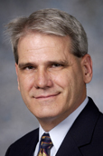
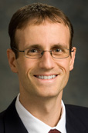

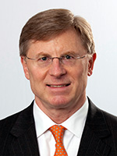
Thank you to my Advisory Committee
Committee Chair
Charles Willis, PhD
Associate Professor
Imaging Physics
MD Anderson
Co-Advisor
Stephen Kry, PhD
Associate Professor
Radiation Physics
MD Anderson
Jingfei Ma, PhD
Professor
Imaging Physics
MD Anderson
Fada Guan, PhD
Assistant Professor
Radiation Physics
MD Anderson
Leif Peterson, PhD
Professor
Bioinformatics & Biostatistics
Houston Methodist
30

Slide 31
References
L. Simonsen, NASA's Mission and Roadmap, presented to NASA Space Radiation Summer School, Upton, NY (2017).
D. Francisco, Human Risks for Exploration Missions, proceedings Aerospace Medical Association Conference, Orlando, Fla. (2015).
J. Huff, L. Carnell, S. Blattnig, L. Chappell, K. George, S. Lumpkins, L. Simonsen, T. Slaba, and C. Werneth, Evidence Report: Risk of Radiation Carcinogenesis, https://humanresearchroadmap.nasa.gov/evidence/reports/Cancer.pdf (2016).
G.A. Nelson, L. Simonsen, and J.L. Huff, Evidence Report: Risk of Acute (In-Flight) or Late Central Nervous System Effects from Radiation Exposure, https://humanresearchroadmap.nasa.gov/Evidence/reports/CNS.pdf (2016).
Z. Patel, J. Huff, J. Saha, M. Wang, S. Blattnig, H. Wu, Evidence Report: Risk of Cardiovascular Disease and Other Degenerative Tissue Effects from Radiation Exposure, https://humanresearchroadmap.nasa.gov/Evidence/reports/CNS.pdf (2016).
L. Carnell, S. Blattnig, S. Hu, J. Huff, M. Kim, R. Norman, Z. Patel, L. Simonsen, and H. Wu, Evidence Report: Risk of Acute Radiation Syndromes due to Solar Particle Events, https://humanresearchroadmap.nasa.gov/Evidence/reports/Acute.pdf (2016).
F. Diaz, J. Squire, R. Bengtson, et al., The Physics and Engineering of the VASIMR Engine, proceedings 36th AIAA/ASME/SAE/ASEE Joint Prop. Conf., Huntsville, Ala. (2000).
E. Semones, Living in a Radiation (Space) Field, proceedings Pumps and Pipes Conference, Houston, Tx. (2015).
NASA SBIR 2009 Phase I Solicitation: X4.01 Advanced Radiation Shielding Materials and Structures (2009).
NASA SBIR 2007 Phase I Solicitation: X6.03 Advanced Radiation Shielding Materials (2007).
R. Bamford, K.J. Gibson, A.J. Thornton, J. Bradford, R. Bingham, L. Gargate, L.O. Silva, R.A. Fonseca, M. Hapgood, C. Norberg, T. Todd, and R. Stamper, Plasma Phys. Control. Fusion (2008).
S.C. Westover, Magnet Architectures and Active Radiation Shielding Study (MAARS), NASA-TP-2014-217390 (2014).
M. Vuolo, M. Giraudo, R. Musenich, V. Calvelli, F. Ambroglini, W.J. Burger, and R. Battiston, Life Sci. Sp. Res. 8 22 (2016).
H. Kamerlingh Onnes, Leiden Comm. 120b, 122b, 124c (1911).
M. Tinkham, Introduction to Superconductivity, 2nd Ed., Dover Publications, Inc., Mineola, New York (1996).
N.C. Christofilos, Geophysics 45, 1144 (1959).
J.A. Van Allen, G. Ludwig, E. Ray, C.E. McIlwain, J. Jet Prop. 28, 588 (1958).
R. Levy, Radiation Shielding of Space Vehicles By Means of Superconducting Coils, USAF-RP-106 (1961).
G.V. Brown, Magnetic Radiation Shielding, proceedings from Int. Conf. High-Intensity Magn. Fields, Cambridge, Mass. (1961).
R.E. Bernert, J.J. Stekly, and E.D. Hoag, Magnetic Radiation Shielding Systems Analysis, NASA-CR-64915 (1964).
31

Slide 32
References
A. Bhattacharjie and I. Michael, AIAA J. 2, 2198 (1964).
R.C. Good, S.P. Shen, and N.F. Dow, Active Shielding Concepts for the Ionizing Radiation in Space, NASA-CR-58950 (1964)
P.F. McDonald and T.J. Buntyn, Space Radiation Shielding with the Magnetic Field of a Cylindrical Solenoid, NASA-TN-R-203 (1966).
A. Reetz and K. O'Brien (Eds.), Protection Against Space Radiation, NASA-SP-169 (1968).
W. Von Braun, Pop. Sci. 98 (1969).
J.F. Engelberger, Space Propulsion System, US Patent Number 3504868 (1970).
D.B. Sullivan (Ed.), The Role of Superconductivity in the Space Program: An Assessment of Present Capabilities and Future Potential, NASA-CR-158701 (1978).
D. Morozov, T. Riabova, K.A. Trukhanov, G.Z. Sedin, and V.V. Tsetlin, Some Aspects of Active Shielding Against the Radiation in Space, proceedings Int. Congress Prot. Against Accel. Sp. Radiat., Geneva, Switzerland (1971).
J.G. Bednorz and K.A Müller, Z. Physik B - Condensed Matter 64, 189 (1986).
G. Landis, in Space Manufacturing 8: Energy and Materials from Space (1991), pp. 383-386.
F.H. Cocks, J. Br. Interplanet. Soc. 44, 99 (1991).
J.S. Herring and B.J. Merrill, Magnetic Shielding for Interplanetary Spacecraft, proceedings 28th Sp. Congress, Cocoa Beach, Fla. (1991).
F.H. Cocks and S.A. Watkins, Magnetic Shielding of Interplanetary Spacecraft Against Solar Flare Radiation, NASA-CR-195539 (1993).
E.J. Hilinski and F.H. Cocks, J. Spacecraft 31, 342 (1994).
J.C. Cocks, S.A. Watkins, F.H. Cocks, and C. Sussingham, J. Br. Interplanet. Soc. 50, 479 (1997).
J.C. Sussingham, S.A. Watkins, and F.H. Cocks, J. Astronaut. Sci. 47, 165 (1999).
L.W. Townsend, Overview of Active Methods for Shielding Spacecraft from Energetic Space Radiation, proceedings 1st Int. Work. Sp. Radiat. Res. (2000).
P. Spillantini, M. Casolino, M. Durante, R. Mueller-Mellin, G. Reitz, L. Rossi, V. Shurshakov, and M. Sorbi, Radiat. Meas. 42, 14 (2007).
J.H. Adams, D.H. Hathaway, R.N. Grugel, J.W. Watts, T.A. Parnell, J.C. Gregory, and R.M. Winglee, Revolutionary Concepts of Radiation Shielding for Human Exploration of Space, NASA-TM-2005-213688 (2005).
L.W. Townsend, Radiat. Prot. Dosimetry 115, 44 (2005).
L.W. Townsend, Critical Analysis of Active Shielding Methods of Space Radiation Protection, proceedings IEEE Aerosp. Conf. 2005 (2005).
32

Slide 33
References
J.H. Heinbockel, et al., Comparison of Radiation Transport Codes, HZETRN, HETC, and FLUKA, Using the 1956 Webber SPE Spectrum, NASA-TP-2009-215560 (2009).
G. Neuberth and M. Westphal, US Patent 7898258 B2 (2011).
E.N. Parker, Sp. Weather (2005).
E.N. Parker, Sci. Am. 294, 40 (2006).
M. Durante, Life Sci. Sp. Res. 1, 2 (2014).
R.C. Singleterry, K. Bollweg, T. Martin, S. Westover, R. Battiston, W.J. Burger, and R. Meinke, A Launch Requirements Trade Study for Active Space Radiation Shielding for Long Duration Human Missions, NASA-TP-2015-218689 (2015).
NASA's Journey to Mars: Pioneering Next Steps in Space Exploration (2015).
Y. Kamide and A. Chian (Eds.), Handbook of the Solar-Terrestrial Environment, Springer, New York (2007).
F.A. Cucinotta, M.Y. Kim, and L.J. Chappell, Space Radiation Cancer Risk Projections and Uncertainties - 2012, NASA-TP-2013-217375 (2013).
M.A. Shea and D.F. Smart, Solar Phys. 127, 297 (1990).
S.E. Forbush, J. Geophys. Res. 74, 3451 (1969).
P. O'Neill, Adv. Space Res. 37, 1727 (2006).
NASA, Badhwar-O'Neill 2011 Galactic Cosmic Ray Flux Model Description, NASA-TP-2013-217376 (2013).
S. Golge, P. O'Neill, and T. Slaba, NASA Galactic Cosmic Radiation Environment Model: Badhwar-O'Neill (2014), proceedings 34th In. Cosmic Ray Conf., The Hague, The Netherlands (2015).
J.W. Wilson, J. Miller, A. Konradi, and F.A. Cucinotta, Shielding Strategies for Human Space Exploration, NASA-CR-3360 (1997).
F.A. Cucinotta, M.Y. Kim, and L.J. Chappell, Evaluating Shielding Approaches to Reduce Space Radiation Cancer Risks, NASA-TM-2012-217361 (2012).
F. Ambroglini, R. Battiston, and W.J. Burger, Front. Oncol. 6, (2016).
BEIR, Health Risks from Exposure to Low Levels of Ionizing Radiation: BEIR VII, Phase 2 (2006).
J. Chancellor, G. Scott, and J. Sutton, Life 4 491 (2014).
33

