Slide 1

Low energy ion measurements at comet 67P
With the rosetta DUAL Langmuir probe, Using SPIS
Fredrik Johansson frejon@irfu.se

Slide 2
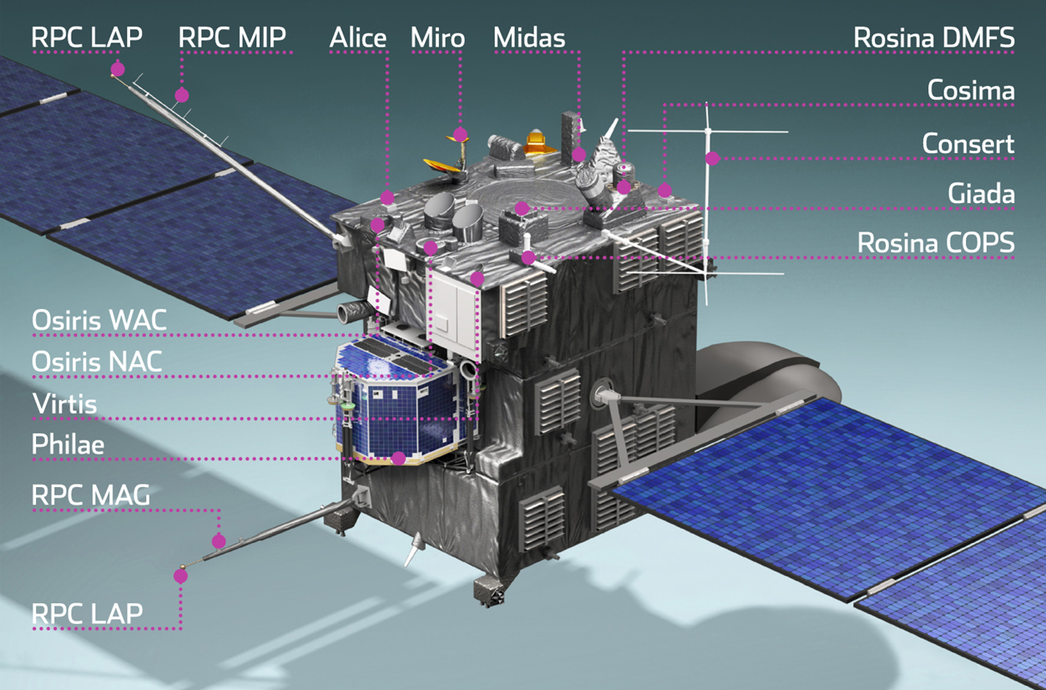
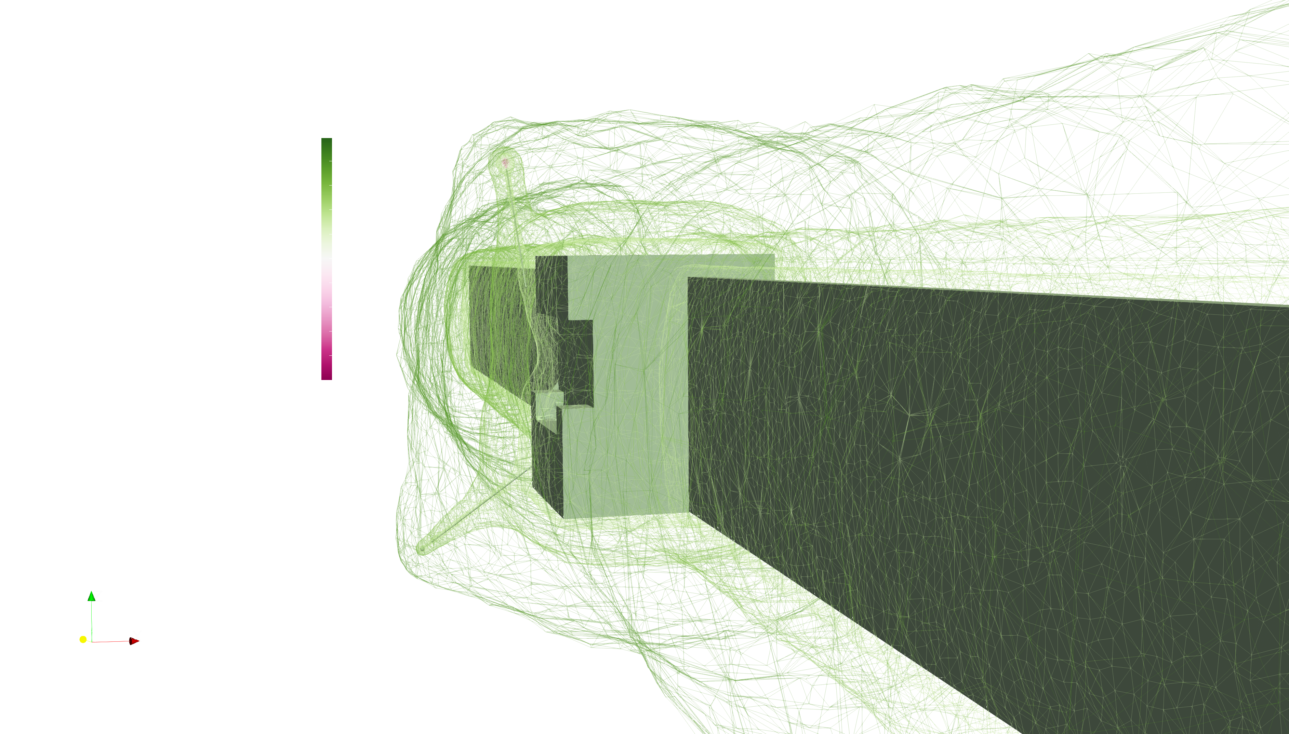
Rosetta & RPCLAP
The Langmuir Probes of Rosetta measures charged particles by varying potential to attract and repel positive and negative particles.
Measures density, temperature, ion flow speed, spacecraft potential V_{sc}, EUV flux
frejon@irfu.se

Slide 3
SPIS
Spacecraft-plasma interaction software
Simulate any plasma, any material. PIC, Maxwell-Boltzmann, others.
Spacecraft electronic circuitry
Secondary effects, photoemission
Open Source, developed by Onera, Artenum under ESA contract.
Can simulate a full Langmuir probe sweep experiment inside the simulation
frejon@irfu.se

Slide 4
Theory
U. Fahleson, C.-G. Fälthammar, and A. Pedersen, “Ionospheric temperaure
and density measurements by means of spherical double probes,”
Planet. Space Sci., vol. 22, pp. 41–66, 1974.
frejon@irfu.se

Slide 5
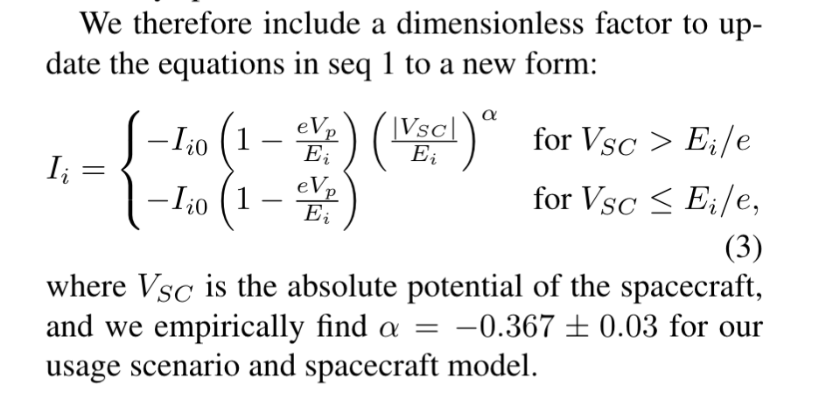
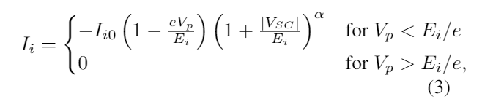
Theory
New Model
U. Fahleson, C.-G. Fälthammar, and A. Pedersen, “Ionospheric temperaure
and density measurements by means of spherical double probes,”
Planet. Space Sci., vol. 22, pp. 41–66, 1974.
frejon@irfu.se

Slide 6
The Problem
Two independent measurements indicate high cometary ion speeds, suggesting the ions are decoupled from the neutrals,
It has been shown [Vigren & Eriksson 2017] that even a small ambipolar electric field is enough to accelerate the ions and decouple them from the neutrals.
Resolving this problem tells us which mechanism is most important for the comet ionosphere.
Neutral gas outflow Velocity
See Poster P189 Today, Odelstad et al. 2018
frejon@irfu.se

Slide 7
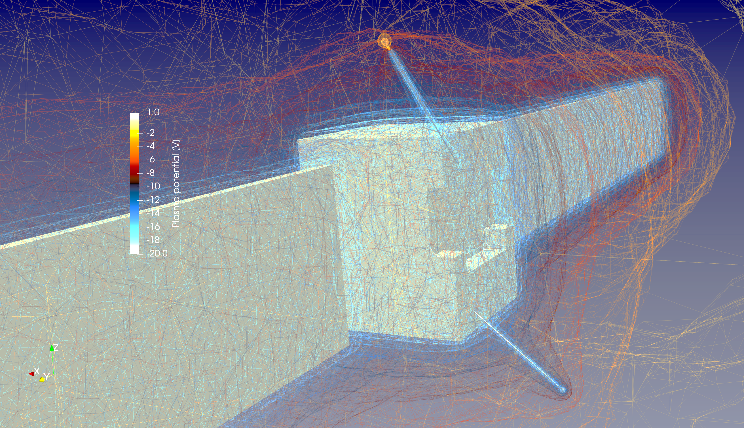
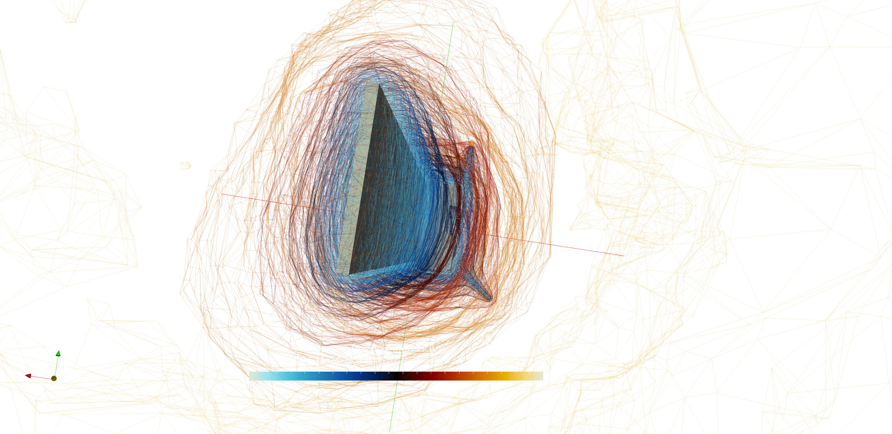
The Simulations
frejon@irfu.se

Slide 8
The Simulations
Probe completely within spacecraft potential profile
frejon@irfu.se

Slide 9
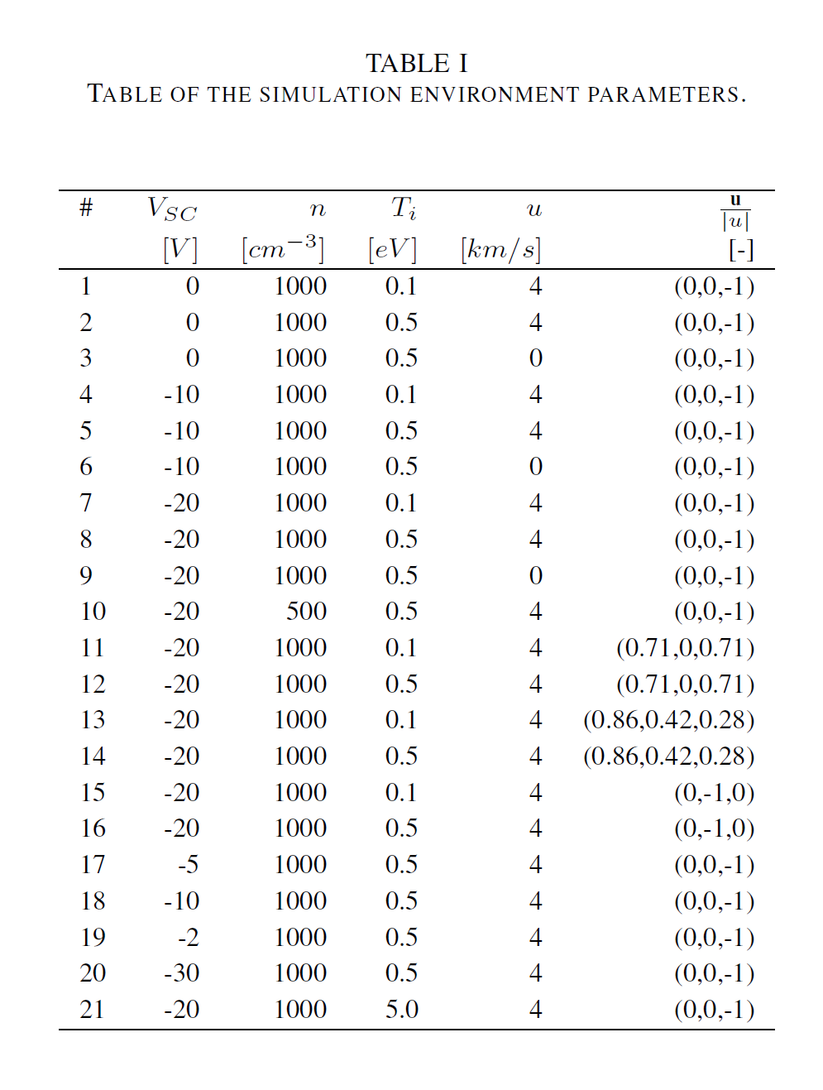
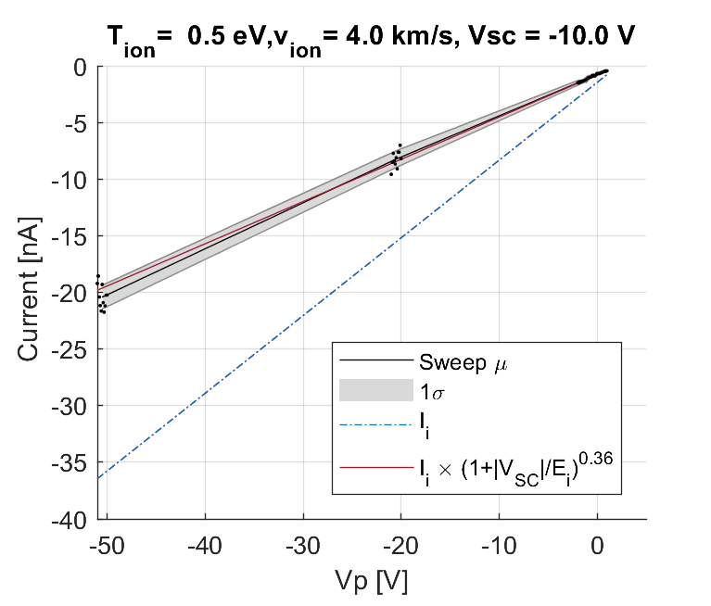
The Simulations
SPIS Simulation: ~ 2 Million PIC Ion macroparticles, M-B electron fluid , 40x40x60m box 400k Tetrahedrons mesh, 10 LP sweeps per simulation
SPIS Langmuir Probe sweep experiment: 200.000 particles back-tracked, 0.02 eV energy resolution
frejon@irfu.se

Slide 10
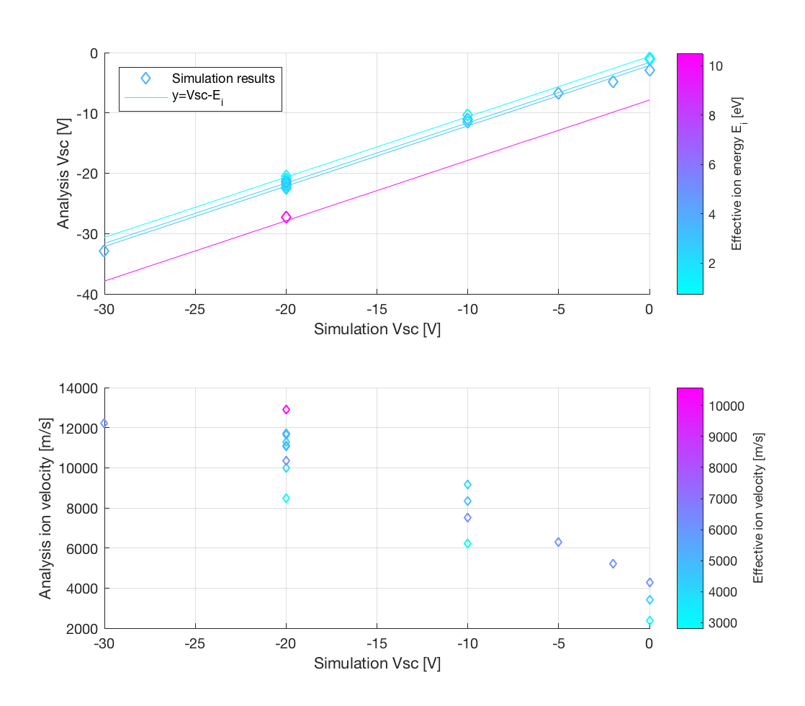
Results
frejon@irfu.se

Slide 11
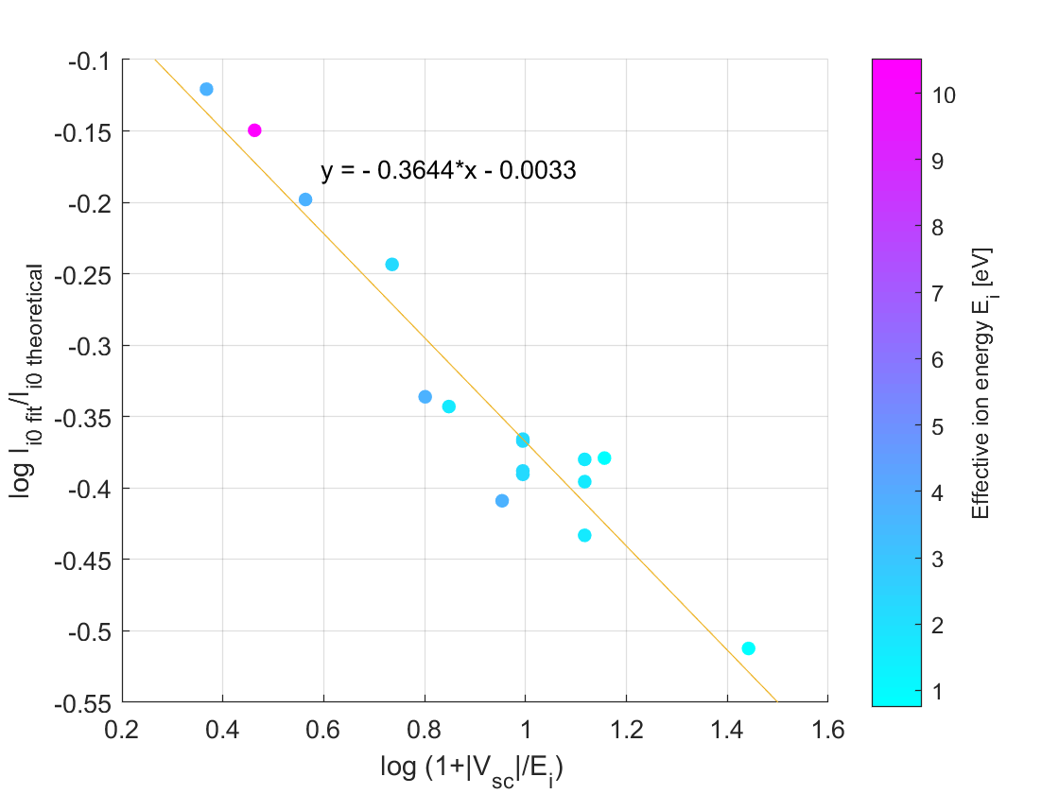
Results
Log-log plot of fraction of measured ion current and expected ion current from theory vs ratio of Spacecraft potential to ion energy, reveals a power law relation
α = -0.36 ± 0.03, used to construct new model.
Offset of the fit is negligibly close to 0 → safely ignore
frejon@irfu.se

Slide 12
Theory
New Model
U. Fahleson, C.-G. Fälthammar, and A. Pedersen, “Ionospheric temperaure
and density measurements by means of spherical double probes,”
Planet. Space Sci., vol. 22, pp. 41–66, 1974.
frejon@irfu.se

Slide 13
New model
Neutral gas outflow velocity
When the spacecraft potential is comparable to the ion energy, the theoretical model no longer holds as the ion trajectories are perturbed. Instead, we present a new model to predict measurements in this regime:
(1+|V_{sc}|/E_{i})^{α} behaves nicely at any value for E_{i}, V_{sc}, simply reduces to Eq 1 for V_{sc}/E_{i} → 0.
frejon@irfu.se

Slide 14
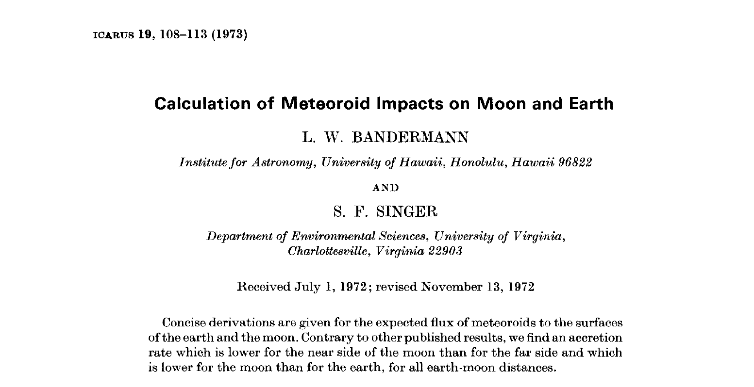
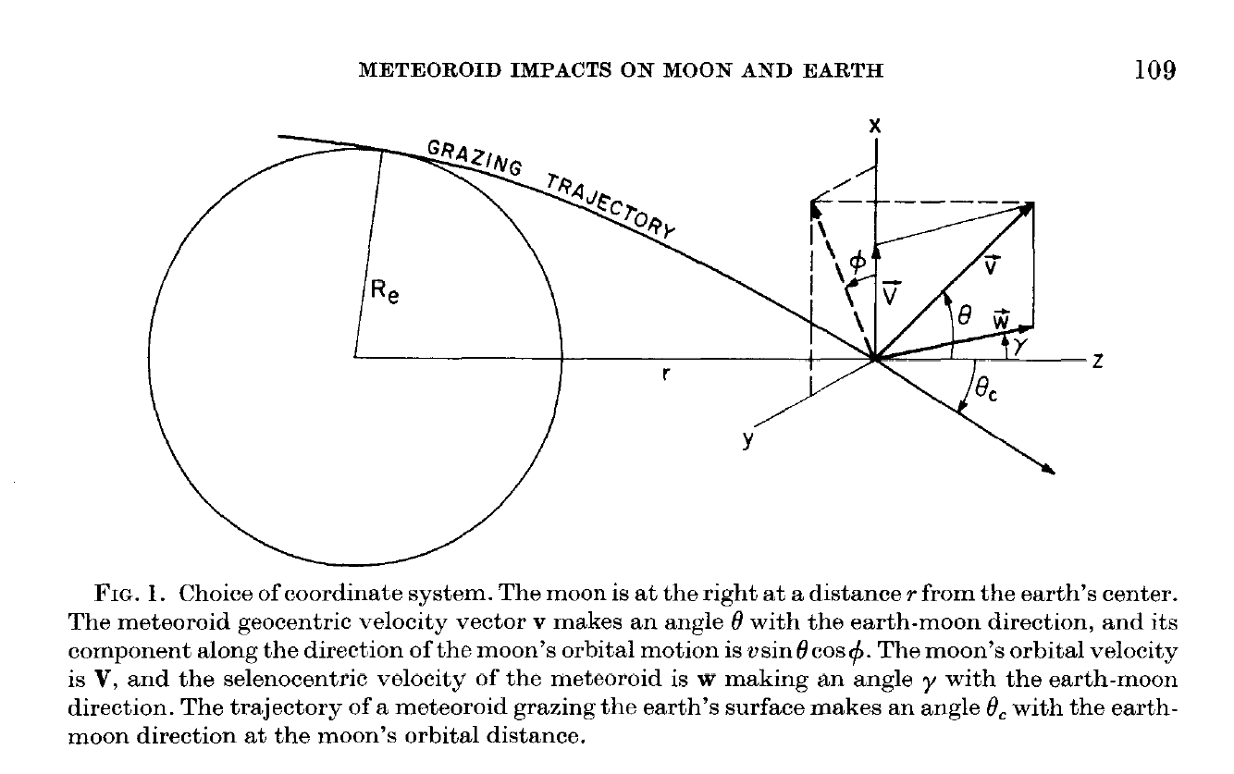
Has this been done before?
Gravitational analogy -> Meteroid impacts on Moon

Slide 15
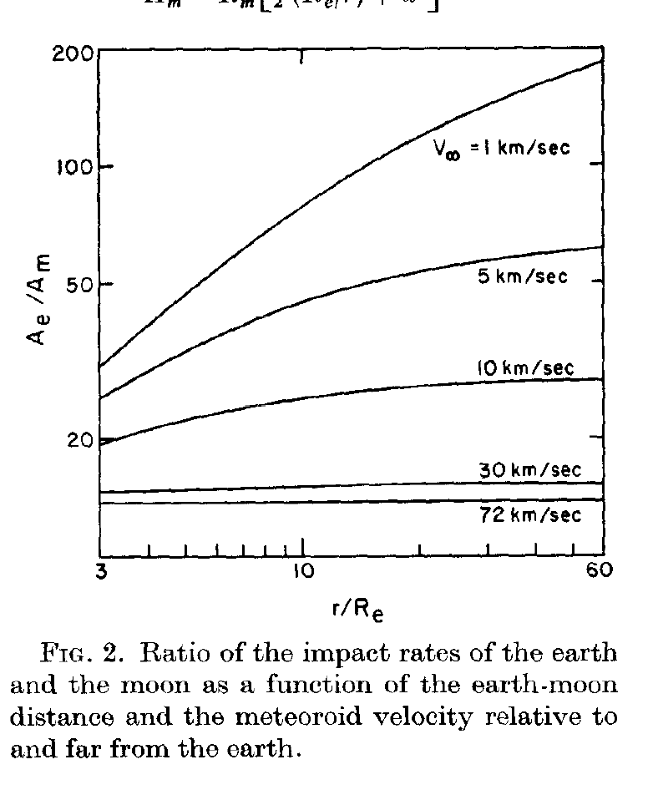
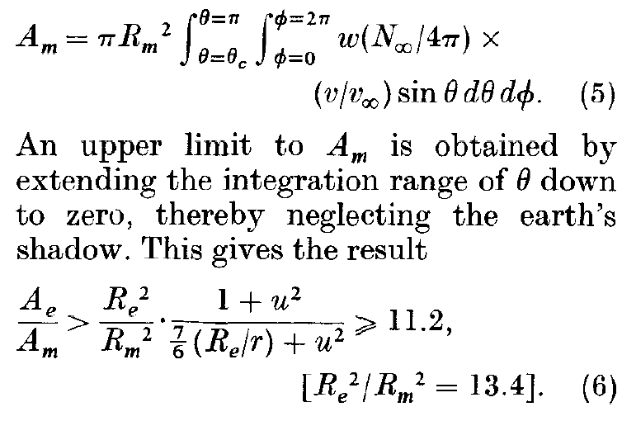
Has this been done before?
Gravitational analogy -> Meteroid impacts on Moon
13.4

Slide 16
Thank you
frejon@irfu.se

Slide 17
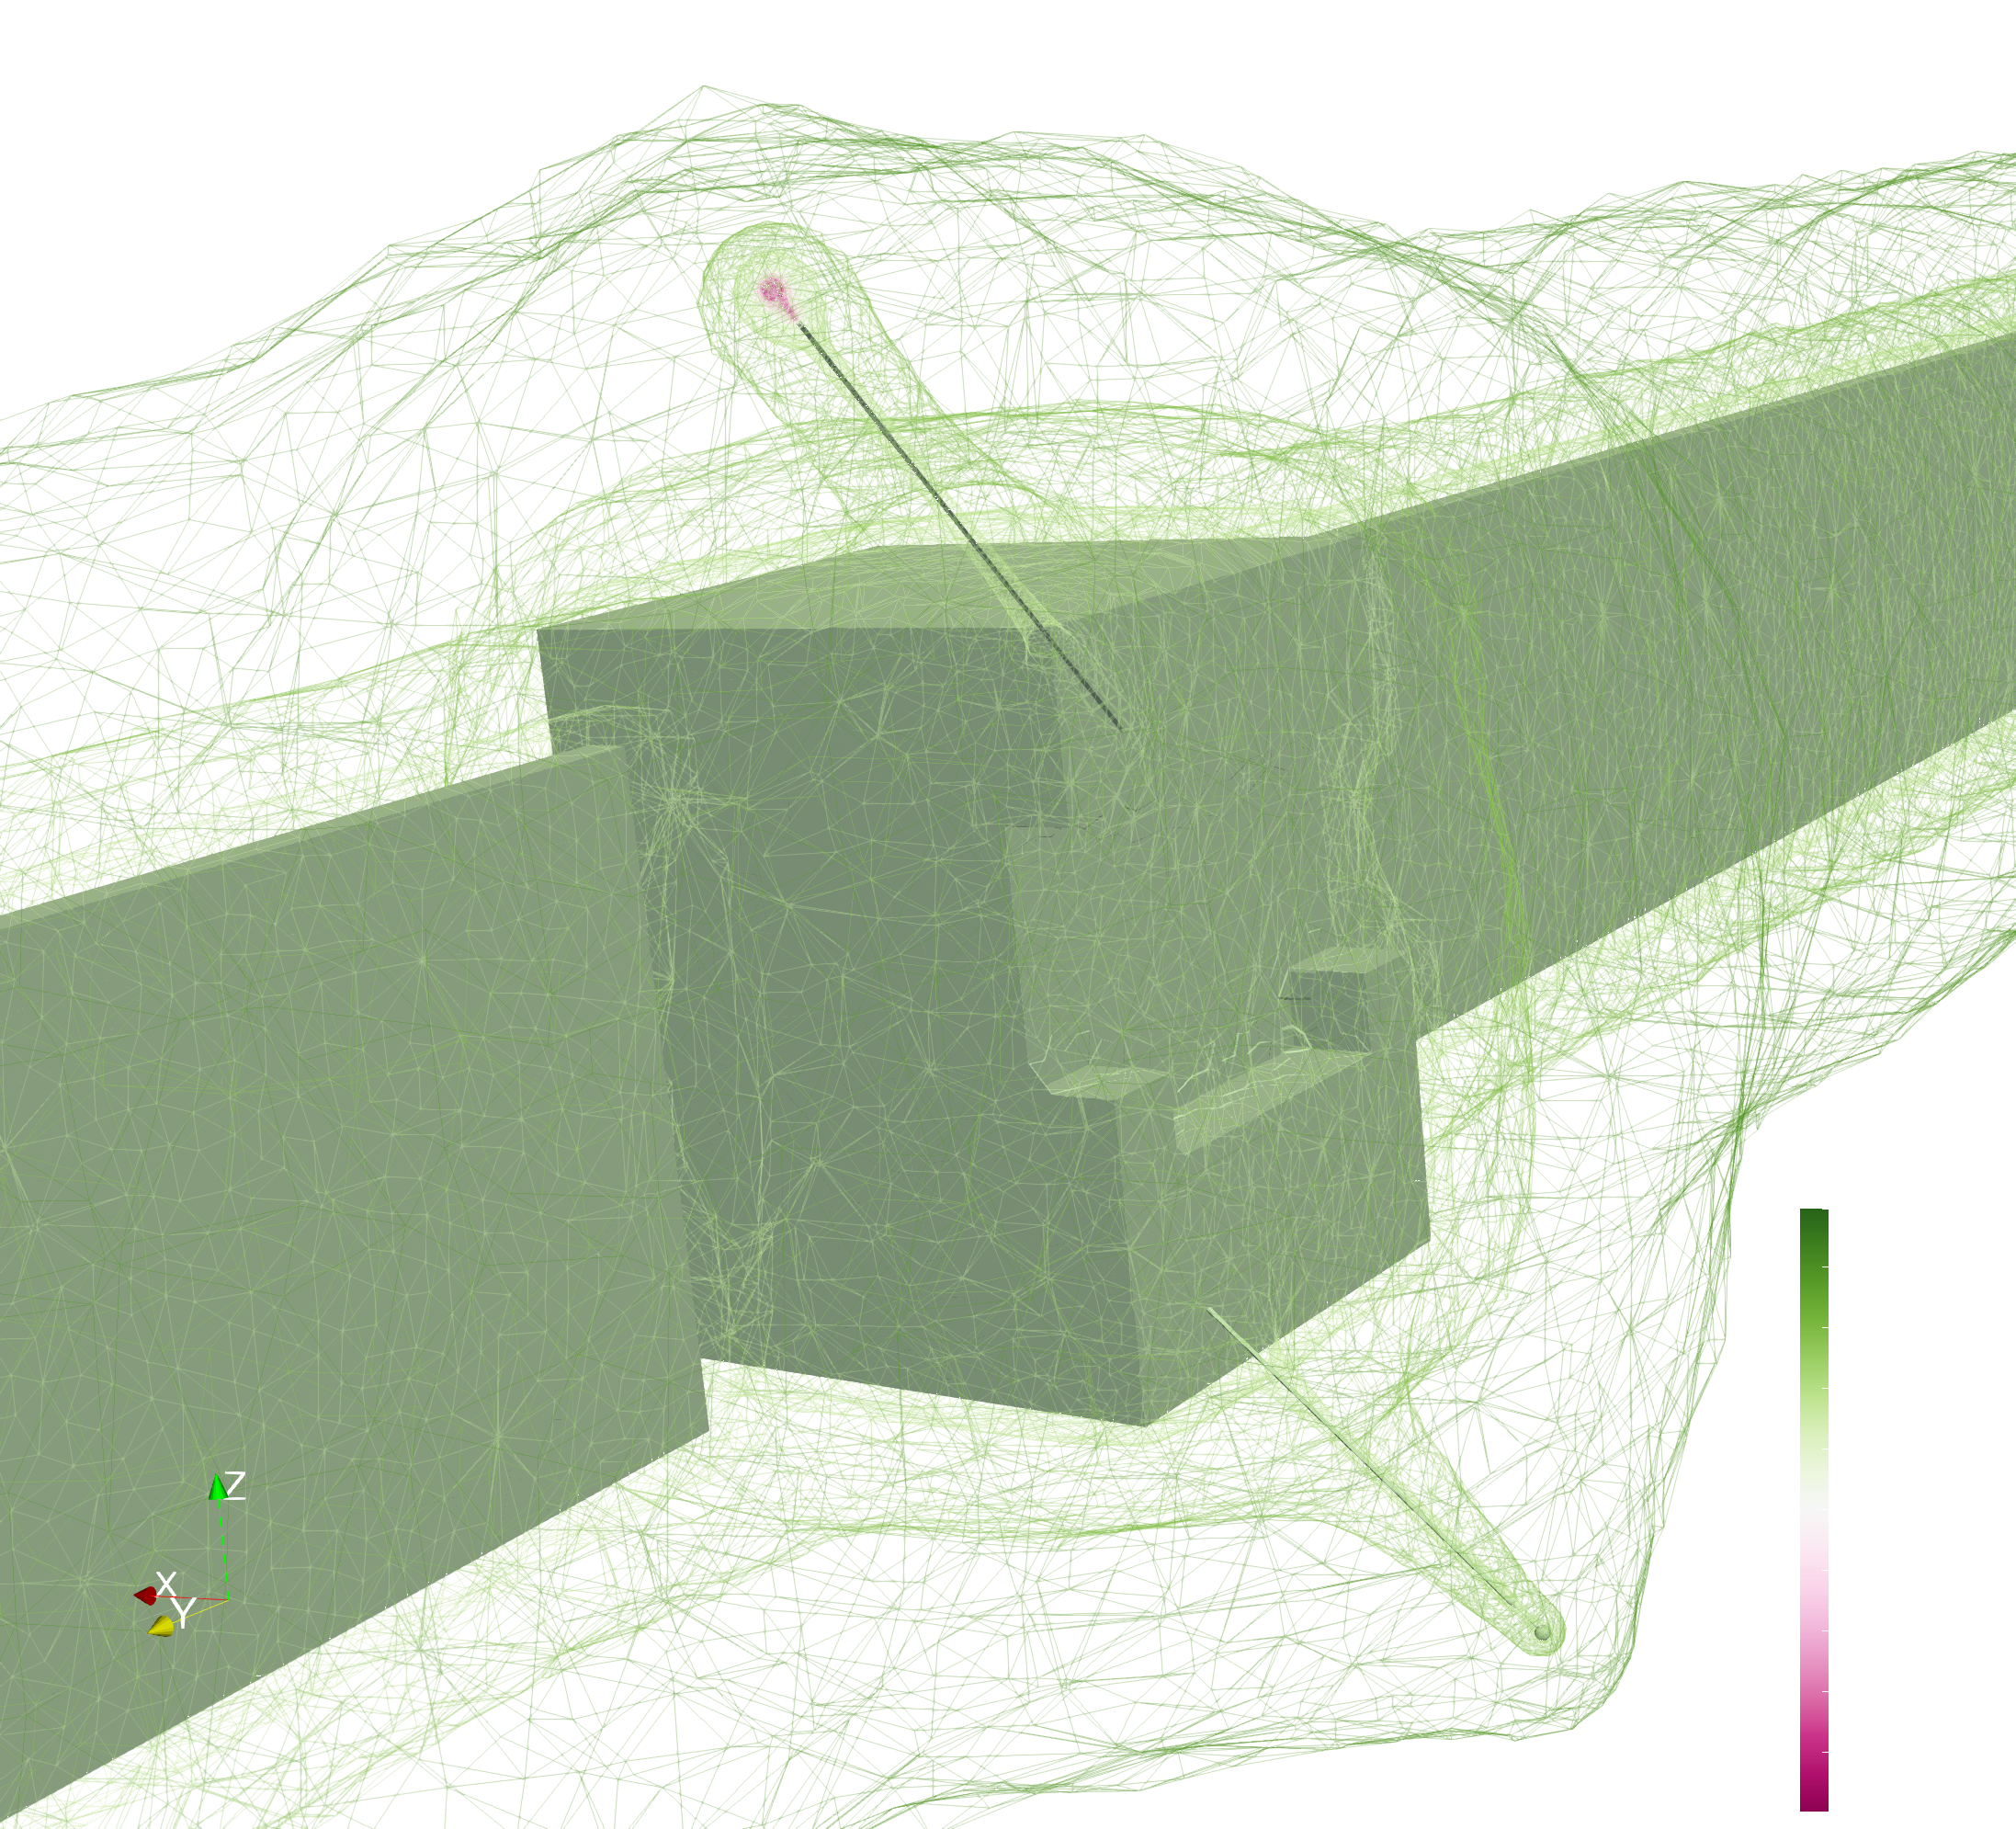
-50V_{p} Equipotential surface profile
frejon@irfu.se

Slide 18
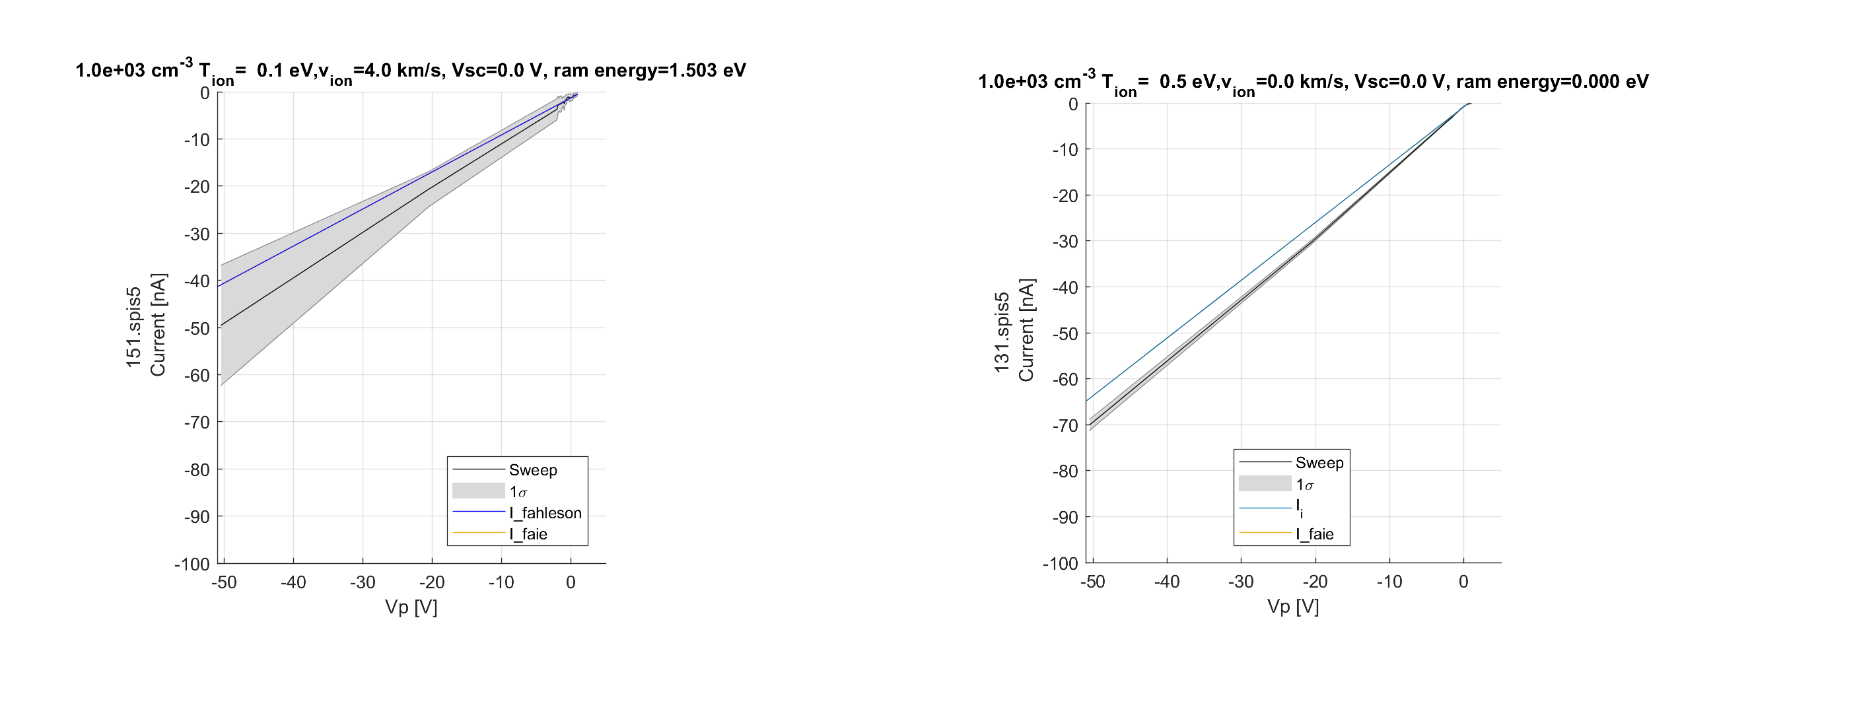
The Simulations
SPIS Simulation: ~ 2 Million PIC Ion macroparticles, M-B electron fluid , 40x40x60m box 400k Tetrahedrons mesh, 10 LP sweeps per simulation
SPIS Langmuir Probe sweep experiment: 200.000 particles back-tracked, 0.02 eV energy resolution
frejon@irfu.se

Slide 19
The Simulations
SPIS Simulation: ~ 2 Million PIC Ion macroparticles, M-B electron fluid , 40x40x60m box 400k Tetrahedrons mesh, 10 LP sweeps per simulation
SPIS Langmuir Probe sweep experiment: 200.000 particles back-tracked, 0.02 eV energy resolution
frejon@irfu.se

