Slide 1
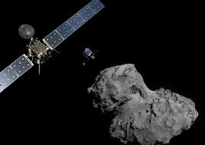
ROSETTA simulations on SPIS for DFMS ion measurements
G. Tcherniatinsky, J.J. Berthelier
LATMOS

Slide 2
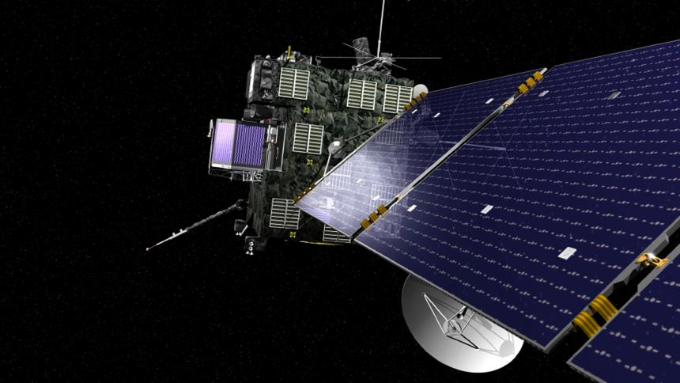
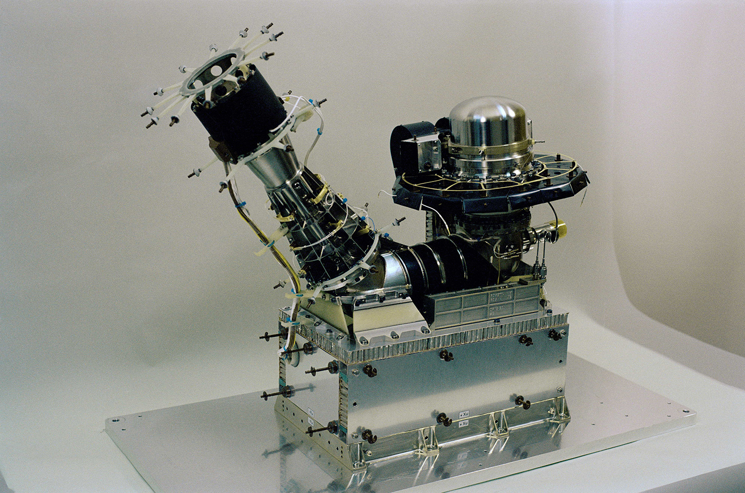
Context : ROSETTA mission and ROSINA mass spectrometer
Up to September in 2016, ROSETTA was an orbiter analyzing the coma of comet 67P.
ROSINA DFMS: instrument facing comet core and using magnetic mass spectrometer to separate masses with a resolution 1/3000 on neutrals.

Slide 3
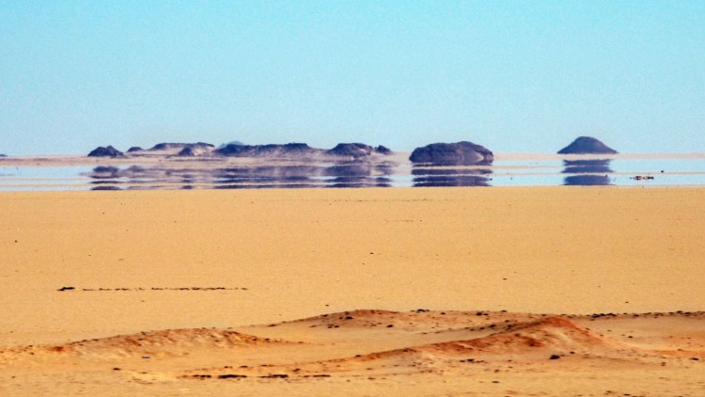
What does ROSINA DFMS really measures in ion mode ?
67P coma : density ~ 1000 part/cm³, electron temp ~ 7 eV → Spacecraft charging ~ -40/0 V
Ion mode : ions entering ROSINA DFMS have already been deflected by plasma sheath.
DFMS is looking straight in a « mirage » : we need to know how the field of view is deflected in ion mode before using its data.

Slide 4
Contents of the study
ROSETTA step-by-step modelization of the sheath using SPIS and study of the influence of each parameter (last presentation in 2017)
Presentation of the results of ROSETTA model.
Study of a sphere and a panel in the same plasma conditions : SPIS in a low ion temperature (0.025 eV).
SPIS issues and questions.

Slide 5
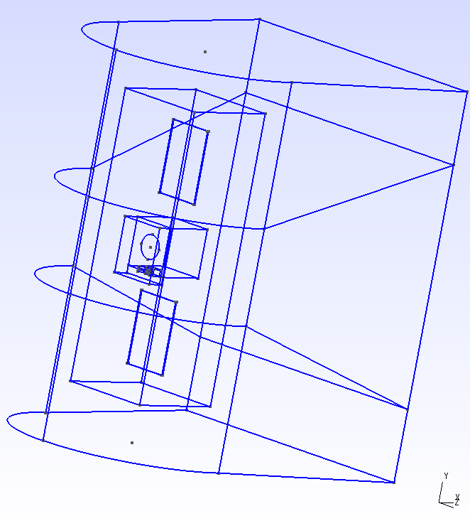
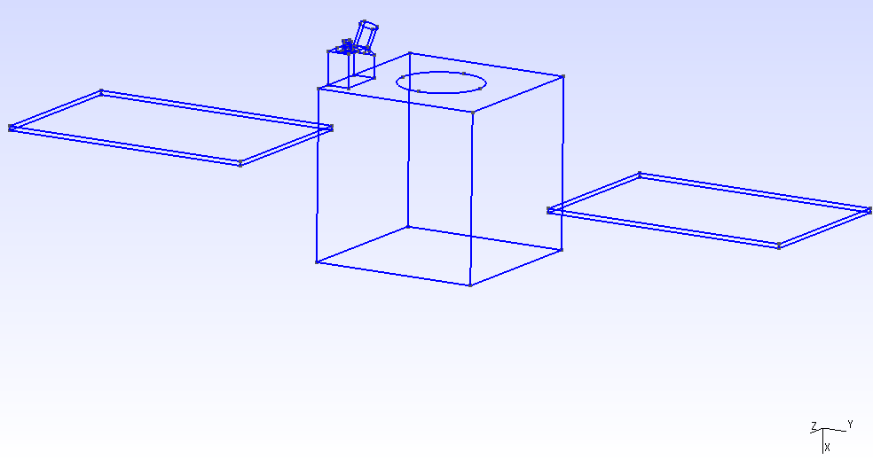
Geometrical model ROSETTA
NUMERICAL MODEL (1)
NUMERICAL MODEL (2)
Y
12m
9m
B2
2m
X
2.8m
3m
2m
B1
2m
Y
16m
Z
X
Z
B
R 5m

Slide 6
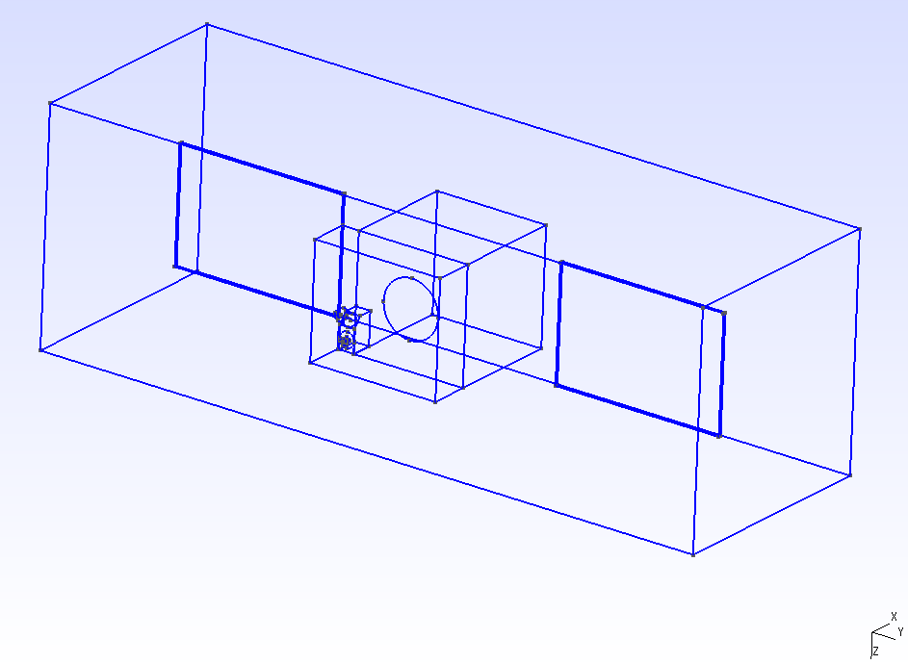
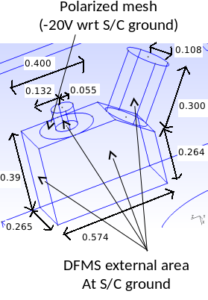
Geometrical model ROSETTA
NUMERICAL MODEL (3)
X
4m
2m
B1
B2
2.3m
0.7m
Y
12m
4m
Z

Slide 7
ROSETTA simulation description
Reducted size of solar panels (15 m to 3m). Effect studied on SPIS in last presentation: potential less negative of ~2V.
Verification with PIC models : equilibrium value of potential is almost the same.
Variation of parameters velocity, temperatures, densities, presence of photoelectrons.

Slide 8
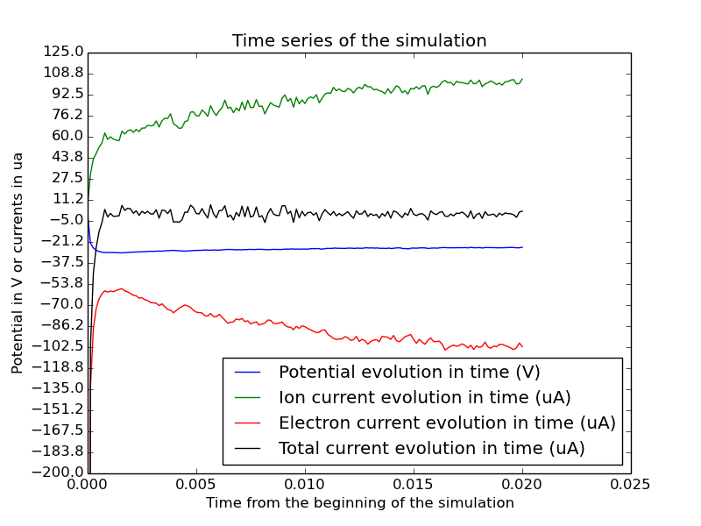
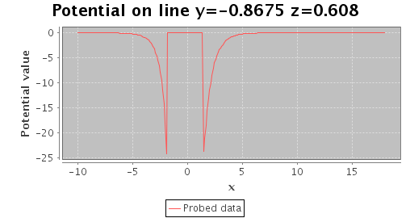
Electron model | Maxwell-Bolzmann
Density (part/m³) | 10⁹
Electron temp (eV) | 7
Ion temp (eV) | 0.0258
Velocity x axis (m/s) | 600
Solar power x axis (relative to 1UA power) | 0.0
Mesh size (m) | 0.6
Detector mesh size | 0.02
Duration (s) | 0.02
SimulationDt (s) | 1.0e-4
PlasmaDt (s) | 1.0e-4
Potential bias (V) | -20
Debye length (m) | 0.61
Equilibrium potential (V) | -26
Ion log density map normal Z
Potential map normal Z

Slide 9
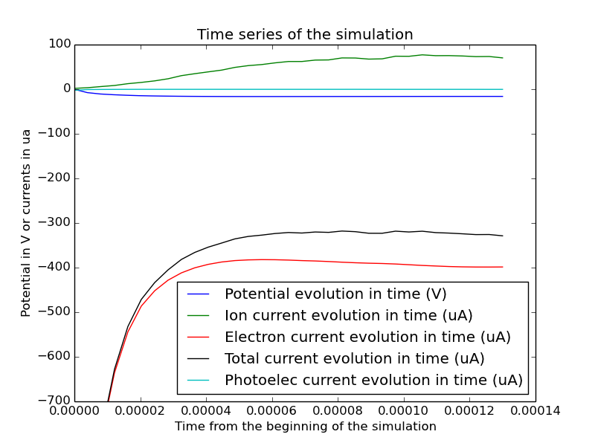
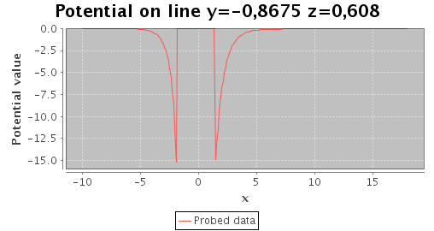
Electron model | Maxwell-Bolzmann
Density (part/m³) | 10⁹
Electron temp (eV) | 7
Ion temp (eV) | 0.0258
Velocity x axis (m/s) | 600
Solar power x axis (relative to 1UA power) | 0.6
Mesh size (m) | 0.6
Detector mesh size | 0.02
Duration (s) | 1.4e-4
SimulationDt (s) | 2.2e-7
PlasmaDt (s) | 2.2e-7
Potential bias (V) | -20
Debye length (m) | 0.61
Equilibrium potential (V) | -16
Ion log density map normal Z
Potential map normal Z

Slide 10
Study of simpler geometries to check our results
We observe that the ion current collected by spacecraft at equilibrium is larger than current entering external boundary. (55 uA against 100 uA)
Very low ion temperature (0.025 eV) in comparison with electron temperature (7 eV)
The results seems reasonable on ROSETTA, but become unreasonable on simpler geometries. Why ?

Slide 11
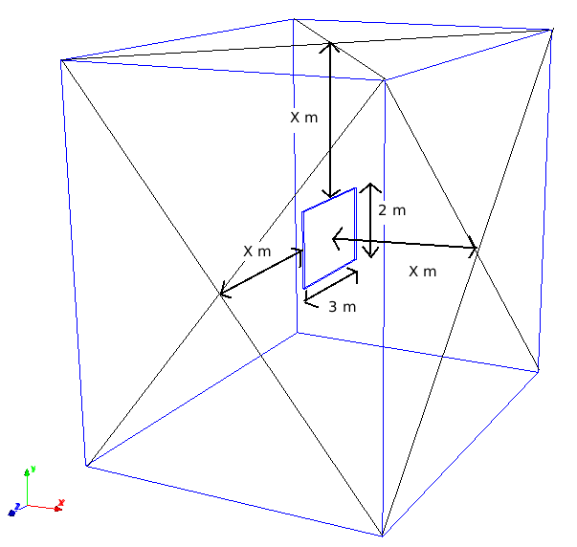
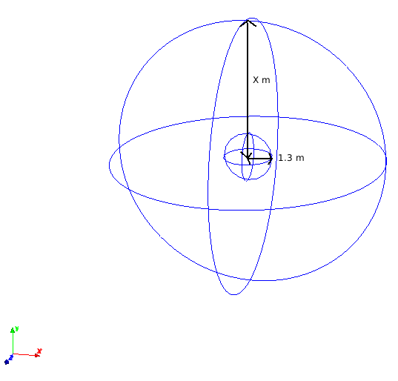
Geometrical models sphere & panel

Slide 12
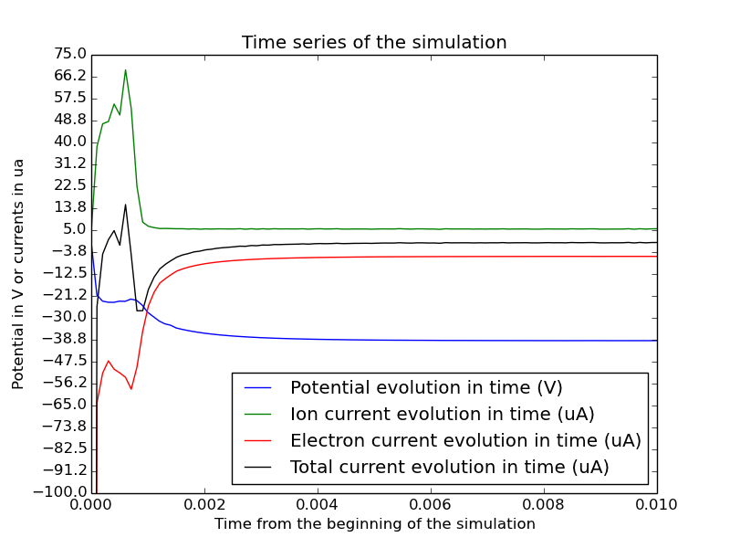
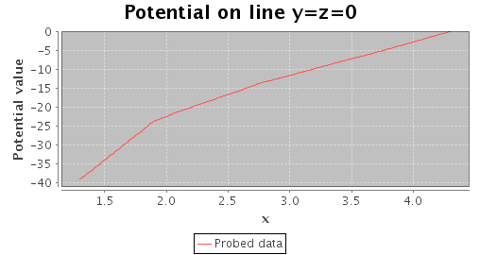
Electron model | Maxwell-Bolzmann
Density (part/m³) | 10⁹
Electron temp (eV) | 7
Ion temp (eV) | 0.0258
Velocity x axis (m/s) | 0
Solar power x axis (relative to 1UA power) | 0.0
Mesh size (m) | 0.6
Detector mesh size | 0.02
Duration (s) | 0.01
SimulationDt (s) | 1.0e-4
PlasmaDt (s) | 1.0e-4
Debye length (m) | 0.61
X (m) | 4.3
Potential map normal Z
Ion log density map normal Z

Slide 13
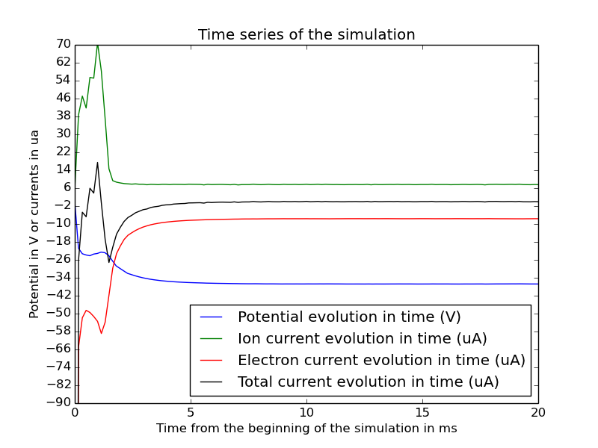
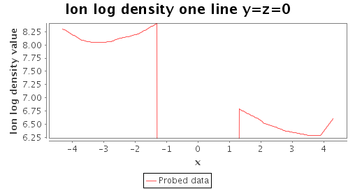
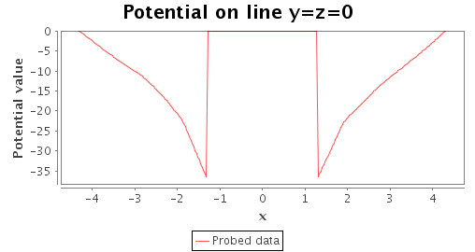
Electron model | Maxwell-Bolzmann
Density (part/m³) | 10⁹
Electron temp (eV) | 7
Ion temp (eV) | 0.0258
Velocity x axis (m/s) | 600
Solar power x axis (relative to 1UA power) | 0.0
Mesh size (m) | 0.6
Detector mesh size | 0.02
Duration (s) | 0.02
SimulationDt (s) | 1.0e-4
PlasmaDt (s) | 1.0e-4
Debye length (m) | 0.61
X (m) | 4.3
Ion log density map normal Z
Potential map normal Z

Slide 14
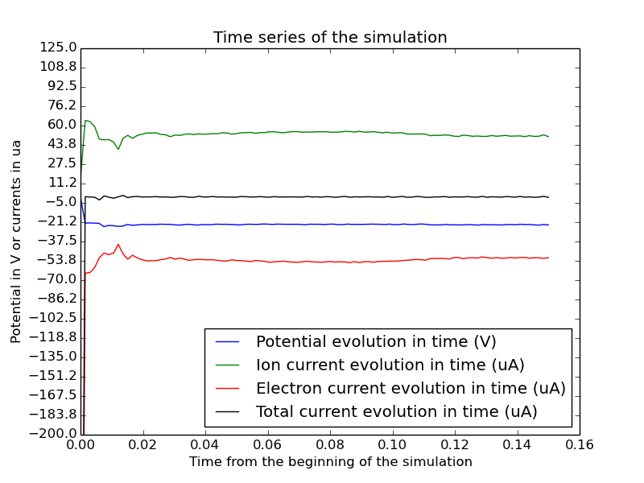
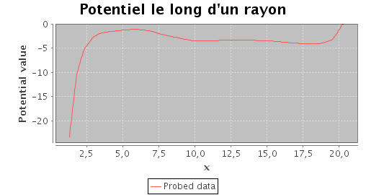
Electron model | Maxwell-Bolzmann
Density (part/m³) | 10⁹
Electron temp (eV) | 7
Ion temp (eV) | 0.0258
Velocity x axis (m/s) | 0
Solar power x axis (relative to 1UA power) | 0.0
Mesh size (m) | 0.6
Detector mesh size | 0.02
Duration (s) | 0.16
SimulationDt (s) | 1.0e-4
PlasmaDt (s) | 1.0e-4
Debye length (m) | 0.61
X (m) | 20.3
Ion log density map normal Z
Potential map normal Z

Slide 15
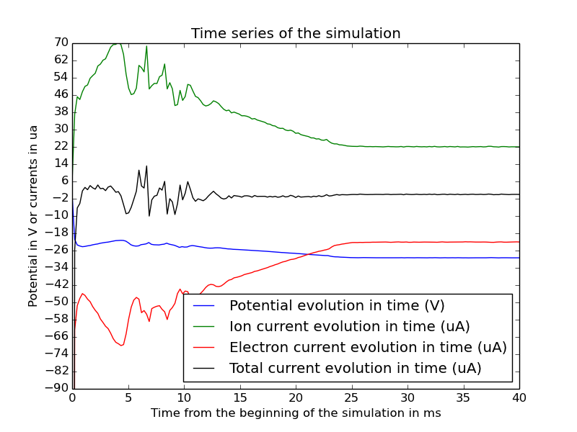
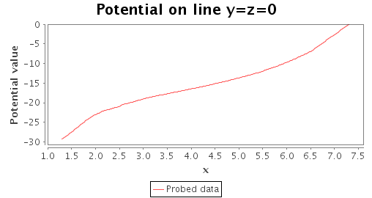
Electron model | Maxwell-Bolzmann
Density (part/m³) | 10⁹
Electron temp (eV) | 7
Ion temp (eV) | 0.0258
Velocity x axis (m/s) | 600
Solar power x axis (relative to 1UA power) | 0.0
Mesh size (m) | 0.6
Detector mesh size | 0.02
Duration (s) | 0.02
SimulationDt (s) | 1.0e-4
PlasmaDt (s) | 1.0e-4
Debye length (m) | 0.61
X (m) | 7.3
Ion log density map normal Z
Potential map normal Z

Slide 16
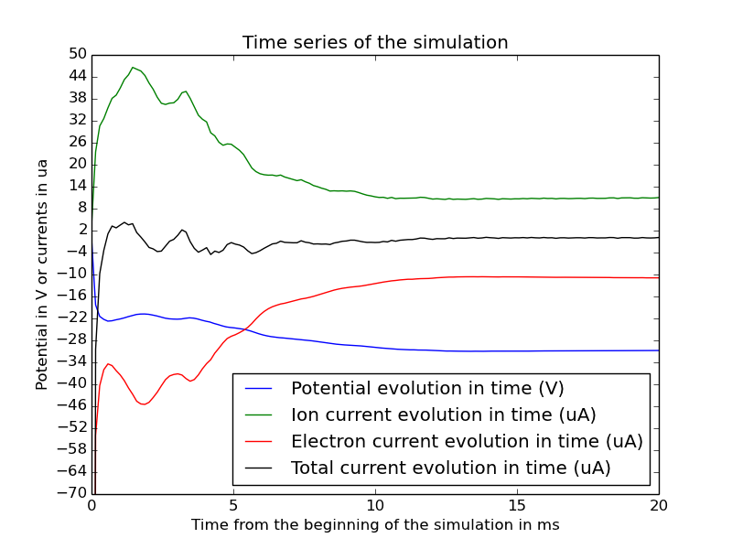
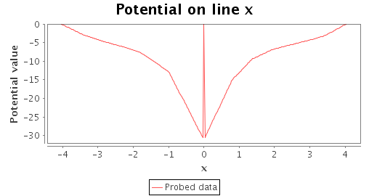
Electron model | Maxwell-Bolzmann
Density (part/m³) | 10⁹
Electron temp (eV) | 7
Ion temp (eV) | 0.0258
Velocity x axis (m/s) | 0
Solar power x axis (relative to 1UA power) | 0.0
Mesh size (m) | 0.6
Detector mesh size | 0.02
Duration (s) | 0.02
SimulationDt (s) | 1.0e-4
PlasmaDt (s) | 1.0e-4
Debye length (m) | 0.61
X (m) | 4.3
Ion log density map normal Z
Potential map normal Z

Slide 17
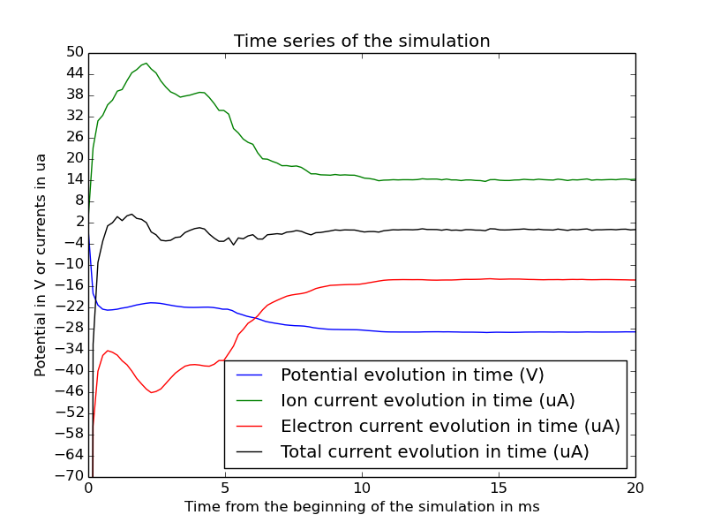
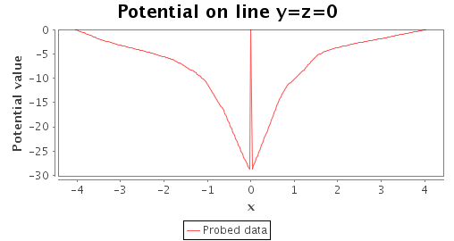
Electron model | Maxwell-Bolzmann
Density (part/m³) | 10⁹
Electron temp (eV) | 7
Ion temp (eV) | 0.0258
Velocity x axis (m/s) | 600
Solar power x axis (relative to 1UA power) | 0.0
Mesh size (m) | 0.6
Detector mesh size | 0.02
Duration (s) | 0.02
SimulationDt (s) | 1.0e-4
PlasmaDt (s) | 1.0e-4
Debye length (m) | 0.61
X (m) | 4.3
Ion log density map normal Z
Potential map normal Z

Slide 18
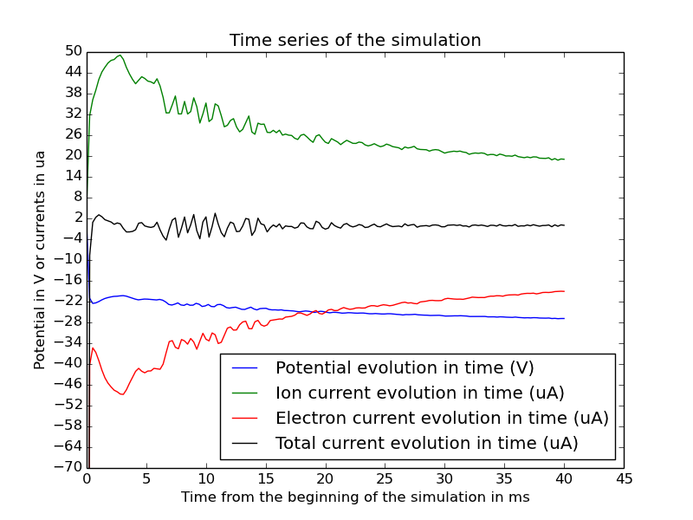
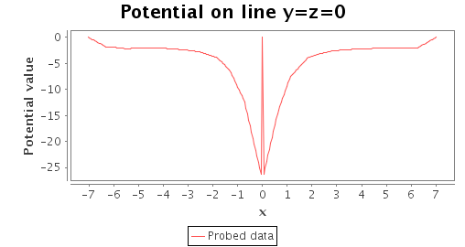
Electron model | Maxwell-Bolzmann
Density (part/m³) | 10⁹
Electron temp (eV) | 7
Ion temp (eV) | 0.0258
Velocity x axis (m/s) | 0
Solar power x axis (relative to 1UA power) | 0.0
Mesh size (m) | 0.6
Detector mesh size | 0.02
Duration (s) | 0.04
SimulationDt (s) | 1.0e-4
PlasmaDt (s) | 1.0e-4
Debye length (m) | 0.61
X (m) | 7.3
Potential map normal Z
Ion log density map normal Z

Slide 19
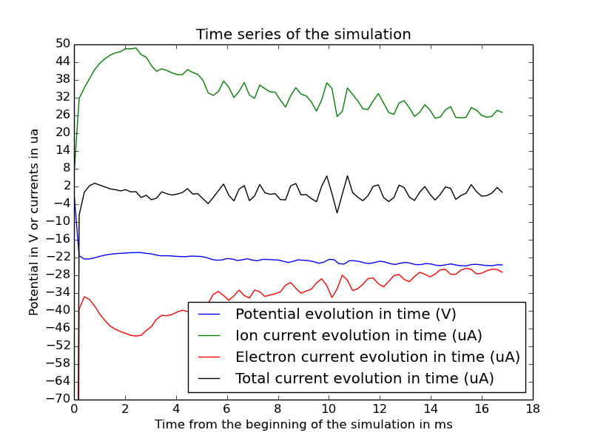
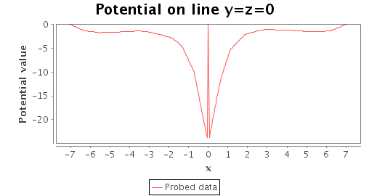
Electron model | Maxwell-Bolzmann
Density (part/m³) | 10⁹
Electron temp (eV) | 7
Ion temp (eV) | 0.0258
Velocity x axis (m/s) | 600
Solar power x axis (relative to 1UA power) | 0.0
Mesh size (m) | 0.6
Detector mesh size | 0.02
Duration (s) | 0.0168
SimulationDt (s) | 1.0e-4
PlasmaDt (s) | 1.0e-4
Debye length (m) | 0.61
X (m) | 7.3
Ion log density map normal Z
Potential map normal Z

Slide 20
Conclusions
Velocity is not the only factor that permits the presence of an asymptote on the sheath for low ion temperatures.
The plane shape does not allow us to get an asymptote for the potential near the external boundary.
We observe a potential floor of ~-4V when external surface is high enough.
We observe an asymptote for ROSETTA sheath but not for simpler geometries : Why ?

Slide 21
Questions
Very cold ions in SPIS : do you observe larger sheaths ? How do you solve this issue ?
Possibility to restart a simulation from a registered intermediate state ?
Huge difference of plasmaDt when using Boltzmann models for electron population. Do you use very low plasmaDt on Boltzmann ?
Precise documentation of the model ?
→ How PIC particles are generated ? (On time steps ? On nodes?)
→ How electron current is computed at each simulationDt when we use Boltzmann model ?
→ How global parameters boundary conditions work ?

