Slide 1
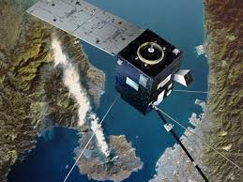
Simulation of Langmuir probes measurements in magnetic fields for DEMETER
G.Tcherniatinsky, J.J. Berthelier

Slide 2
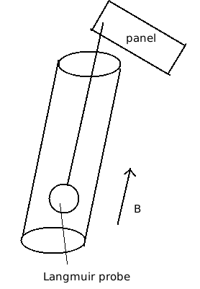
Situation
How the current/voltage curves are influenced by the presence of a magnetic field ?
Later : how does the presence of a panel to block part of the incoming current influences the measurements ?

Slide 3
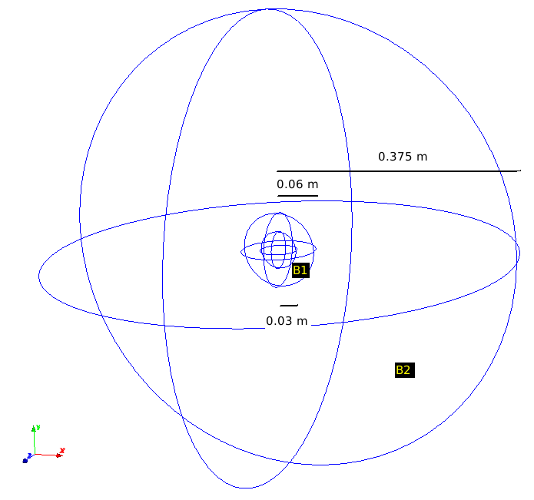
SPIS geometrical model
B1 mesh size : 5 mm
B2 mesh size : 5mm to 34.5 mm
Debye length : 34.5mm
Giration radius when magnetic field : ~30mm

Slide 4
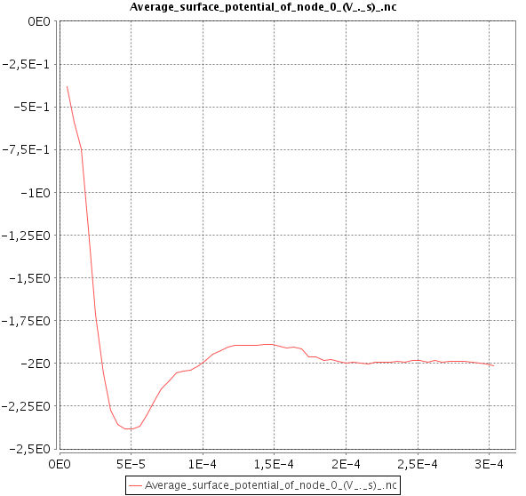
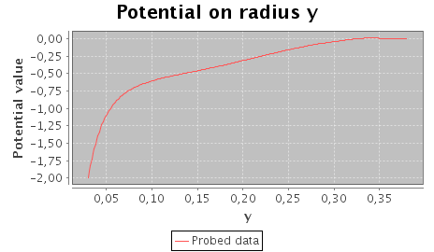
Electron model | PIC
Density (part/m^3) | 1.0e10
Electron temperature (eV) | 0.22
Ion temperature (eV) | 0.17
Velocity along x axis (m/s) | 0
Sphere radius (m) | 0.03
External box radius (m) | 0.375
B1 mesh size (m) | 0.005
B2 mesh size (m) | 0.0345
Duration (s) | 5.0e-4
simulationDt(s) | 2.2e-7
plasmaDt(s) | 2.2e-7
electronDt(s) | 2.0e-8
ionDt(s) | 2.2e-7
Csat(F) | 3.0e-12
Magnetic field along z axis (T) | 0.0
Spacecraft potential mode | floating
Potential map normal X
Ion log density map normal X

Slide 5
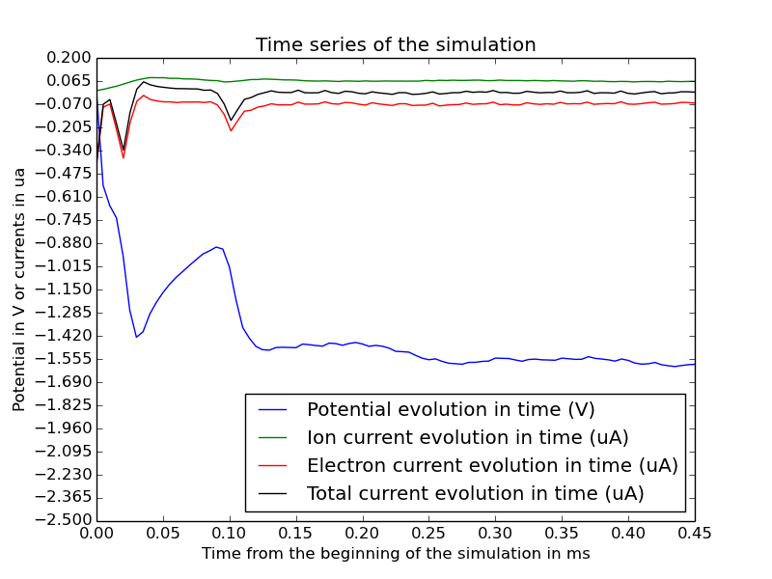
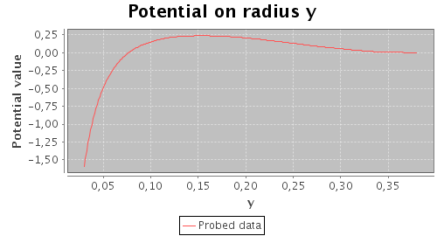
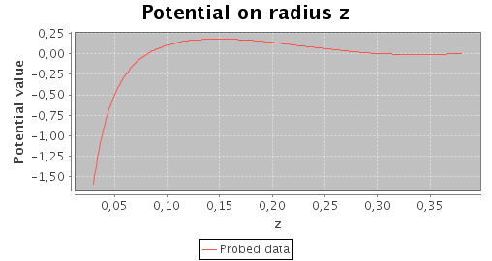
Electron model | PIC
Density (part/m^3) | 1.0e10
Electron temperature (eV) | 0.22
Ion temperature (eV) | 0.17
Velocity along x axis (m/s) | 0
Sphere radius (m) | 0.03
External box radius (m) | 0.375
B1 mesh size (m) | 0.005
B2 mesh size (m) | 0.0345
Duration (s) | 4.5e-4
simulationDt(s) | 2.2e-7
plasmaDt(s) | 2.2e-7
electronDt(s) | 2.0e-8
ionDt(s) | 2.2e-7
Csat(F) | 3.0e-12
Magnetic field along z axis (T) | 2,5e-5
Spacecraft potential mode | floating
Potential map normal X
Ion log density map normal X

Slide 6
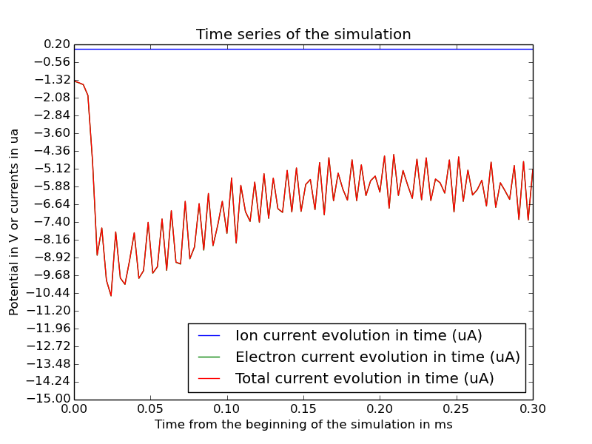
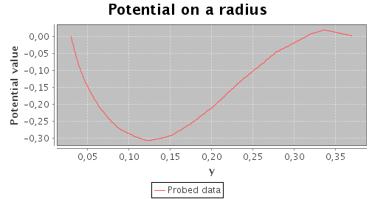
Electron model | PIC
Density (part/m^3) | 1.0e10
Electron temperature (eV) | 0.22
Ion temperature (eV) | 0.17
Velocity along x axis (m/s) | 0
Sphere radius (m) | 0.03
External box radius (m) | 0.375
B1 mesh size (m) | 0.005
B2 mesh size (m) | 0.0345
Duration (s) | 3.0e-4
simulationDt(s) | 2.2e-7
plasmaDt(s) | 2.2e-7
electronDt(s) | 2.0e-8
ionDt(s) | 2.2e-7
Csat(F) | 3.0e-12
Magnetic field along z axis (T) | 0.0
Spacecraft potential mode | Fixed 0V
Ion log density map normal X
Potential map normal X

Slide 7
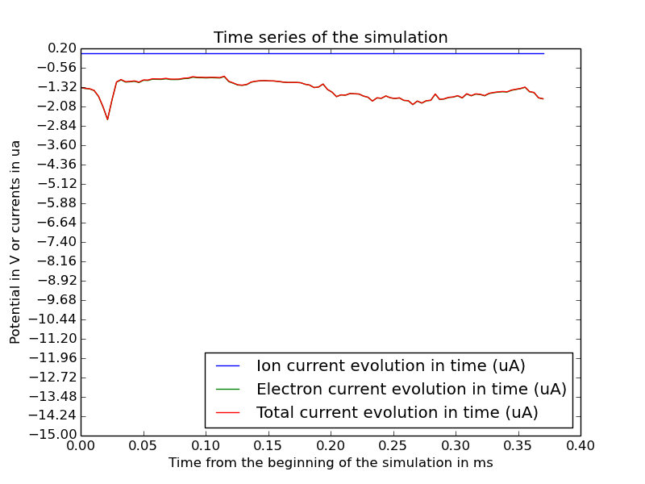
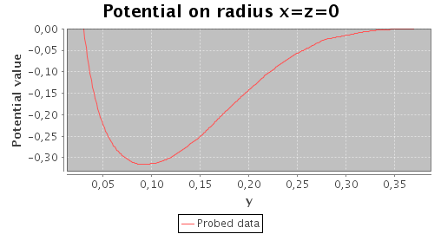
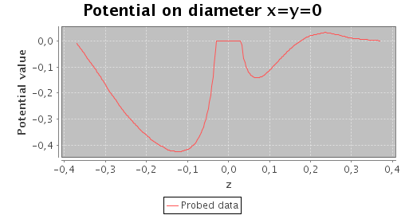
Electron model | PIC
Density (part/m^3) | 1.0e10
Electron temperature (eV) | 0.22
Ion temperature (eV) | 0.17
Velocity along x axis (m/s) | 0
Sphere radius (m) | 0.03
External box radius (m) | 0.375
B1 mesh size (m) | 0.005
B2 mesh size (m) | 0.0345
Duration (s) | 3.7e-4
simulationDt(s) | 2.2e-7
plasmaDt(s) | 2.2e-7
electronDt(s) | 2.0e-8
ionDt(s) | 2.2e-7
Csat(F) | 3.0e-12
Magnetic field along z axis (T) | 2.5e-5
Spacecraft potential mode | Fixed 0V
Ion log density map normal X
Potential map normal X

Slide 8
Conclusions
Asymptotic convergence ok for non-magnetic case.
Apparition of a low positive potential barrier in case of magnetic floating simulation.
When spacecraft potential fixed to 0V, there is a negative potential between spacecraft and external boundary.
Observation of a significative assymetry on z axis when potential is fixed and magnetic field is non-zero.
Convergence seems difficult when we fix the potential.

