Slide 1
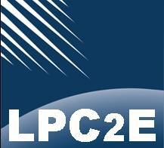
SPIS simulations of BepiColombo MMO/MIO spacecraft
L. Bucciantini, P. Henri and BepiColombo/MMO/PWI/AM2P team
LPC2E, CNRS, Orléans, France
25th SPINE WORKSHOP
25-26/10/2018
Notes:
Good morning everybody, I am Luca Bucciantini and I work at the space laboratory LPC2E of CNRS. With this presentation I will show you the results of some SPIS simulations that we performed about the MMO orbiter of the BepiColombo mission. I will give you a brief introduction of the missions and then I will pass to the results of my simulations.

Slide 2
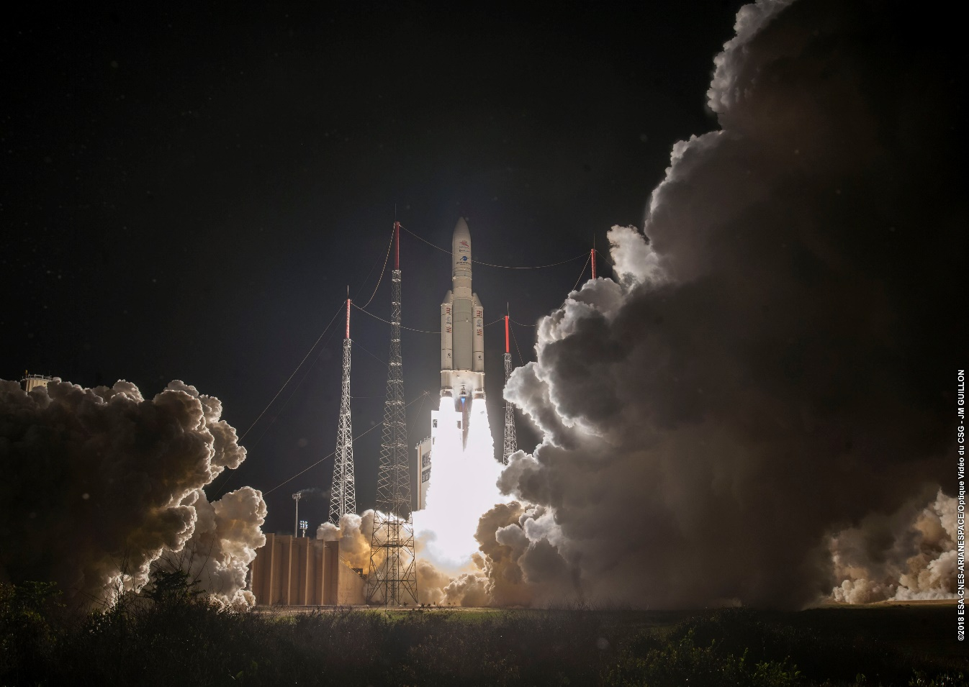
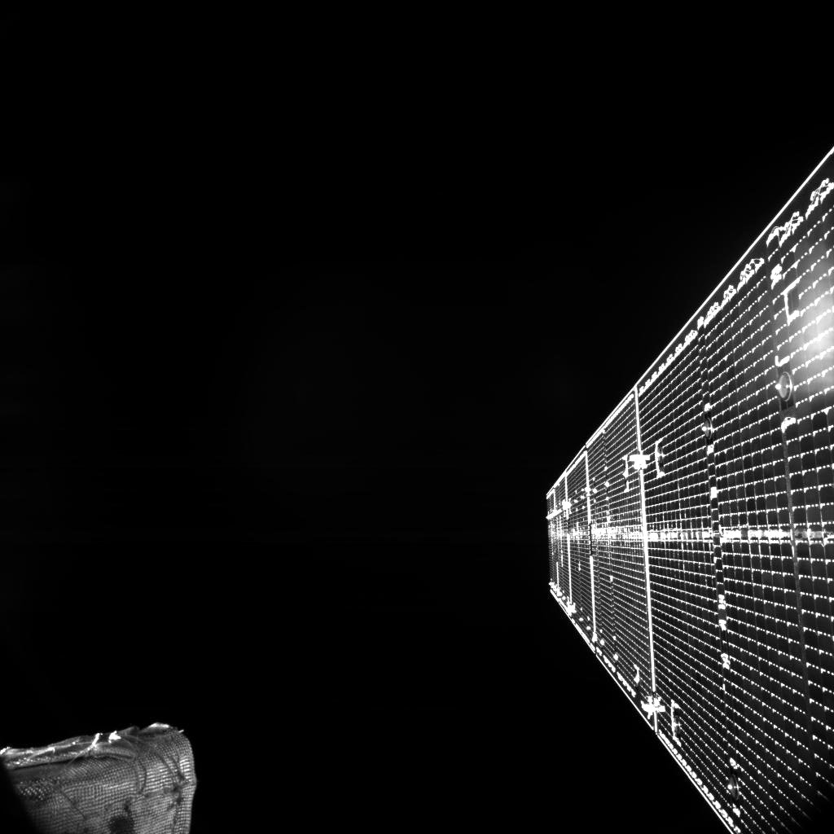
The BepiColombo launch last week in Kourou was a success!
BepiColombo lift off.
[Credit: 2018 ESA-CNES-Arianespace]
BepiColombo’s first image from space.
[Credit: ESA/BepiColombo/MTM, CC BY-SA 3.0 IGO]
Notes:
First of all, the BepiColombo spacecraft was launched last Saturday morning from Kourou. The launch was a success and everything went as scheduled. On the left you can see an image of the launch. After the detachment from the last stage of the launcher (an Ariane 5) and after the first system checks, the BepiColombo transfer module started deploying its solar arrays. In the same day, the spacecraft sent on the ground its very first image, that you can see here on the right.

Slide 3
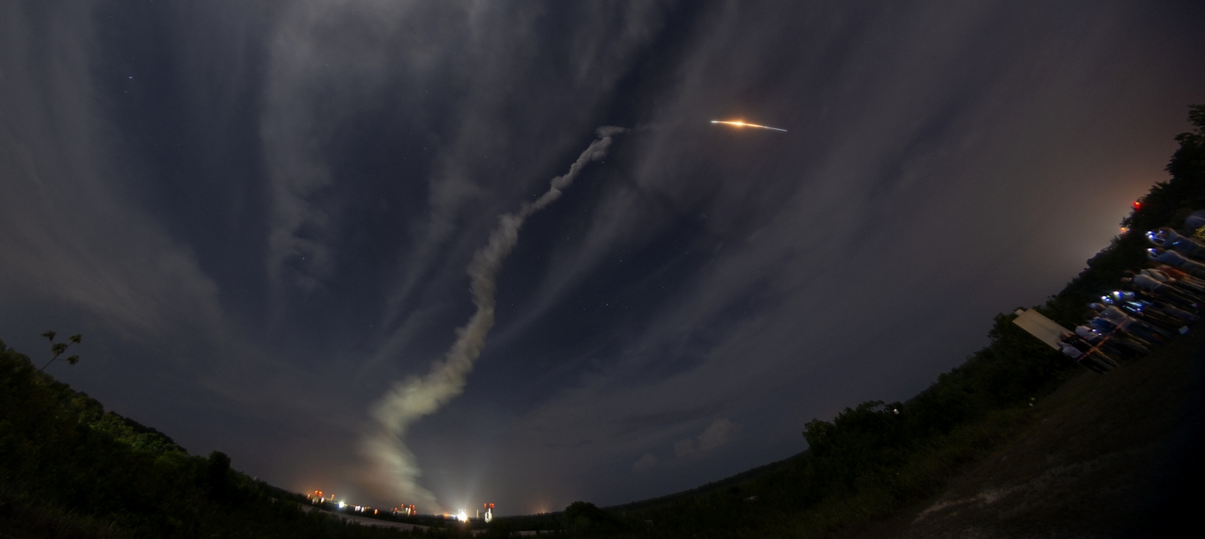
The BepiColombo mission
Joint mission between ESA and JAXA
Goals:
Provide better understanding of Mercury’s surface and internal composition
Find the origin of Mercury’s magnetic field
Study Mercury’s exosphere and magnetosphere
The mission:
Successful launch on 20th October at 01:45:28 GMT from Kourou
Cruise of 7 years with 9 flybys in total (at Earth, Venus and Mercury itself)
Expected arrival at Mercury: December 2025
Nominal mission of one year (forseen extension of an extra year)
BepiColombo lift off.
Credit: [ESA - M. Pedoussaut]
Notes:
This mission is a joint mission between ESA and JAXA and the first time that Europe and Japan go to Mercury. The mission was named after the Italian scientist Giuseppe Colombo, [who is known for explaining Mercury’s characteristic of rotating around its axis three times every two mercurian revolutions (year = 87.97 days on Earth). Moreover he proposed to NASA the interplanetary trajectory that first led Mariner 10 to Mercury, after several gravitational assists.]
The goal of this mission is to fully explore Mercury and its surrounding environment, that means to understand its composition as well as its surface topology, find the origin of its magnetic field, study its exosphere, magnetosphere and interaction with the Sorlar Wind.
The spacecraft was launched last Saturday, now Bepi is in the cruise phase of the mission. The cruise will last 7 years, during which 9 gravitational assists will take place. The expected arrival is in December 2025.
The nominal mission is of 1 year, but since the spacecraft was built in order to allow a 2 years mission an extention of an extra year is forseen.

Slide 4
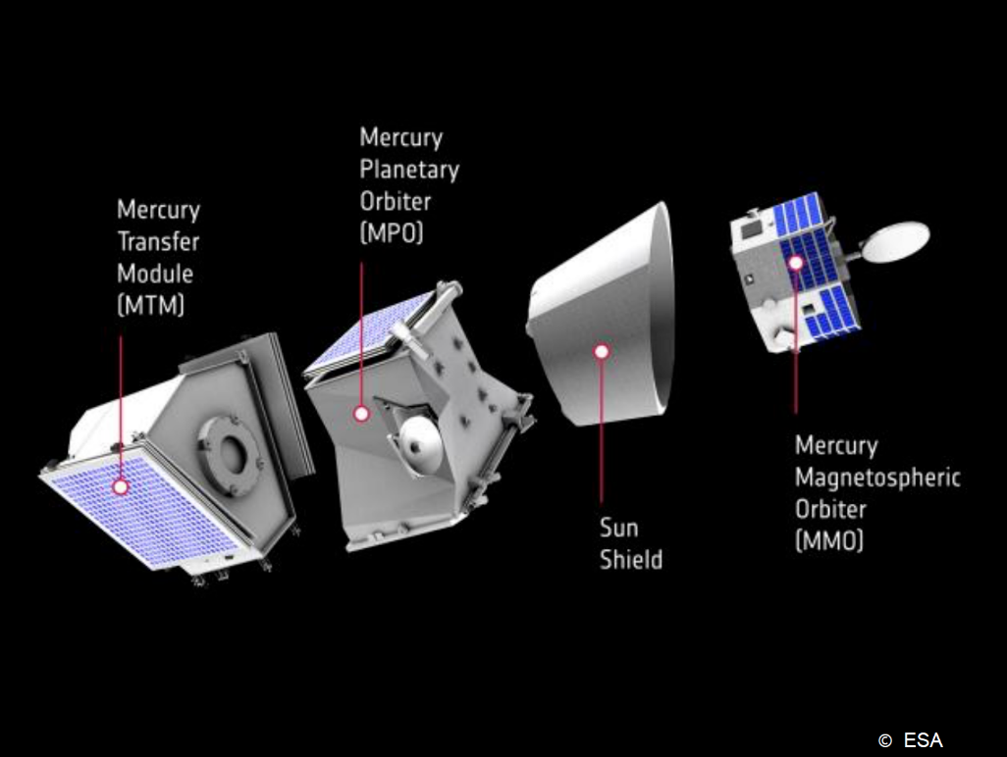
The BepiColombo mission
BepiColombo = 3 spacecraft:
1 transfert module
2 orbiters:
MPO (Magnetospheric Planetary Orbiter, ESA)
MMO (Mercury Magnetosperic Orbiter, JAXA)
MMO is dedicated to plasma measurements (Mercury’s magnetosphere, Solar Wind in front of Mercury, Mercury-Solar wind interaction).
Mercury Composite Spacecraft [Credits: ESA]
➔ Goal of this presentation is to characterize the interaction between MMO and the surrounding plasma (e.g. MMO charging, plasma sheath around MMO) to assess the s/c-plasma possible spurious effects on in situ plasma measurements.
Notes:
The spacecraft that was launched is the Mercury Composite Spacecraft, that is composed of a transfer module, two orbiters (MMO and MPO, respectively from JAXA and ESA) and a sun shield, where MMO will be stored during the whole cruise phase. Once close to Mercury, the MMO orbiter will detach, as well as the sun shield and the transfer module.
The MMO orbiter is dedicated to plasma measurements (density, magnetic field,..) that will help characterizing the different environment conditions in the Mercury surroundings (magnetosphere, solar wind)
The goal of this presentation is to characterize the interaction between MMO and the surrounding plasma, thus the charging of the spacecraft and its effects on the surrounding particles. In particular we want to asses the effects on in-situ measurements.

Slide 5
The BepiColombo mission
MMO (Mercury Magnetosperic Orbiter)
Mercury Plasma Particle Experiment
Magnetic Field Investigation
Plasma Wave Investigation
Mercury Dust Monitor
Mercury Sodium Atmosphere Spectral Imager
AM2P experiment within the PWI consortium
(heritage of Rosetta/MIP, responsibility LPC2E, CNRS)
MMO [Credits: JAXA / ESA]
Notes:
Here is a list of instruments/consortia on board the MMO s/c. In this presentation I will mostly refer to MPPE and PWI.
The Mercury Plasma Particle Experiment (MPPE):
Consists of 7 sensors, for example ions and electron energy spectrum analyzers. Such sensors are mounted on the body of MMO.
ion -> both high energy sensors and low energy particles. Can measure between 5 eV to 1.5 MeV
electron -> both high energy and low energy particles. Can measure between 5eV and 700keV.
neutrals [of little interest here]
Plasma Wave Investigation: 4 antennas of 15 m (WPT, MEFISTO) and three-axis magnetic sensors at the top of the MAST (5m boom). This setup was chosen in order to minimize contamination from the body of the spacecraft (and the rest of the experiments taking place there). Several experiments, among which SORBET (spectroscopy of radio waves and thermal electrostatic noise), Langmuir Probes, AM2P (Active Measurements of Mercury’s Plasma). AM2P is a mutual impedance experiment, under LPC2E responsibility, that measures the self and mutual impedance of the MEFISTO antennas. For AM2P to properly sound the plasma, a distance between transmitter and receiver > Debye L is required.
I am performing SPIS simulations of MMO in order to better characterize the expected capabilities of the AM2P experiment, in particular regarding the effect of the plasma sheath on mutual impedance measurements.
What I will show today are some considerations about the PWI and MPPE measurements, taking into account the various plasma conditions that the MMO spacecraft will encounter.

Slide 6
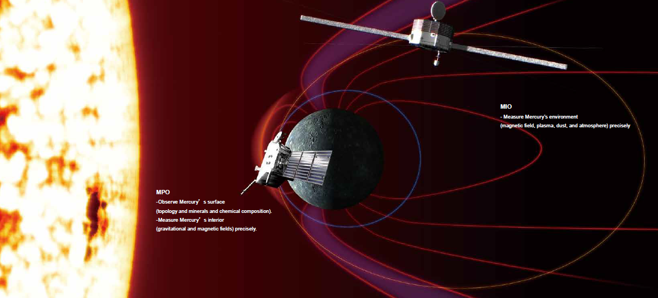
The BepiColombo mission
Plasma sheet
[n_p = 1-20 cm-3; Te=Ti=180-1000 eV;
$λ_{D}$=20 – 250 m]
MMO and MPO orbits
[Credits: JAXA]
Solar wind
[n_p = 50-60 cm-3; Te=Ti=9-18 eV;
$λ_{D}=3−4 m$]
Lobes
[n_p = 0.01-1 cm-3; Te=Ti=5-10 eV;
$λ_{D}$= 15 – 250 m]
Cusps
Mercury Orbit: 0.31 AU to 0.47 AU
MMO Orbit: 500 x 12 000 km
Notes:
Mercury’s distance from the Sun is 0.31 – 0.47 AU.
The orbits of the MMO spacecraft around Mercury will be polar orbits (500 x 12 000 km).
-> say a few words on each type of environment.
Note that the Hermean magnetosphere is composed of about … % of H and … % of Sodium-like ions.
For now we have only considered H+ in our simulations, both in the solar wind and Mercury’s magnetosphere, but we aim at improving the magnetosphere cases by adding also populations of Sodium-like ions.
Solar wind: debyeL =3-4 [m]
Lobes: debyeL = 15 - 250 [m]
Plasma sheet: debyeL = 20 - 250 [m]

Slide 7
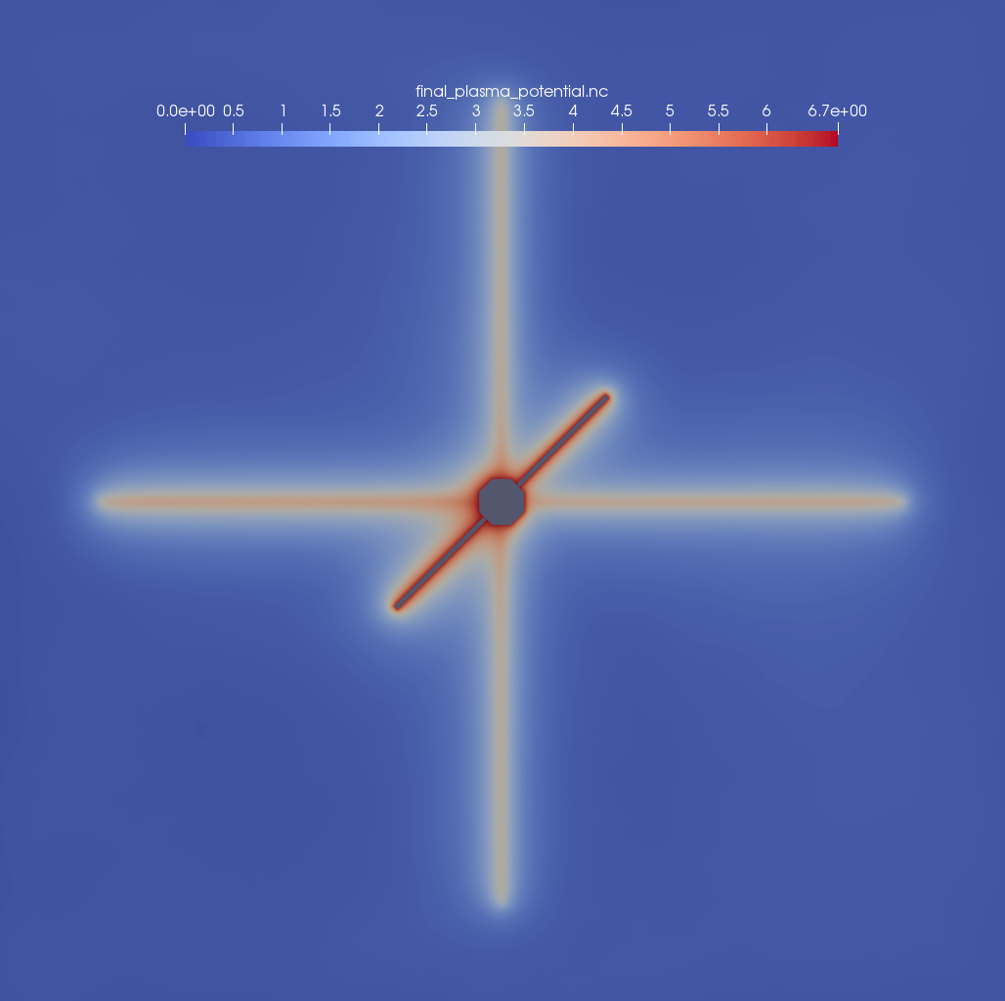
MMO spacecraft charging in Solar Wind condition
Plasma potential [V]
Expected plasma parameters when in Solar Wind conditions:
Plasma density = 50 cm-3
Electron temperature = 9 eV ($v_{th,e}=1800 km/s$)
Ion temperature = 9 eV(${(v}_{th,i}=40\frac{km}{s}$)
Solar wind drifting speed = 420 km/s ($E_{e}≅13eV$, $E_{i}≅1keV$)
$λ_{D}$=3 m
Distance from the Sun = 0.47 AU
Source: Baker et al., 2009, 2011 (from simulations) ;
in agreement with Mariner10 data.
➔ MMO S/C potential: 6.7 V
0
6.7 [V]
Solar wind
Notes:
Here I present the results from a simulation in Solar Wind (in the panel showing the potential of the plasma surrounding MMO the Sun is on the right).
Remark the distance from the Sun and the debye length.
In the solar wind, our SPIS simulations show that the MMO positive s/c potential is a few volt, as expected when photoionization of the s/c body dominates.
This is not expected to affect solar wind ion measurements (expected at ~ 1keV, given the mean solar wind velocity). However it could affect the measurement of core electrons. This is as expected for solar wind measurements (similar to what is observed on WIND for instance, with a slightly higher positive s/c potential due the close vicinity of the Sun).

Slide 8
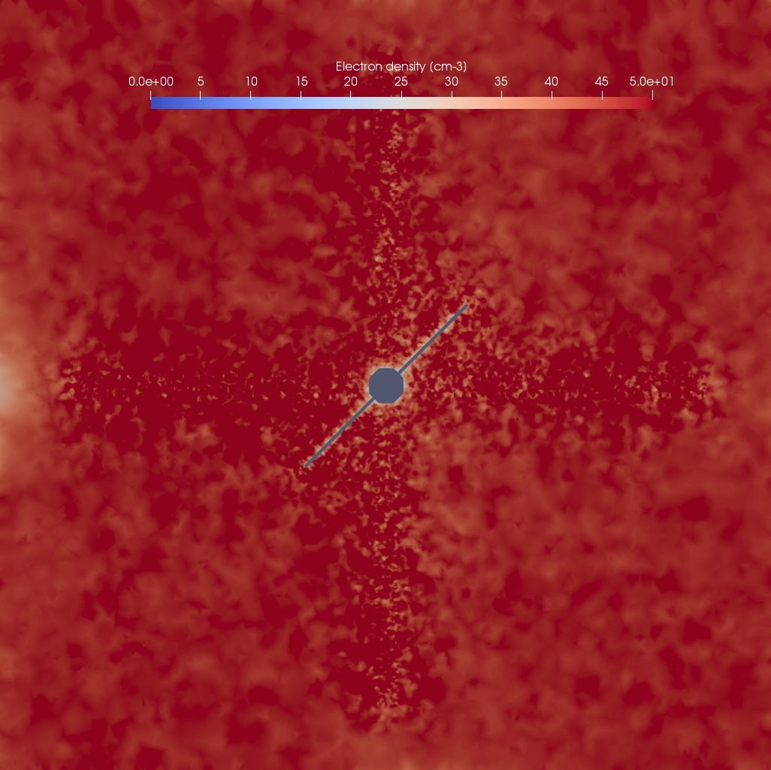
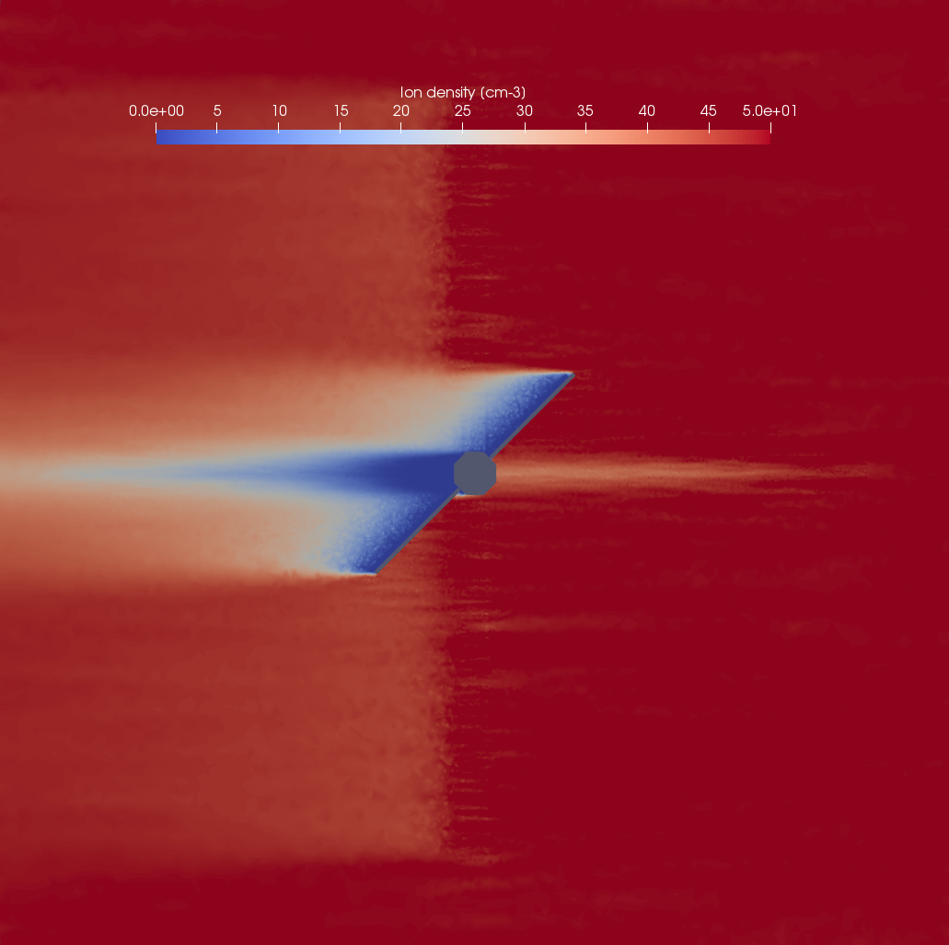
MMO spacecraft charging in Solar Wind condition
Electron density [cm-3]
Ions density [cm-3]
0
50 [cm-3]
0
50 [cm-3]
Solar wind
Solar wind
→ Formation of an ion wake (particles measurements [MPPE, located on the edge of the spacecraft body] expected to be affected)
Notes:
If we check the ambient populations densities (electrons on the left and ions on the right)
Electrons enhanced around MMO
Ion wake
The trace we see on the right panel is actually left there by the antennas (that are on a different plane w.r.t. the cut)
MPPE ion measurements are expected to be affected when in the wake
MPPE electron measurements not expected to be affected
Langmuir probe not expected to be affected
AM2P not expected to be affected

Slide 9
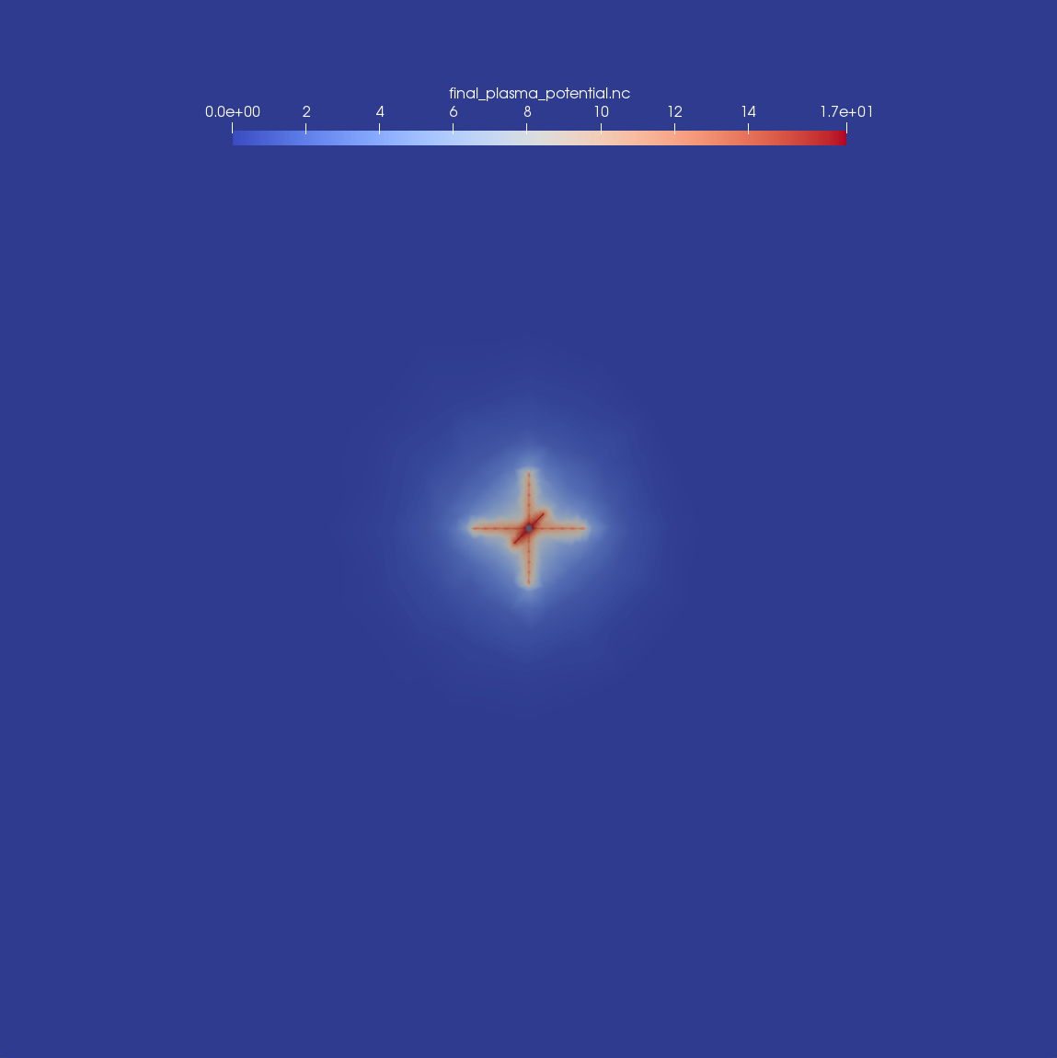
MMO spacecraft charging in Magnetosphere (lobe condition)
Plasma potential [V]
Expected plasma parameters when the spacecraft is in the lobes:
Plasma density = 0.01 cm-3
Electron temperature = 5 eV
Ion temperature = 5 eV
$λ_{D}$ = 150 m
Distance from the Sun = 0.31 AU
Ions type = H+
Source: Kasaba et al (2010),
Cumnock et Blomberg (2003)
From analytic computation, considering the thick plasma sheath limit (OML) and assuming a spherical shape (r=1.5m), the expected spacecraft potential is 16 V.
➔ MMO S/C potential: 17 V
0
17 [V]
→Large spacecraft potential w.r.t. the energy of ambient electrons and ions.
→Ions and electrons measurements expected to be affected [MPPE].
Notes:
Here I show the results of simulations when the MMO spacecraft is in the magnetospheric lobes. Still the plasma potential around MMO on the left, the Sun is still on the right but this time at a distance of 0.31 AU.
Remark the debye length -> so large because of the low plasma density of the ambient populations.
The potential from the simulation is larger that the electron energy of both electrons and ions→ their measurements is expected to be affected
The spacecraft potential of 16.7 V is pretty close to the 16 V that I obtained with analytic computations, considering the thick plasma sheath limit (Orbit Motion Limit theory) and assuming sphere-like spacecraft of 1.5m radius. In this analytic computation, the dominating term was the photoelectron current, due to the vicinity to the Sun.

Slide 10
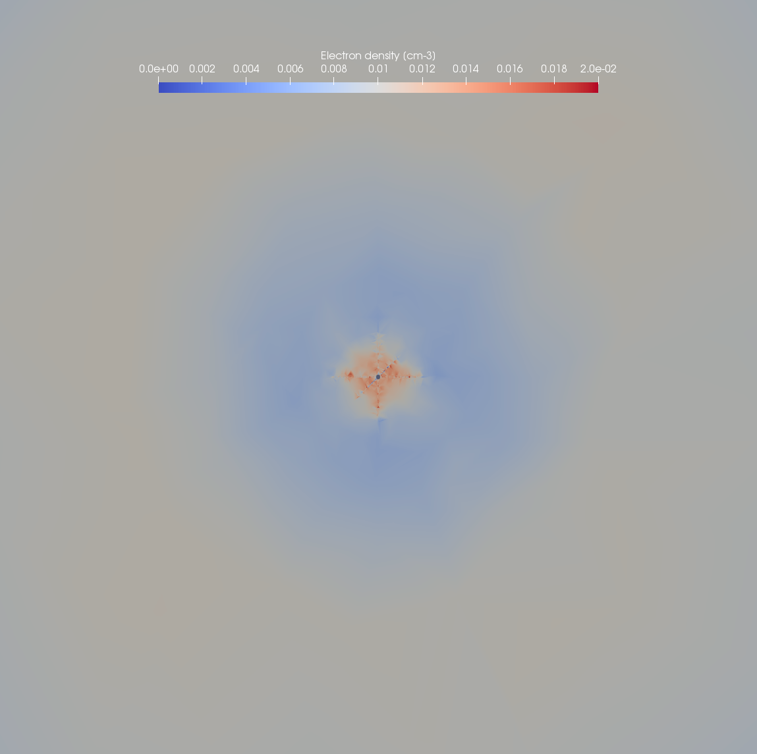
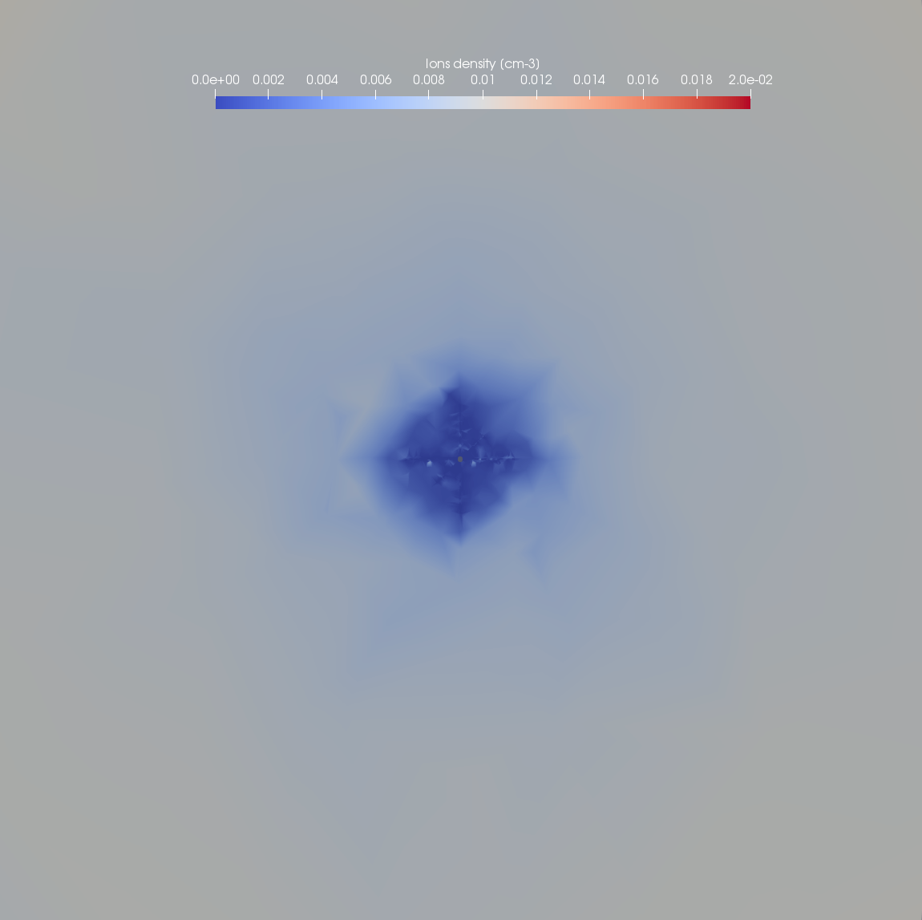
MMO spacecraft charging in Magnetosphere (lobe condition)
Electron density [cm-3]
Ion density [cm-3]
0
0.02 [cm-3]
0
0.02 [cm-3]
→ Langmuir Probes, AM2P and MPPE expected to be affected.
Notes:
Here I show the density of ambient electrons on the left and ambient ions on the right. AS EXPECTED, they are affected by the potential of MMO spacecraft. This will affect the measurements of MPPE.
DebyeL > distance between emitter and receiver (about 30m) → AM2P not expected to perform measurements in this condition.
Given the huge plasma sheath surrounding the MMO s/c, also Langmuir Probe s/c potential measurements are expected to be affected.
This are average conditions for lobe. DebyeL is expected to be between 25 m and 250 m → To be checked the 25m condition. More simulations are needed.

Slide 11
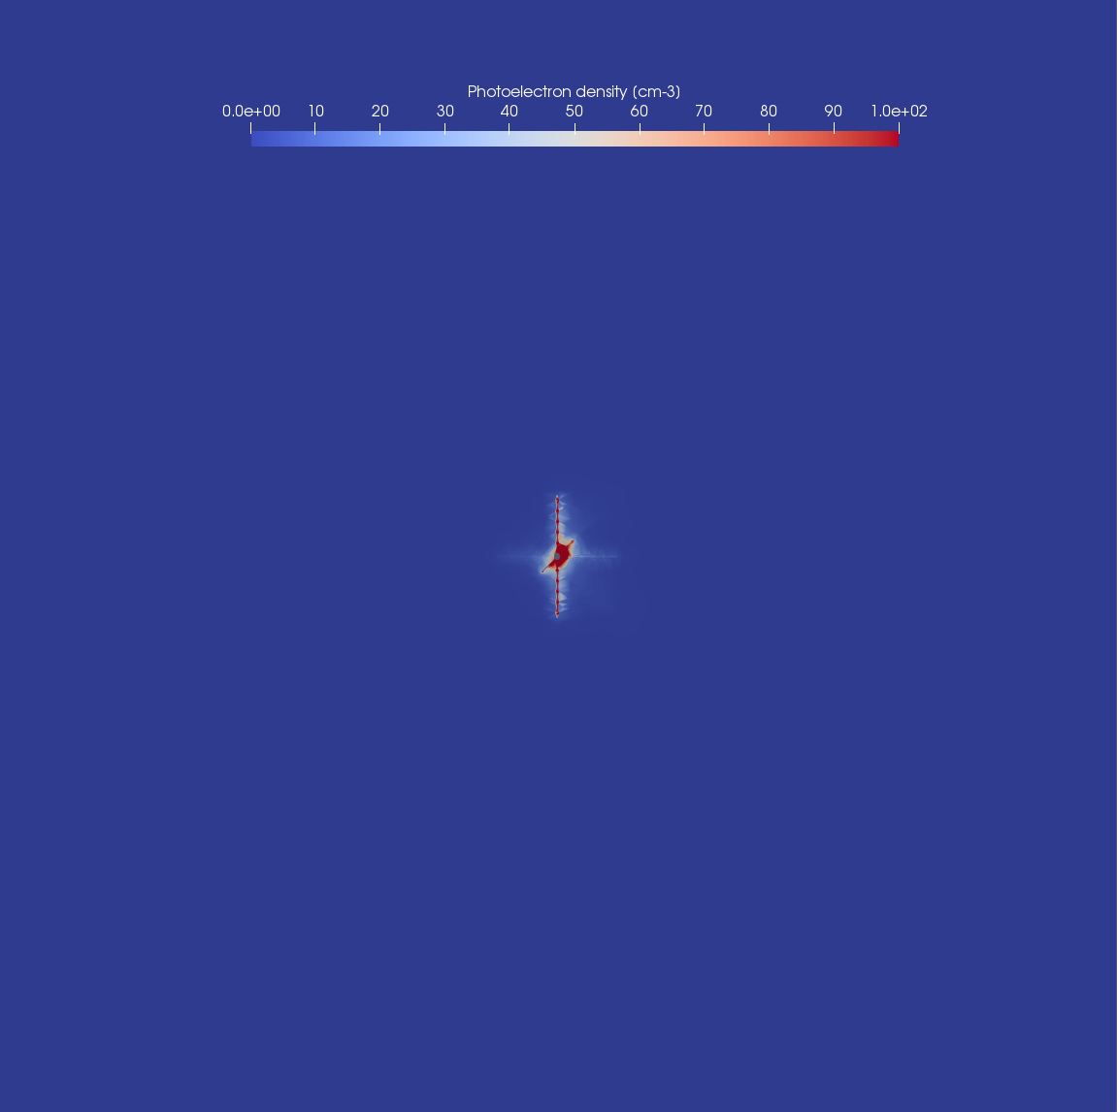
MMO spacecraft charging in Magnetosphere (lobe condition)
Photoelectron density [cm-3]
0
0
100 [cm-3]
Notes:
I am showing this slide because I wanted to give you a direct idea of the effects of the photoionization in this simulation. Here I am showing the density of photoelectrons surrounding MMO. The color scale goes from 0 to 100 cm-3. While regarding the ambient populations, the density imposed is 0.01 cm-3.

Slide 12
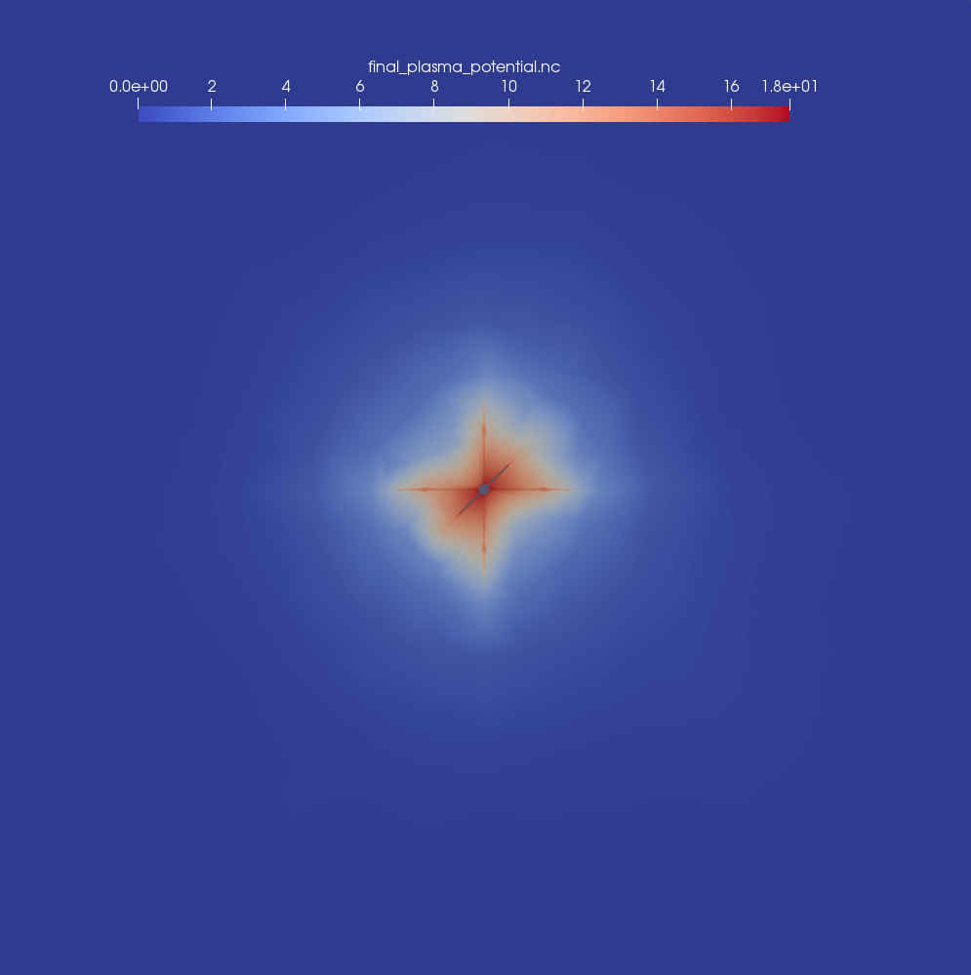
MMO spacecraft charging in Magnetosphere (plasma sheet)
Plasma parameters:
Plasma density = 1 cm-3
Electron temperature = 180 eV
Ion temperature = 180 eV
$λ_{D}$= 100 m
Distance from the Sun = 0.31 AU
Ions type = H+
Source: Raines et al. (PSS,2011)
Ogilvie et al. (JGR, 1977)
Gershman et al. (GRL, 2014)
From analytic computation, considering the thick plasma sheath limit (OML) and assuming a spherical shape (r=1.5m), the expected spacecraft potential is 15 V.
➔ MMO S/C potential: 18 V
Plasma potential [V]
0
18 [V]
→Large variation of ambient population temperatures and densities did not result in large variation of S/C potential
As for the simulation in lobes conditions, the interaction is dominated by photoelectron currents
Notes:
Compare with lobes:
Larger density
Larger ambient population energies
Same distance from the Sun.
→ Just as I have shown in the case of MMO standing in the magnetospheric lobes, the expected s/c potential is strongly positive, because of the dominating photoelectron current.
Again, comparing the spacecraft potential with analytic computations, the difference is pretty low.
I will not show the comparison of ambient population densities because I find the same results as for the magnetospheric lobes simulation.
MPPE expected to be affected (mainly ions)
Langmuir probe affected
AM2P affected
Remind the range of debyeL: 20 – 250 m → more simulations are needed.

Slide 13
MMO spacecraft charging - SUMMARY
 | Solar Wind in from of Mercury | Magnetospheric lobes | Plasma sheet
Electron particle measurements
Ion particle measurements
Langmuir probe measurements
Mutual impedance probe measurements
As expected, the spacecraft potential is dominated by photoelectron currents.
The equilibrium potential of the spacecraft is found to be close to the expected value from analytic computations (assuming OML and spherical symmetry) within an error of about 15%.
Notes:
This is the condition so far. The measurements are not expected to be affected for lower DebyeL. More simulations need to be performed in order to confirm the expectations.
Non ci sono casi in cui siamo sicuri di non avere misure (forse I cusp dove la temperatura è molto alta e la densitá è bassa, ma queste simulazioni ancora non le ho fatte. <- penso comunque di aggiungere qualcosa a riguardo, in modo da dare un’idea.

Slide 14
Thanks for the attention!

Slide 15
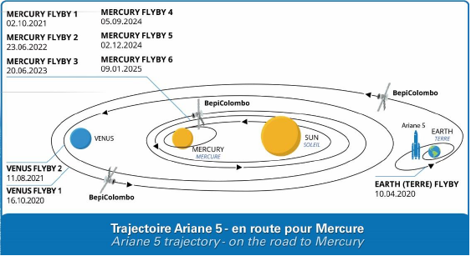
The BepiColombo mission
Flybys.
Credits: Arianespace arianegroup, VA245 Octobre 2018, BepiColombo

Slide 16
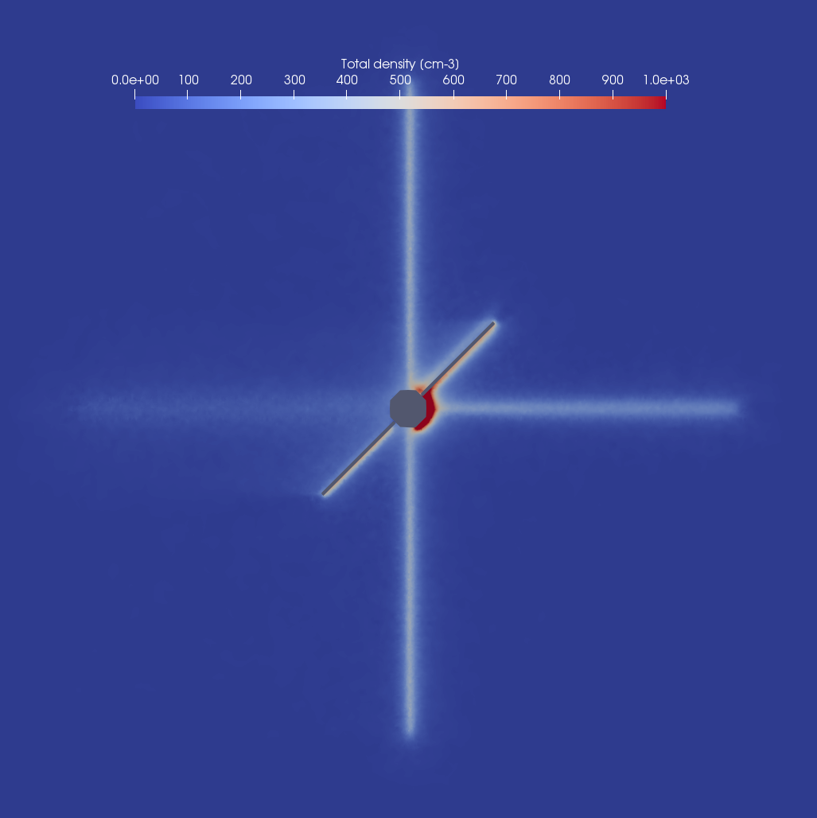
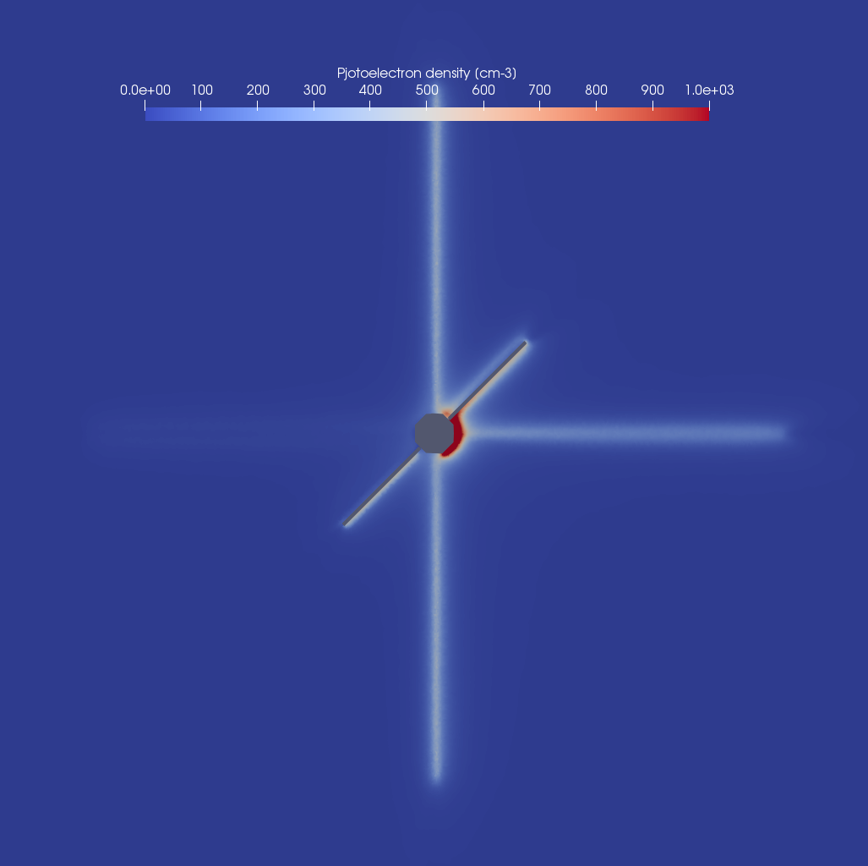
MMO spacecraft charging in Solar Wind condition
Total density [cm-3]
Photoelectron density [cm-3]
0
1000
0
1000
Solar wind
Solar wind

Slide 17
MMO spacecraft charging in Solar Wind condition
Total density [cm-3]
Ions density [cm-3]

Slide 18
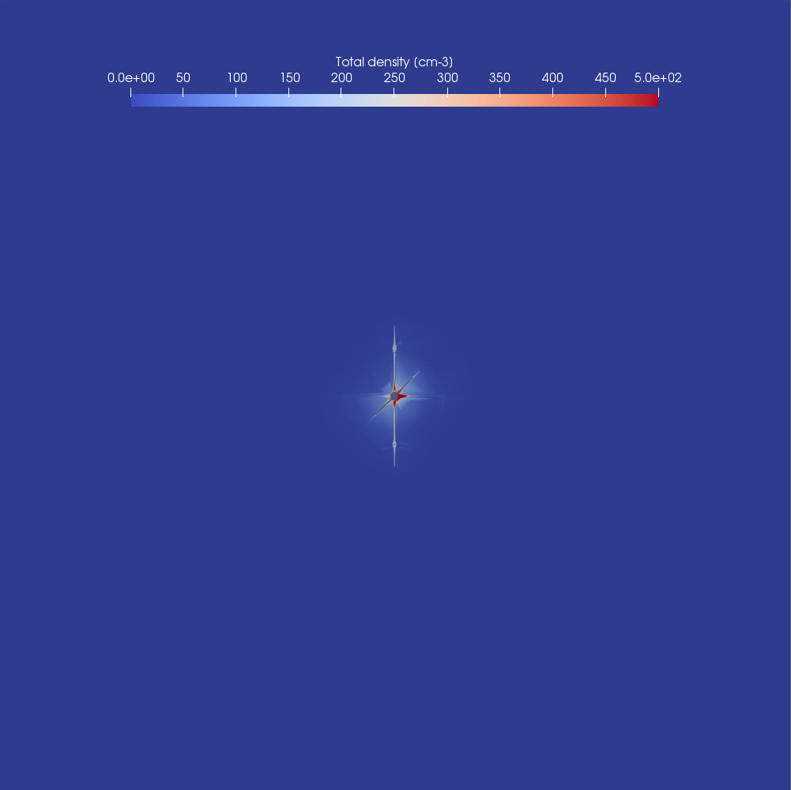
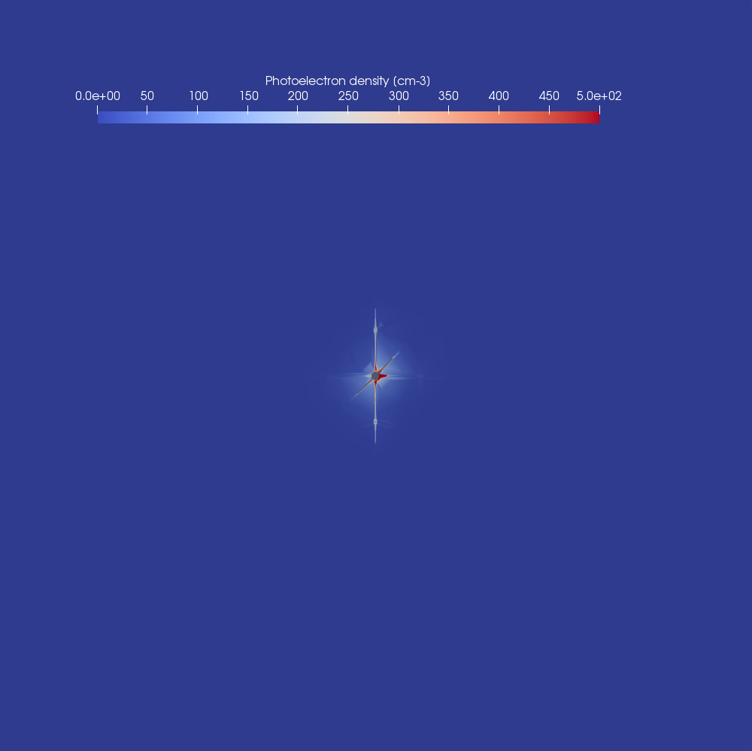
MMO spacecraft charging in Magnetosphere (plasma sheet)
Total density [cm-3]
Photoelectron density [cm-3]
0
500 [cm-3]
0
500 [cm-3]
→ Interaction dominated by the photoelectron current.

Slide 19
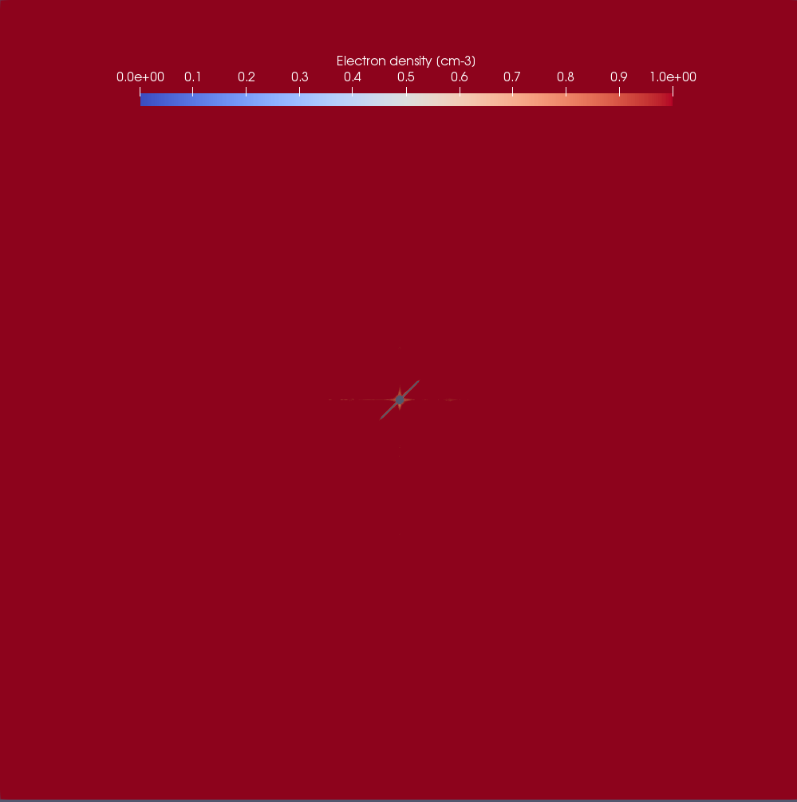
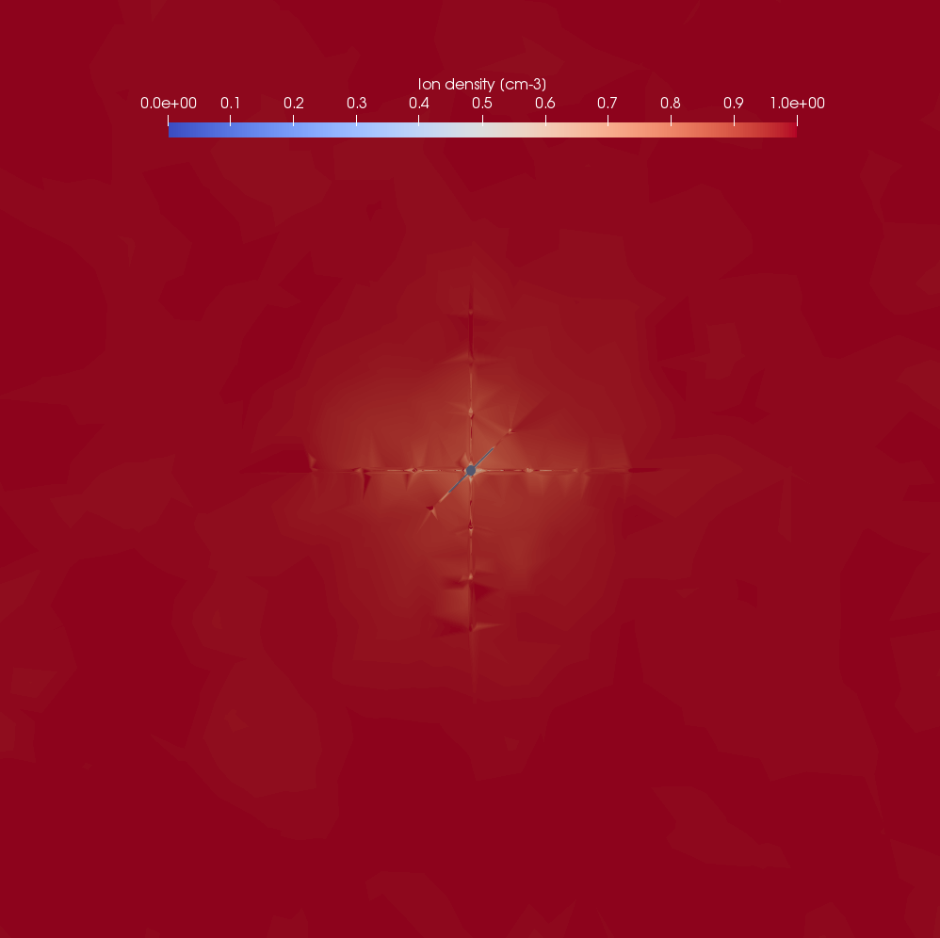
MMO spacecraft charging in Magnetosphere (plasma sheet)
Electron density [cm-3]
Ion density [cm-3]
0
1 [cm-3]
0
1 [cm-3]
→ Ambient populations slightly affected by MMO s/c potential.
Notes:
No influence on the background populations (i.e. ambient electrons and ambient ions) because the space potential close to the spacecraft is negligible w.r.t. the particles thermal energy.

