Slide 1
25th SPINE workshop Mika Holmberg, Fabrice Cipriani, Grégoire Déprez, David Rodgers, Sebastien Hess, Thomas Nilsson ESA/TEC-EPS, ONERA, IRF 25/10/2018
Cassini plasma wake simulations compared to
Langmuir probe measurements

Slide 2
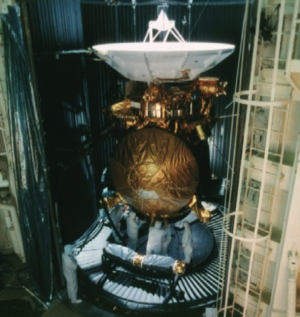
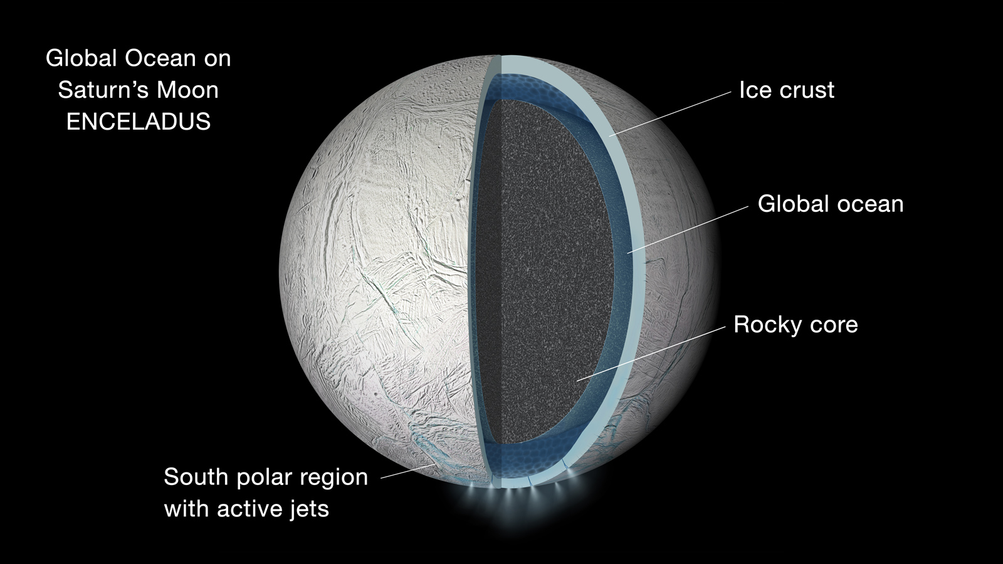
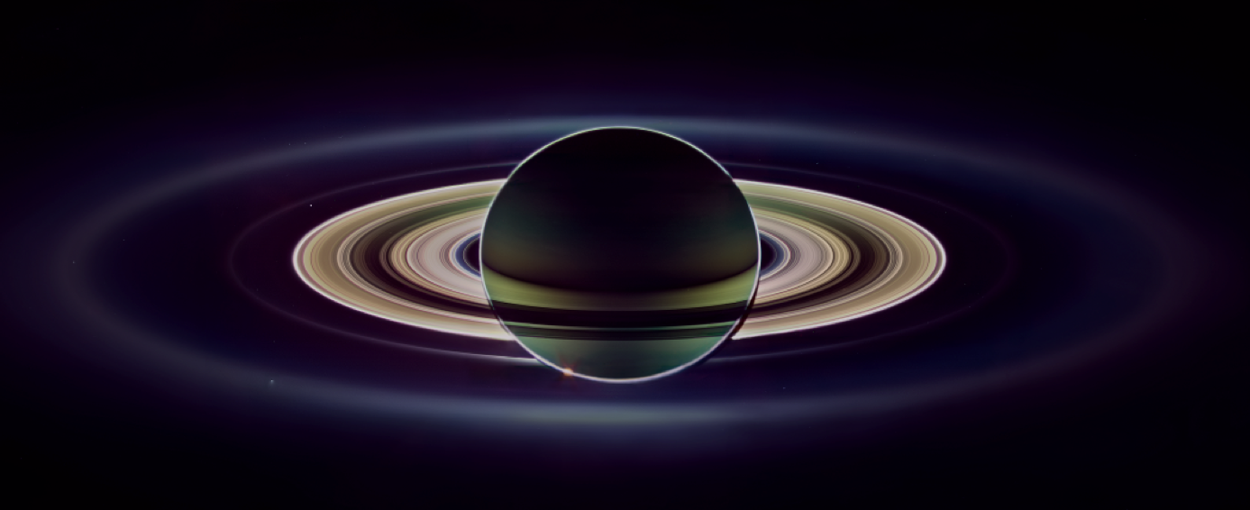
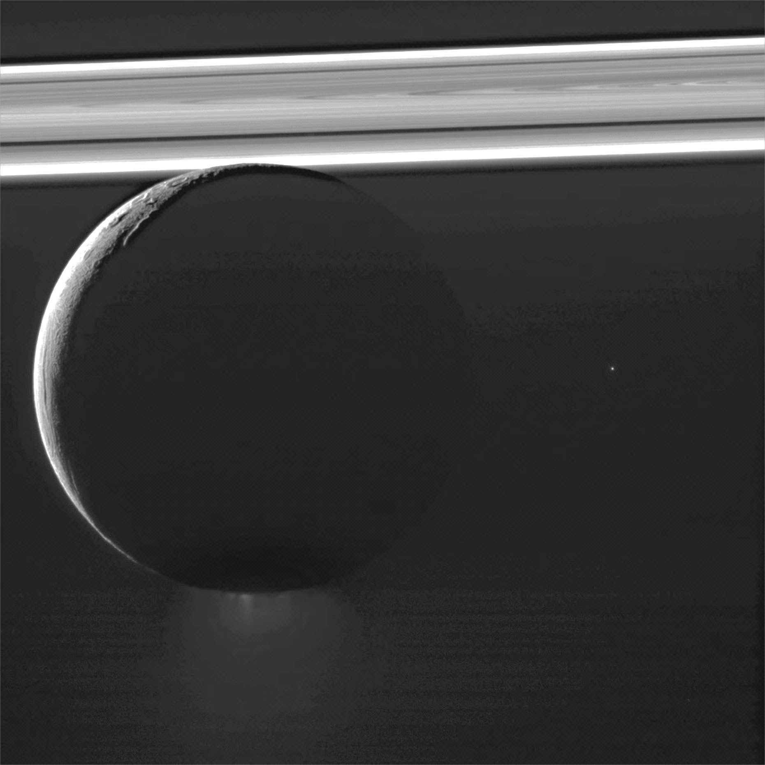
Introduction – Studying the Enceladus plasma torus
The Cassini mission to Saturn, 2004-2017
New method to derive ion properties from LP sweeps
Plasma torus created from Enceladus’ subsurface ocean
No correction for plasma wake effects
Small impact on statistical studies but, potentially, very important for case studies
Image credits: NASA/JPL-Caltech/AP/Space Science Institute

Slide 3
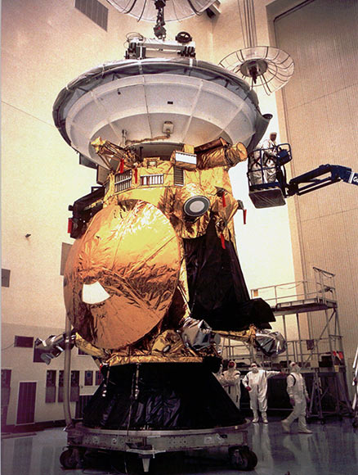
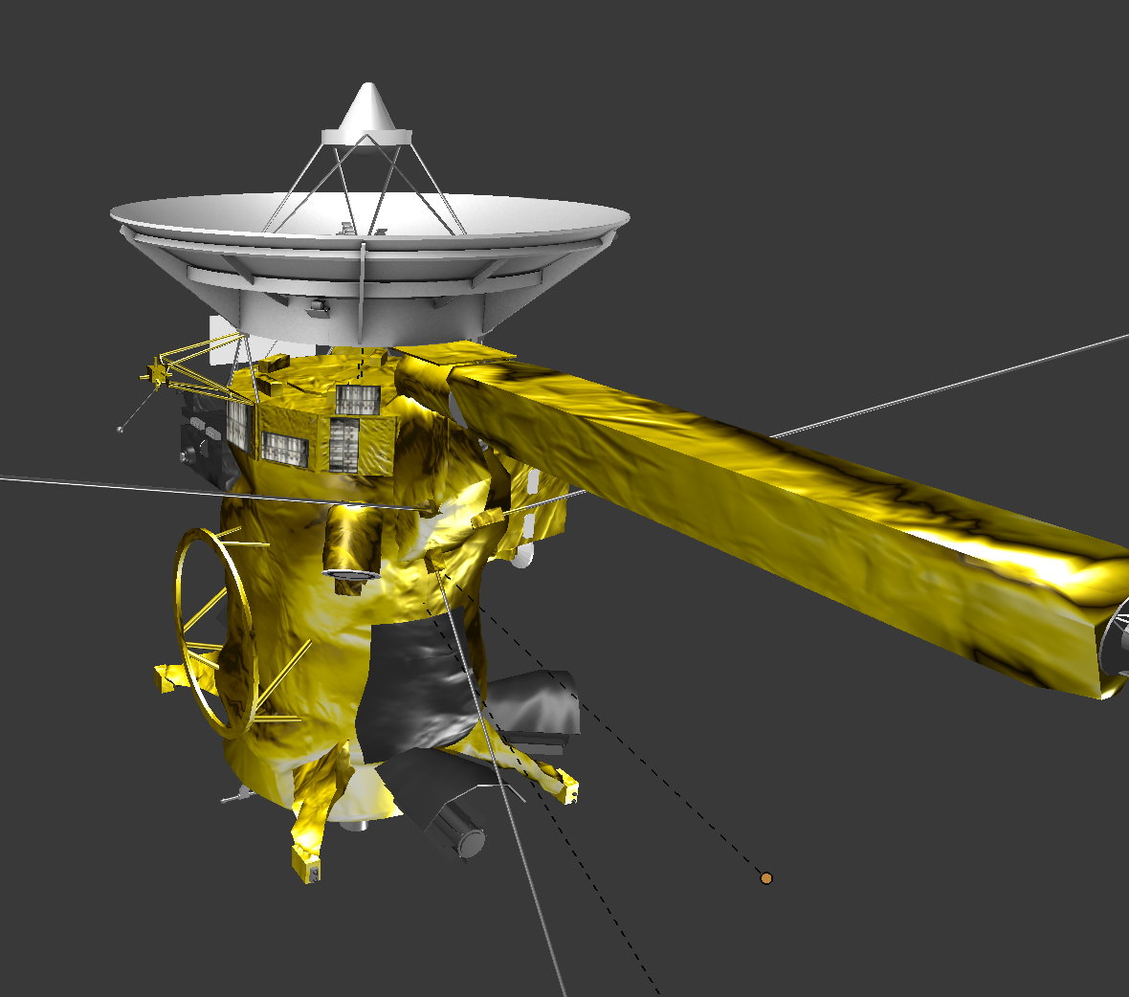
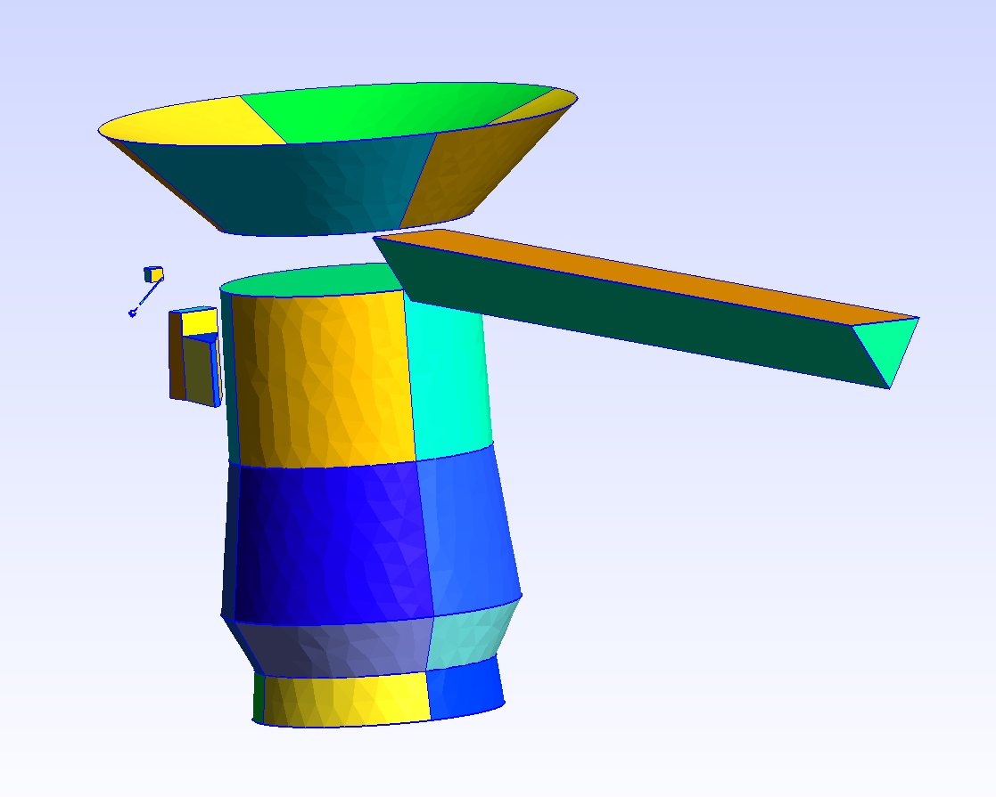
The Cassini model
Spacecraft model, excluding the lander Huygens
Body h = 3.64 m, r_{min} = 1.00 m, r_{max} = 1.26 m
High gain antenna h = 0.11 m, r_{min} = 1.08 m, r_{max} = 2.00 m
MAG h = 0.56 m, l = 9.66 m
CAPS/MIMI/INMS
Search coil magnetometer and Langmuir probe (LP) (optional)
Cassini prior to launch
Image credits: NASA/JPL-Caltech
Blender model provided by Brian Kumanchik,
NASA/JPL-Caltech
Simplified model suitable for SPIS

Slide 4
Simulation setup – Mesh and materials
Computational volume, egg-shaped 16 x 20 x 27 m
100,281 tetrahedra
Materials
Body BK2K, Black kapton
High gain antenna PCBZ, White paint, assumed to be conductive
MAG BK2K, Black kapton
CAPS/MIMI/INMS BK2K, Black kapton
Search coil mag. (optional) BK2K, Black kapton
LP (optional) AU2K, Gold, actually TiN
All on one electrical node, except the LP
Material specifications of the multilayer insulation blankets from Stultz and Reeve 1995

Slide 5
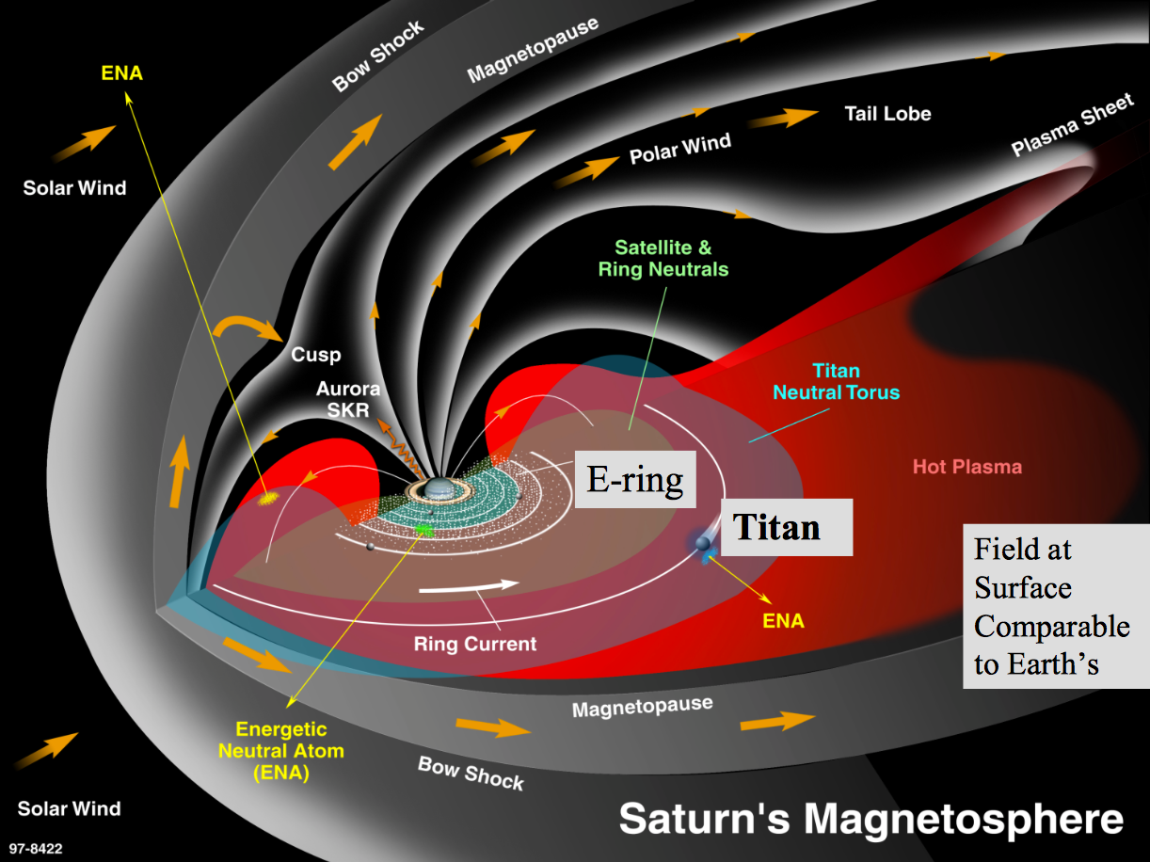
Simulation setup - The environment and the spacecraft
Time interval 2010-03-03 10:10 to 11:00
Inner to middle magnetosphere, inside the Enceladus plasma torus but outside the orbit of Enceladus at 3.95 R_{S}
Close to cold plasma density maximum at 4.6 R_{S}
Plasma flow in same direction as ring current (white arrow)
Gyroradii ion ~ 10 km and electron ~ 20 m
Debye length ~ 2 m
X

Slide 6
Simulation setup – Global parameters
For time interval 2010-03-03 10:10 to 11:00
Parameter | Value | Reference
avPartNbPerCell | 50
n_{e} | 50 cm⁻³ | Holmberg et al. 2012, 2017
T_{e} | 2 eV | Schippers et al. 2013
n_{e,h} | 0.01 cm⁻³ | Schippers et al. 2008
T_{e,h} | 500 eV | Schippers et al. 2008
n_{i} | 50.01 cm⁻³ | Holmberg et al. 2012, 2017
T_{i} | 18 eV | Sittler et al. 2006, Thomsen et al. 2010
v_{i,θ} | 28 km/s | Holmberg et al. 2012
Ion species | H₂O⁺ | Young et al. 2005, Sittler et al. 2008
Z_{Sun} | 0.011
v_{s/c,x}, v_{s/c,y}, v_{s/c,z} | 0 – 13.2 km/s, -13.3 – 9.4 km/s, 8.2 – 8.7 km/s | The Cassini ephemeris tool from RPWS in Iowa
B | 100 nT | Estimated, assuming dipole field

Slide 7
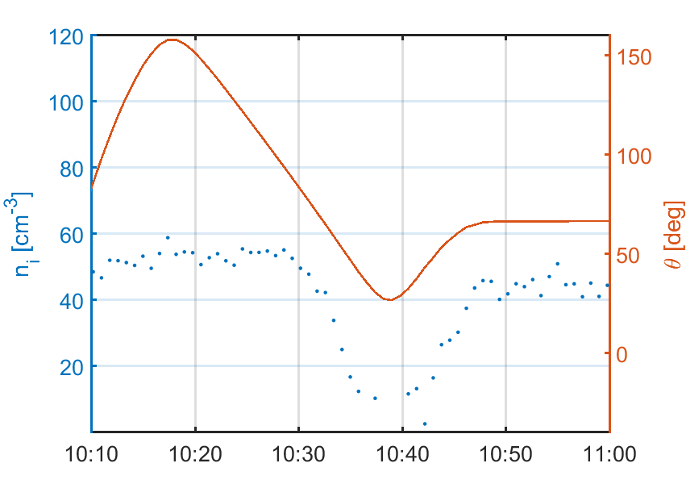
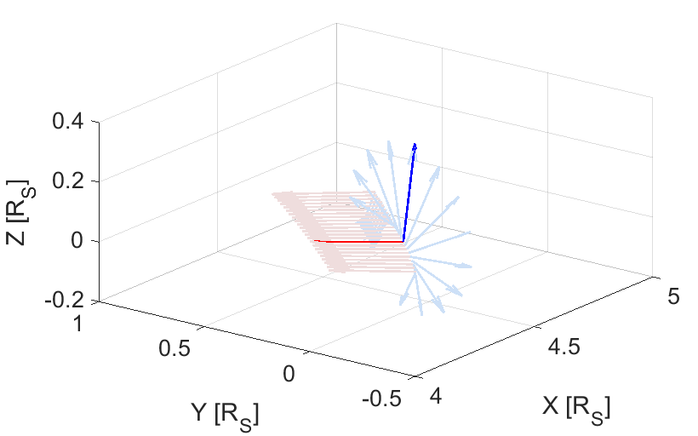
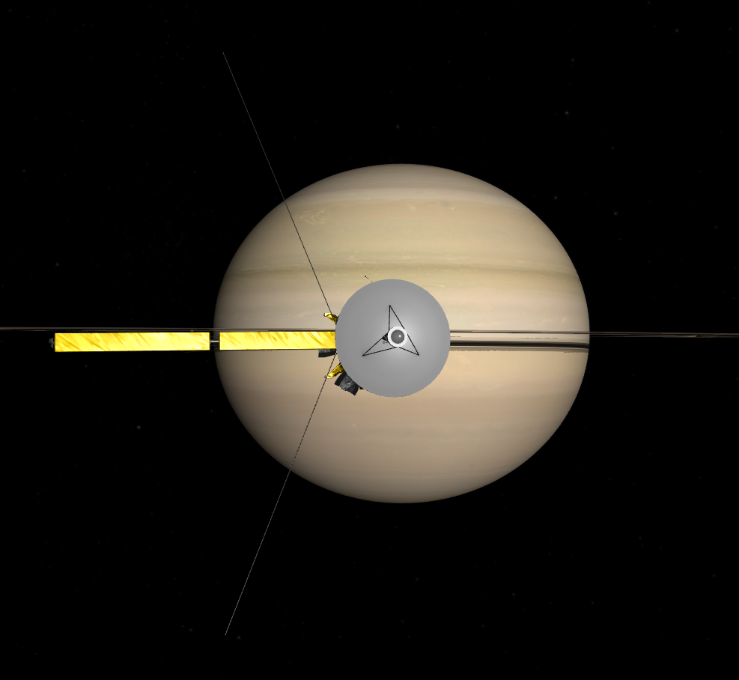
Simulation setup - The environment and the spacecraft
HGA pointing towards Earth and Sun, and spacecraft rolls
10:10 to 10:29 LP in undisturbed plasma flow
10:30 to 10:48 LP in region where the plasma flow is disturbed by the spacecraft, i.e., the ion wake
*
Studied time interval, 2010-03-03
Plasma flow
LP
Relative flow direction (red), LP direction (blue), and the position of the s/c in Saturn Sun equatorial coordinates and over time

Slide 8
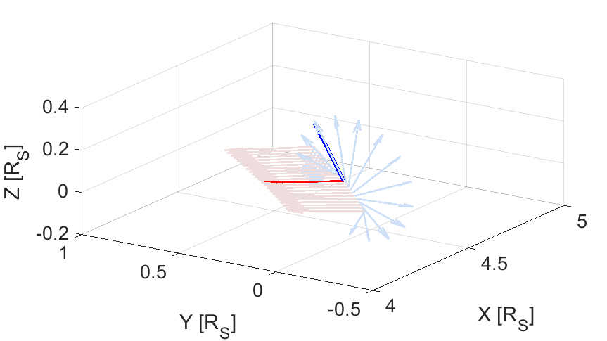
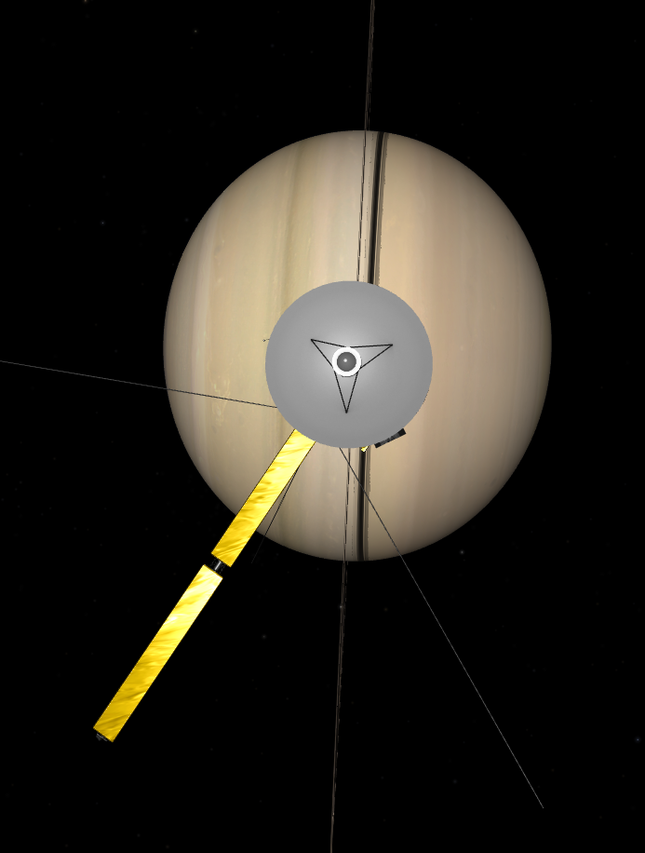
Simulation setup - The environment and the spacecraft
HGA pointing towards Earth and Sun, and spacecraft rolls
10:10 to 10:29 LP in undisturbed plasma flow
10:30 to 10:48 LP in region where the plasma flow is disturbed by the spacecraft, i.e., the ion wake
*
Studied time interval, 2010-03-03
Plasma flow
LP
Relative flow direction (red), LP direction (blue), and the position of the s/c in Saturn Sun equatorial coordinates and over time

Slide 9
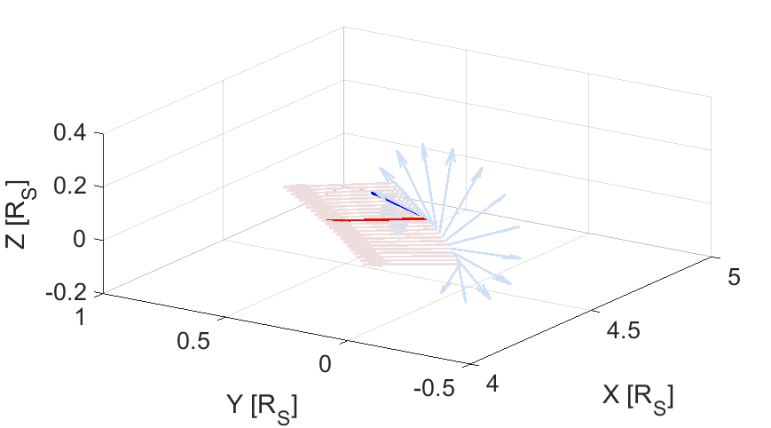
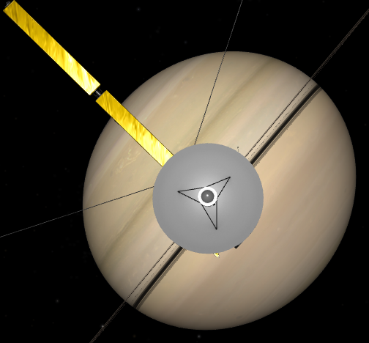
Simulation setup - The environment and the spacecraft
HGA pointing towards Earth and Sun, and spacecraft rolls
10:10 to 10:29 LP in undisturbed plasma flow
10:30 to 10:48 LP in region where the plasma flow is disturbed by the spacecraft, i.e., the ion wake
*
Studied time interval, 2010-03-03
Plasma flow
LP
Relative flow direction (red), LP direction (blue), and the position of the s/c in Saturn Sun equatorial coordinates and over time

Slide 10
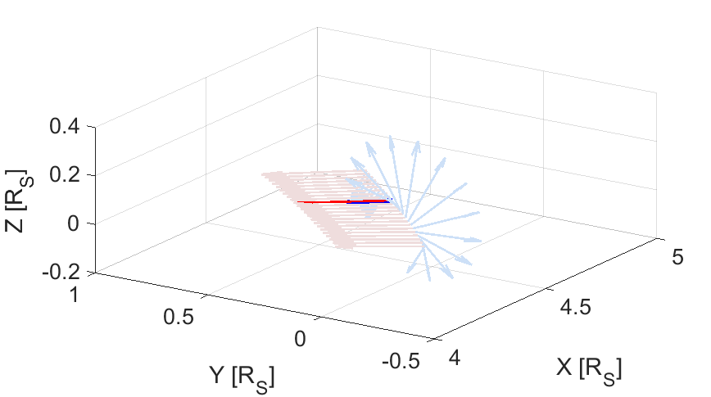
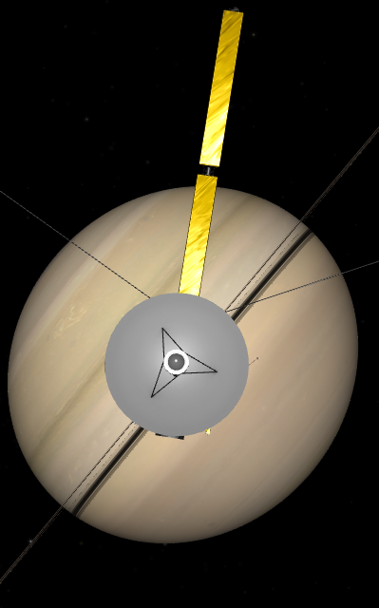
Simulation setup - The environment and the spacecraft
HGA pointing towards Earth and Sun, and spacecraft rolls
10:10 to 10:29 LP in undisturbed plasma flow
10:30 to 10:48 LP in region where the plasma flow is disturbed by the spacecraft, i.e., the ion wake
*
Studied time interval, 2010-03-03
Plasma flow
LP
Relative flow direction (red), LP direction (blue), and the position of the s/c in Saturn Sun equatorial coordinates and over time

Slide 11
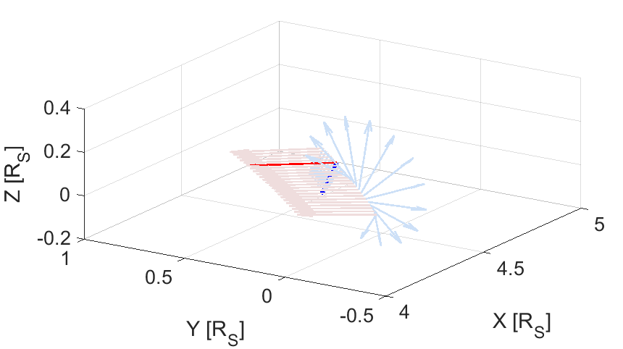
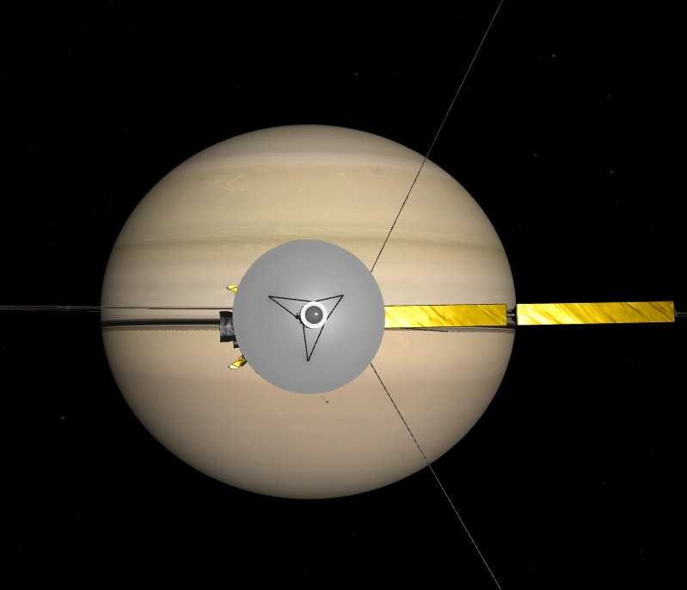
Simulation setup - The environment and the spacecraft
HGA pointing towards Earth and Sun, and spacecraft rolls
10:10 to 10:29 LP in undisturbed plasma flow
10:30 to 10:48 LP in region where the plasma flow is disturbed by the spacecraft, i.e., the ion wake
*
Studied time interval, 2010-03-03
Plasma flow
LP
Relative flow direction (red), LP direction (blue), and the position of the s/c in Saturn Sun equatorial coordinates and over time

Slide 12
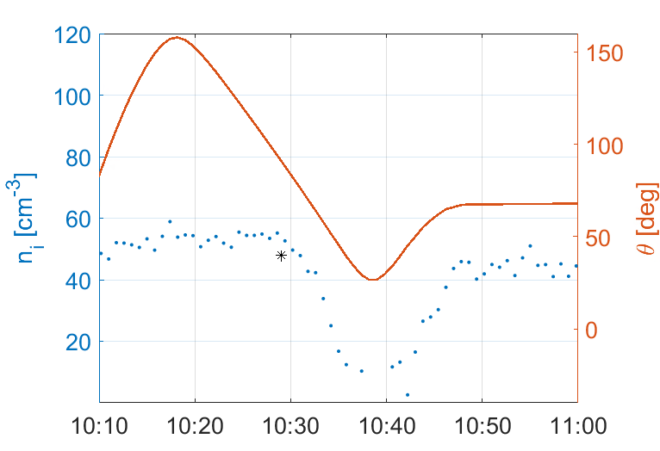
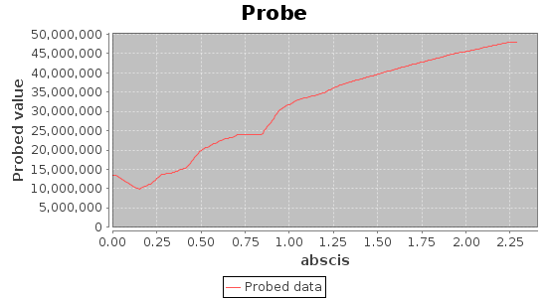
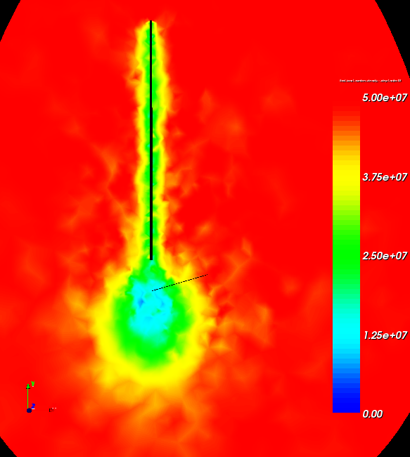
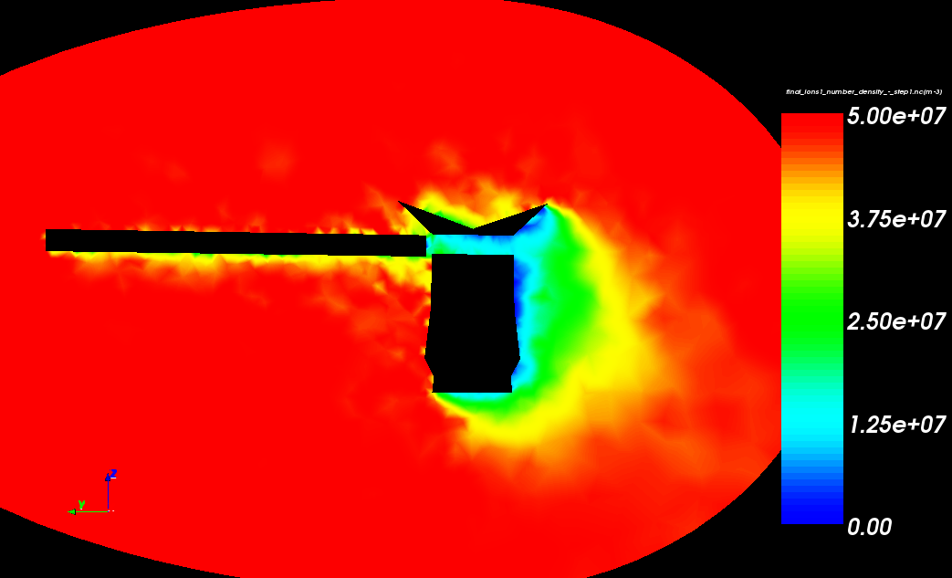
Results – Plasma wake structure
Ion density at the position of the probe
50
45
40
35
30
25
20
15
10
5
0
n_{i} (cm⁻³)
Studied time interval, 2010-03-03
d (m)
Plasma flow
V_{s/c}
Plasma flow
n_{i} (cm⁻³)
n_{i} (cm⁻³)
V_{s/c}

Slide 13
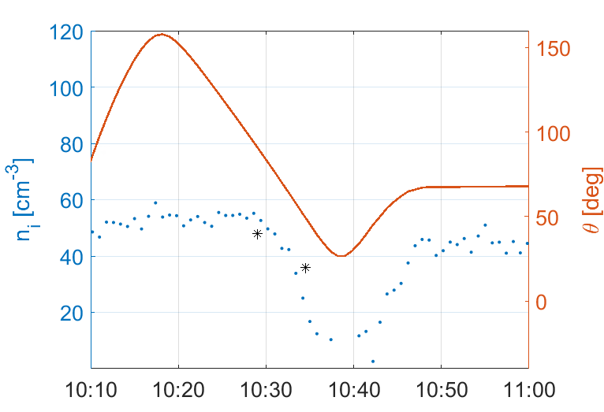
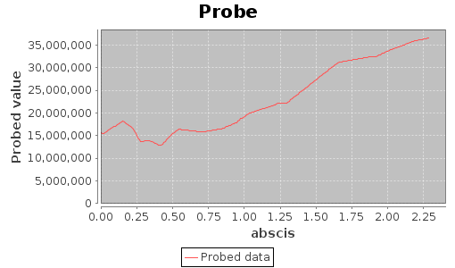
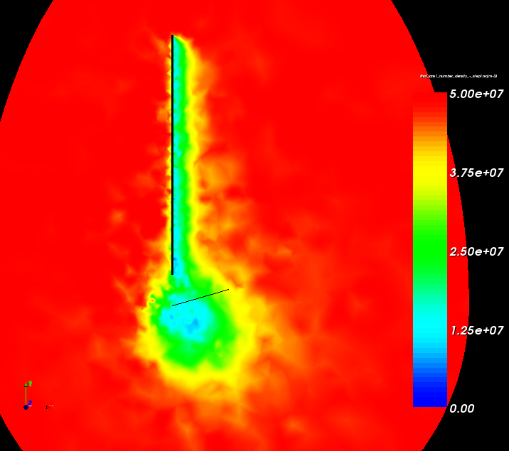
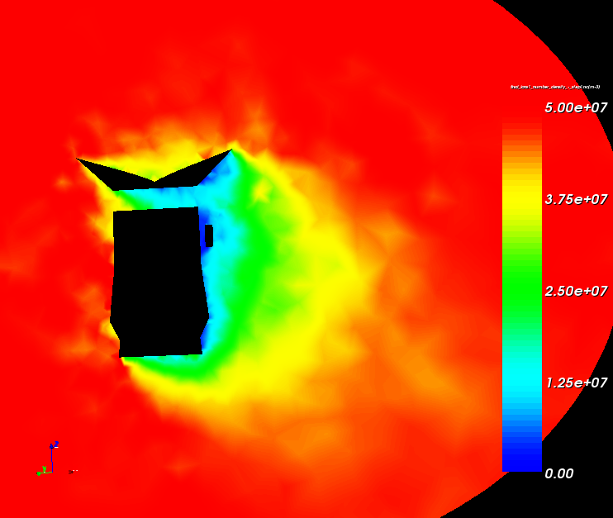
Results – Plasma wake structure
Ion density at the position of the probe
35
30
25
20
15
10
5
0
n_{i} (cm⁻³)
Studied time interval, 2010-03-03
d (m)
V_{s/c}
Plasma flow
Plasma flow
n_{i} (cm⁻³)
n_{i} (cm⁻³)
V_{s/c}

Slide 14
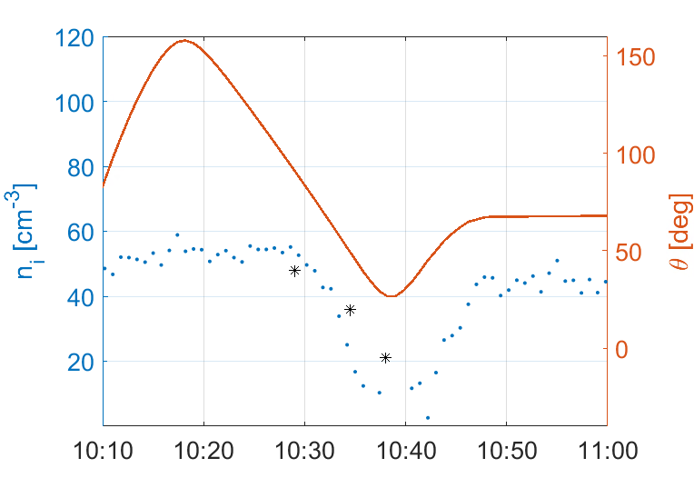
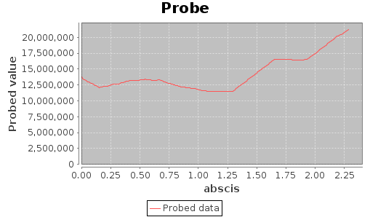
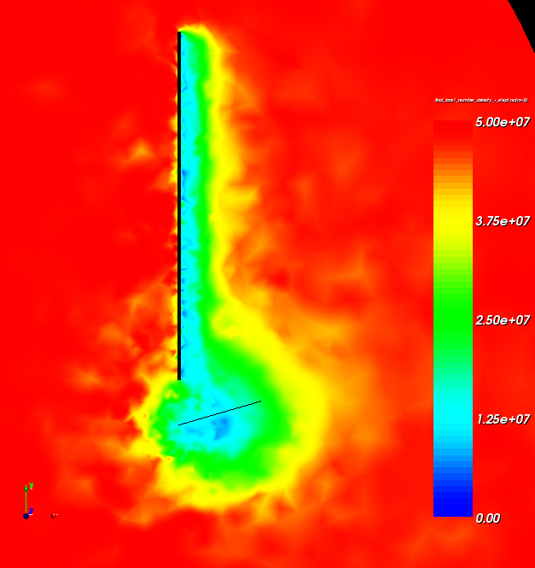
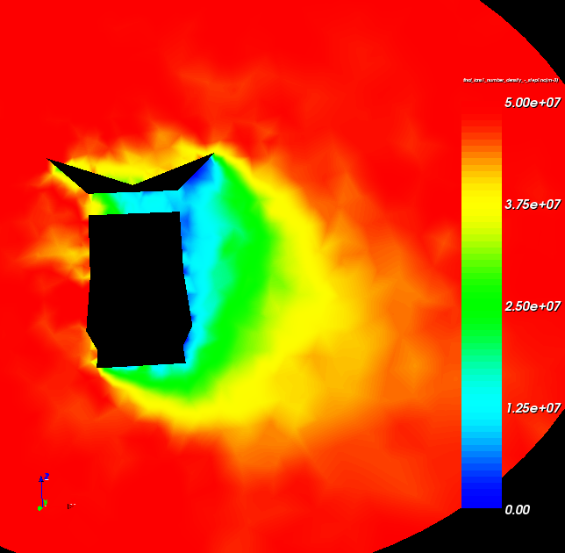
Results – Plasma wake structure
Ion density at the position of the probe
20.0
17.5
15.0
12.5
10.0
7.5
5.0
2.5
0.0
n_{i} (cm⁻³)
Studied time interval, 2010-03-03
d (m)
Plasma flow
V_{s/c}
Plasma flow
n_{i} (cm⁻³)
n_{i} (cm⁻³)
V_{s/c}

Slide 15
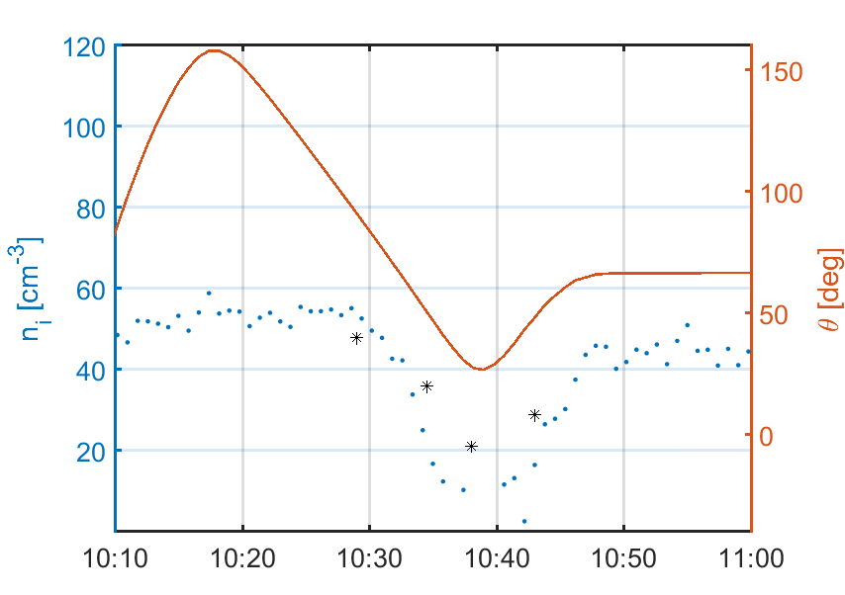
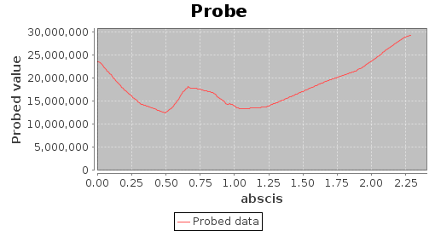
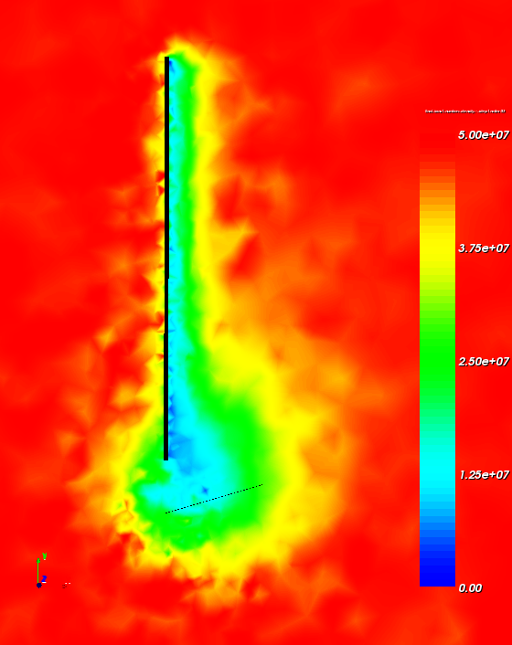
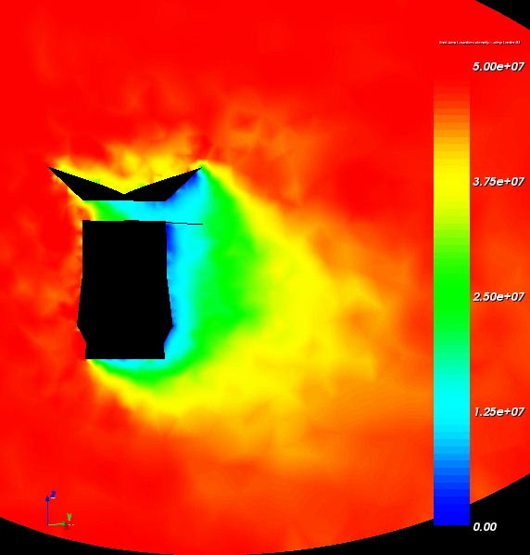
Results – Plasma wake structure
Ion density at the position of the probe
30
25
20
15
10
5
0
n_{i} (cm⁻³)
Studied time interval, 2010-03-03
d (m)
V_{s/c}
Plasma flow
Plasma flow
n_{i} (cm⁻³)
n_{i} (cm⁻³)
V_{s/c}

Slide 16
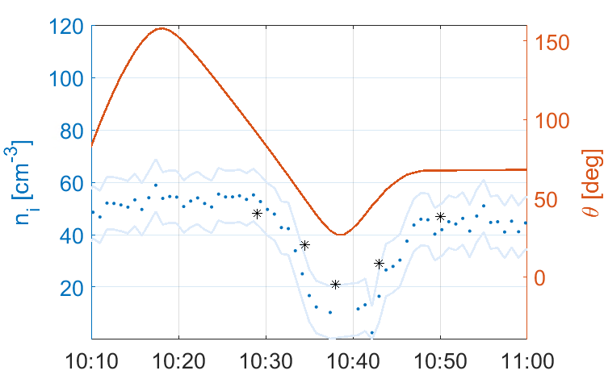
Results – Measured vs. simulated
Error of LP n_{i} ~±10 cm⁻³
Angle between probe and relative flow direction (red), measured ion density (blue), measurement uncertainty (light blue) and simulated ion density (black) for 2010-03-03.

Slide 17
Conclusion and future work
Simulated ion densities agrees well with ion densities measured with the Cassini/LP
An excellent agreement can be obtained by varying T_{i} and v
SPIS can be concluded to be very reliable for wake simulations in this plasma regime
Possible indication that T_{i} is lower than measured by CAPS
i.e., in better agreement with LP T_{i} estimates
Additional simulations with smaller mesh size
Additional simulations that include the LP, but with larger mesh size
Additional simulation for larger radial distance, i.e. lower plasma density, to show why the wake is less important for statistical studies
Same kind of simulations are being set-up for JUICE, to prepare for future plasma measurements

Slide 18
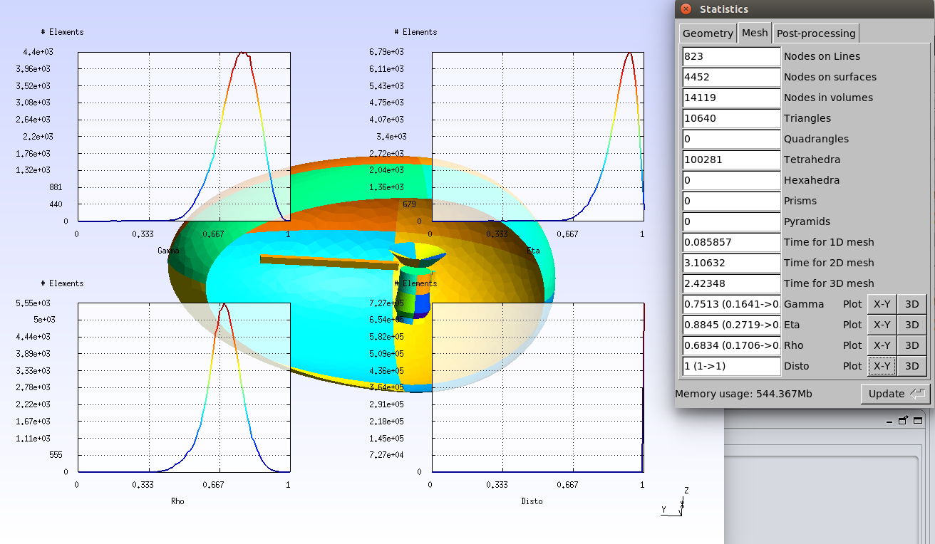
Mesh optimization
Cassini model without LP

Slide 19
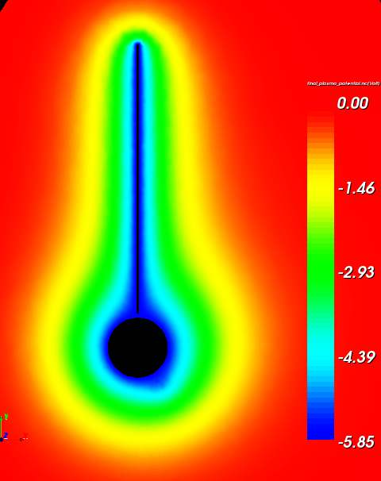
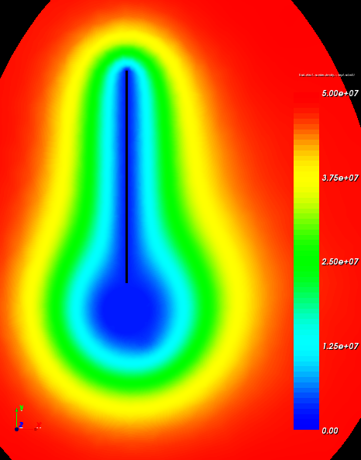
Potential and electron density
Cassini model without LP
Potential (not visibly affected by wake structure)
Electron density (not visibly affected by the wake structure)

