Slide 1
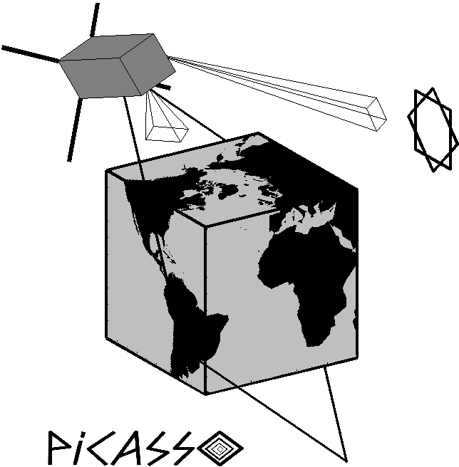
Charging of the PICASSO CubeSat
S. Ranvier¹, A. Waets², F. Cipriani², J. De Keyser¹ and J.P. Lebreton³
¹ Royal Belgian Institute for Space Aeronomy (BIRA-IASB), Avenue Circulaire 3, 1180 Brussels, Belgium
² ESA, TEC-EPS (Space Environment and Effects Section), Keplerlaan 1, Noordwijk 2200AG, The Netherlands
³ Laboratoire de Physique et Chimie de l’Environnement et de l’Espace (LPC2E), 3A, Avenue de la Recherche Scientifique, 45071 Orléans cedex 2, France
Contact: sylvain.ranvier@aeronomie.be
25th Spacecraft Plasma Interaction Network in Europe (SPINE) Workshop, 25-26 October 2018
ESTEC, Noordwijk, the Netherlands

Slide 2
Outline
PICASSO mission
PICASSO platform
SLP: scientific objectives
SLP instrument
S/C charging due to the use of LP
S/C charging due to the plasma environment
Conclusions

Slide 3
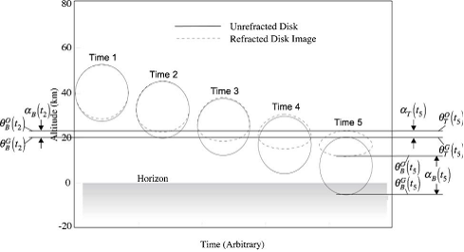
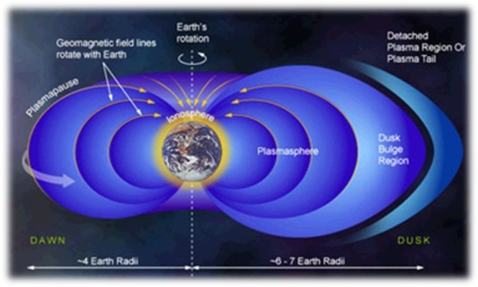
PICASSO mission
ESA in-orbit demonstrator
Quasi polar orbit, altitude: 500 - 600 km
expected orbital lifetime: 1-2 years
Launch in 2019
2 scientific instruments:
VISION: visible and near-infrared hyper-spectral imager
Scientific objectives:
Polar and mid-latitude stratospheric ozone vertical profile retrieval
Upper atmosphere temperature profiling based on the Sun refractive flattening
SLP: Sweeping Langmuir Probe

Slide 4
PICASSO platform
Triple unit (34x10x10 cm, 1U for payload), four 2U deployable solar panels
Telecom: UHF/VHF + S-Band
Attitude control: magneto-torquers & dynamical wheels
Attitude: inertial flight, one face towards the Sun
Mass: 3.9 kg, power consumption: 8 W
Downlink: 40 MB/day, Uplink: 400 kB/day
Pointing accuracy: ~1° (knowledge: 0.2°)
Star tracker & GPS

Slide 5
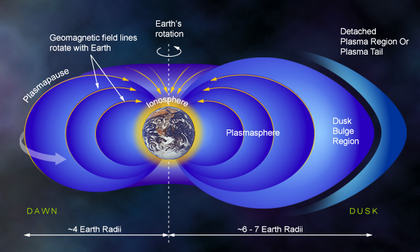
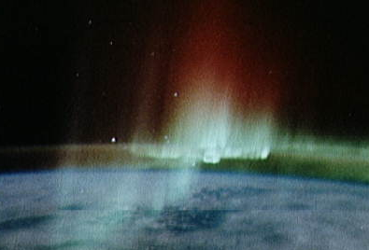
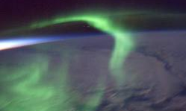
SLP: scientific objectives
Scientific objectives
In-situ study of:
Ionosphere-plasmasphere coupling
Subauroral ionosphere and corresponding magnetospheric features
Aurora structures
Turbulence (multi-scale behavior, spectral properties)
Expected plasma environment
 | Minimum (> 95% probability) | Maximum (> 95% probability)
Plasma density (#/m³) | 10⁸ (10⁹) | 10¹³ (5x10¹²)
Electron temperature (K) | 600 (700) | 10 000 (5 000)

Slide 6
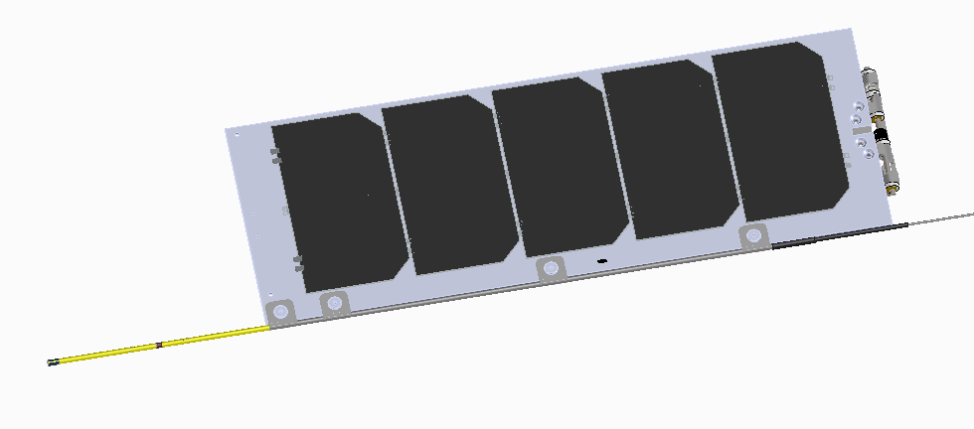
SLP instrument
Instrument overview
Four thin cylindrical probes whose electrical potentials are swept. From the electric current collected by each probe, the following parameters will be retrieved on ground:
electron density and temperature
ion density
spacecraft potential
Download raw data: I-V curves contain more information than only 3 parameters !
Key numbers:
4 probes
4 independent channels
Probe diameter: 2 mm
Probe length: 40 mm
Boom length: 40 mm
Sampling frequency: 10 KHz
> 10 I-V curves/s => Ne, Te, Ni, V_{S/C}
Bias voltage: -5 V to 13 V wrt S/C GND

Slide 7
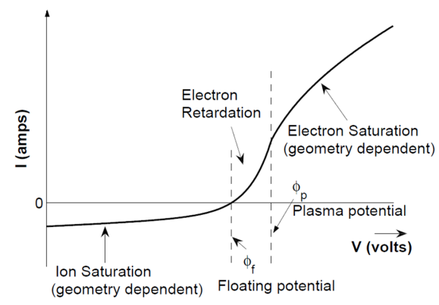
SLP instrument
Typical I-V mode:
Apply bias, measure current
On board plasma potential estimation => adaptive sweep
Sweeps with different bias steps according to the region, e.g.:
Ion saturation: 5 steps
Electron retardation: 30 steps
Electron saturation: 8 steps
Fast Ne measurement:
Acquire simultaneously with at least 2 probes the current when probes biased with different potential in the electron retardation region => retrieve Ne only
5 KHz sampling rate => ~ 1,5 m resolution
Floating potential:
Measure the potential of the probes wrt the S/C GND

Slide 8
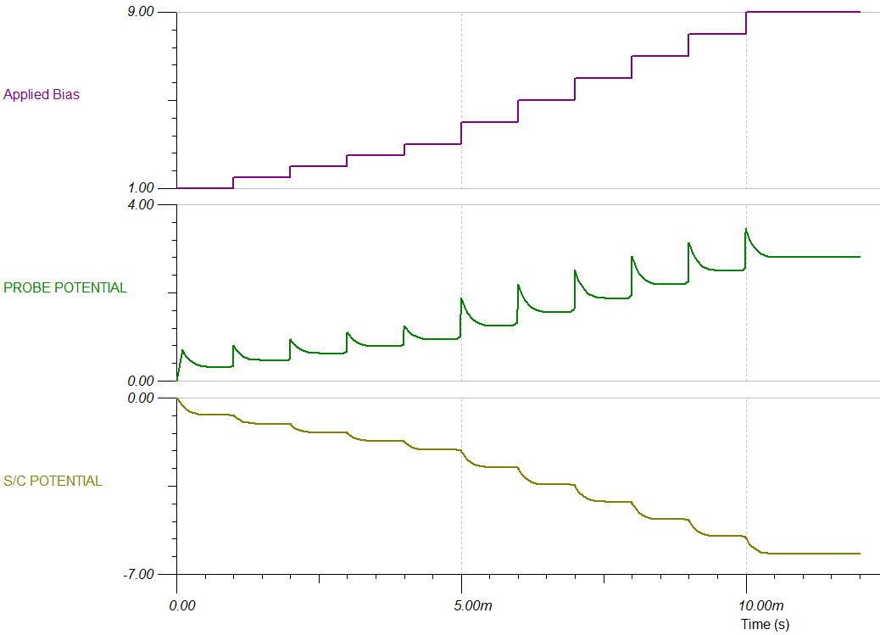
S/C charging due to the use of LP
Problem of using LP on board Pico-Satellite
Limited conducting area of the S/C with respect to the area of the probe
Spacecraft charging (e- saturation region)
Drift of the instrument’s electrical ground during the measurement
Unusable data
Risk:
Too low S/C potential: unable to sweep appropriate potentials (e- saturation region)

Slide 9
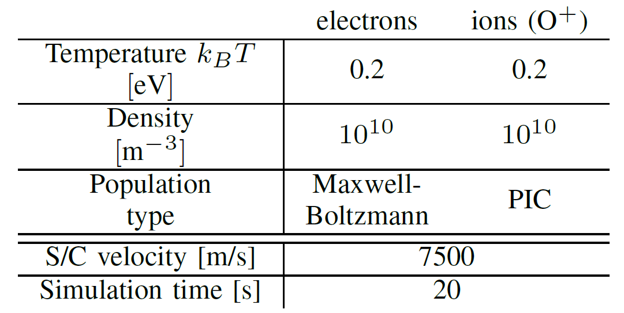
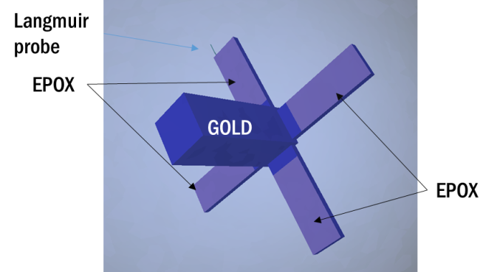
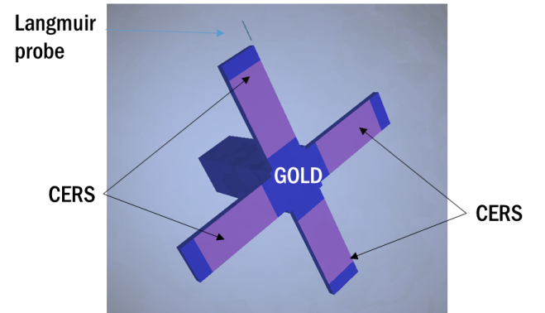
S/C charging due to the use of LP
Particle-in-cell (PIC) modelling and simulations with SPIS

Slide 10
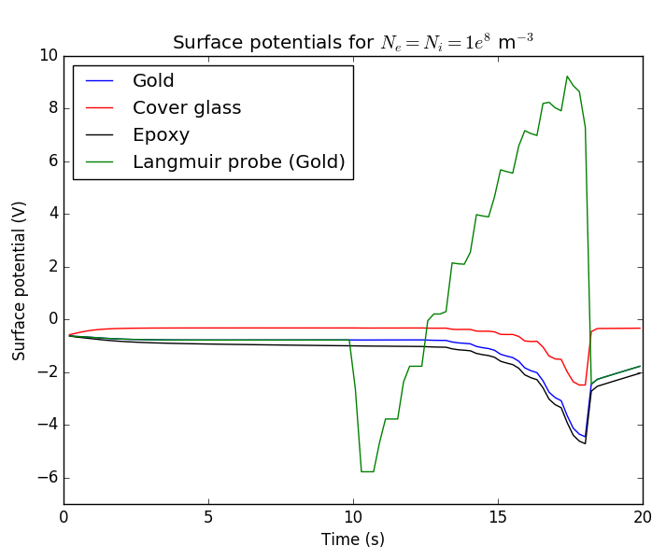
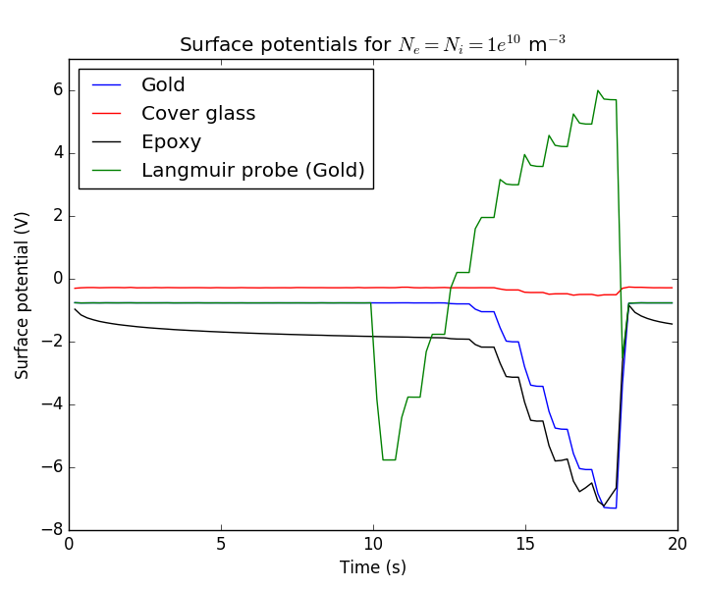
S/C charging due to the use of LP
Example of sweeps in eclipse
Bias: from -5 V to + 13 V
Ne = Ni = 1e8/m³ ; Te = Ti = 0,2 eV
Ne = Ni = 1e10/m³ ; Te = Ti = 0,2 eV

Slide 11
S/C charging due to the use of LP
Proposed solution
Increase conducting surface of the S/C (at least 200 cm² on all sides of the S/C, incl. solar panels)
Measure the floating potential of one probe while measuring the I-V curve with another probe
=> The 2 probes that are in the same environment (light/shadow, wake)
Advantages
Robust: no filament
No risk of electron collection from e-gun
Disadvantage
Limited range in e- saturation region in very high density plasma

Slide 12
S/C charging due to the use of LP
Test at ESTEC in July 2015 and February 2017
Functional test in plasma chamber (ESTEC Feb. 2017)
Red: I as function of bias (wrt to S/C GND)
Blue: I as function of bias (wrt to plasma pot.)
Floating pot. of one probe (wrt to S/C GND) as function of applied bias on other probe

Slide 13
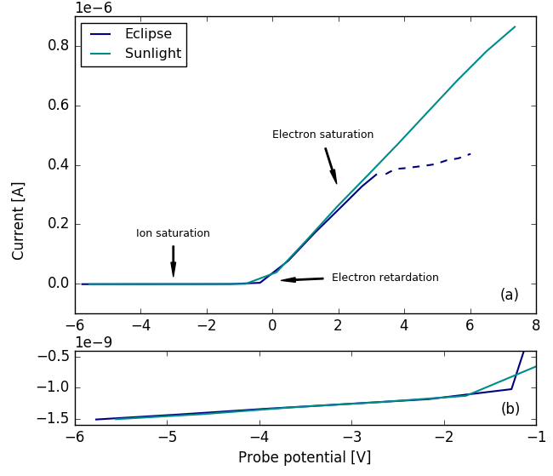
S/C charging due to the use of LP
Effect of photoemission
Bias: from -5 V to + 13 V
Eclipse:
Max bias (wrt plasma): ~6 V
S/C charging effect: from ~3 V
Sunlight:
Max bias (wrt plasma): ~10 V
S/C charging effect: from ~8 V
IV curves from LP sweeps in eclipse and sunlight.
Ne = Ni = 1e10/m³ ; Te = Ti = 0,2 eV

Slide 14
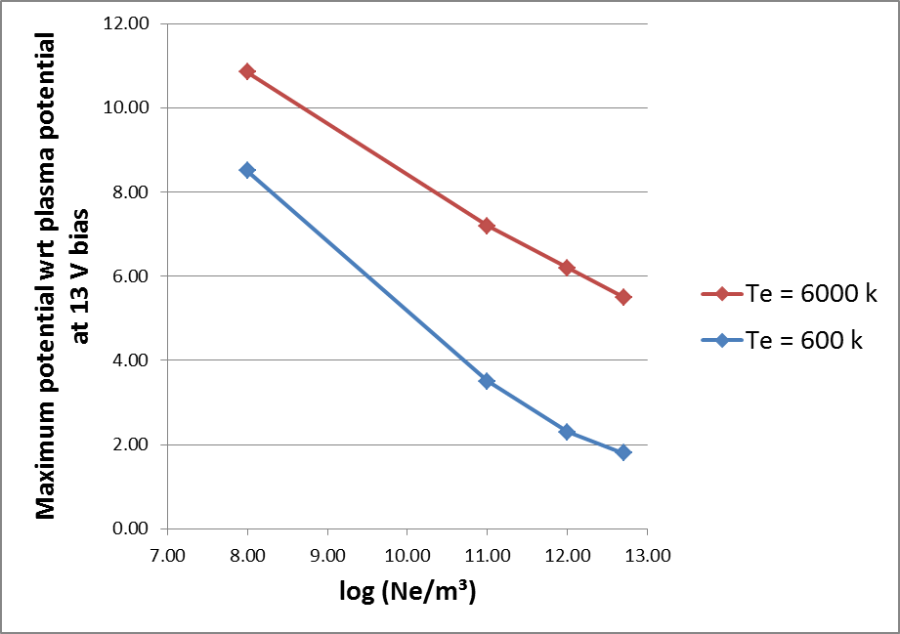
S/C charging due to the use of LP
Maximum probe potential with respect to plasma potential
SPIS simulations for extreme cases
Most unfavorable case:
High Ne
Low Te
Eclipse (no photoelectron)
Floating potential:
-0.16 V for Te = 600 K
-1.9 V for Te = 6000 K
=> Always possible to reach electron saturation region
Probe potential for extreme cases (eclipse)

Slide 15
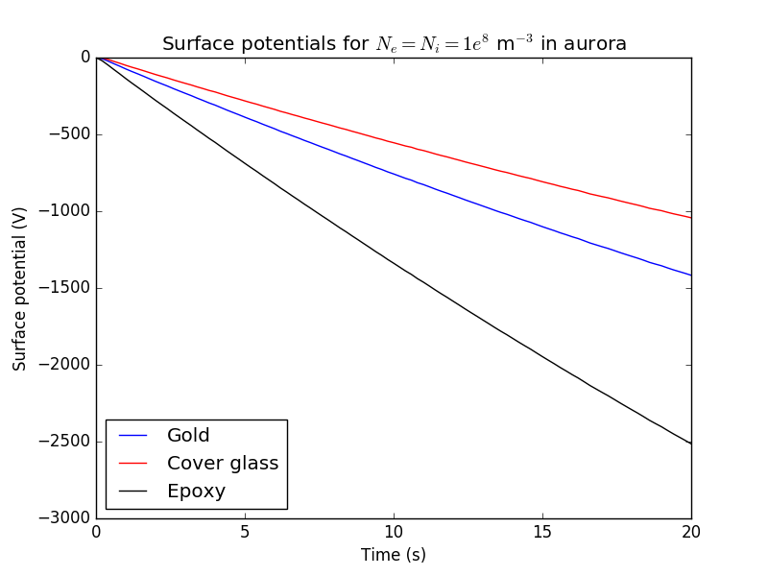
S/C charging due to the plasma environment
Auroral environment: Maxwellian fit of the ECSS worst case distribution with Ne = 1.23E7/m³ and Te = 11keV
After 10 seconds:
800V differential charging between epoxy and cover glass
550V differential charging between epoxy and gold (S/C GND)
Background ion and e- populations: Ne = Ni = 1e8/m³, Te = Ti = 0.2 eV

Slide 16
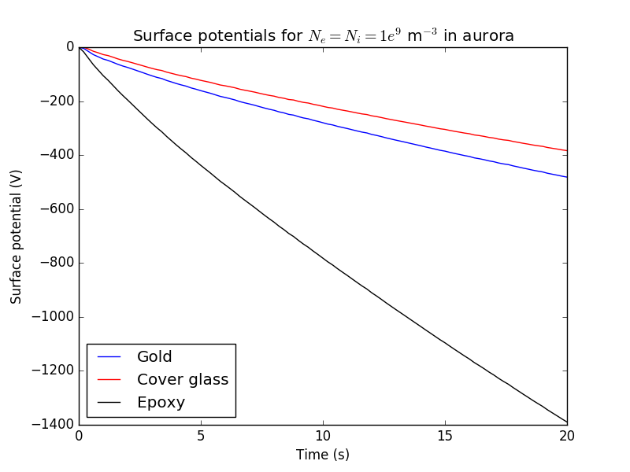
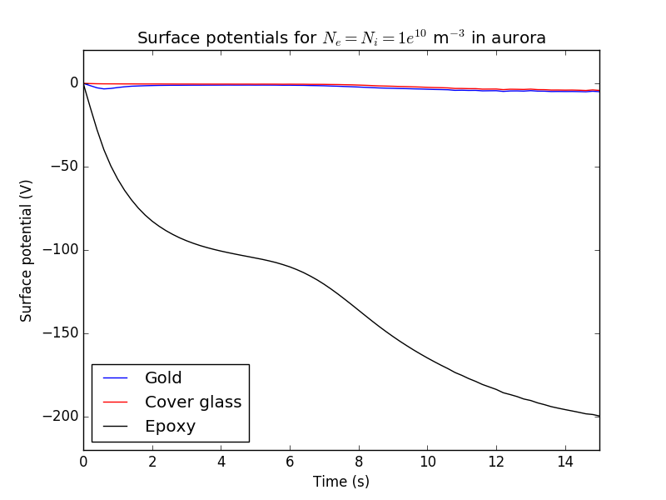
S/C charging due to the plasma environment
Background ion and e- populations: Ne = Ni = 1E9/m³, Te = Ti = 0.2 eV
Background ion and e- populations: Ne = Ni = 1E10/m³, Te = Ti = 0.2 eV
After 10 seconds: 550V differential charging between cover glass and epoxy
After 10 seconds: 165V differential charging between cover glass and epoxy

Slide 17
Conclusions
SLP (Sweeping Langmuir Probe) instrument to fly on board PICASSO in 2019
Uses adaptive sweep => download raw data
Can acquire > 10 I-V curves/s => Ne, Te, Ni, V_{S/C} on ground
Problem of using LP on board pico-satellite:
Limited conducting area of the S/C with respect to the area of the probe
Spacecraft charging (e- saturation region)
Drift of the instrument’s electrical ground during the measurement
Unusable data
Proposed solution
Maximize conducting surface of the S/C
Measure the floating potential of one probe while measuring the I-V curve with another probe
Allows sweeping bias in e- saturation region even in the worst conditions of the PICASSO mission
Differential charging up to several 100 V might occur in auroral regions depending on background plasma density

Slide 18
Thank you for your attention!

