Slide 1
Diversity at the RAS
Dr Sheila Kanani
Education, Outreach and Diversity Officer
ESA meeting January 2019
@ras_outreach
skanani@ras.ac.uk

Slide 2
History
RAS started in 1820
First women were formally allowed to be Fellows in 1916 – centenary celebrations in 2016
Women in Astronomy and Geophysics committee for some years
Now CDAG – meet twice a year

Slide 3
Why a focus on diversity?
To promote and foster an inclusive, diverse and vibrant astronomy and geophysics community which is reflected in the Society’s Fellowship, Council, committees and conferences.
To improve and encourage the diversity of the RAS and the wider A&G community
To embed diversity and equality considerations into the working practices of the RAS
To use data driven evidence to steer our work and promote wider participation
To promote and have an inclusive working environment where all are respected and valued.

Slide 4
Why a focus on diversity?
To advise Council
To collect data through surveys and other means
To support and carry out large- and small-scale projects addressing any identified diversity issues
To liaise with groups with similar aims from other societies
To provide a support network for Fellows on diversity matters

Slide 5
Progress since 2014
Signed a diversity declaration of action
Hired diversity officer - me!
Council Diversity Champion
Benchmarking and surveys
Implemented a Diversity and Inclusion Policy and a Code of Conduct for the RAS, and a Safeguarding Policy for the education and outreach work we do.
Lots of training, attending conferences, networking etc.
RAS200 staff lead – working with diverse audiences from prison inmates to visually impaired astronomers
Work with specific organisations which meet our diversity needs e.g. Generating Genius working with BME students
Partnerships e.g. LGBT+ Physical Sciences Network
Conferences e.g. NAM and UKSEDS DISC
One off events e.g. Hidden Figures screening
Annual events e.g. Ada Lovelace Day
e-mentoring and other support mechanisms
Sexual harassment and bullying work

Slide 6
LGBT+ Network
-The first meeting was in March 2016 led by the RAS and the Institute of Physics, expanded recently to include Royal Society of Chemistry
-Support network, steering group with members from academia and industry, contributions and suggestions from members.
-LGBT+ STEMinar
-International Day of LGBT+ people in STEM

Slide 7
LGBT+ climate survey
-First UK and Ireland survey of working, teaching and studying climate for LGBT+ physicists, astronomers and chemists, and those in related science and jobs.
-Over 1000 people responded.
-Results have been collected and the launch of the results will be in April 2019.

Slide 8
LGBT+ climate survey

Slide 9
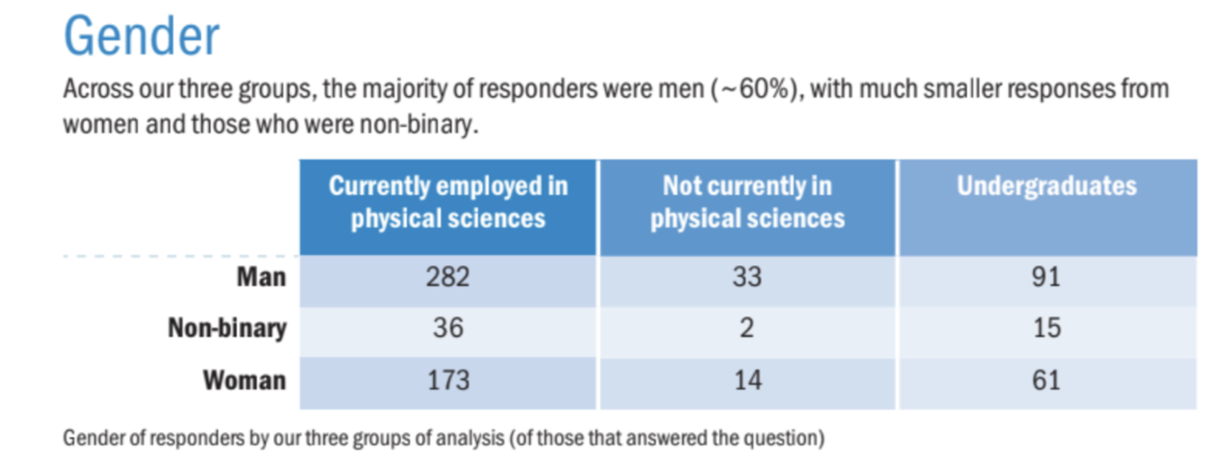
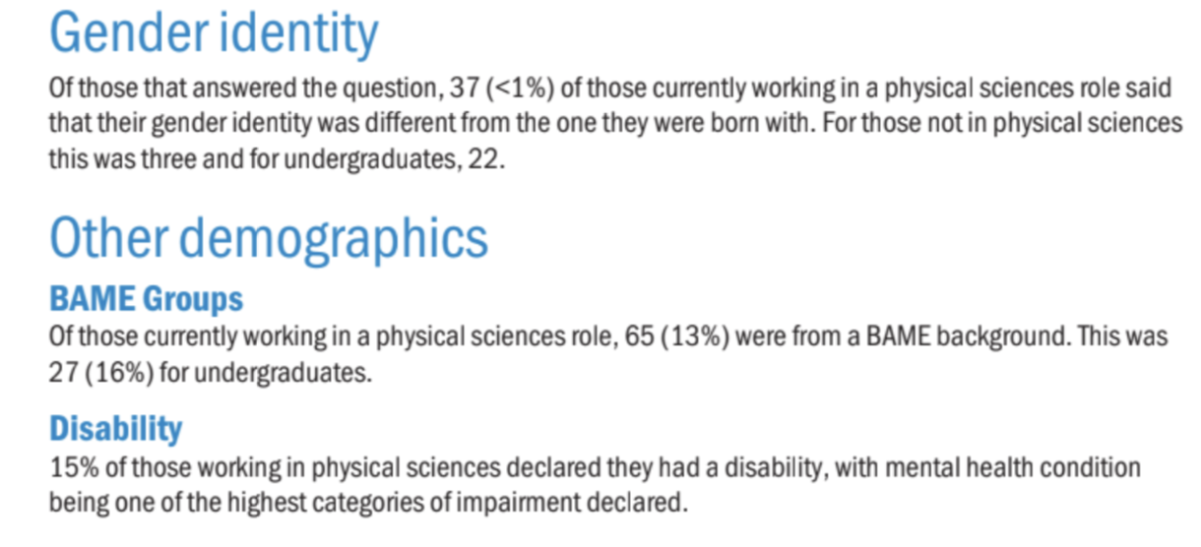

Slide 10
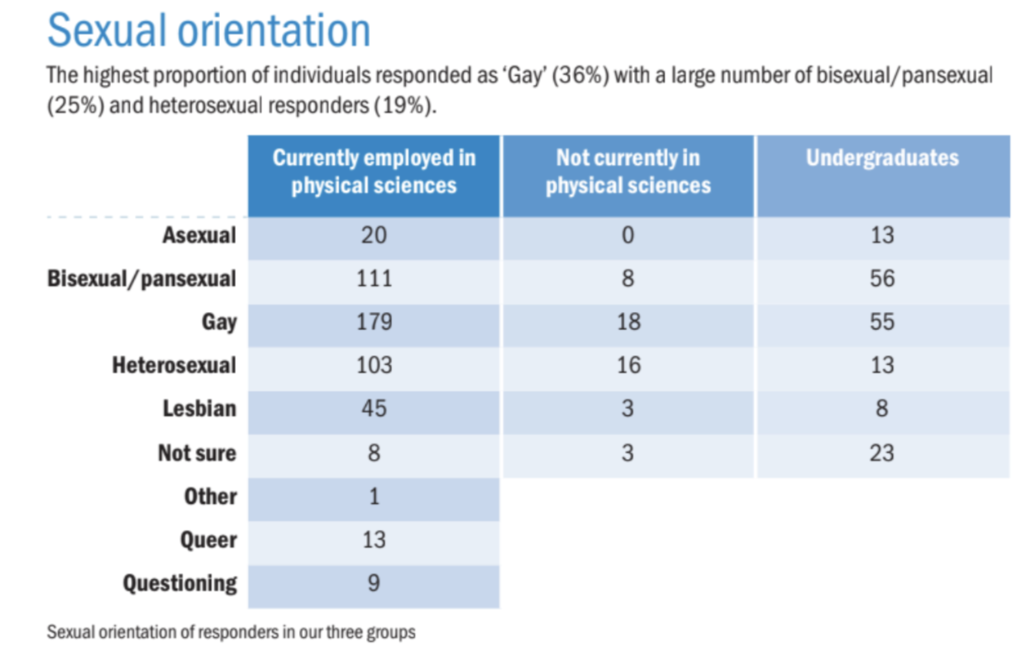

Slide 11
Challenges, questions and opportunities
I was new to diversity work in 2014, had to do a lot of training to get to where I am now, and I am not trained in areas like what to do if a harassment or bullying report is disclosed to me.
We are not the police/judge/jury and we are often limited to what we can achieve (and I am the only designated diversity officer in my area).
We are not the employer so again we are limited.
PhD students, supervisors, funding, mental health, diversity training - talking about LGBT+ or gender is just the beginning of a bigger, much wider conversation!
Intersectionality is important to address (but difficult in my field).
However:
Our members are starting to feel that they can come to us with their problems
We do care, we do hear what they are saying, we are trying to make things better and more diverse.
As a learned society we have the power to make universities (and other organisations) listen to us and initiate the changes we want to see happen.

Slide 12
Diversity at the RAS
Dr Sheila Kanani
Education, Outreach and Diversity Officer
ESA meeting January 2019
@ras_outreach
skanani@ras.ac.uk

