Slide 1
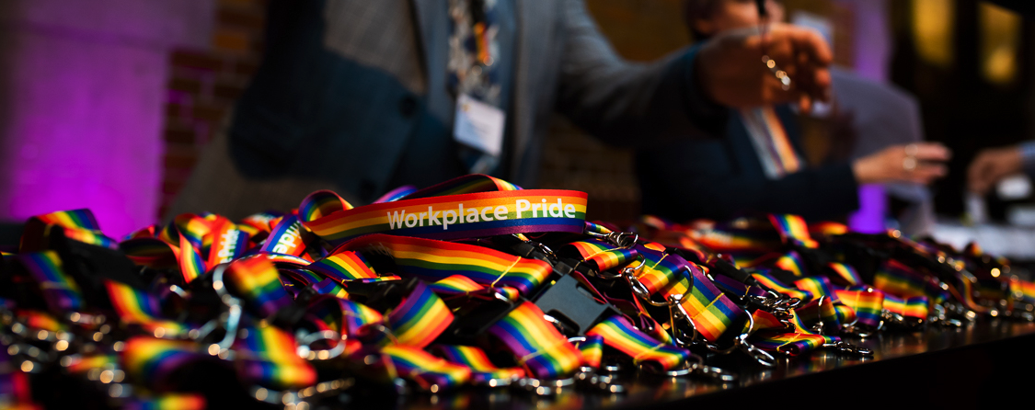
LGTBI Policies and Practices at Work
Creating an environment where everyone can be themselves
Presentation to ESA, January 14th 2019
David Pollard
Executive Director

Slide 2
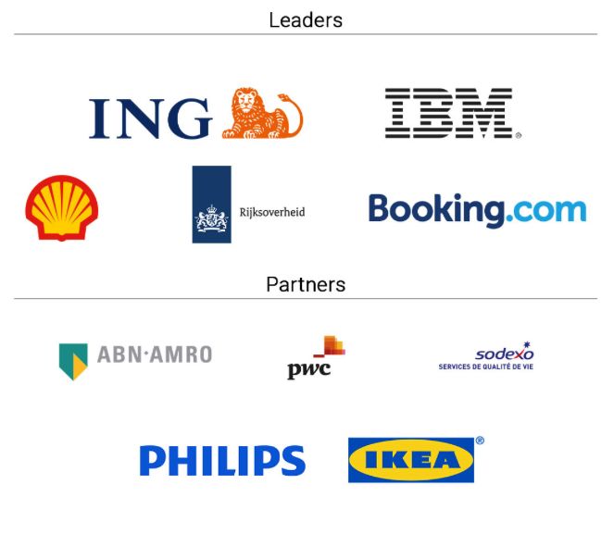
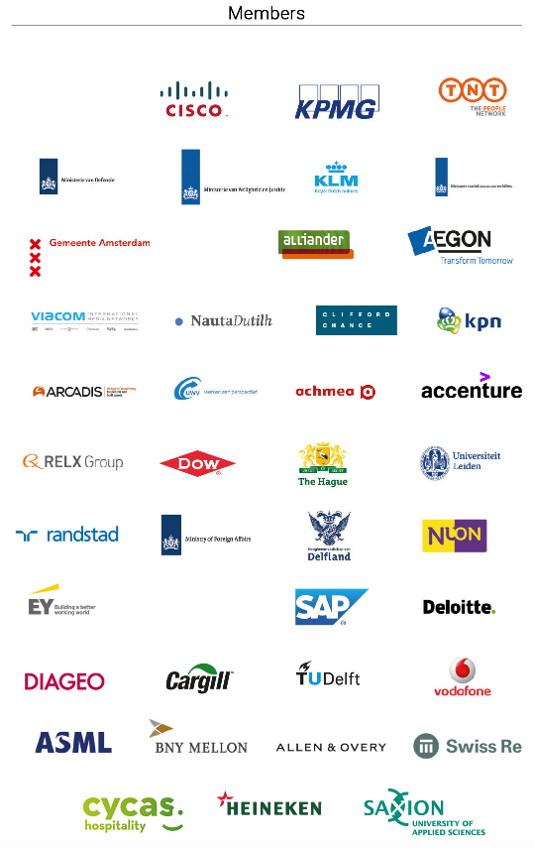
Members
OUR MEMBERS INCLUDE:
Major Dutch and Multinational
Businesses, both public & private sectors plus academia who support
LGBTI workplace inclusion

Slide 3
WHAT WE DO
Mission Statement:
Dedicated to improving the lives of LGBTI people at work
International events, publications, connections re LGBTI workplace inclusion
Point of reference for HR & D&I professionals & LGBTI community for best practices
Gives employers, governments & NGOs the tools they need to create real change
Realising the full potential of LGBTI workplace inclusion for all stakeholders

Slide 4
LGBTI AT WORK
35%
Of your total waking hours over a working life is spent at work
30%
The percentage of productivity and creativity loss we estimate if LGBTI people cannot be themselves at work
If you cannot be openly yourself at work, this is bad for you, bad for your employer & ultimately bad for economies due to productivity loss.

Slide 5
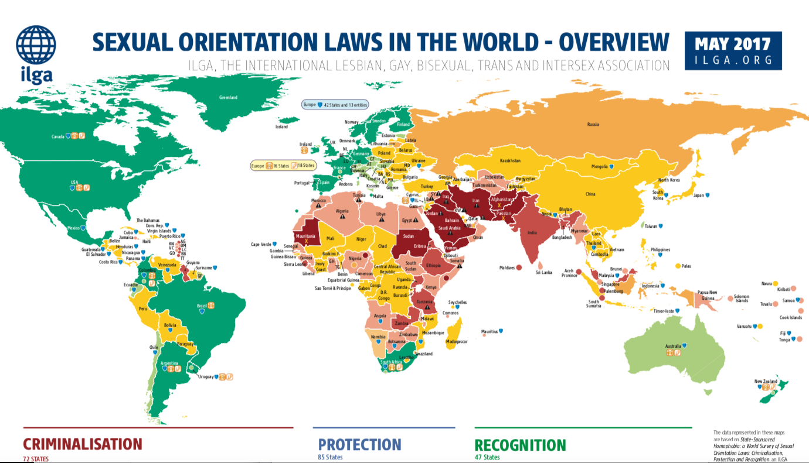
THE DILEMMA

Slide 6
THE DILEMMA
Most organisations have global Diversity and Inclusion and LGBT policies
But varying laws and cultural norms make implementation difficult
First step is to know where you stand with LGBTI Workplace Inclusion…Measure it!

Slide 7
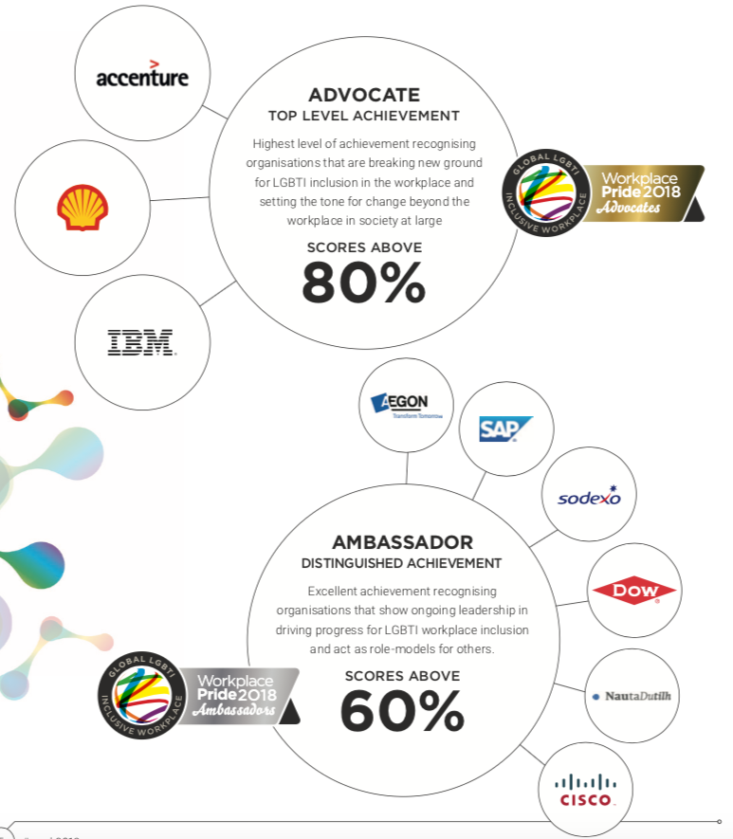
MEASUREMENT
Workplace Pride
Global Benchmark
Annual measurement tool for cross-border LGBTI policies and practices
Participation reveals many opportunities to make positive - low threshold - changes in organisations

Slide 8
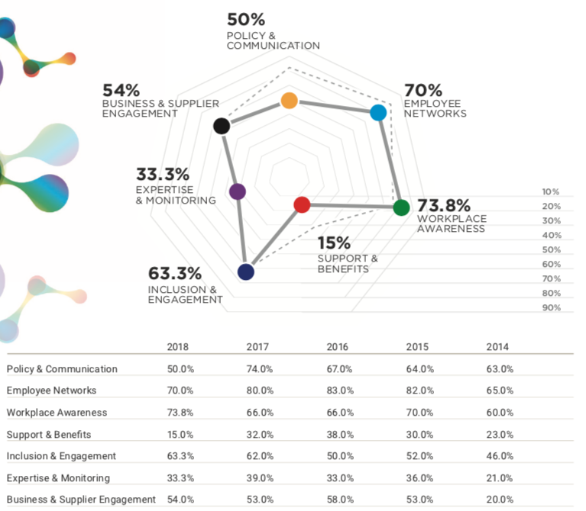
MEASUREMENT
Designed as management tool
7 Business-relevant sections:
Policy and Communication
Employee Networks
Workplace Awareness
Support & Benefits
Inclusion & Engagement
Expertise & Monitoring
Business & Supplier Engagement

Slide 9
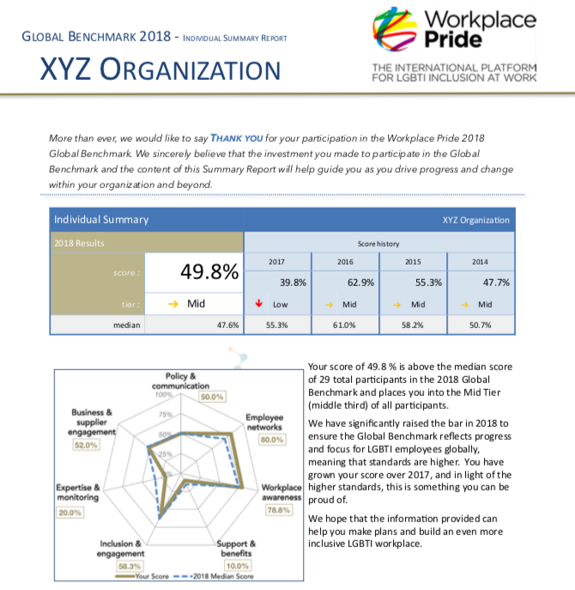
MEASUREMENT
Individual results provide specific advice for how to improve LGBTI inclusion
Baseline comparison to make changes for LGBTI workplace Inclusion

Slide 10
2018 Findings
Workplace Pride Global Benchmark
Support and benefits measures still need to be put in place to eliminate or reduce specific obstacles that LGBTI employees face in the workplace
Organisations are still struggling with monitoring of LGBTI inclusion at work
Employee networks remain critical to making progress with LGBTI inclusion
How can we make progress collectively?

Slide 11
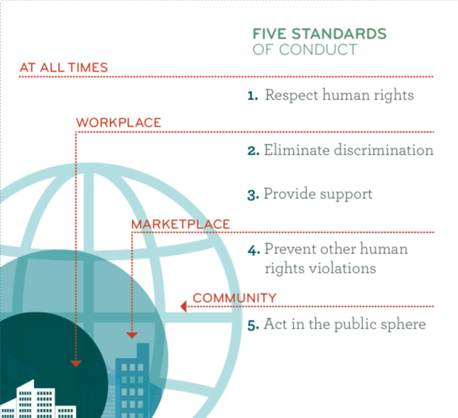
THE way forward
United Nations: Human Rights
LGBTI Standards of Conduct for Business

Slide 12
THE way forward
United Nations: Sustainable Development Goals
5
LGBTI tie-in to SDG’s
In education
At work
In society
8
10

Slide 13
relevance for STEMM
STEMM people are LGBTI as well!
Promotes inclusive environments for universities, businesses, researchers
Untapped pool of talent: inclusive employers attract better and more diverse recruits
LGBTI technical community is organising itself!
Tech@WorkplacePride: Last October at Brainport Eindhoven - large LGBTI technical event supported by leading technical oriented multinationals (ASML, IBM, Phillips, Arcadis, TU Eindhoven, TU Delft, etc.)!

Slide 14
relevance for STEMM
“Companies that engage in pro-LGBT advocacy perform better on various measures of business competitiveness compared with their peers, based on self-reported factors”
The Economist Intelligence Unit: Pride and Prejudice Report 2018

Slide 15
www.workplacepride.org

