Slide 1
Radiation Assessment for JPL Missions:
Models and Tools
Copyright 2019 California Institute of Technology. Government sponsorship acknowledged.
Insoo Jun, JPL/NASA
May 31, 2019
AP9/AE9/IRENE Meeting
Sykia, Greece

Slide 2
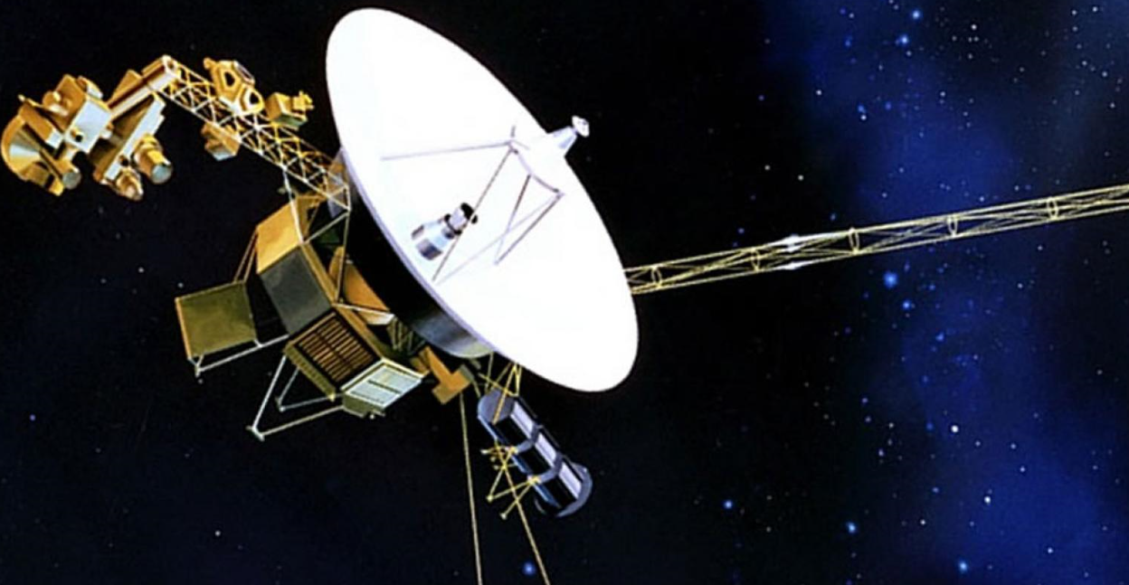
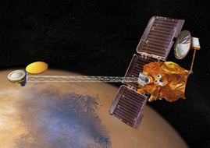
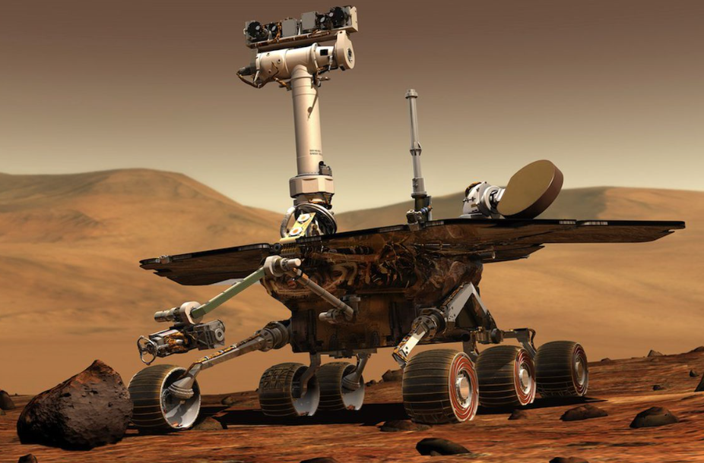
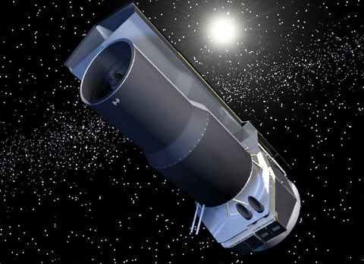
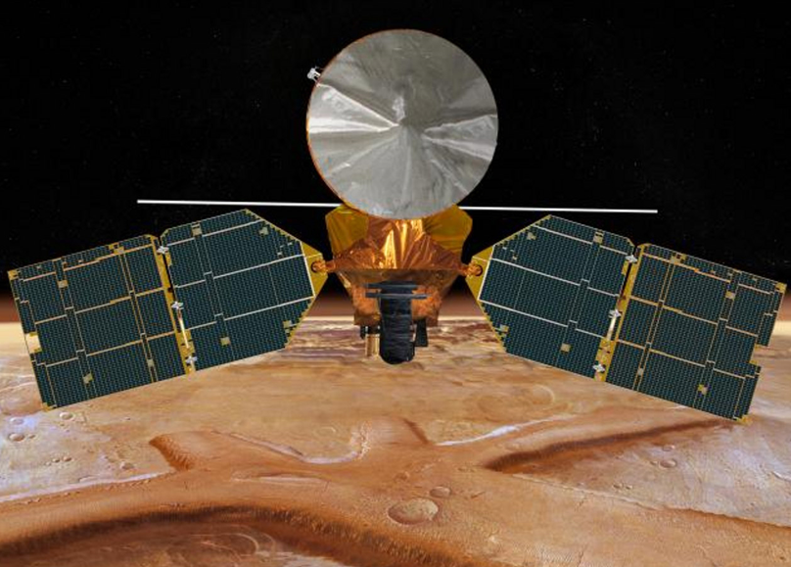
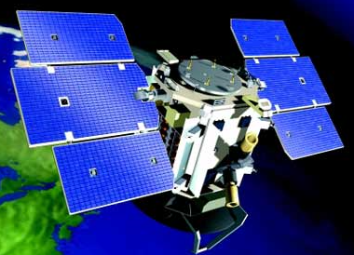
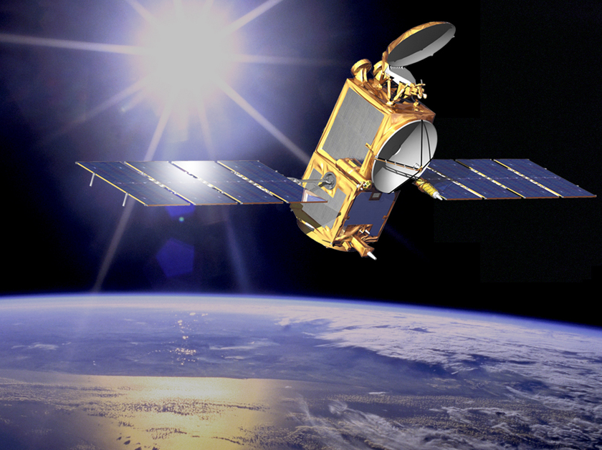
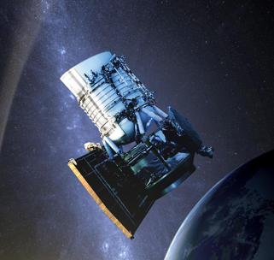
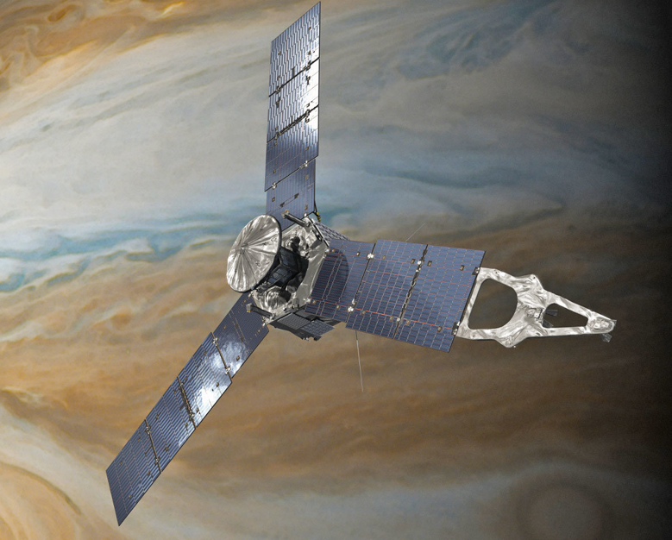
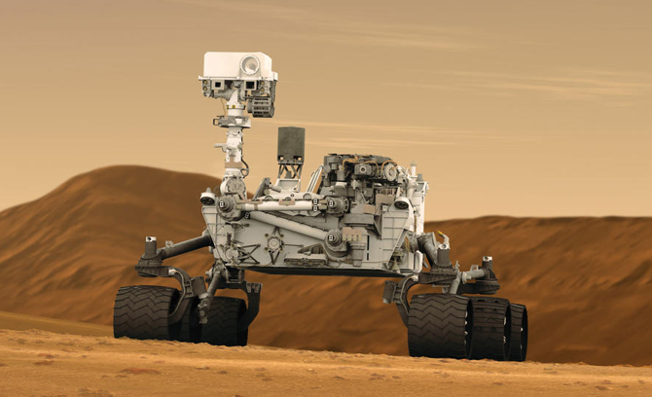
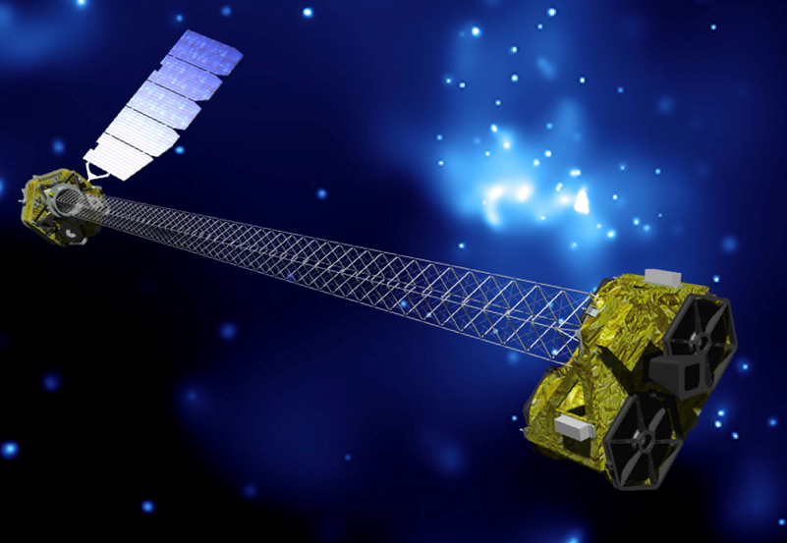
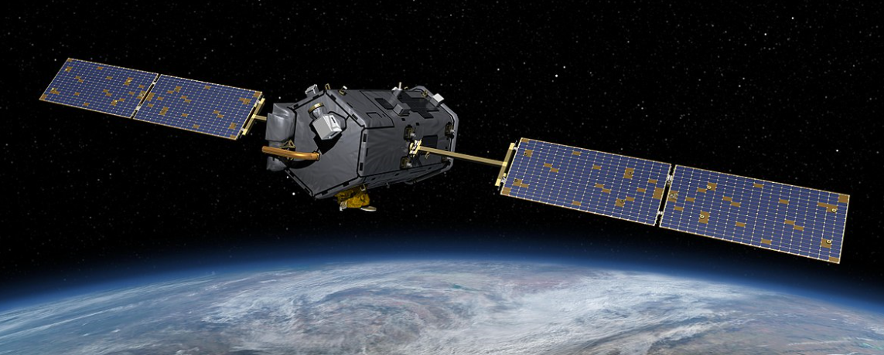
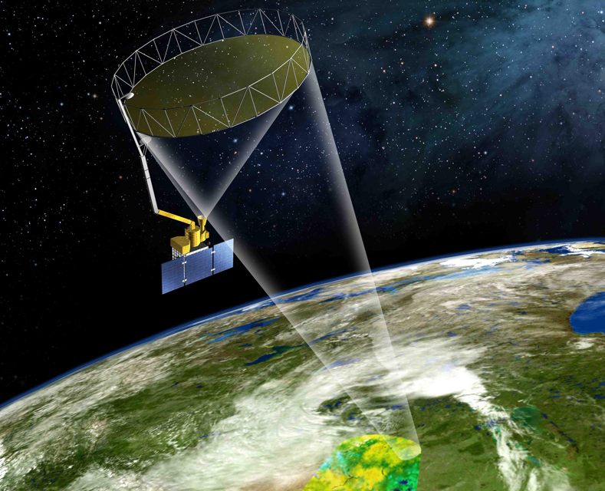
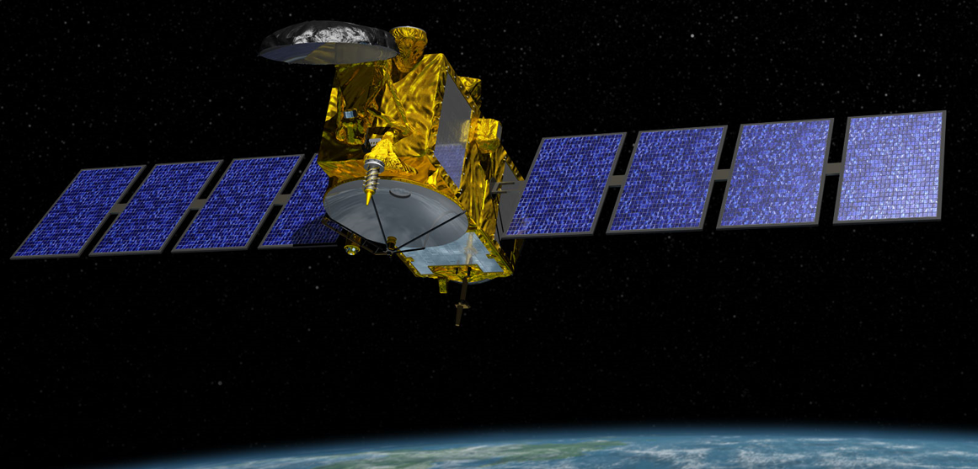
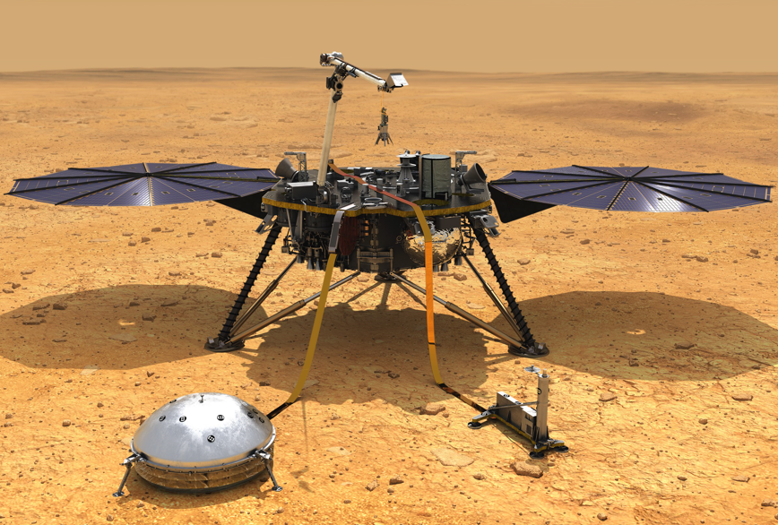
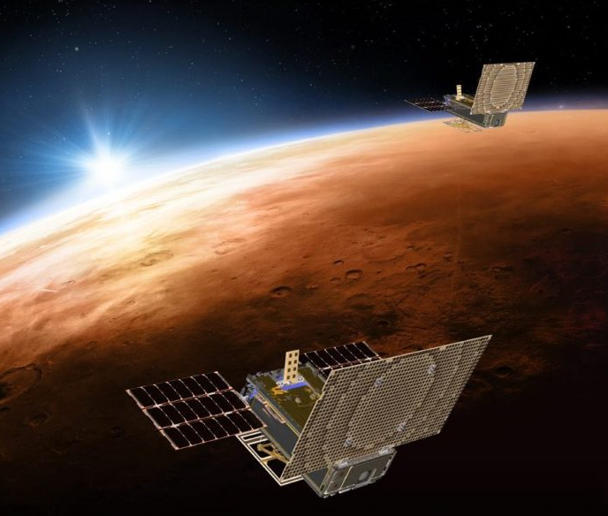
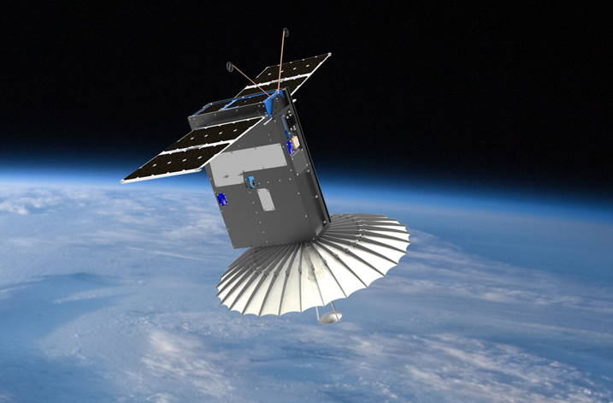
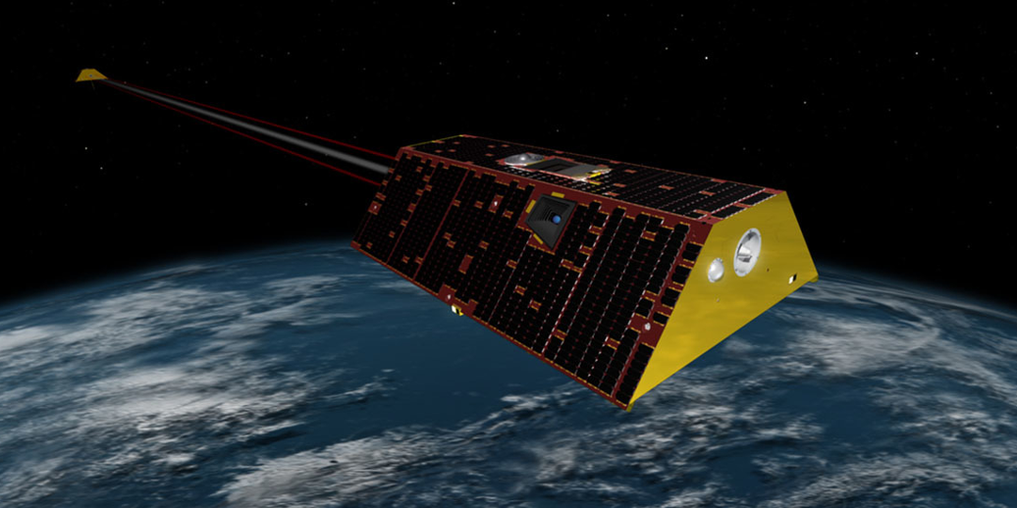
20 Spacecraft and 8 Instruments in Operation
Across the Solar System and Beyond
1977
Voyagers 1 & 2
2001
Mars Odyssey
2003
Opportunity
2003
Spitzer
2005
Mars Reconnaissance Orbiter
2006
CloudSat
2008
Jason 2
2009
NEOWISE
2011
Curiosity
2012
NUSTAR
2014
OCO-2
2011
Juno
2016
Jason 3
2018
InSight
2018
MarCO
2018
RainCube
2018
Grace Follow-On
2015
SMAP
Instruments
Earth Science
Planetary
• MISR (1999) • AIRS (2002) • MLS (2004) • ASTER (2009)
• OPALS (2014) • ECOSTRESS (2018) • CAL (2018) • OCO-3 (2019)
• MARSIS (2003)

Slide 3
JPL Missions
Robotic Solar System Exploration
  Mars
  Outer Planets
    Gas Giants
    Ice Giants
    …
  Deep Space
    Asteroids
    …
Earth Science
  Mostly LEO orbits
  …
Astrophysics
  Spitzer
  WISE
  Hubble (instrument)
  JWST (instrument)
  …
….

Slide 4
JPL Missions
Robotic Solar System Exploration
  Mars
  Outer Planets
    Gas Giants
    Ice Giants
    …
  Deep Space
    Asteroids
    …
Earth Science
  Mostly LEO orbits
  …
Astrophysics
  Spitzer
  WISE
  Hubble (instrument)
  JWST (instrument)
  …
….

Slide 5
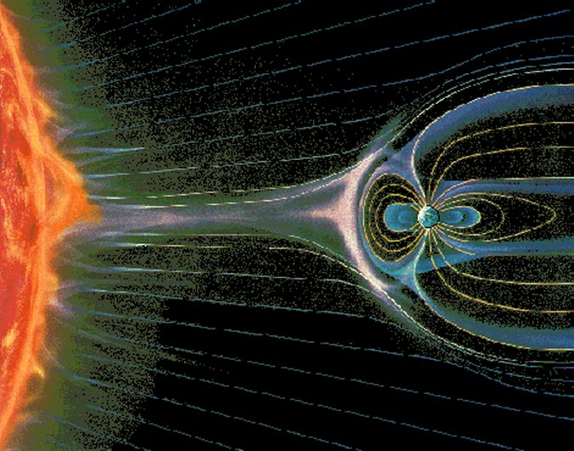
The Space Radiation Environment
  Interplanetary Space: Galactic Cosmic Rays
  Sun
  Solar Wind
  Solar Protons and Heavier ions
  Trapped Particles
CHARGED PARTICLES

Slide 6
Environment Models
Environment | Models (Present) | Models (Future)
GCR | CREME96
SEP | JPL | SAPPHIRE (?)
Trapped Earth Jupiter Saturn Uranus Neptune | AE8/AP8 GIRE3 SATRAD UMOD NMOD | AE9/AP9/IRENE (*) GIRE4 with Juno data (+)
(*)
Continue to validate against on-orbit data
Will be used for selected missions
Waiting for community’s acceptance based on wider and more comprehensive validation effort
(+)
Just started working on analyses of noise background data available in PDS

Slide 7
Summary: Environment -> Effect
Source Particles | Environment Effects
Trapped electrons; Trapped protons ; Solar protons | Total Ionizing Dose (TID) and Displacement Damage Dose (DDD)
Auroral electrons; Plasma electrons/ions | Surface Charging
High energy (> 1 MeV) trapped electrons | Internal Charging (IESD)
Trapped protons; Solar protons; Galactic cosmic ray | Single Event Effects (SEE)
MMOD | Structural Damage; ESD
Atomic oxygen UV | Material Degradation

Slide 8
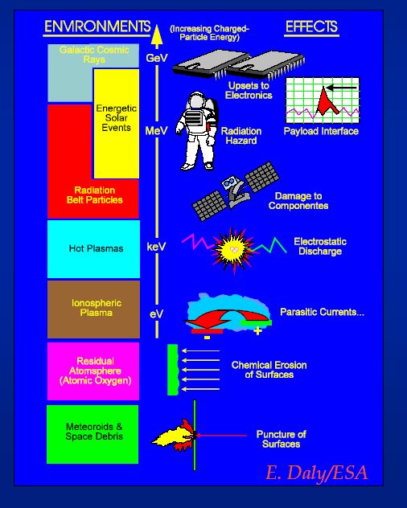
Overview: Radiation and Effects
Charging
Total Ionizing Dose
Displacement Damage Dose
Single Event Effects
Radiation induced noise in scientific sensors/detectors
Radiation effects on astronauts

Slide 9
Overview: Radiation and Effects
Charging
Total Ionizing Dose
Displacement Damage Dose
Single Event Effects
Radiation induced noise in scientific sensors/detectors
Radiation effects on astronauts

Slide 10
Dose-Depth Curves for JEO and JGO
A dose-depth curve provides the TID level at the center of a “spherical shell” or “solid sphere” spacecraft for various aluminum thicknesses

Slide 11
Beyond Dose-Depth Curve
The use of dose-depth curve for shielding design is convenient and fast
  However, ray-tracing is not an accurate radiation transport method because it does NOT include:
    Different material effects (e.g., dose-enhancement effect)
    Multiple scatterings of electrons
    Nuclear reactions
    Secondary particles
Thus, the shielding mass estimate using a dose-depth curve is an approximation
Comprehensive particle transport codes are required for detailed shielding design and analyses

Slide 12
Transport Codes – Applications
Transport codes are needed to consider the following
  Total ionizing dose
  Displacement damage dose
  Single event effects
  Internal charging
  Secondary particle environment behind shield
Transport codes can be used for particle detector simulation
Radiation transport analyses will be required to cover a wide range of radiation effects

Slide 13
Ray Tracing Codes
Ray tracing codes are useful to quickly perform system level trade studies
Ray-tracing codes with CAD interface capability are most useful
Tools available:
  FASTRAD: http://trad.fr/
  MEVDP: http://www-rsicc.ornl.gov/
  “SIGMA” option in Novice: tj@empc.com
  etc.

Slide 14
Transport Codes – Species
Transport codes model actual particle interactions in the material (Ray tracing codes do not)
It is important to model all particle species when performing transport analyses
  Electrons
  Photons
  Protons
  Neutrons
  Heavy Ions
Each transport code considers only a specific set of particles
Radiation transport analyses will be required to cover a wide range of particle species

Slide 15
Commonly Available Radiation Transport Codes
 | Electron | Photon | Proton | Neutron | Heavy Ion
CREME96 creme96.nrl.navy.mil |  |  | √ |  | √
TRIM www.srim.org |  |  | √ |  | √
ITS3.0 www-rsicc.ornl.gov | √ | √
FASTRAD (FMC) Trad.com | √ | √ | √ | ? | ?
NOVICE tj@empc.com | √ | √ | √ |  | √
MCNP(X) mcnpx.lanl.gov | √ | √ | √ | √ | √
Geant4 geant4.web.cern.ch/geant4/ | √ | √ | √ | √ | √
Radiation transport codes not covered: EGS4, CEPXS, HZETRN, SpaceRad, PENELOPE, FLUKA, MARS, etc

Slide 16
Features of Common Transport Codes
Code | Primary Application | Comments
CREME96 | Heavy Ion LET Spectra | Limited to spherical shell aluminum shielding
TRIM | Proton or heavy ion beam simulation | 1-dimensional Only Coulomb interaction
ITS3.0 (TIGER) | Electron or photon beam simulation for dose and charging rate profiles | Excellent electron/photon physics Extensively benchmarked
FASTRAD | Spacecraft level shielding analysis | Ray tracing and Forward MC
NOVICE | Spacecraft level shielding analysis | “Adjoint” (fast for space environment application) No secondary neutrons Not accurate for secondary electrons
MCNP(X) | Full 3-D detector/sensor simulation Transients calculation | Good physics and extensive development history Slow for space application
Geant4 | Full 3-D detector/sensor simulation Transients calculation | Good physics Many Geant4-based “tools” are available Slow for space application
Comments are based on current JPL experience

Slide 17
Shielding Design Process
After the initial use of dose-depth curve, the same set of tools should be used throughout the shielding design process across the project
The fidelity of mass model will increase as the hardware design matures (see next chart for an example)
The shielding design will require many rounds of iterations or trades
  Simple tools in the initial design stage
  More complex tools as design matures
The careful selection of the right tools up front is critical

Slide 18
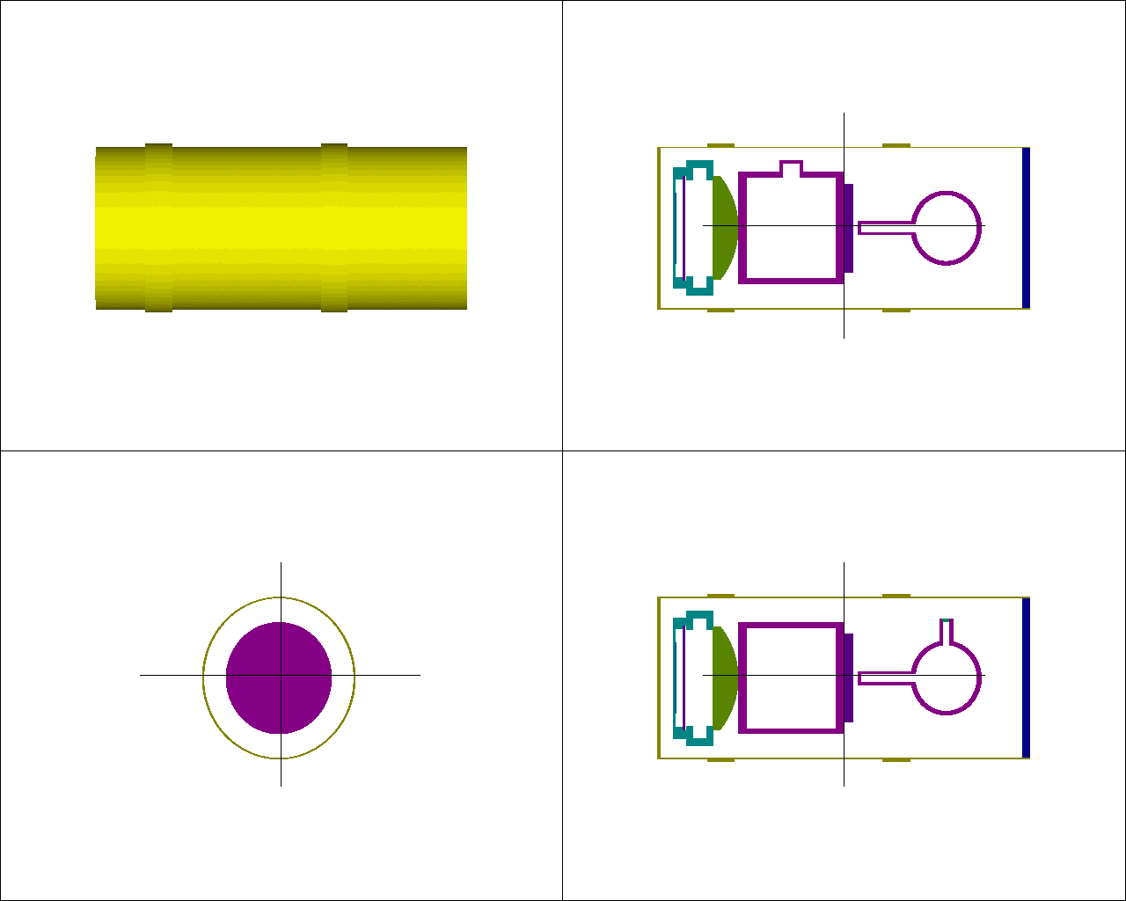
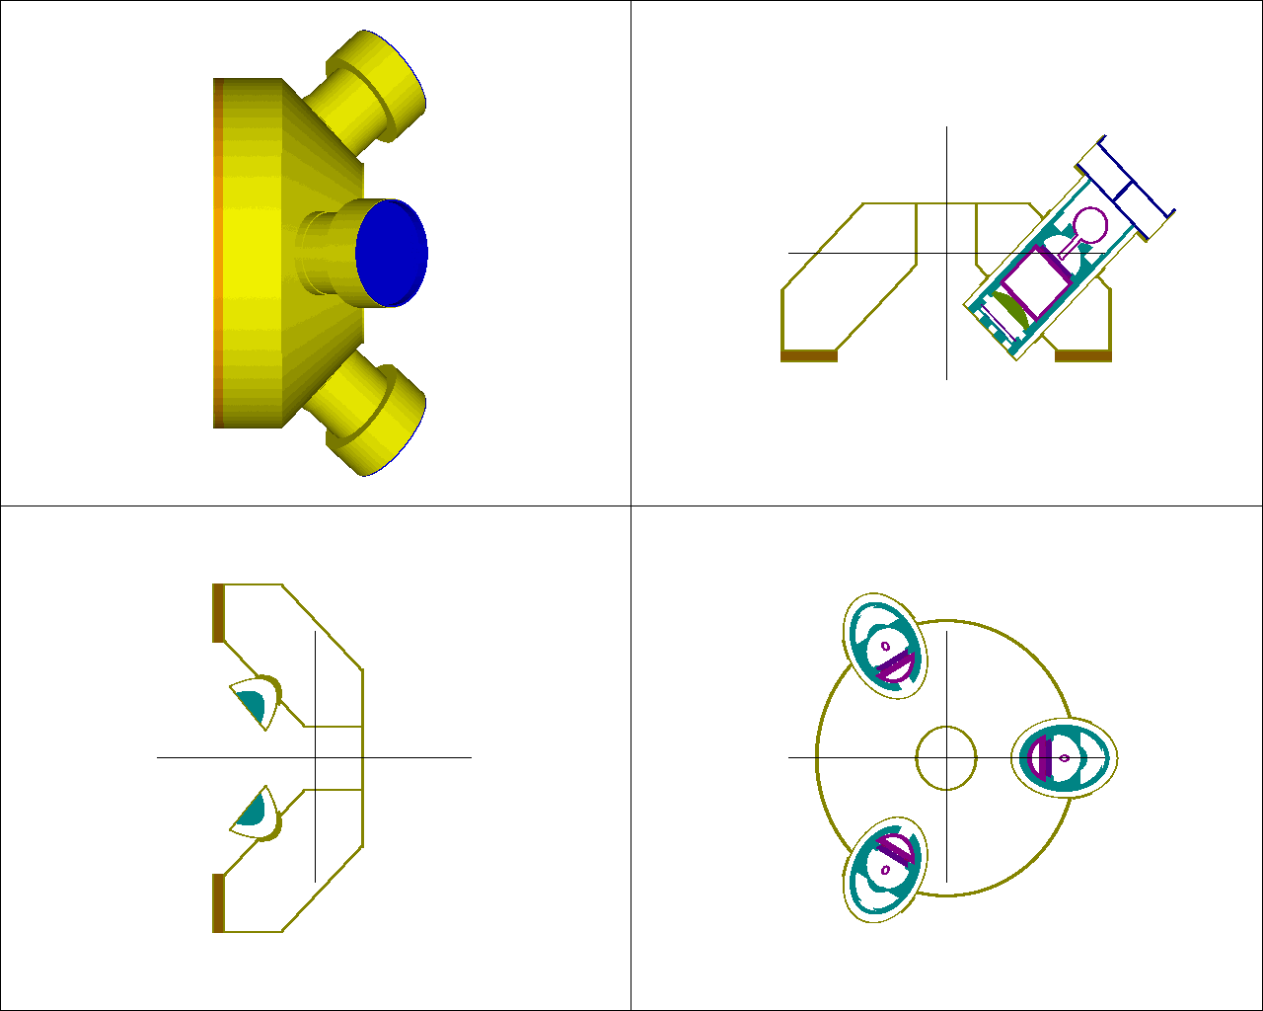
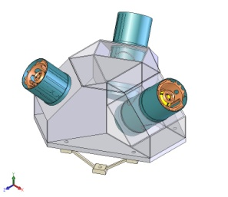
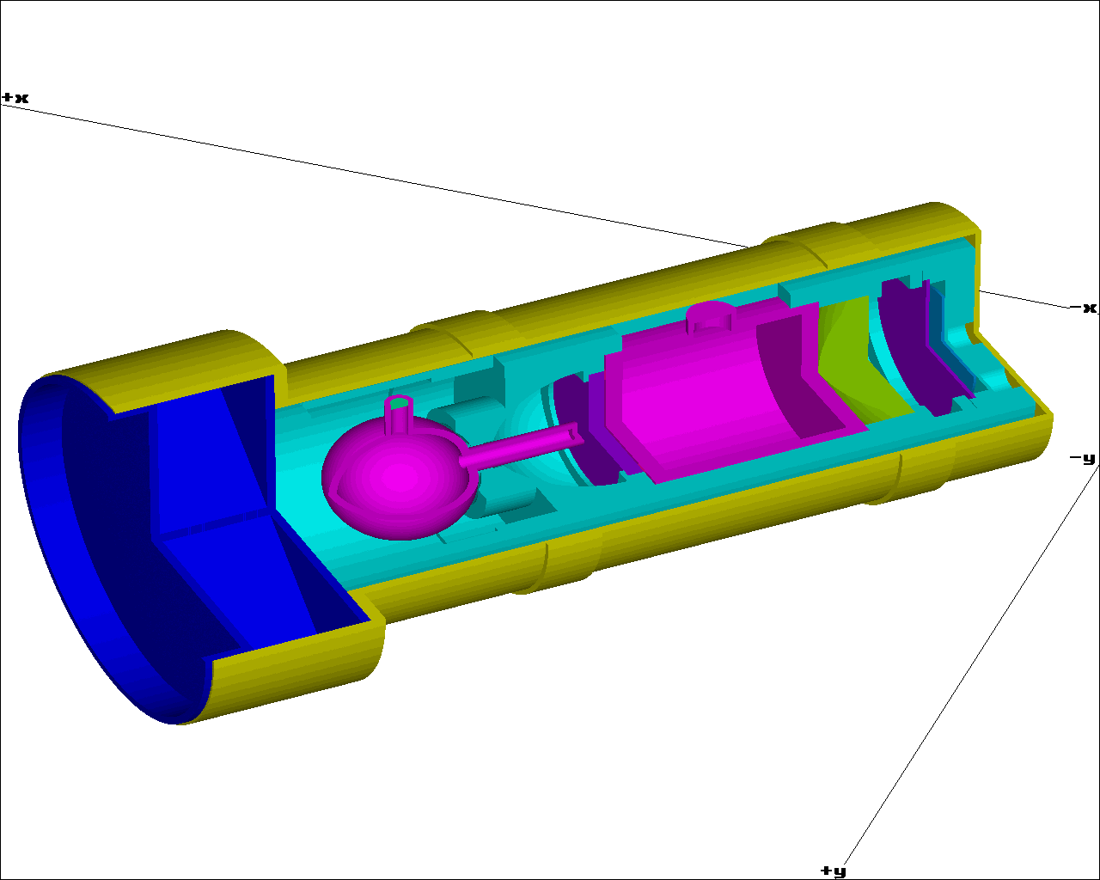
Example: Progress of Mass Modeling Fidelity
Mass model of a preliminary design
(e.g., at PDR): Simple model
Mass model of the final design
(e.g., at CDR): Detailed model

Slide 19
Shielding Design Lesson Learned from Juno/Europa
SNR shielding analysis and testing required multiple iterations
SNR analysis required transport analysis tool with comprehensive physics package (i.e., correct treatment of secondary particles)
Shielding enclosure of instruments required multiple design iterations to optimize implementation and shielding effectiveness
Board and component level analyses were required to optimize shield mass
Graded shielding approach sometimes turned out to be difficult to implement or not efficient

Slide 20
Overview: Radiation and Effects
Charging
Total Ionizing Dose
Displacement Damage Dose
Single Event Effects
Radiation induced noise in scientific sensors/detectors
Radiation effects on astronauts

Slide 21
Charging Tools
Surface Charging
  NASCAP-2K
Internal Charging
  NUMIT
  NUMIT 2.0
  3D NUMIT → 3 dimensional charging analysis “package”

Slide 22
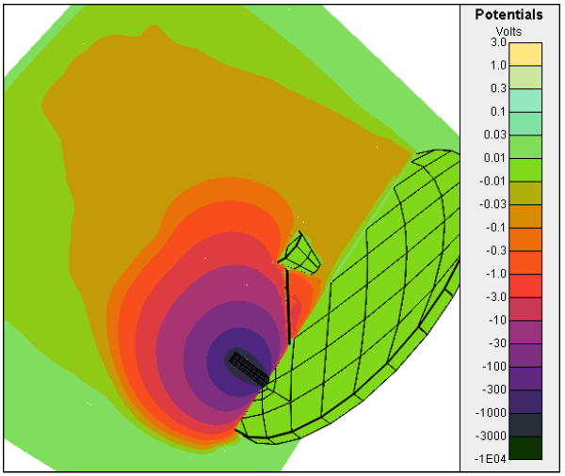
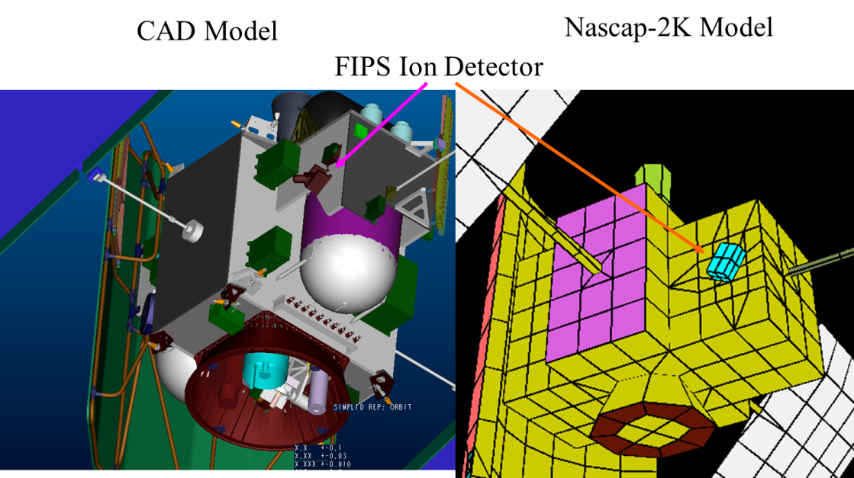
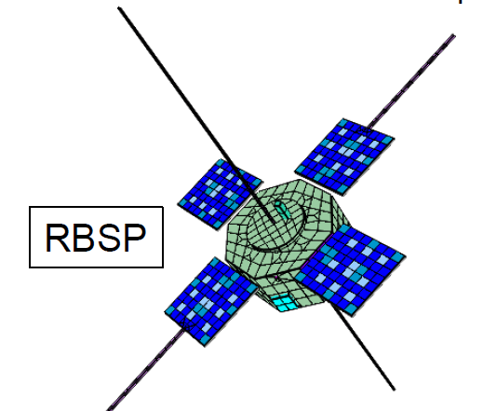
What is NASCAP (or NASCAP-2k)?
3-D spacecraft charging code developed by Leidos for NASA & AFRL
Used by many science missions, e.g.
  Messenger – JHU/APL
  Multi-Scale Magnetosphere (MMS) – NASA/GSFC
  Van Allen Probe (VAP) – JHU/APL
  Communication/Navigations Outage Forecasting Systems (C/NSOFS) - AFRL
  STEREO – NASA/GSFC
  CHAWS (Wake shield) – AFRL
  Juno – JPL/LM
  ECM
CHAWS
Messenger

Slide 23
Modeling Flow with Nascap-2k

Slide 24
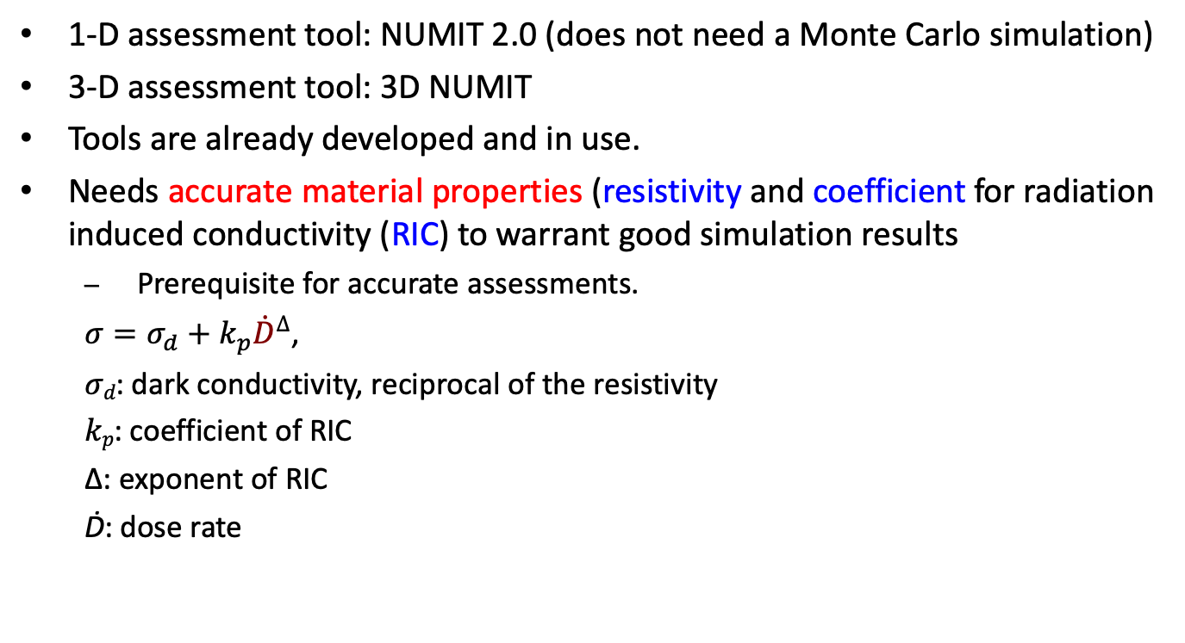
IESD Assessment Tools
1-D assessment tool: NUMIT 2.0 (does not need a Monte Carlo simulation)
3-D assessment tool: 3D NUMIT
Tools are already developed and in use.
Needs accurate material properties (resistivity and coefficient for radiation induced conductivity (RIC) to warrant good simulation results
  Prerequisite for accurate assessments.
$σ=σ_{d}+k_{p}{\dot{D}}^{∆}$,
𝜎_{𝑑}: dark conductivity, reciprocal of the resistivity
𝑘_{𝑝}: coefficient of RIC
∆: exponent of RIC
Ḋ: dose rate

Slide 25




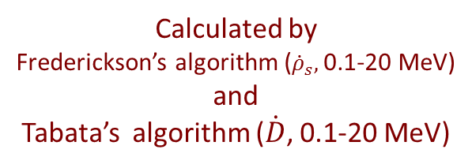

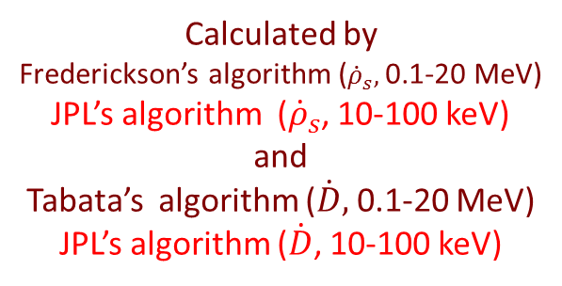
w/ and w/o
ground
Very thin
electrode
NUMIT 2.0
1-D internal charging simulation tool
100 keV - 20 MeV
NUMIT
1-D internal charging simulation tool
100 keV - 20 MeV
Time-varying spectrum
Mono-energy constant intensity
Vertical incident
10
Charge and Energy
Deposition Rates
Charge Movement
$\frac{∂ρ}{∂t}={\dot{ρ}}_{s}−\left(∇∙J\right)$
$J=σE$
  $σ=σ_{d}+k_{p}{\dot{D}}^{∆}$
$∇∙(εE)=−ρ$
Continuity Equation
Ohm’s law
Poisson’s Equation
$${\dot{ρ}}_{s}$$
charge deposition rate
$$\dot{D}$$
energy deposition rate
Calculated by
Frederickson’s algorithm (${\dot{ρ}}_{s},$0.1-20 MeV)
JPL’s algorithm (${\dot{ρ}}_{s}$, 10-100 keV)
and
Tabata’s algorithm ($\dot{D},$0.1-20 MeV)
JPL’s algorithm ($\dot{D}$, 10-100 keV)
Material Constants
$σ_{d}$: dark conductivity
$k_{p}$: coefficient of RIC
$∆$: exponent of RIC
$ε$: permittivity
Calculated by
Analytical Equations
or
Monte Carlo Simulation
Calculated by NUMIT
$E$: Electric field
$ρ$: Charge density
$J$: Current density
Calculated by
Frederickson’s algorithm (${\dot{ρ}}_{s},$0.1-20 MeV)
and
Tabata’s algorithm ($\dot{D}$, 0.1-20 MeV)

Slide 26
NUMIT -- Example
Small but non-zero conductivity alters dynamics significantly.
σ = 1 x 10⁻¹⁸ / Ω∙cm

Slide 27
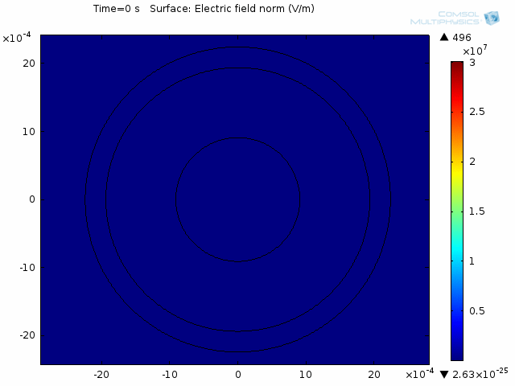
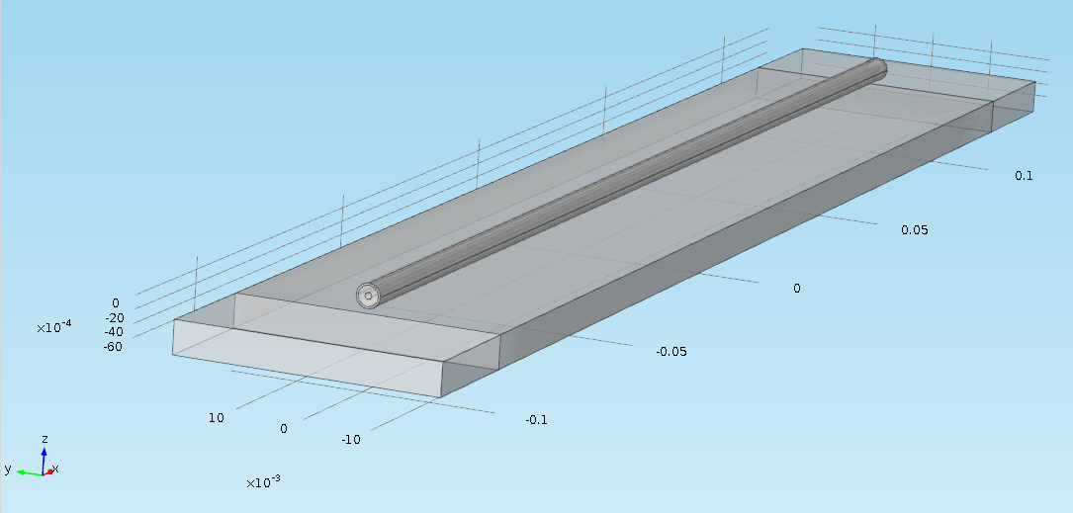
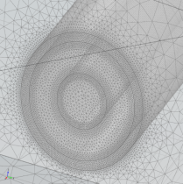
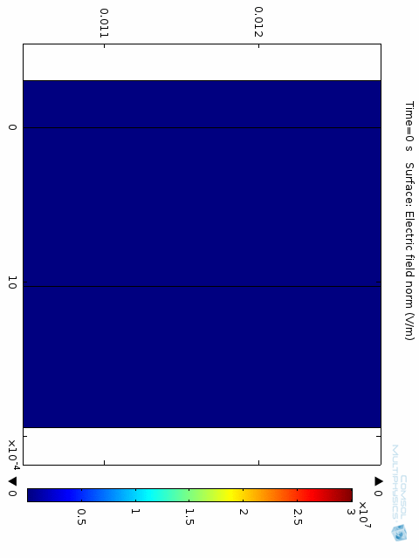
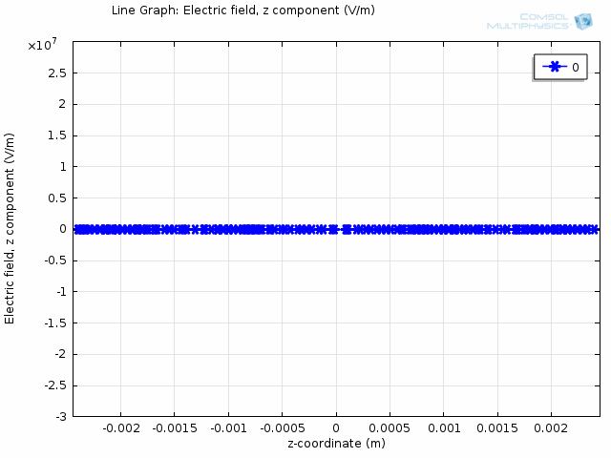
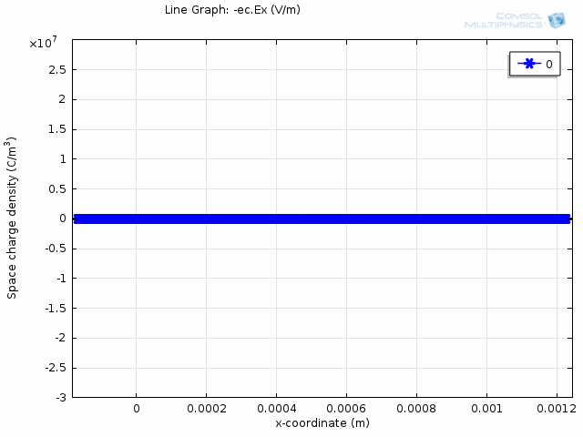
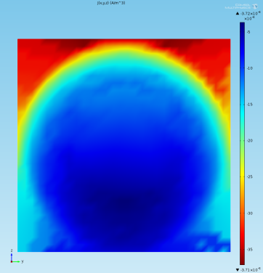
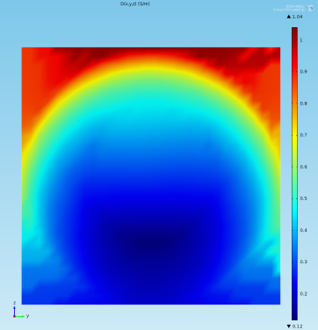


3D NUMIT -- Example
3D NUMIT is a general 3D internal charging simulation tool, further improved from a previously developed 3D Internal charging simulation tool CB_IESD (by Ira Katz and Wousik Kim) which can be applied only to circuit board with a maximum of one floating trace.
3D - cross section vs 1D approximation
Problem Geometry – semi-rigid coax cable on Al plate
Inputs to the simulation tool (calculated by Monte Carlo tool)
3D vs 1D - line probe
Charge Deposition Rate
Energy Deposition Rate
Time, sec
Dielectric Strength
$${\dot{ρ}}_{s}$$
$$\dot{D}$$

Slide 28
Summary
Many models and tools are being used to ensure adequate radiation design for space missions
Proper understanding of capabilities and limitations of those models and tools is critical
  Models and tools are continuously being updated with mode in-flight data or lab test data
  Validation and verification are important steps before using them for spacecraft design
Open and sufficiently frequent communications within the international community is also important

