Slide 1
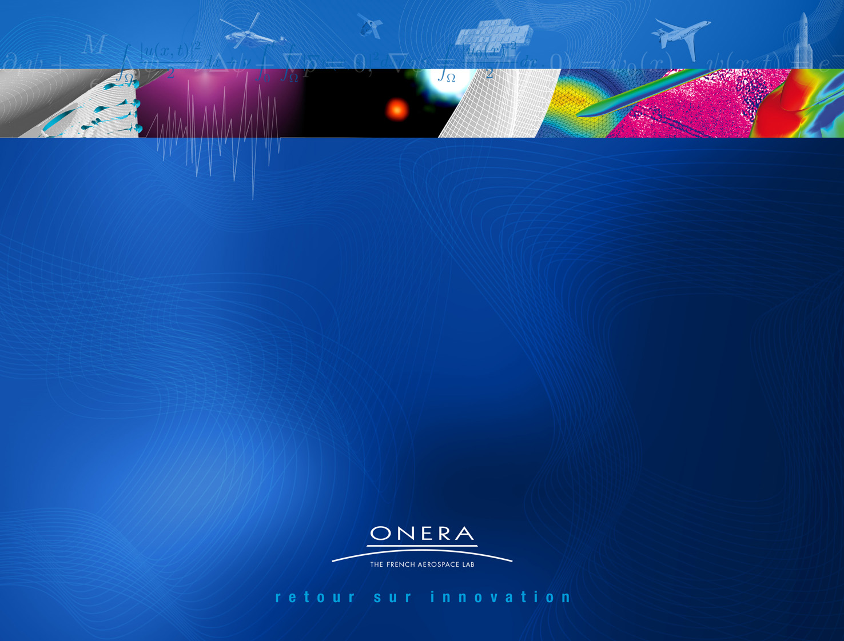
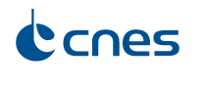
IPODE : Ionizing Particle ONERA DatabasE for Earth’s Radiation Belt Analysis
A. Sicard, D. Lazaro, S. Bourdarie, V. Maget, A. Brunet

Slide 2
Outline
  Context
  IPODE
    Time and spatial coverage
    Data sources
    Update
  Applications
    Specification models
    Services (Alarm, radiation belts activity index)
    Salammbô
    Data assimilation
  Conclusion

Slide 3
Context
User needs
    To help understanding the dynamics of the radiation belts
    To develop specification models (local or global)
    To create services for specific needs (alarm, index of activity,…)
Potential users
    Space industries
    Scientist
    Space agencies
Financial support
    CNES (ONERA/CNES CRATERRE Project *)
    ONERA own funding
IPODE (Ionising Particle ONERA DatabasE)
*http://craterre.onecert.fr//home.html

Slide 4
IPODE : Time and spatial coverage
Ionising Particle Onera DatabasE
  More than one hundred couples SC/instrument
  Several kind of orbits
  Time resolution from seconds to minutes
  Charged particles (e-, p+,He)
  Heavy ions in the interplanetary medium
  Energy coverage e-: ~0.1 keV to few MeV
  Energy coverage p+: ~0.1 keV to few 100 MeV

Slide 5
IPODE : Time and spatial coverage
XMM
JASON-2
CLUSTER
GOES
NOAA-15/NOAA-18/NOAA-19
THEMIS-A
RBSP-A
Spacecraft alive on 24/05/2018 in IPODE:
ACE NOAA-15/18/19
CLUSTER-1/2/3/4 RBSP-A/B
GOES-13/15 THEMIS-A/D/E
INTEGRAL XMM
JASON-2/3 METOP-01/02

Slide 6


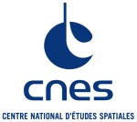



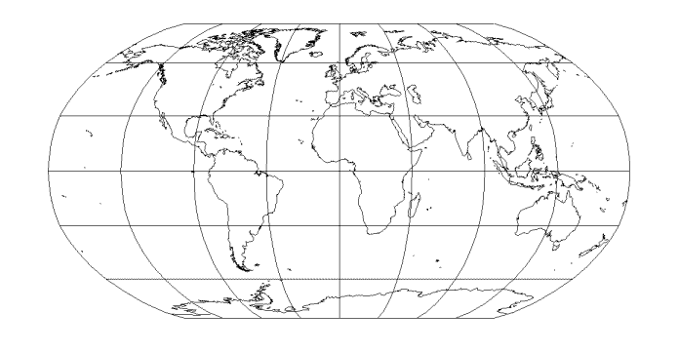



IPODE : Sources of data
  Collaborations between ONERA and international institutions
IPODE@ONERA

Slide 7
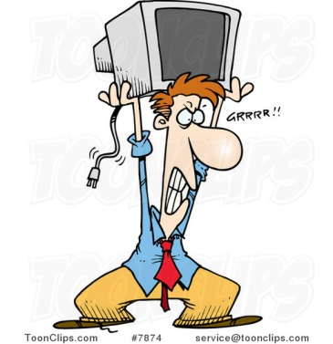
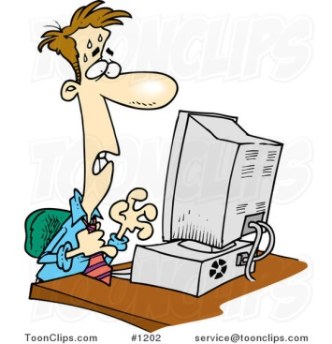
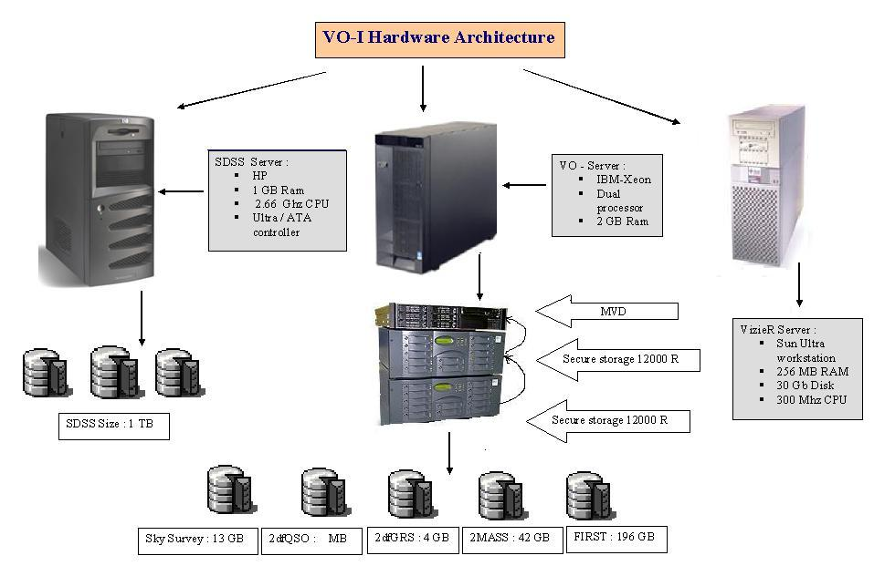
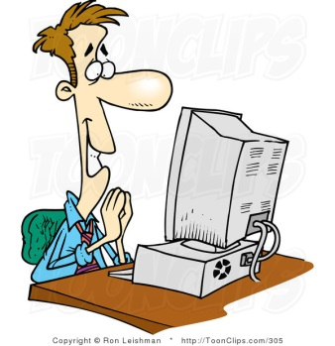
IPODE : Update
3 hourly jobs
24 daily jobs
20 weekly jobs
4 monthly jobs
Input data
(ascii, binary, CDF, HDF, NetCDF, CSV,…)
Sauvegarde
Output data
PRBEM/CDF*
Standard format
IPODE
IRBEM Library**
(magnetic coordinates, orbit propagator,…)
Data analysis with IPSAT tool
(saturation, contamination,…)
* Panel on radiation Belt Environment Modelling
(COSPAR)
** International Radiation Belt Environment Modelling
Library (PRBEM - COSPAR)

Slide 8
Applications
Salammbô:
Use of data for boundary conditions,…)
Comparison of results
Specification models development
IPODE
Services:
Radiation belts indices
Alarm
Data assimilation
- Salammbô + data

Slide 9
Applications: Specification models
Models
Data used
IGE-2006 ⁽¹⁾
LANL GEO
DRTS
Slot model ⁽²⁾
NOAA-POES, SAC-C
HEO3, HEO1
CRRES, ICO
MEO-V2 ⁽³⁾
NS-18, NS-24,…NS-33
OPAL ⁽⁴⁾
NOAA-POES
JASON 2/3
GREEN ⁽⁵⁾
All data above
+ RBSP + POLAR + THEMIS
(1) A. Sicard-Piet et al., "A new international geostationary electron model: IGE-2006, from 1 keV to 5.2 MeV," in Space Weather, vol. 6, no. 7, pp. 1-13, July 2008.doi: 10.1029/2007SW000368.
(2) A. Sicard-Piet, D. Boscher, D. Lazaro, S. Bourdarie and G. Rolland, "A New ONERA-CNES Slot Electron Model," in IEEE Transactions on Nuclear Science, vol. 61, no. 4, pp. 1648-1655, Aug. 2014.doi: 10.1109/TNS.2013.2293346.
(3) A. Sicard-Piet, Bourdarie, S., Boscher, D., Friedel, R., andCayton, T.: Solar cycle electron radiation environement atGNSS like altitude, 57th International Astronautical Congress,International Astronautical Congress (IAF), Valencia, Spain,https://doi.org/10.2514/6.IAC-06-D5.2.04, 2006.
(4) D. Boscher, Sicard-Piet, A., Lazaro, D., Cayton, T., and Rol-land, G.: A new Proton Model for Low Altitude HighEnergy Specification, IEEE T. Nucl. Sci., 61, 3401–3407,https://doi.org/10.1109/TNS.2014.2365214, 2014.
(5) A. Sicard, D. Boscher, S. Bourdarie, D. Lazaro, D. Standarovski, et al.. GREEN: the new Global Radiation Earth ENvironment model (beta version). Annales Geophysicae, European Geosciences Union, 2018, 36, pp.953-967.

Slide 10
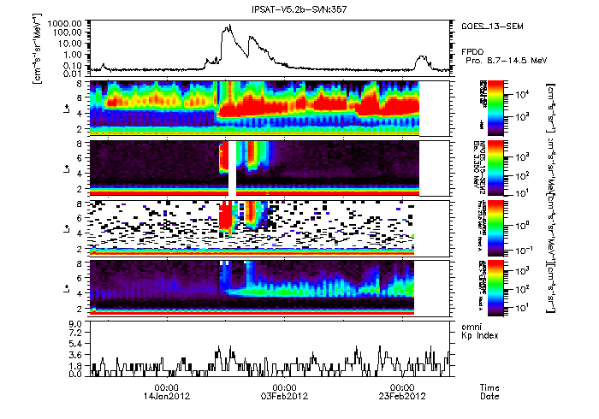
Applications: Specific services
*http://craterre.onecert.fr//home.html
IPODE@ONERA
Monitoring the Space Environment
& events analysis
Services *
(Indices of activity of radiation belts,
Solar flares eruption)
Possibility of service dedicated to specific needs
D. Lazaro, D. Boscher, S. Bourdarie, A. Sicard-Piet, G. Rolland, R. Ecoffet and E. Lorfèvre , Radiation Belt Activity Indices and Solar Proton Event Alarm, IEEE Nuc. Sci., vol 61 N°4.

Slide 11
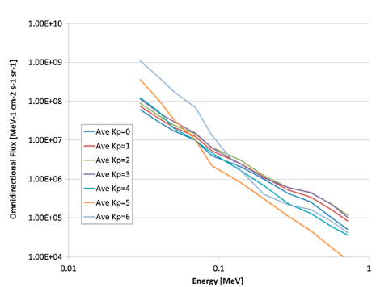
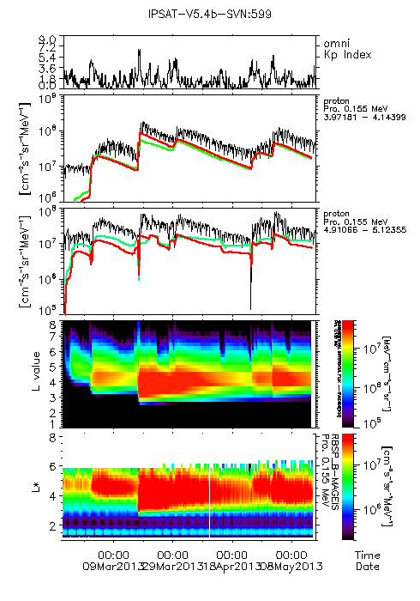
Applications: Salammbô
Construction of
boundary conditions
Comparison
with Salammbô
Boundary condition for Salammbô from THEMIS data
V. Maget, A. Sicard-Piet, S. Bourdarie, D. Lazaro, D.L. Turner, et al.. Improved outer boundary conditions for outer radiation belt data assimilation using THEMIS-SST data and the Salammbo-EnKF code. Journal of Geophysical Research : Space Physics, American Geophysical Union/Wiley, 2015, 120 (7), p. 5608-5622.

Slide 12
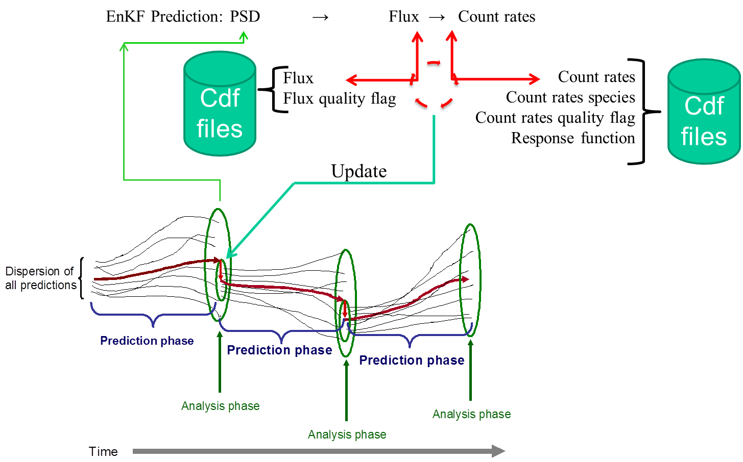
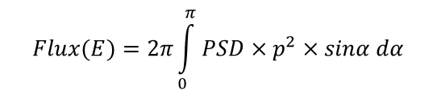
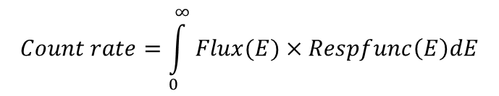
Applications: Data assimilation
$$Flux(E)=2π\int_{0}^{π}{PSD×p^{2}}×sinα dα$$
$$Count rate=\int_{0}^{∞}{Flux(E)×Respfunc\left(E\right)dE}$$
IPODE

Slide 13
Applications: Conclusion
IPODE is developed at ONERA since more than 10 years and contains more than 100 couples SC/instrument
IPODE is updated each day with new data
In addition to the particles flux or counts, CDF files in IPODE contain magnetic parameters (L, L*, Bl, Beq, …) and some flags which indicate the quality of the data (saturation, contamination,…)
IPODE is essential in many parts of our activities at ONERA for the radiation belts: specification models, salammbô, data assimilation or other specific services
Some data in IPODE are public and others are not.
http://craterre.onecert.fr//home.html

