Slide 1
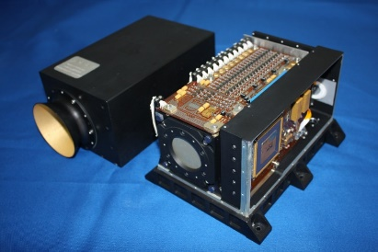
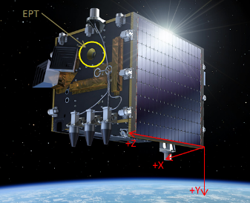
Introduction | Former PAD data | New PAD data | Comparison AP8 & IRENE/AP9 | SSA EPT rad. mod. | Conclusion
Angular proton distributions measured by Proba-V/EPT and their
comparison to AP8 and IRENE/AP9
Stanislav Borisov, Sylvie Benck, Mathias Cyamukungu
Center for Space Radiations, Earth and Life Institute, Université catholique de Louvain (UCL/ELI/CSR),
Place Louis Pasteur, 3,
B-1348 Louvain-la-Neuve, Belgium

Slide 2

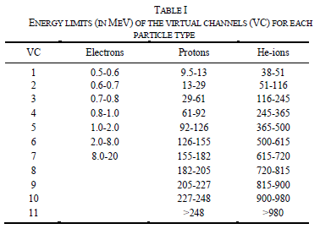
Introduction | Former PAD data | New PAD data | Comparison AP8 & IRENE/AP9 | SSA EPT rad. mod. | Conclusion
The instrument
Proba-V with EPT onboard was launched on 7 May 2013 into a sun-synchronous polar orbit at ~820 km altitude
The EPT is oriented WEST when in daylight and oriented EAST when in eclipse
M. Cyamukungu et al., IEEE TNS, vol. 61, no. 6, pp. 3667-3681, December 2014

Slide 3
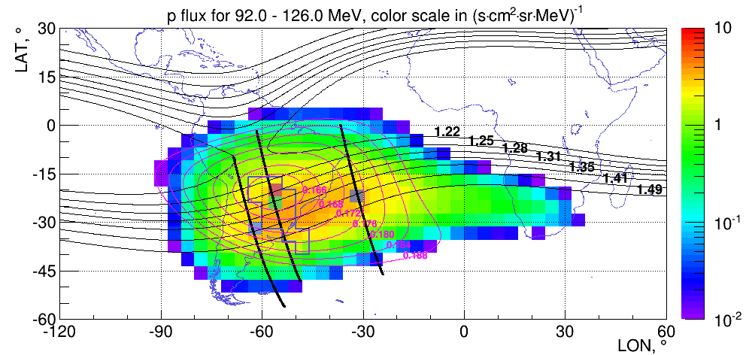
Introduction | Former PAD data | New PAD data | Comparison AP8 & IRENE/AP9 | SSA EPT rad. mod. | Conclusion
The off-pointing measurements
Off-pointing done in regions where no East-West effect is observed
2 campaigns to measure angular distributions of protons at various positions in the SAA:
  from June 2013-January 2014 (P1)
  from December 2017- February 2018 (P2)
Objective of the off-pointing measurements in 2017:
  to better characterize the performances of EPT after its recalibration in summer 2014
  to extend the angular distribution study to regions of higher L and B

Slide 4
Introduction | Former PAD data | New PAD data | Comparison AP8 & IRENE/AP9 | SSA EPT rad. mod. | Conclusion
Proton angular distribution in the SAA
At -56°±2° longitude, -20°±2° latitude, 828 km altitude (centred at L=1.27 and B=0.165 G).
Measured count rate as a function of the boresight orientation
counts prediction based on the best fit PADmodel (F=J₀sin^{n}(α): search for n and J₀ that best fits the data given the efficiency matrices calculated for a set of anisotropy factors n and β)
The inset shows:
­­Badhwar-Konradi scaling factor for the RP.
normalized PAD of the form sin^{n}(α) with n =25
normalized PAD of the form sin^{n}(α) with n =18
shape of AP9 pitch angle distribution for 40 MeV protons.
Borisov et al., IEEE TNS, vol. 61 Issue: 6, pp3371-3379, Dec. 2014

Slide 5
Introduction | Former PAD data | New PAD data | Comparison AP8 & IRENE/AP9 | SSA EPT rad. mod. | Conclusion
Proton spectra in the SAA
AP9 (V1.05.001) unidirectional flux at 90° for 40 MeV (median):
44 #/cm²/s/sr/MeV (factor x ~7)
!! Steepness of PAD ??
Omnidirectional flux divided by 4π: 9.2 #/cm²/s/sr/MeV
Single proton spectrum measured by the EPT on Nov. 17th, 2013.
Note that here the differential spectra were extracted using a method that assumes isotropic flux in the half-hemisphere facing the instrument aperture. This method allows measuring the average flux of protons over the EPT ≤52° FOV. The same method was applied to measure the average fluxes over the RPS 26° FOV.

Slide 6
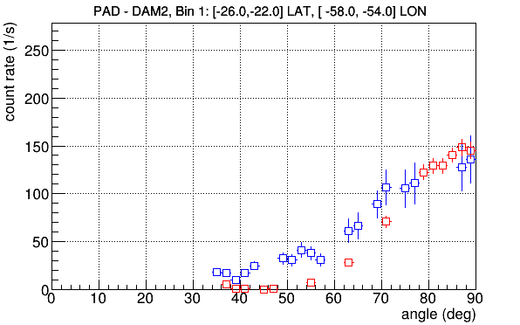
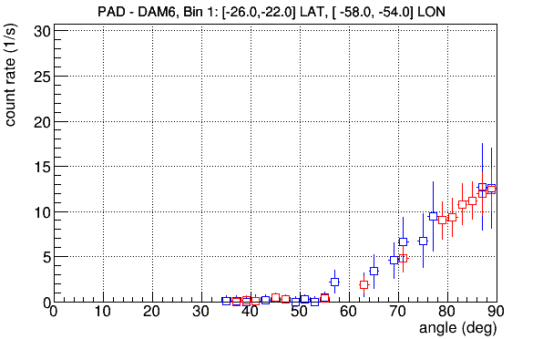
Introduction | Former PAD data | New PAD data | Comparison AP8 & IRENE/AP9 | SSA EPT rad. mod. | Conclusion
Bin 1: LON [-58°, -54°] and LAT [-26°,-22°]
Significant FOV deterioration for measurements up to DAM 3 ➔ Discard those measurements from the analysis
≤ DAM3
≥ DAM4
Red: P1
Blue: P2
P1 : All energies
P2: E > 92 MeV
➔
Bin 2: LON [-64°,-60°] and LAT [-34°,-30°]
Bin 3: LON [-34°,-30°] and LAT [-24°,-20°]
➔ Analysis only for E > 92 MeV

Slide 7
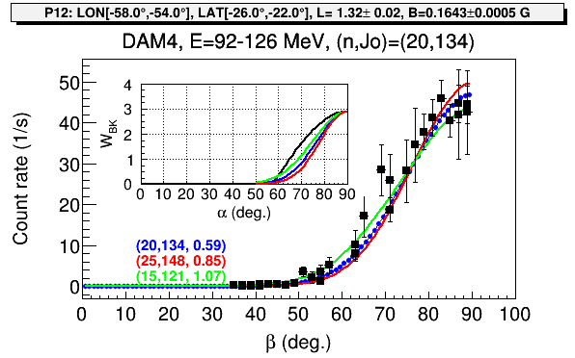
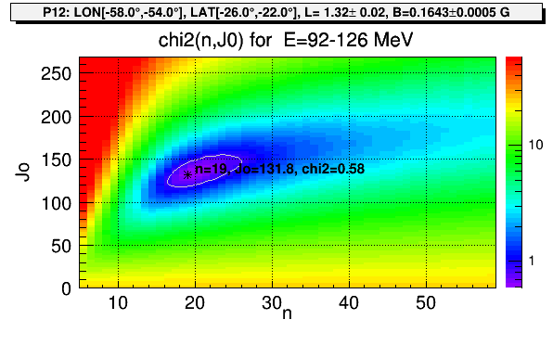
Introduction | Former PAD data | New PAD data | Comparison AP8 & IRENE/AP9 | SSA EPT rad. mod. | Conclusion
The analysis:
Check of the quality of the minima found by the TMinuit class in the Root framework ➔ Draw CHi2 map
W_{BK} = BK-MAX parameters from Trend-3 Report, 1996 (Kruglanski and Lemaire)
n = 20-25
To get the unidirectional flux at 90° in #/cm²/s/sr/MeV: do J₀/ΔE

Slide 8
Introduction | Former PAD data | New PAD data | Comparison AP8 & IRENE/AP9 | SSA EPT rad. mod. | Conclusion
The comparison:
___ AP9 uni 90° mean (v1.50.001)
___ AP8 uni 90° (= omni/4π * W_{BK} )
[-26°,-22°] LAT, [-58°, -54°] LON
[-34°,-30°] LAT, [-64°,-60°] LON
[-24°,-20°] LAT, [-34°,-30°] LON

Slide 9
Introduction | Former PAD data | New PAD data | Comparison AP8 & IRENE/AP9 | SSA EPT rad. mod. | Conclusion
Investigation on the differences observed:
Example of Bin 1
a)
Normalized PAD for differential fluxes of 150 MeV protons
fit with a function of the form sin^{n}(α) with n=24
➔ OK
b)
AP9 omni > AP8 omni

Slide 10
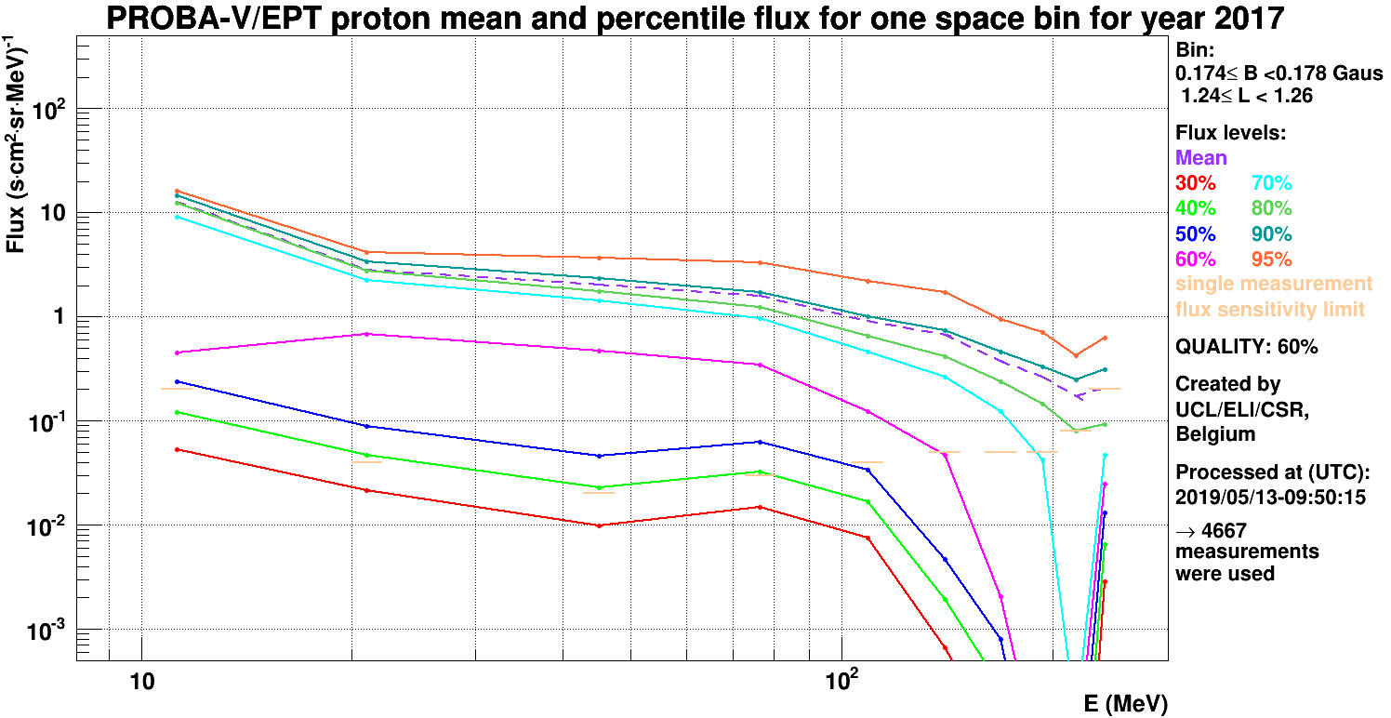
Introduction | Former PAD data | New PAD data | Comparison AP8 & IRENE/AP9 | SSA EPT rad. mod. | Conclusion
Forthcoming new products on http://swe.ssa.esa.int/web/guest/csr-ept-federated:
Proba-V/EPT radiation modelling

Slide 11
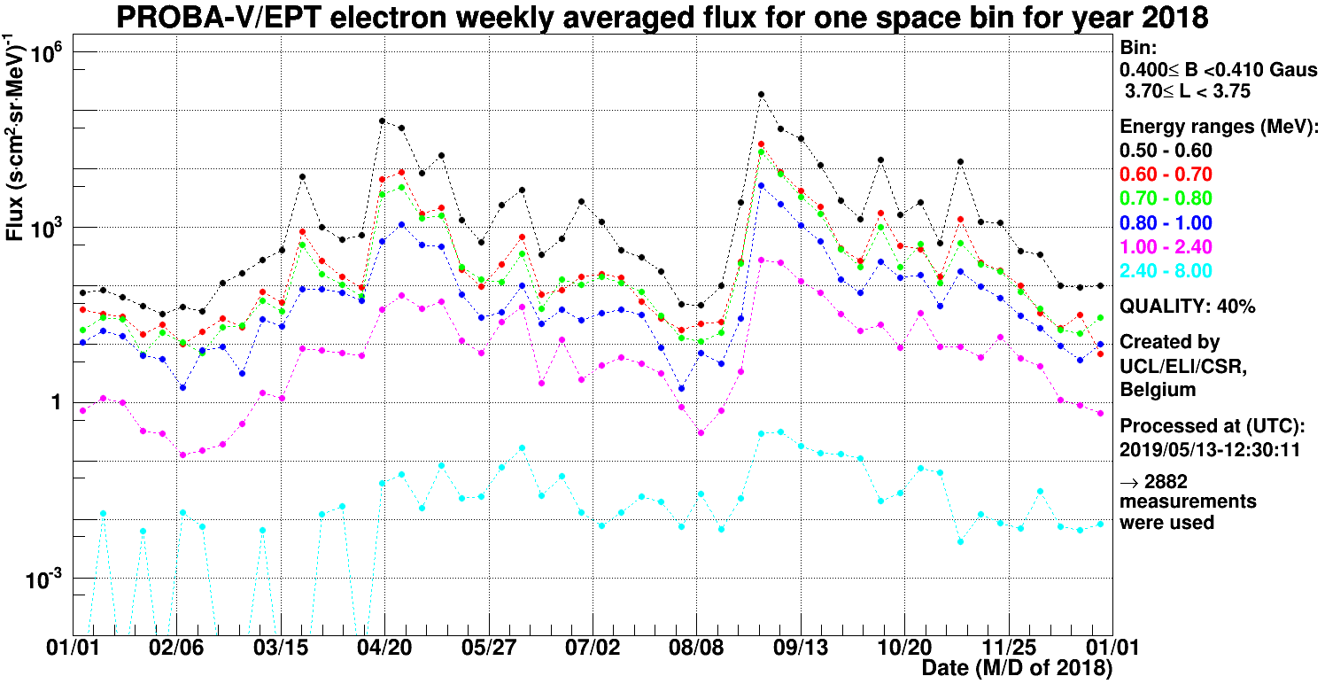
Introduction | Former PAD data | New PAD data | Comparison AP8 & IRENE/AP9 | SSA EPT rad. mod. | Conclusion
➔ Observation of general trends linked for example to high Dst decrease (|Dst| ~ 170 nT) or small Dst events (|Dst| < 60 nT)

Slide 12
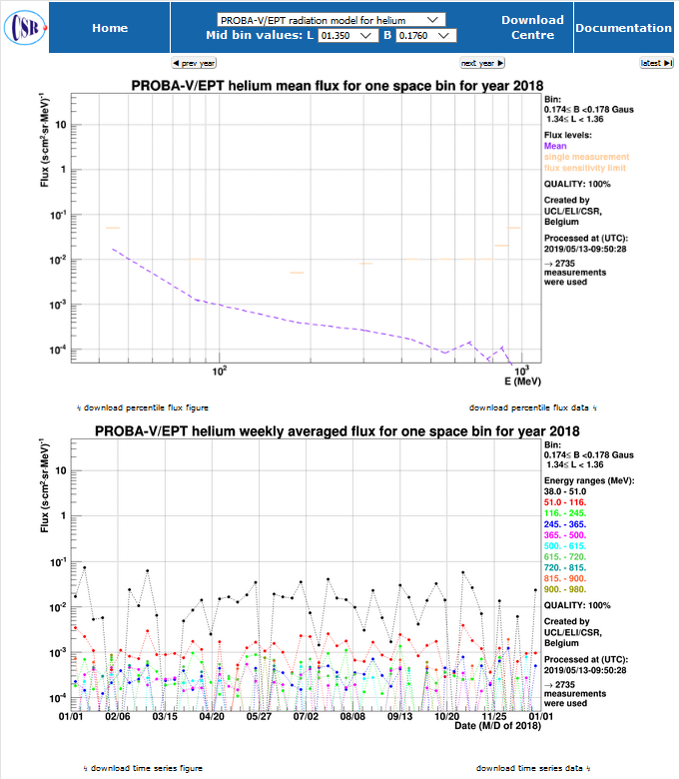
Introduction | Former PAD data | New PAD data | Comparison AP8 & IRENE/AP9 | SSA EPT rad. mod. | Conclusion

Slide 13
Introduction | Former PAD data | New PAD data | Comparison AP8 & IRENE/AP9 | SSA EPT rad. mod. | Conclusion
Summary:
Despite FOV degradation due to noise increase in front sensor, analysis of PAD proton data is still possible for E>92 MeV
New anisotropy factors for proton flux distribution have been obtained for different positions in the SAA: n ~ 20-25
Earlier measurements from Fischer et al. reported n values of ~12 for L=1.3-1.4 for E=5.6 - 46 MeV based on a completely different approach.
The mean unidirectional fluxes at 90° from Irene/AP9 overestimate the one from EPT by a factor of about 2-3 while showing a similar PAD shape.

Slide 14
Introduction | Former PAD data | New PAD data | Comparison AP8 & IRENE/AP9 | SSA EPT rad. mod. | Conclusion
Thank You
Acknowledgements: The authors are grateful to the PROBA-V/EPT teams at B.USOC and ESA/Redu for deep involvement in the data acquisition process. They thank P. Coquay, J. Nijskens, H. Verbeelen, and W. Verschueren at the Belgian Science Policy – Space Research and Applications (BELSPO) for support to the PRODEX project entitled “PROBA-V/EPT – Data Exploitation-Extension”, ESA/PRODEX PEA N° C4000107617. They also thank ESA/ESTEC members P. Nieminen, H. Evans, E. Daly, P. Jiggens for their continuous support throughout the EPT project and ESA/ESOC members for funding EPT product developments within the Space Weather program (SSA – ESC – P2 and –P3). Finally the CSR team would also like to express its gratitude to H. Laur, K. Mellab, E. Tilmans, E. Martin, C. Baijot and their colleagues for authorizing, preparing and performing the off-pointing manoeuvres without which these PAD measurements would not have been possible.

