Slide 1

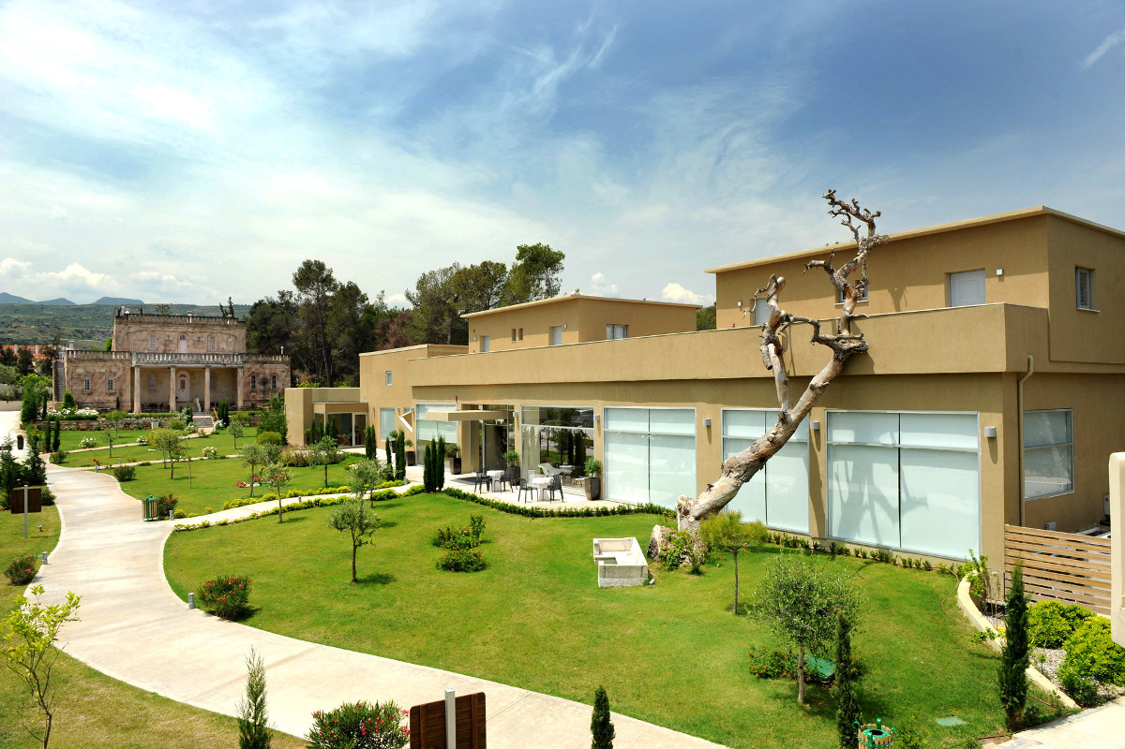
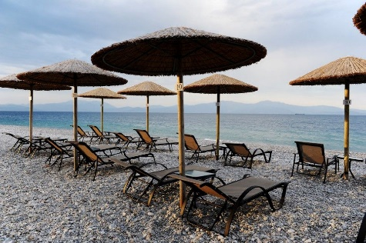
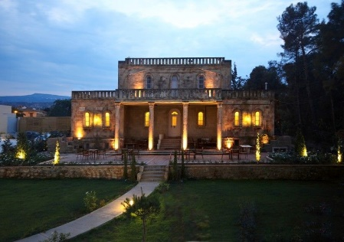
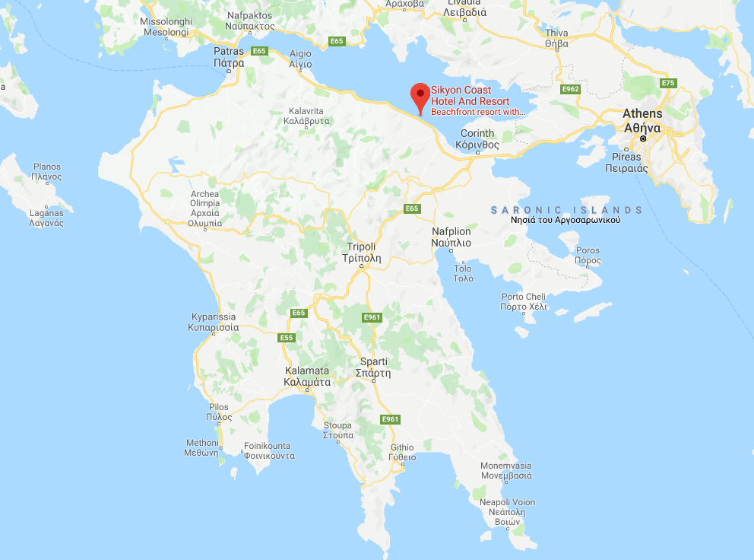
14th Geant4 Space Users’ Workshop
21-23 October 2019
Sikyon Coast Hotel & Resort
Sykia, Greece

Slide 2
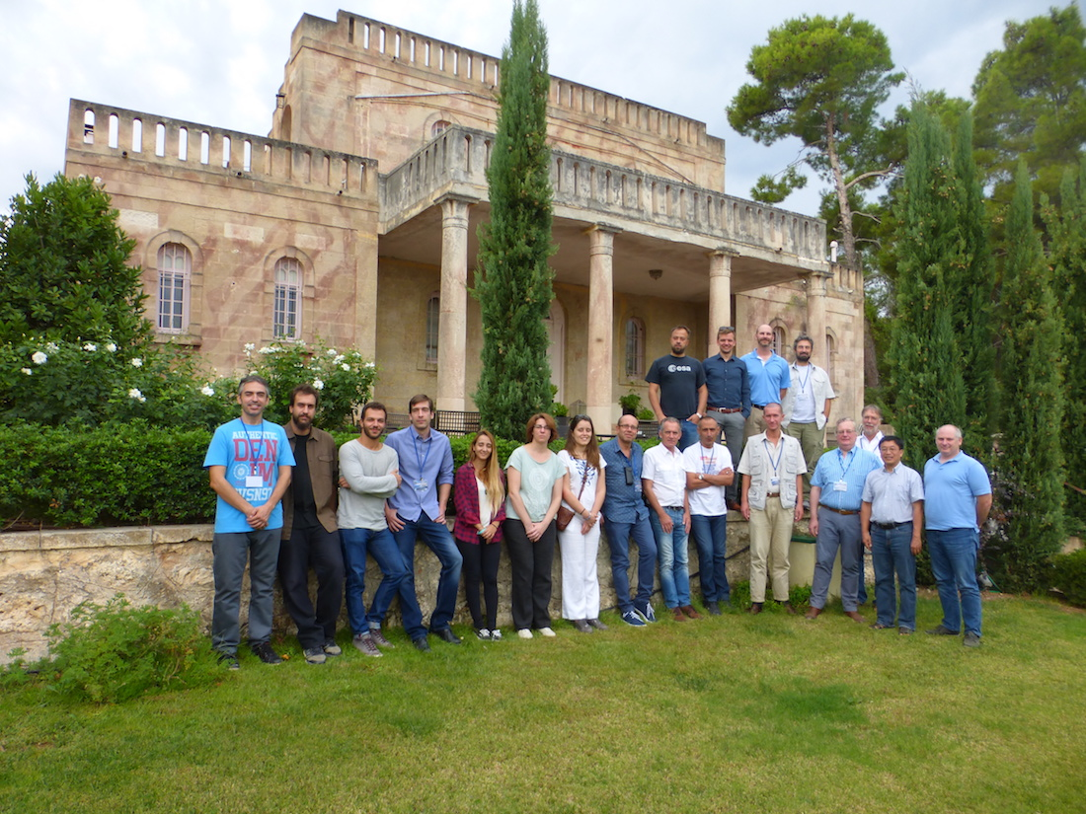
2016 Space Radiation Modelling and Data Analysis Workshop

Slide 3
Home of Angelos Sikelianos and Eva Palmer

Slide 4
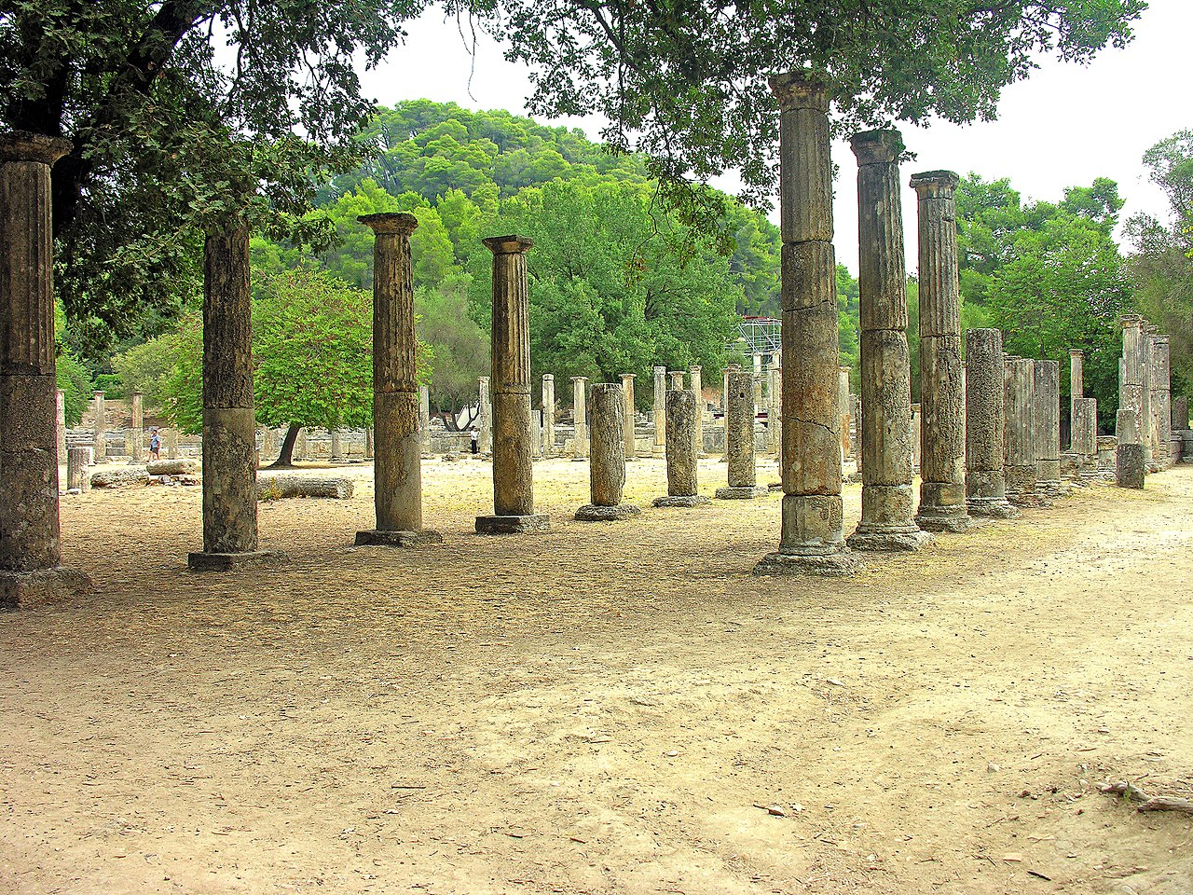
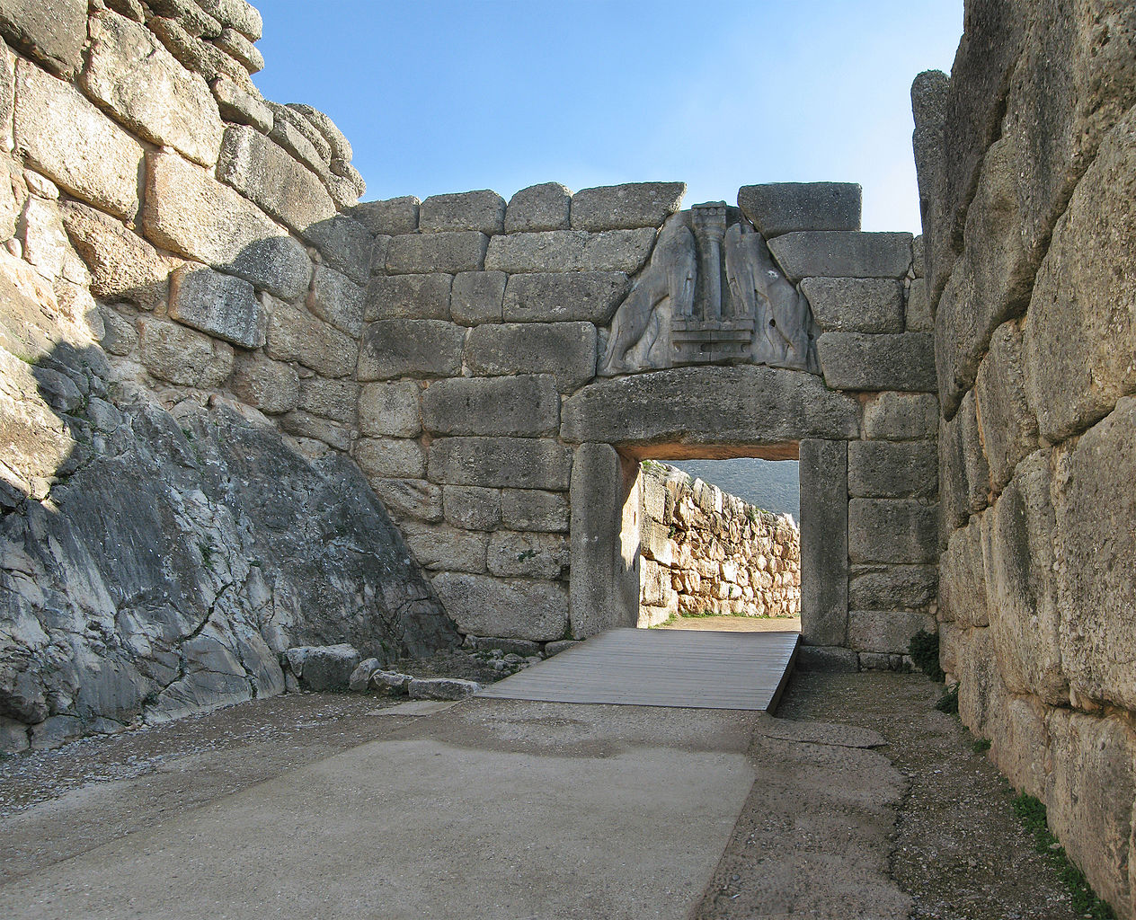
Olympia
Mycenae
Notes:
2,5 hrs / 1 hr

Slide 5
Agenda Monday
Introduction & G4G / ESA status report
10:30 Coffee Break
11:00 Geant4 usage at JPL - Xiaoyu Zhu
11:30 Geant4 usage at JAXA – Masanobu Ozaki
12:00 Persistency of Geant4 Phase-Space Information for Radiation Effects and Instrument Background Analysis - Pete Truscott
12:30 Lunch Break
14:00 AREMBES: Geant4 validation for X-ray space missions and G4 simulator development – Simone Lotti
14:30 Measurements and Geant4 simulations of the back-scattered electrons off ATHENA X-ray mirrors – Fan Lei
15:00 Latest Updates of Grazing Angle Soft Proton Scattering on X-ray Optics – Sebastian Diebold
15:30 Coffee Break
16:00 GEANT4 simulation Study of the MIDAS dosimeter/radiation monitor - Christos Papadimitropoulos
16:30 The impact of low-energy electrons on EP-WXT based on Geant4 simulations – Donghua Zhao

Slide 6
Logistics
WiFi Password: sikyoncoast

Slide 7
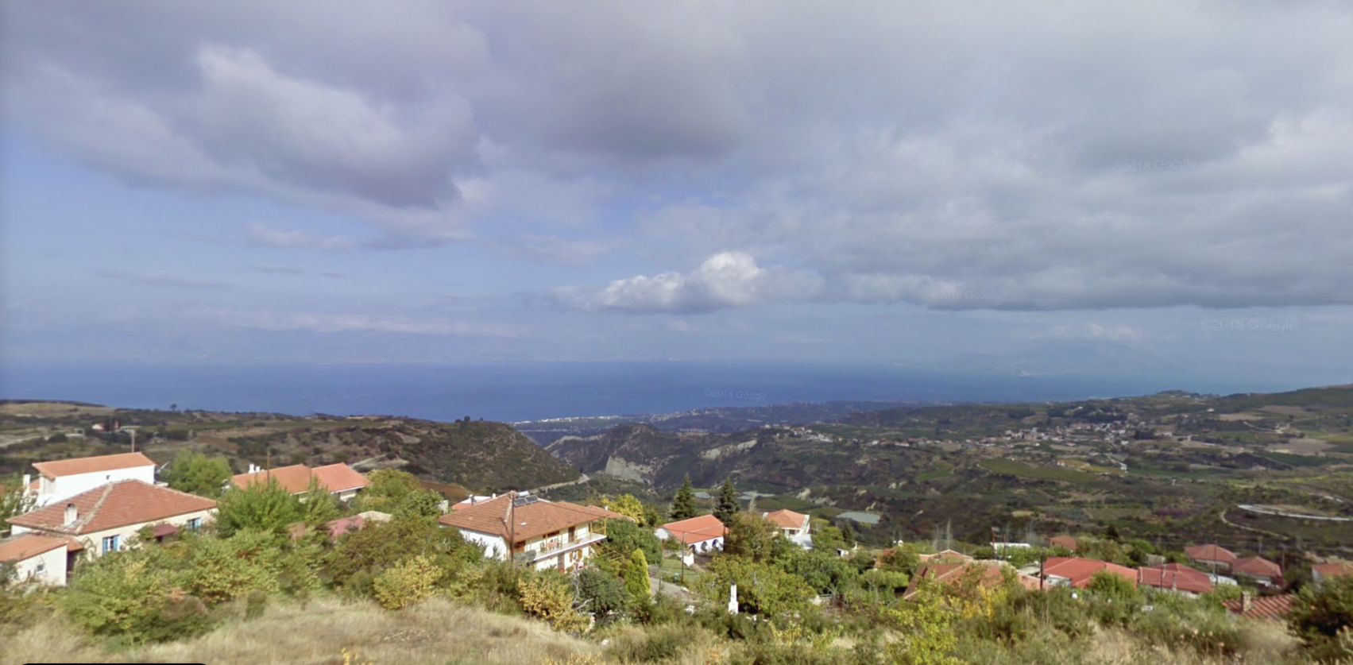
Logistics
Lunch break: 12:30 (Wed incl)
Monday dinner in Sykia
Tuesday dinner in Throfari (buses leave @17:30)

Slide 8
Acknowledgements
Omiros Giannakis
Christos Tsironis
Dimitris Lenis
Michalis Axiotis

Slide 9

Acknowledgements
Omiros Giannakis
Christos Tsironis
Dimitris Lenis
Michalis Axiotis
Ingmar Sandberg and SPARC

Slide 10
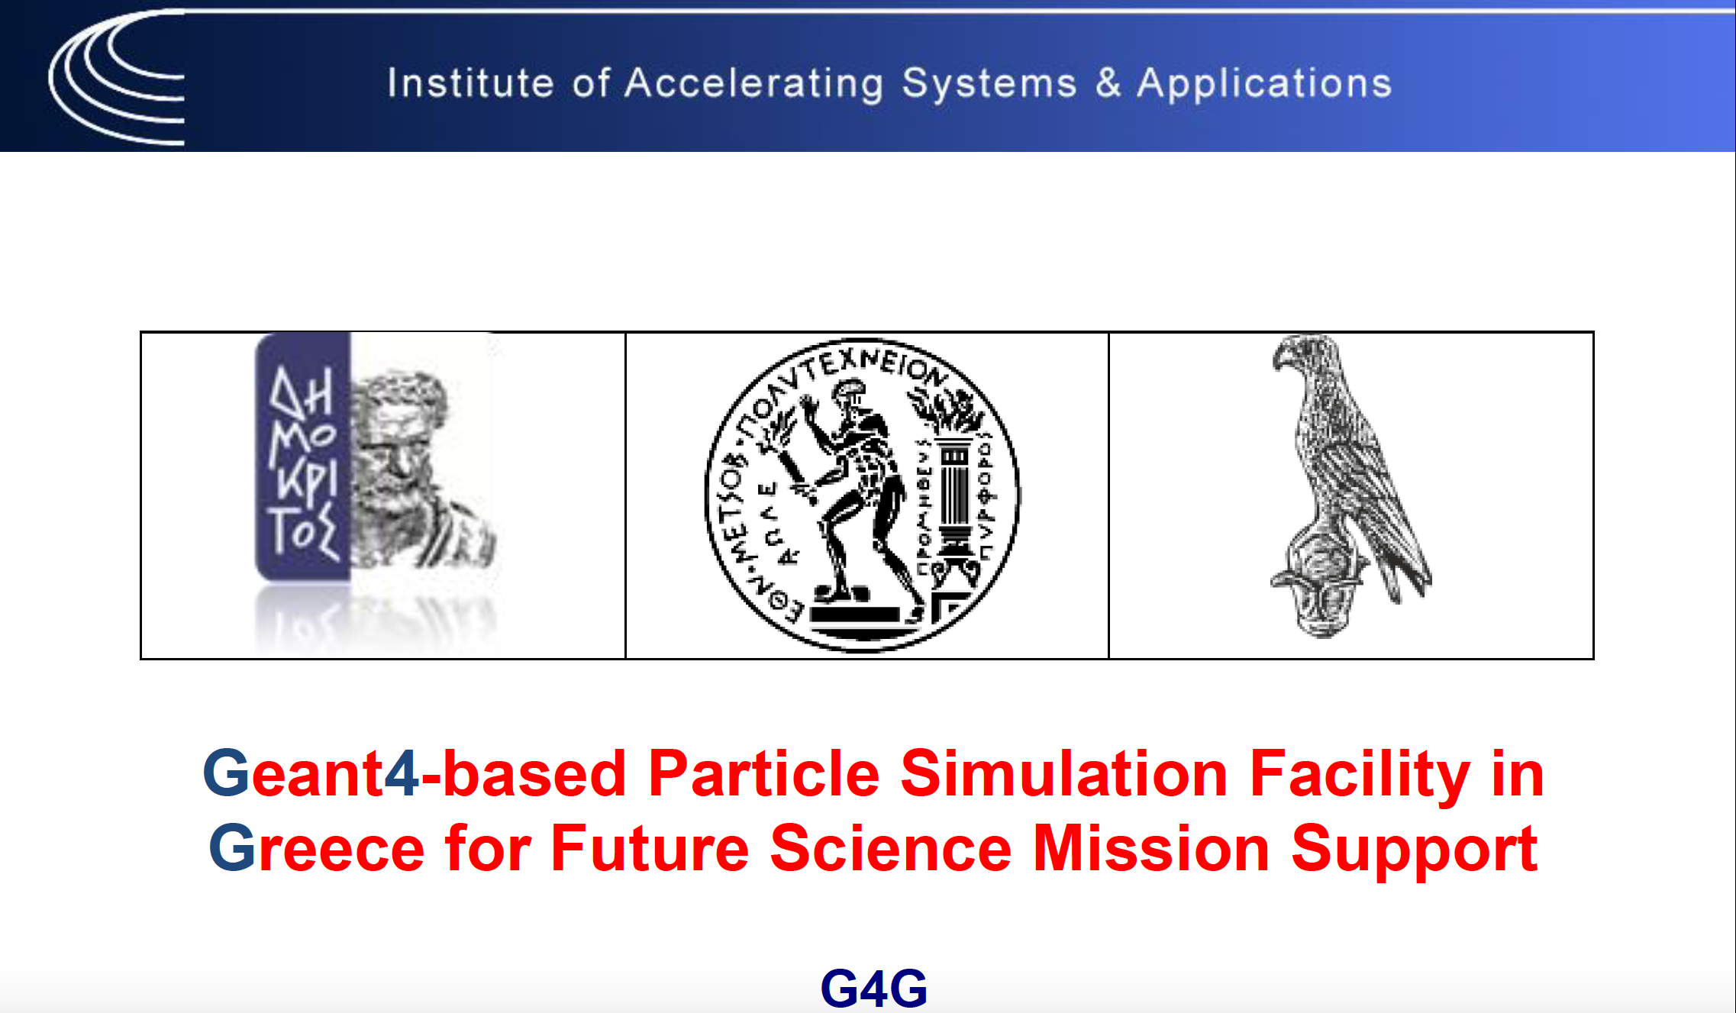


Slide 11
G4G: Geant4-based Particle Simulation Facility in Greece for Future Science Mission Support
Work Packages
WP01000: Review of existing Geant4 ESA developments
WP02000: Establishment of a Simulation Framework
WP03100: Analysis and Improvement of Particle Transport and Effects Models for
EM Interactions
WP03200: Review of Particle Transport and Effects of Models for Hadronic Interactions
WP04000: Software Implementation and General Improvements
WP05000: Improvements and extension to GREET/Planetocosmics-J codes
WP06000: Reverse Monte-Carlo improvements and validation for simulation speed-up

Slide 12
WP01000: Review of existing Geant4 ESA developments
ESA SPENVIS (SPace ENVironment Information System)
  We performed several tests using the following packages/tools:
        The orbit generator (SAPRE)
        Radiation Sources and Effects
        Spacecraft Charging
        Database Queries
  We also reviewed:
        the output formats of SPENVIS (html, ascii, graphical outputs)
        the SPENVIS architecture
Omiros Giannakis

Slide 13
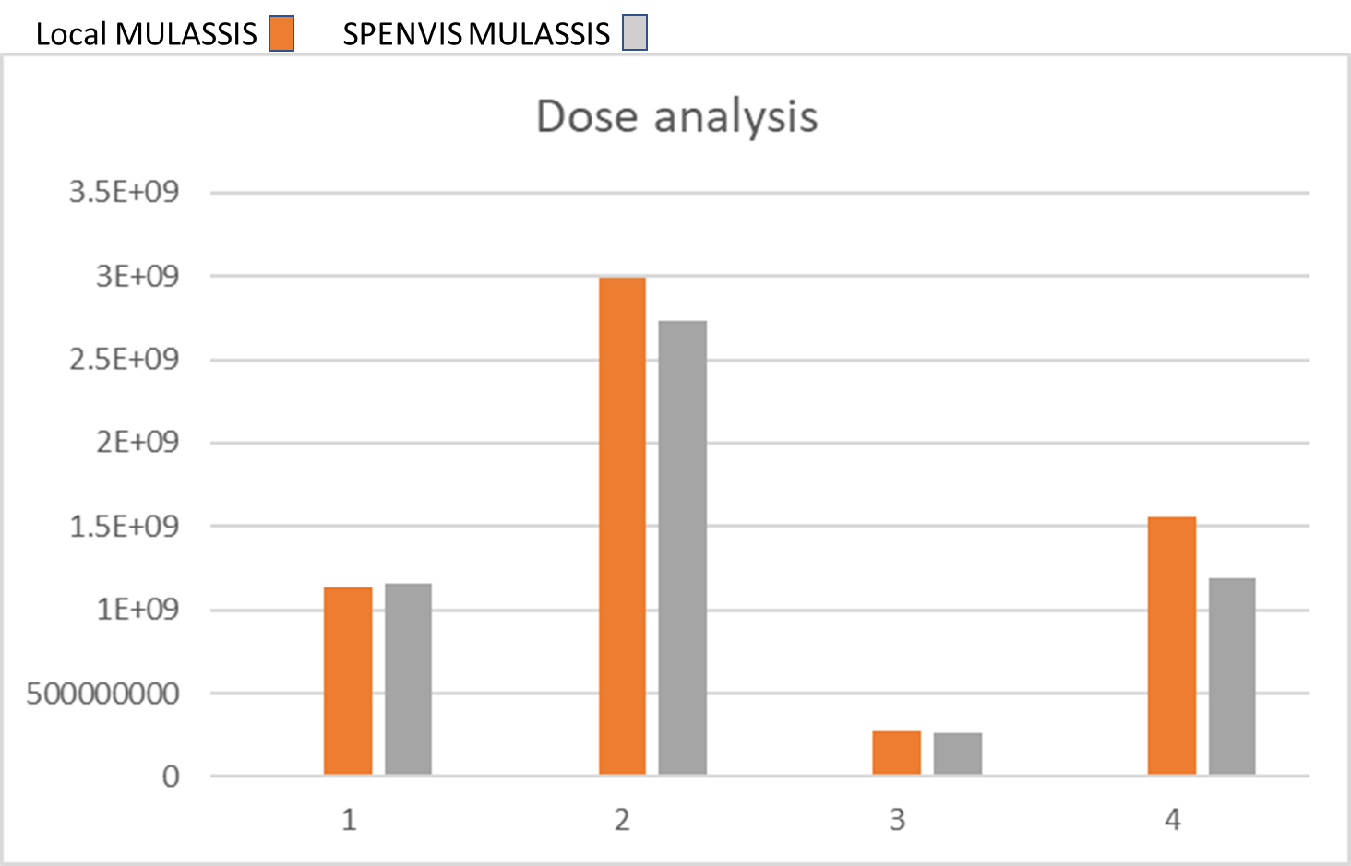
WP01000: Review of existing Geant4 ESA developments
MULASSIS (The Multi-Layered Shielding Simulation)
Installation:
  Local installation of MULASSIS
  Local installation of geant4-09-06-patch-04
  Local installation of dawn_3_90b visualization system
Testing (local):
  Development of MULASSIS G4 macro files (including geometry, predefined materials, adding new materials, Physics to include, Incident Particle Specification)
  Performed several test runs
Test runs for MULASSIS implemented in SPENVIS
  We performed a number of test runs
  Cross checking of radiation effects (NID, TID, Fluence, PHS) outputs between the local installation of MULASSIS and the MULASSIS implemented in SPENVIS
Omiros Giannakis

Slide 14
WP01000: Review of existing Geant4 ESA developments
Review of the SR-NIEL toolkit
We have reviewed the physics of SR-NIEL software with regard to electron and hadron beams.
We have reviewed the implementation of SR-NIEL in Geant4.
We have validated the SR-NIEL calculator against Geant4 v10.4 for electrons and protons over a broad energy range (0.1 MeV – 10 GeV) incident in Si and GaAs using the test58 example.
Ioanna Kyriakou & Dimitris Emfietzoglou, Medical Physics Lab, University of Ioannina, Greece
Notes:
Screened Relativistic Non-Ionizing Energy Loss

Slide 15
WP01000: Review of existing Geant4 ESA developments
  Reviewed GEMAT software
              Suggested to be discontinued and merged with GRAS
  Reviewed GRAS software
              Suggested following updates/improvements:
              Update to latest Geant4 version
              Multi Threading
              Merge with GEMAT, MULASSIS, etc

Slide 16
WP02000: Establishment of a Simulation Framework
  Simulation Framework (so far)
    3xVMs, 8CPUs with 14GB RAM each
    Multiple Geant4 versions (8.1.2, 9.3.2, 9.4.4, 9.5.2, 9.6.4, 10.0.4, 10.1.3, 10.2.3, 10.3.3, 10.4.2 and 10.5.1)
    All ESA provided software
    (GEMAT, GRAS, GREET, Magnetocosmics, MULASSIS, Planetocosmics, SD2Q, SSAT)

Slide 17
WP03100: Analysis and Improvement of Particle Transport and Effects Models for EM Interactions
Review the low-energy EM models of Geant4 (Geant4-DNA, Livermore, Penelope) and comparison of their performance at nanoscale using Geant4-DNA examples
        TestEm12, microyz, svalue, etc.
Recommendations offered to the Geant4 EM physics WG
      Replace Penelope by Livermore ionization models for electrons below 1 MeV in Standard EM physics (done in version 10.5)
      Establish a new Geant4-DNA constructor (Option 7) which combines Option 2 (10 keV – 1 MeV) with Option 4 (10 eV – 10 keV)
      Recommend Option 7 to extend the Standard EM physics down to 10 eV for micro- and nano-scale applications (in progress)
Ioanna Kyriakou & Dimitris Emfietzoglou, Medical Physics Lab, University of Ioannina, Greece

Slide 18
WP03100: Analysis and Improvement of Particle Transport and Effects Models for EM Interactions
Study of the performance of Standard EM Option 4 (version 10.5) for microdosimetry calculations of the Quality Factor using different parameter settings (work in progress)
Extension of Geant4-DNA Option 4 up to 1 MeV (work in progress)
    Calculation of new relativistic shell-ionization and excitation-level cross sections for liquid water
    Upgrade of Geant4-DNA Option 4 as the default model for micro- and nano-scale dosimetry
Ioanna Kyriakou & Dimitris Emfietzoglou, Medical Physics Lab, University of Ioannina, Greece

Slide 19
WP03200: Energy Loss
(Geant4 vs MCNP, FLUKA & PHITS)
dE/dx for 1 MeV up to 1 GeV for:
protons, alphas, ¹²C, ¹⁶O & ⁵⁶Fe
on
Al, Cu, Si, Fe & H₂O
Good agreement in general
except
MCNP: for Z>8 (overestimates dE/dx with respect to other codes)
Mike KOKKORIS

Slide 20
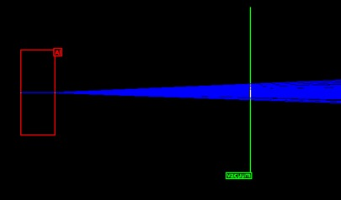
WP03200: Multiple scattering
(Geant4 vs PHTIS)
160 MeV proton beam
10⁴ protons
Target: Al, Be, C, Cu
Thickness: 0.08 - 8 cm
RESULT: very good agreement for both codes with respect to experimental data
Coming soon…
Multiple scattering for MCNP and FLUKA
will be also considered
+
(p,x_{n}) double differential neutron yield
Notes:
Aluminum Beryllium Carbon Copper

Slide 21
WP04000 – Software Implementation and General Improvements
Main focus on GRAS (Geant4 Radiation Analysis for Space)
  Ported to Geant4 version 10.05 (completed)
  Dropped AIDA and ESABASE support (completed)
  Incorporate GEMAT and MULASSIS (ongoing)
  Bring it to Geant4 philosophy (ongoing)
  Add multi-threading support (ongoing)
  Add ICRP 123 Equivalent Dose Analysis Module (ongoing)

Slide 22
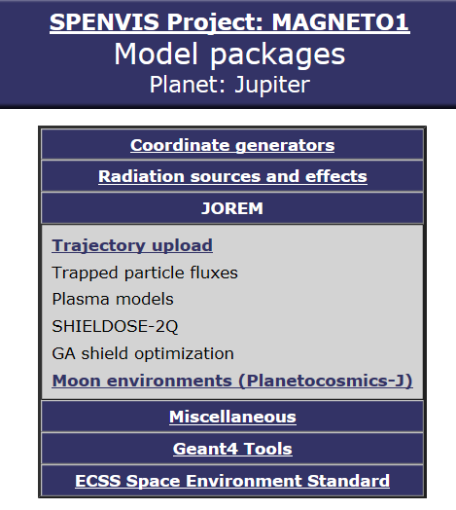
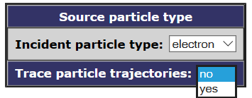
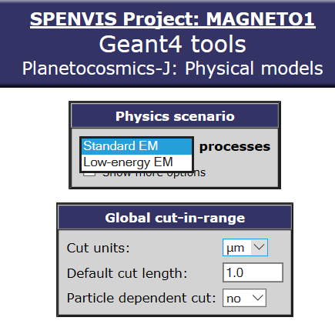
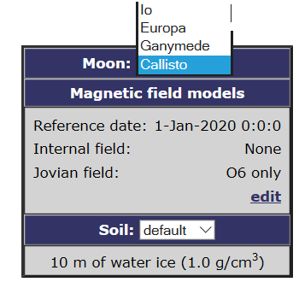
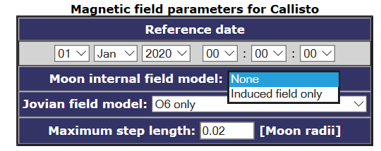

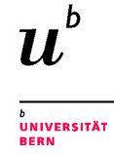



WP05000: Improvements and extension to
GREET/Planetocosmics-J codes
MODEL FACTS | user INFORMATION
Particle tracing code in planetary environments, modeling of interaction physics between cosmic rays and matter | Compute the motions of charged particles & associated parameters ---> Compute cut-off rigidity, particle flux & energy deposition vs position & incidence direction ---> Visualize cosmic ray particle trajectories & magnetic field lines
Deploys the Geant4 toolkit | Utilize Geant4 physics models (low/high-energy EM, hadronic)
Uses variety of physics models | Models for the planetary magnetic fields, atmospheres and soils
PLANETOCOSMICS is included in the SPENVIS environment
User input
Source particles
Planetary settings
Geometry definition
Analysis parameters
Advanced settings
PLANETOCOSMICS code versions
● Addition of particle interactions with the planetary soil
● Transition (upgrade) to Geant4 version 8.1
● Use of Geant4 high energy models (QGSC, FTFC, FTFP)
● Latest version available in SPENVIS (G4 version = 9.3)
● Focus on Jovian moons (+ Jupiter magnetic field model)
● GREET module for Ganymede radiation (JOREM menu)
2
J

Slide 23
Overview of work planned for improving PLANETOCOSMICS
Tasks performed, in progress & considered
WP05000: Improvements and extension to GREET/Planetocosmics-J codes
Review of physics models & SPENVIS version
Magnetic field – atmosphere – soil (Earth, Mars, Mercury, Jovian moons) G4 tools, source particles, geometry, analysis parameters
Introduce new planetary environments (now Earth, Mars, Mercury, Jovian moons)
High priority: Uranus & Neptune (future icy-giant mission support)
Optional: Saturn, Venus
Physics upgrades to the Jovian environment model (Jupiter + 4 larger moons: Ganymede, Europa, Io, Callisto)
Trapped particle effects, GCR & electron tracking, GCR shadows
Additional proposals for future improvements
Inclusion of electric field models (convection, storm-time)
Transition from Geant4 version 9.3 to version 10.5
Advantages in G4 10.x: multithreading, Reverse Monte Carlo methods, versatile geometry & visualization primitives

Slide 24
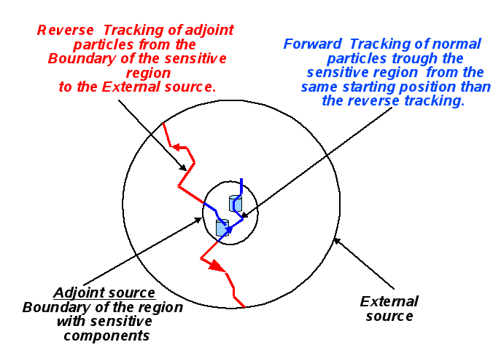
WP06000: Reverse Monte-Carlo improvements and validation for simulation
RMC (Reverse – or Adjoint – Monte Carlo method) was implemented in GRAS
It has already been implemented (partially) into Geant4:
  eg by replacing
  GRASAdjointSimManager G4AdjointSimManager
The scope of this package is the full implementation of RMC
methods within GEANT4
So far only minor additions, bugs, initial tests etc
Work hand-in-hand with WP04000 (GRAS improvements)

