Slide 1
Recent developments and plans - non-physics part
Makoto Asai (SLAC)
Geant4 Space Users Workshop 2019

Slide 2
Outline
Overview of planned developments for 2019-
Kernel modules
Physics (see talks by V.Ivantchenko)
Detailed patch release notes:
http://cern.ch/geant4-data/ReleaseNotes/Patch4.10.5-1.txt
List of planned features for 2019:
http://cern.ch/geant4/support/planned_features
Current version
Version 10.5-patch01 (released on April 17th)
Next release
Version 10.6 (scheduled on December 6th)

Slide 3
Infrastructure
Migration of HyperNews fora to Discourse •
Migration of web site to Drupal-8
Upgrade from existing Drupal-7 site
Testing infrastructure in Jenkins •
Adoption of Docker containers for testing
Versioning of builds through pipelines
Enhancements to Geant4 GitLab workflow •
Addition of code formatting hooks; integration with Coverity analysis; …
Adaptation to new features in future versions of GitLab; study of GitLab CI use
Build and publication of Docker/Singularity images for releases
Migration of static preprocessor –D flags to #define/undef directives •
Modularization of Geant4 Libraries •
Global/granular/optional
Optimization of Data Libraries
Simplify data library configuration/location using layered lookup via self-location, single environment variable, UI commands/C++ API
Provide C++ API for accessing/parsing data libraries
Optimize file access patterns and formats to minimize number of small files opened

Slide 4
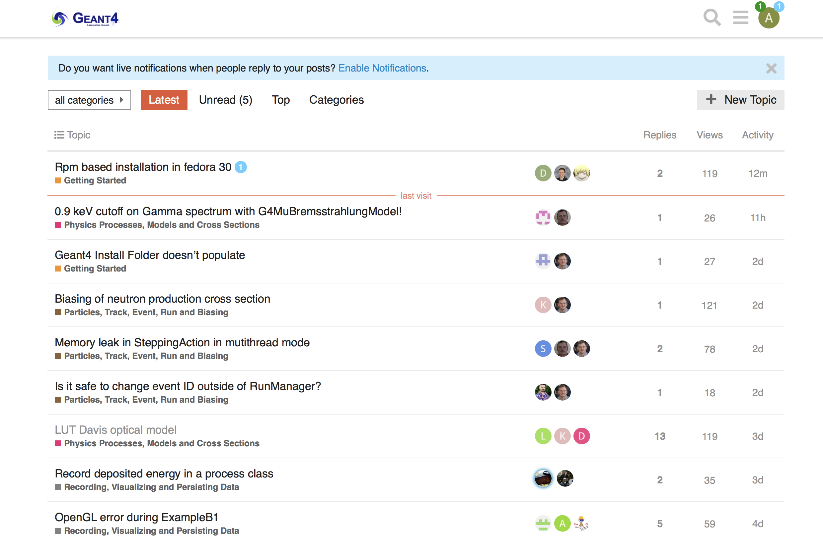
https://geant4-forum.web.cern.ch

Slide 5
Geometry & Transportation
VecGeom
Implementation of missing shapes/constructs: ellipsoid, elliptical cone, etc.. •
Enhancements to specialized navigators, neighbor volume detection
Addition of replicas/divisions – proposed summer project
Use of Embree library for tessellated shapes – proposed summer project
GDML writer & ROOT I/O persistency – proposed summer project •
Generation of polyhedral meshes for shapes •
Overlaps checking – proposed summer project •
Implementation of a prototype navigator based on VecGeom •
Separate safety computation and state from navigator
Implement strategy for a light-weight base navigator class not holding navigation state
Profiling and optimization of multiple navigation
Revise design and implementation of multiple navigation and coupled-transportation
Revision of transportation processes
Specialized transportation processes for neutral and charged particles

Slide 6
Field Propagation
Enable default use of interpolation in intersection calculation in field propagation •
Revise protocol between transportation and tracking to better cope with particles looping in field •
Review accuracy of boundary crossing in field •
Recent ALICE and CMS requirement

Slide 7
Materials & Biasing
Implementation of an extension for multiple particle type biasing
Enrich event biasing options
leading particle biasing, DXTRAN-like biasing, implicit capture •
Extend generic biasing scheme for at rest case •
Prototype implementation of generic biasing techniques:
biasing of charged particles (with cross-section changing over the step) •
occurrence biasing (continuous density change inside a same volume)
material/isotope biasing; Woodcock tracking
Adoption of the new elastic differential cross-section class in hadron elastic •
Implementation of new elastic differential cross-section class to be used in DXTRAN biasing option
Investigation on potential difficulties in propagating tiny weights for large cross-section change (neutrino interactions)
Revision of the GFlash fast-simulation model •

Slide 8
Persistency & Analysis
Enabling of import/export of assemblies envelopes in GDML •
Improvements to n-tuple merging in row-wise mode •
Addition of analysis "executive" to provide possibility to choose output type at run-time •
Additional flexibility in resetting/deleting histograms
Review support for writing same histogram/profile on file several times
Handling of more files by analysis manager •
Particles & Track
Improvements and update of G4IonTable and G4ParticleTable to cope with muonic atom and hyperons •
Review of production thresholds

Slide 9
Run, Event & Detector Response
Multi-threading:
Workspace and memory cleanup in MT
Finalize new design of threads though tasking mechanism (allow threads to join/leave workers pool) •
Implement hooks for allowing sub-event level parallelism
Implementation of phase-space file interface to GPS
Revision of production thresholds
Command-based scoring for real-world volumes •

Slide 10
Extending command-based scorer
Current command-based scorer works as following.
Construct a parallel world with mesh geometry and register a dedicated G4ParallelWorldProcess to ProcessManager of all particle types
Instantiate thread-local G4MultiFunctionalDetector and register requested PrimitiveScoere(s)
Set thread-local G4MultiFunctionalDetector to logical volume of the mesh cell in the parallel world
HitMap of each PrimitiveScoere is summed up after each event, and merged over the worker threads after the event loop
Idea is to provide the same command-based scoring mechanism for volumes defined in mass world.
Steps 2. and 4. can be reused. The only addition is setting thread-local G4MultiFunctionalDetector to a logical volume in the mass world
Thanks to the recent developments, a logical volume may have more than one sensitive detectors
Also, we can utilize the G4Analysis package to create histograms, plots, n-tuples on the fly without writing any single line of C++ code.

Slide 11
Command examples
Construct geometry via reading GDML or ordinary detector construction, etc.
Command samples
/score/create/realWorldLogVol <logVolName> <geoLevel>
/score/quantity/energyDeposit <primitiveScorerName> <unit>
/score/close
/score/analysis/1D/create <logVolName> <primitiveScorerName> <copyNo>
/score/analysis/1D/set <nBin> <low> <high> <unit>
/score/analysis/1P/create <logVolName> <primitiveScorerName> <nBin>
/score/analysis/1P/set <low> <high> <unit>
/score/analysis/plot
/run/beamOn 1000
/score/dumpAllQuantitiesToFile <logVolName> <fileName>
<logVolName> could be the name of any logical volume used in the mass geometry, either hard-coded or imported from CAD/GDML
Note: some command names are still tentative

Slide 12
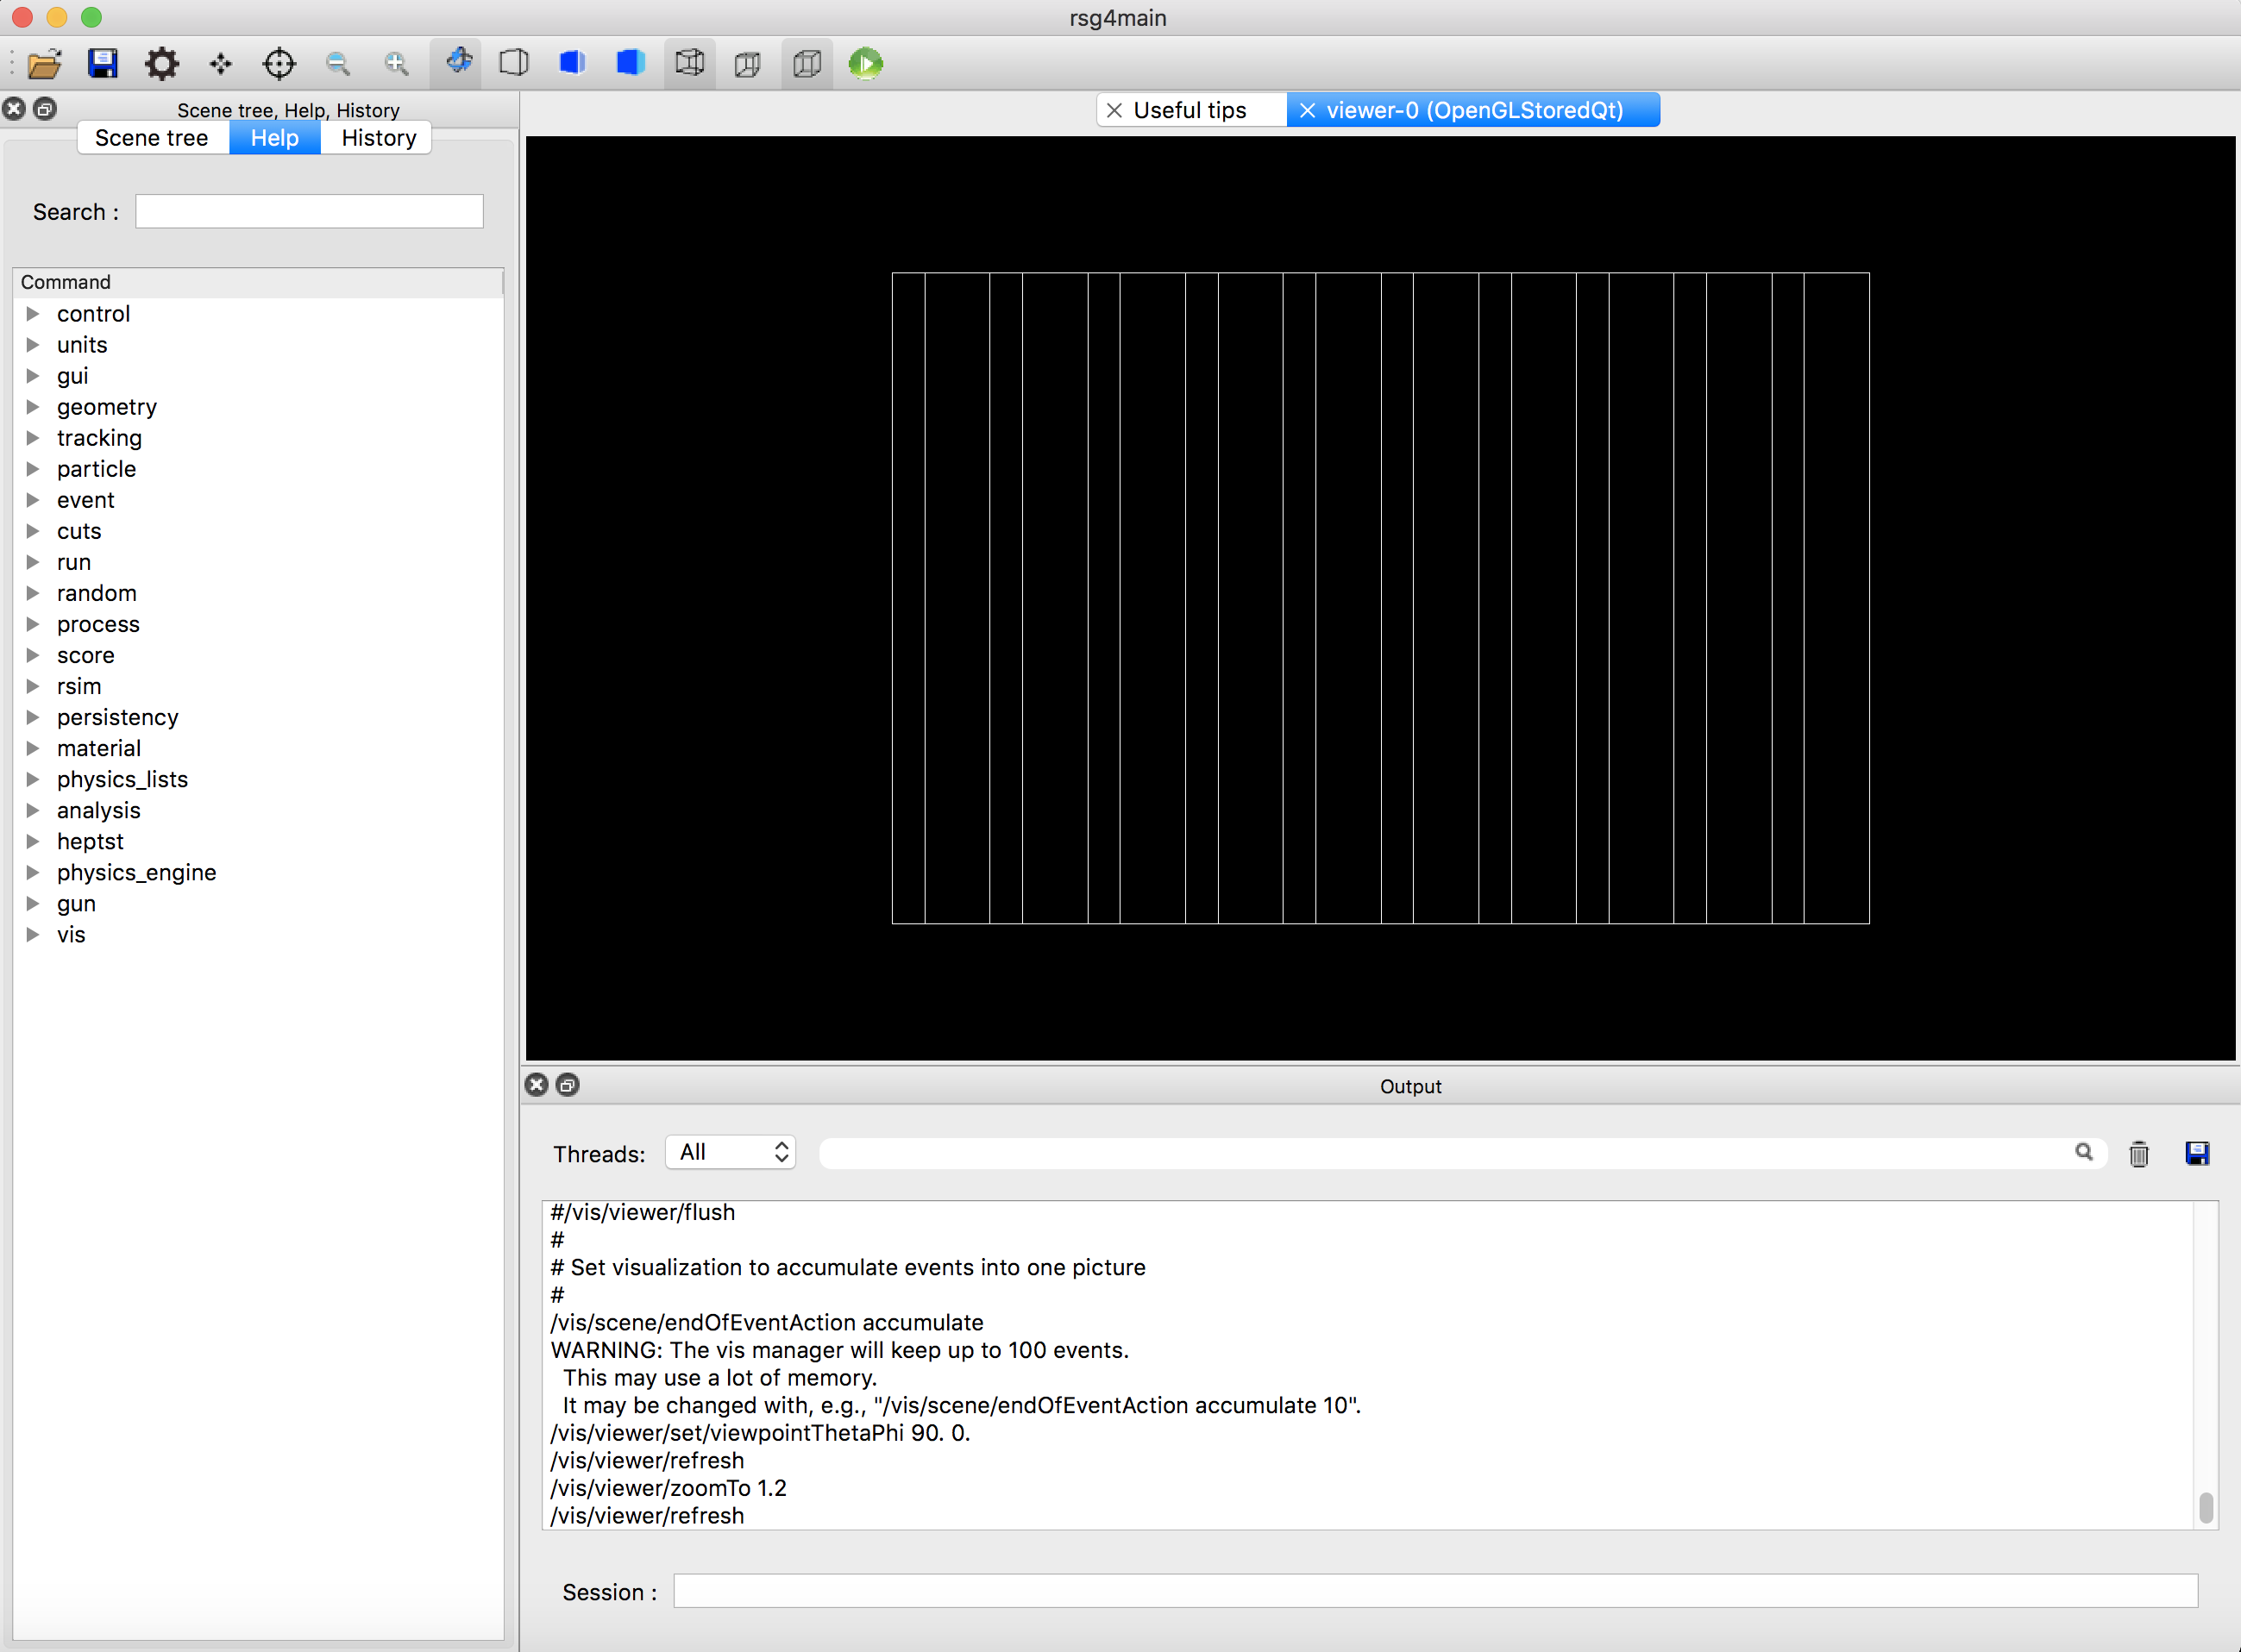
Basic/B4a geometry
/score/create/realWorldLogVol Gap 1
/score/quantity/energyDeposit eDepRW MeV
/score/close
/score/analysis/1D/create Gap eDepRW
/score/analysis/1D/set 100 0. 50. MeV
/score/analysis/1P/create Gap eDepRW 10
/score/analysis/1P/set 0. 50. MeV
/score/analysis/plot
/run/beamOn 1000

Slide 13
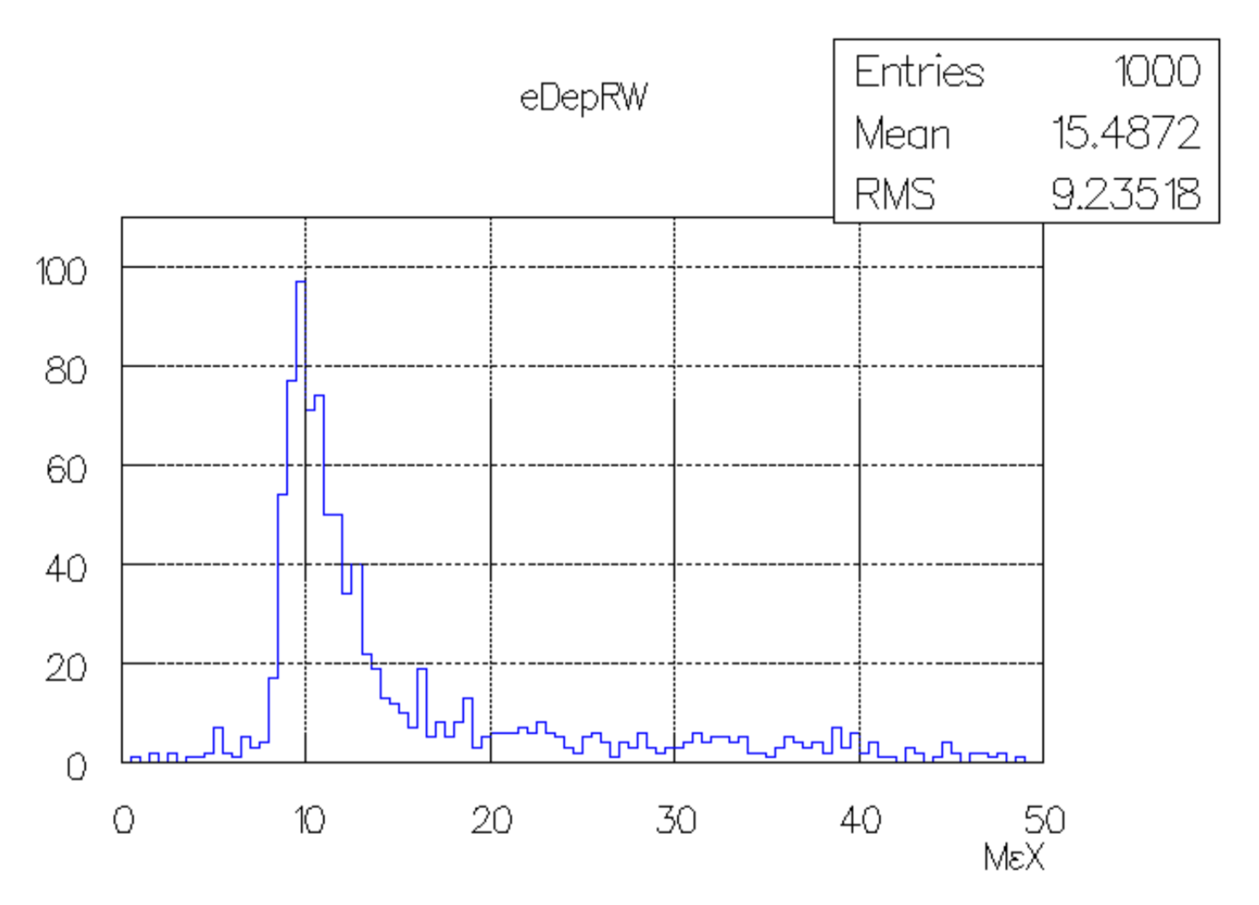

Slide 14
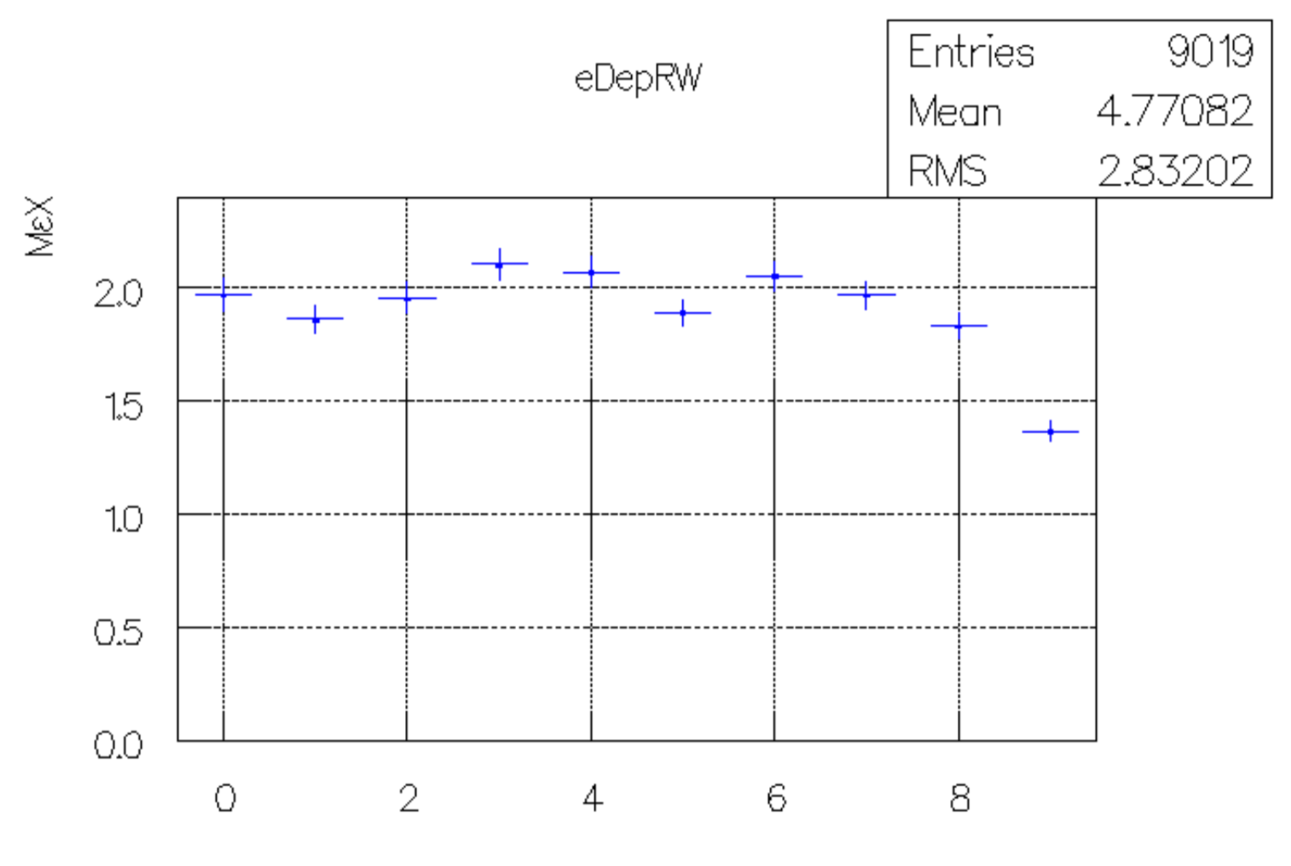

Slide 15
Plan
Version 10.6 will include some limited functionalities
/score/create/realWorldLogVol and related commands to define scorers to mass-world volume
Year-2020 release will have full functionalities including histogram/plot/n-tuple
histogram/plot/n-tuple will also be available for parallel-world scoring mesh defined through current command-based scorer
Part of the code will be inside Geant4 source, and other part in an example

Slide 16
User and Category Interfaces
Improvements to ZeroMQ interface / Jupyter frontend (backend for UI-command distribution using ZeroMQ message-queue service)
Integration of G4Py module to CMake build •

Slide 17
Visualisation
OpenGL drivers:
New driver OGLFile to produce image files in batch jobs
Improvements to toolbar in OpenGL Qt
Adaptions to newer OpenGL versions, exploit new functionalities and replace deprecated calls •
Other drivers:
New Apple/Metal driver for MacOS and native Qt driver •
New driver for export to format readable by Paraview
Updates to gMocrenFile and gMocren to support visualization attributes and other information
New driver G4DAE exporter for export in Collada format
Updates to OpenInventor Extended Viewer
Development of visualization solutions for iOS and Android devices
Rewrite of Wt driver
Change from flat format to hierarchical format in VRML
Support for visualisation of Boolean shapes •
New tool to support high resolution transparent visualization with ability to rotate and zoom
Visualisation of geometry overlaps •
Support of user-drawn primitives in multi-threaded mode
Integrated visualization of field lines •

Slide 18
Novice & Extended Examples
New example "dnadamage" for Geant4-DNA •
Simulation of a DNA chromatin segment with molecular definition
New cross-sections for gas materials in the "icsd” DNA example
New example illustrating generic biasing
"DXTRAN" MCNP-like option and implicit capture
Extended biasing examples •
Fix overlap among B02, B03 and GB03 examples
Updating selected examples with usage of G4Accumulable •
Porting of Geant4e and related example to multi-threading
Extension to the DICOM reader to support RT Dose format
Complete migration to MixMax in EM examples •
Review of examples macros and tests •
Complete application of coding guidelines & code review •

Slide 19
Advanced Examples
Development of alternative approaches for LET calculation in hadron-therapy •
New example for nanomedicine
Gold nanoparticles in X-ray radiotherapy
Migration of air_shower example to multi-threading
Assessment of physics of advanced examples and analysis of software quality metrics •
Code review and coding guidelines •

