Slide 1
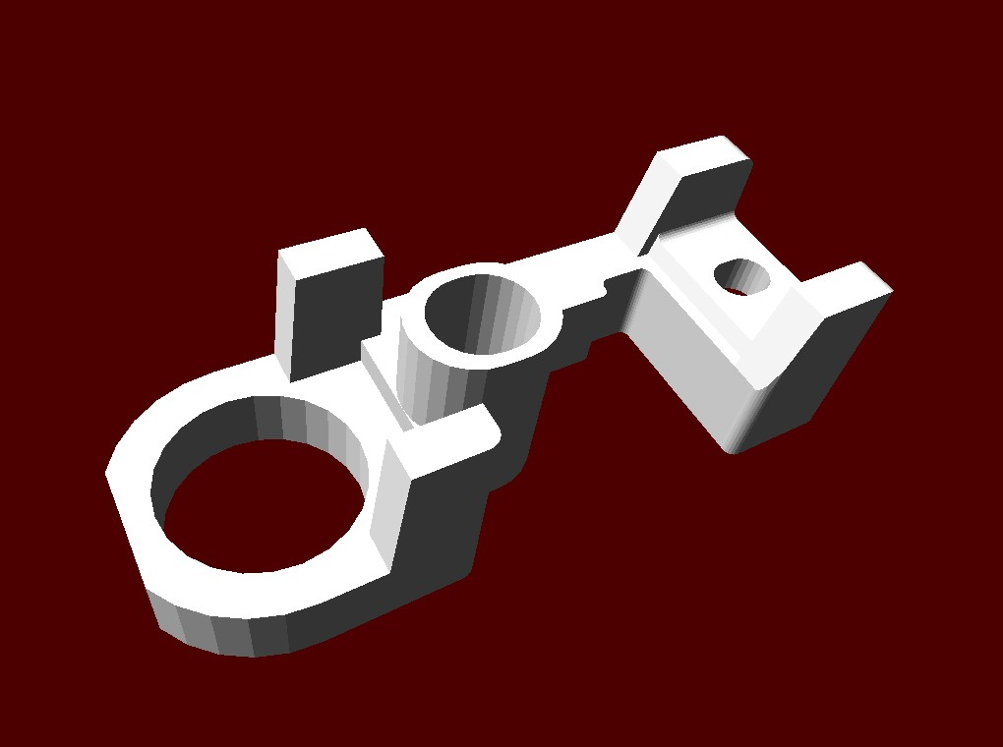
Tessellated solids
G4TessellatedSolid
Generic solid defined by a number of facets (G4VFacet)
Facets can be triangular (G4TriangularFacet) or quadrangular (G4QuadrangularFacet)
Constructs especially important for conversion of complex geometrical shapes imported from CAD systems
But can also be explicitly defined:
By providing the vertices of the facets in anti-clock wise order, in absolute or relative reference frame
GDML binding
G4ExtrudedSolid is re-implemented to internally use G4TessellatedSolid.
Notes:
can be converted from STEP (see TEST directory)
vertices need to be defined in the right order with absolute of relative positions

Slide 2
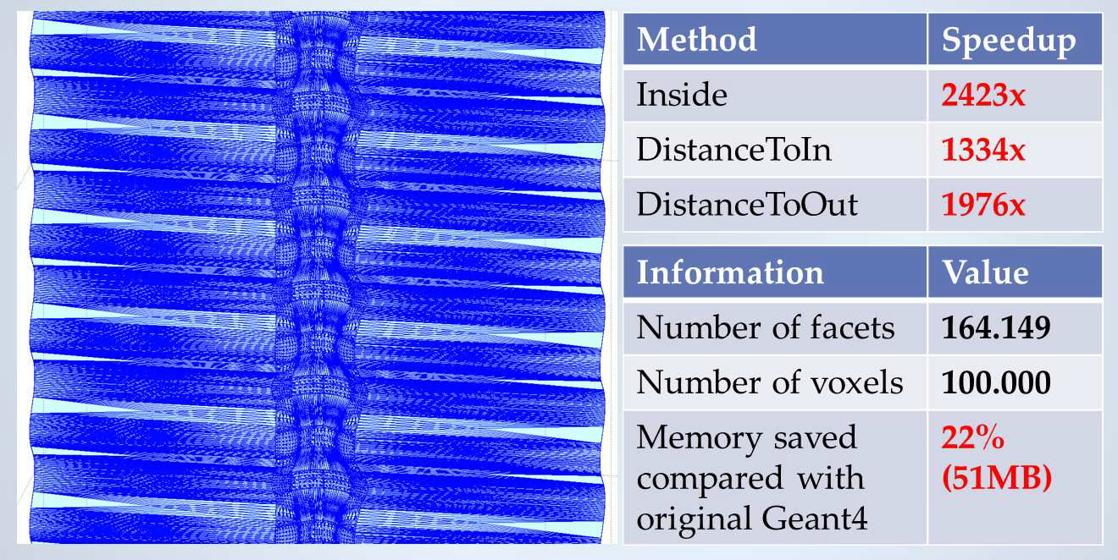
Geometry updates – New solid library
An important effort was begun in the last few years to write a new solid library, reviewing at the algorithmic level most of the primitives and provides an enhanced, optimized and well-tested implementation to be shared among software packages.
In most cases considerable performance improvement was achieved.
For example, the time required to compute intersections with the tessellated solid was dramatically reduced with the adoption of spatial partitioning for composing facets into a 3D grid of voxels.
Such techniques allow speedup factors of a few thousand for relatively complex structures having of order 100k to millions of facets, which is typical for geometry descriptions imported from CAD drawings.
Consequently, it is now possible to use tessellated geometries for tuning the precision in simulation by increasing the mesh resolution, something that was not possible before.
New in v10.4

Slide 3
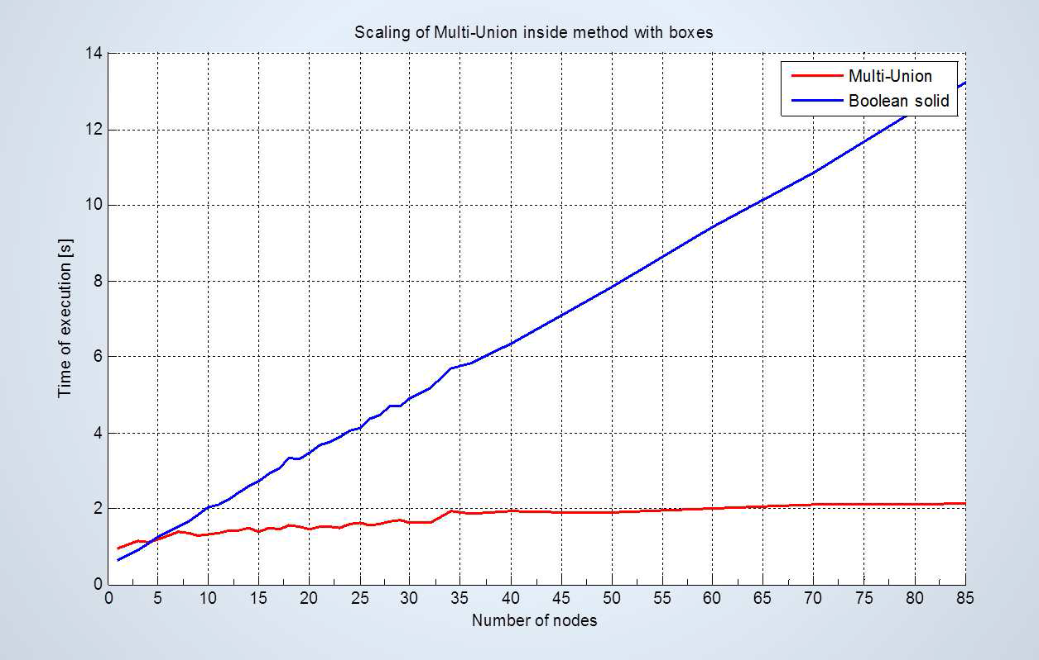
New “multi-union” solid
In addition to a full set of highly optimized primitives and a tessellated solid, the library includes a new "multi-union” structure implementing a composite set of many solids to be placed in 3D space.
This differs from the simple technique based on Boolean unions, with the aim of providing excellent scalability on the number of constituent solids.
The multi-union adopts a similar voxelization technique to partition 3D space, allowing dramatically improved speed and scalability over the original implementation based on Boolean unions.
New in v10.4

Slide 4
G4MultiUnion
G4MultiUnion* munion_solid = new G4MultiUnion(“UnitedBoxes");
for( int i=0 ; I < nNode ; i++)
{
G4Box* aBox = new G4Box(…);
G4ThreeVector pos = G4ThreeVector(…);
G4RotationMatrix rot = G4ThreeVector(…);
G4Transform3D tr = G4Transform3D(rot, pos);
munion_solid -> AddNode( *aBox, tr );
}
munion_solid -> Voxelize();
Note : G4MultiUnion is a solid. Use it to create a logical volume.

