Slide 1
Phase II
Final Presentation Days
Noordwijk, January 22nd, 2020

Slide 2
Overall Summary
Introduction
Design Consolidation
Wafer Realisation
On-wafer Measurement Results
Conclusions

Slide 3
Introduction - 1
The first phase of the SCFE project has been successfully completed with the final review on July 31st 2014.
The target of the first phase was the design of a SCFE in C Band adopting UMS and Selex ES technologies (0.25µm and 0.5µm respectively).
The second phase is focusing on the actual realisation of a SCFE with the same basic specifications, making use of the Leonardo 0.25µm GaN technology (SG025).
Being SG025 a brand new technology, the entire SCFE design has been consolidated, with a preliminary evaluation and tuning of the available foundry models and PDK. In particular Noise models for a family of Leonardo active devices have been purposedly extracted for use in the new design as part of the activity.
The new SCFE project phase II has concurrent and potetially synergic projects running on related topics (e.g. C-Band TRM led by TAS-I and/or Leonardo GaN technology space evaluation).

Slide 4
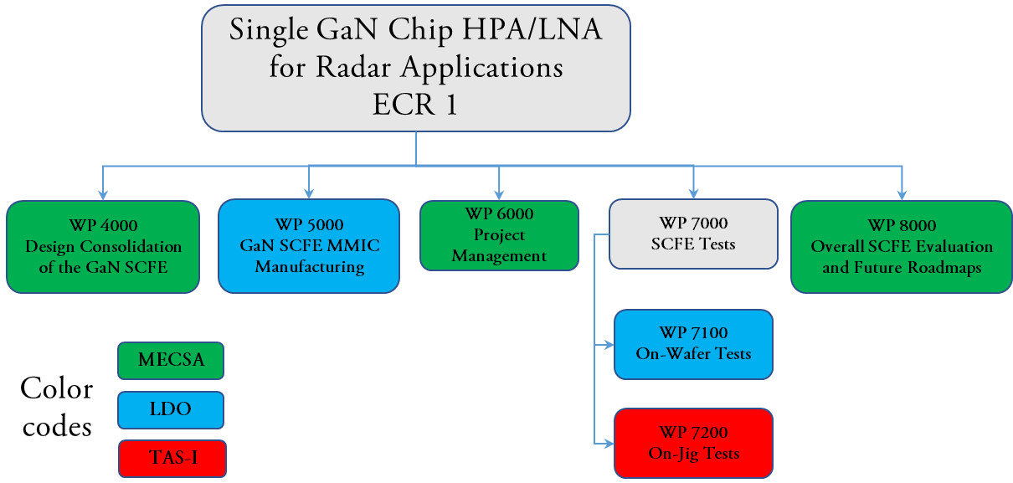
Introduction - 2
The final goal of the SCFE Project is to design, realise and test a Single-Chip Front-End in monolithic GaN HEMT technology, integrating high-power and low noise amplification together with signal routing (SPDT switching). The WBS is

Slide 5
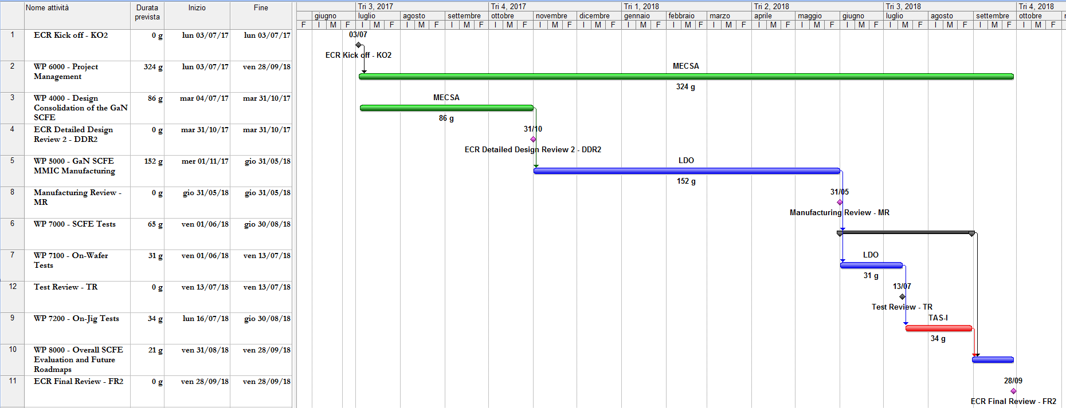
Introduction - 3

Slide 6
Design Consolidation - 1
WP 4000 – Design Consolidation
Model verification for key active devices intended to be used for HPA, LNA and Switching functionalities
Model verification for passive devices
Critical review of performances and specifications and eventual update
Re-design of individual circuit functions (HPA, LNA and Switch)
Integration into the SCFE of the individual circuit functions
EM simulations and eventual tuning of critical portions of the SCFE.
Tile generation, that will include at least one version of the SCFE and eventually, depending on available mask size, standalone functionalities (HPA, LNA and Switch)
Test plan generation for On-Wafer tests (including LDO contribution)
Test plan generation for In-Jig tests (including TAS contribution)

Slide 7
Design Consolidation - Tx Requirements
Parameter | Value | Remarks
Nominal Output Power (NOP) | > 40 W | Peak power during pulse @ 2dB below SOA or as per [AD.1], whichever is lower at Antenna port
Power-Added Efficiency (Tx_only) | > 40 % | @ NOP @ worst case backside temp. The same efficiency will be achieved in RM while Rx power consumption will be subtracted (see AD.4)
Centre Frequency | 5.405 GHz | C Band
Bandwidth (BW) | Minimum 320 MHz | For ± 0.1 dB variation of NOP over BW
Gain | Minimum 36 dB | @ NOP
Gain Compression Level | 2 dB below SOA | SOA = safe operating area as per [AD.1]
Pulse-to-Pulse Gain stability | < 0.1 dB | Comparing the same part of the pulses, over the full pulse length
Within Pulse Gain Ripple including BW and Droop | < 0.2 dB | Up and down chirp @ NOP
Pulse-to-Pulse Phase Shift Stability | < 3 deg | Comparing the same part of the pulses, over the full pulse length
Within Pulse Phase Shift Stability | < 3 deg | Up and down chirp
AM/AM Compression | 0.5 dB/dB | Over ± 1 dB dynamic range from nominal power
AM/PM Conversion | 5 deg/dB | Over ± 1 dB dynamic range from nominal power

Slide 8
Design Consolidation - Tx Requirements
Parameter | Value | Remarks
Input Reflection coefficient | < -15 dB | @ NOP, over entire BW
2nd , 3rd and 4th harmonic rejection | < -45 dBc | Target
VSWR handling capability / Ruggedness | 10:1 | For all phases at Antenna port. during Transmit cycle.
Sensitivity to load variations dB(S21), ph(S21) | < 0.5 dB < 6 deg | For any load with return loss < 8 dB and arbitrary phase
Spurious Emission In-Band | -55 dBc
Spurious Emission Out-of-band (not harmonics) | -70 dBc | Outside BW frequency range is 50 MHz to 18 GHz
Operation with Signal 1 | Full performance will be reached with Signal 1, in a 50 Ω env. In particular junction temperature will be with this signal.
Stability | The Tx path will be unconditionally stable when any impedance is presented at its input and output at any power level.

Slide 9
Design Consolidation - Rx Requirements
Parameter | Value | Remarks
Centre Frequency | 5.405 GHz
Bandwidth (BW) | Minimum 320 MHz | Gain Flatness within BW ± 0.15 dB
Nominal Input Power (NIP) | -80 to -30 dBm | At Antenna port
Gain | Minimum 36 dB | @ NIP over entire BW
Noise Figure (NF) | < 2.5 dB | @ room temperature (22 °C) and NIP. For whole path from Antenna to Rx output ports.
NF variation with Temperature | 0.017 dB/K
Pulse to Pulse Gain Stability | < 0.05 dB
Receive Window Gain Stability | < 0.2 dB | Receive window defined as: (1/(Duty Cycle)-1)* Pulse width
Gain Ripple vs. BW | < 0.5 dB | Within any position inside the receive window
Pulse to Pulse Phase Shift Stability | < 1 deg
Receive window Phase Shift Stability | < 1 deg | Receive window defined as: (1/(Duty Cycle)-1)* Pulse width
Phase Ripple over Bandwidth | < 5 deg | Deviation from linear phase

Slide 10
Design Consolidation - Rx Requirements
Parameter | Value | Remarks
Maximum Power Consumption during Rx_only mode | < 0.3 W | Within NIP range The same power consumption corrected by the Duty Cycle will be achieved in RM
Input Overdrive capability | > 30 dBm | Pulsed signal with pulse length as specified in AD.4 for conditions : - Chip completely unbiased - Gate bias applied, drain unbiased - In receive mode (no performance required)
Maximum Power Consumption during Overdrive | < 0.5 W | SPDT DC contribution excluded
Maximum Output Power during Overdrive | < 10 dBm | At Rx output port
Input Reflection Coefficient | < -10 dB | @ NIP, over entire BW
Output Reflection Coefficient | < -15 dB | @ NIP, over entire BW
OIP3 | > 20 dBm | Worst case over temperature
Return Loss in Rx_off condition | < -2 dB | At Antenna port

Slide 11
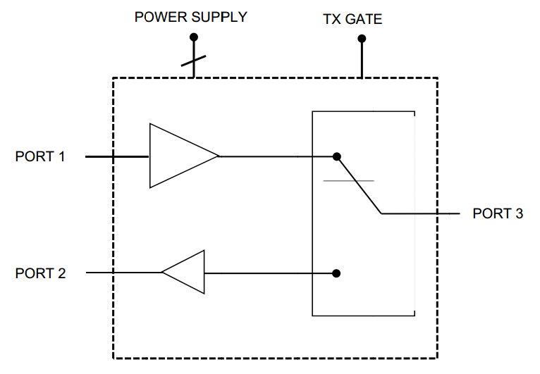
Design Consolidation - 6
Single Chip Front-end
2 versions have been developed:
    2 HPAs
    2 LNAs
LNA output
RF probe port
SCFE v1:
SPDT
HPA v1
LNA v1
Antenna in/out
PORT 4
PORT 3
PORT 1
HPA input
SCFE v2:
SPDT
HPA v2
LNA v2
PORT 2
Tx Gate
Power supply
The SCFE v1 is featured by a higher ‘designer risk’: single-side bias for the HPA, limiter at the end of the Rx Chain
The SCFE v2 is the ‘baseline design’.

Slide 12
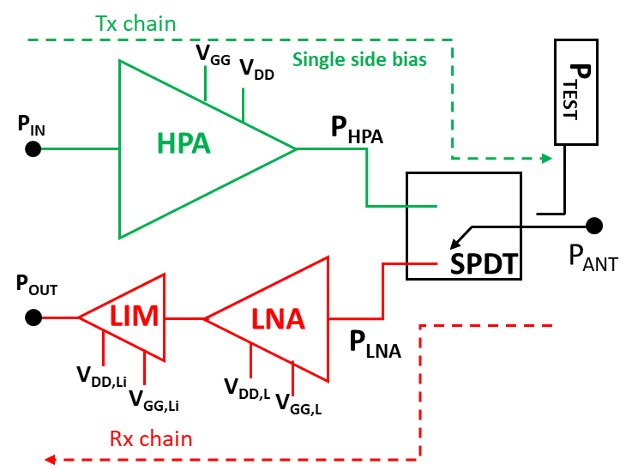
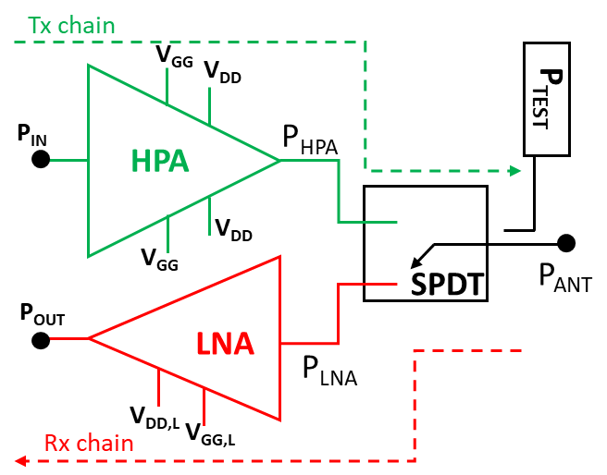
Design Consolidation - 7
SCFE V1
SCFE V2
3-stage single side bias HPA
3-stage LNA
A limiter towards the core chip
SPDT Switch
Power sampler
  3-stage dual side bias HPA
  3-stage LNA
  SPDT Switch
  Power sampler

Slide 13
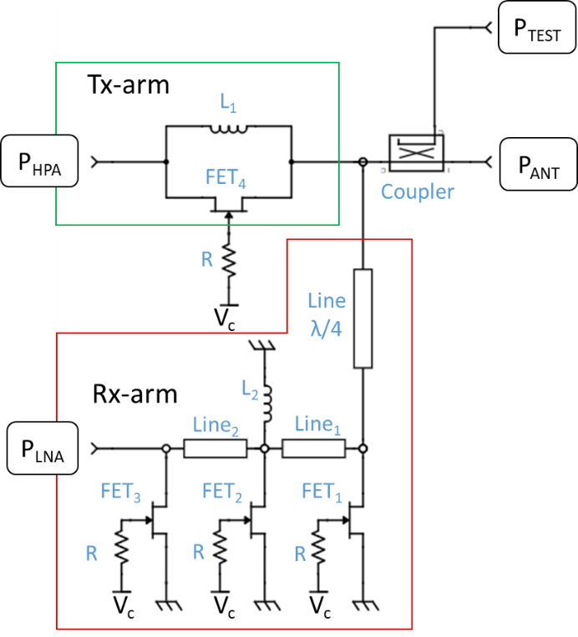
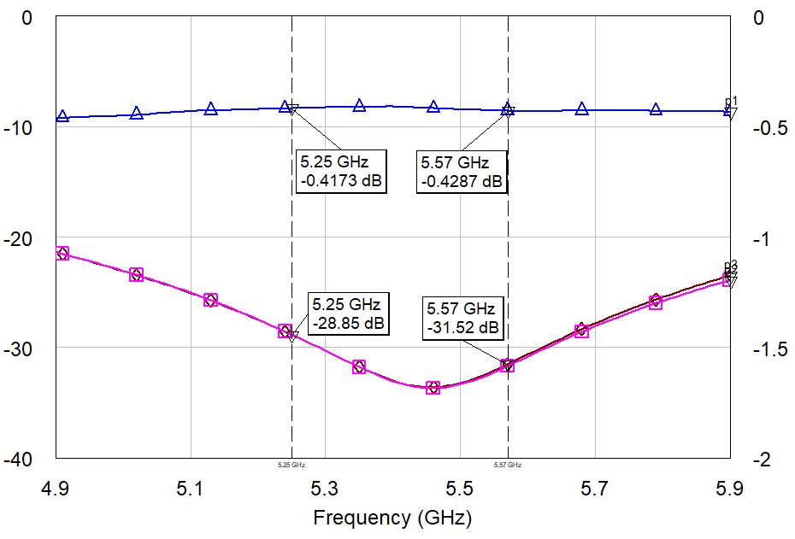
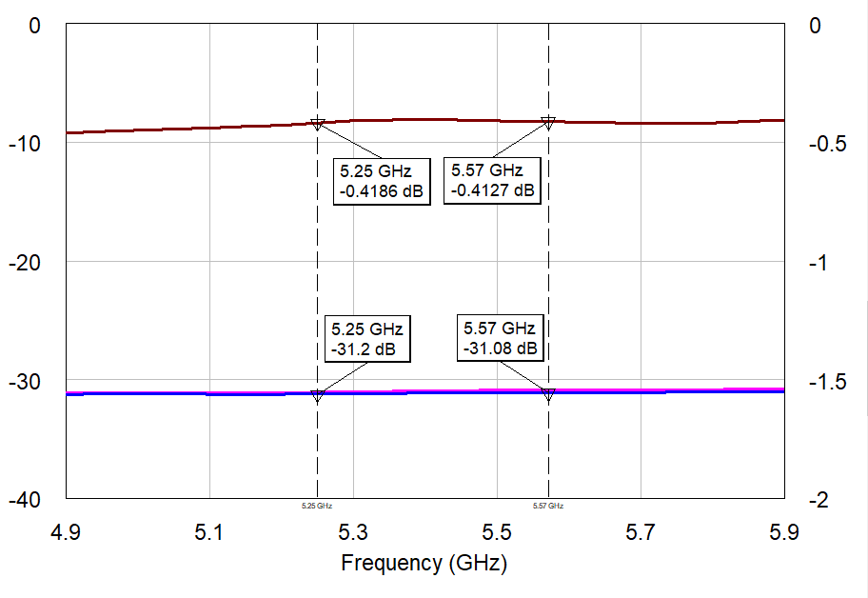
Design Consolidation - 8
SPDT: Same on both versions, reflective architecture, switches between Rx and Tx mode
Rx Path (P_{ANT}-to-P_{LNA})
  FET₁ – FET₃
  L₂ & λ/4@f₀
Tx Path (P_{HPA}-to-P_{ANT})
  FET₄ & L₁
FET₁, FET₂, FET₃ | SP5FZ (5x175 µm)
FET₄ | SS8G (8x200 µm)
V_{C}= -50V SPDT in Rx Mode
  FET₁-FET₃ //L2 ≈ Open Circuit
  FET₄//L₁≈ Open Circuit
V_{C}=0V SPDT in Tx Mode
  FET₁-FET₃ //L2 ≈ Short Circuit
  FET₄//L₁≈ Short Circuit
Electrical Scheme
Isolation & Insertion Losses

Slide 14
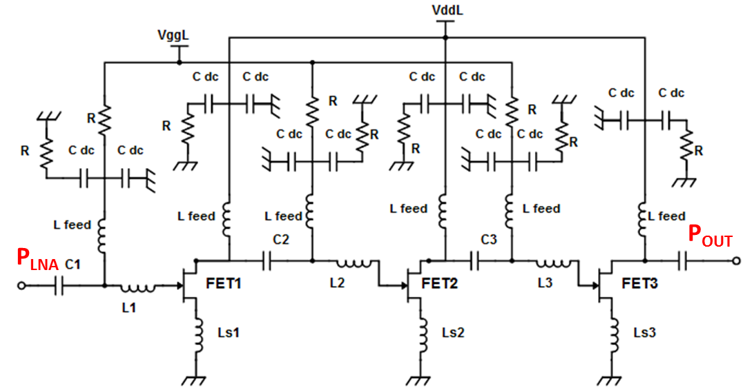
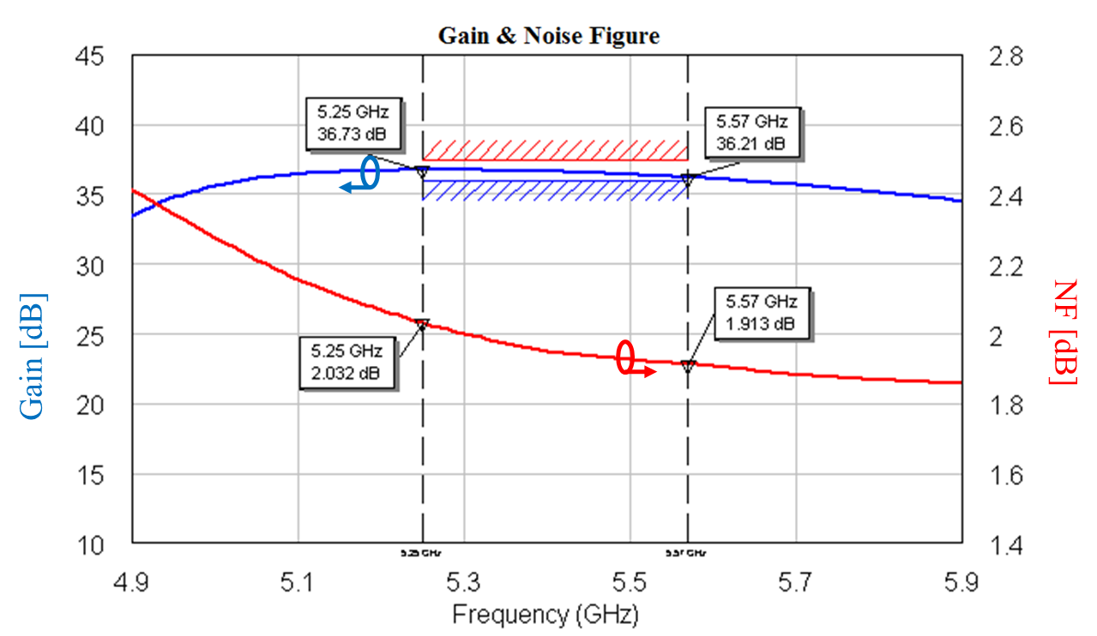
Design Consolidation - 9
In both Versions, inductive feedback in all stages was selected to design the LNA
In V1, a HEMT limiter follows the third stage
FET₁ & FET₂ are 4x50um
FET₃ is 4x25um
R_{gate}=5kΩ for robustness
V_{DD}=10V & V_{GG}=-3V
The circuit exhibits an abrupt saturation around 24 dBm of output power.
This aids to limit the power towards Core Chip
NF_{LNA}=1.6 dB
Gain=36 dB
P_{DC}=0.25 W
Electrical Scheme (V2)
Rx Performance (w SPDT in V2)

Slide 15
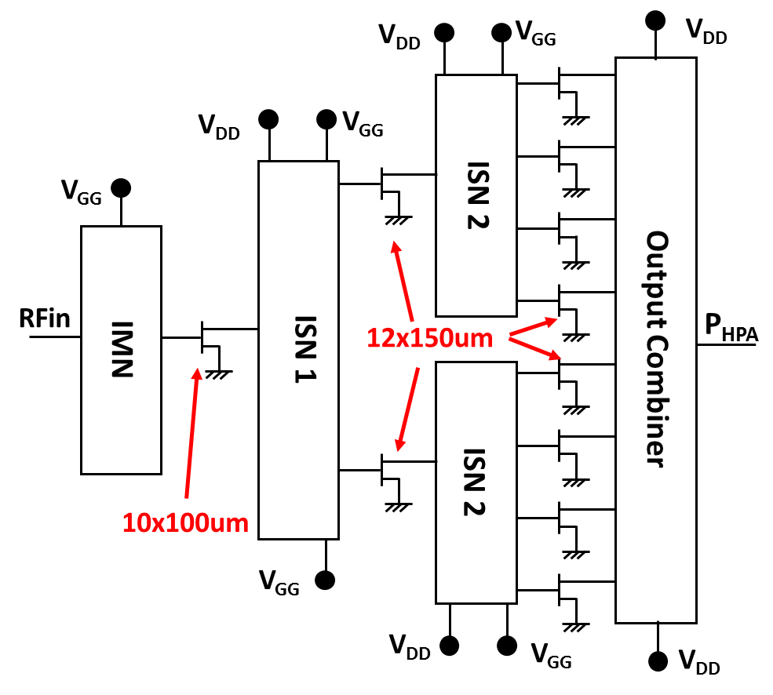
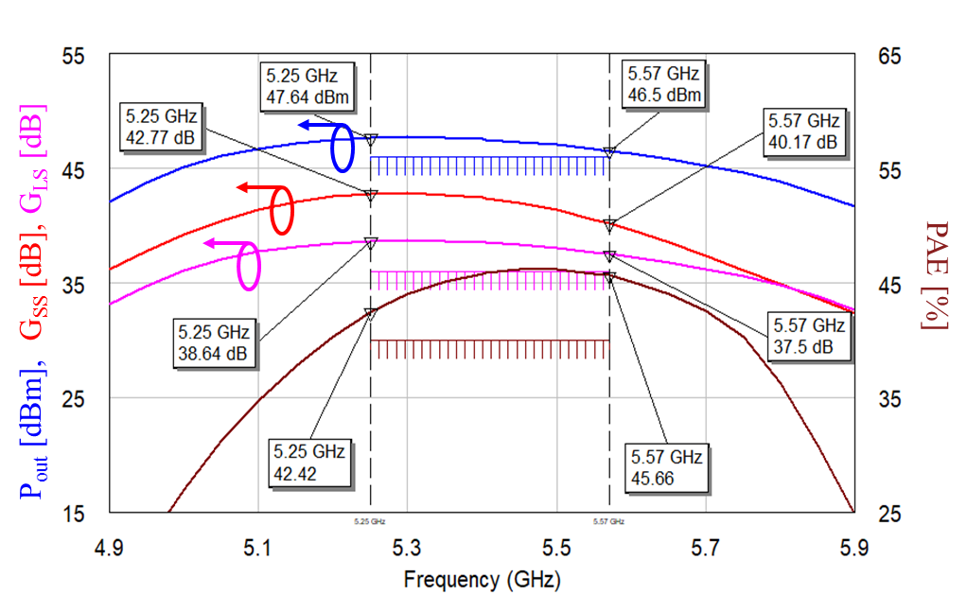
Design Consolidation - 10
Three stage architecture: FET₁ is 10x100um, whereas FET₂ and FET₃ are 12x150um.
Same active periphery in both versions for all stages
Bias Point: V_{DD}=30 V, V_{GG}= -3 V & I_{D}=1.6 A
Internal stability checked under both linear and nonlinear regimes
10Ω Resistors added between gates in the final stage
HPA Topology
V2 Performance (w SPDT)

Slide 16
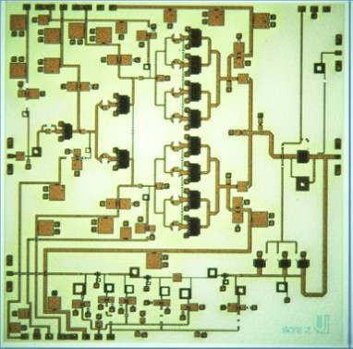
Design Consolidation - 10
HPA (V2)
Coupler
The HPA is placed on the upper left area. The LNA is positioned below the HPA, whereas the SPDT switch is placed among the amplifiers and the antenna.
A -30 dB coupled line was added at the antenna port
DC pads are placed at the upper and lower sides aiming at providing to the HPA a power supply as symmetrical as possible.
Chip size is 7x7mm².
LNA (V2)
SPDT

Slide 17
Wafer Realisation - 1
Both versions have been realized on two wafers with different epitaxy:
  SLX4 CG01
  SLX4 ID10
V1
V2
Sizes are 7.0 mm x 7.0 mm

Slide 18
Wafer Realisation - 2
Mask set
Dec. 2017 ÷ Feb. 2018 = Definition of the mask-set and reticle supplying.
Feb. 2018 = Definition of wafer’s shotmap. Difficulty increased by such a large die, divided in two different reticles.
Batch 1
Mar. 2018 ÷Sep. 2018 = Process up to PCM measurements. Wafers processed
with a wrong mask-set (SCFE-LDO-NCR-001 – Ohmic missing on switches).
Delays during the process, (common with High Power GaN C-Band TRM batch), due to:
  Clean room expansion (completed)
  Ion implanter malfunctioning (solved)
  Activities re-scheduling
Mask set
Sep. 2018 = Mask set correction and new reticles delivery.
Batch 2
Oct. 2018 ÷Apr. 2019 = Process and OWT completed on 2 wafers.
One wafer aborted for low breakdown (CF10)
Delays due to:
  Gate adhesion issue observed on different wafers. SCFE wafers waited for Gate step until DOE was completed and the problem was solved (Nov. 2018).
  Activities re-scheduling
Batch 3
Mar. 2019 ÷On hold = Process restarted on 2 wafers to replace CF10 wafer.

Slide 19
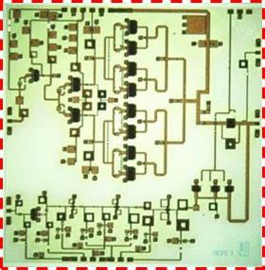
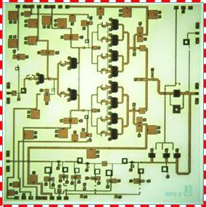
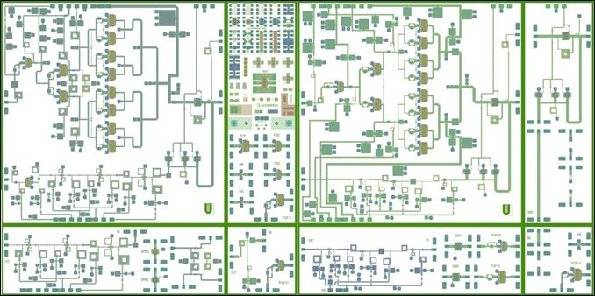
Wafer Realisation - 3
Mask composition:
#2 different version of SCFE (V₁, V₂)
#1 SPST Switch
#2 stand-alone LNAs + SPST
RF test structures
Discrete devices
PCM

Slide 20
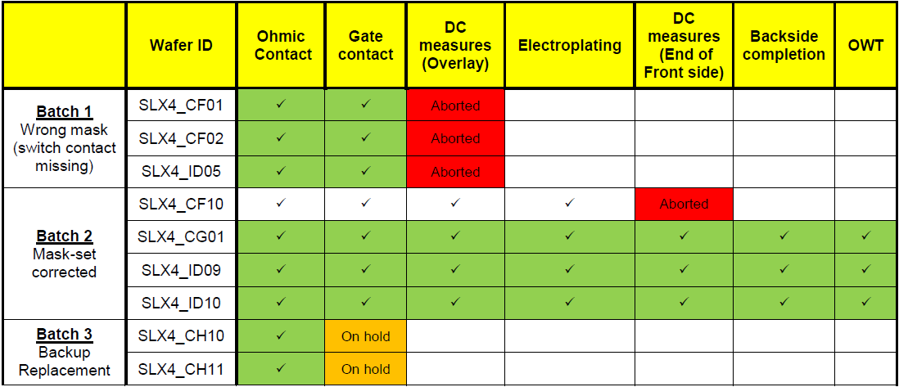
Wafer Realisation - 4
First batch composed by wafers SLX4_CF01, CF02 and ID05 were processed with a wrong mask-set (SCFE-LDO-NCR-001), where switches belonging to the MMIC SCFE V2 were missing.
Process have so been started on batch 2 composed by wafers SLX4_CG01, CF10, ID09 and ID10.
A breakdown voltage issue occurs in different ways on Batch 2 wafers. In particular:
CF10: very low breakdown voltage at the end of front side. Process aborted.
CG01, ID09: breakdown voltage lower than the specs (≈65V instead of >100V);
ID10: breakdown voltage in line with the specs.
As a backup solution, a further batch (CH10 and CH11) has been started.
All the wafers of batch 2 have been completed in terms of fabrication as well as DC, Pulsed and RF characterisation.
A total of 9 wafers (3 batches) have been dedicated to this project.

Slide 21
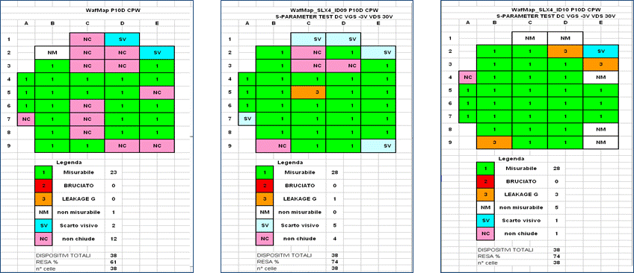
Wafer Realisation – RF Screening on P10D
CG01
ID09
ID10
Considering:
3 functions (HPA, LNA and SPST) in the SCFE
the High Power GaN C-Band TRM Demonstrator yield (best case 72%);
a total yield lower than 10% can be foreseen for the complete SCFE.
 | Main RF FoM on P10D CPW – End of Front Side
 | ft [GHz] | fMAX [GHz] | Gmax@5.5GHz [dB] | Pout@30V [W/mm] | Drain Eff. [%] | Yield [%]
Ref. | 22,50 | 49,00 | 18,40 | 6,50 | 74 | >60
SLX4_CG01 | 22,41 | 41,90 | 19,70 | 7,04 | 67,88 | 61
SLX4_ID09 | 21,49 | 46,94 | 19,58 | 6,90 | 69,76 | 74
SLX4_ID10 | 20,95 | 42,77 | 19,29 | 6,62 | 69,10 | 74
RF measurements are in line with the specs.

Slide 22
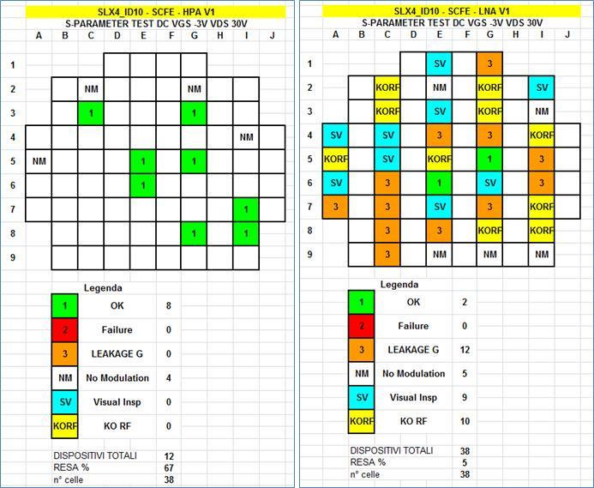
Wafer Realisation – SLX4_ID10 – SCFE V1
Screening criteria:
All the LNAs V₁ have been measured as a wafer screening, and so only the functioning Rx chain dies, even if out of specs (KORF), have been measured also in terms of Tx chain.
Derogation has been selected in order to indicate working SCFEs, even if not properly within the specs due to the complexity of the design and fabrication related to a very large area and multi-functional MMIC.
Spec1 (SCFE): Dies E6, G5
Tx mode: Pout>46dBm, Linear Gain= 43dB
Rx mode: Gain>36dB, NF<3dB
Spec2 (derogation): Dies G8, C3, G3
Gain Rx>20dB, NF<4.5dB

Slide 23
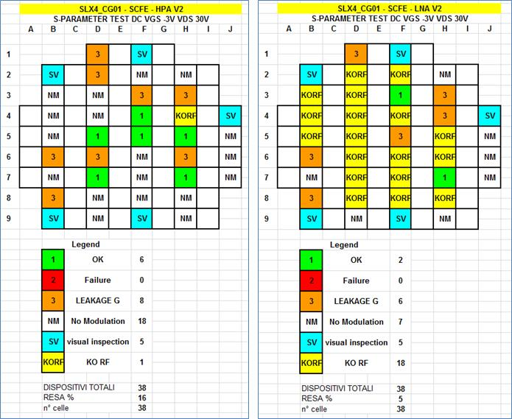
Wafer Realisation – SLX4_CG01 – SCFE V2
Screening criteria:
All the LNAs and HPAs V₂ have been measured.
Derogation has been selected in order to indicate working SCFE, even if not properly within the specs due to the complexity of the design and fabrication related to a very large area and multi-functional MMIC.
Spec1 (SCFE): Die H7
Tx mode: Pout>45,5dBm, Linear Gain= 41,5dB
Rx mode: Gain>34dB, NF<3,5dB
Spec2 (derogation): Die F4
NF<4.5dB

Slide 24
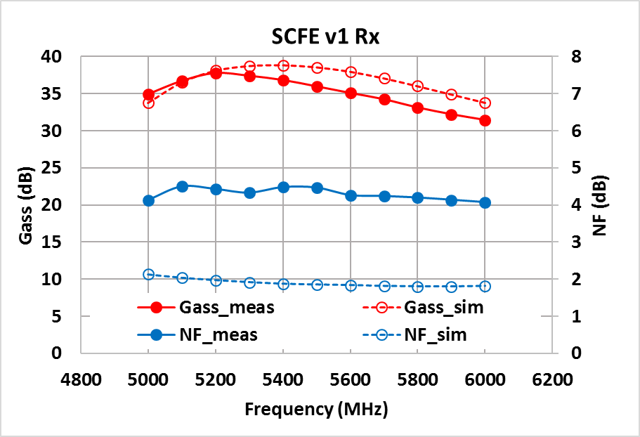
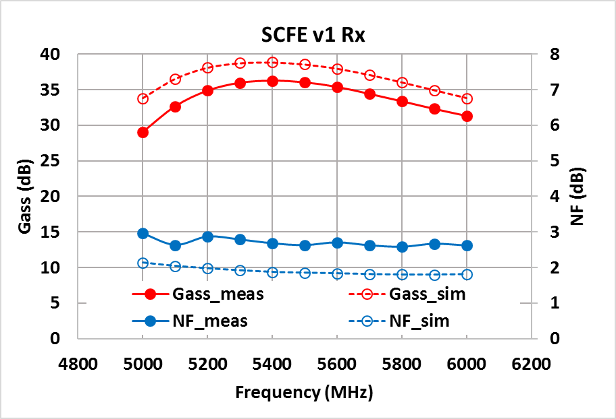
On-wafer Results - Rx chain V1
SLX4 CG01
SLX4 ID10
Chip DG8
V_{DD,m}=10V, V_{GG,m}=-3V, I_{D,m}=32.6mA
V_{DD,s}=10V, V_{GG,s}=-3V, I_{D,s}=50mA
Chip DG5
V_{DD,m}=10V, V_{GG,m}=-3V, I_{D,m}=40mA
V_{DD,s}=10V, V_{GG,s}=-3V, I_{D,s}=50mA

Slide 25
On-wafer Results - Rx chain V1: SLX4 ID10
Chip DG5
V_{DD,m}=10V, V_{GG,m}=-3V, I_{D,m}=40mA
V_{DD,s}=10V, V_{GG,s}=-3V, I_{D,s}=50mA
Ports are inverted in measurements

Slide 26
On-wafer Results - Rx chain V1: SLX4 CG01
Chip DG8
V_{DD,m}=10V, V_{GG,m}=-3V, I_{D,m}=34mA
V_{DD,s}=10V, V_{GG,s}=-3V, I_{D,s}=50mA
Ports are inverted in measurements

Slide 27
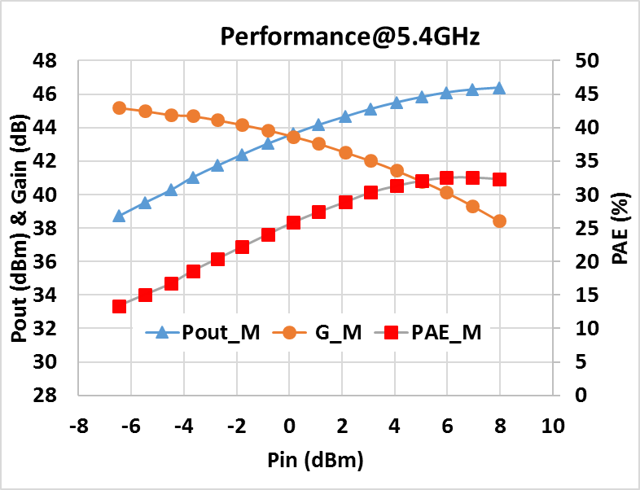
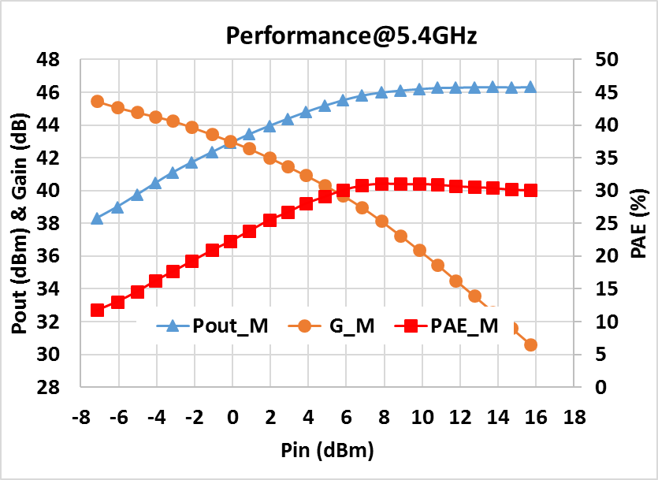
On-wafer Results - Tx chain V1
SLX4 CG01
SLX4 ID10
Chip DG3
V_{DD,m}=30V, V_{GG,m}=-2.9V, I_{D,m}=1.6A
Chip DI7
V_{DD,m}=30V, V_{GG,m}=-2.8V, I_{D,m}=1.6A

Slide 28
On-wafer Results - Tx chain V1: SLX4 ID10
Chip DI7
V_{DD,m}=30V, V_{GG,m}=-2.8V, I_{D,m}=1.6A
V_{DD,s}=30V, V_{GG,s}=-3V, I_{D,s}=1.6A
Ports are inverted in measurements

Slide 29
On-wafer Results - Tx chain V1: SLX4 CG01
Chip DG3
V_{DD,m}=30V, V_{GG,m}=-2.9V, I_{D,m}=1.6A
V_{DD,s}=30V, V_{GG,s}=-3V, I_{D,s}=1.6A
Ports are inverted in measurements

Slide 30
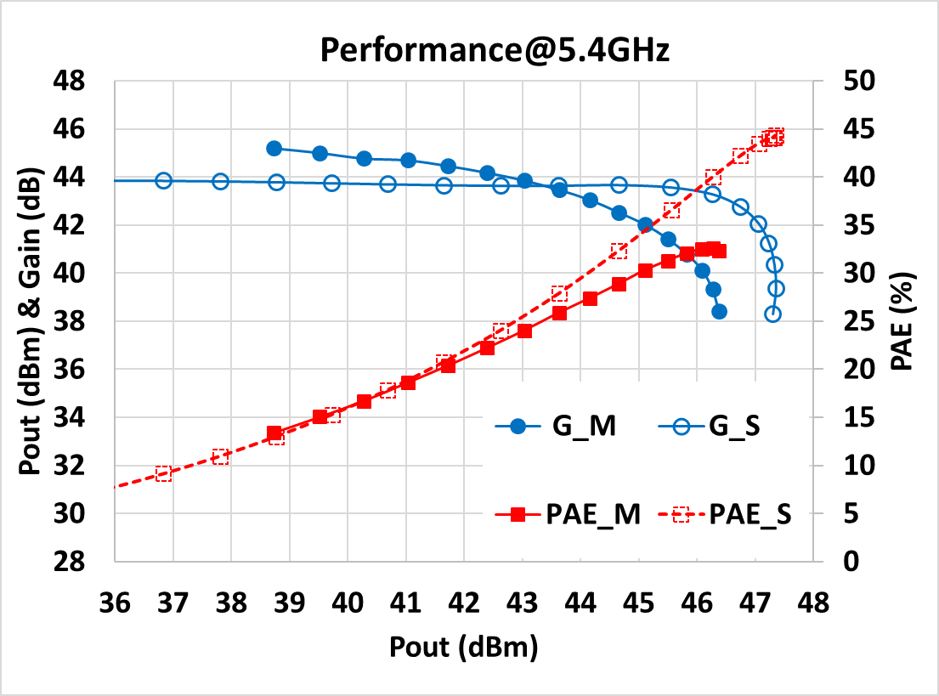
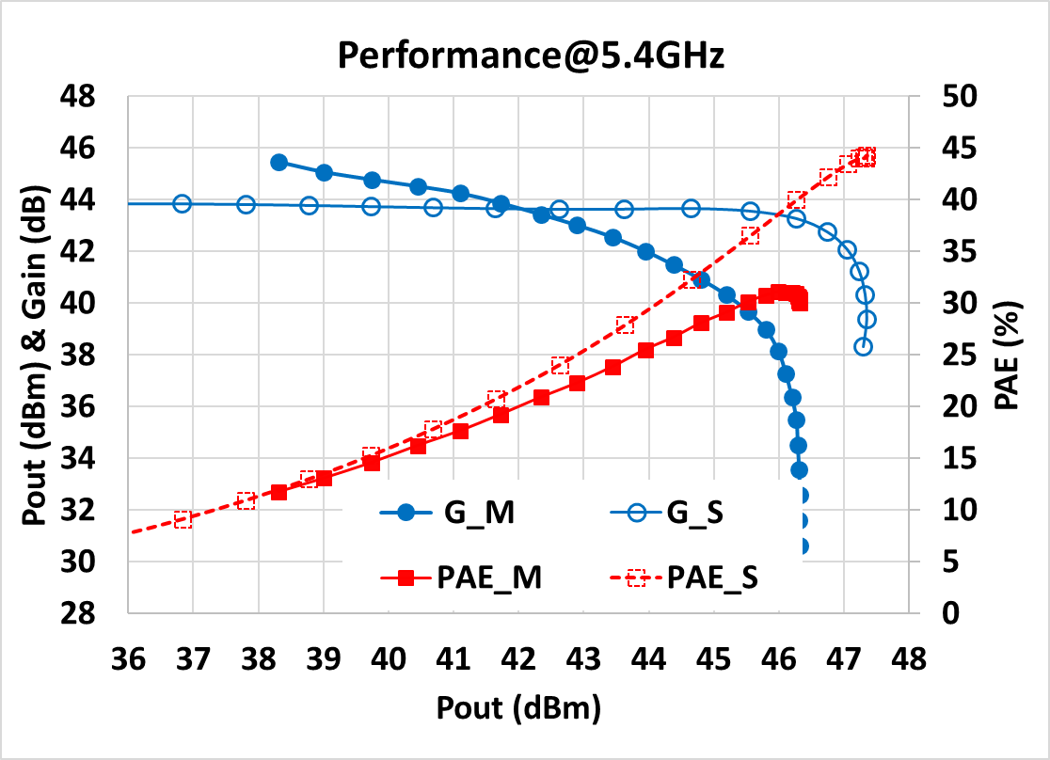
On-wafer Results - Tx chain V1 meas. vs. sim
SLX4 CG01
SLX4 ID10
Chip DG3
V_{DD,m}=30V, V_{GG,m}=-2.9V, I_{D,m}=1.6A
V_{DD,s}=30V, V_{GG,s}=-3V, I_{D,s}=1.55A
Chip DI7
V_{DD,m}=30V, V_{GG,m}=-2.8V, I_{D,m}=1.6A
V_{DD,s}=30V, V_{GG,s}=-3V, I_{D,s}=1.55A

Slide 31
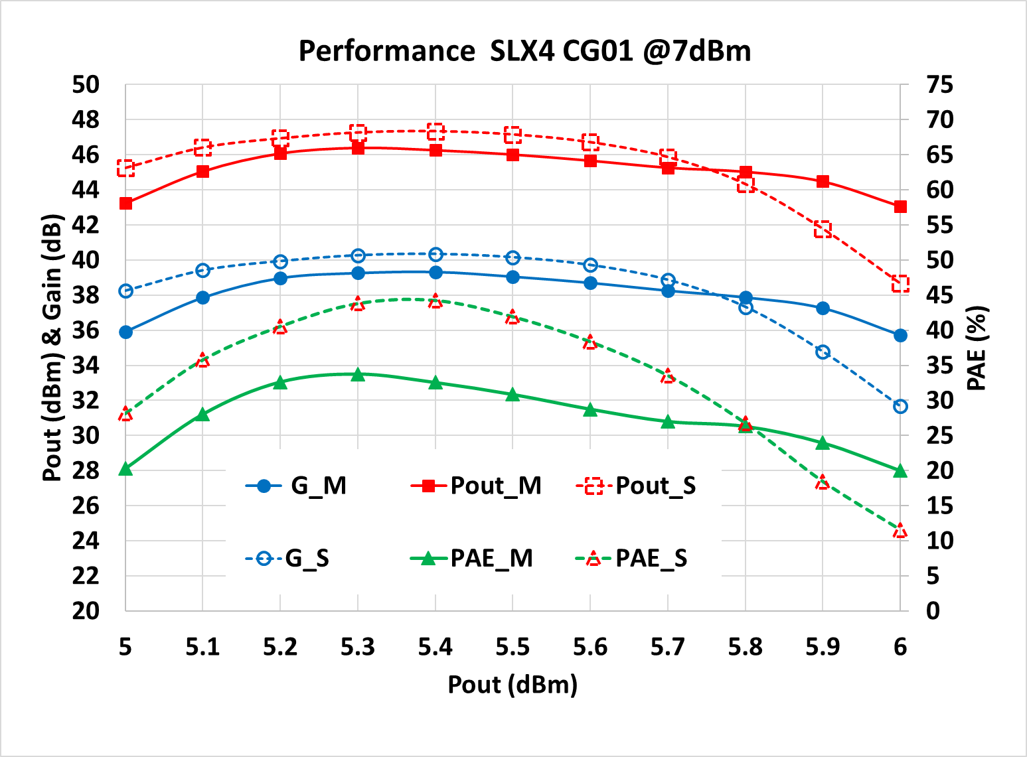
On-wafer Results - Tx chain V1 meas. vs. sim
Chip DG3

Slide 32
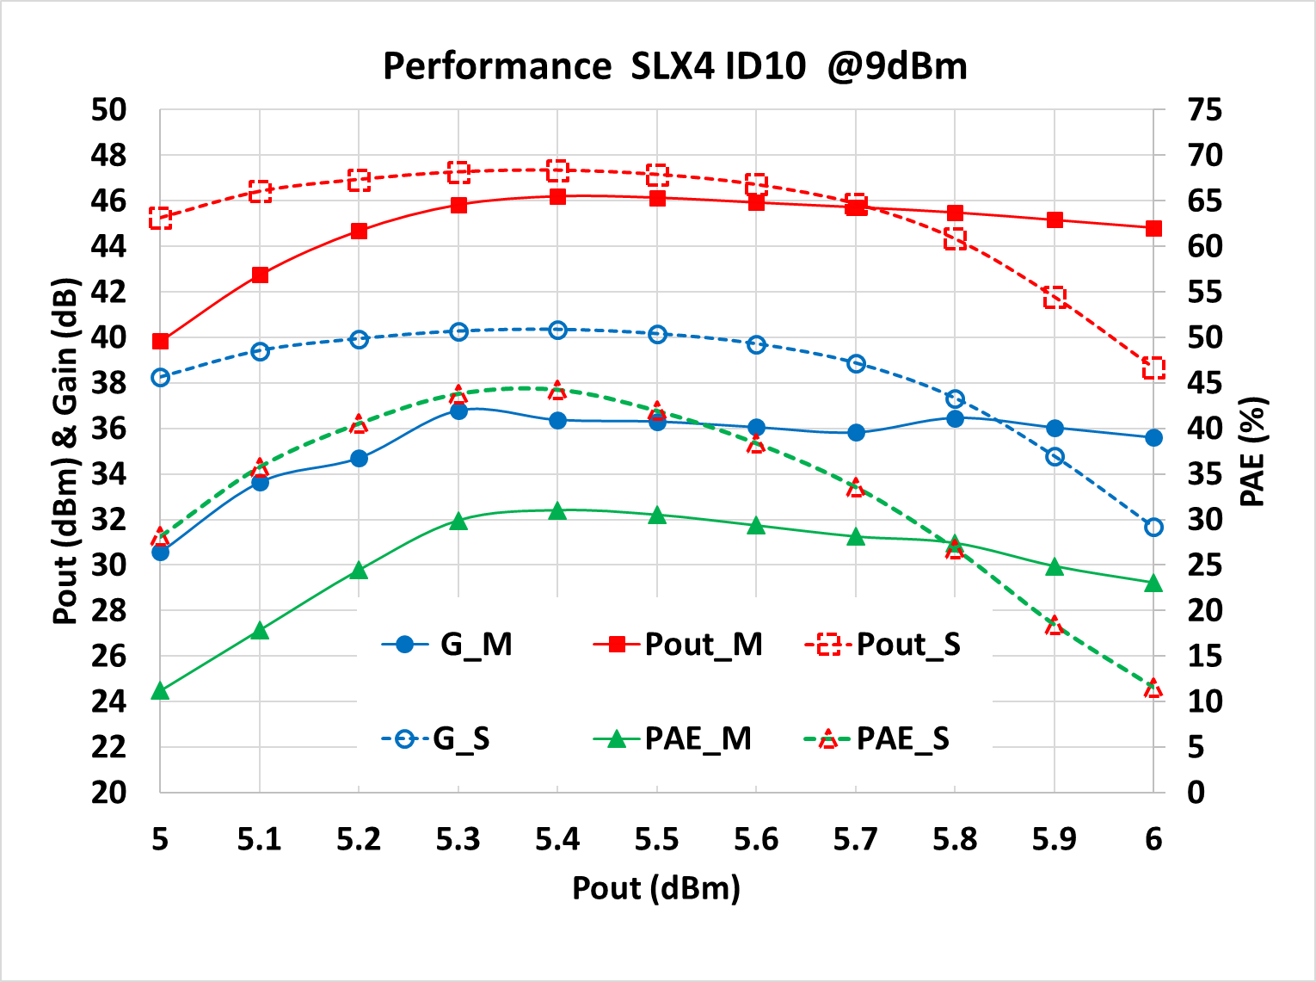
On-wafer Results - Tx chain V1 meas. vs. sim
Chip DI7

Slide 33
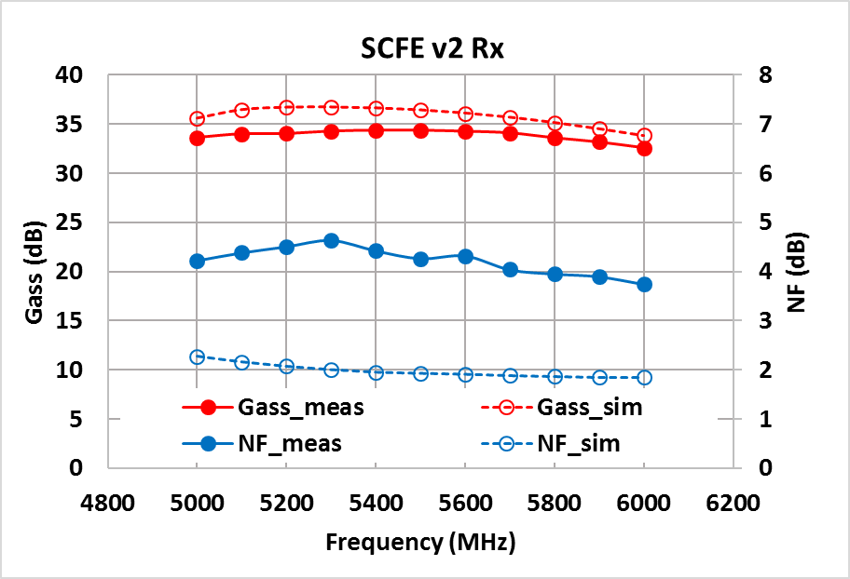
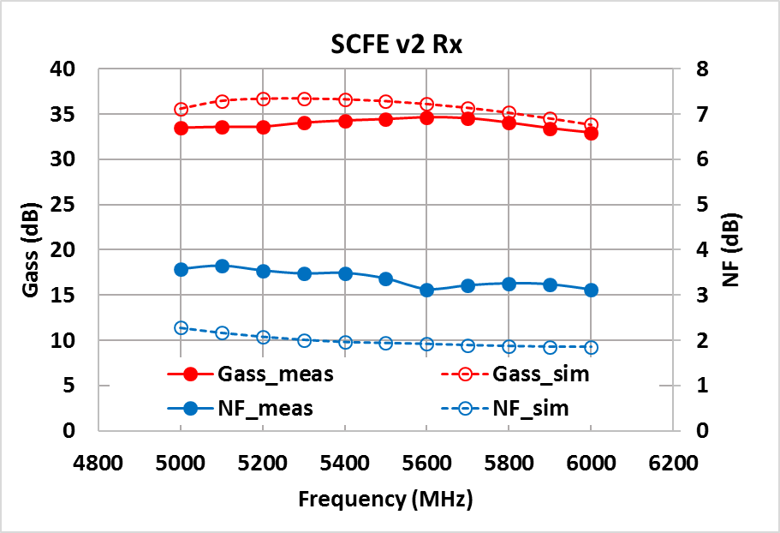
On-wafer Results - Rx chain V2
SLX4 CG01
SLX4 ID10
Chip AF4
V_{DD,m}=10V, V_{GG,m}=-2,8V, I_{D,m}=39.2mA
V_{DD,s}=10V, V_{GG,s}=-3V, I_{D,s}=25mA
Chip DF6
V_{DD,m}=10V, V_{GG,m}=-2.9V, I_{D,m}=38,9mA
V_{DD,s}=10V, V_{GG,s}=-3V, I_{D,s}=25mA

Slide 34
On-wafer Results - Rx chain V2: SLX4 ID10
Chip DF6
V_{DD,m}=10V, V_{GG,m}=-3V, I_{D,m}=XXmA
V_{DD,s}=10V, V_{GG,s}=-3V, I_{D,s}=25mA
Ports are inverted in measurements

Slide 35
On-wafer Results - Rx chain V2: SLX4 CG01
Chip DF4
V_{DD,m}=10V, V_{GG,m}=-2.8V, I_{D,m}=40mA
V_{DD,s}=10V, V_{GG,s}=-3V, I_{D,s}=25mA
Ports are inverted in measurements

Slide 36
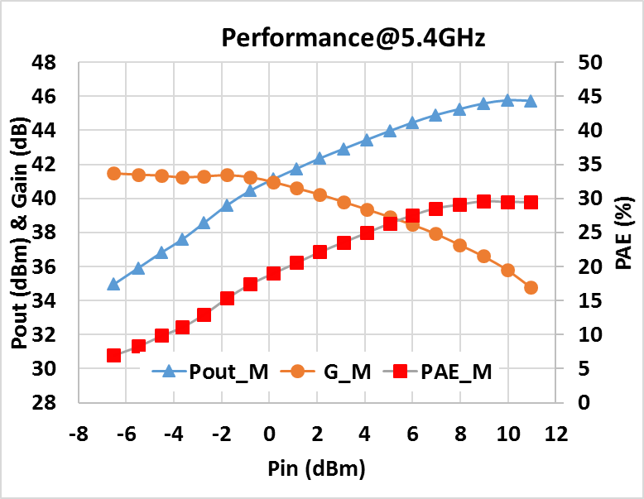
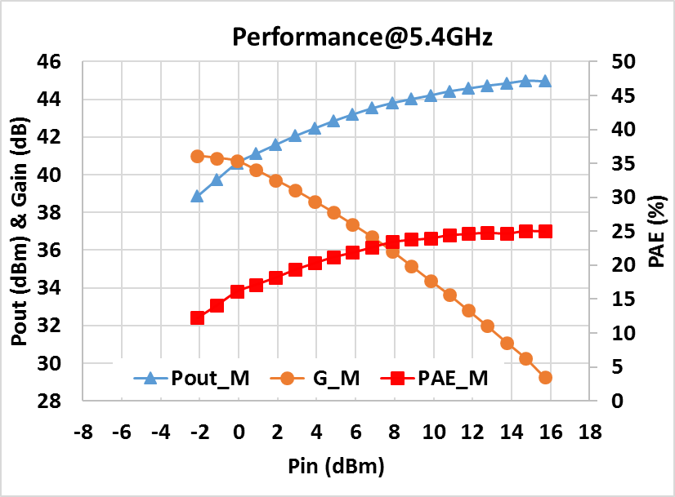
On-wafer Results - Tx chain V2
SLX4 CG01
SLX4 ID10
No Spar meas
Chip DF4
V_{DD,m}=30V, V_{GG,m}=-2.9V, I_{D,m}=1.6A
No Spar meas
Chip DH7
V_{DD,m}=30V, V_{GG,m}=-2,8V, I_{D,m}=1.6A

Slide 37
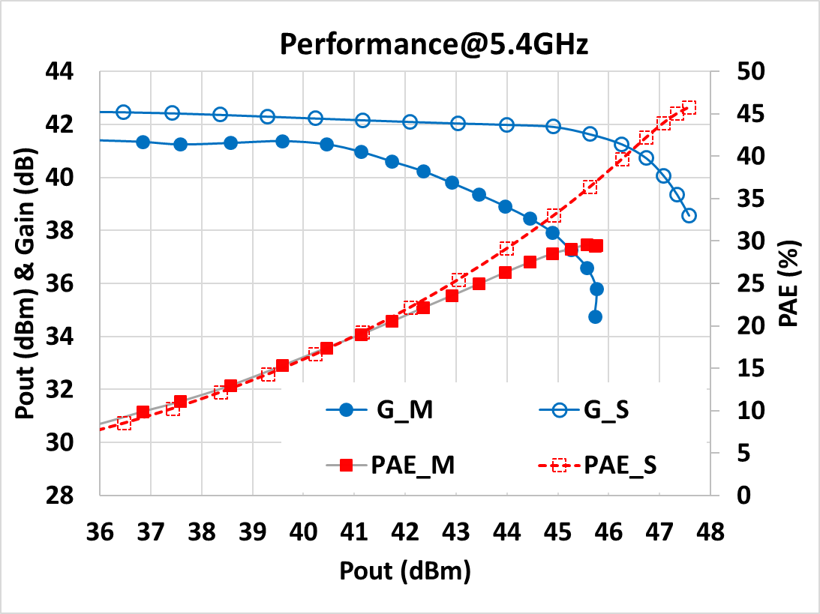
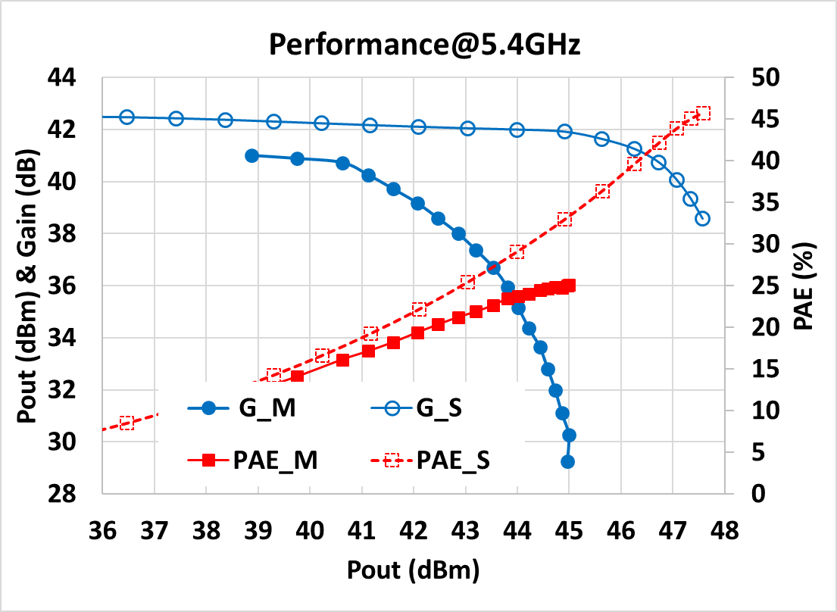
On-wafer Results - Tx chain V2 meas. vs. sim
SLX4 CG01
SLX4 ID10
No Spar meas
Chip DF4
V_{DD,m}=30V, V_{GG,m}=-2.9V, I_{D,m}=1.6A
V_{DD,s}=30V, V_{GG,s}=-3V, I_{D,s}=1.55A
No Spar meas
Chip DH7
V_{DD,m}=30V, V_{GG,m}=-3V, I_{D,m}=1.6A
V_{DD,s}=30V, V_{GG,s}=-3V, I_{D,s}=1.55A

Slide 38
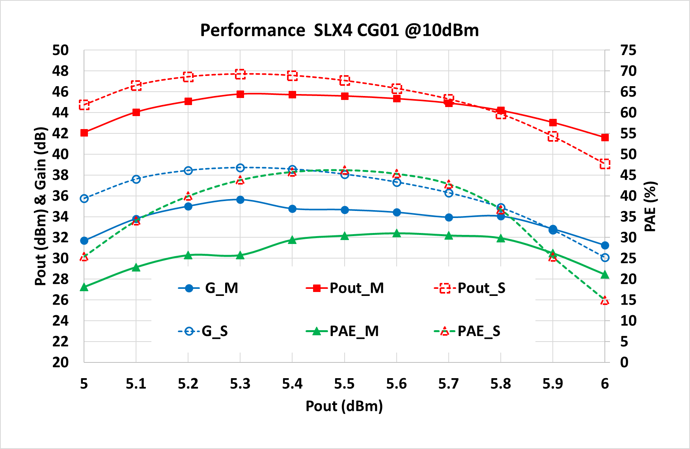
On-wafer Results - Tx chain V2 meas. vs. sim
Chip DF4

Slide 39
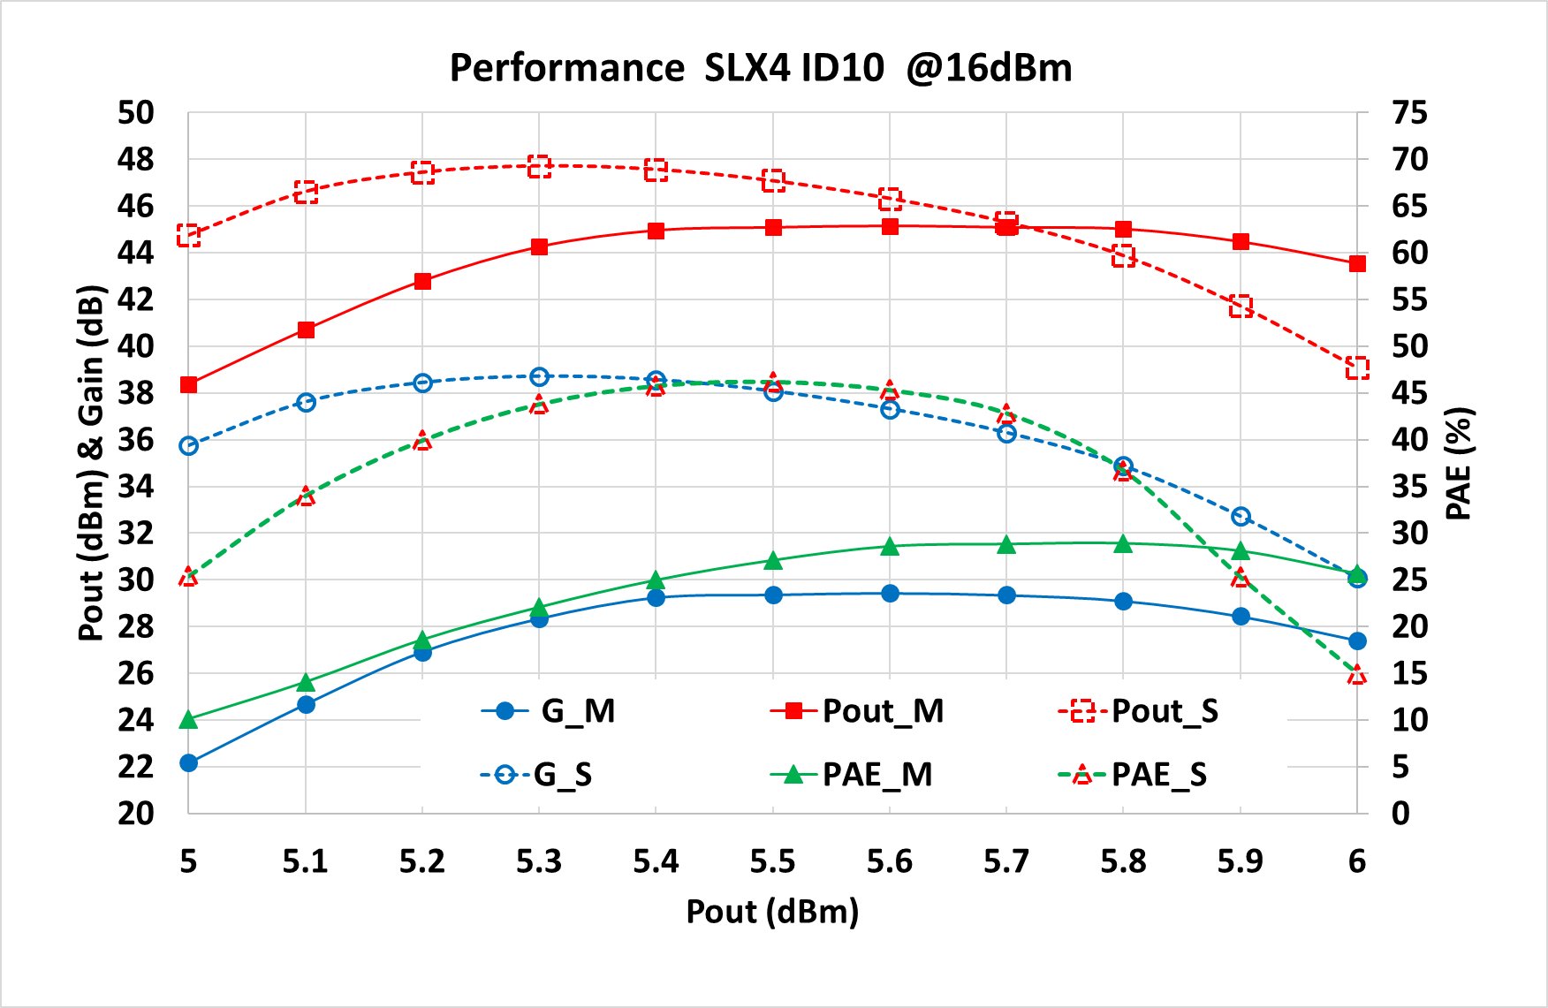
On-wafer Results - Tx chain V2 meas. vs. sim
Chip DH7

Slide 40
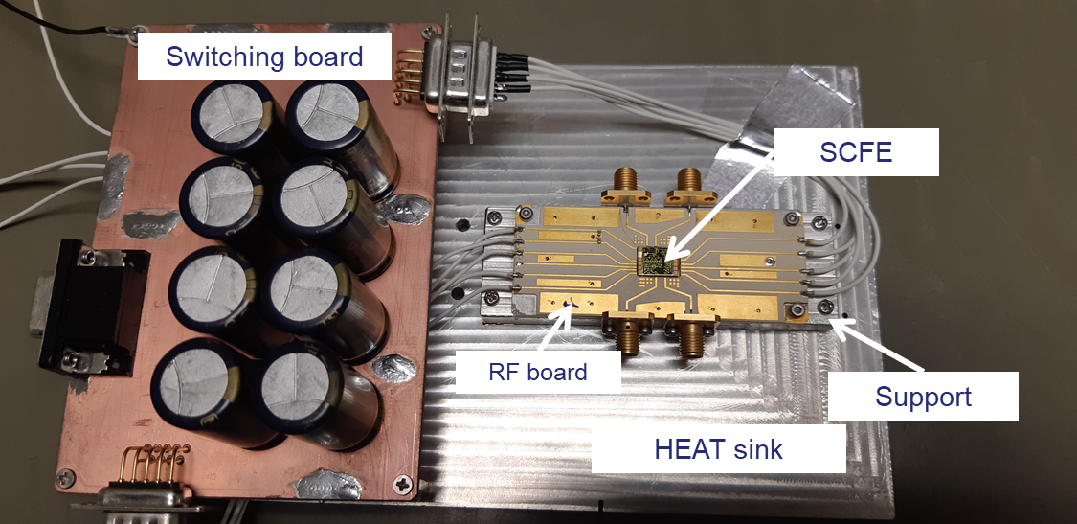
In-Jig Results – Mounting 1

Slide 41
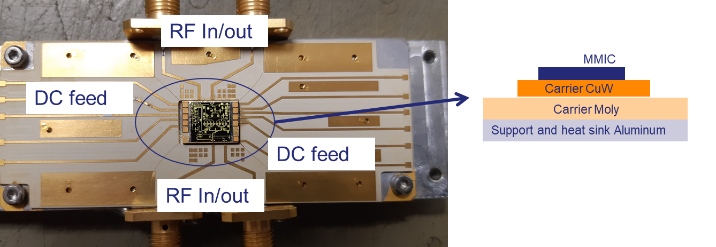
In-Jig Results – Mounting 2

Slide 42
Conclusions
The design and experimental results of two C-band SCFEs realized on a 0.25μm GaN LDO technology have been presented.
Even though some differences between measurements and simulations have been observed in this first run, the experimental characterization has demonstrated interesting results.
    CG01 - V1: 1 sample shows a Pout greater than 46.5dBm with a linear Gain of 43dB in Tx mode, together with a Gain greater than 34dB and NF<4dB in Rx mode.
    CG01 - V2: 1 sample shows a Pout greater than 45.5dBm with a linear Gain of 41.5dB in Tx mode, together with a Gain greater than 34dB and NF<4.5dB in Rx mode.
    ID10 - V1: 1 sample shows a Pout greater than 46dBm with a linear Gain of 43dB in Tx mode, together with a Gain greater than 36dB and NF<3dB in Rx mode.
    ID10 - V2: 1 sample shows a Pout greater than 45dBm with a linear Gain of 41dB in Tx mode, together with a Gain greater than 34dB and NF<3.5dB in Rx mode.
    In-Jig measurements are being performed (completion by end of January)

Slide 43
State-of-the-Art
Feature | Unit | Limiti et al. [2015] | Choi et al. [2015] | Van Heijn. et al. [2017] | Masuda et al. [2012] | Giofrè et al. [2018] | Biondi et al. [2016] | T. W.
Freq. | GHz | 5.25-5.57 | 5.7-6.7 | 5.2-5.6 | 10.5 | 13% in S-Band | 8.6-11.2 | 5.25-5.57
G_{RX} | dB | 36 | 8 | 31.5 | 18.5 | 30 | 15.5 | 35
NF | dB | 2.5 | 3.7 | 2.4 | 2.3 | 1.75 | 2.75 | 3.2
G_{TX} | dB | 35 | 4 | 18.5 | 20 | 35 | 24 | 36
Pout | W | 40 | 2.5 | 40 | 6.3 | 40 | 8 | 40
PAE | % | 35 | 44* | 36 | 28 | 43 | 25 | 30

