Slide 1
Monopulse radar sensor as a proof-of-concept for future miniaturized radar sensors fit for small satellites
January 2020

Slide 2
Objective of the activity
Design and prototyping of a monopulse radar sensor based on in-house developed MMICs that will be a proof-of-concept for a future portfolio of miniaturized and low-power radar sensors fit for the application in small satellites.

Slide 3
Main steps of the activity
The plan for the activity assumed the process to be divided into two major steps:
1. For the first iteration of the sensor a single TX channel, double RX channel miniature low-power monopulse FMCW radar was developed.
2. As a second iteration, a radar sensor with four RX channels was developed, which, through the use of the two-plane monopulse technique, gave the radar the full 3D capability.

Slide 4
Example applications
Due to the small size and low power consumption of the device, it can be integrated into many devices. For example:
1. CubeSat payload for debris detection, formation flying or docking.
2. Drone sense and avoid system.
3. Perimeter security.

Slide 5
SIRC’s in-house developed MMICs
“TX2”: VCO with two buffered outputs and integrated divide-by-8 output

Slide 6
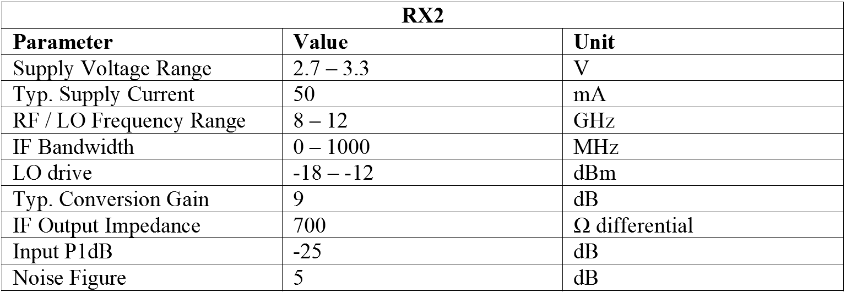
SIRC’s in-house developed MMICs
“RX2”: Two channel downconversion I/Q mixer with LNA and differential IF outputs

Slide 7
Bare die bonded to PCB
Laboratory tests: bare die bonded to PCB for tests
RX2
TX2

Slide 8
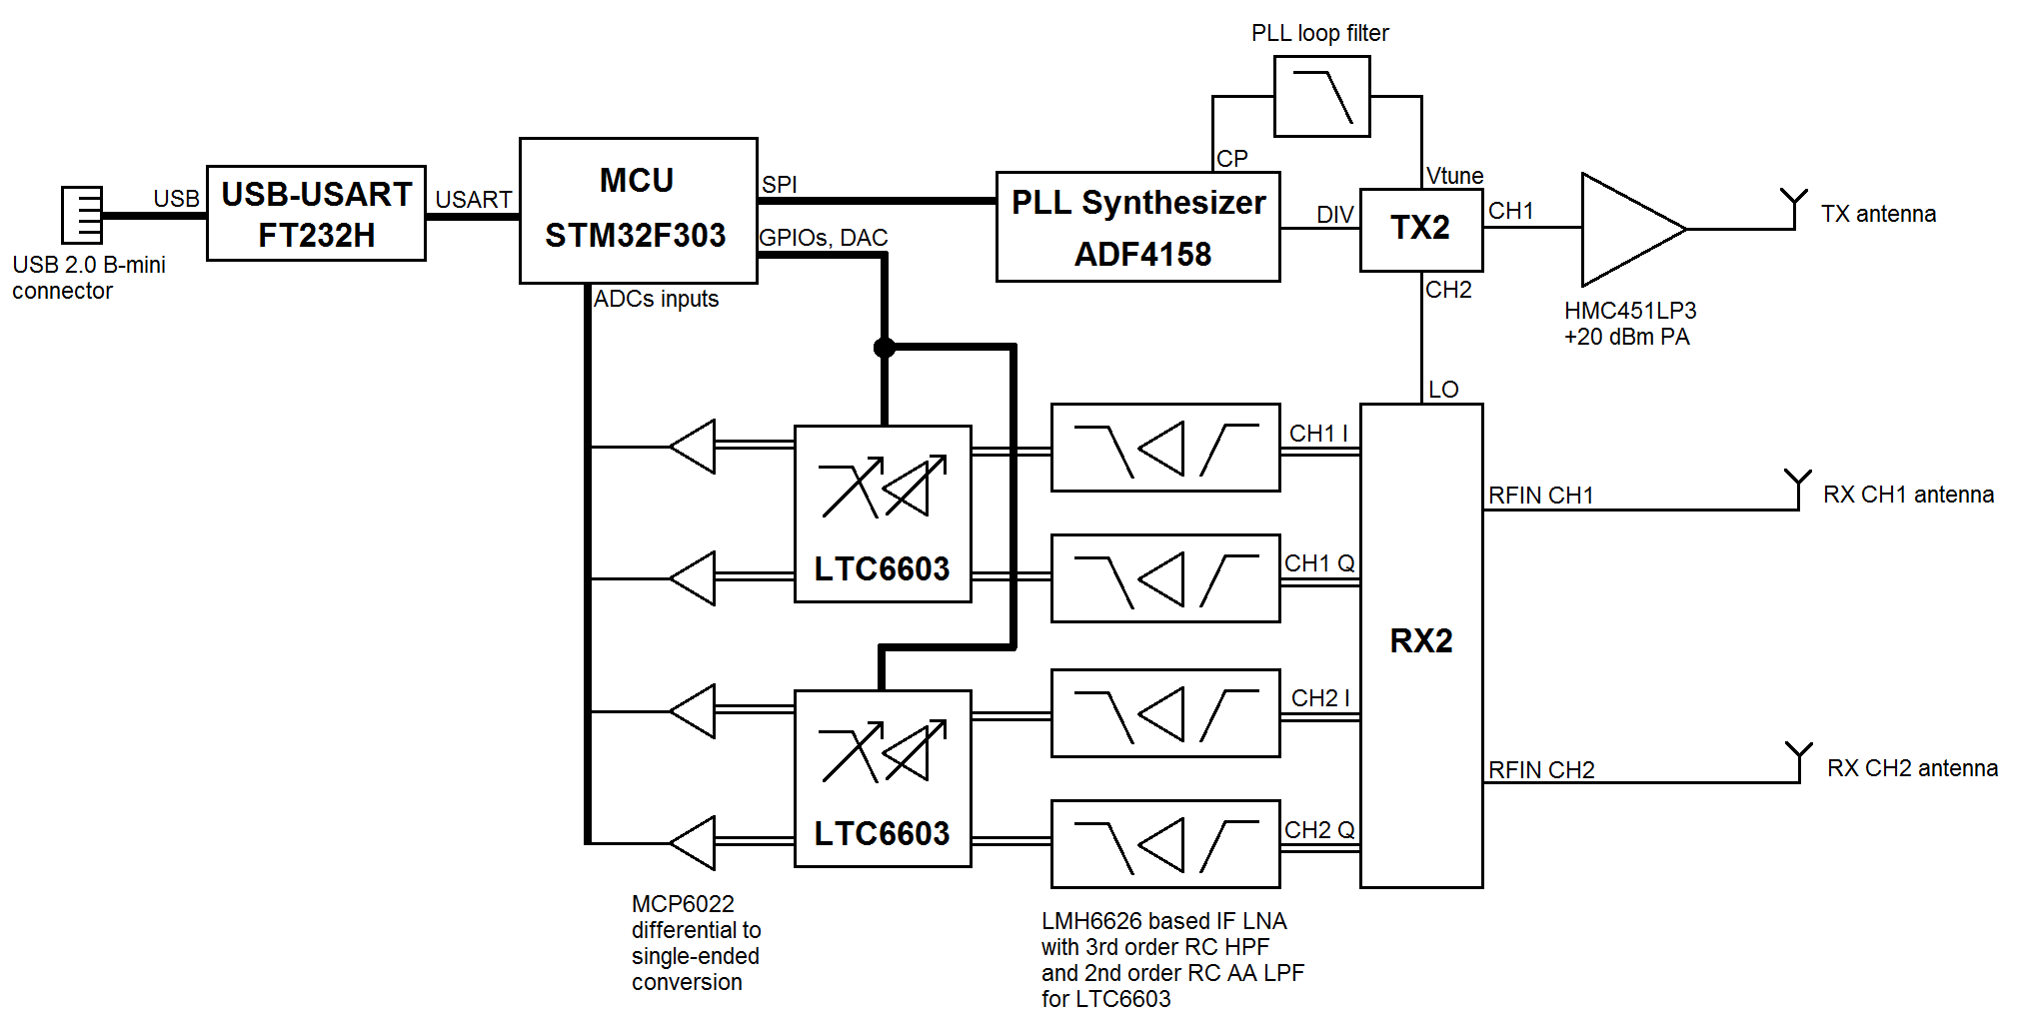
First iteration of the sensor
Block diagram of the first version of the radar sensor:

Slide 9
DSP algorithm
The radar signal processing algorithm is fully coherent for maximum sensor sensitivity and is based on a set of consecutive Fast Fourier Transforms (FFT). Afterwards, CFAR detection algorithms are implemented and the target’s Angle of Arrival (AoA) is calculated using the monopulse method.

Slide 10
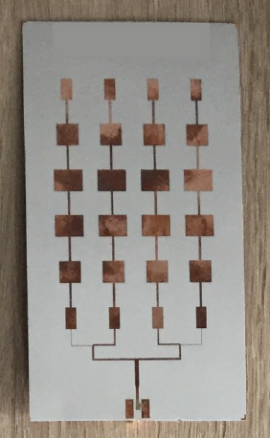
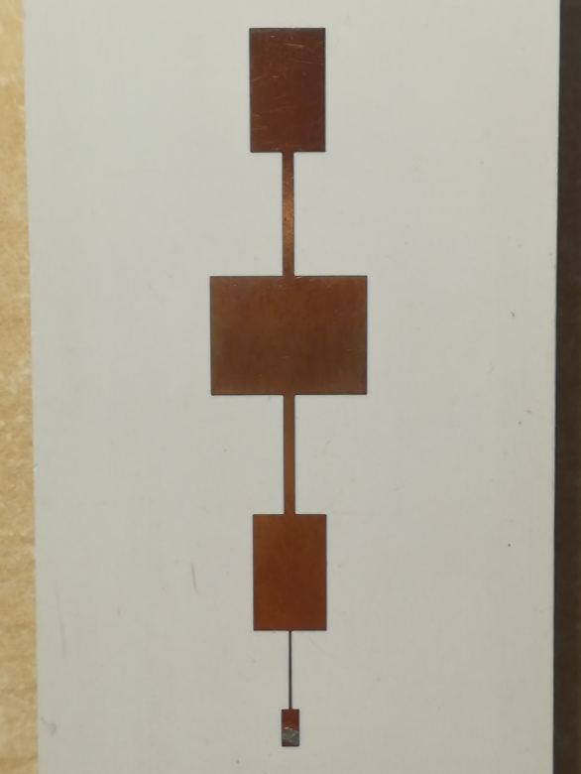
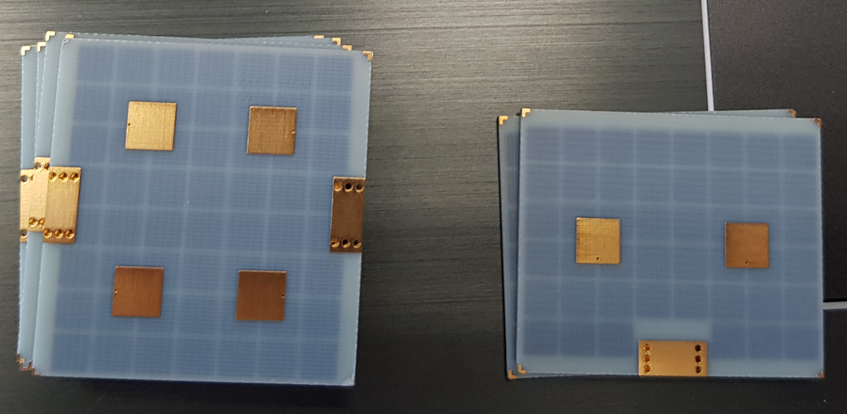
First iteration of the sensor
Variants of the antennas developed for the radar:

Slide 11
First iteration of the sensor
Radar functional limits for all the devised radar operating parameters (ramp frequency span, ramp duration, utilised antenna type, IF sampling frequency, etc.) configurations:

Slide 12
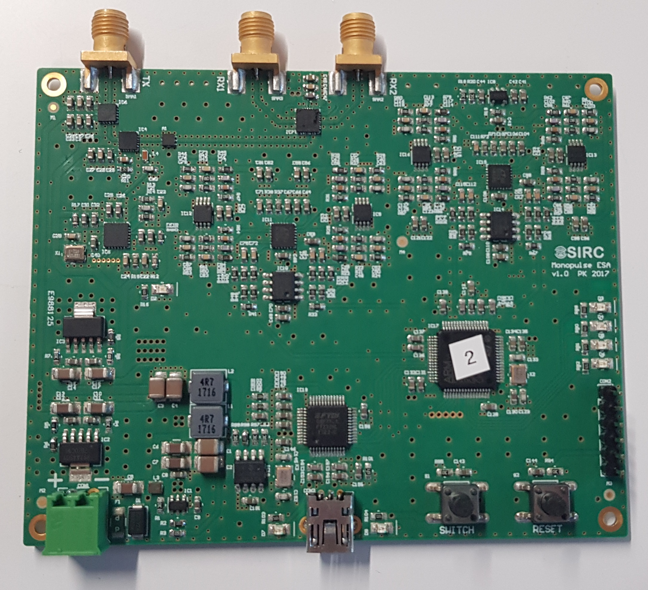
First iteration of the sensor
Photograph of a fully assembled first prototype of the radar sensor:

Slide 13
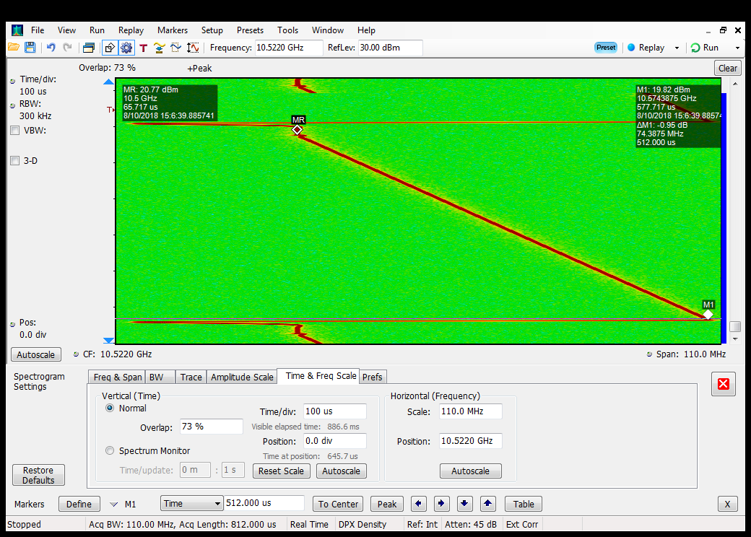
First iteration of the sensor
Laboratory tests: Time-domain real-time spectrum analysis of the radar TX signal during normal FMCW operation

Slide 14
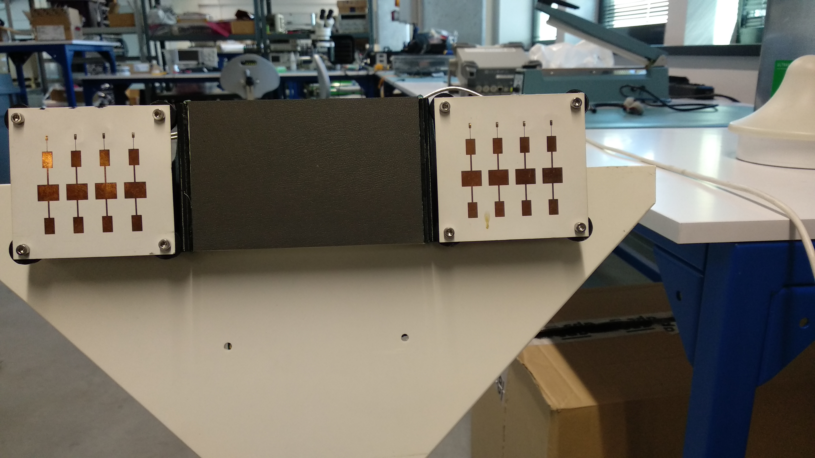
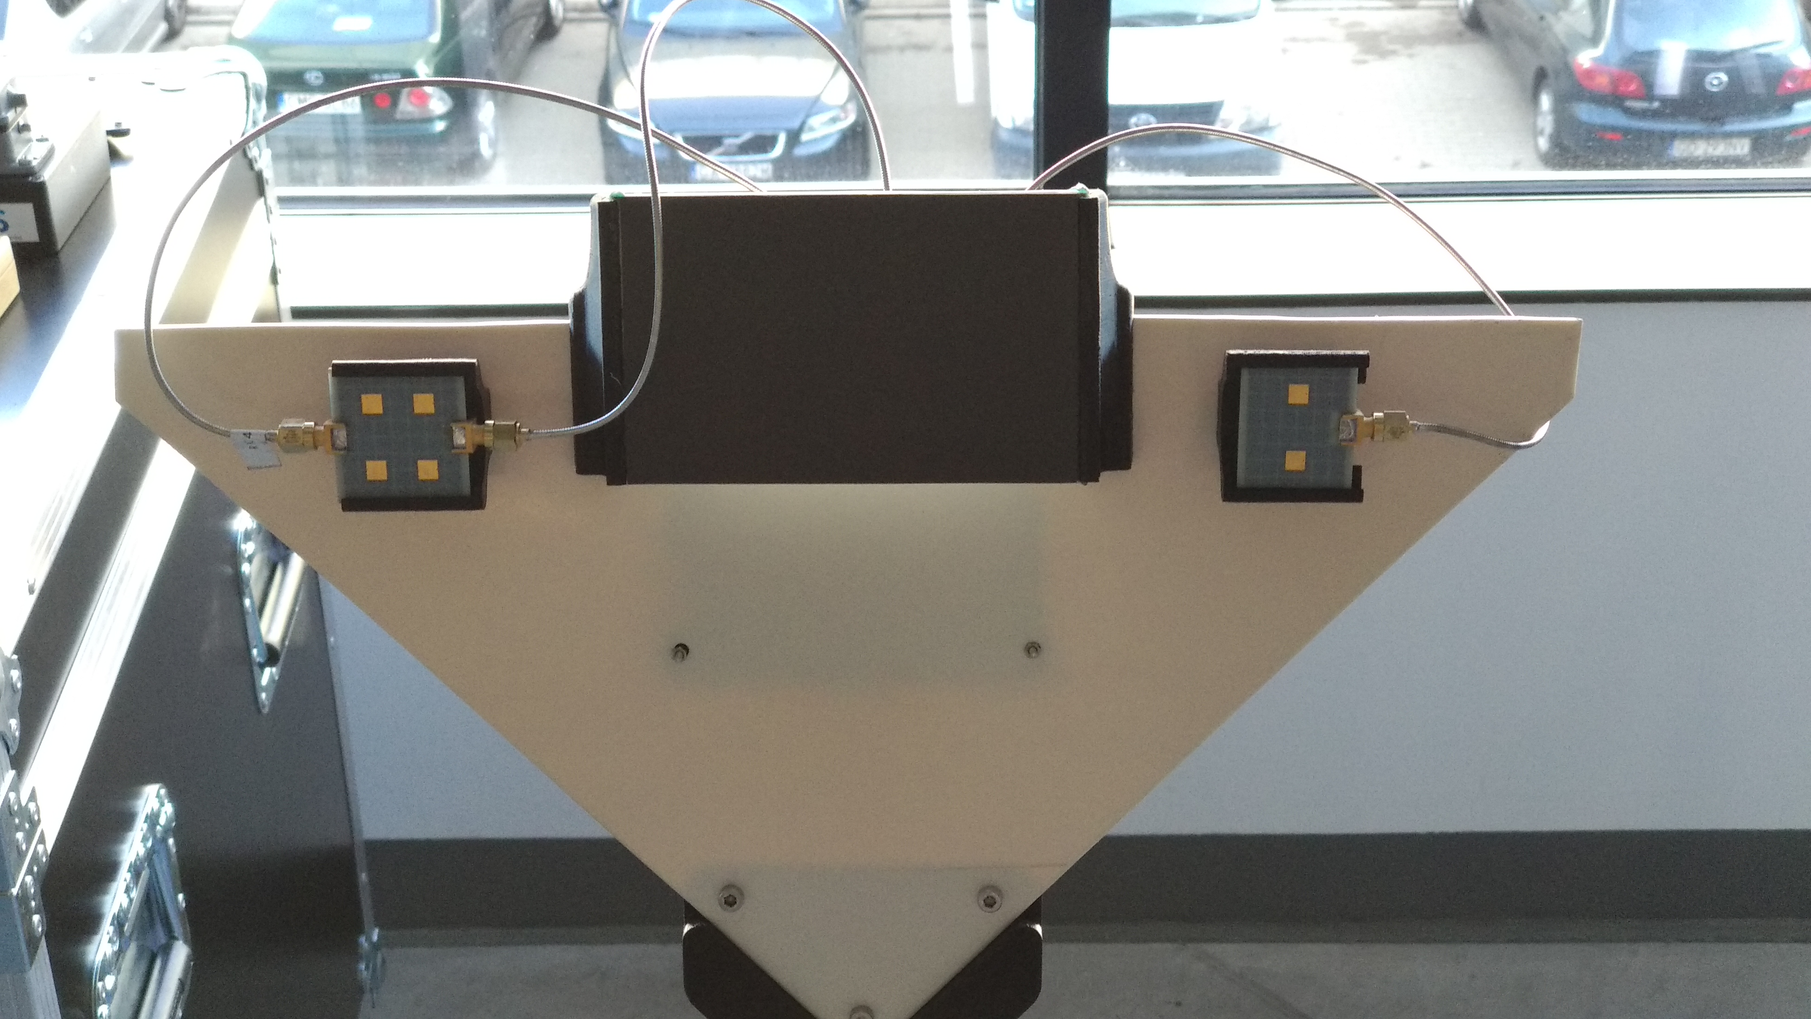
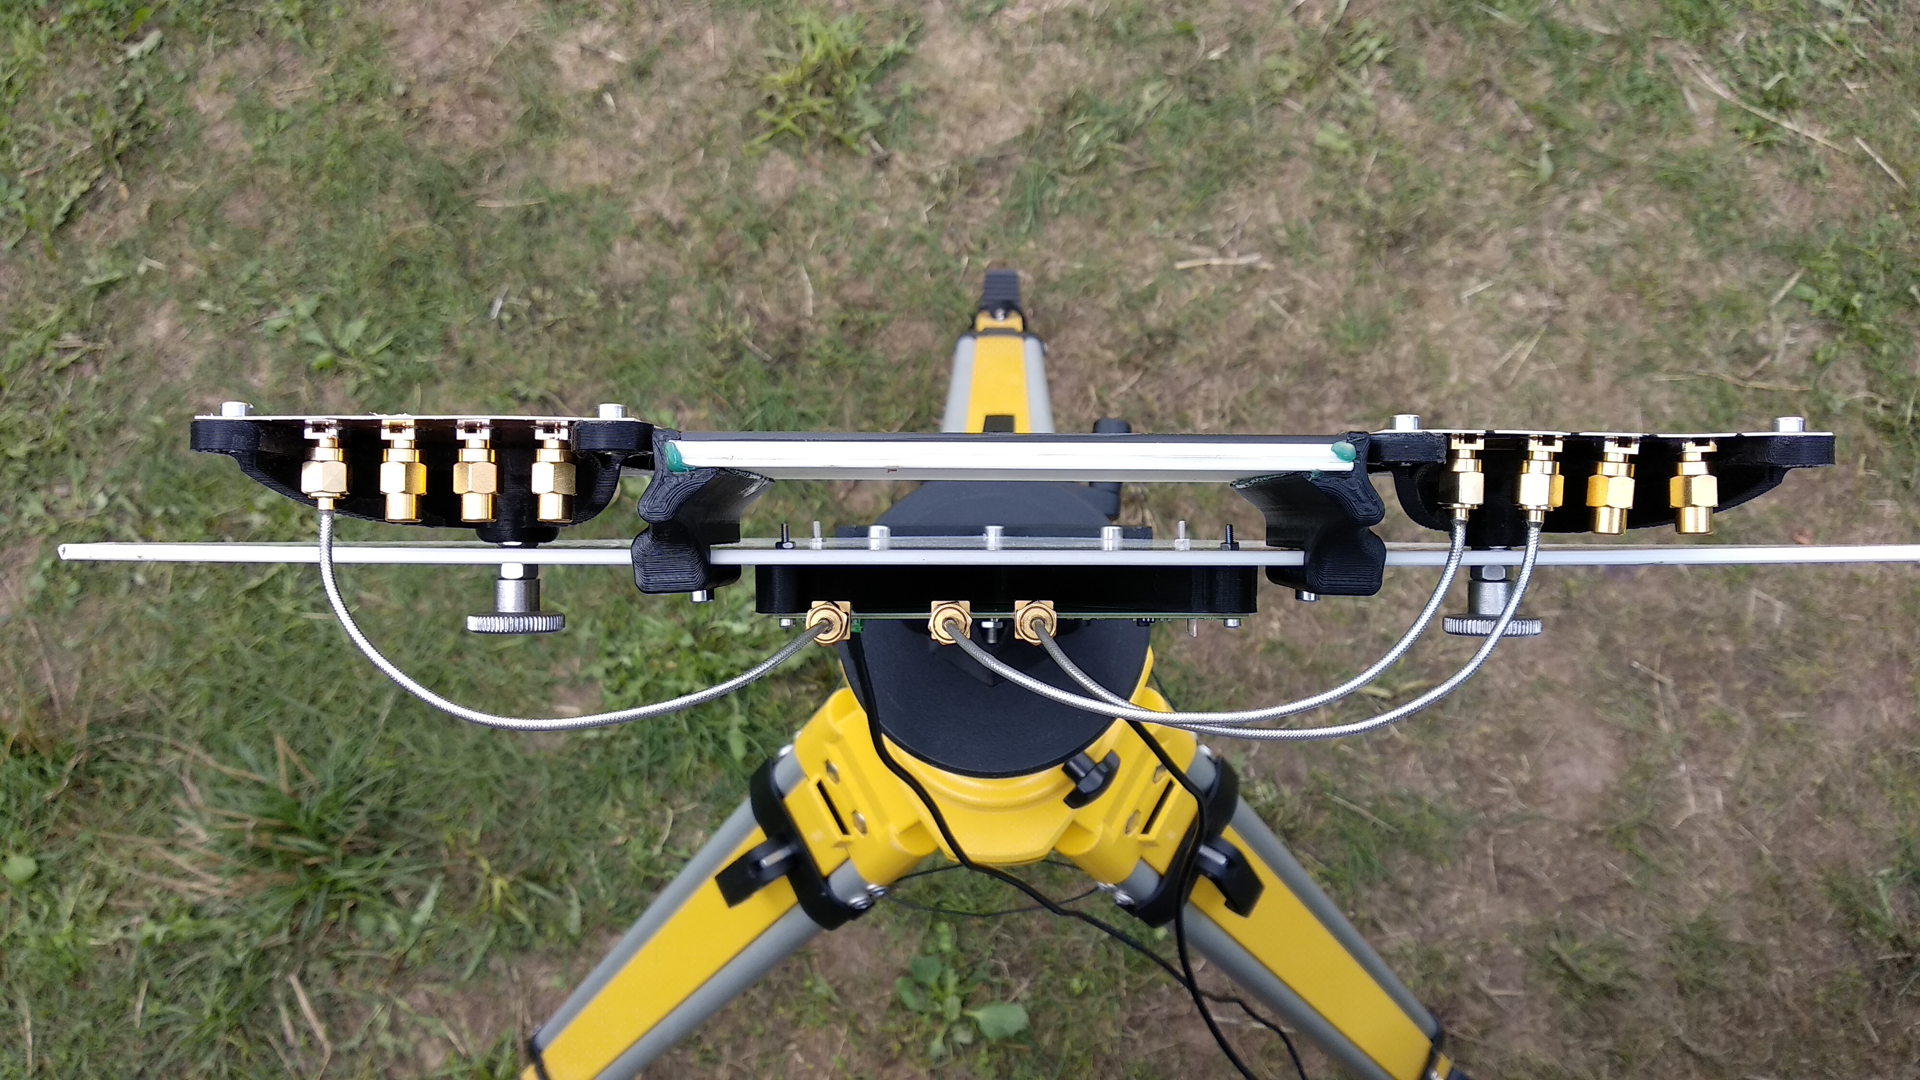
First iteration of the sensor
Field tests: Photographs of the antenna setups

Slide 15
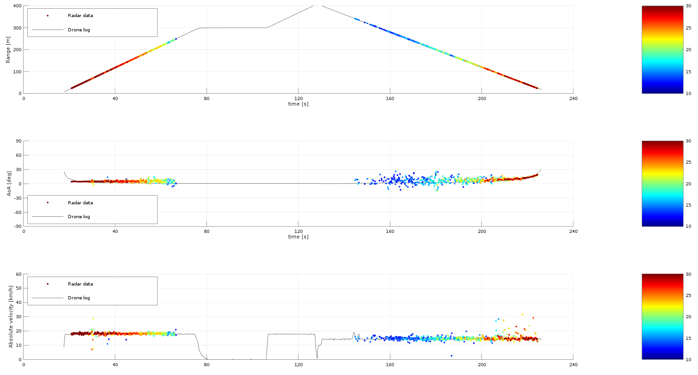
First iteration of the sensor
Field tests: Exemplary results of the radar’s detection of a small UAV - DJI Phantom 4

Slide 16
First iteration of the sensor
Brief evaluation of the first prototype of the radar sensor by the comparison tables:
Laboratory measurements:
Field testing results:

Slide 17
Final version of the radar sensor
The first prototype has been declared successful, thus according to the plan of the activity the final version of the radar sensor was a four RX channel design.
Apart from the doubling of the radar’s RX channels some other modifications to the radar electronics has been devised, with the most significant change being MCU replacement with a model that potentially could handle all the developed DSP procedures at real-time.

Slide 18
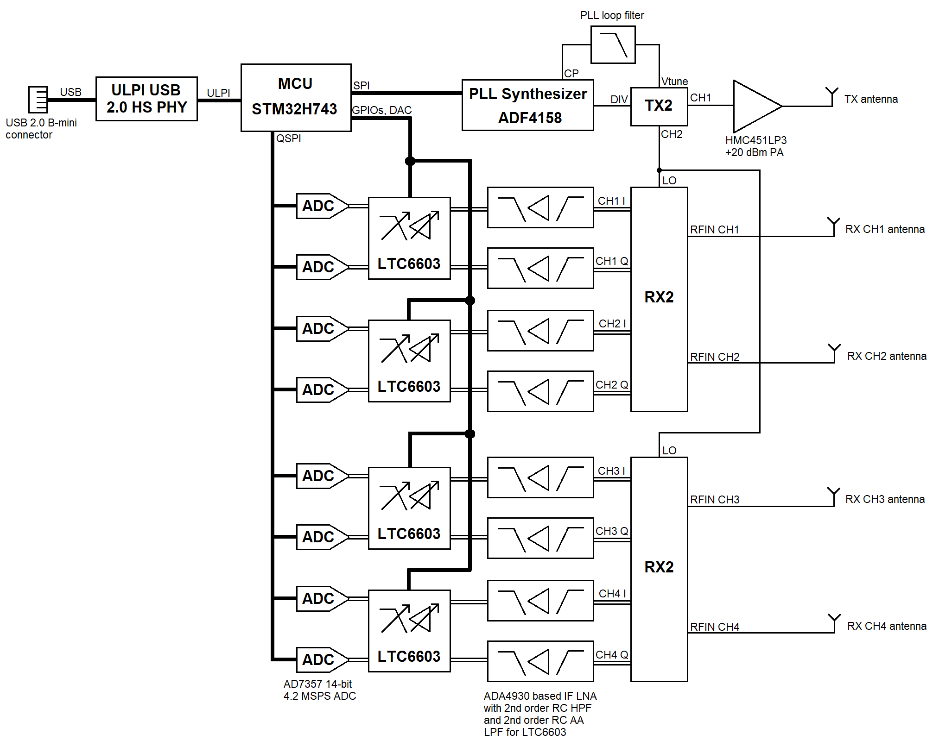
Final version of the radar sensor
Block diagram of the designed final version of the radar sensor:

Slide 19
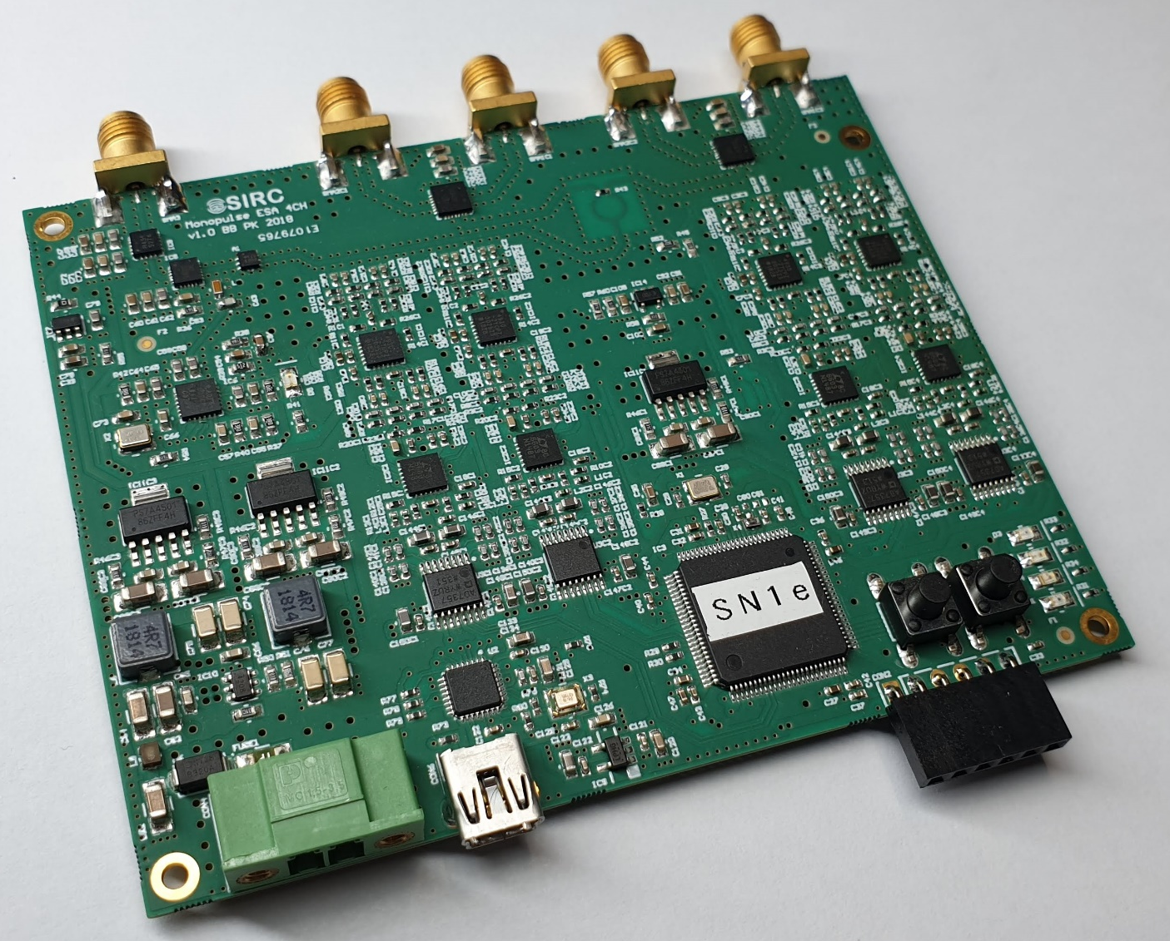
Final version of the sensor
Photograph of a fully assembled final prototype of the radar sensor:

Slide 20
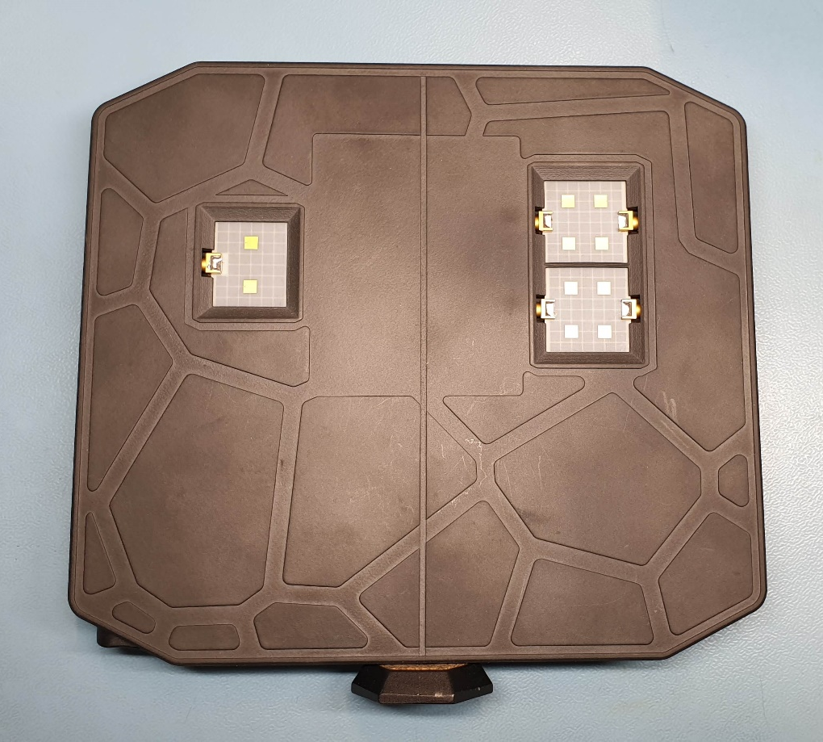
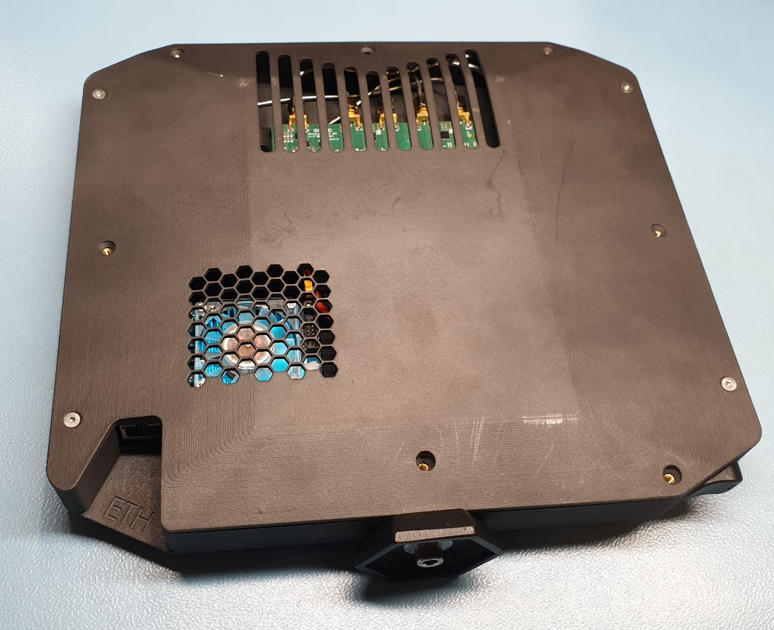
Final version of the sensor
Photograph of a fully assembled final prototype of the radar sensor:

Slide 21
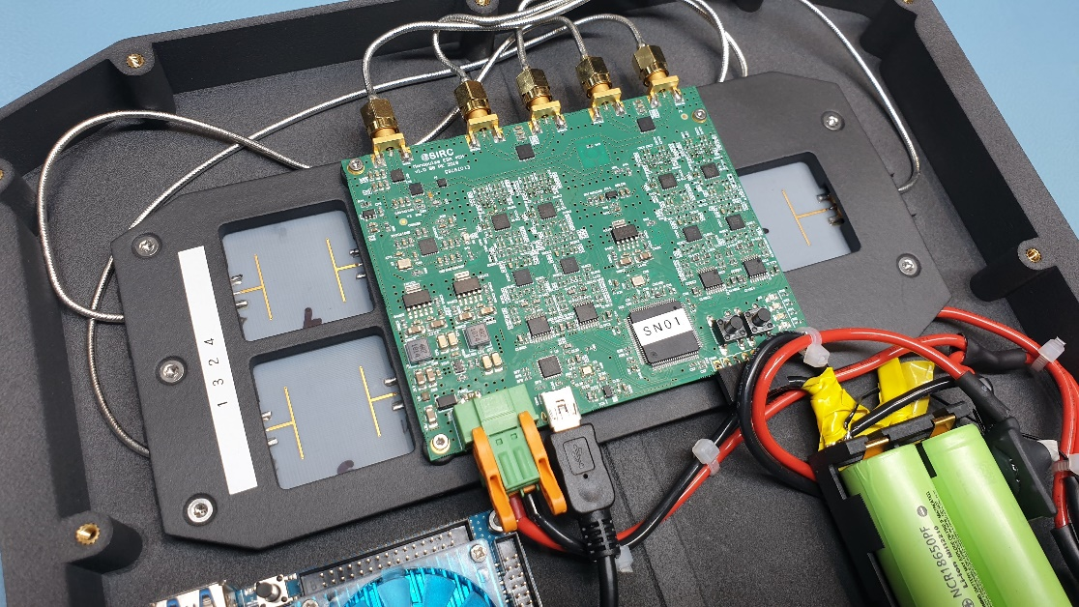
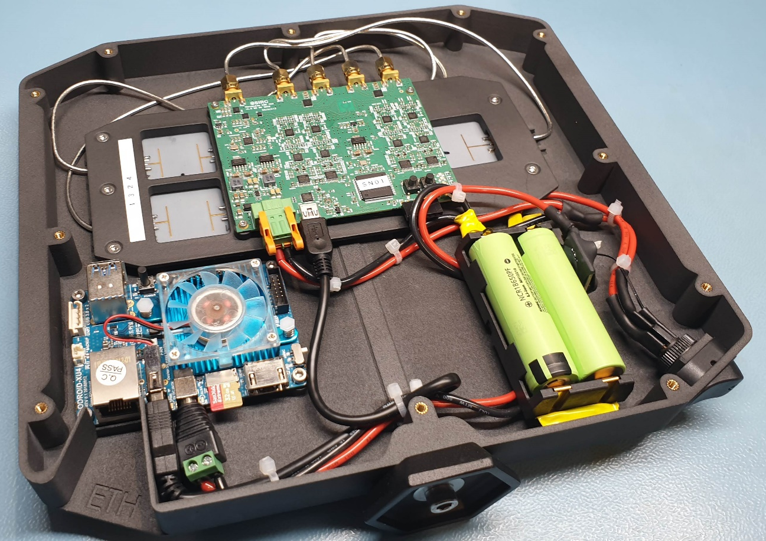
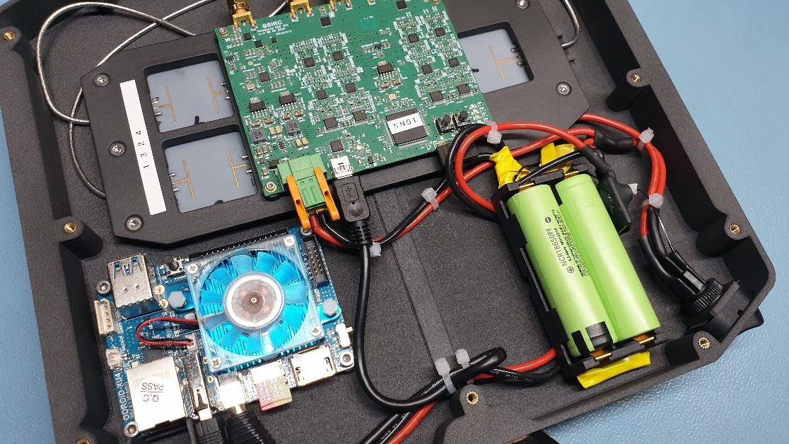
Final version of the sensor
Photograph of a fully assembled final prototype of the radar sensor:

Slide 22
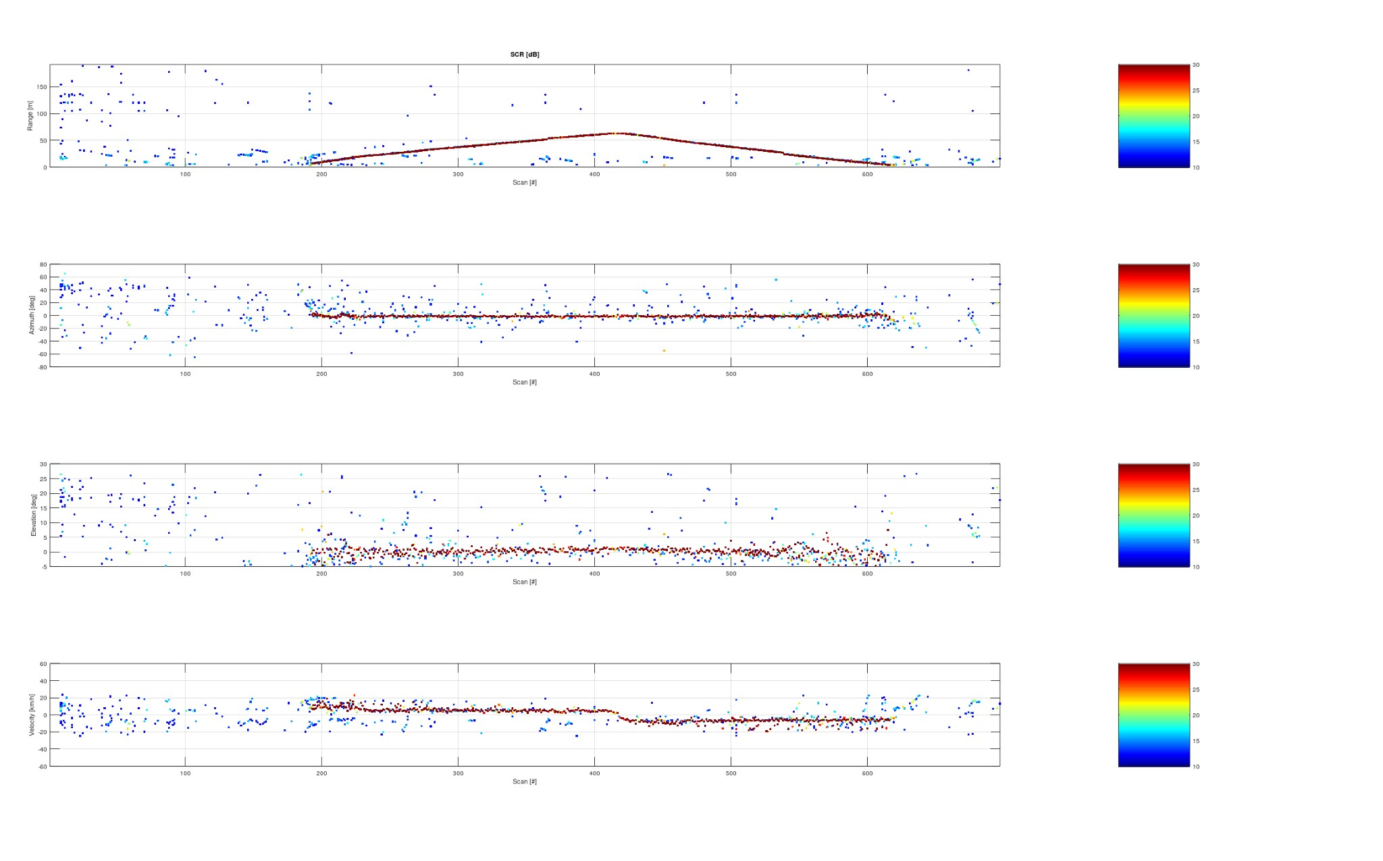
Final version of the radar sensor
Field tests: Exemplary results of the radar’s detection of a walking man

Slide 23
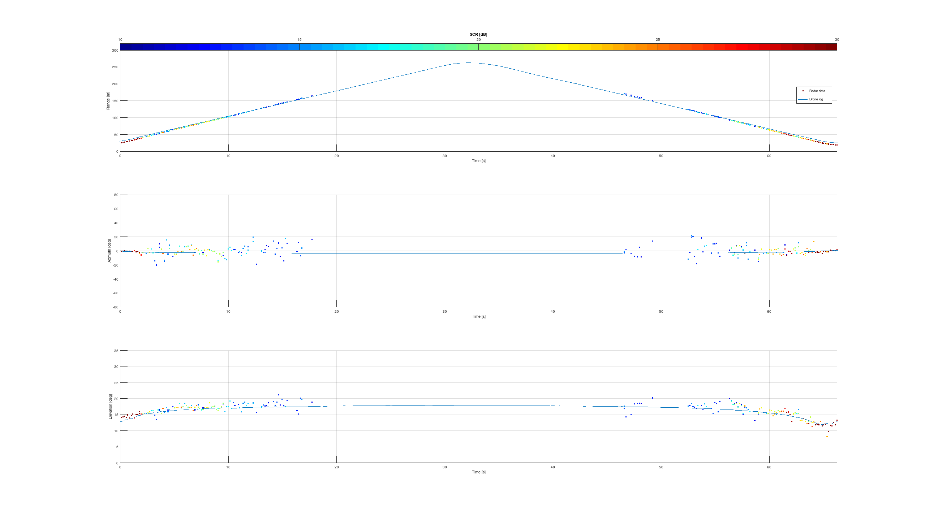
Final version of the radar sensor
Field tests: Exemplary results of the radar’s detection of a small UAV - DJI Phantom 4

Slide 24
Results of the activity
The final version of the radar sensor has been positively verified through a series of laboratory and field tests.
The goal of the activity has been successfully achieved: a miniaturized, low-power monopulse FMCW radar sensor fit for the application in small satellites has been designed, prototyped and positively verified through a broad series of evaluation tests.

Slide 25
Key features
Compact size of 80 mm x 100 mm
4 channel coherent sampling
Full 3D capability
High onboard processing power
Low power consumption
Low cost
Lightweight

Slide 26
Possible future activities
Due to the successful closing of the activity following activities could be started:
Bringing the project to higher TRL.
Further miniaturization of the device by designing a 4 channel version of RX chip.
Improving the performance of the ICs.

Slide 27
Thank you for your attention!

