Slide 1
VALIRENE: Radiation Belt Model Development and Validation
D.Heynderickx DH Consultancy BVBA, Leuven, Belgium
I. Sandberg, C. Papadimitriou, S. Aminalragia-Giamini SPARC, Athens, Greece
P. Truscott Kallisto Consultancy, Farnborough, UK
F. Lei RadMod Research, Camberley, UK
I.A. Daglis IASA & National and Kapodistrian University of Athens, Athens, Greece

Slide 2
Project info
Radiation Belt Model Development and Validation: AP9/AE9/SPM models (IRENE, hence VALIRENE)
ESA Contract No 4000117974/16/NL/LF
Consortium
DH Consultancy (Belgium, D. Heynderickx): prime contractor
SPARC (Greece; I. Sandberg, C. Papadimitriou, S.A. Aminalragia-Giamini)
Kallisto Consultancy (UK, P. Truscott)
RadMod Research (UK, F. Lei)
IASA & National and Kapodistrian University of Athens (Greece, I. Daglis)
Consultants: British Antarctic Survey (UK; A.R. Lozinski, R.B. Horne)
ESA Technical Officers: H. Evans, P. Jiggens

Slide 3
VALIRENE objectives
Detailed evaluation of the AP9/AE9/SPM (IRENE) models
Against in situ datasets
Against ECSS and other radiation environment models
Consolidation and calibration of in situ datasets
Ingestion in ODI database
Investigation of instrument calibration
Cleaning and cross calibration
Evaluation and enhancement of UNILIB/IRBEM
Establishment of a toolkit to use the IRENE models for radiation effects studies
Involvement of European industry
Provide early visibility and invite feedback
Organise workshops with industry: Airbus (France), INTA (Spain), SSTL (UK), OHB (Germany), SES (Luxemburg)
Collaboration with P. O’Brien and S. Huston of the IRENE team

Slide 4
UNILIB/IRBEM validation
Comparison of outputs on geographic coordinate sets
Spacecraft trajectories
Coordinate grids for a series of dates, external field models, Kp
Analysis of source codes and algorithms
Comparison of magnetic field component outputs to outputs from IAGA codes
Develop high level Fortran interface routines for UNILIB, similar to IRBEM
Update software codes where required, and feed back to software repositories
IRBEM L* is lower than UNILIB L* by about 4% (current epoch) as IRBEM uses current geomagnetic moment

Slide 5
IRBEM calls in UNILIB
IRBEM routine | Comments
IRBEM_FORTRAN_VERSION | Return the UNILIB version number as long integer scaled appropriately (e.g. x 1000).
IRBEM_FORTRAN_RELEASE | Return e.g. 'UNILIB v2.23'.
GET_IRBEM_NTIME_MAX | Return the size of pre-allocated Fortran arrays. Defined in include file IRBEMAPI.inc.
MAKE_LSTAR1 | Magnetic coordinates for local pitch angle 90°.
MAKE_LSTAR_SHELL_SPLITTING1 | Magnetic coordinates for up to 25 local pitch angles.
COORD_TRANS1 | Coordinate transformation for a single position vector.
COORD_TRANS_VEC1 | Coordinate transformation for an array of position vectors (calls coord_trans1).
GET_FIELD1 | Calculate magnetic vector components for a single geographic location.
GET_FIELD_MULTI | Calculate magnetic vector components for an array of geographic locations (calls GET_FIELD1).
GET_DOY | Calculate day of year.
JULDAY_TO_YDOYUT | New API to simplify handling of date times.
YDOYUT_TO_JULDAY | New API to simplify handling of date times.
GET_MLT1 | Calculate magnetic local time.
LSTAR_PHI1 | Calculate L* from Ф, or vice versa.
GET_COORDINATES | Convert input coordinate vector to GEO and GDZ coordinates.

Slide 6
Dataset processing

Slide 7
Dataset selection
LEO: SAMPEX/PET, PROBA-V/EPT, PROBA1/SREM (fluxes and counts), TSX-5/CEASE, AZUR/EI-88
MEO: GioveA/MERLIN, GioveB/SREM, GPS
GTO: RBSP/HOPE/MAGEIS/REPT/RPS, CRRES/MEA/HEEF/PROTEL
HEO: INTEGRAL/IREM (fluxes and counts), XMM/ERMD (fluxes and counts)
GEO: GOES/SEM (entire energy range for p+ and e-), LANL/CPA/SOPA/ESP/MPA, Himawari-8,9/SEDA
POLAR/CEPPAD
All datasets were ingested into an ODI instance to facilitate processing

Slide 8
Production of reference datasets
The selected datasets have been cleaned and cross-calibrated where possible.
For each dataset, a file with data quality flags was produced, with epochs matching the original dataset.
Updated reference datasets were produced
ODI skeleton and configuration files were produced to describe the reference datasets
An ODI post-creation hook was written to
Copy the data from the original dataset
Merge in the cleaning flags
Apply the calibration factors
The resulting reference datasets were dumped into daily CDF files.

Slide 9
Reference datasets
Dataset | Cleaned Quantities |  | Calibrated Quantities
 | Protons | Electrons | Protons | Electrons
amc_12_cease_esa_e |  | CEDO, FEDO
azur_ei_88 | FPDU
crres_mea_tle |  | FEDU
crres_protel_lpa_1m | FPDU
gioveb_srem_pacc_l2 | FPDO | FEDO | FPDO | FEDO
himawari_seda_e_5m |  | FEDO |  | FEDO
himawari_seda_p_5m | FPDO
integral_irem_pacc_l2 | FPDO | FEDO | FPDO | FEDO
integral_irem_pacc_v0 | COUNTRATE
polar_ceppad_maarble_e |  | FEDO |  | FEDO
polar_ceppad_maarble_p | FPDO |  | FPDO
proba1_srem_pacc_l2 | FPDO | FEDO | FPDO | FEDO
proba1_srem_pacc_v0 | COUNTRATE
rbsp_mageis_r4_l2_e |  | FEDO_CORR |  | FEDO_CORR
rbsp_mageis_r4_l3_e_corr |  | FEDU_CORR |  | FEDU_CORR
rbsp_rept_l2 | FPDO, FPIO | FEDO, FEIO | FDPO, FPIO | FEDO, FEIO
rbsp_rept_l3_e |  | FEDU |  | FEDU
rbsp_rept_l3_p | FPDU |  | FPDU
rbsp_rps_l2_1m | DATA_CHANNEL_COUNTS, FPDO |  | FPDO
s3_3_pt | FPDU
sampex_pet_h | FPDU |  | FPDU
tsx_5_cease_p | FPIO |  | FPIO
xmm_ermd | FPDO, FPIO | FEDO, FEIO | FPDO, FEIO | FEDO, FEIO
xmm_ermd_counts | Countrate_LE, Countrate_HES, Countrate_HEC

Slide 10
Dataset Evaluation
Generation of summary plots that allow for the quick evaluation of a dataset and the detection of problematic channels
Time coverage of daily files
Time coverage of measurements
Magnetic Coordinate Coverage of measurements
Distribution of measurements per channel
Mean Spectra of concurrent valid measurements

Slide 11
Temporal coverage: data files

Slide 12
Temporal coverage: measurements

Slide 13
Magnetic Coordinates coverage
Number of FEDO Measurements for RBSP-A vs L

Slide 14
Magnetic Coordinates coverage
Number of FEDO Measurements for RBSP-A on an MLT vs L grid

Slide 15
Magnetic Coordinates coverage
Number of FEDO Measurements for RBSP-A on an MLT vs a_{eq} grid

Slide 16
Flux Distributions per Channel
Distributions of FEDO Measurements for RBSP-A

Slide 17
Flux Distributions per Channel
Distributions of FEDO Measurements for RBSP-A
flagged channels

Slide 18
Flux Distributions per Channel
Distributions of FEDO_CORR Measurements for RBSP-A
flagged channels
channels with significantly less measurements

Slide 19
Mean Spectra
Mean Spectra of concurrent valid FEDO measurements for CRRES/MEA

Slide 20
Dataset Cleaning
Combination of manual and automated methods for the removal of outliers
For each channel
Remove FILL values
Remove values that were flagged in the original data files
Time Series Plots of the measurements with manual selection of outliers
Adjacent channel cross plots with manual selection of outliers
Statistical detection and flagging of outliers
Generation of a pdf report with the results of the cleaning and a summary with the final conclusions on the quality/usability of the dataset

Slide 21
Time Series Cleaning

Slide 22
Time Series Cleaning
systematic errors
initial period of suspicious behavior

Slide 23
Cross-Plots Cleaning
SAMPEX/PET Scatter Plots of FPDU-11 vs FPDU-12 measurements

Slide 24
Cross-Plots Cleaning
SAMPEX/PET Scatter Plots of FPDU-11 vs FPDU-12 measurements

Slide 25
Cross-Plots Cleaning
SAMPEX/PET Scatter Plots of FPDU-11 vs FPDU-12 measurements
AFTER CLEANING

Slide 26
Statistical Cleaning
Identify and Flag outliers based on a moving median window (≈10 points)
Simple method
x(i) > k₁∙MovMedian(i)
Advanced method
x(i) > MovMedian(i) + k₂∙IQR(i)
with IQR = q₇₅ – q₂₅
(Interquartile Range)

Slide 27
Dataset Cross-Calibration
Proton Dataset Cross-Calibration
SEP-based xCal, using the SEPEM RDS v2.0 as Reference
Find time periods for which the satellite was exposed to SEP radiation (e.g. L > 10)
Interpolate SEPEM fluxes to the energies of the target dataset
Generate cross plots of simultaneous measurements (average target dataset’s measurements if necessary)
Fit with either a power law or a linear relationship
Fitting parameters can be used as cross-calibration factors

Slide 28
Dataset Cross-Calibration
Electron Dataset Cross-Calibration
Conjunction-based xCal using RBSP/MagEIS as Reference
Keep only measurements within certain limits
L ϵ [3, 7]
MLT ϵ [4, 8] – or – MLT ϵ [16, 20]
Kp below 3 for up to 48 hours prior to conjunction
Find conjunctions between the two datasets
Δt < 3 hrs
ΔL < 0.1
Δ(B/B₀) < 0.1
Δ(MLT) < 2 hrs
Produce scatter plot and fit either a power law or a linear function (fitting parameters are the cross calibration coefficients)
Similar method as the one used in AE9

Slide 29
Proton Cross-Calibration
Identity Line: y=x
Power Law fit
Linear Fit (ignoring background)
Linear Fit (including background)
Linear Fit without offset

Slide 30
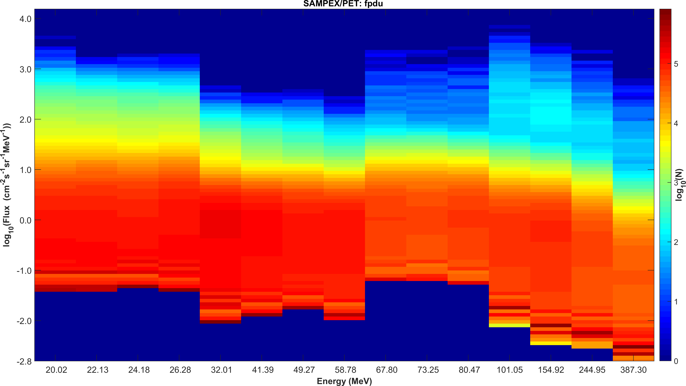
Example: SAMPEX/PET
BEFORE CLEANING /CROSS-CALIBRATION

Slide 31
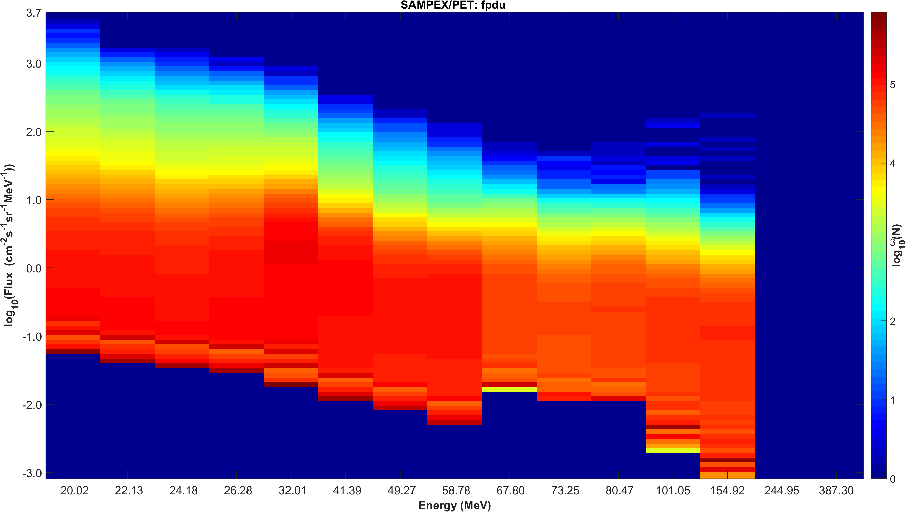
Example: SAMPEX/PET
AFTER CLEANING /CROSS-CALIBRATION

Slide 32
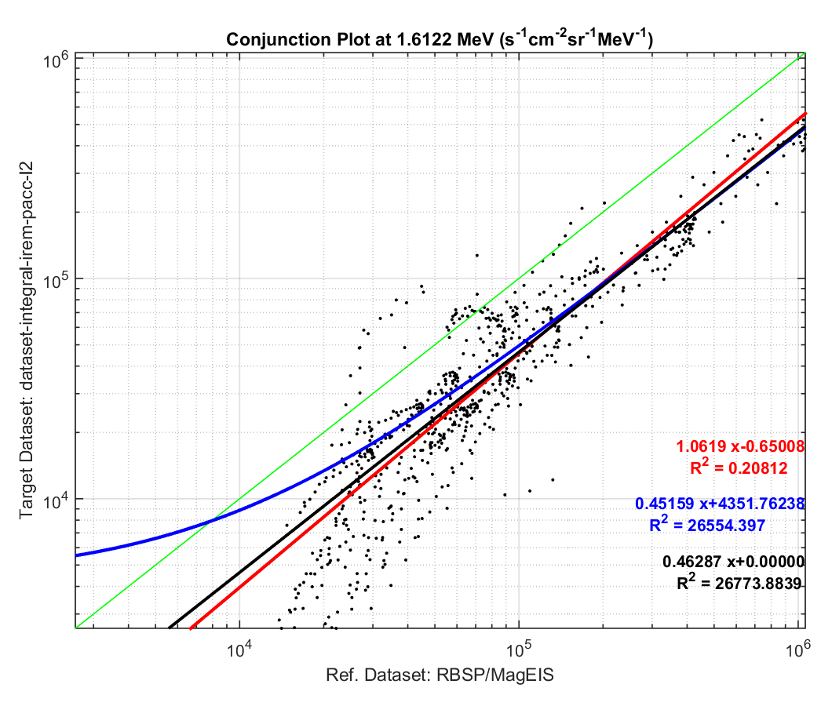
Electron Datasets Cross-Calibration
Identity Line: y=x
Linear Fit
Power Law Fit

Slide 33
IRENE VALIDATION

Slide 34
Solar Cell Degradation Due to Proton Belt Enhancements During Electric Orbit Raising to GEO

Slide 35
Summary
Study of enhanced solar cell degradation on EOR trajectories caused by dynamic enhancements in trapped proton flux
3 EOR trajectories (generated from SPACE-TRACK TLEs): SES-14/15 (Guiana, 5.2°N, low apogee), ABS-2A (Kennedy SC, 28.6°N, high apogee)
AFRL CRRESPRO model is used to model “quiet” and “active” proton fluxes with SPENVIS runs
Incremental displacement damage dose calculated with MC-SCREAM for Azur Space 3G30 triple junction cell with 100, 150 and 200 μm cover glass -> P/P₀ (200 days)
Electron contribution is ≈2–13 % (depending on model) -> <1% in P/P₀

Slide 36
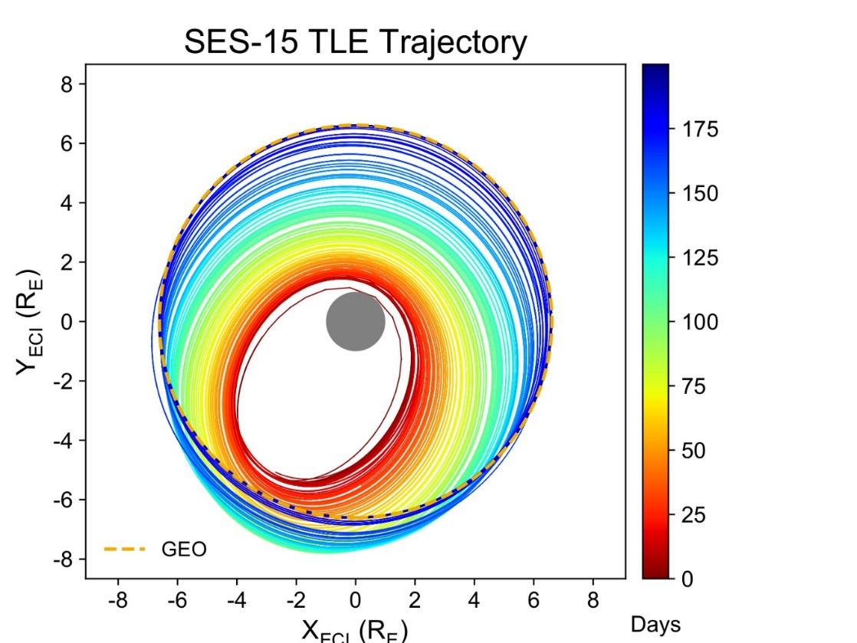
EOR proton environment changes
↑ Proton belt before/ after March 1991 geomagnetic storm
← Example EOR orbit in relation to this environment
Notes:
Proton belt changes
Quiet / Active belt come from time averages taken before / after the March 1991 storm. The active environment shows a sustained enhancement
[show how the example EOR trajectory crosses this enhancement]
So we need to be careful about modelling the environment with static/statistical models because large scale dynamic changes can occur in the outer zone which these models do not capture

Slide 37
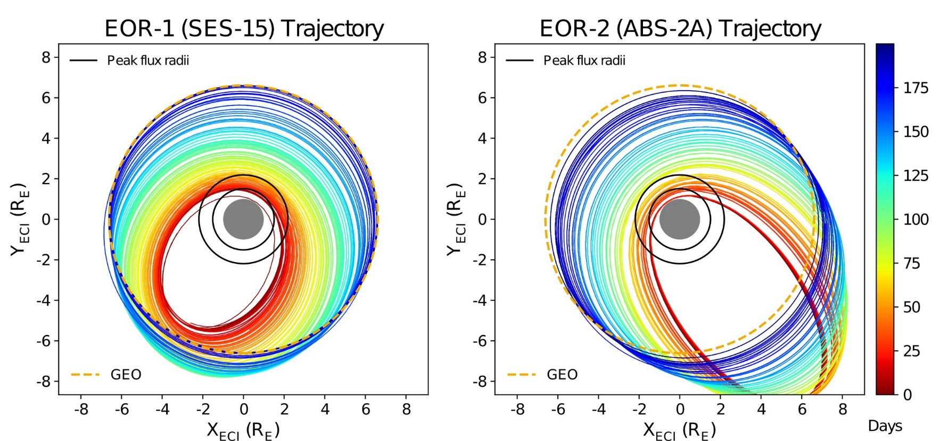
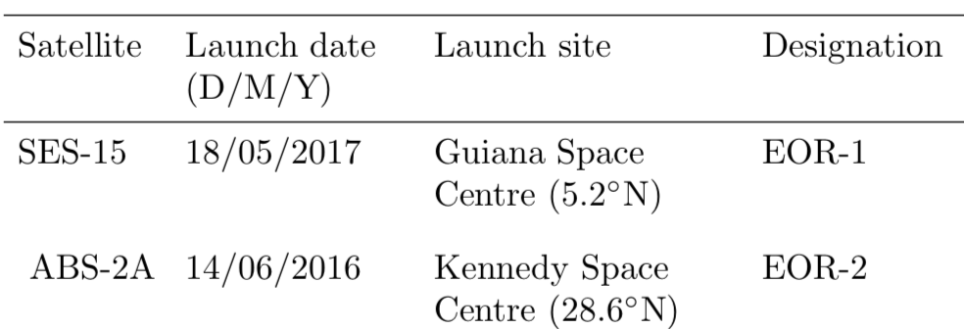
Types of Electric Orbit Raising
EOR-1 = low apogee near-equator launch
EOR-2 = high apogee
high-latitude launch
Notes:
Feedback from industry contacts has indicated that EOR is quite open in terms of trajectory so we experiment with two. These trajectories characterise launch from low latitude and launch from high latitude
Annotating a few key features:
EOR-2 high apogee due to inclination
subtle – hangs in GTO [come back to this point later]

Slide 38
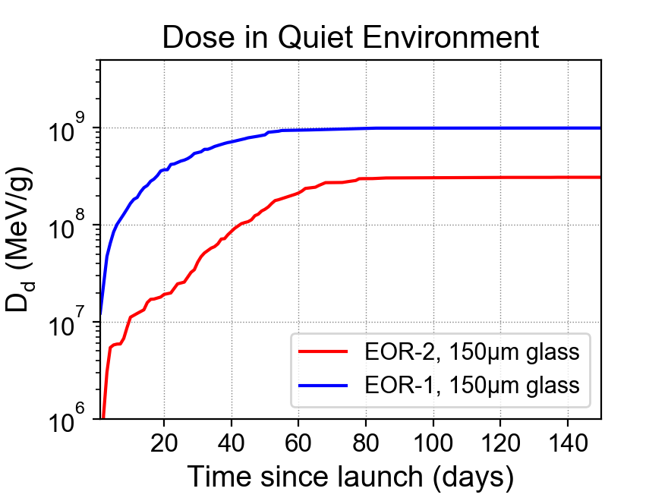
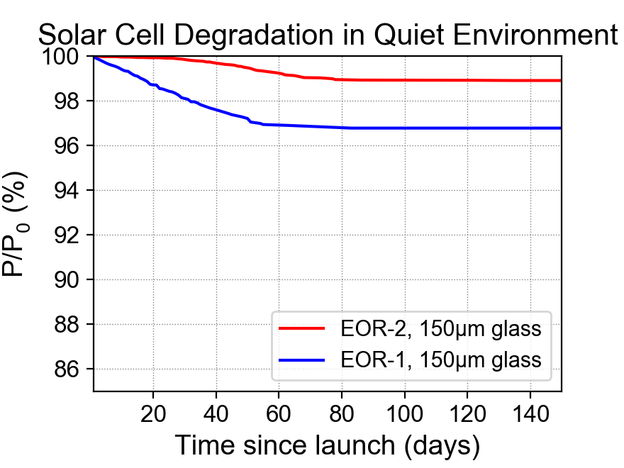
‘quiet’ environment results…
EOR-1: ~3% power drop
EOR-2: ~1% power drop
EOR-1: most dose between days 1 – 60
EOR-2: most dose between days 30 – 90
EOR-1 = low apogee near-equator launch
EOR-2 = high apogee
high-latitude launch
Notes:
The day range is not as relevant – just demonstrate power drop difference
2 differences:
time window of exposure
total dose

Slide 39
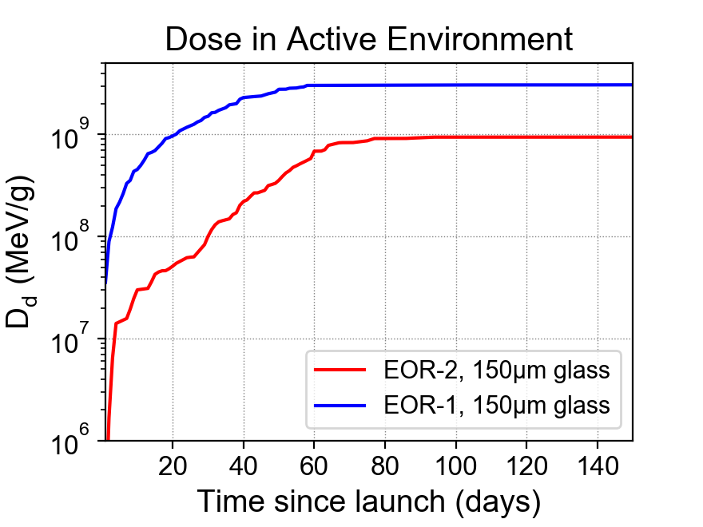
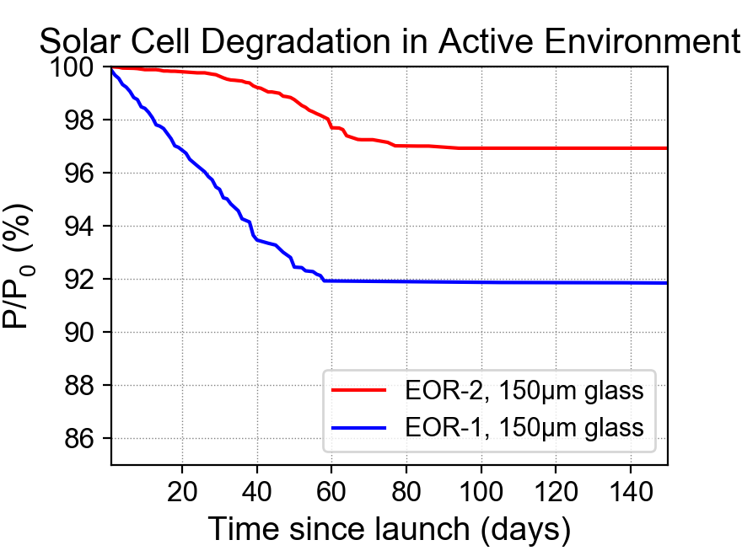
‘active’ environment results…
EOR-1: ~8% power drop (vs. 3% quiet)
EOR-2: ~3% power drop (vs. 1% quiet)
Degradation occurred over the same time period as quiet environment case
EOR-1 = low apogee near-equator launch
EOR-2 = high apogee
high-latitude launch
Notes:
Clearly EOR-1 is more susceptible
2 – 5% difference from TRAJECTORY
2 – 5% difference from ENVIRONMENT
But environmental impact can be limited by choosing a good trajectory
However another interesting feature is that the time window over which degradation was accrued doesn’t change much.
This is because the environment increased flux at low energies but NOT the spatial extent of these fluxes

Slide 40
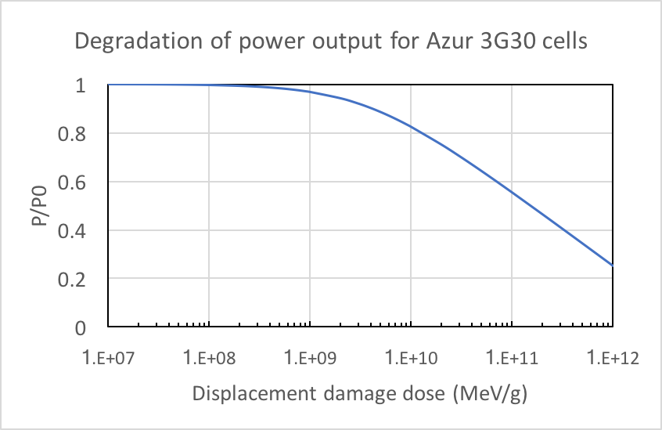
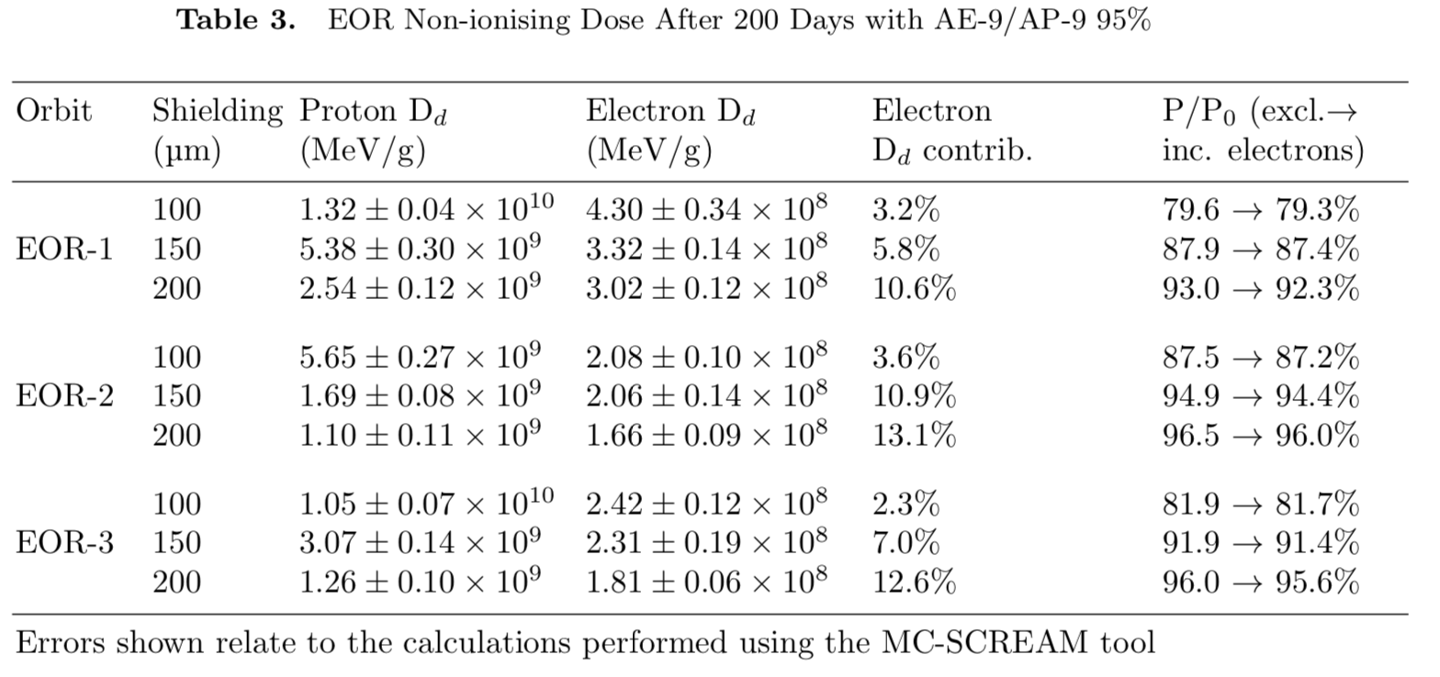
ELECTRONS
Electrons contribute up to ~10% extra dose
However, because P/P0 is logarithmic, the extra degradation is very small
Notes:
Before we summarise, something about electrons…

Slide 41
RECOMMENDATIONS FOR EOR
Key characteristic of trajectory is the initial GTO apogee – higher is better as it allows faster transit through the proton belt!
Plan for worst-case scenarios in terms of ~5MeV proton flux increases
Increasing coverglass thickness somewhat follows a law of diminishing returns… but more important for trajectories with high exposure
Recalibrate degradation curves for new BOL at GEO

Slide 42
Final conclusions

Slide 43
Final conclusions: data
The XMM/ERMD flux and count data should be re-calibrated
An in-depth calibration analysis should be performed of the POLAR/CEPPAD data.
PROBA1/SREM data need to be re-calibrated taking into account the opening angle of the instrument and the substantial spacecraft shielding.
The EMU datasets should be added to the analysis.

Slide 44
Final conclusions: IRENE
There is no compelling reason to use AE-9 at this point to model the electron environment.
There are some regions in space and energy where AP-9 outperforms AP-8, but also a few regions where the reverse holds.
As the models are still heavily under development, it is not recommended to use the current version as a standard.
Since the validation work, new versions of the RBSP datasets have been released. The model/data comparisons should be repeated using the new dataset versions.
AE-9 fails at reproducing the variability in the electron environment indicated by the various datasets.
More work is needed to analyse the Monte Carlo version of IRENE in order to understand short term variability.

