Slide 1
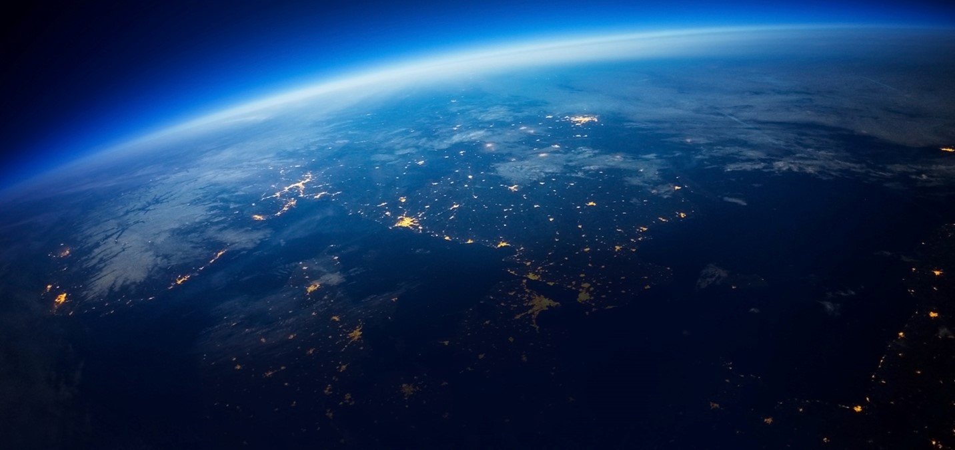
Charging of the MetOp-SG satellites in the polar auroral zone
Dr.-Ing. Christian Imhof

Slide 2
Outline
  Introduction
    Overview of the satellite
    Analysis approach
  Modelling of the Satellite
    Geometrical Modelling
    Material Distribution
    Plasma Parameters
  Simulations Results
  ESD Assessment
  Feedback from Implementation Phase
  Summary and Conclusions

Slide 3
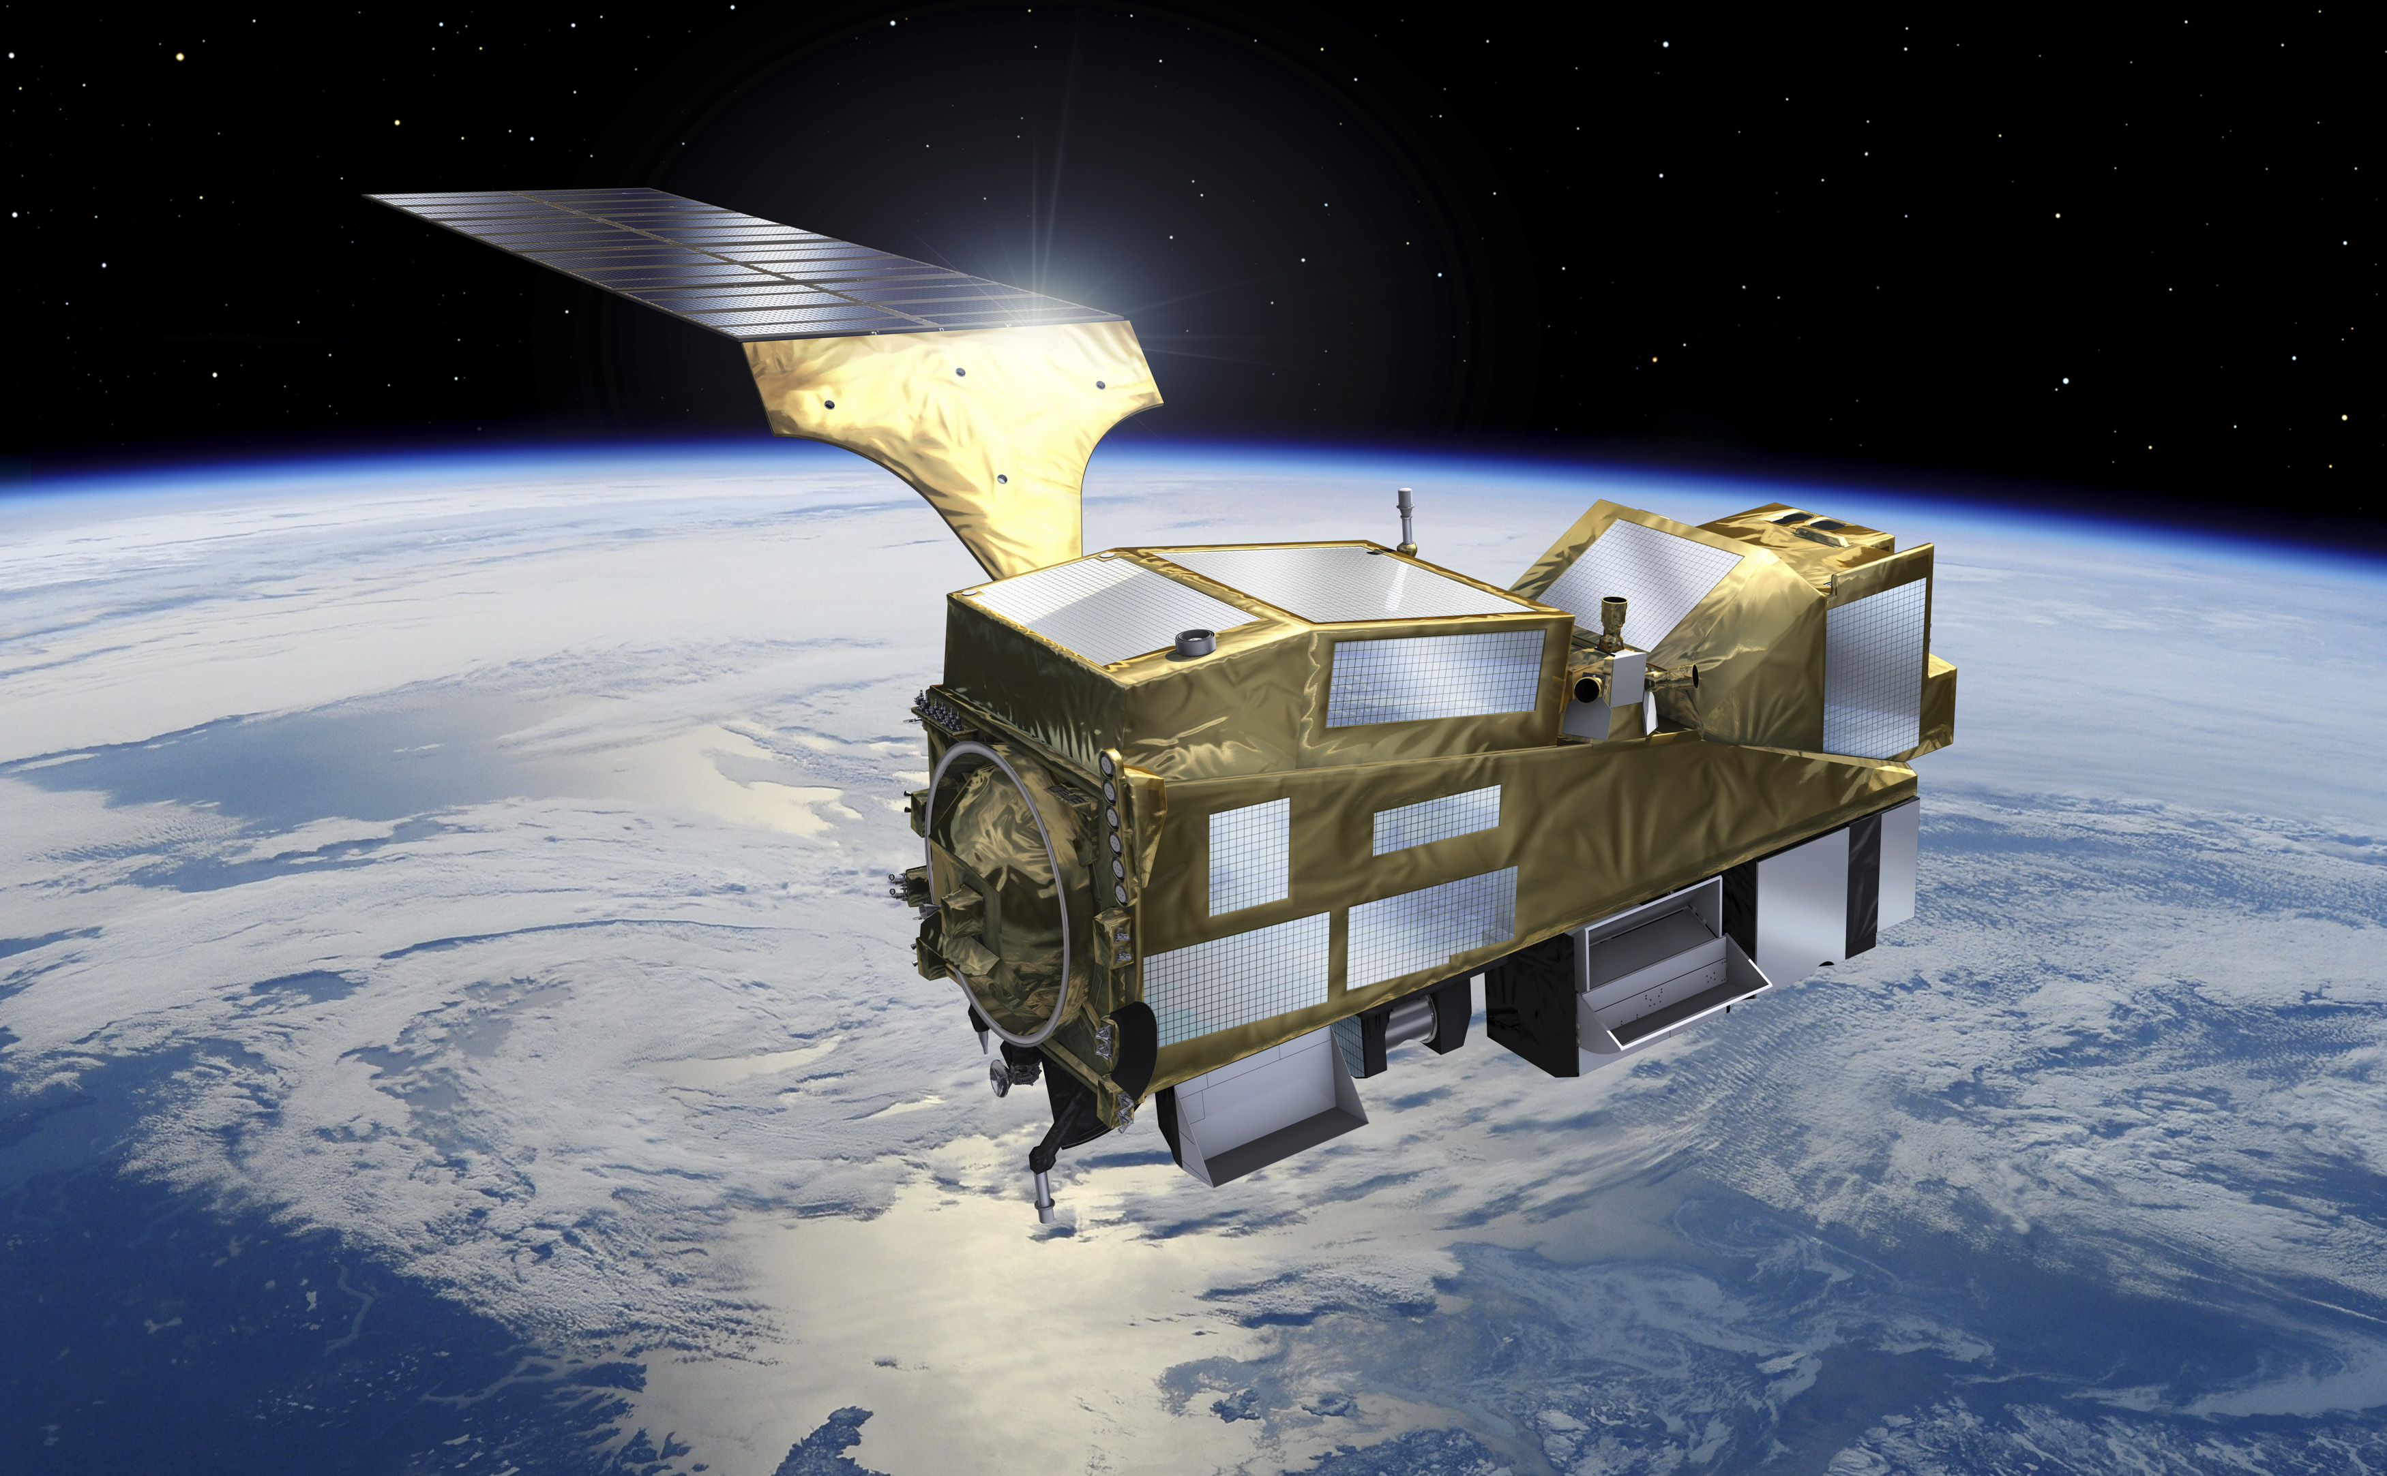
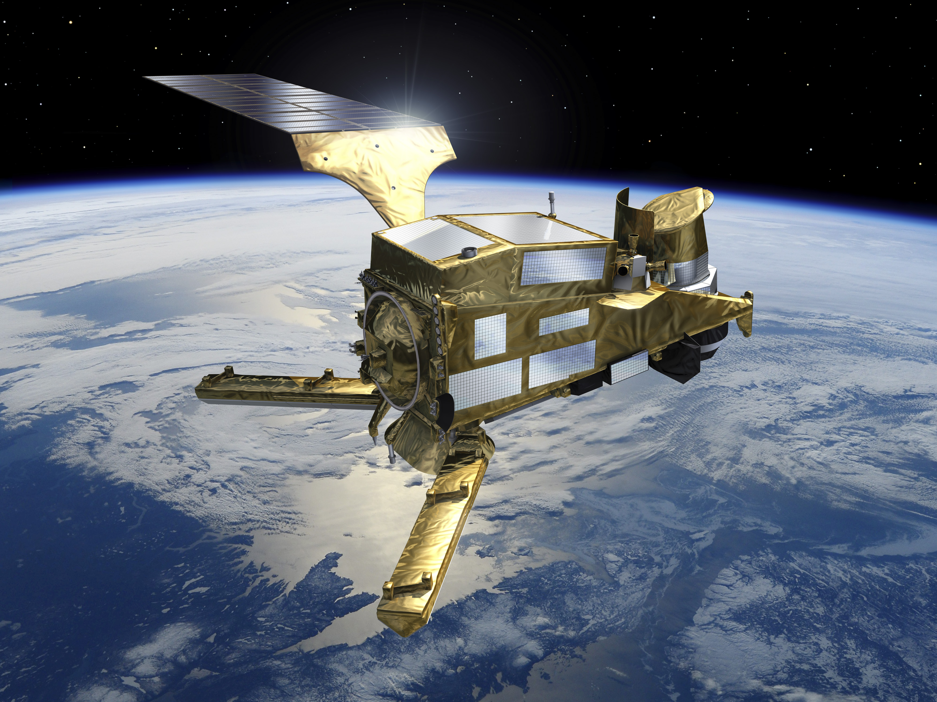
Introduction – MetOp-SG Satellite Overview
  Second generation of European low earth orbit meteorological satellites operated by Eumetsat
  Satellite constellation built up by two polar orbiting satellites
    Sat-A hosting mainly optical payloads
    Sat-B hosting mainly RF instruments
  Orbit Details
    Polar sun-synchronous orbit with altitude of 817 km
    auroral zone will be crossed which defines the worst case plasma for
    the orbit
Pictures by courtesy of ESA

Slide 4
Introduction – Analysis approach
  With the recently published update of the ECSS charging standard 20-06C Rev.1 the use of 3D simulation tools is strengthened
    Now it is clearly stated that certain materials can be allowed if a properly made charging analysis shows that there is no risk to the system
    This approach is reflected in the analysis that has been performed for the MetOp-SG satellites
  Overall chosen workflow
    3D charging analysis
    Identification of critical areas
    ESD criticality assessment
    Initiation of additional tests if needed
  The described method is also well reflected in the new handbook published along with the updated standard
  Assessment of space worst case charging handbook – ECSS-H-HB-20-06A

Slide 5
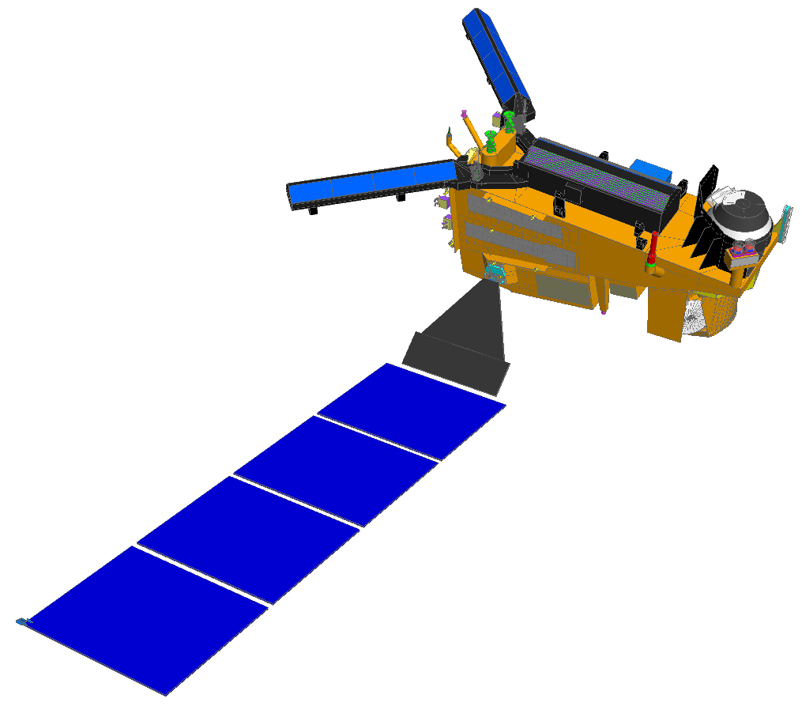
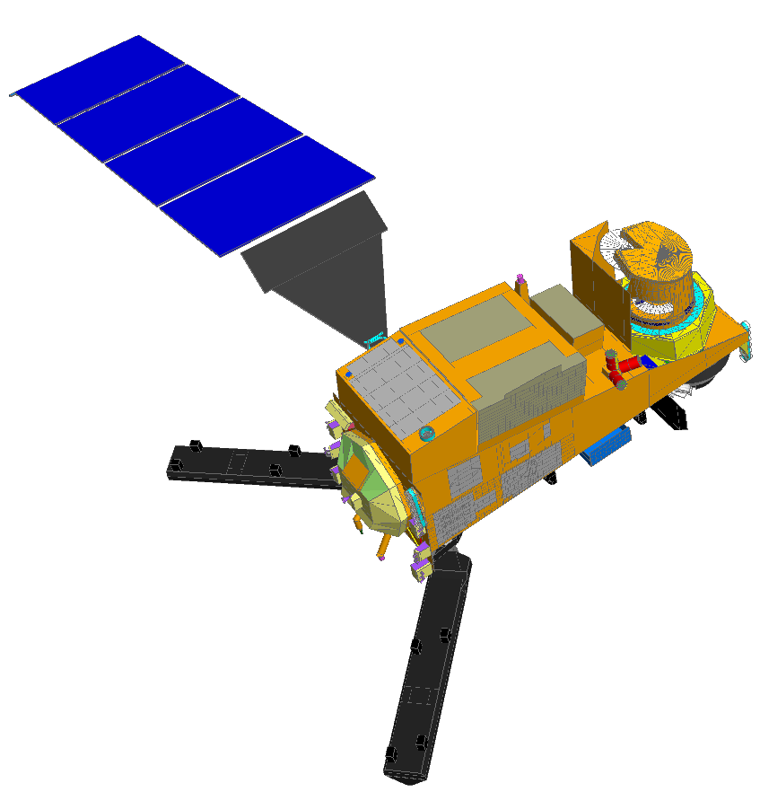
Modelling of the satellite
  Presentation focuses on the simulations for satellite B
    Detailled results on the other satellite A have been published in CEAS Space Journal 12,137-147, 2020
  The simulation model is based on the detailed thermal model of the satellite

Slide 6
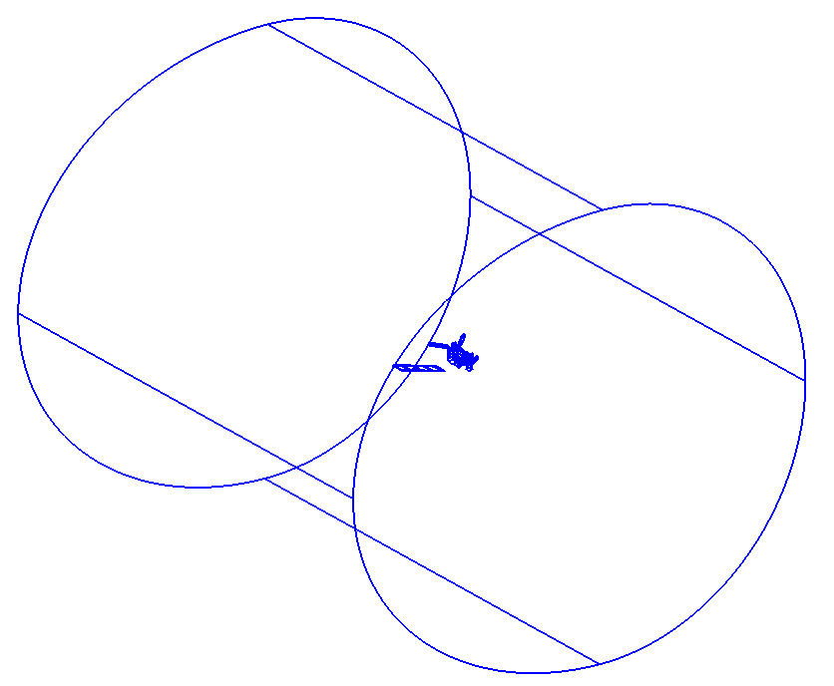
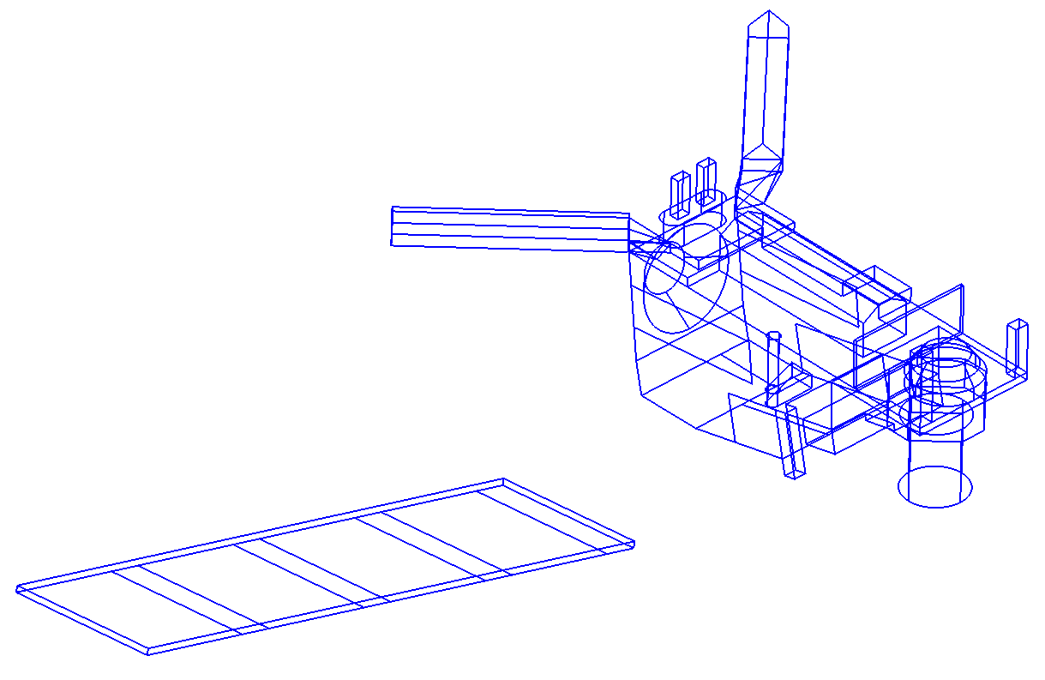
Modelling of the satellite
  Geometrical model is directly generated within GMSH with some simplifications
    Merging of spread radiator surfaces into single surfaces with representative area
    SA yoke is omitted and the SA panels are merged into one large panel with the same area
    Modifications to the baffles and cancelling of small superstructure elements
  Simulation Volume has to be chosen very large
    Due to the expected strong charging the volume has to be large enough to represent the complete sheath to have a realistic ion current to the satellite
99 m
95 m
83 m

Slide 7
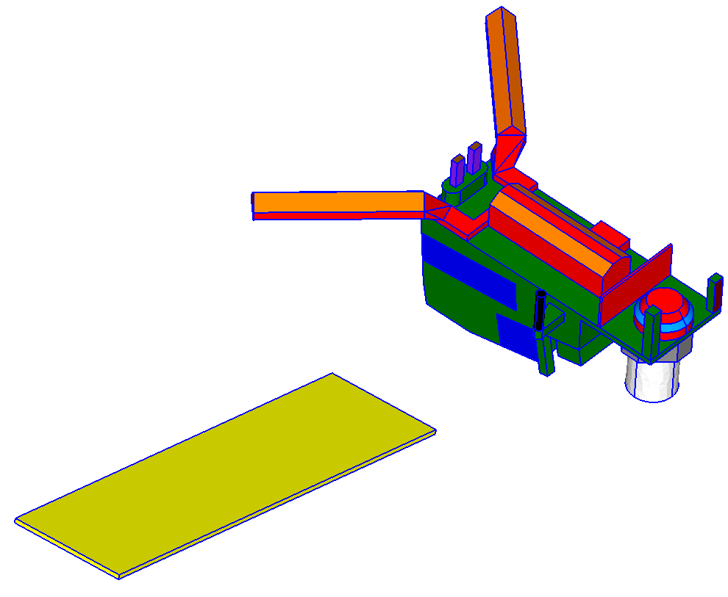
Modelling of the satellite
  Material distribution on the satellite model
HGA; Anod. Alu 20 µm
Black Kapton MLI
HGA Mechanism Rad; Teflon 250 µm
Antennas; White Paint PSG121 100 µm
SCA Antennas; Alu
SA Panel; Epoxy 50 µm
Inst MLI Kapton 50 µm
Sat MLI Kapton 50 µm
Radiators; Teflon 125 µm

Slide 8
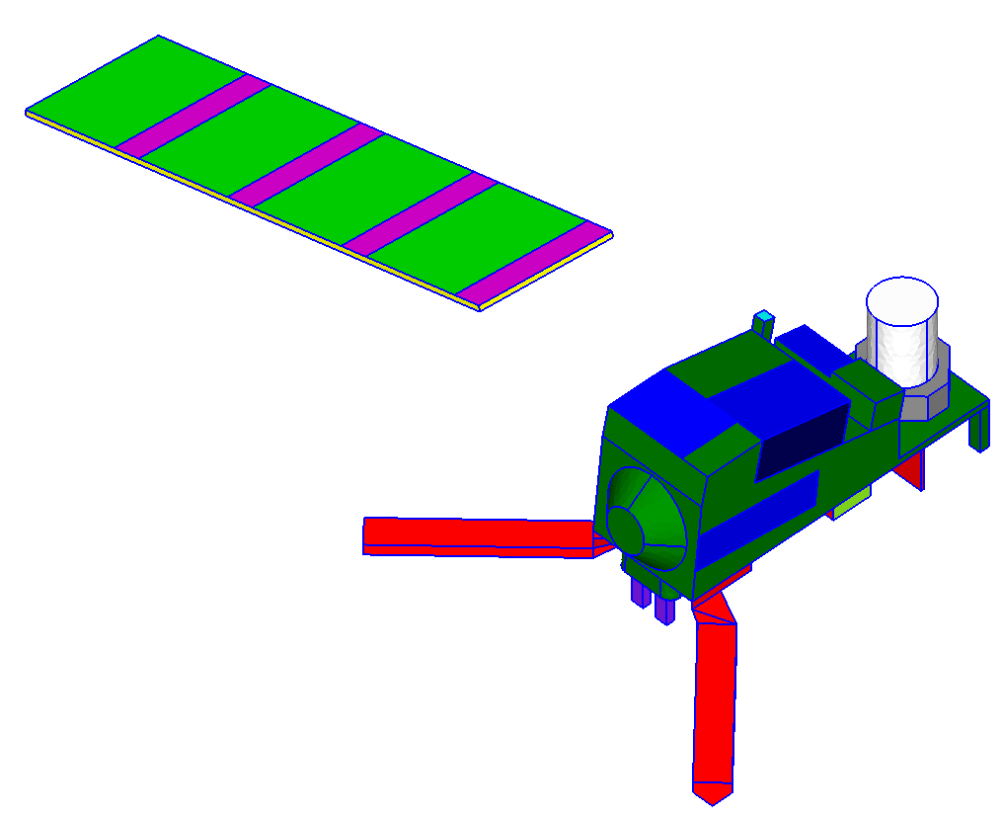
Modelling of the satellite
  Material distribution on the satellite model
SA Cells; Cover Glass 100 µm
Antenna; White Paint PSG121 100 µm
SA; unpopulated areas; Kapton 50 µm
MWI MLI Kapton 50 µm
MWI Radiator Teflon 125 µm
PEP Radiator; White Paint PSG121 100 µm
Black Kapton MLI
Radiators; Teflon 125 µm

Slide 9
Modelling of the satellite
  Summary of the assignment of colors with surface materials properties and the type of material which is used in SPIS
  For the white paint PSG121FD a conductivity of 4.5e-15 S/m is used
  For anodized Aluminum a conductivity of
  1e-13 S/m is used
Color | Description | Material | SPIS Material
Red | ICI & SCA MLI | Black Kapton | Black Kapton 2k
Dark Green | Satellite MLI | Kapton/VDA; 50 µm | Kapton; 50 µm
Blue | Platform Radiators | SSM Tape; 125 µm | Teflon; 125 µm
Brown | HGA Antennas | Anodized Aluminium | Anod Alu; 20 µm
Purple | HGA Radiators | SSM Tape; 250 µm | Teflon; 250 µm
Yellow | SA Structure | CFRP | Epoxy; 50 µm
Light Green | SA Cells | Cover Glass | CERS; 100 µm
Pink | SA front unpopulated | Kapton/VDA; 50 µm | Kapton; 50 µm
Light Blue | ICI Radiator | SSM Tape; 125 µm | Teflon; 125 µm
White | MWI MLI | Kapton/VDA; 50 µm | Kapton; 50 µm
Grey | MWI Radiator | SSM Tape; 125 µm | Teflon; 125 µm
Black | ADCS Antenna Radome | White Paint SG121FD | SG121FD; 100 µm
Orange | SCA Antennas | VDA/Kapton | Aluminium
Light Green | SCA FEE Radiator | SSM Tape; 250 µm | Teflon; 250 µm
Cyan | SBA Radome | White Paint SG121FD | SG121FD; 100 µm
Dark Red | RO Antennas | Anodized Aluminium | Anod Alu; 20 µm
Dark Blue | PEB PY Radiator | White Paint SG121FD | SG121FD; 100 µm

Slide 10
Simulation Results
Structure Potentials
Instrument Potentials
  Basic simulation settings for the LEO auroral charging simulation
    Satellite is assumed to be in eclipse conditions
    Plasma definition as contained in the recent update of the ECSS standard 10-04C Rev.1 which will be published soon
    Satellite velocity is taken into account to address the ram/wake effect for the slow ions
  Time dependent evolution of the surface potentials on the satellite
    Strong absolute charging down to about -5 kV
    Strong differential potentials evolving on the dielectric surfaces of the satellite

Slide 11
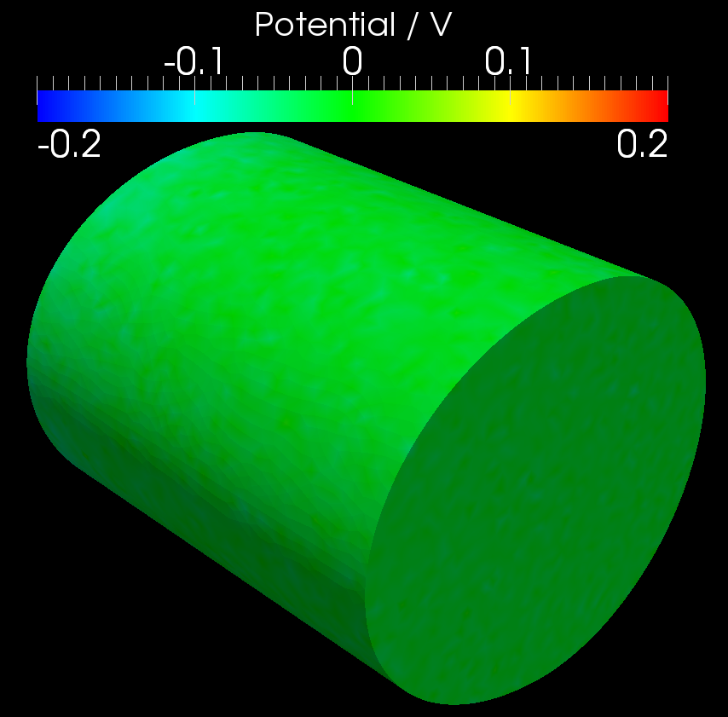
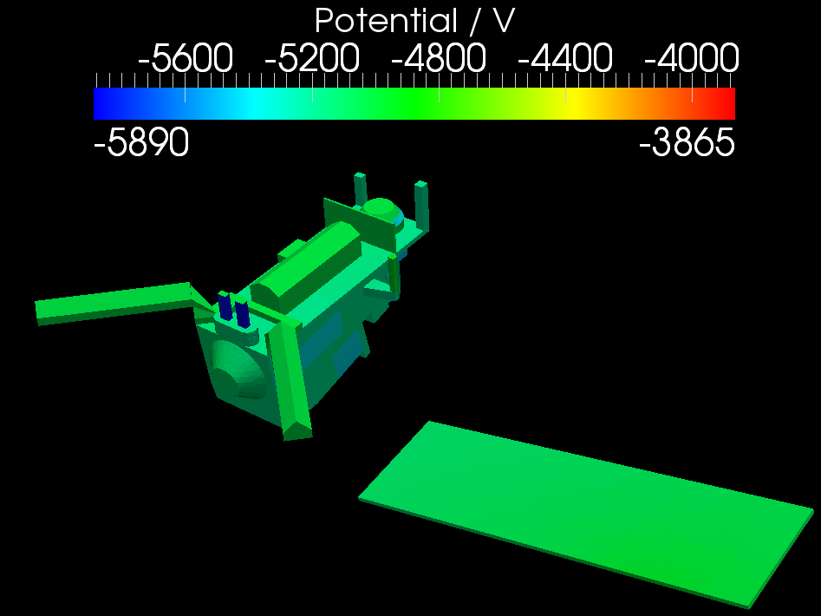
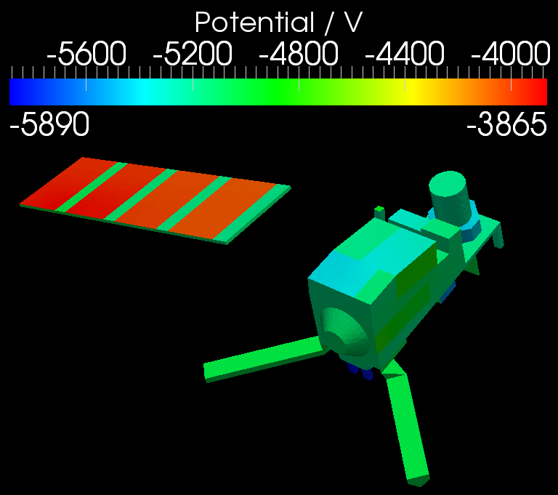
Simulation Results
  Surface potential distribution after 10 s in the worst case plasma environment
    In the spatial distribution the maximum potential differences can be identified
      Maximum direct potential gradient of 890 V between ground and the thick SSM parts on the HGA pointing mechanism
      Very strong inverted potential gradient on the SA cover glasses -> possibility for ESD

Slide 12
ESD Assessment
  Assessment of possibility for ESDs
    The threshold levels for the onset of ESD are specified in the ECSS standard 20-06C Rev.1
      2000 V for direct potential gradients
      300 V for inverted potential gradients
  For MetOp-SG the only critical elements identified by the analysis are the solar array cover glasses
    Due to the strong inverted potential gradient ESD between the cover glass and the cells or cell interconnectors is very likely in the worst case plasma environment
  Impact on the satellite system
    Primary ESD on the solar cells can be accepted and does not lead to permanent damage of the system
    → but: the occurrence of secondary arcs has to be prevented in this case

Slide 13
ESD Assessment
  Implemented design measures on MetOp-SG
    String and section laydown with sufficient gaps between adjacent strings and sections
      1 mm nominal string separation; 0.6 mm minimum
      3 mm nominal section separation; 2.5 mm minimum
    String laydown minimizing the potential difference between strings in nominal operating conditions
      44 V maximum gap voltage in nominal operations
    Use of string blocking diodes
  Robustness of the solar array and photovoltaic assembly design has been verified in an ESD test at coupon level
    Test conditions 0.5 mm gap tested with voltage up to 107 V with nominal string current (446 mA)
    No secondary arcs have been observed under these conditions
  → robustness of the SA against arcing is assured

Slide 14
Feedback from the Implementation Phase
  SSM Tapes (perforated FEP over a silver layer) are widely used on satellites
    Check the grounding and the design
  On MetOp-SG two cases with critical grounding have been identified
    SSM used on CFRP panels with non-conductive glue due to adhesion problems for the given temperature range
      Solved by using abrasion of the Epoxy layer in the regions where the SSM Tapes shall be applied
    SSM on the high gain antenna pointing mechanism also foreseen with non-conductive glue
      Glue variant changed
  Be always prepared to challenge thermal designs
  High gain antenna pointing mechanism
    Use of thick (250 µm) SSM tapes along with non-conductive adhesive
    After the discussion was opened due to the floating silver layer the thickness has also been discussed
    Outcome:
    conductive adhesive is used
    thinner SSM tapes with more typical thickness of 125 µm are now used; thermal engineers simply went for the thick variant since this is the solution with the best thermal performance, but the device is also working perfectly with the thinner tape

Slide 15
Summary and Conclusions
  Simulations of the charging of the MetOp-SG satellite B in the auroral zone have been presented
    Analysis and overall workflow is now well represented in the updated standards
    Simulations confirm that strong charging in the auroral plasma is possible on the satellite
  Assessment of the possibility of ESD has shown that ESDs on the solar cell cover glasses are possible
    Design measures for the avoidance of secondary arcs are implemented for MetOp-SG
    Secondary arcing test on coupon level has been passed successfully
  → although strong charging is simulated on the satellite there are no risks to the system
  Feedback from Implementation phase on identified design “mistakes” is presented
    Always remember 20-06C Rev.1 clause 6.8.1 on inspection of proper grounding

Slide 16
Thank you

