Slide 1
M. Holmberg, F. Cipriani, G. Déprez,
D. Rodgers, T. Cassidy, C. Imhof,
N. Altobelli, J.-E. Wahlund,
H. Huybrighs, O. Witasse,
T.-M. Bründl
ESA/TEC-EPS, ESA/SOC,
IRF, ESA/Science Faculty,
LASP, Airbus DS GMbH,
27th SPINE workshop
19/02/2020
JUICE spacecraft charging simulations
and implications for particle measurements

Slide 2
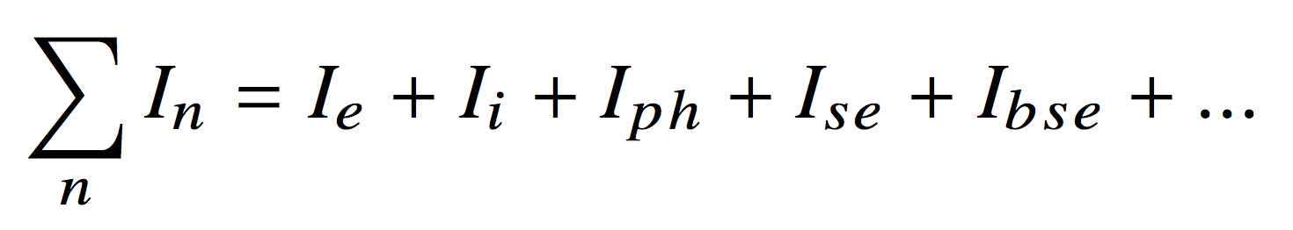
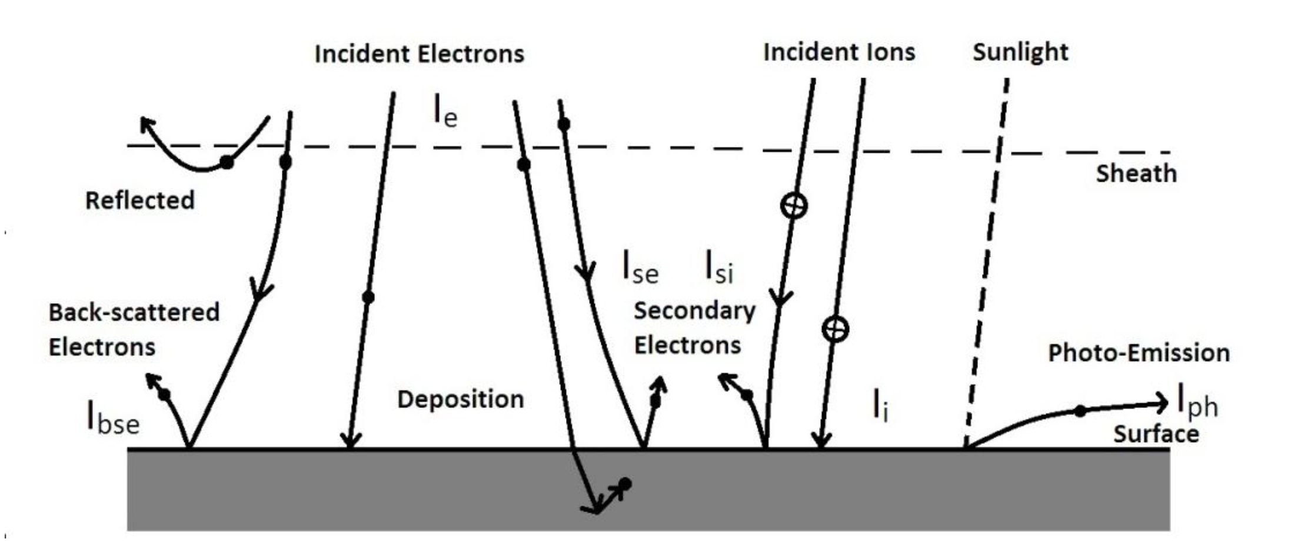
Introduction – Spacecraft charging
  Accumulation of charges on surfaces or in materials
  Can damage onboard electronics and interfere with measurements
Only for dielectrics ➔
Relevant charging processes for JUICE. From Joslyn and Ketsdever, 2010.

Slide 3
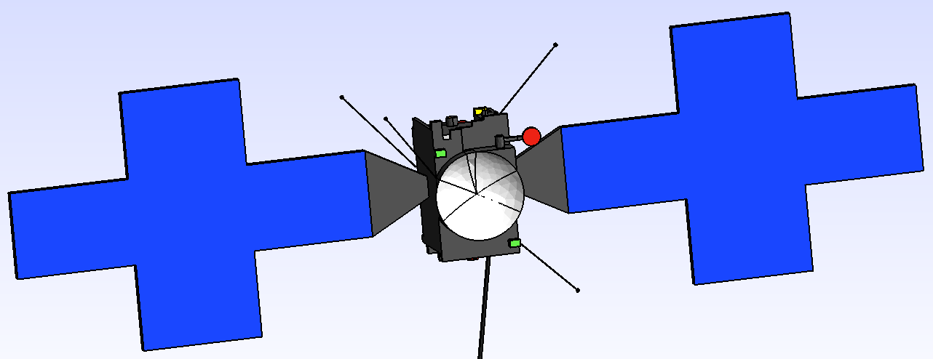
Simulation setup – JUICE spacecraft model
  Body x = 2.50 m, y = 2.25 m, z = 3.52 m
  High gain antenna x = 0.49 m, r = 1.27 m
  Solar panels y = 12.07 m (including mounting), z = 7.44 m
  MAG l = 10.57 m
Z
X
Y
Simplified JUICE spacecraft model suitable for the Spacecraft Plasma Interaction Software (SPIS)

Slide 4
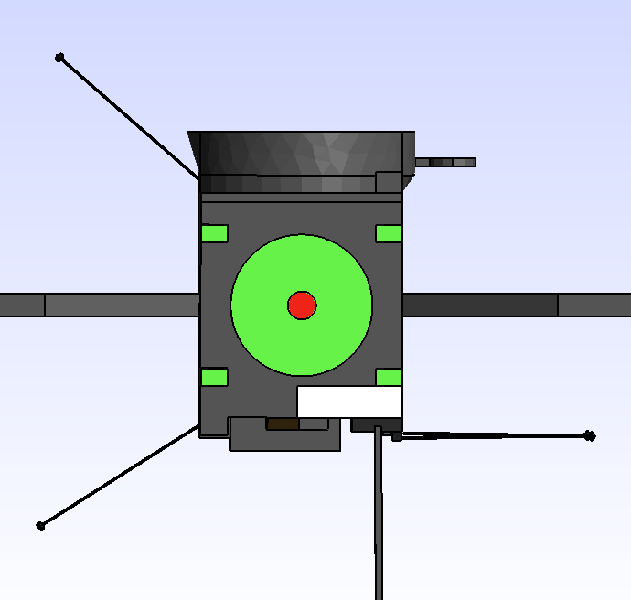
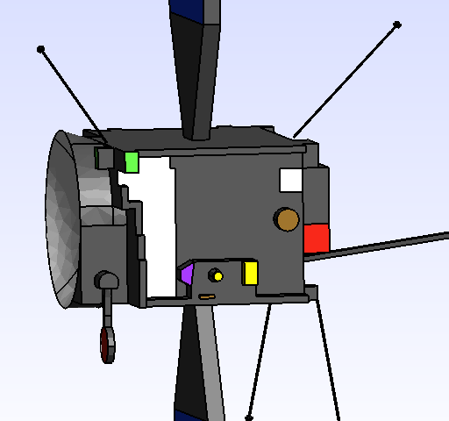

Simulation setup – Juice spacecraft model
Black kapton (grey), s/c body, UVS, J-MAG
ITO coating (blue), solar panels
White paint Z93C55 (white), HGA, radiators
White paint PSG 120FD (purple), PEP card rack radiator
Electrodag 501 (brown), GALA, PEP/JNA, PEP/JDC
Enbio SolarBlack (green), MLI around main engine, thrusters
Gold equivalent (yellow), PEP/NIM detector, PEP/JENI
Titanium (black), RPWI/Langmuir probes and booms
Steel (red), MGA, SWI, main engine nozzle
Bottom
Top
Front
Back

Slide 5
Simulation setup – Juice spacecraft model
Black kapton (grey), s/c body, UVS, J-MAG
ITO coating (blue), solar panels
White paint Z93C55 (white), HGA, radiators
White paint PSG 120FD (purple), PEP card rack radiator
Electrodag 501 (brown), GALA, PEP/JNA, PEP/JDC
Enbio SolarBlack (green), MLI around main engine, thrusters
Gold equivalent (yellow), PEP/NIM detector, PEP/JENI
Titanium (black), RPWI/Langmuir probes and booms
Steel (red), MGA, SWI, main engine nozzle
Bottom
Top
Front
PEP
Back

Slide 6
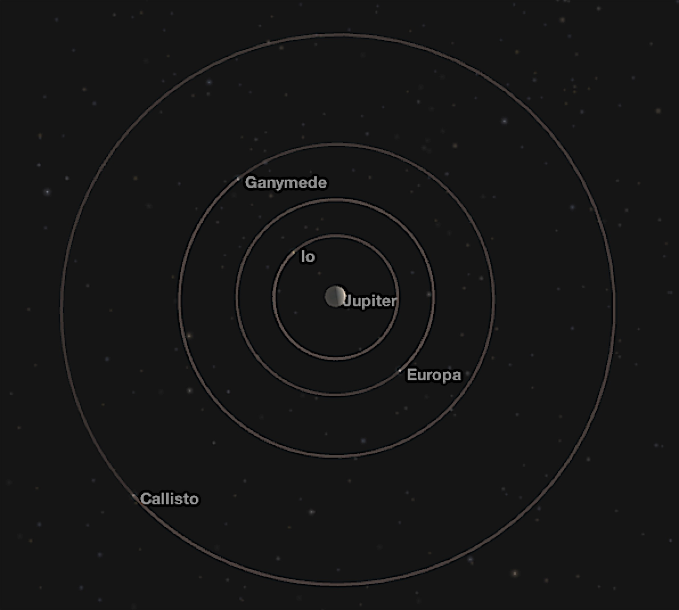
Simulation setup – The environment
Magnetosphere at 9.5, 15, and 26.3 R_{J}, ionospheres of Europa and Ganymede
Future studies: ionospheres of Ganymede and Callisto, and solar wind at 5.2 AU (orange markers)
Simulation results available (green markers)
Orientation of spacecraft (white arrows)
View from above
sw
X
View from above
X
x
z
X
Plasma flow direction
X
Io
Jupiter
Solar radiation
Europa
X
X
Ganymede
Callisto
X
y
x
X

Slide 7
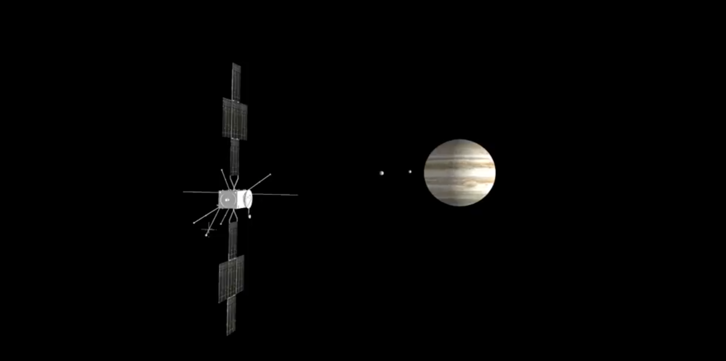
Simulation setup – The environment
Side view
Magnetosphere at 9.5 R_{J}, 15 R_{J}, and 26.3 R_{J}, ionosphere of Europa
B field direction
Future studies: ionospheres of Ganymede and Callisto, and solar wind at 5.2 AU (orange markers)
Simulation results available (green markers)
Orientation of spacecraft (white arrows)
View from above
sw
X
X
x
z
X
Plasma flow direction
X
Io
Plasma flow direction
Jupiter
Solar radiation
x
Europa
X
y
X
Ganymede
Callisto
X
y
x
X

Slide 8
Simulation setup – Global parameters for the magnetosphere
For 9.5 R_{J} (Europa at 9.38 (9.30-9.47) R_{J}, CA at 9.3 R_{J}), λ_{D} = 5 m, r_{g,i} = 45 km
For 15 R_{J} (orbit of Ganymede), λ_{D} = 105 m, r_{g,i} = 204 km
For 26.3 R_{J} (orbit of Callisto), λ_{D} = 430 m, r_{g,i} = 1330 km
GP | 9.5 R_{J}, Europa | 15 R_{J}, Ganymede | 26.3 R_{J}, Callisto
Cold e⁻ density, n_{e,c} | 50 cm⁻³ | 1 cm⁻³ | 0.12 cm⁻³
Cold e⁻ temperature, T_{e,c} | 20 eV | 30 eV | 35 eV
Warm e⁻ density, n_{e,w} | 1.3 cm⁻³ | 0.2 cm⁻³ | 0.05 cm⁻³
Warm e⁻ temperature, T_{e,w} | 250 eV | 300 eV | 350 eV
Hot e⁻ density, n_{e,h} | 0.08 cm⁻³ | 0.04 cm⁻³ | 0.01 cm⁻³
Hot e⁻ temperature, T_{e,h} | 2 keV | 3 keV | 3 keV
Ion density, n_{i} | 51.38 cm⁻³ | 1.24 cm⁻³ | 0.18 cm⁻³
Ion temperature, T_{i} | 190 eV | 400 eV | 650 eV
Flow velocity, v_{θ} | 100 km/s | 155 km/s | 200 km/s
Dominant ion species | O⁺ | O⁺ | O⁺
Spacecraft velocity, |v_{s/c}| | 17.2 km/s | 13 km/s | 9 km/s
Magnetic field strength, |B| | 420 nT | 110 nT | 35 nT
Values are obtained from published Galileo, Voyager and Ulysses data
The electron parameters are confirmed by new fits to Galileo and Voyager electron measurements

Slide 9
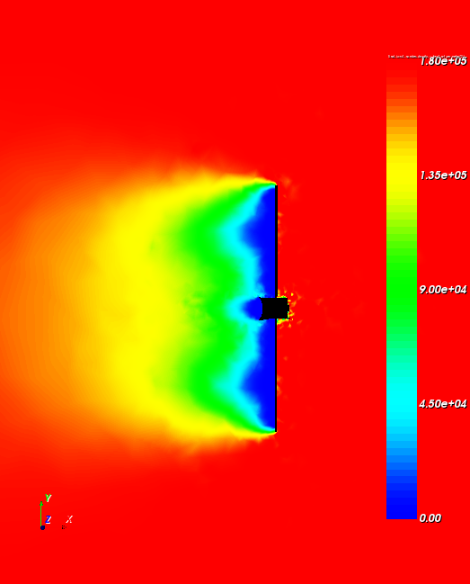
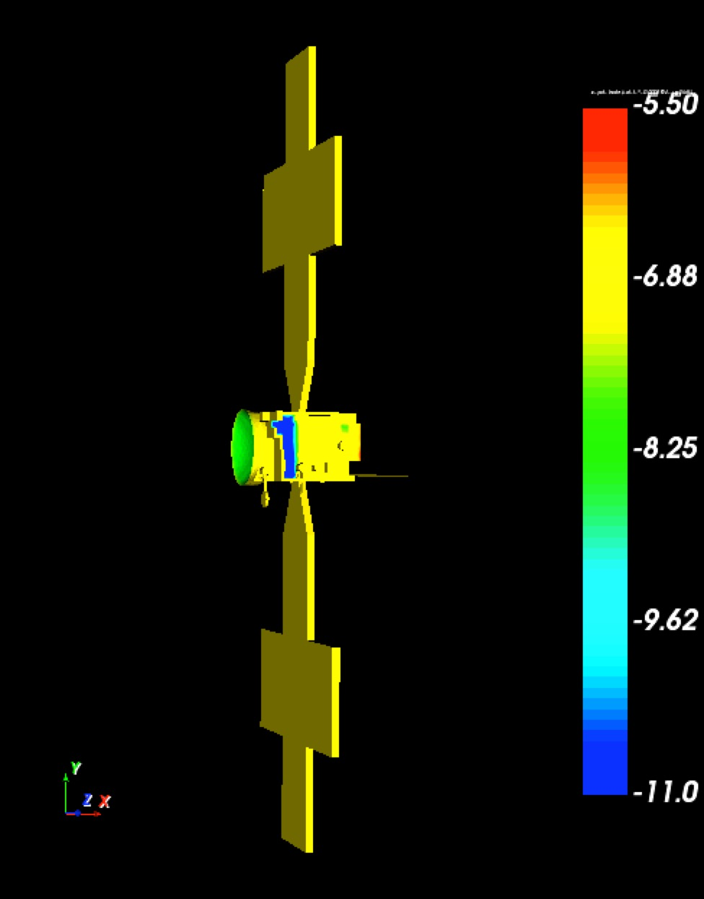
Results 9.5 R_{J} – Plasma wake structure and surface potential
Solar radiation and plasma flow in opposite direction, B_{y} = 420 nT
Ion density (cm⁻³)
Surface potential (V)
v_{flow} > v_{th,i}
50
37.5
25
12.5
0
Plasma flow direction
Solar radiation

Slide 10
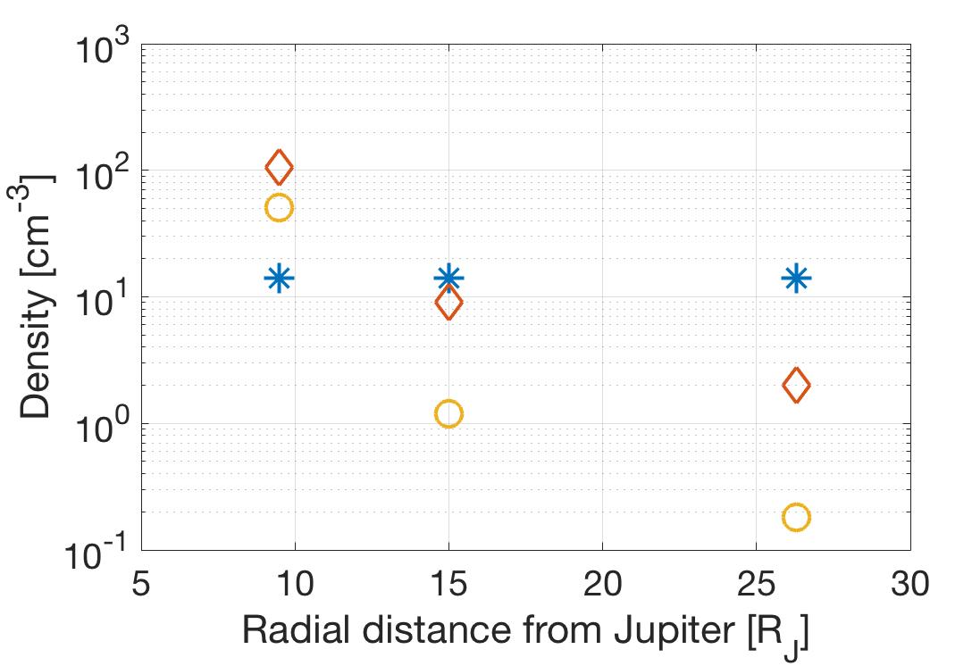
Results – particle densities
Ambient plasma density (yellow circles)
Maximum photoelectron density (blue stars)
Maximum secondary electron density (red diamonds)
Europa (9.3 R_{J}) Ganymede (15 R_{J}) Callisto (26.3 R_{J})

Slide 11
Results – particle densities
Ambient plasma density (yellow circles)
Maximum photoelectron density (blue stars)
Maximum secondary electron density (red diamonds)
Europa (9.3 R_{J}) Ganymede (15 R_{J}) Callisto (26.3 R_{J})

Slide 12
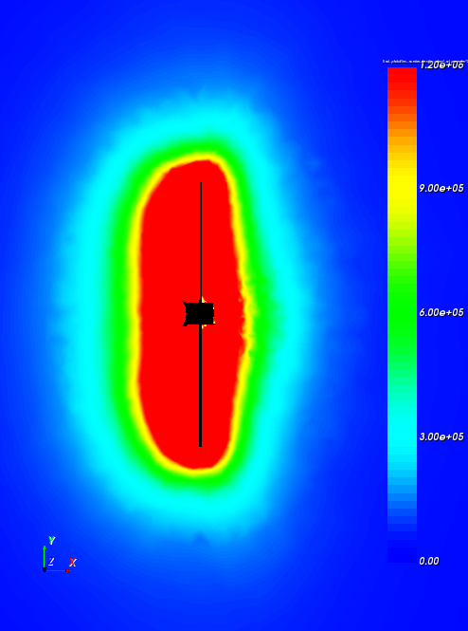
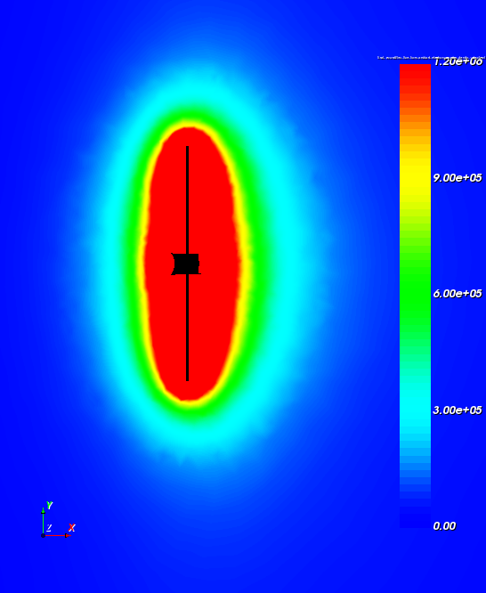
Results 15 R_{J}
Photoelectron density (cm⁻³)
Secondary electron density (cm⁻³)
n_{ph,max} = 14 cm⁻³
n_{se,max}= 9 cm⁻³
1.2
0.9
0.6
0.3
0
1.2
0.9
0.6
0.3
0
Solar radiation
Plasma flow direction

Slide 13
Results – Current balance
At 9.5 R_{J} I_{ce} + I_{se}= I_{se,e}
At 15 R_{J} I_{se} + I_{ph} + I_{ce} + I_{we} + I_{he} = I_{se,e} + I_{ph,e}
At 26.3 R_{J} I_{ph} + I_{se} = I_{ph,e} + I_{se,e}
In eclipse
At 15 R_{J} I_{se} + I_{ce} + I_{we} + I_{he} = I_{se,e}
At 26.3 R_{J} I_{se} + I_{we} + I_{ce} + I_{he} = I_{se,e}
  ce = cold electrons, we = warm electrons, he = hot electrons
  se = secondary electrons, se,e = emitted secondary electrons
  ph = photoelectrons, ph,e = emitted photoelectrons

Slide 14
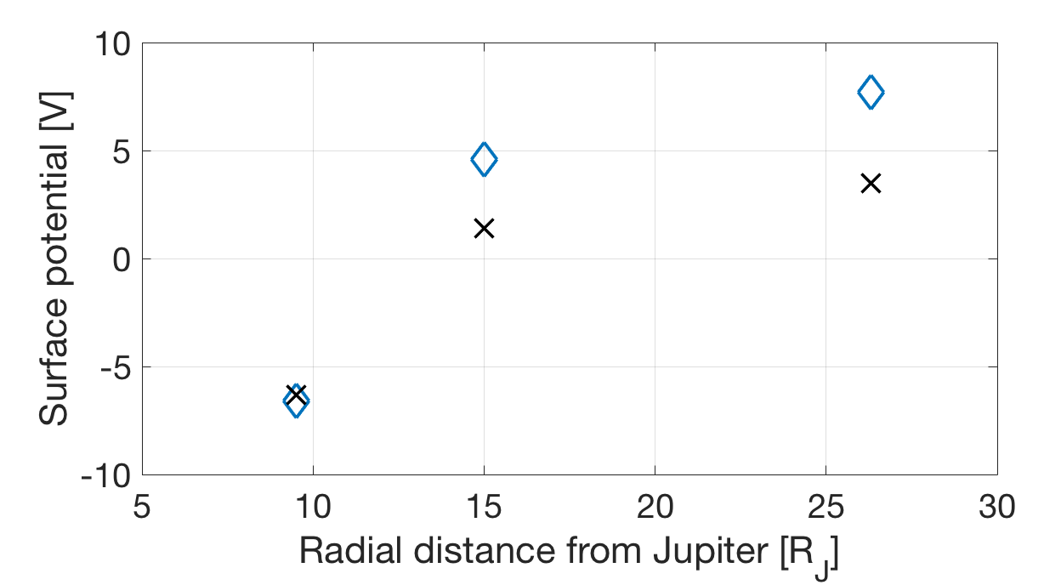
Summary – Regions relevant for spacecraft charging in the Jovian magnetosphere
  Simulated spacecraft surface potential with I_{ph} (blue diamonds) and without I_{ph} (black crosses)
  Negative spacecraft surface potential, current dominated by ambient electrons (blue region)
  Positive spacecraft surface potential, current dominated by secondary electrons (white region)
  Positive spacecraft surface potential, current dominated by the photoelectron current (red region)
Europa
Ganymede
Callisto

Slide 15
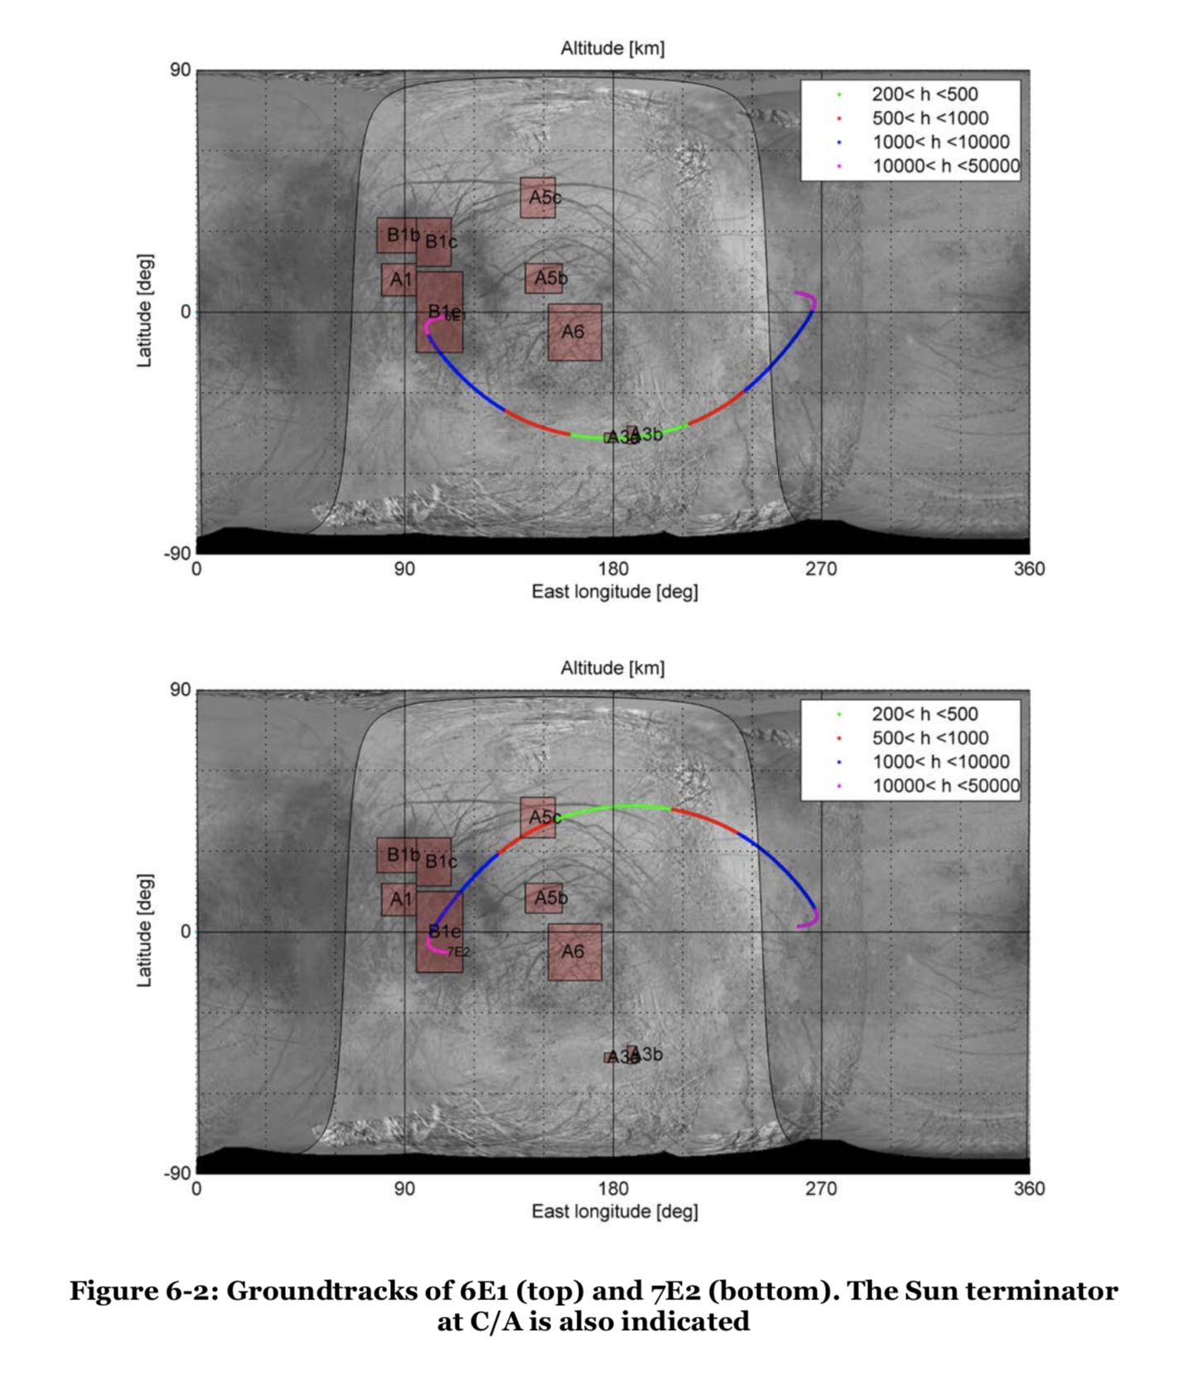
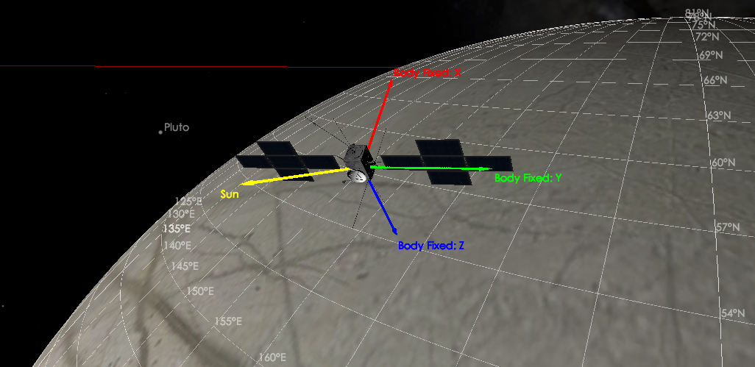
Simulation setup - Europa flybys
LT = 14:30,
Flybys are not in wake

Slide 16
Simulation setup – E2 CA
LT = 14:30,
Flybys are not in wake
Juice attitude for E2

Slide 17
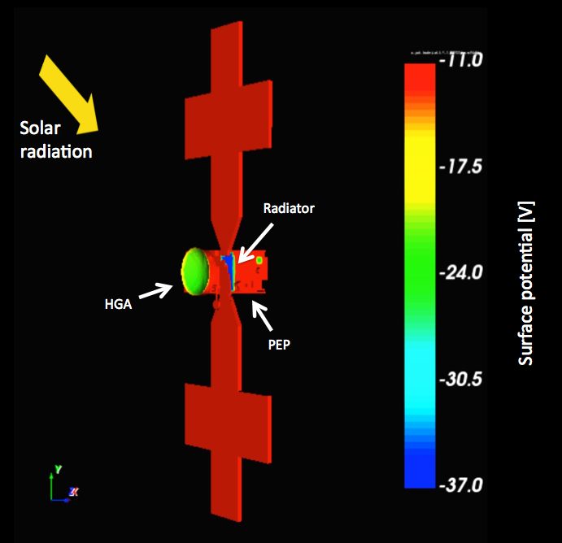
Results - Europa’s ionosphere, surface potential
n_{e} = 200 cm⁻³, T_{e} = 20 eV, T_{i} = 90 eV, Ion species O⁺
No hot electron component gives s/c -11 V, HGA -22 V and top vault radiator -37 V
Hot electron component, n_{e} = 1.3 cm⁻³ and T_{e} = 250 eV gives s/c -11 V, HGA -14 V and top vault radiator -24 V
Adding I_{ph} will not improve surface charging of top vault radiator
Solar panel orientation?

Slide 18
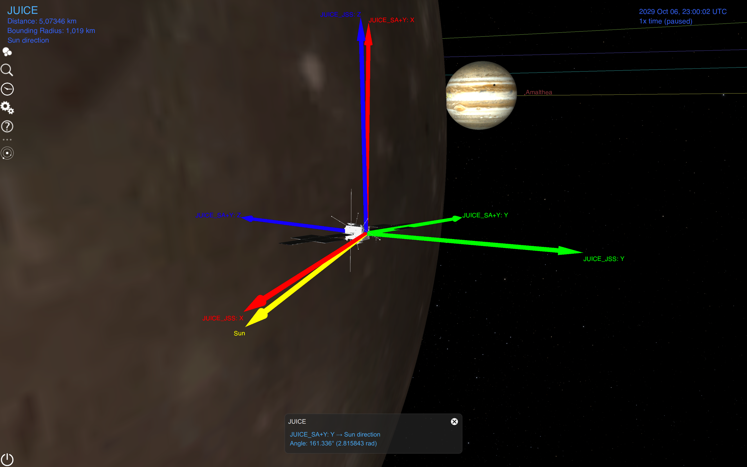
Simulation setup - Ganymede flyby 2G2
Sunlit s/c, angle between solar panel and Sun ~20°
CA, close to equatorial at 401 km
The solar panel orientation is not final

Slide 19
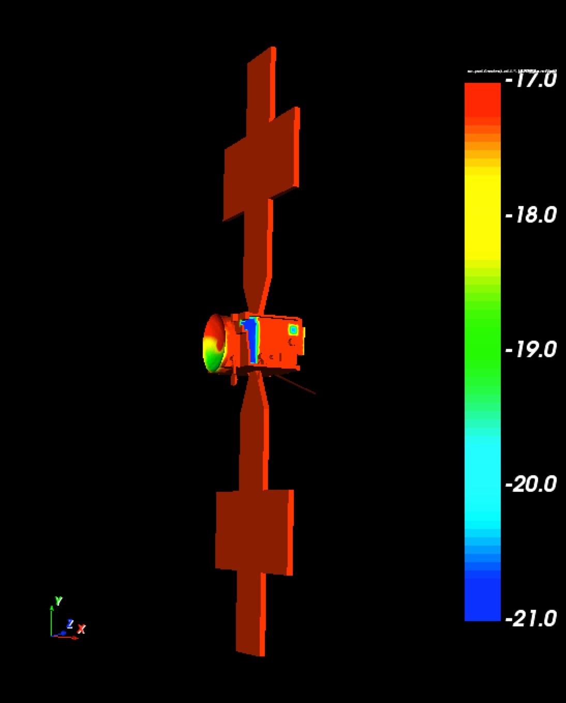
Results - Ganymede’s ionosphere, surface potential
n_{e} = 100 cm⁻³, T_{e} = 5 eV, T_{i} = 50 eV, Ion species O₂⁺
No hot electron component gives s/c -17 V, HGA -17 to -19 V and top vault radiator -21 V
T_{e} = 5 eV, but no simulation results available that includes a hot electron component, yet
Plasma flow and solar radiation direction

Slide 20
What’s next?
Juice spacecraft charging shouldn’t be a problem for most magnetospheric measurements
  Variability of the magnetospheric environment?
  Check high-latitude environment
Cold plasma measurements in the ionosphere of Europa will be limited
  Plume measurements?
  Impact of solar panel orientation?
Cold plasma measurements in the ionosphere of Ganymede will be limited
  Auroral particle measurements?
  Spacecraft charging in the auroral zone?
Callisto’s ionopshere?
Solar wind?

Slide 21
Extra slides
  SPIS overview
  Global parameters, references and fits
  Electron densities
  Electron temperatures
  Probed ion density
  Total currents on spacecraft and average surface potentials
  Charging including non-conductive surfaces, Z93C55, for 26.3 R_{J}

Slide 22
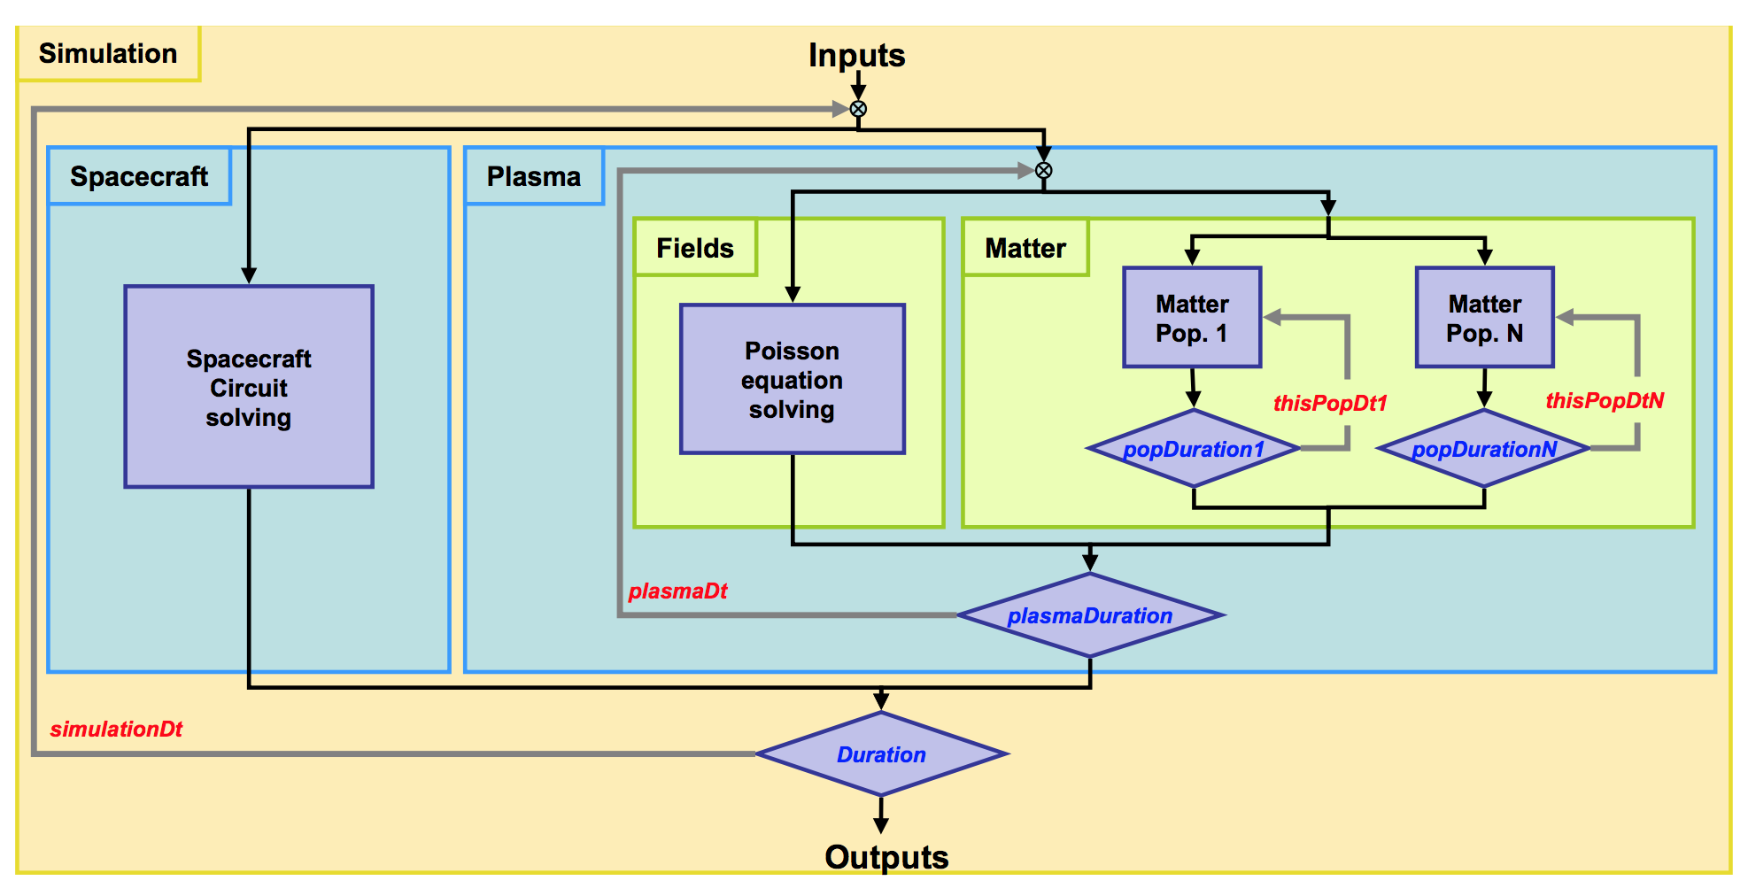
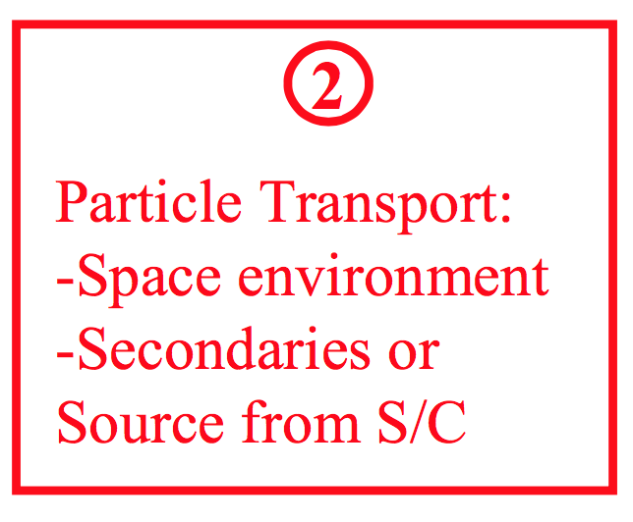
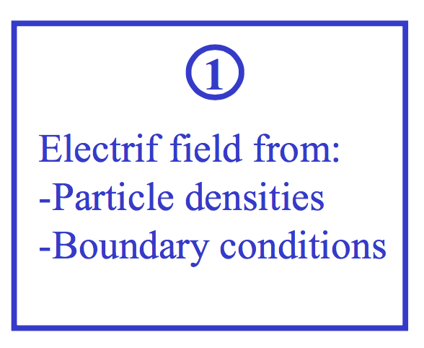
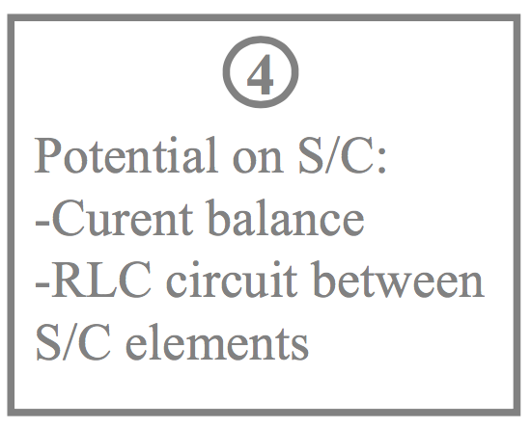
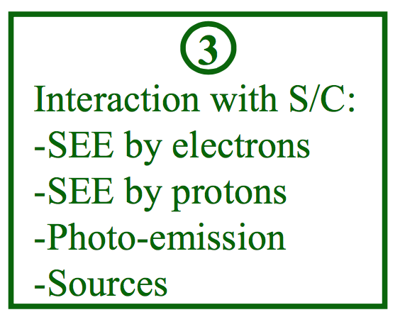
SPIS
Numerical time loop

Slide 23
Simulation setup – Global parameters
For 9.5 R_{J} (Europa at 9.38 (9.30-9.47) R_{J}, CA at 9.3 R_{J} ), hybrid, λ_{D} = 5 m, r_{g,i} = 45 km
Parameter | Value | Estimates and ranges | References
n_{e,c} | 50 cm⁻³ | 60 (50-80), 32 (26-104), 130, 108 (97-121), 120, 200 (18-250), fit 50 measured (7-200), (63-290), 18 (16-20), 50 (3-250), 19-53 | Sittler and Strobel 1987, Bagenal 1994, Neubauer 1998, Ansher 2001, Frank et al. 2002, Kivelson et al. 2004, Bagenal and Delamere 2011, Bagenal et al. 2015, Phipps and Withers 2017, Futaana et al. 2018, Garrett et al. in preparation
T_{e,c} | 20 eV | 25 (15-30), 19 (15-25), 18, (10-30), 32-37 | Sittler and Strobel 1987, Bagenal 1994, Neubauer 1998, Bagenal et al. 2015, Garrett et al. in preparation
n_{e,w} | 1.3 cm⁻³ | 1.3, 0.7-2.3 (2 component fit) | Fit to average electron energy spectrum, Garrett et al. in preparation
T_{e,w} | 250 eV | 250, 690-813 (2 component fit) | Fit to average electron energy spectrum, Garrett et al. in preparation
n_{e,h} | 0.08 cm⁻³ | 0.08, 0.08 (0.008-0.5) | Fit to average electron energy spectrum, Futaana et al. 2018
T_{e,h} | 2 keV | 2 keV, 1.2 keV (9 R_{J}), 200 eV, (200-1200), 2.9 (1-5.5) keV | Fit to average electron energy spectrum, Scudder et al. 1981, Bagenal 1994, Bagenal et al. 2015, Futaana et al. 2018
n_{i} | 51.38 cm⁻³ |  | Assuming n_{i} ≈ n_{e,tot}
T_{i} | 190 eV | 150 (120-170), 290 (280-300), 270, 370, 100 (50-400), fit 130 measured (30-600), (48-340), 120 (20-800) | Sittler and Strobel 1987, Bagenal 1994, Neubauer 1998, Frank et al. 2002, Kivelson et al. 2004, Bagenal and Delamere 2011, Bagenal et al. 2015, Futaana et al. 2018
v_{i,θ} | 100 km/s | 85, 90 (70-100), 105 (45-145) | Neubauer 1998, Kivelson et al. 2004, Futaana et al. 2018
Dominant ion species | O⁺ | (~32% O+, ~13% O++, ~6% S++), 13.7 amu, 18.5 amu, (~30% O+, ~14% S++, 12 % H++), (~30% O+,~13% S++, 7% O++, 18 amu) | Bagenal 1994, Neubauer 1998, Kivelson et al. 2004, Delamere et al. 2005, Bagenal et al. 2015
|v_{s/c}| | 17.2 km/s |  | JUICE orbit parameters (from N. Altobelli, SOC)
B | 420 nT | 420, 420, (370-460), 450 (423-480) | Kivelson et al 1997b, Showman and Malhotra 1999, Kivelson et al. 2004, Bagenal et al. 2015
The ranges include all data points measured within ± 0.1 R_{J} of 9.5 R_{J}, except for Garrett et al. where ± 0.5 R_{J} of 9.5 R_{J} was used

Slide 24
Simulation setup – Electron energy spectra for 9.5 ± 0.5 R_{J}
Fit to the average electron energy spectra from Voyager PLS, Galileo PLS and EPD (from APL) measurements recorded between 9 and 10 R_{J}, from T. Cassidy, LASP

Slide 25
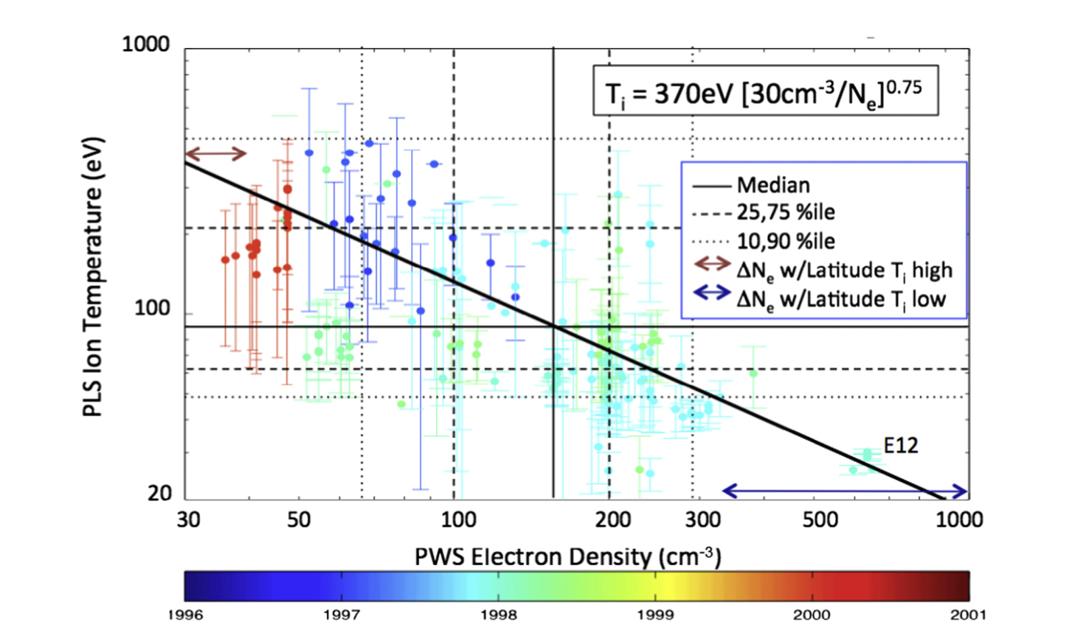
Simulation setup – Plasma density and ion temperature
Galileo PLS and PWS measurements
*
For radial distances from 8.8 to 9.9 R_{J}, Bagenal et al. 2015

Slide 26
Simulation setup – Global parameters
For 15 R_{J} (orbit of Ganymede), full PIC, λ_{D} = 105 m, r_{g,i} = 204 km
Parameter | Value | Estimates and ranges | References
n_{e,c} | 1 cm⁻³ | 3.7, 5.4 (4.7-6.2), 2.1-2.8, 5 (1-10), 1.2, fit 2 measured (0.2-2), 1.7 (0.3-8), 1-3.2 | Neubauer 1998, Ansher 2001, Frank et al. 2002, Kivelson et al. 2004, Barnhart et al. 2009, Bagenal and Delamere 2011, Futaana et al. 2018, Garrett et al. in preparation
T_{e,c} | 30 eV | 30, 100, 37-120 | Fit to average electron energy spectrum, Neubauer 1998, Garrett et al. in preparation
n_{e,w} | 0.2 cm⁻³ | 0.2, 0.2-24 (2 component fit) | Fit to average electron energy spectrum, Garrett et al. in preparation
T_{e,w} | 300 eV | 300, 483-2687 (2 component fit) | Fit to average electron energy spectrum, Garrett et al. in preparation
n_{e,h} | 0.04 cm⁻³ | 0.04, 0.04 (0.01-0.6) | Fit to average electron energy spectrum, Futaana et al. 2018
T_{e,h} | 3 keV | 3, 3 (1-6) | Fit to average electron energy spectrum, Futaana et al. 2018
n_{i} | 1.24 cm⁻³ |  | Assuming n_{i} ≈ n_{e,tot}
T_{i} | 400 eV | 360, 586-1638, fit 400 measured (50-1000), 400 (150-1500) | Neubauer 1998, Frank et al. 2002, Bagenal and Delamere 2011, Futaana et al. 2018
v_{i,θ} | 155 km/s | 180, 150 (95-163), 155 (95-205) | Neubauer 1998, Kivelson et al. 2004, Futaana et al. 2018
v_{r} | 5 km/s | (2-10) | Bagenal and Delamere 2011
Dominant ion species | O⁺ | 13 amu, 14 amu | Neubauer 1998, Kivelson et al. 2004
|v_{s/c}| | 13 km/s |  | JUICE orbit parameters (from N. Altobelli, SOC)
B | 110 nT | 120, 120, (64-113) | Kivelson et al 1996, Showman and Malhotra 1999, Kivelson et al. 2004
The ranges include all data points measured within ± 0.1 R_{J} of 15 R_{J}, except for Garrett et al. where ± 0.5 R_{J} of 15 R_{J} was used

Slide 27
Simulation setup – Electron energy spectra for 15 ± 0.5 R_{J}
Fit to the average electron energy spectra from Voyager PLS, Galileo PLS and EPD (from APL) measurements recorded between 14.5 and 15.5 R_{J}, from T. Cassidy, LASP

Slide 28
Simulation setup – Global parameters
For 26.3 R_{J} (orbit of Callisto), full PIC, λ_{D} = 430 m, r_{g,i} = 1330 km
Parameter | Value | Estimates and ranges | References
n_{e,c} | 0.12 cm⁻³ | 1.1, 0.23 (0.04-0.7), 0.15 (0.01-0.7), 0.11-1.2, fit 0.15 measured (0.02-0.4), 0.55-1.1, 0.12 (0.05-0.5), 0.04-0.6 | Neubauer 1998, Ansher 2001, Kivelson et al. 2004, Barnhart et al. 2009, Bagenal and Delamere 2011, Lindkvist et al. 2015, Futaana et al. 2018, Garett et al. in preparation
T_{e,c} | 35 eV | 100, 35, 40-313 | Neubauer 1998, Fit to average electron energy spectrum, Garrett et al. in preparation
n_{e,w} | 0.05 cm⁻³ | 0.05, 0.03-0.12 (2 component fit) | Fit to average electron energy spectrum, Garrett et al. in preparation
T_{e,w} | 350 eV | 350, 578-1729 (2 component fit) | Fit to average electron energy spectrum, Garrett et al. in preparation
n_{e,h} | 0.01 cm⁻³ | 0.01 (0.0006-0.1) | Futaana et al. 2018
T_{e,h} | 3 keV | 3 (1.8-6) | Futaana et al. 2018
n_{i} | 0.18 cm⁻³ |  | Assuming n_{i} ≈ n_{e,tot}
T_{i} | 650 eV | 200, 60 (10-100), fit 650 measured (30-1800), 650 (500-1200) | Neubauer 1998, Kivelson et al. 2004, Bagenal and Delamere 2011, Futaana et al. 2018
v_{i,θ} | 200 km/s | 175, 200 (130-280), 200 (200-300) | Neubauer 1998, Kivelson et al. 2004, Futaana et al. 2018
v_{r} | 35 km/s | (10-60) | Bagenal and Delamere 2011
Ion species | O+ | 15 amu, 16 amu | Neubauer 1998, Kivelson et al. 2004
|v_{s/c}| | 9 km/s |  | JUICE orbit parameters (from N. Altobelli, SOC)
B | 35 nT | 33, 35, (4-42) | Khurana et al. 1997, Showman and Malhotra 1999, Kivelson et al. 2004
The ranges include all data points measured within ± 0.1 R_{J} of 26.3 R_{J}, except for Garrett et al. where ± 0.5 R_{J} of 26.3 R_{J} was used

Slide 29
Simulation setup – Electron energy spectra for 26 to 27 R_{J}
Fit to the average electron energy spectra from Voyager PLS, Galileo PLS and EPD (from APL) measurements recorded between 26 and 27 R_{J}, from T. Cassidy, LASP

Slide 30
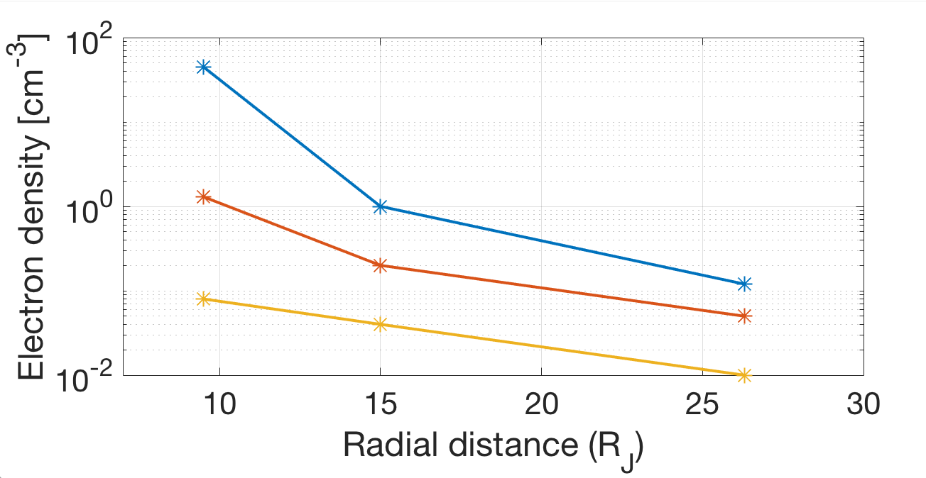
Electron densities
Densities for a cold (blue), warm (red), and hot (yellow) electron populations

Slide 31
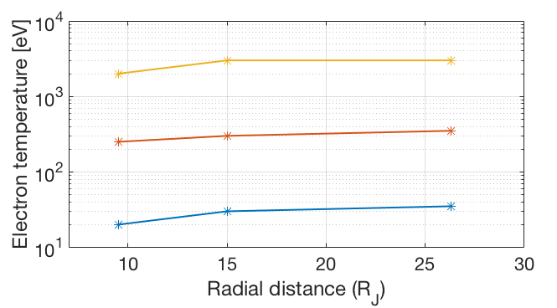
Electron temperatures
Temperatures for a cold (blue), warm (red), and hot (yellow) electron populations

Slide 32
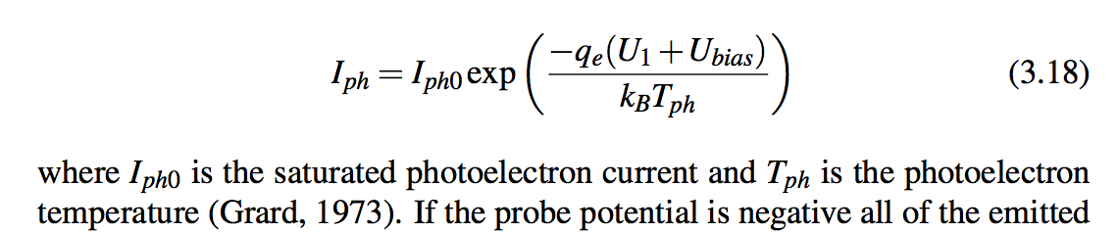
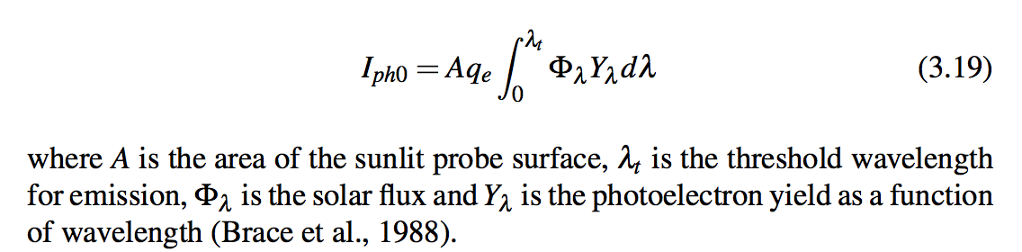
Photoelectron current

Slide 33
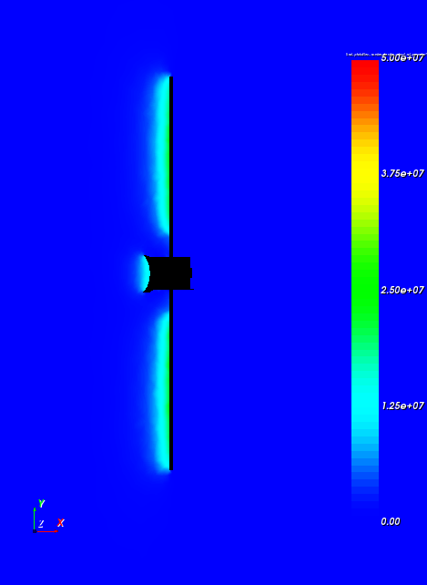
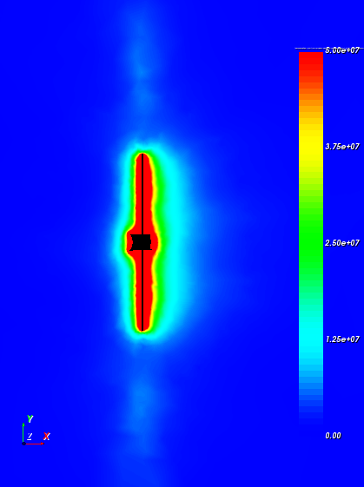
Results 9.5 R_{J}
Photoelectron density (cm⁻³)
Secondary electron density (cm⁻³)
50
37.5
25
12.5
0
50
37.5
25
12.5
0
n_{ph}= 14 cm⁻³
n_{se}= 105 cm⁻³

Slide 34
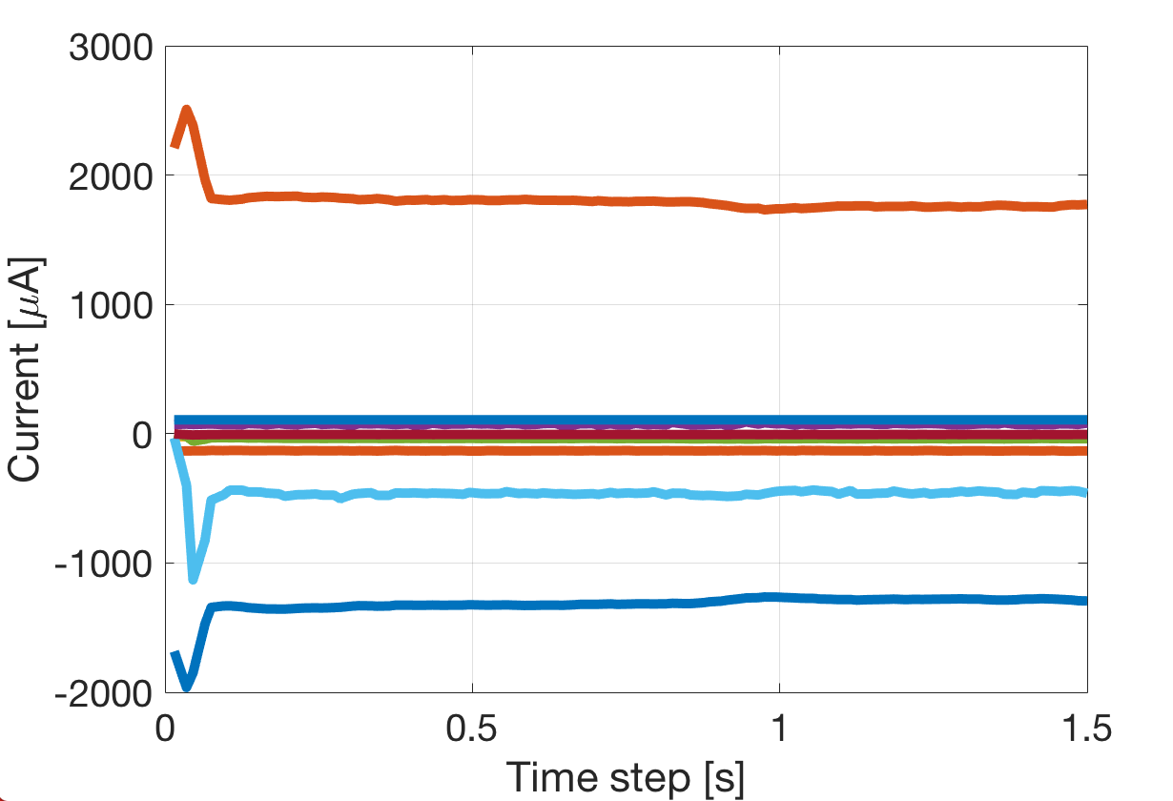
Results 9.5 R_{J}
Secondary electrons,
emitted
Photoelectrons, emitted
Ions
BS electrons
Hot electrons
Photoelectrons
Warm electrons
Secondary electrons
Cold electrons

Slide 35
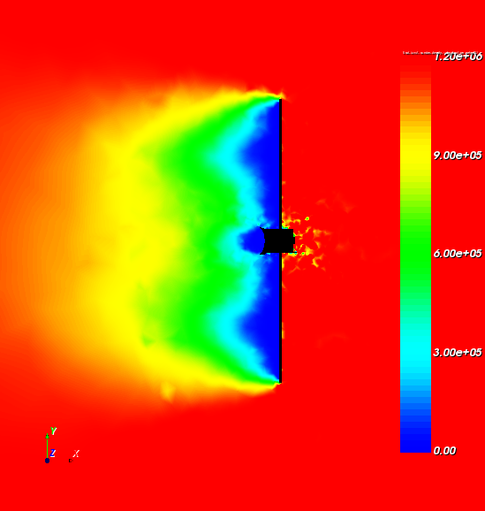
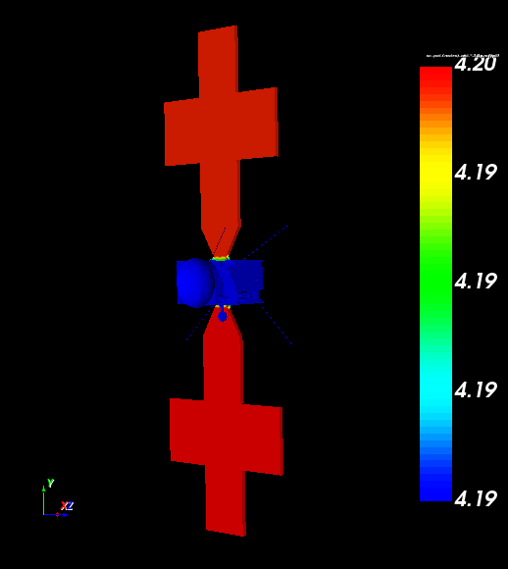
Results 15 R_{J} – Plasma wake structure, n = 1 cm⁻³
Ion density (cm⁻³)
Surface potential (V)
1.2
0.9
0.6
0.3
0
Plasma flow direction
Solar radiation

Slide 36
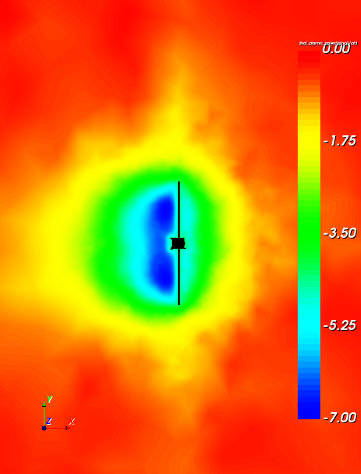
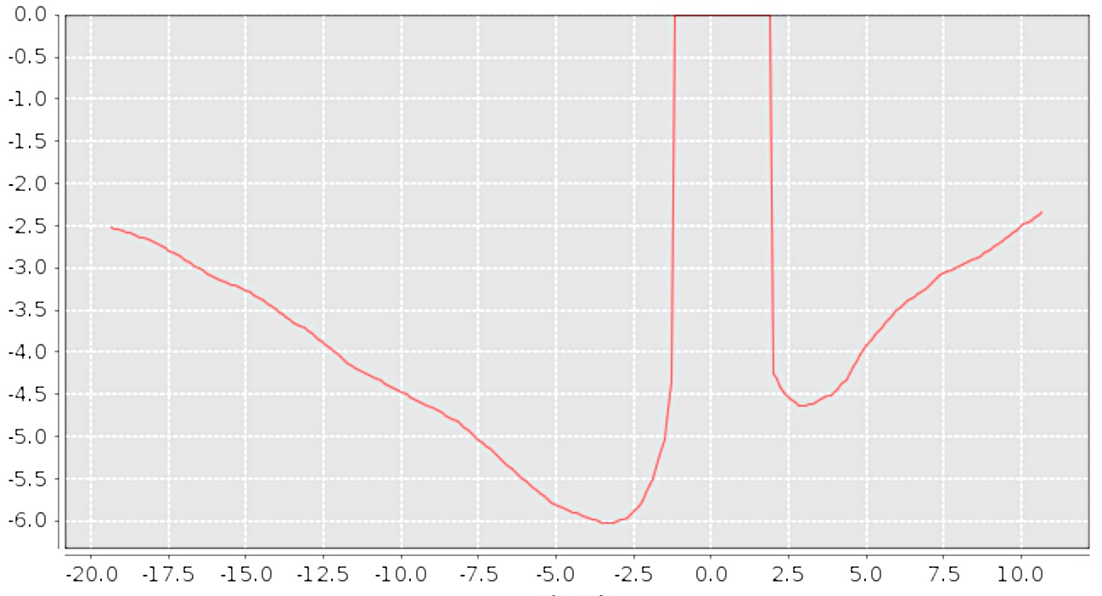
Results 9.5 R_{J}
Spacecraft potential (V)
Spacecraft potential (V)
Distance (m)

Slide 37
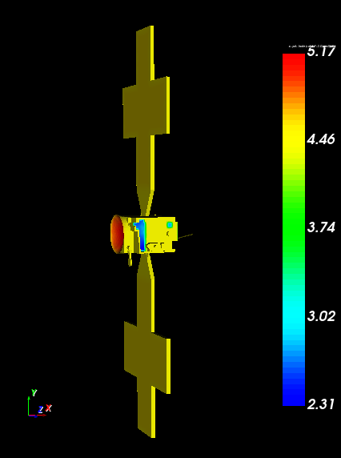
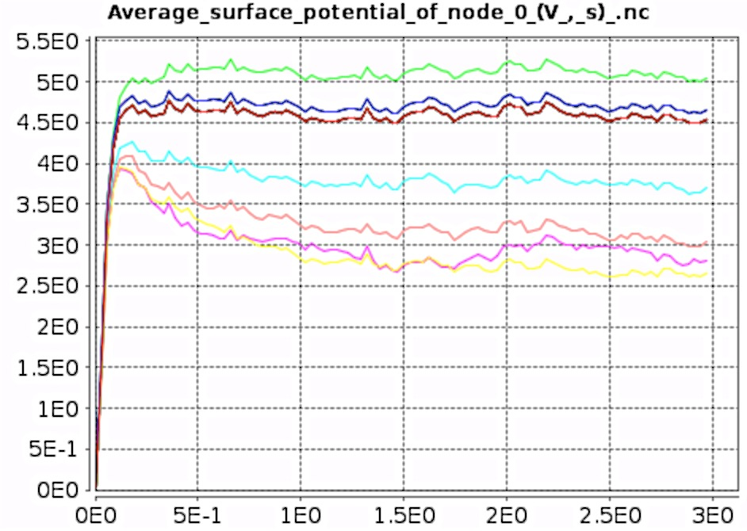
Results 15 R_{J} – Including non-conductive surfaces, Z93C55
Surface potential (V)
HGA
Spacecraft body
Radiators

Slide 38
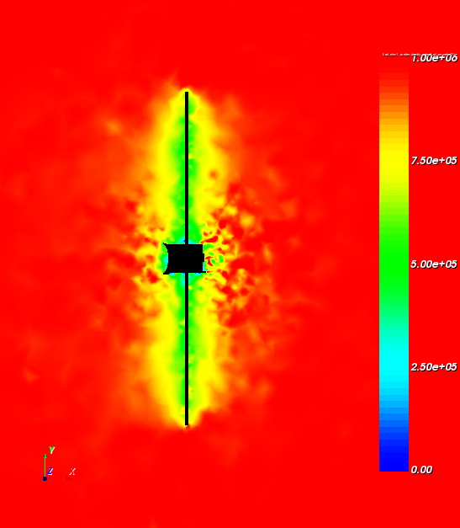
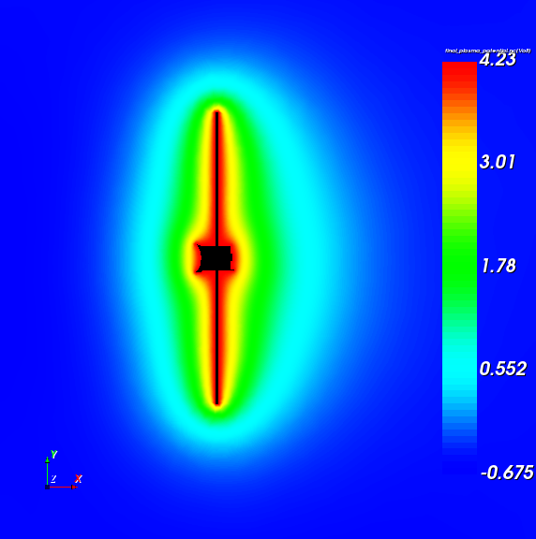
Results 15 R_{J}
Electron density (cm⁻³)
Spacecraft potential (V)
1
0.75
0.5
0.25
0

Slide 39
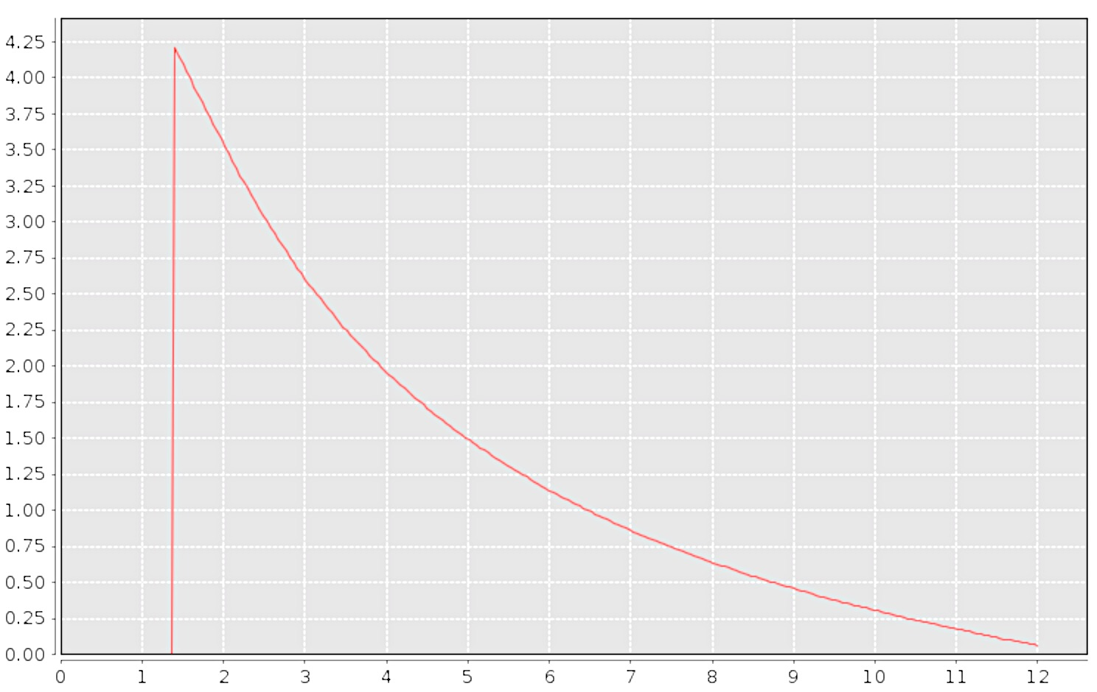
Results 15 R_{J}
Spacecraft potential (V)
Spacecraft potential (V)
Distance (m)

Slide 40
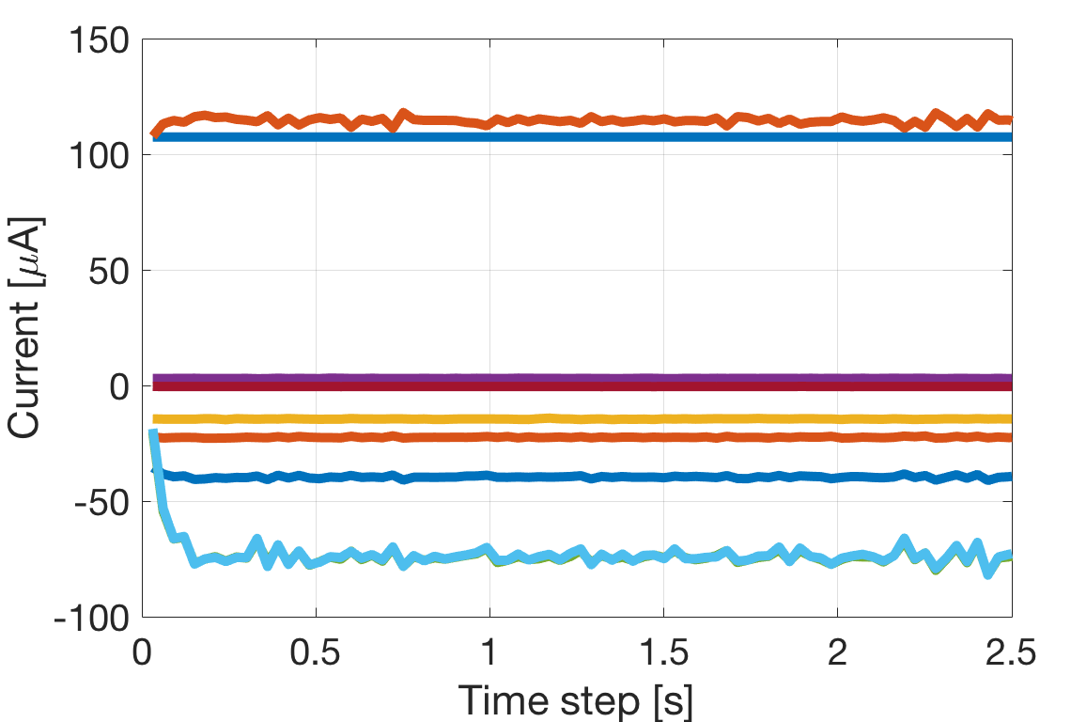
Results 15 R_{J}
Secondary electrons,
emitted
Photoelectrons,
emitted
Ions
BS electrons
Hot electrons
Warm electrons
Cold electrons
Photoelectrons
Secondary electrons

Slide 41
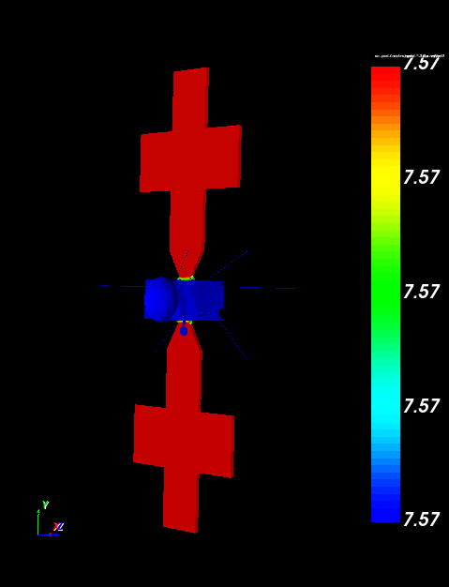
Results 26.3 R_{J} – Plasma wake structure, n_{e}=0.12 cm⁻³
Ion density (cm⁻³)
Surface potential (V)
0.18
0.135
0.09
0.045
0
Plasma flow direction
Solar radiation

Slide 42
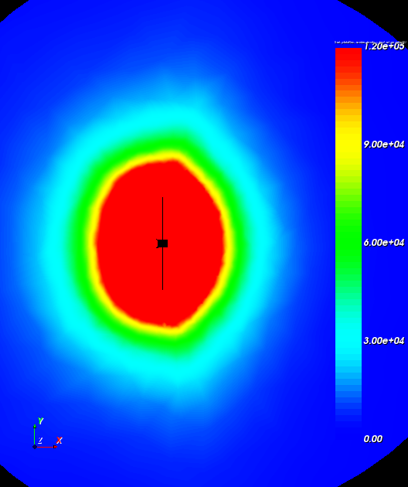
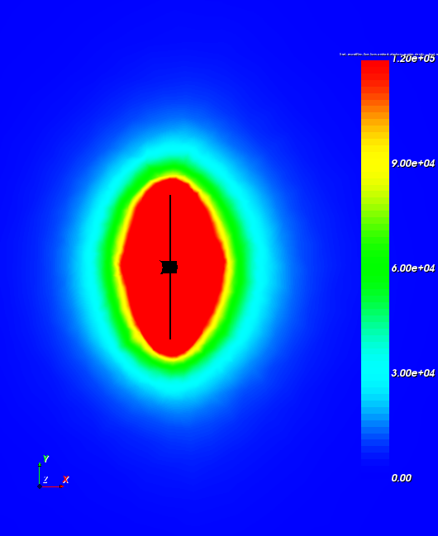
Results 26.3 R_{J}
Photoelectron density (cm⁻³)
Secondary electron density (cm⁻³)
0.12
0.09
0.06
0.03
0
0.12
0.09
0.06
0.03
0
n_{ph}= 15 cm⁻³
n_{se}= 2 cm⁻³

Slide 43
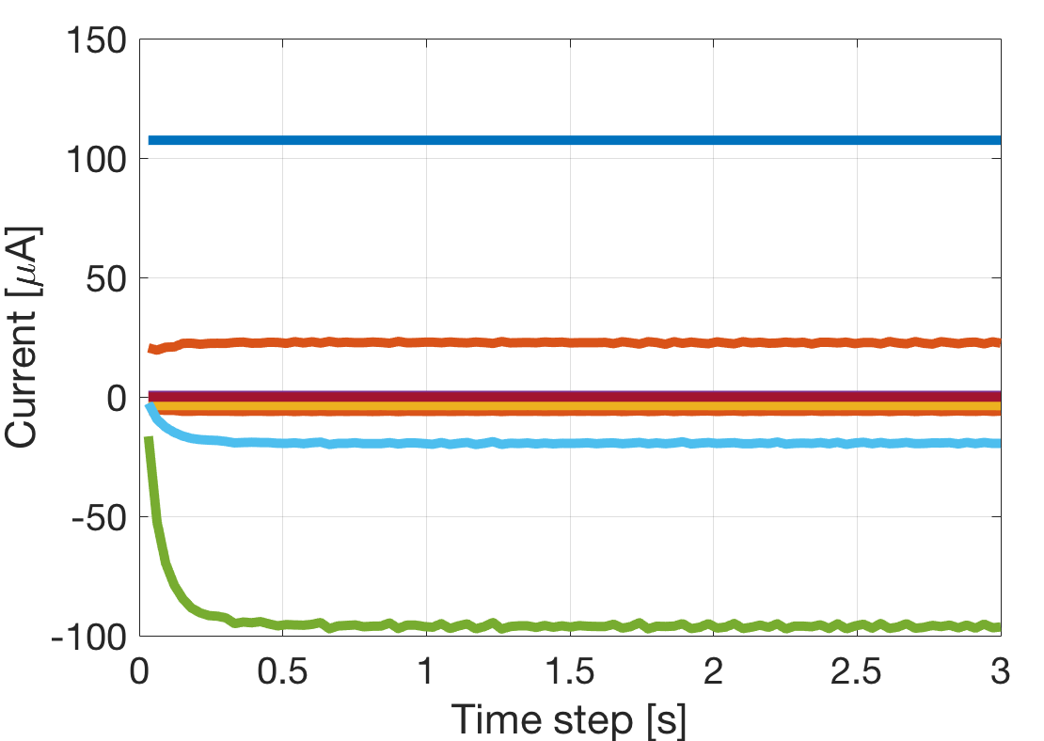
Results 26.3 R_{J}, full PIC
Photoelectrons,
emitted
Secondary electrons,
emitted
Ions
BS electrons
Hot electrons
Cold electrons
Warm electrons
Secondary electrons
Photoelectrons

Slide 44
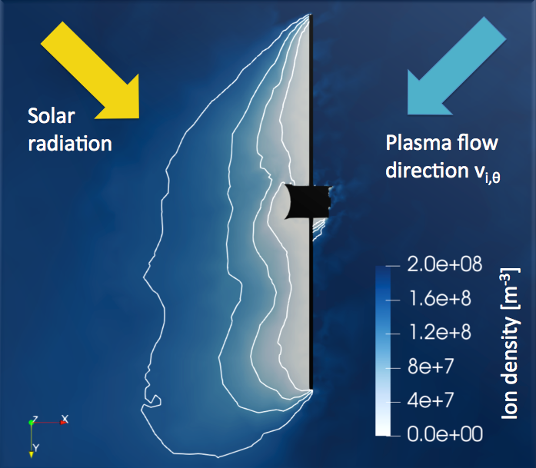
Results Europa’s ionosphere – ion wake

Slide 45
Simulation setup – Global parameters
For ionosphere of Europa at 403 km (2 flybys), r_{E} = 1562 km
Parameter | Value | Estimate and range | Reference
n_{e} | 200 cm⁻³ | 2500 (200-5000 from occultation), 110 (E6 at 586 km), 110 (E6 at 586 km) 600 (E12 at 201 km, possible plume) and 40 (E26) | Kliore et al. 1997, Gurnett et al. 1998, Kurth et al. 2001
T_{e} | 20 eV | 35 (E4) | Rubin et al. 2015
n_{i} | 200 cm⁻³ (n_{i} ≈ n_{e}) | 30 (E06 at 586 km), 25 (E4 and E26) | Paterson et al. 1999, Rubin et al. 2015
T_{i} | 90 eV | 260 (E06 at 586 km), 90 (E4) | Paterson et al. 1999, Rubin et al. 2015
v_{i,θ} | 60 km/s | 60 (E4) | Rubin et al. 2015
Ion species | O⁺ | O⁺, O⁺ (above ~300 km) | Paterson et al. 1999, Rubin et al. 2015
|v_{s/c}| | 17.2 km/s |  | Crema 3.2 trajectory data
Ambient Jovian B | 420 nT | 420, 440 | Showman and Malhotra 1999, Kivelson Moon/magnetosphere workhop 2019
Piled-up magnetic field | 480 nT | 500 (E4), 480 (at 513 km) | Rubin et al. 2015, Kivelson Moon/magnetosphere workhop 2019

Slide 46
Simulation setup – Global parameters
For ionosphere of Ganymede at 401 km (1.15 R_{G}), G1 and G2, R_{G} = 2631.2 (or 2634.1) km
Parameter | Value | Estimate and range | Reference
n_{e} | 100 cm⁻³ | 40-50 (at 835 km), 115, 100 (at 835 km) | Gurnett et al. 1996, Eviatar et al. 2001, Collinson et al. 2018
T_{e} | 5 eV |  | Discussion with Ronan Modolo
n_{i} | 100 cm⁻³ (n_{i} ≈ n_{e}) | 10-60 (simulated) | Carnielli et al. 2019
T_{i} | 50 eV | ~50, ~800-3000 (simulated) | Jia et al. 2009, Carnielli et al. 2019
v_{i,θ} | 65 km/s | ~50-80 (simulated) | Carnielli et al. 2019
Ion species | O2⁺ | O2⁺, O2⁺ | Eviatar et al. 2001, Carnielli et al. 2019
|v_{s/c}| | 13 km/s |  | Crema 3.2 trajectory data
Ambient Jovian B | 120 nT | 120, 120 | Showman and Malhotra 1999, Kivelson Moon/magnetosphere workhop 2019
Closed magnetic field lines | 500 nT | B_{eq} = 719 nT, 400 (at 835 km) and 900-1050 (at 400 km high latitude), 420 (at 835 km) | Kivelson et al. 2002, Jia et al. 2008, Collinson et al. 2018

Slide 47
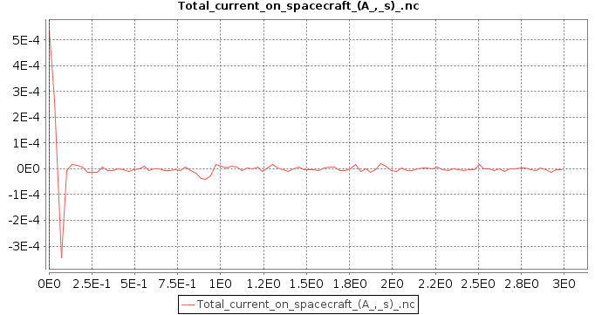
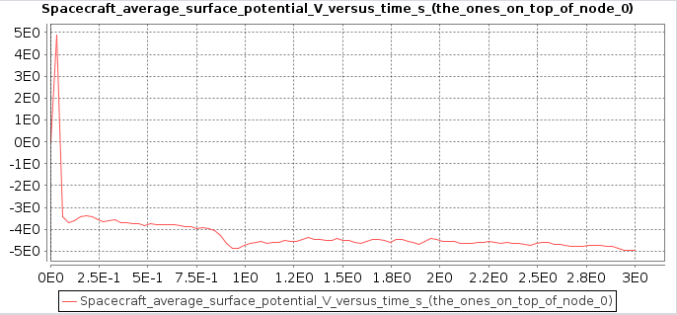
Results 9.5 R_{J}

Slide 48
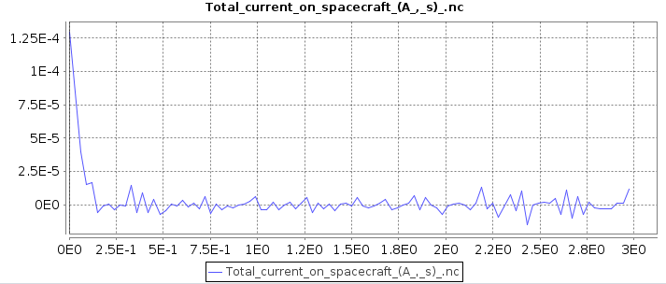
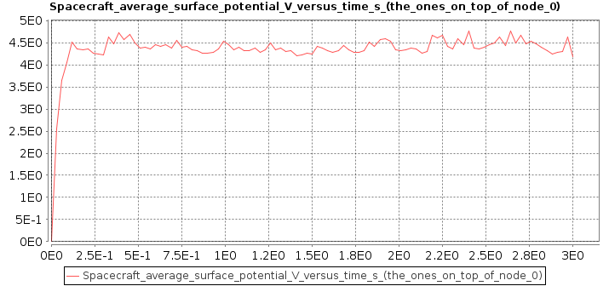
Results 15 R_{J}, full PIC

Slide 49


Results 26.3 R_{J}, full PIC

Slide 50

Results 26.3 R_{J}, full PIC

Slide 51


Results 26.3 R_{J} – Including non-conductive surfaces, Z93C55
Surface potential (V)
Spacecraft body
HGA
Radiator
Radiator
Radiator
Radiator

Slide 52


Results 26.3 R_{J} – Including non-conductive surfaces, Z93C55
Surface potential (V) with conductive surfaces
Surface potential (V) with dielectric materials

Slide 53
Simulation setup – Global parameters
For solar wind at 5.2 AU
Parameter | Value | Estimations | Reference
n_{e} | 0.25 cm⁻³ | 0.04-0.24, 0.2 and 0.29 | Alexeev and Belenkaya 2005, Ebert et al. 2014
T_{e} | eV
n_{e,h} | cm⁻³
T_{e,h} | keV
n_{i} | 0.25 cm⁻³ | 0.2 and 0.3 | Assuming n_{i} ≈ n_{e,tot}
T_{i} | 2.5 eV | 1.7 and 3.6 | Ebert et al. 2014
v_{x} | 420 km/s | 320-440, 391 and 496 | Alexeev and Belenkaya 2005, Ebert et al. 2014
Ion species | H+
Z_{Sun} | 0.037 |  | 1/(5.2 AU)²
|v_{s/c}| | km/s |  | JUICE orbit parameters (from Nicolas Altobelli)
B_{IMF} | 0.73 nT | 0.72 and 0.74 | Ebert et al. 2014

