Slide 1
Microthrusters and droplet dynamic modeling in SPIS : SPIS-µThrusters
M. Villemant¹, P. Sarrailh¹, S. Hess¹
¹ ONERA, The French Aerospace Lab, 31055 Toulouse Cedex, France
17th SPINE
19-20/02/2020

Slide 2
Presentation plan
Presentation of SPIS-µThrusters problematic
SPIS-µThrusters new abilities presentation
Preliminary simulation of micro-thruster in LISA space environment
SPIS-µThrusters validation cases
Conclusion and further studies

Slide 3
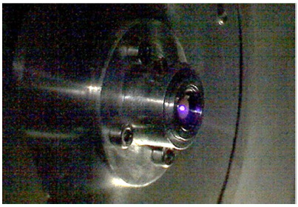
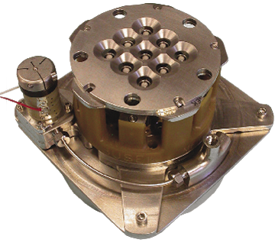
FEEP and colloids thruster technologies
Interest of space agencies and private companies for FEEP and colloids technologies
Figure 1 : Example of FEEP thruster (NanoFEEP, NASA)
Figure 2 : Example of colloid thruster (NASA)
Very high specific impulse
High compactness
Table 1 : In-FEEP thruster characteristics [1]
Specific impulse | 1600-8000 s
Thrust | 0.1-100 µN
Total thruster mass | 2.5 Kg
Total power supply | 13 W
Low mass
Droplets emission
Low thrust
3

Slide 4
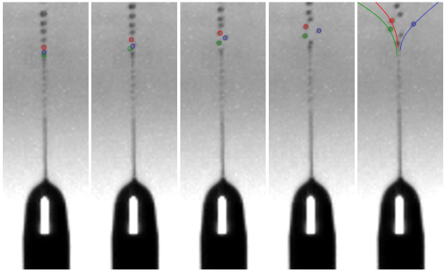
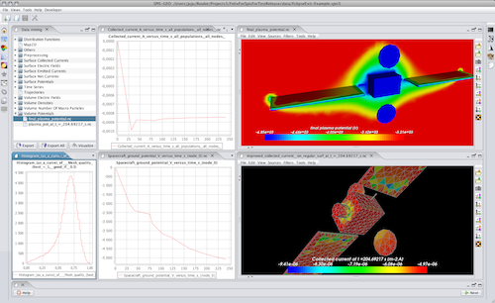
One of the main problems of FEEP and colloids : droplets emission
Satellite surface contamination by droplets
FEEP ⇒ use of liquid metal ⇒ satellite surface metallization (solar panels, optics, etc.)
Colloids ⇒ Complex organic molecules ⇒ Chimical reaction at satellite surface
Figure 3 : Example of droplet emitted from a FEEP thruster
Droplet behaviour around satellites body is a topic interest for space agencies and industrials
Need for simulation of droplet satellite body interaction
⇒ SPIS software
Figure 4 : SPIS software interface
4

Slide 5
Droplets evolution and interactions with spacecraft body and environment
Droplets charging
Droplets
Surface contamination
Droplets splitting
Evaporation
Neutrals
Surface contamination
Interaction with the environment
Ionization
Surface contamination
Charge exchange ions
Surface charging
Surface erosion
Complex interaction between droplet populations, spacecraft body and environment
Need to take these phenomena into account in satellites simulations
5

Slide 6
Miscellaneous models implemented in SPIS-µThrusters
Mass fraction of the emitted species
Micro-Thrusters emission models
Energy and angular distribution of the emitted species
Droplets mass, charge and radius distributions
Droplets temperature changes
Droplets thermal model
Droplets evaporation
Outgassing
Droplets solidification
Droplets collection
Droplets interactions with spacecraft surfaces
Droplets erosion
Droplets rebounds
Spacecraft surfaces temperature taken into account
Droplets evaporation on surfaces

Slide 7
SPIS-µThrusters software new abilities

Slide 8
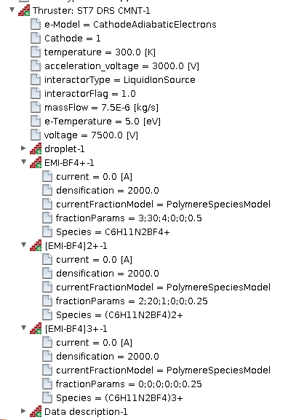
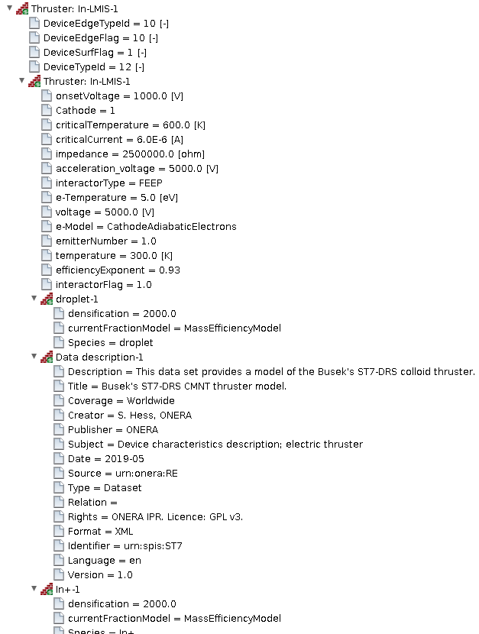
Setting of electrospray and FEEP thrusters
8

Slide 9
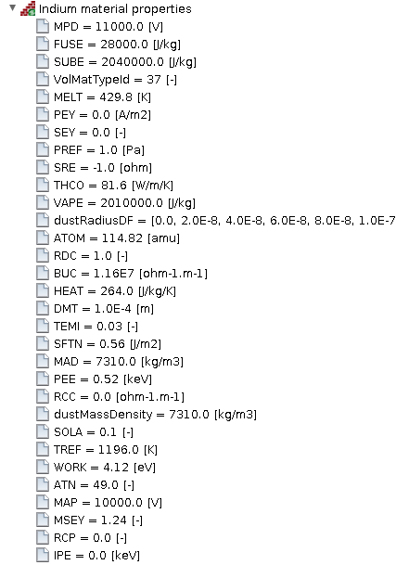
Setting of micro-thrusters propellants
Definition of emitting surfaces materials properties:
For colloids thruster:
EMI-BF₄
EMI-TfN₂
For FEEP thruster:
Caesium
Indium
9

Slide 10
Experimental data on propellant material
Parameter | EMI-BF₄ | EMI-Tf₂N | Indium | Caesium
SFTN: superficial tension [J/m²] | 0.0452 | 0.0349 | 0.56 | 0.06
dustRadiusDF: distribution of droplets [m] | - | - | - | -
SUBE: sublimation energy [MJ/kg] | 0.8 | 0.41 | 2.04 | 0. 53
VAPE: vaporization energy [MJ/kg] | 0.75 | 0.35 | 2.01 | 0. 51
FUSE: fusion energy [kJ/kg] | 48 | 58 | 28 | 16
MELT: fusion temperature [K] | 285.75 | 277.75 | 429.75 | 301.6
WORK: Work function [eV] | - | - | 4.12 | 1.95
THCO: thermal conductivity [W/M/K] | 0.2 | 0.130 | 81.6 | 35.9
HEAT: specific heat [J/kg/K] | 1281 | 1290 | 264 | 240
PREF: pressure reference [Pa] | 0.013 | 0.0062 | 1 | 1
TREF: temperature reference [K] | 300 | 441.7 | 1196 | 418
SOLA: sun light absorbance [-] | 0.1±0.05 | 0.1±0.05 | 0.1±0.05 | 0.1±0.05
RDC: relative dielectric permitivity | 12.9 | 12.2 | 1 | 1
BUC: electric bulk conductivity [S/m] | 1.4 | 0.88 | 11.6.10⁶ | 4.89.10⁶
MAD: material density [kg/m³] | 1294 | 1520 | 7310 | 1879
TEMI: thermal emissivity | 0.5? | 0.5? | 0.03 | 0.03
PEY: photo emission yield [A/m²/F₀] | missing | missing | missing | missing
SRE: surface resistivity[W] | 1,4.10⁹ | 1,8.10⁹ | -1 (∞) | -1 (∞)
10

Slide 11
Thruster information displayed

Slide 12
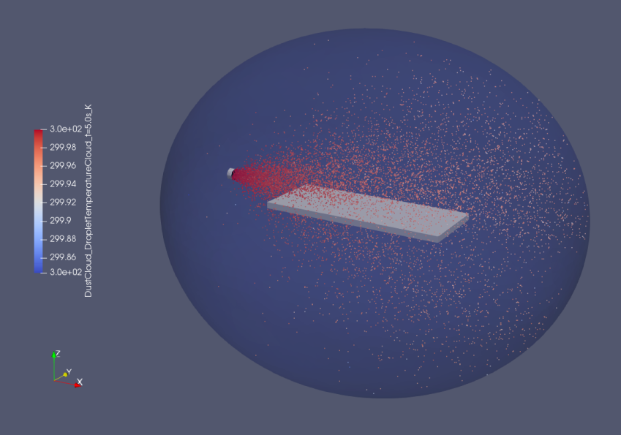
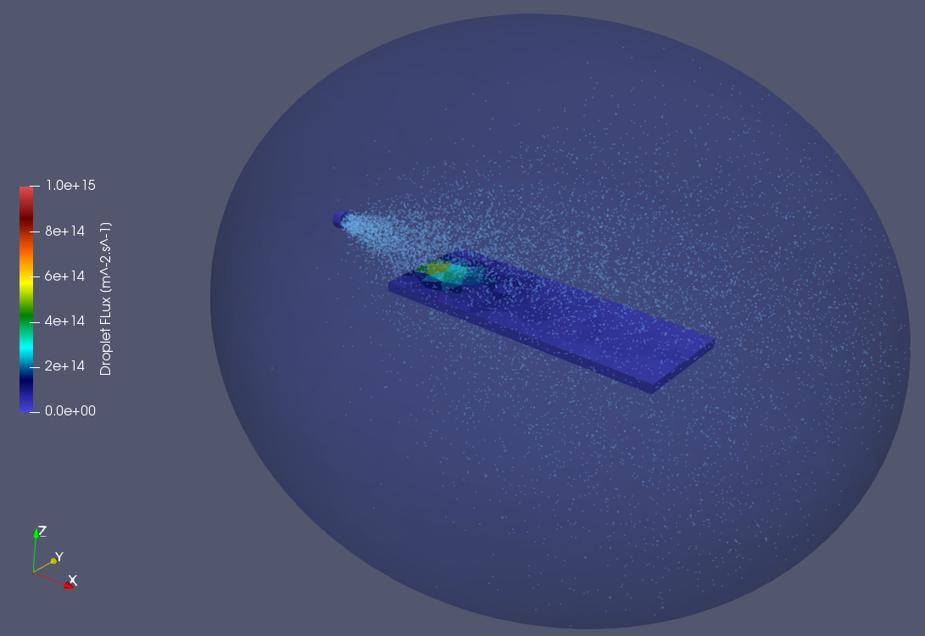
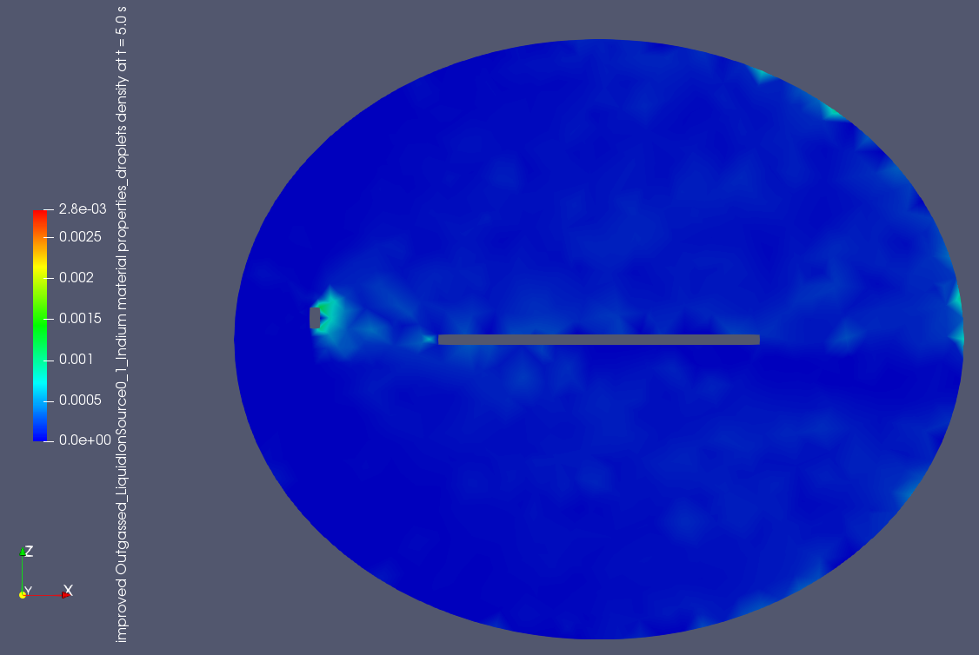
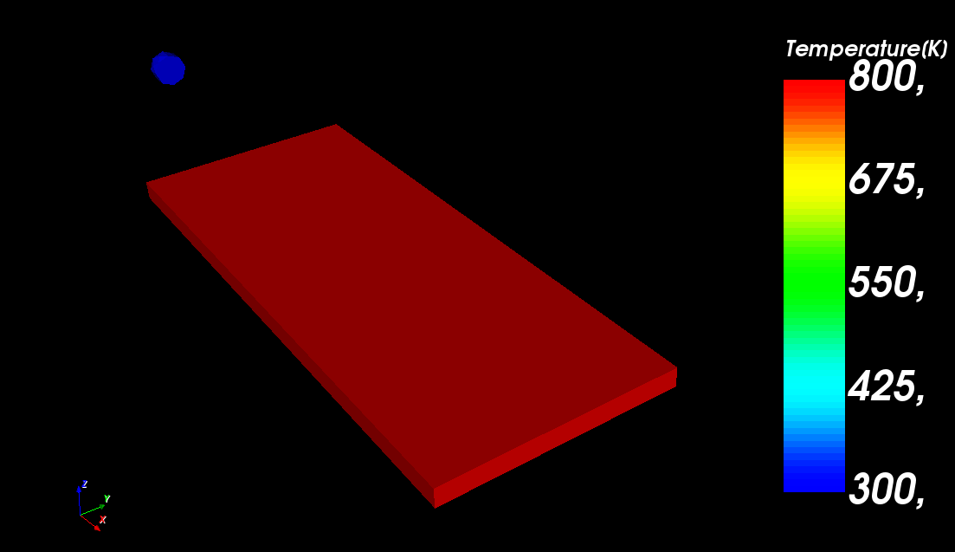
Data output specific to droplets simulations
Droplets cloud of points:
Droplet flux on spacecraft surfaces
Droplet outgassing
Spacecraft surfaces temperature
12

Slide 13
Example of contamination modelling on a spacecraft by FEEP and colloids thrusters

Slide 14
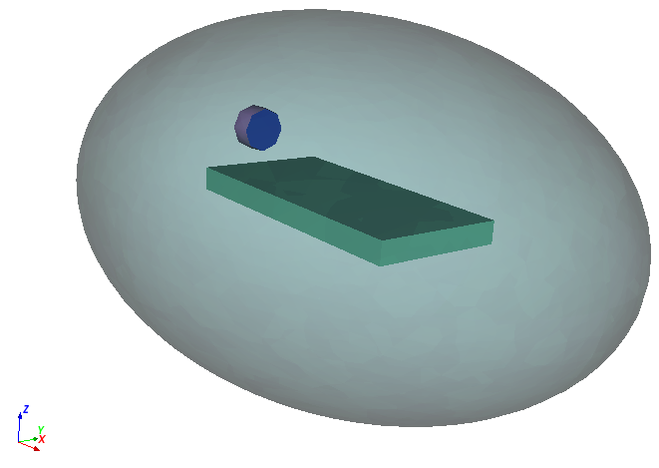
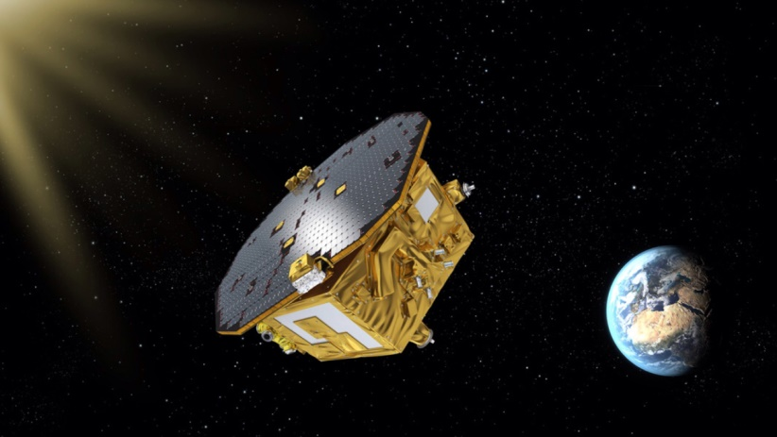
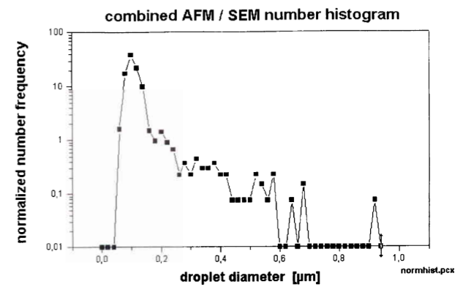
Simulation initialization
Figure 6: Artist concept of LISA pathfinder satellite
Emitted droplets and plasma characteristics extracted from experimental data
Figure 5: Contamination test case simulation geometry
Environment plasma representative of LISA mission
1 AU from the sun
Solar wind electrons and protons:
Density : $7 cm^{−3}$
Temperature : $10 eV$
Figure 7: Measured distribution of emitted droplet by the InFEEP thruster as a function of droplet radius
14

Slide 15
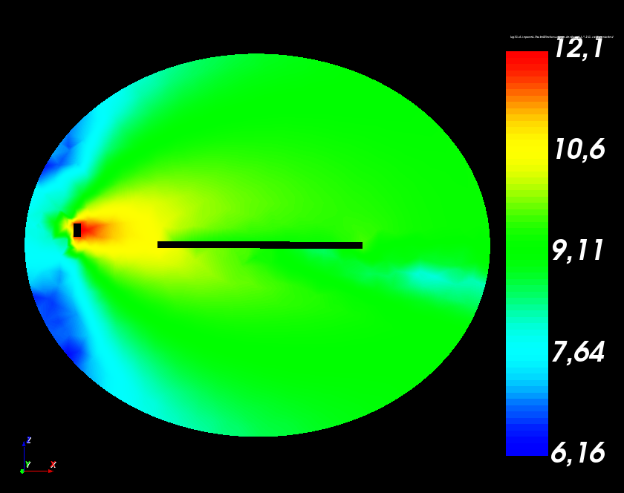
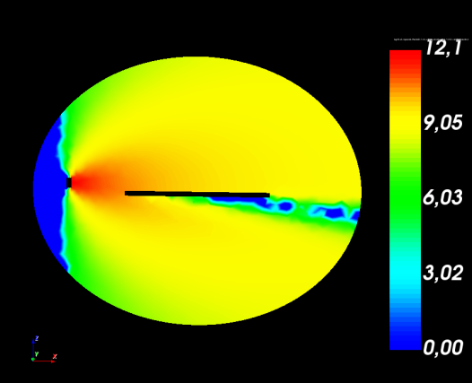
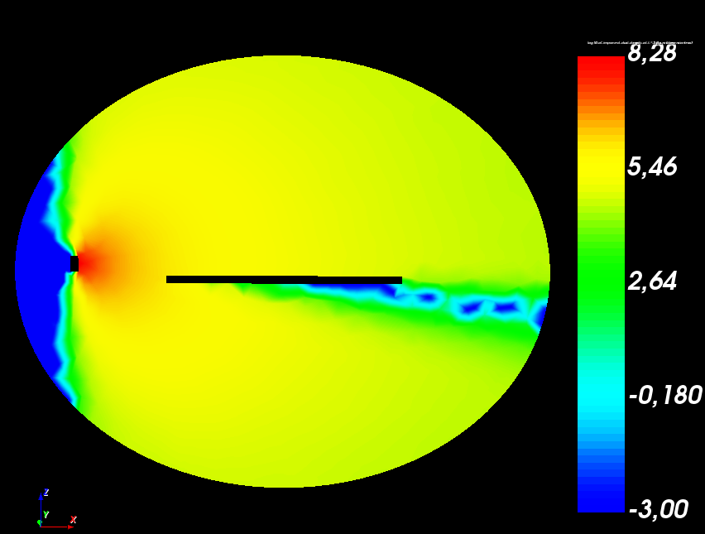
FEEP simulation : Results analysis
Electrons
In⁺
Droplets
Figure 8 : densities of cathode electrons (right), thruster ions (center) and droplets (right) in log(m-3).
Ability of SPIS software to simulate droplets dynamic
Non negligible divergence of droplet flow from the thruster
Spacecraft body contamination by FEEP droplets could be a real threat

Slide 16
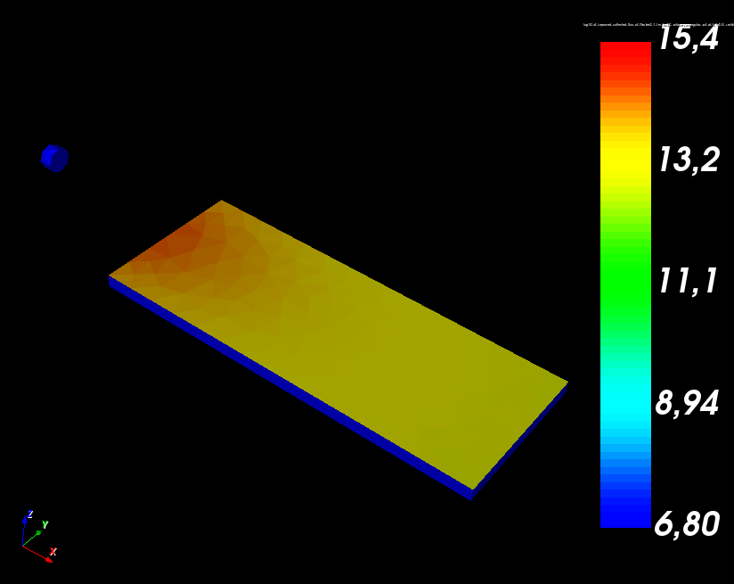
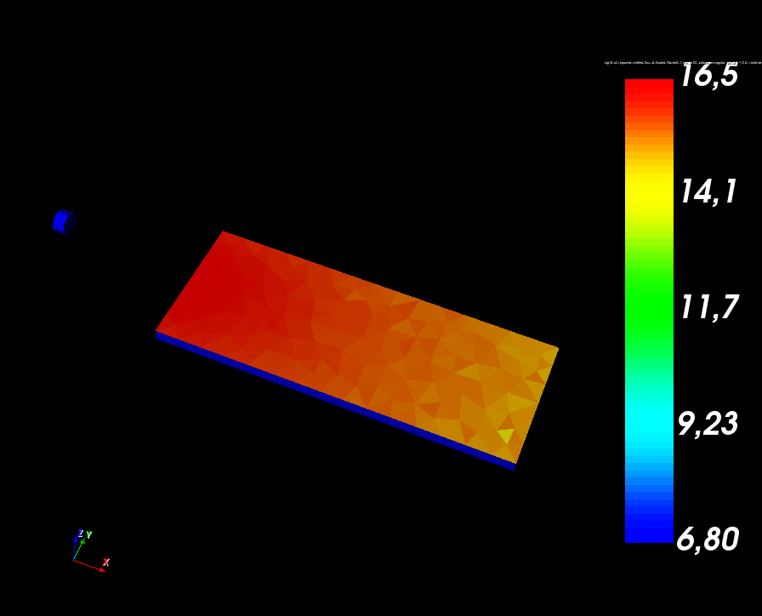
FEEP simulation : Erosion simulation due to In⁺ ions impact
Figure 10: In+ ion flux on the plate surface [log of ion.m-2.s-1]
Figure 11: eroded product flux, in log of molecule.m-2.s-1
SPIS ability to model spacecraft surface erosion and eroded product emission from spacecraft surface
Non-negligible erosion of spacecraft surface by FEEP thruster

Slide 17
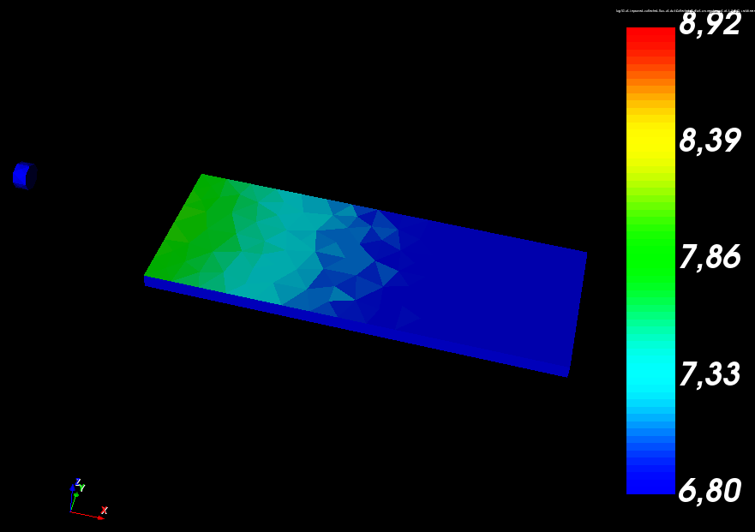
FEEP simulation : Spacecraft body contamination by droplets
Figure 12 : flux of droplet deposited on the plate [log of droplet.m-2.s-1]
Non-negligible contamination of spacecraft body by droplets

Slide 18
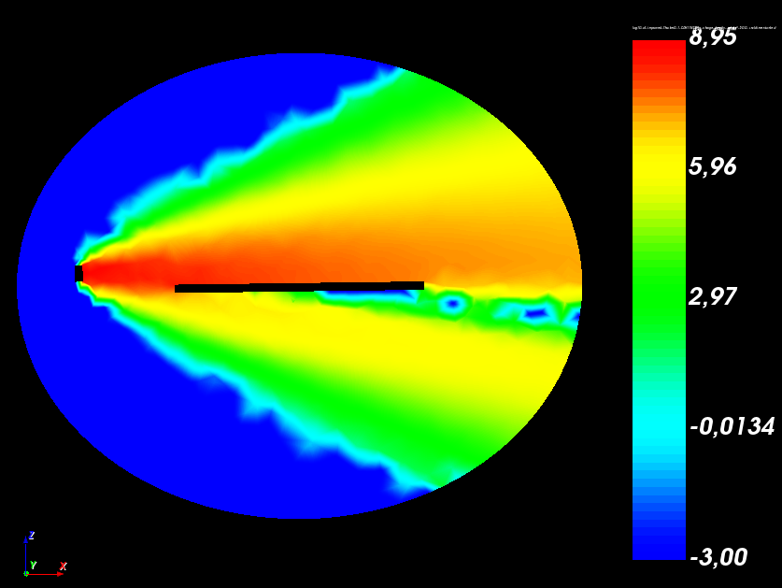
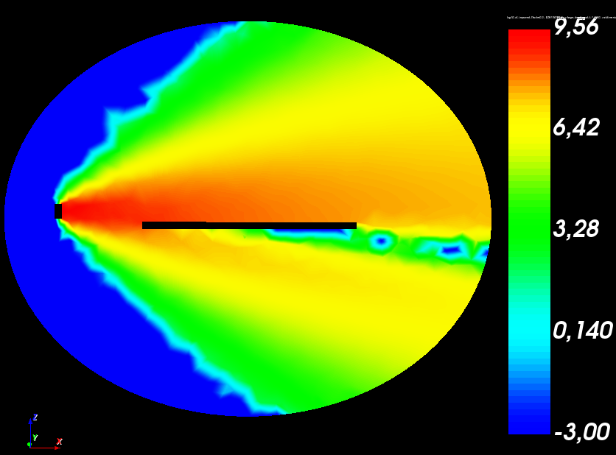
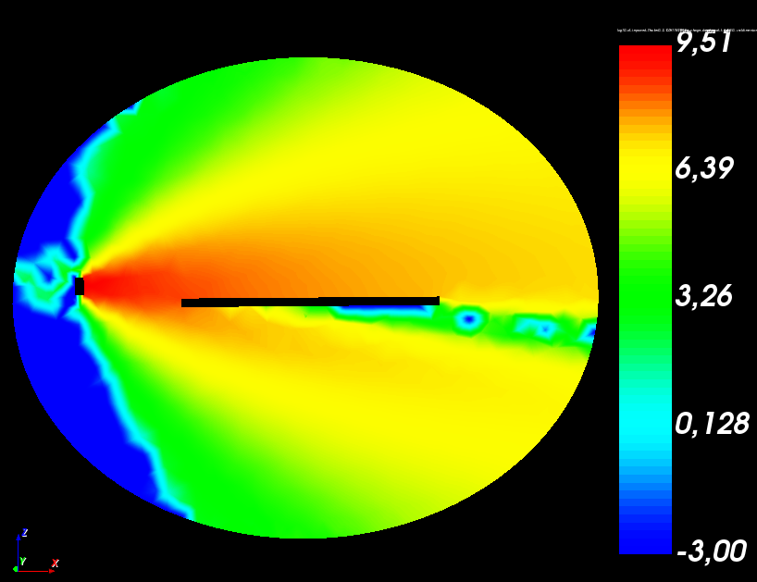
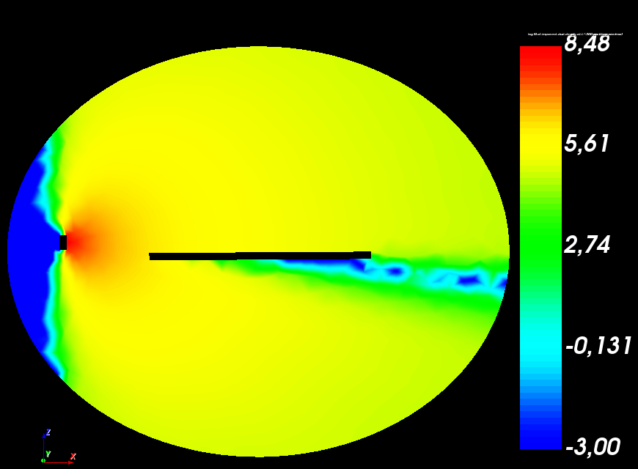
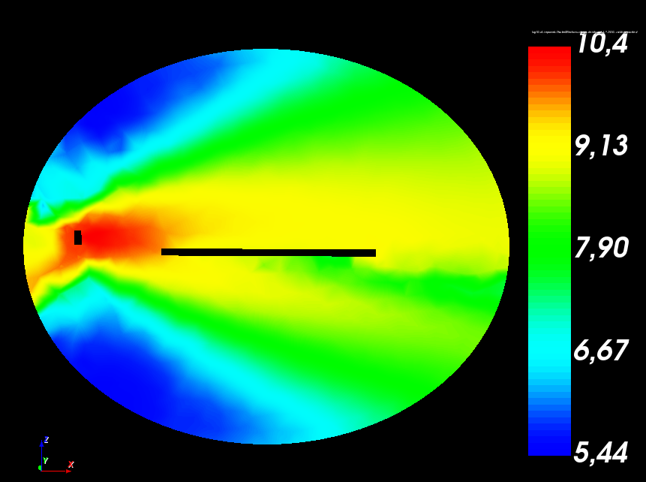
Colloids simulation : emitted species densities
EMI-[BF₄]⁺
EMI-[BF₄]²⁺
EMI-[BF₄]³⁺
Droplets
Electrons
SPIS ability to model the different species emitted by a colloid thruster
Similar densities in the volume for monomers, dimers and trimers
Figure 13 : Densities of (EMI-BF4)+, (EMI-BF4)2+, (EMI-BF4)3+, EMI-BF4 droplets and cathode electrons
Figure 13 : From top to bottom : densities of (EMI-BF4)+, (EMI-BF4)2+, (EMI-BF4)3+, EMI-BF4 droplets and cathode electrons

Slide 19
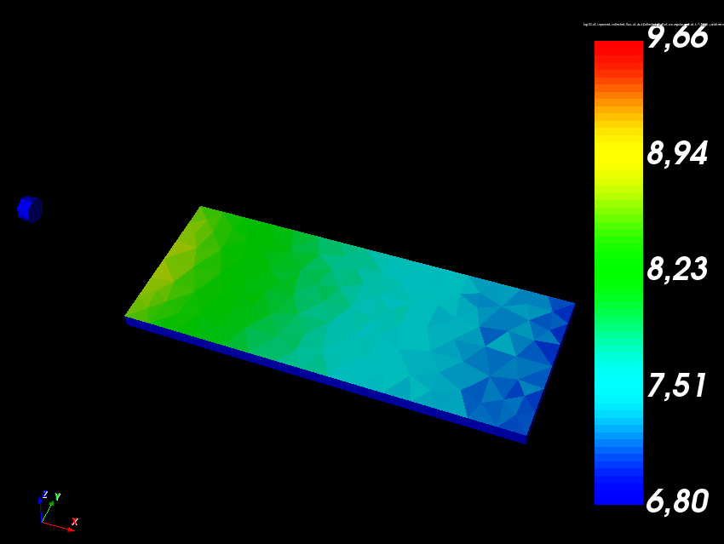
Colloids simulation : droplets deposition on spacecraft body
Figure 14 : flux of droplet deposited on the plate [log of droplet.m-2.s-1]
Non-negligible contamination of spacecraft body by droplets
Comparable contamination to Indium in FEEP thrusters
Figure 13 : From top to bottom : densities of (EMI-BF4)+, (EMI-BF4)2+, (EMI-BF4)3+, EMI-BF4 droplets and cathode electrons

Slide 20
SPIS-µThrusters validation cases

Slide 21
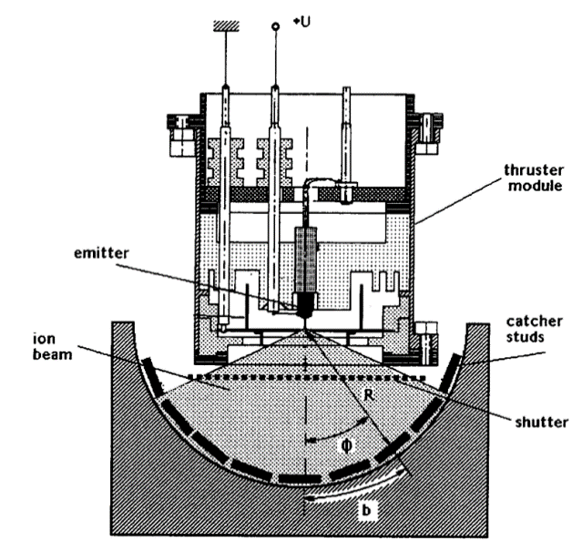
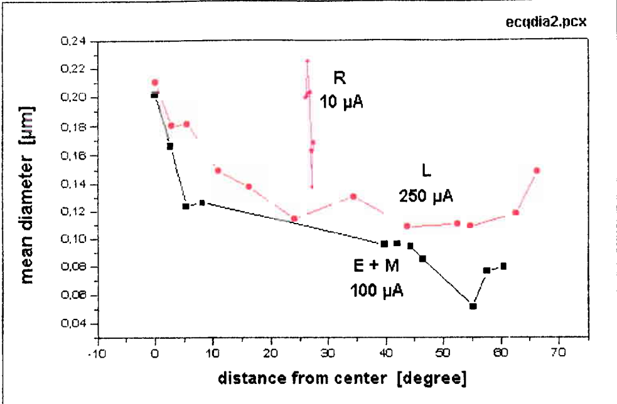
LMIS FEEP thruster modelling
Comparison between SPIS simulation and experimental data from ESA
FEEP current measurement and comparison to FEEP model
Angular distribution of emitted current

Slide 22
Geometry data on LMIS and justification on non-available data
Symbol | Definition | Value (mm)
$$r_{FC}$$ | Radius of FEEP case | 7,5
$$l_{FC}$$ | Length of FEEP case | 10
$$r_{F,app}$$ | Radius of FEEP aperture | 5
$$t_{F,app}$$ | Thickness of FEEP aperture | 1,5
$$w_{p}$$ | Plates width | 1
$$l_{p}$$ | Plates length | 5
$$t_{p}$$ | Plates thickness | 0.3
$$N_{p}$$ | Number of plates | 12
$$d_{F−p}$$ | Distance between FEEP and plates | 40
$$θ_{p}$$ | Angle between plates | 15°
$$r_{VC}$$ | Radius of the vaccuum chamber | 50
$$h_{VC}$$ | Height of the vacuum chamber | 200
$$L_{gap,VC}$$ | Gap between vacuum chamber and thruster | 30
: Data extracted from literature
: Data deduced from literature
: Data chosen arbitrary

Slide 23
LMIS other data
All the nodes grounded
Thruster selected : Thruster : In-LMIS
Thruster Material : Indium Material Properties
No cathode
Simulations boundaries grounded and considered as perfectly absorbing for incident particles.
Chosen emission current :
100 µA ⇒$V_{offset}=1100 V$
250 µA ⇒ $V_{offset}=1700 V$

Slide 24
Results on LMIS ESA experiment

Slide 25
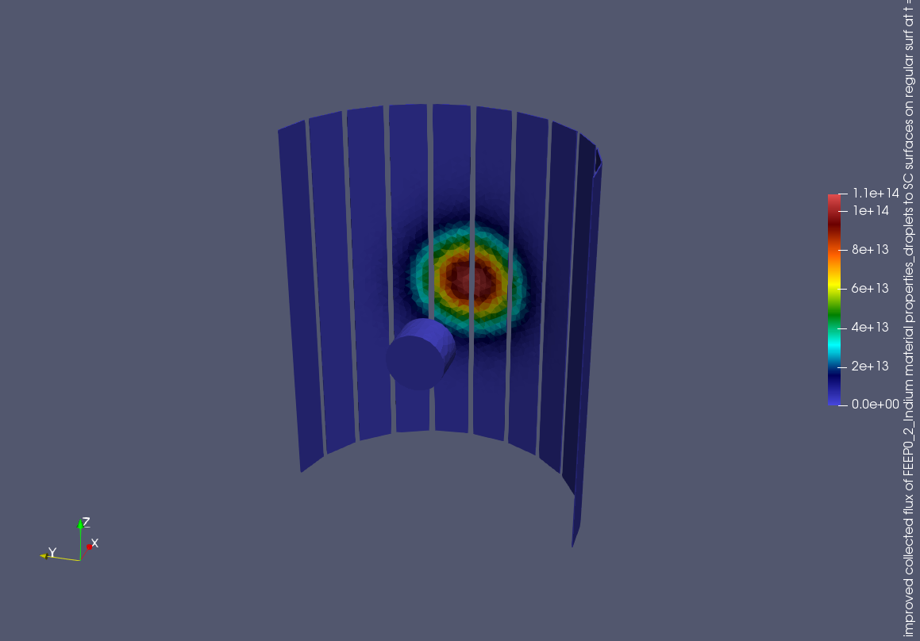
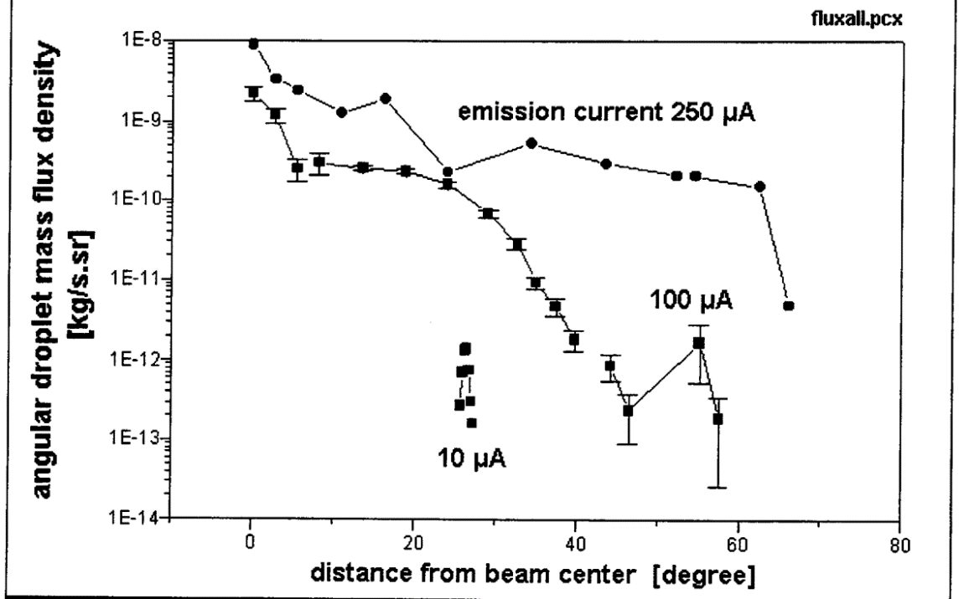
Results on LMIS ESA experiment comparison with simulations: droplet massflow to the surface
$$<m_{d}> =3.0×{10}^{−17}kg$$
$$S=5.0 mm^{2}$$
$Ω =2×\frac{15}{180}×π=0,52 sr$
Scale factor equal to : $3.0×{10}^{−22}$ to compare with a ratio of ${10}^{−23}$
$$Γ_{d}\left(θ=0°\right)=1.1×{10}^{14} m^{−2}.s^{−1}$$
$$Γ_{d}\left(θ=30°\right)=1.0×{10}^{13} m^{−2}.s^{−1}$$
$$Q_{d}\left(θ=0°\right)=1.1×{10}^{−9} kg.sr^{−1}.s^{−1}$$
$$Q_{d}\left(θ=30°\right)=9.0×{10}^{−11}kg.sr^{−1}.s^{−1}$$
Good representativeness of droplet contamination modelling by SPIS-µThrusters

Slide 26
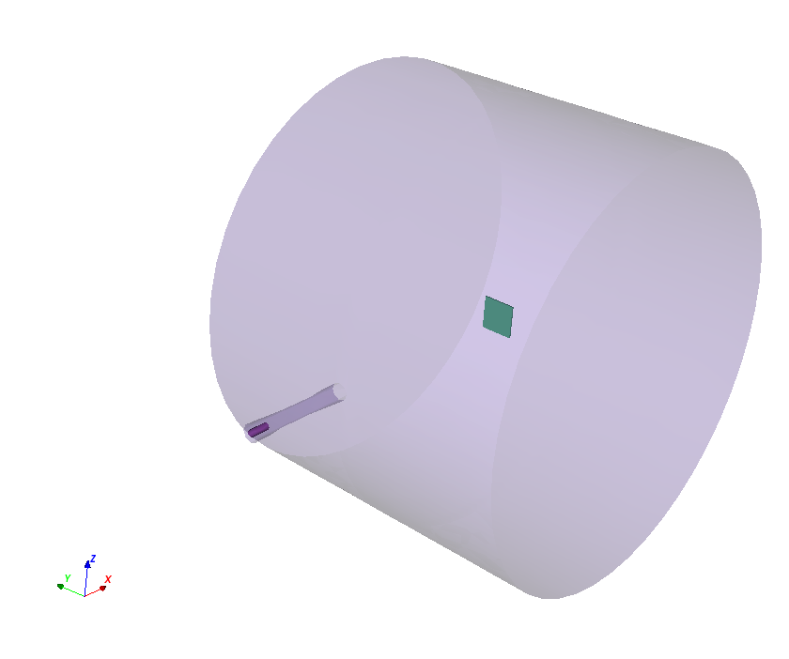
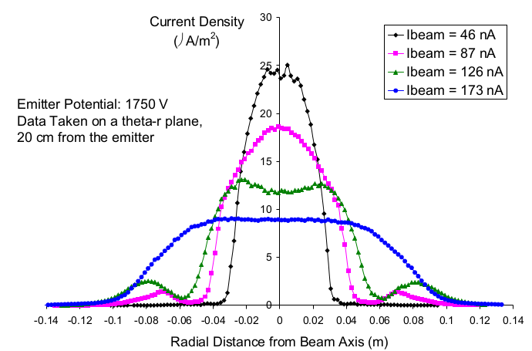
Colloid ST7 thruster modelling
Comparison between SPIS simulation and experimental data from JPL
Colloid current measurement and comparison to Colloid model
Angular distribution of emitted current

Slide 27
Geometry data on ST7 and justification on non-available data
Symbol | Definition | Value
$$d_{ESVC}$$ | Diameter of the electrospray vacuum chamber | 5 cm
$$l_{ESVC}$$ | Length of the electrospray vacuum chamber | 6 cm
$$L$$ | Length of the main vacuum chamber | 130 cm
$$D$$ | Diameter of the main vacuum chamber | 100 cm
$$d_{ES,App}$$ | Diameter of the electrospray aperture | 0.8 cm
$$a_{Col}$$ | Collector side length | 10 cm
$$d_{ES}$$ | Diameter of the electrospray | 1 cm
$$l_{ES}$$ | Length of the electrospray | 5 cm
$$g_{ES}$$ | Gap between the electrospray and the back of the vacuum chamber | 1 cm
$$d_{ES−C}$$ | Distance between the colector and the electrospray | 5 cm
: Data extracted from literature
: Data deduced from literature
: Data chosen arbitrary

Slide 28
Geometry data on ST7 and justification on non-available data

Slide 29
Conclusion and further studies
Preliminary simulations highlight the need to have realistic modelling of droplet emission and dynamic around spacecraft
SPIS-µThrusters is operational (end of code development)
The set of experimental data seems sufficient to carry out a relevant validation of SPIS-LISA
SPIS-µThrusters seems to simulate realistic order of magnitude for droplets angular dispersion
Get more relevant data on Electrospray thrusters
Compare results to in-flight data of satellites using micro-thrusters (LISA-Pathfinder, etc.)
One SNAPSHOT version of SPIS-µThrusters (with num core 6.0.4) will be released before the end of 2020 ⇒ Feedbacks from the community will be much appreciated to improve this new version
Looking for new inflight data extracted from last European development in micro- and nano-satellites and micro-thrusters (e.g. Impulsion)

Slide 30
Appendix

Slide 31
References
[1] ‘Electrospray Thrusters Boost Efficiency, Precision’. [Online]. Available: https://spinoff.nasa.gov/Spinoff2016/ip_9.html. [Accessed: 17-Sep-2019].
[2] M. Fehringer, F. Rüdenauer and W. Steiger, “Ultra-Precise Indium Thruster - WP 2000: Droplet Emission,” Nordwijk, 2001
[3] ‘News | A Final Farewell to LISA Pathfinder’. [Online]. Available: https://www.jpl.nasa.gov/news/news.php?feature=6901. [Accessed: 17-Sep-2019].

Slide 32
Droplet emission
Droplet display in simulation
Droplet temperature evolution
Droplet rebound

Slide 33
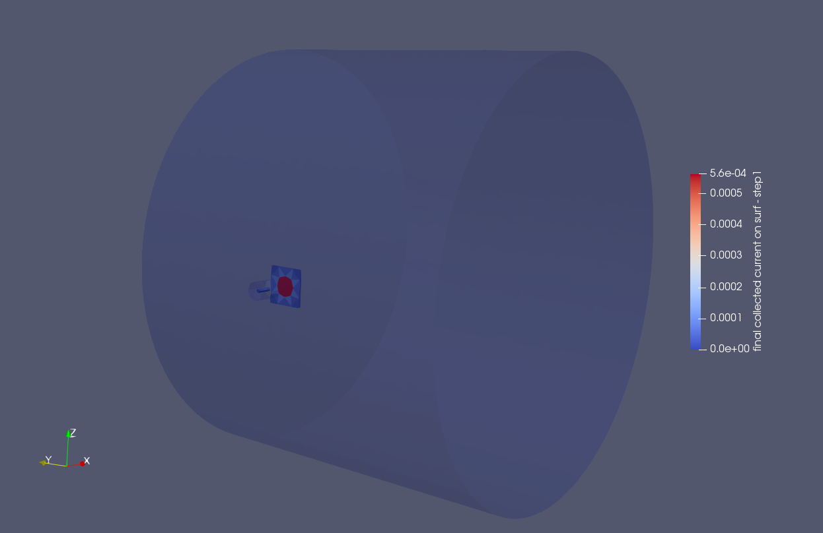
Results on ST7 from JPL experiment

Slide 34
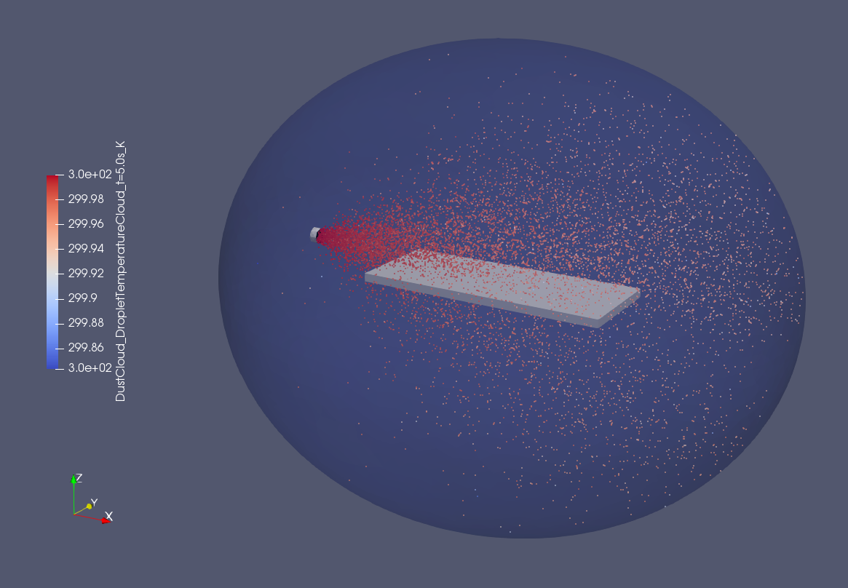
Simulation of droplets rebounds on surfaces
Display of droplets cloud of points:
34

Slide 35
Micro-Thrusters models

Slide 36
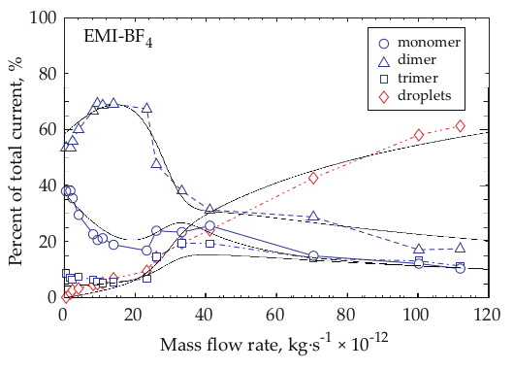
Electrospray emission model
Beam current : $I=f(ε){\left(\frac{Qκγ}{ε}\right)}^{1/2}$
Droplet diameter : $\left\langle D_{d}\right\rangle =g(ε){\left(\frac{Qε_{0}ε}{κ}\right)}^{1/3}$
Charge-mass ratio : $\left\langle q/m\right\rangle =\frac{I}{ρQ}= \frac{f(ε)}{ρ}{\left(κγ/Qε\right)}^{1/2}$
$$f\left(ε\right)=−449−0.21ε+157ε^{\frac{1}{6}}+336ε^{−1/6}$$
$$g\left(ε\right)=−10.87ε^{−\frac{6}{5}}+4.08ε^{−1/3}$$
$$w_{monomer}={\left(3e^{\left(−\frac{{\dot{m}}^{4}}{{30}^{4}}\right)}+0.5\right)}/s$$
$I$ $:Total emitted current [A]$
$Q$ : Emitted massflow [$kg.s^{−1}$]
$q$ : Droplet charge [C]
$m$: Droplet mass [kg]
$ρ$: Droplet mass density $[kg/m^{3}]$
$κ$ : Droplet electrical conductivity [$S/m^{3}$]
$γ$ : Droplet surface tension [N/m²]
$ε$ : Droplet relative electrical conductivity [$∅$]
$$w_{dimer}={\left(2e^{\left(−\frac{\dot{m}}{20}\right)}+0.25\right)}/s$$
$$w_{trimer}{=0.25}/s$$
$w_{droplet}=0.012\dot{m}/s$
$$s= \left(3e^{\left(−\frac{{\dot{m}}^{4}}{{30}^{4}}\right)}+0.5\right)+\left(2e^{\left(−\frac{\dot{m}}{20}\right)}+0.25\right)+0.25+0.012\dot{m}$$
36

Slide 37
FEEP emission model
$$η={\left(\frac{I}{I_{c}}\right)}^{α}\frac{\left.f(T\right)}{φ_{e}}$$
$$f\left(T\right)=\frac{π−2.atan\left(\left.10.{\left(T−T_{C}\right)}/(T_{C}−T_{M}\right)\right)}{π−2.\operatorname{atan}\left(\left.10.{\left(T_{M}−T_{C}\right)}/(T_{C}−T_{M}\right)\right)}$$
$$ZI={\left(\frac{φ_{e}}{φ_{on}}−1\right)}^{−β}$$
$$α=1−2β$$
$$S=\left\{\begin{aligned}&1 \\ &0.5−\left(T−T_{0}\right)∗{∆T}^{−1} \\ &0\end{aligned}\begin{matrix}T<T_{0}−0.5∆T \\ T>T_{0}+{0.5}/∆T\end{matrix}\right.$$
37

