Slide 1
Io plasma torus and Jovian aurora activities seen by Hisaki: Recent result, current status, and future plan F. Tsuchiya, I. Yoshikawa, A. Yamazaki, K. Yoshioka, T. Kimura, G. Murakami, H. Kita, M. Kuwabara, C. Tao, R. Koga, R. Hikida, K. Masunaga, M. Kagitani, T. Sakanoi, H. Misawa, Y. Kasaba, Hisaki science team
Recent results of Io plasma torus related with HISAKI
Tacking oxygen ions from source to sink based on neutral and ion measurement. (Koga et al., 2019, JGR, see also presentation by Howard Smith)
Spatially asymmetric increase in hot electron population during volcanically active period (Hikida et al. 2019, JGR)
Change in the azimuthal variation (so-called system IV) in the Io plasma torus (Coffin et al., 2020, JGR; Tsuchiya et al. 2019, JGR)
Search for influence of the dawn-dusk electric field on the torus and the radiation belt (Kita et al. 2019, ApJ)
Collaboration with Juno and groundbased observations
Kita et al. 2019, JGR) Jovian UV aurora’s response to the solar wind: Hisaki EXCEED and Juno observations
Yao et al. 2019, JGR On the Relation Between Jovian Aurorae and the Loading/Unloading of the Magnetic Flux: Simultaneous Measurements From Juno, HST, and Hisaki
Roth et al. 2020, Icarus An attempt to detect transient changes in Io's SO2 and NaCl atmosphere

Slide 2
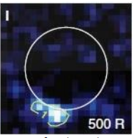
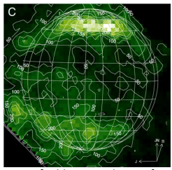
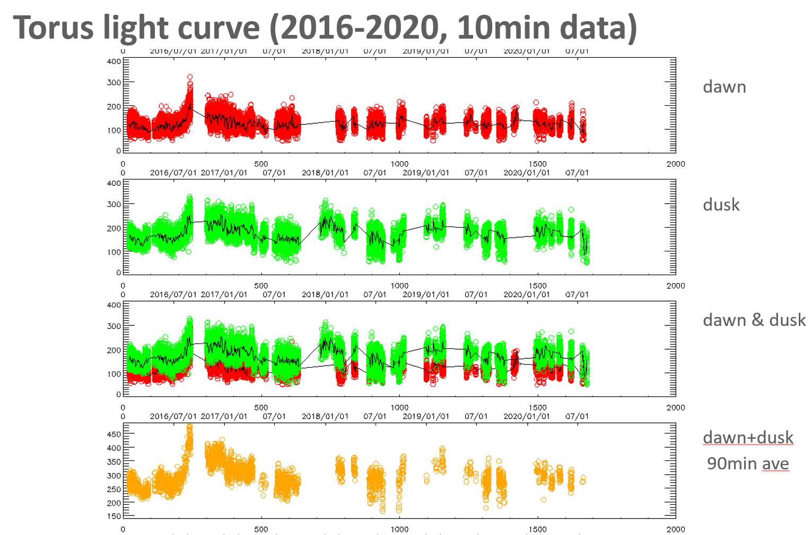
Current status of HISAKI
The post HISAKI mission
Water plumes, icy moon atmospheres, & aurora (115-190nm)
High spatial & spectral resolution (0.1” & 0.02nm)
High sensitivity (x100 of HISAKI)
Phase-A study will start soon.
Target launch year: 2029 / Fun with JUICE & Europa Clipper !
Extension of the mission life time until the end of March 2022.
Fun with JUNO !
EUV spectrograph is healthy
No guide camera since October 2016
2016
2017
2018
2019
2000

Slide 3
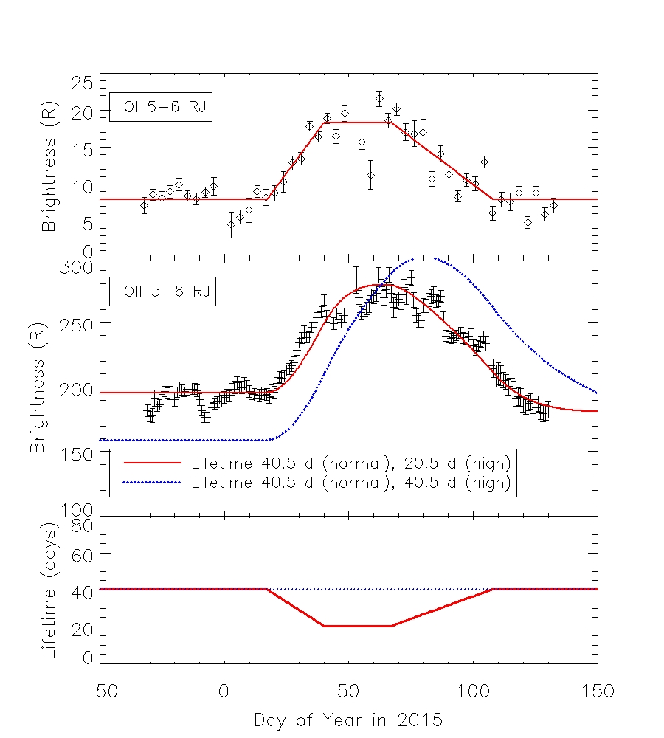
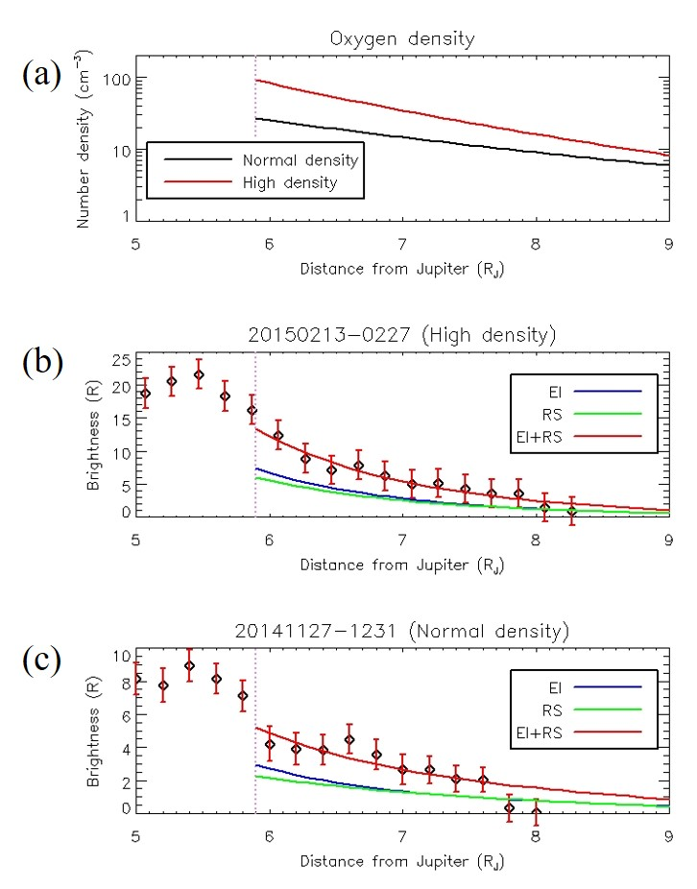
Transient change of Io’s neutral oxygen cloud and plasma torus observed by Hisaki (Koga et al, 2019, JGR-Space Physics).
The lifetime of O⁺ was estimated from time variations of O and O⁺, and it shortened during the density enhancement in 2015 (left figure).
The number density of O at Io’s orbit during the high density period is three times larger than that during the normal density period (right figure).
O+ lifetime=> Normal density period; 40.5 days
High density; 20.5 days

Slide 4
Spatially asymmetric increase in hot electron fraction in the Io plasma torus during volcanically active period revealed by observations by Hisaki/EXCEED from November 2014 to May 2015 (Hikida+19, JGR).
Long-term continuous monitoring revealed that the plasma environment around Jupiter fluctuated coincident with Io's volcanic activity.
Around 40 days after the volcanic activity starts, hot electron components inside the torus began to increase especially on the dusk side.
We present evidence that enhanced mass production produces either increased inward transport of hot electrons or local heating.
Figure. Time variation in (i) outward flux tube velocity and (ii) inward flux tube velocity, estimated by plasma diagnosis and chemical model.

Slide 5
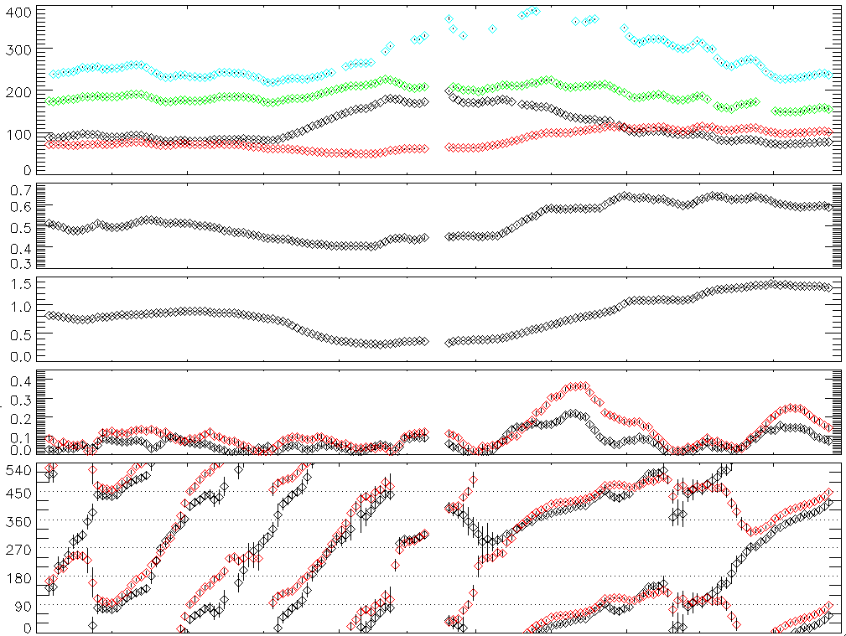
Change in planetary period modulation (System-IV)
Azimuthal Variation in the Io Plasma Torus Observed by the Hisaki Satellite From 2013 to 2016 (Tsuchiya et al., 2019, JGR-Space physics)
Change in planetary period modulation is observed for the first time.
The shortening of the System IV period did not correlate with increase in mass-loading in the torus.
It seems to occur associated increase in electron temperature.
<Pillan/Kurdalagon>
S²⁺ 68.0nm
O⁺ 83.4nm
S⁺ 76.5nm S³⁺ 65.7nm
Intensity[R]
S⁺
S³⁺
Proxy of Thermal electron Temp: Te
Proxy of Ion Composition
S³⁺/S⁺
Amplitude of the azimuthal modulation
Te
S³⁺/S⁺
Te
Peak λIII of the azimuthal modulation
S³⁺/S⁺
Jan Feb Mar Apr May
DOY 1 32 60 91

Slide 6
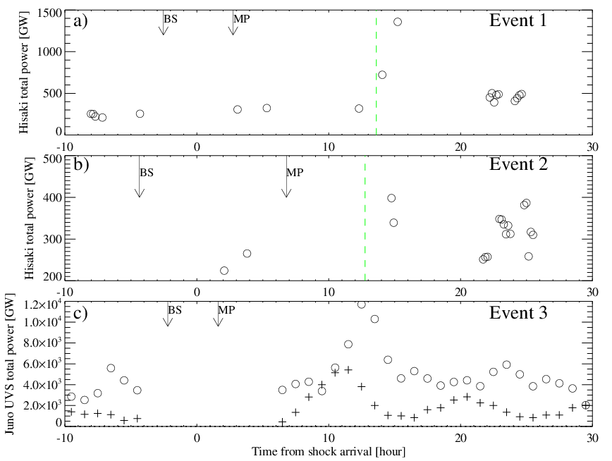
Jovian UV aurora’s response to the solar wind: Hisaki EXCEED and Juno observations (Kita et al., 2019, JGR)
Juno: monitor day-to-day variability in solar wind dynamic pressure before the orbit insertion.
Reveal auroral response to solar wind by first-ever complete in-situ dataset with auroral observation.
Transient brightenings responded to major solar wind shocks with ~10h lag time
A brightening was triggered by a dynamic pressure elevation of 0.03 nPa, but a 0.1 nPa elevation did not trigger a brightening.
These results can be used to test theoretical and numerical model of Jupiter's auroral response to solar wind driving.
10h lag
Transient event
10h lag
Transient event

Slide 7
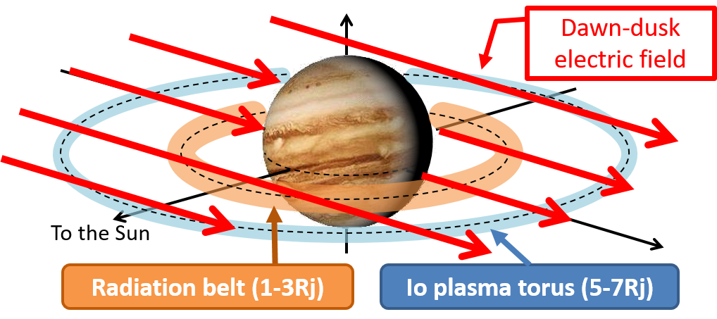
Short-term Variation in the Dawn–Dusk Asymmetry of the Jovian Radiation Belt Obtained from GMRT and Hisaki EXCEED Observations (Kita et al., 2019, APJ Letter)
It is believed that the dawn-dusk asymmetry of Io plasma torus can be explained by the dawn-dusk electric field. If such an electric field penetrates inside Io’s orbit, the radiation belt electron also affected by the electric field.
→ Any correlation between the dawn-dusk asymmetry of Io plasma torus and radiation belt??
The radiation belt and Io plasma torus do not have a significant correlation.
➔The dawn-dusk electric field was masked by some other process (the conductivity variation and/or time-variable longitudinal asymmetry of radiation belt)?

