Slide 1
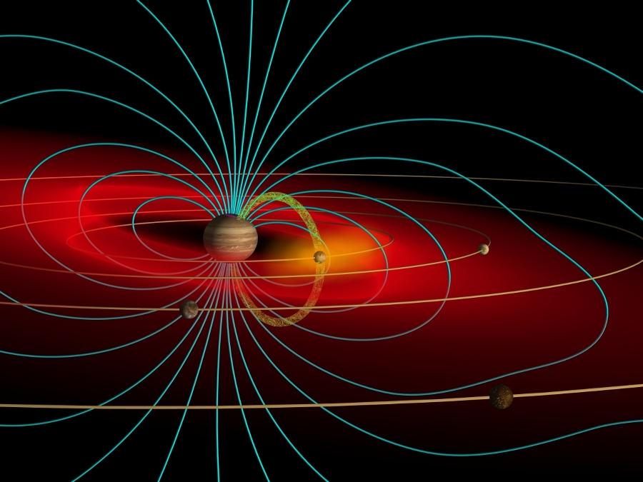

The Io-Torus Interaction
As Seen Through a Telescope
Carl Schmidt
schmidtc@bu.edu
Graphic by John Spencer

Slide 2
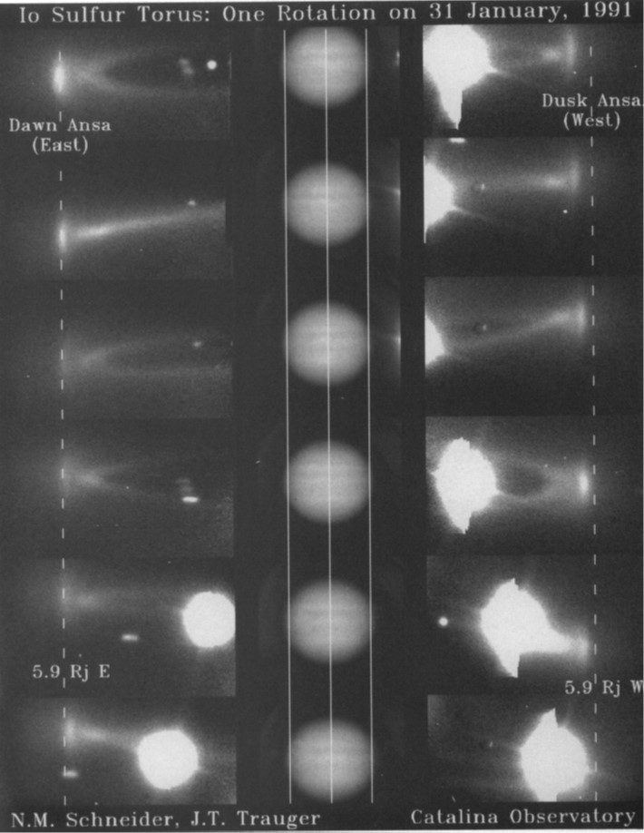
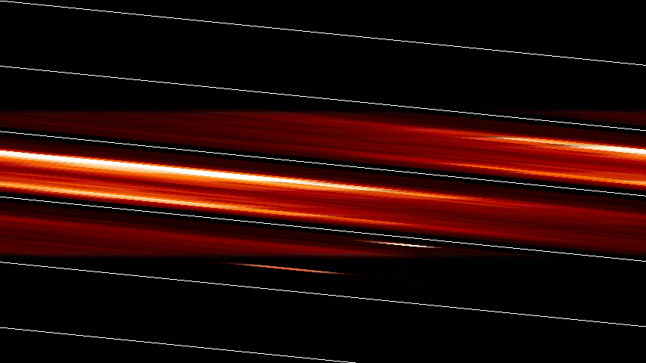



Emission From Io’s Plasma Torus
Cassini 834Å (A. Steffl & I. Stewart)
Dawn
Dusk
$$4πI=\int{A_{ji}f_{j}\left(T_{e},n_{e}\right)n_{i}}dl$$
EUV:
$$T_{e}≥9 to 20 eV$$
Visible:
$$T_{e}≥1.8 to 3.3 eV$$
Jupiter & Moons much brighter.
Small scale structure
S⁺ Visible Wavelengths

Slide 3
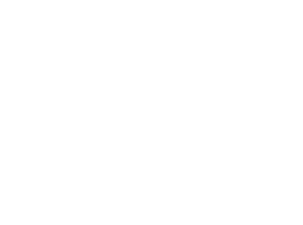
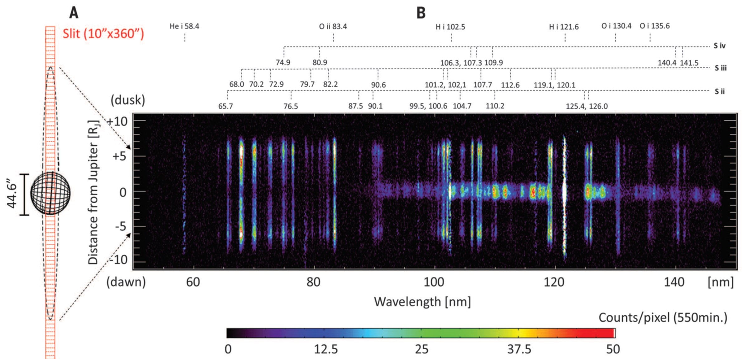
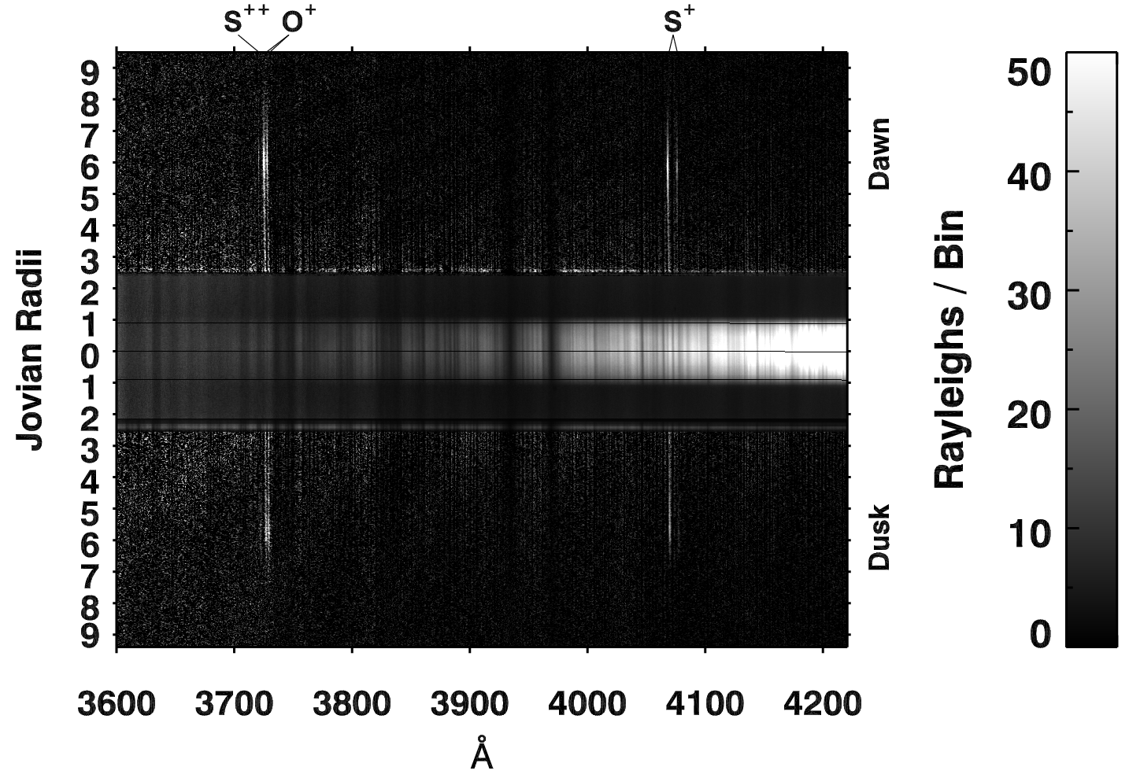
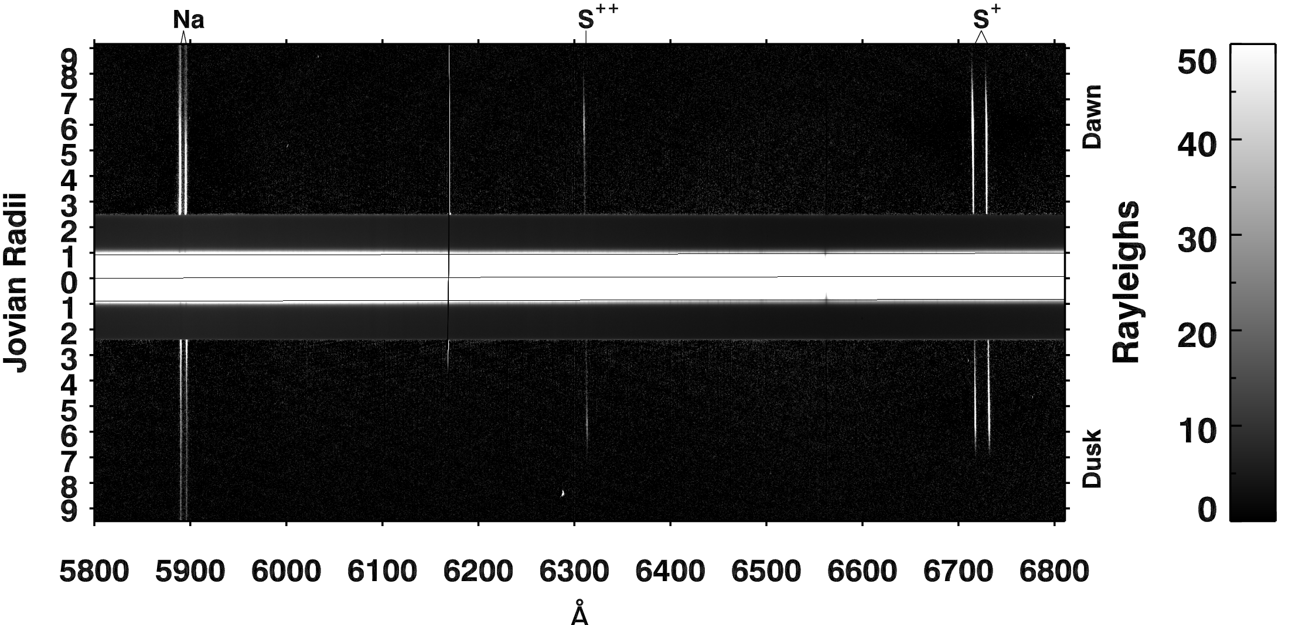
UV: Hisaki
Yoshioka+ 2014
Dawn
Dusk
Optical: Apache Point Observatory
Schmidt+ 2018

Slide 4
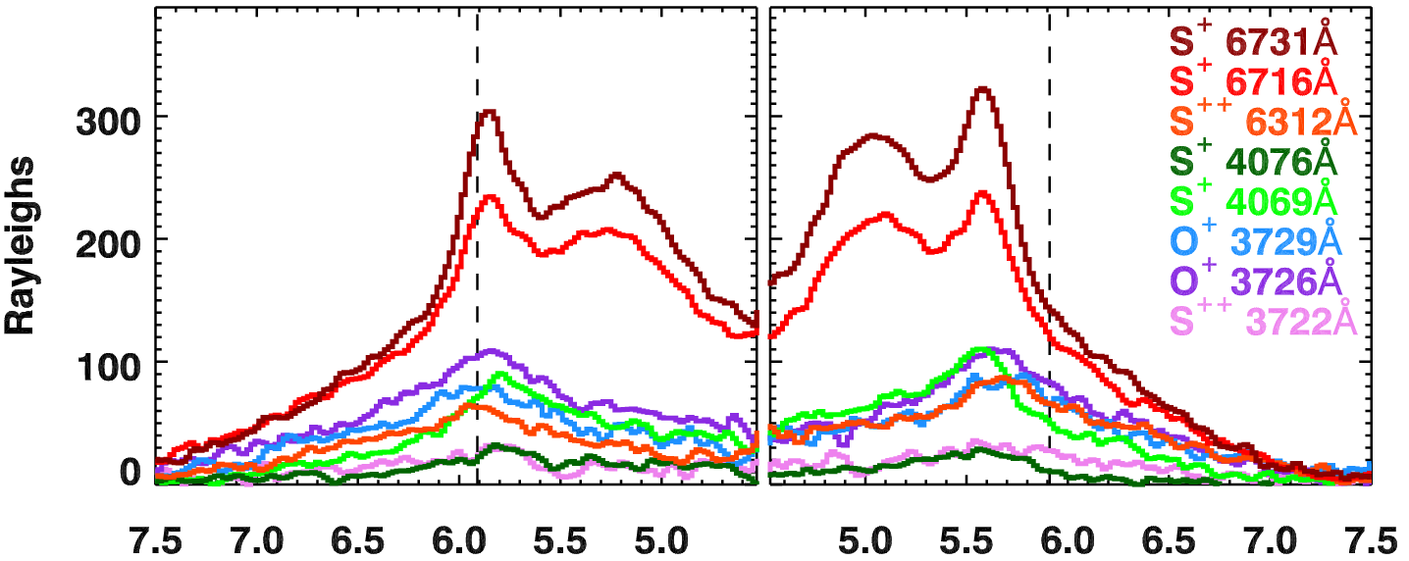
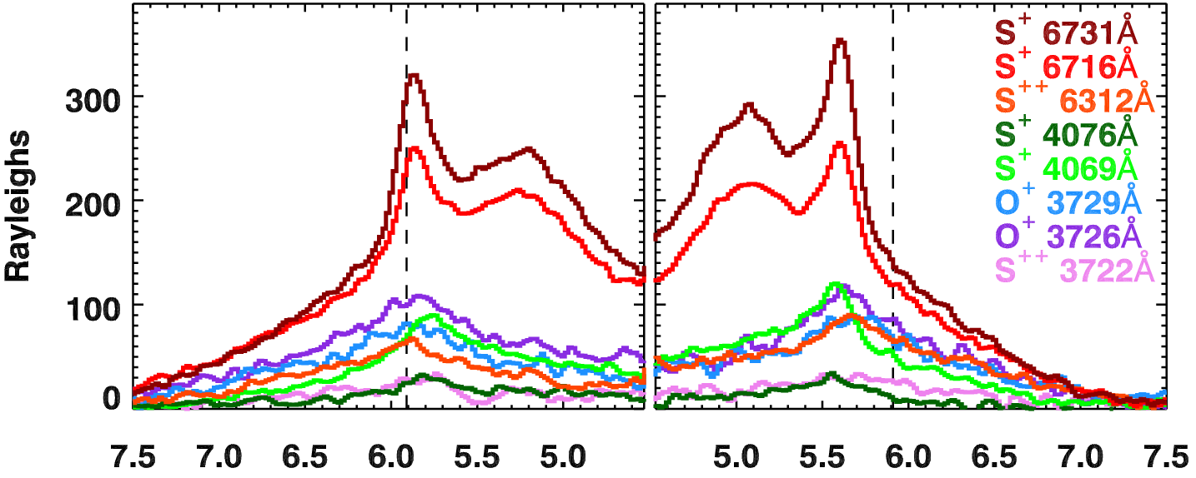
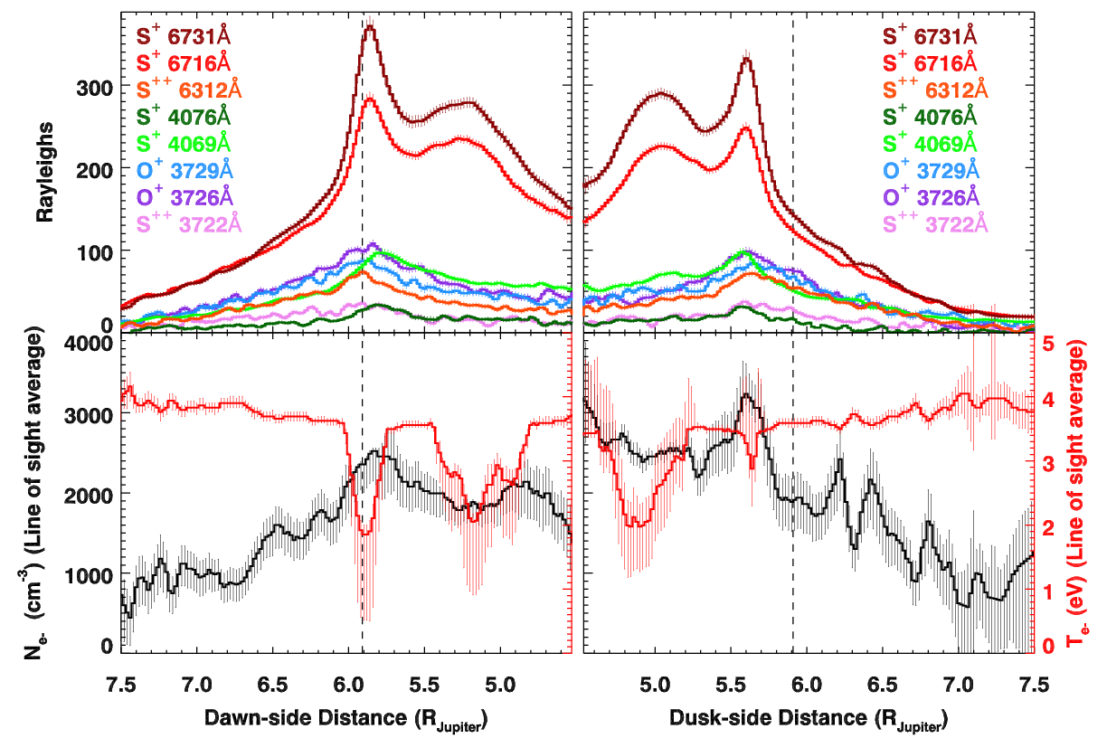
Torus Structure at Optical Wavelengths
Schmidt et al. 2018
Dawn/Dusk offset is evident. E-field varies 1 - 7 mV/m, mean is 4.
Brightness asymmetry <1.5 seen in the UV. Suggests T_{e-}, not n_{e}
Features wobble radially as Jupiter rotates. Above aligns the 0.1 R_{J} wobble in the red S⁺ ribbon. Cold torus wobbles more, 0.2 R_{J}.
Cold-torus is really cold, absent in all transitions > 2eV

Slide 5
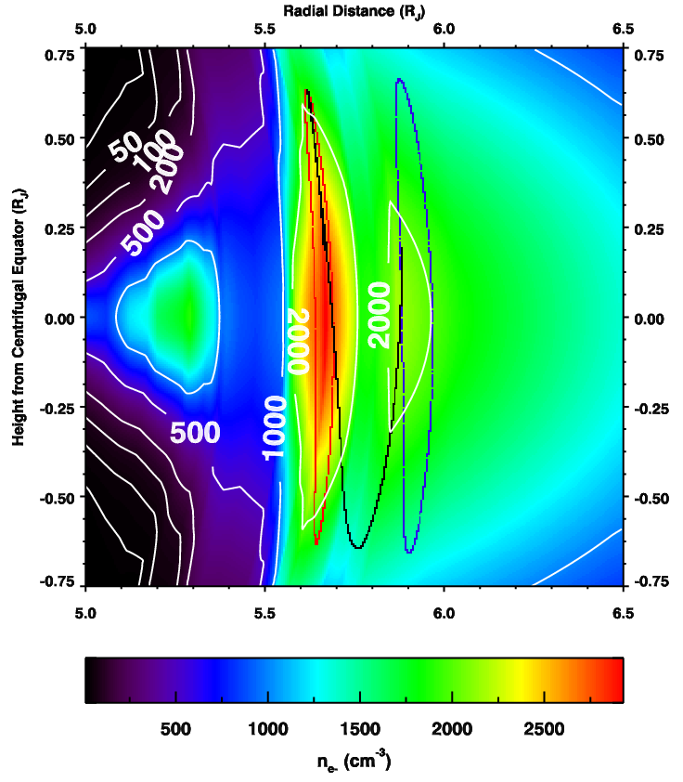
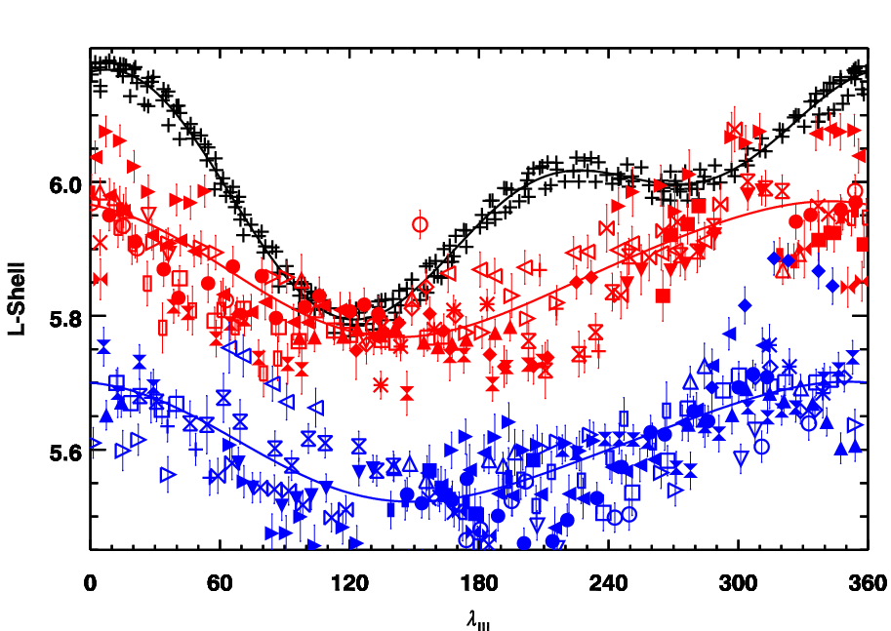
Geometry Matters for the Local Interaction
Io
Dawn
Dusk
Magnetic separation between Io and the torus “ribbon”
Density sweeping past Io
Variability is not all volcanic outgassing, solar wind. Interaction depends on jovian magnetic longitude, Io’s orbital longitude.

Slide 6
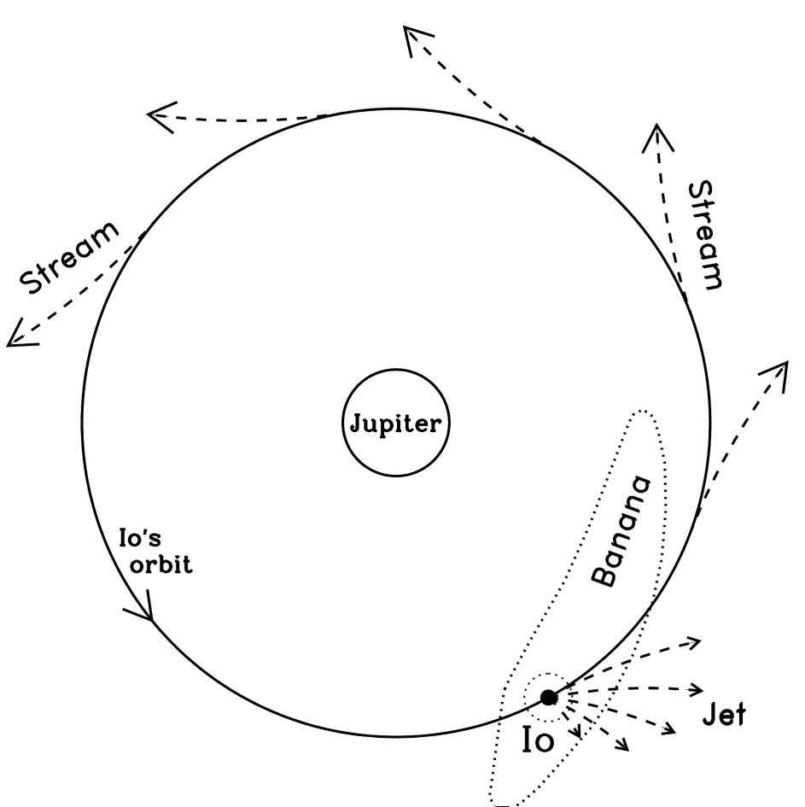
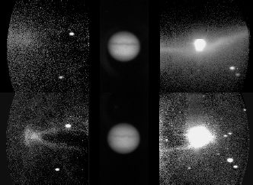
Sodium: A Tracer for the Io-Torus Interaction
The “Banana Cloud” illuminates
low energy escape
“Jets & Streams” illuminate
high energy escape
NaCl + γ ➔ NaCl⁺
NaCl + torus ion ➔ Na + …
NaCl⁺ + e⁻ ➔ Na* + Cl
Sodium
Wilson et al. 2002
Sulfur⁺
Schneider & Trauger 1995

Slide 7
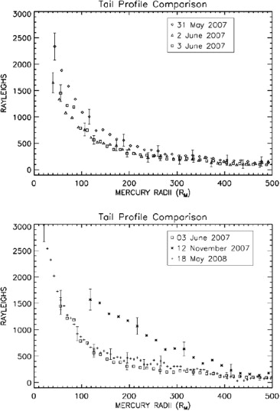
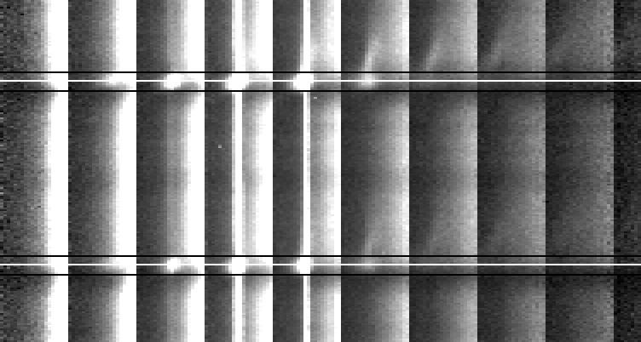
Integral Field Spectroscopy: Sorting by Doppler Shift
Scattered Jupiter
Io Surface Reflection
Reflection
2.8 km s⁻¹ pix⁻¹
Spectra
D₂
Io Absorption
Io Emission
dλ
Jupiter Absorption
D₁

Slide 8
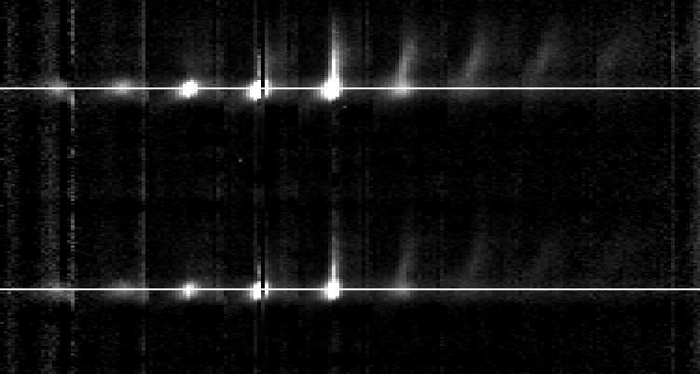
Integral Field Spectroscopy: Sorting by Doppler Shift
Residual Noise
75 km / s
WRT Io
Spectra
D₂
Slow Sodium
Fast Sodium
dλ
D₁

Slide 9
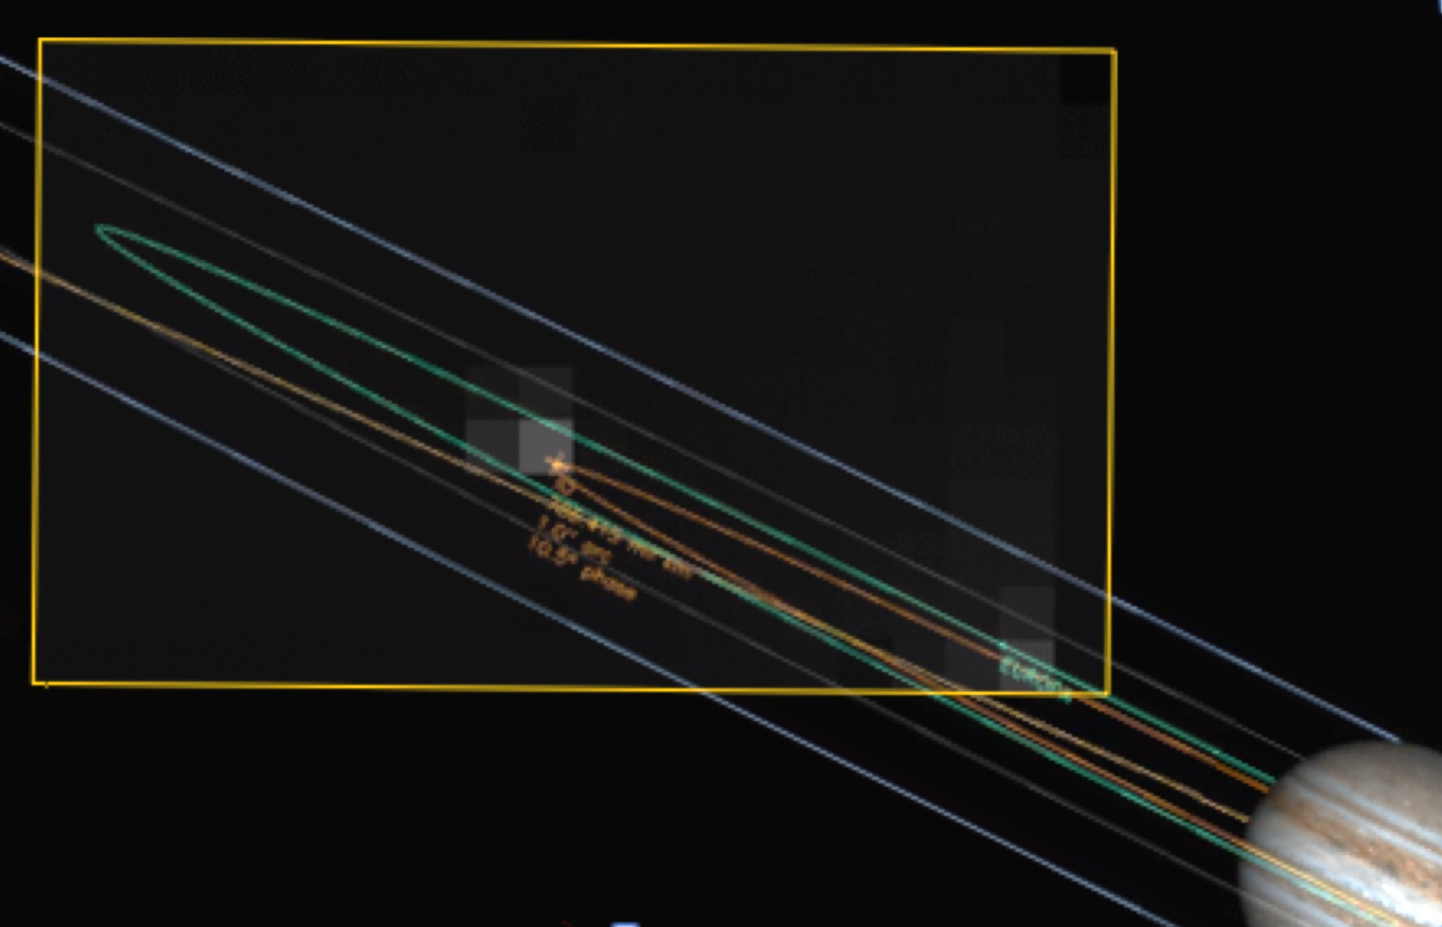
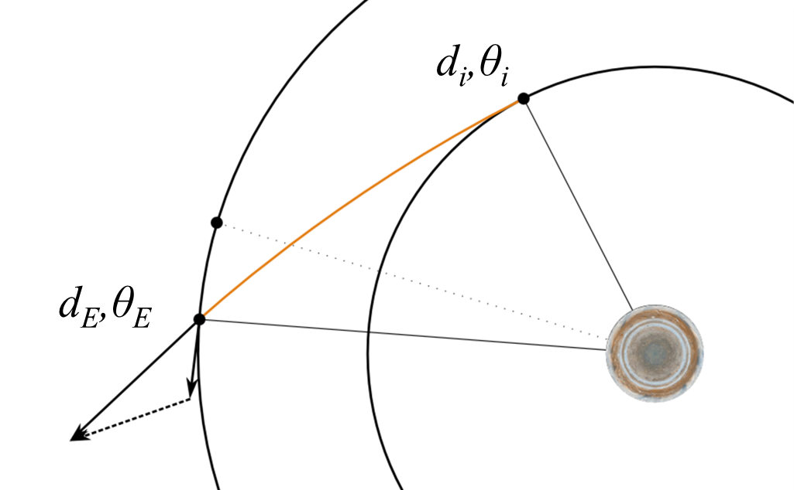
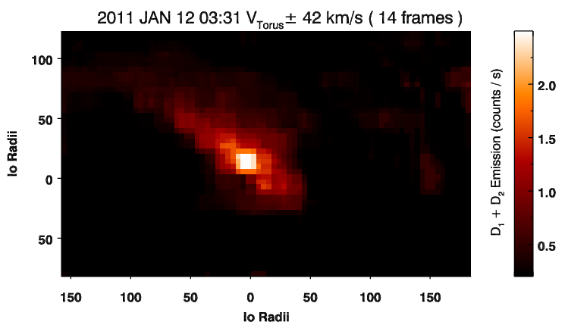
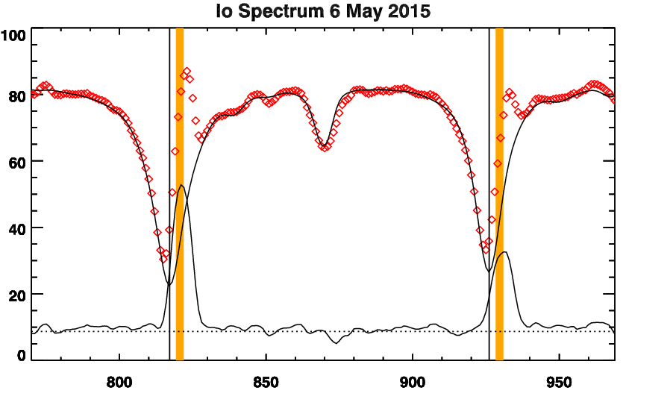
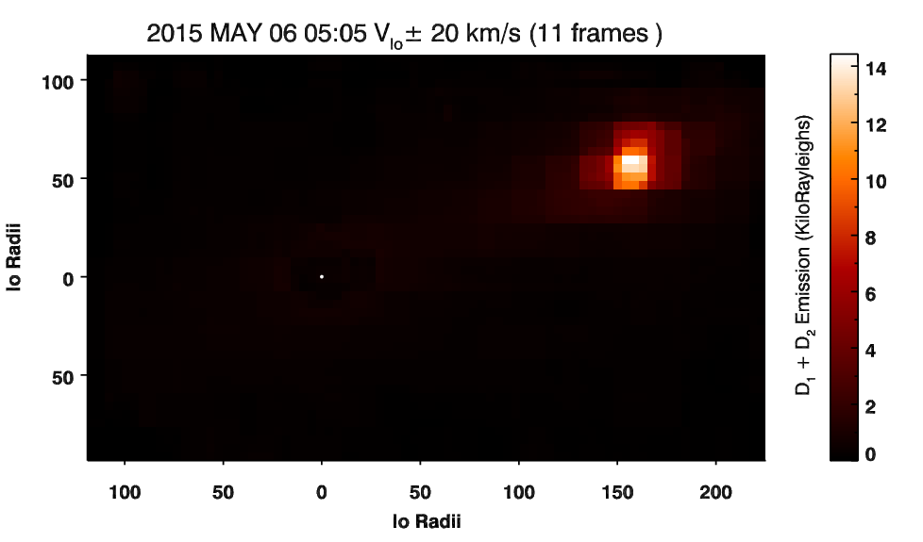
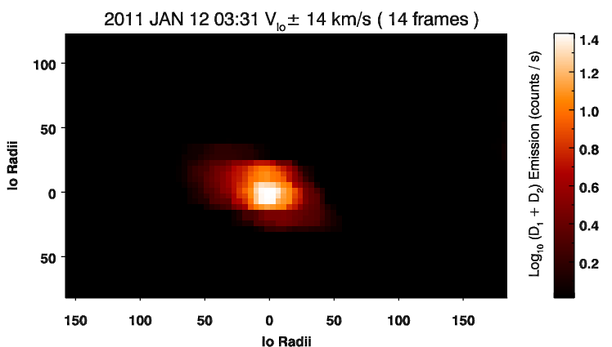
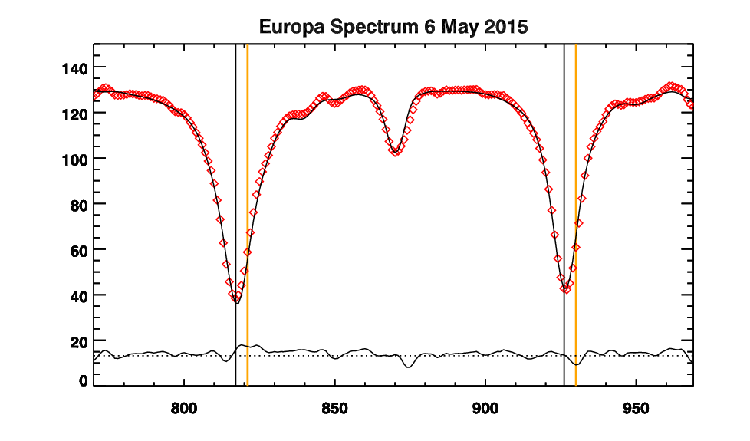
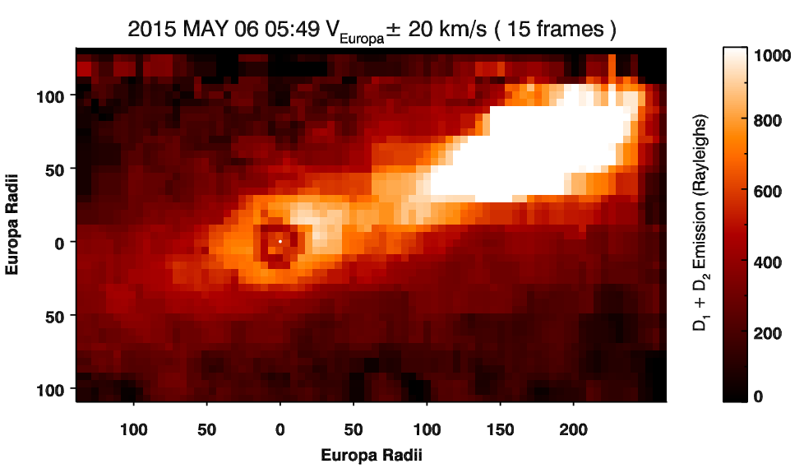

Re-assembling the images
Io-Europa Transfer
$$V_{S}≈\frac{2π\sqrt{d_{E}^{2}−d_{I}^{2}}}{ω_{I}\left[\cos^{−1}\left({d_{I}}/{d_{E}}\right)− \left(θ_{E}−θ_{I}\right)\right]}$$
$$V_{rel}≈ \sqrt{V_{E}^{2}+V_{S}^{2}−2V_{E}V_{s}\left({d_{I}}/{d_{E}}\right)}$$
$$h≈ \sqrt{r_{E}^{2}+\frac{2r_{E}GM_{E}}{V_{rel}^{2}}}$$
$F_{IE}≈\frac{{10}^{6}Bcos(φ)V_{rel}πh^{2}}{Zg_{s}}$
A few 10²² Na atoms/s NOT MUCH
λ_{III} dawn = 132° ΔL = 0.03
λ_{III} dawn = 294° ΔL = 0.07
Europa
Io
Ion Recombination
Sputtered Atmosphere

Slide 10
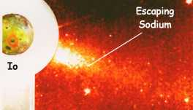
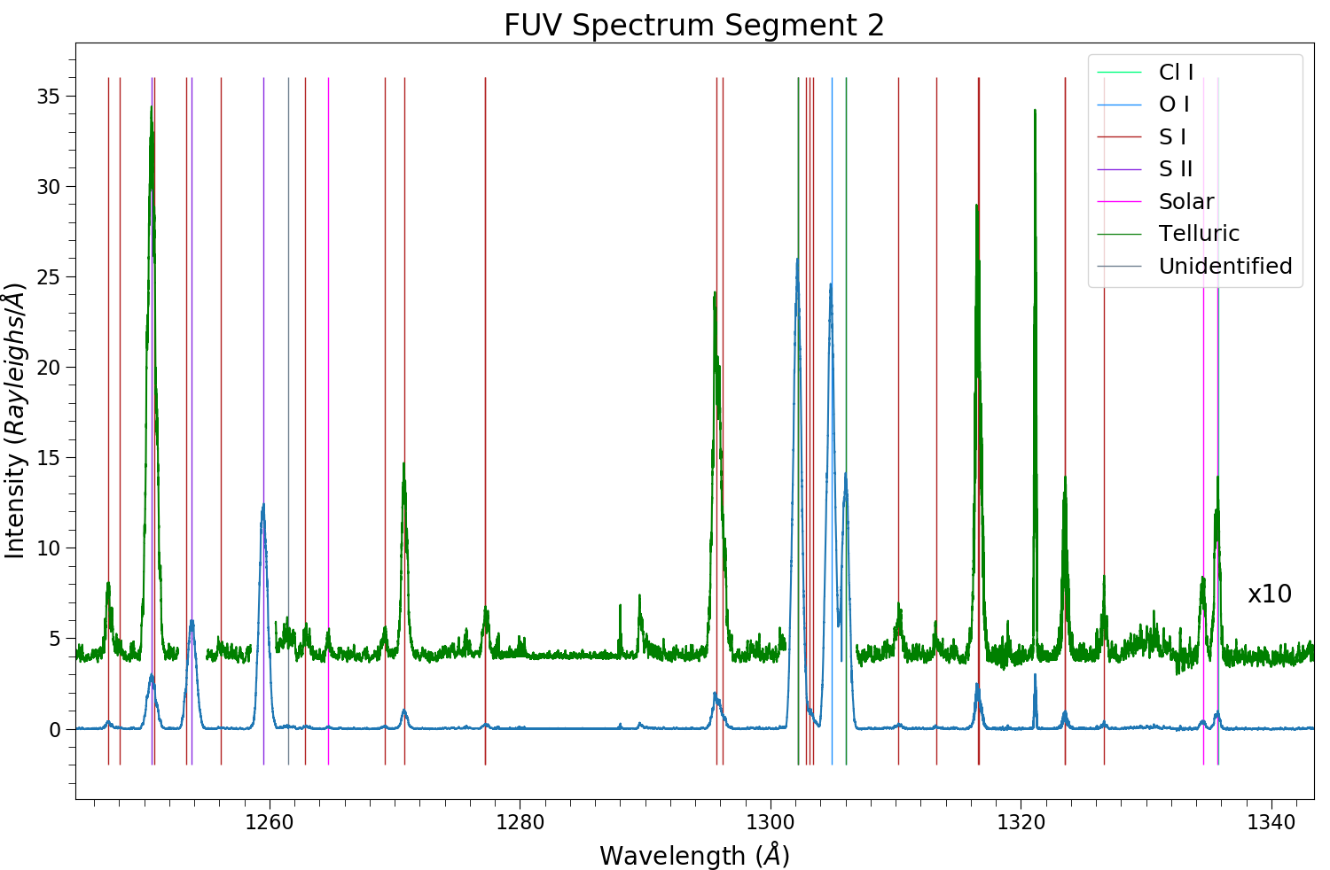
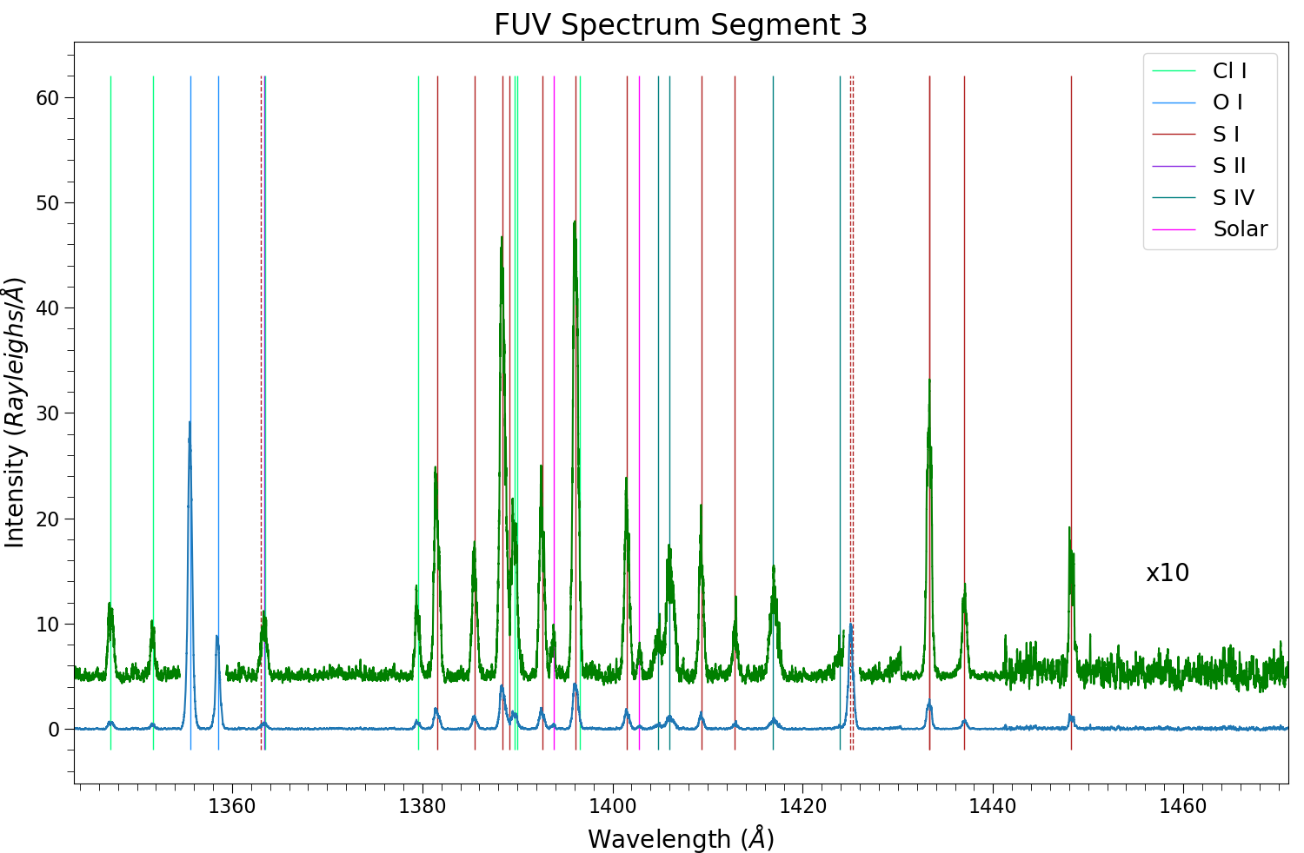
Any O and S jets similar to Sodium?
Upstream of Io
Downstream of Io
Cremonese et al. (1992)
Burger et al. (1999)
O & S are fainter than Na, but maybe if we sum all the neutral lines with HST?

Slide 11
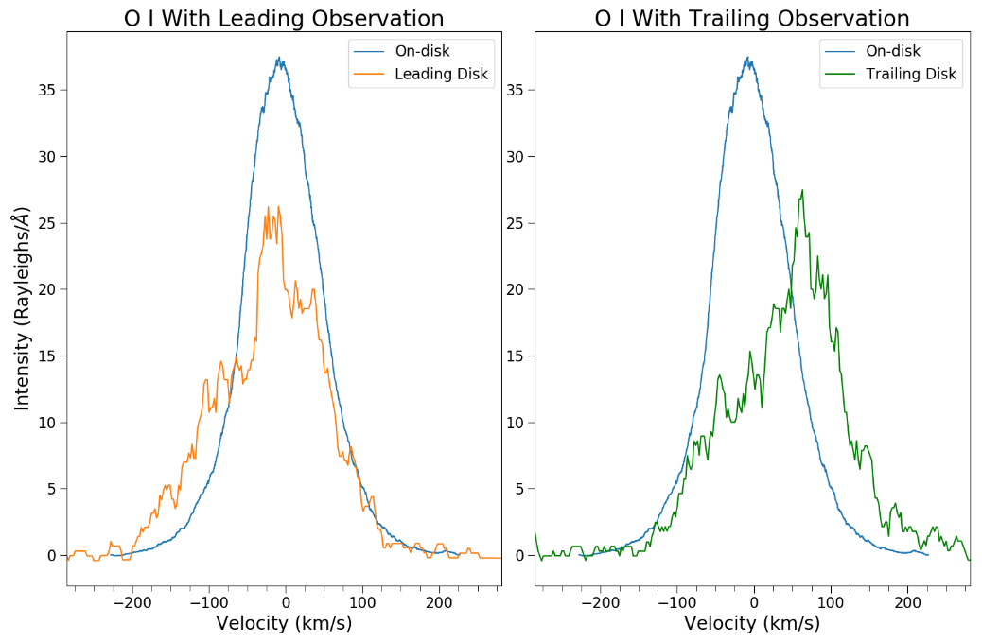
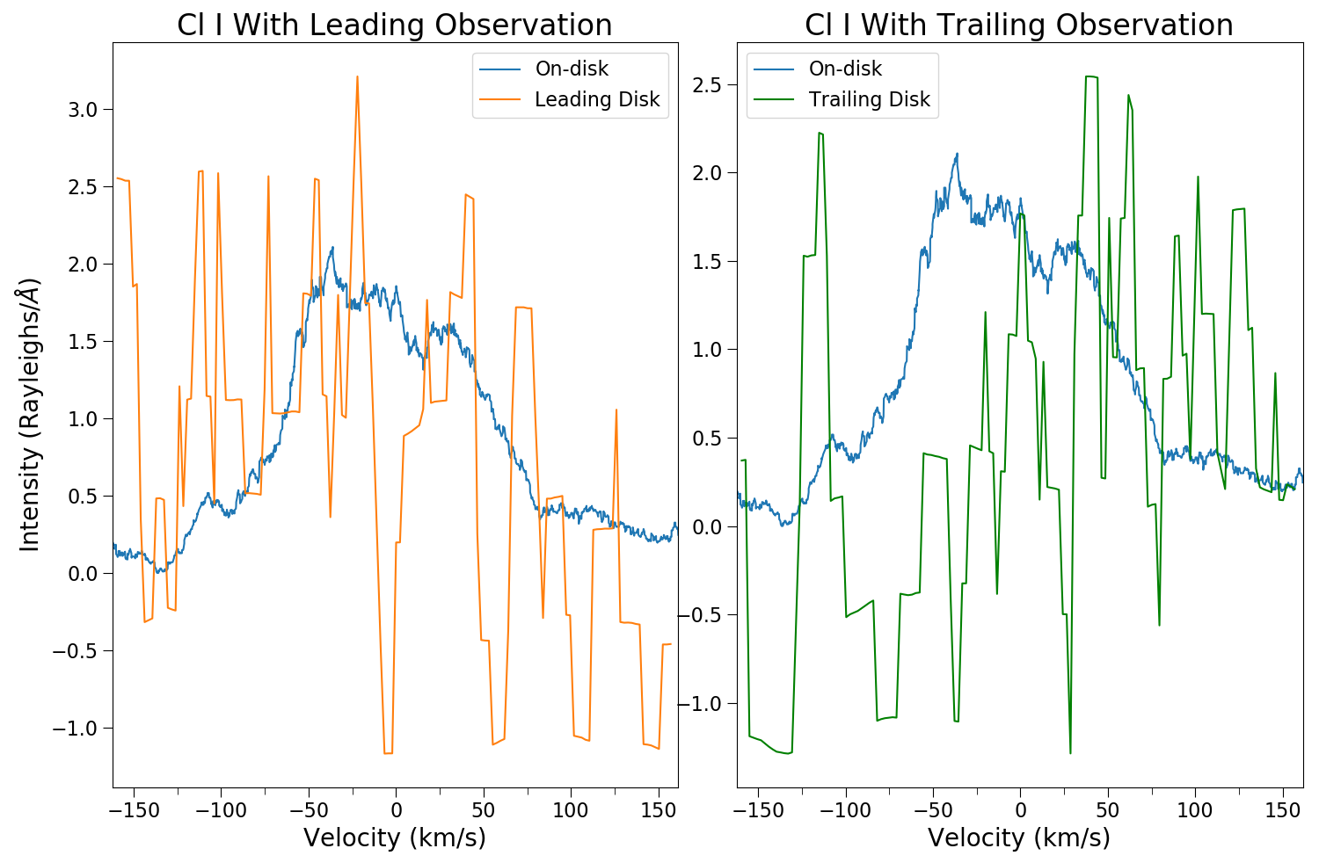
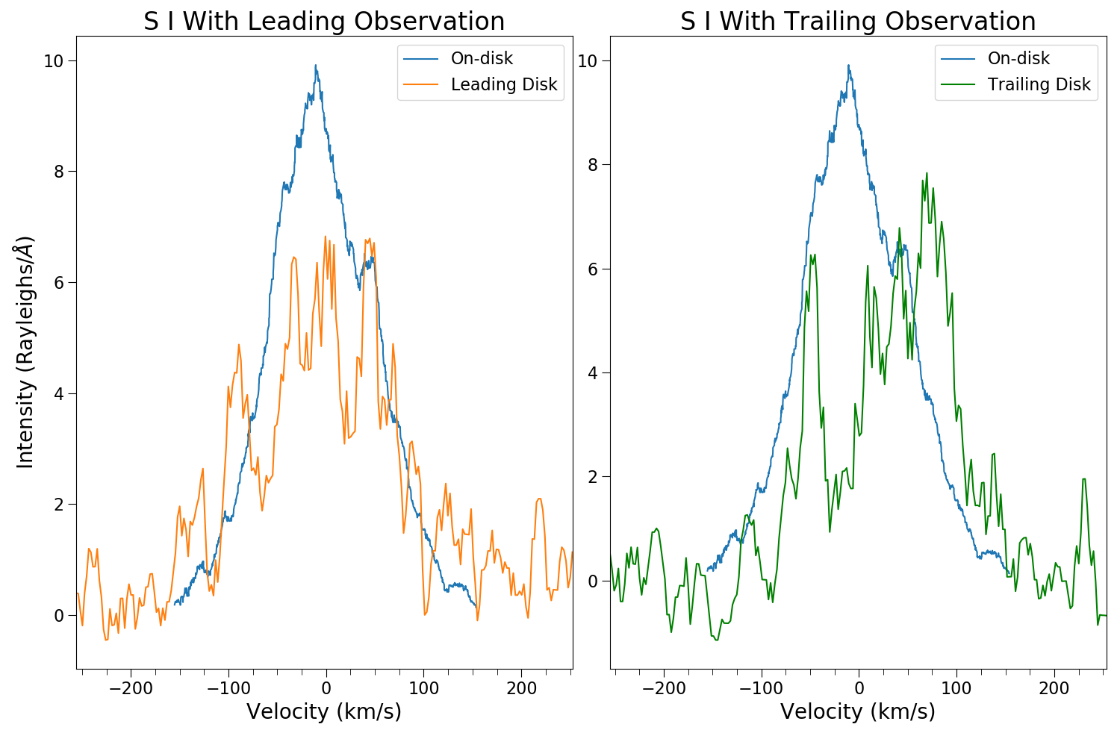
Comparing Doppler Shifts On-disk vs. the Jet
Burger et al. (1999)
Summer student C. Moye

Slide 12
Eclipses: Natural Laboratory to Study Io’s Atmosphere
Surface temperature drops
Montanes-Rodriguez et al. (2015)
Sublimated SO₂ atmosphere responds
SO2 atmosphere only partially collapses
3x change observed while sublimation predicts ~1000x
Plumes probably supply the rest
de Pater et al. (2020) sees similar at egress
How does the atomic atmosphere / ionosphere respond?
Tsang et al., 2016

Slide 13
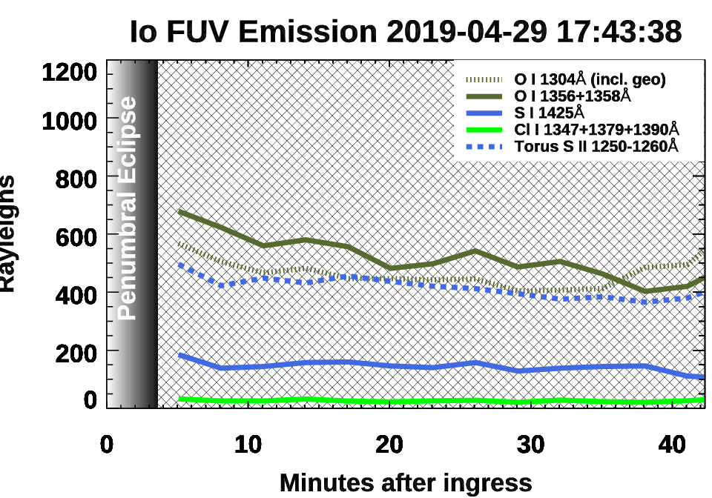
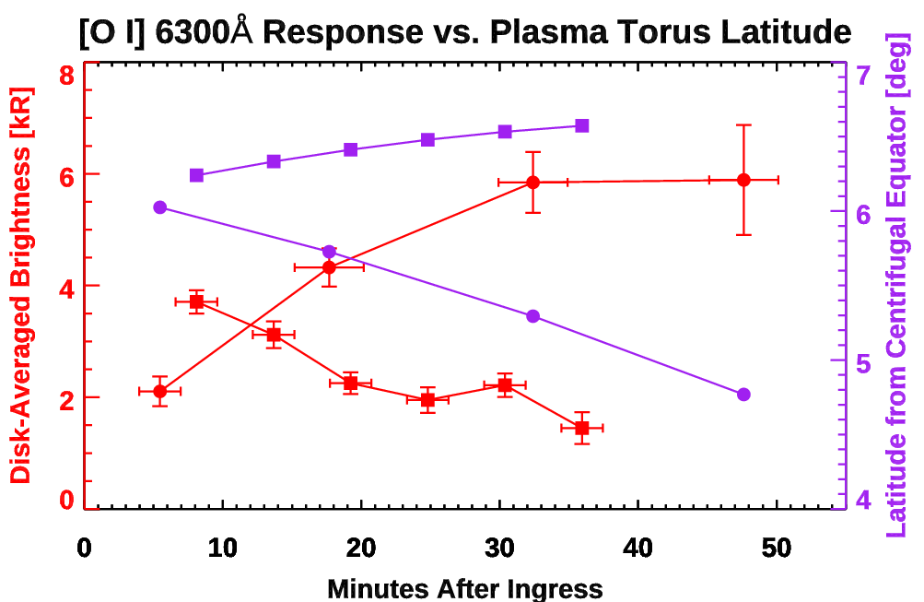
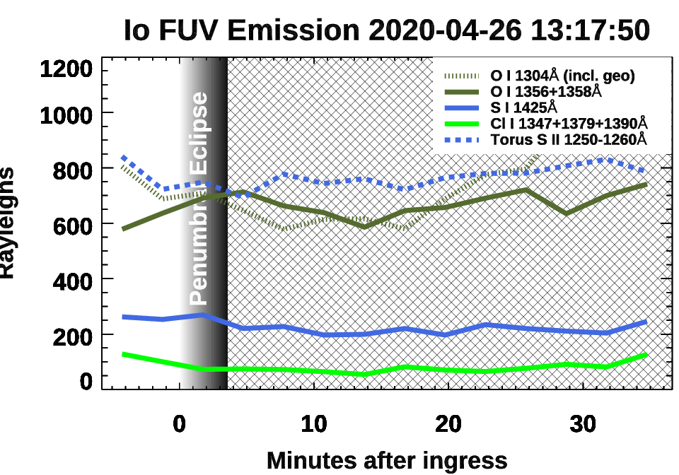
The atomic atmosphere seems indifferent to eclipse.
Neutral atoms are seem to track the plasma emission in the UV.
Brightness reflects electron impact excitation rates---electron limited?
Io’s latitude in the torus matters a lot more than surface temperature or photochemistry

Slide 14
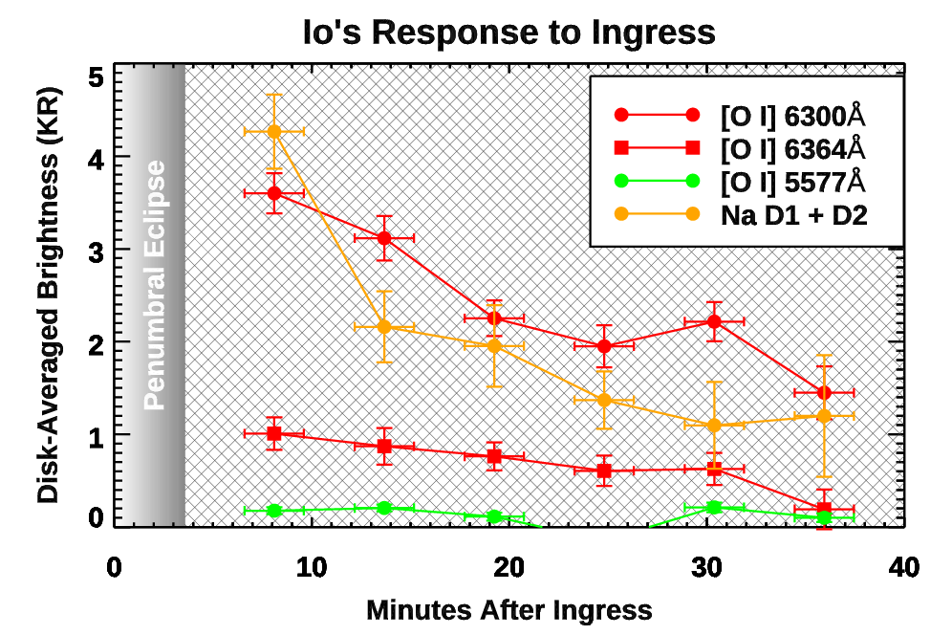
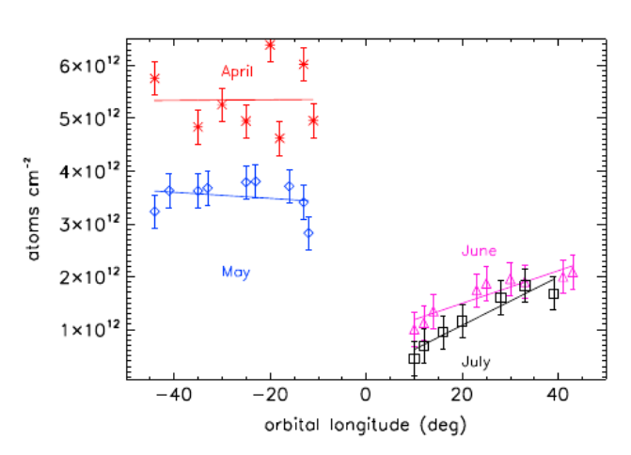
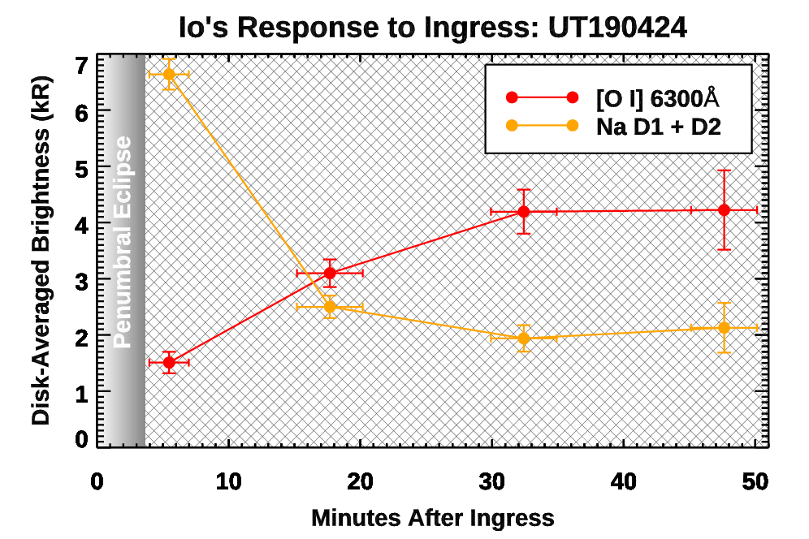
Na behavior is decoupled from O & S. Unclear why.
APO 20/03/18
Na column density
pre-eclipse
~3.5 hours
post-eclipse
Grava et al. 2014
LBT 24/04/19
Timescale at egress differs. So...?
Na has photon contamination we don’t understand? We’re investigating this, but there’s no evidence in its line shape.
Io’s ionosphere is collapsing within 20 min. Maybe the ionosphere excites Na & the torus dissociates SO2 and excites O by cascade?

Slide 15
Thanks for tuning in!
schmidtc@bu.edu
Graphic by John Spencer

