Slide 1
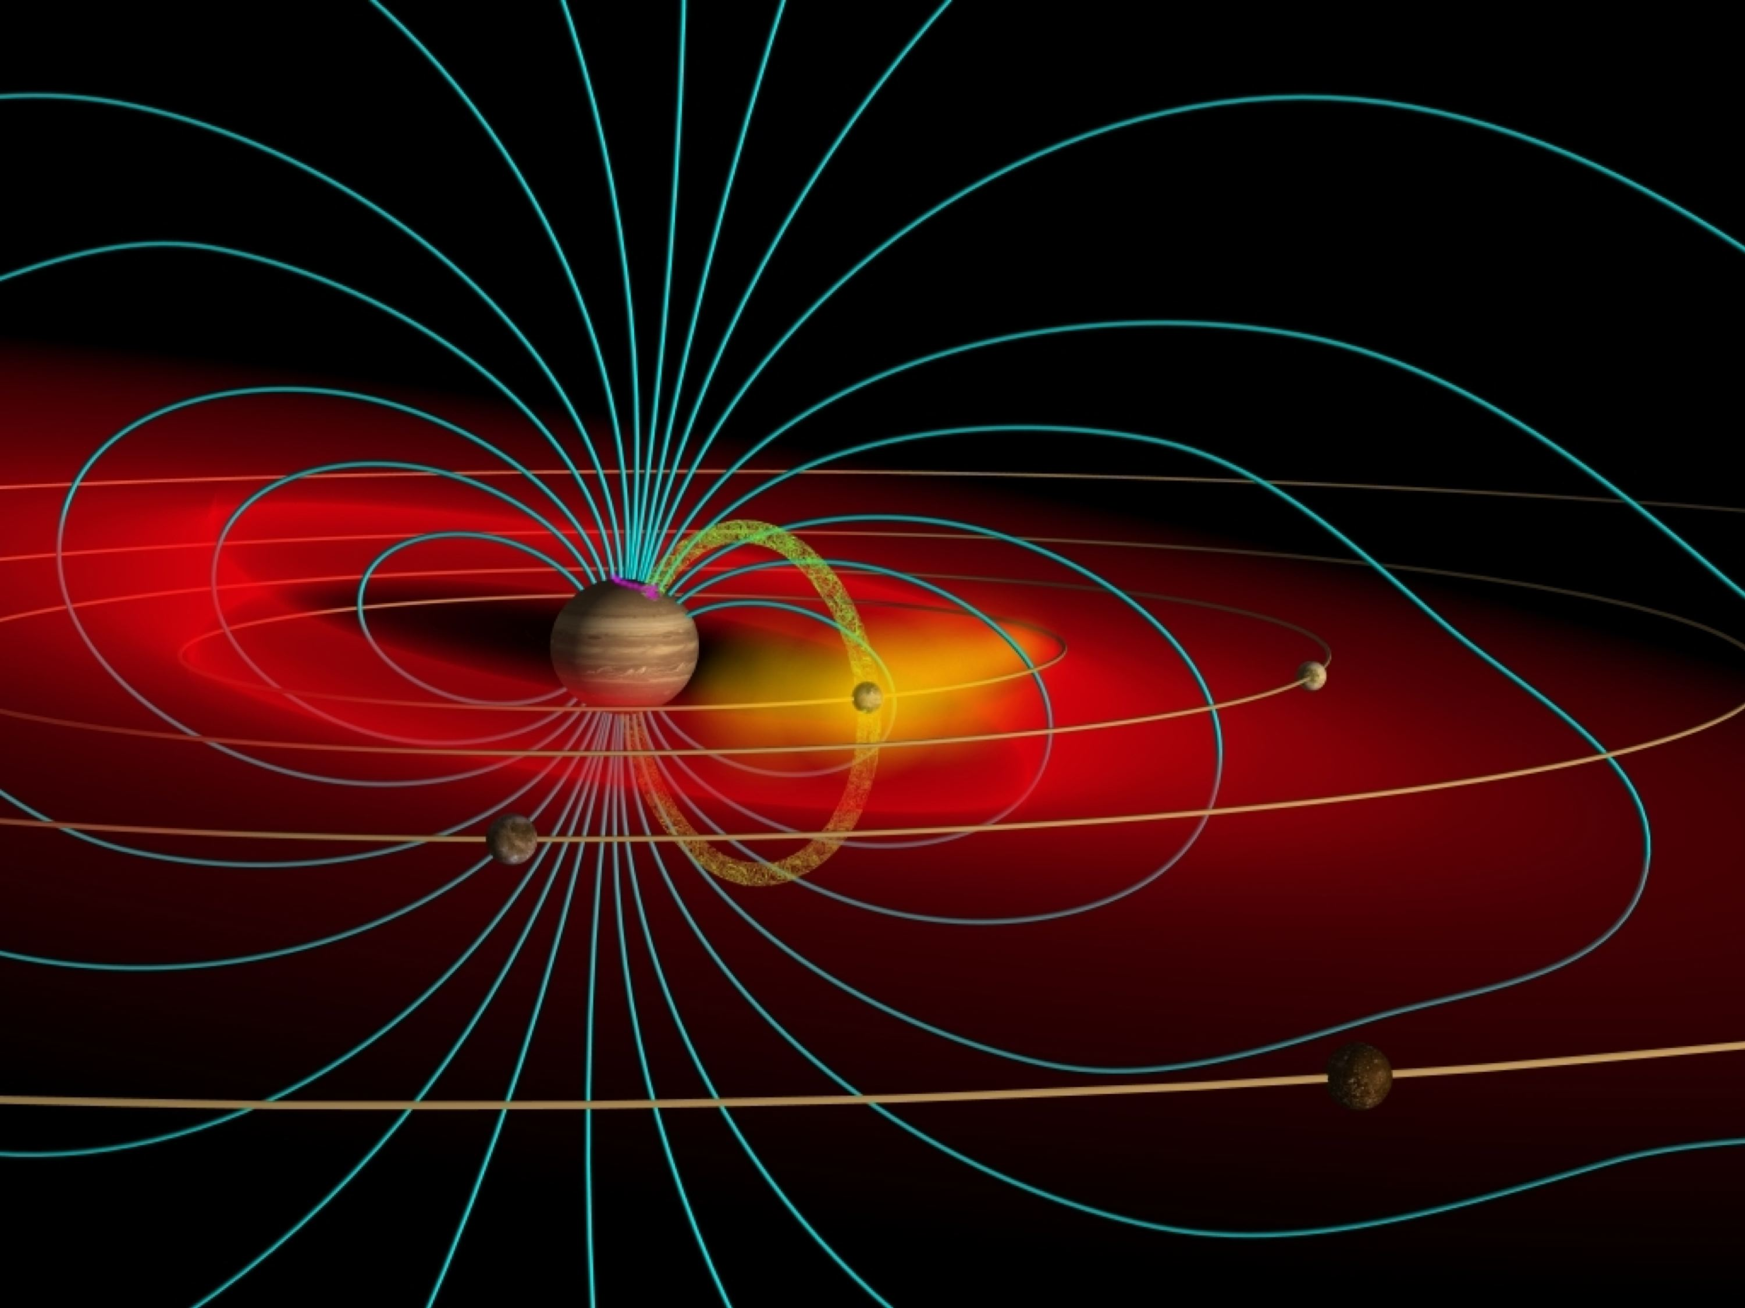
Moon-magnetosphere interactions of Io and Enceladus:
A high-resolution, in-situ parametric study
Ali Sulaiman (University of Iowa, ali-sulaiman@uiowa.edu)
Image Credit: J. Spencer
Outer Planet Moon-Magnetosphere Interaction Workshop 2020

Slide 2

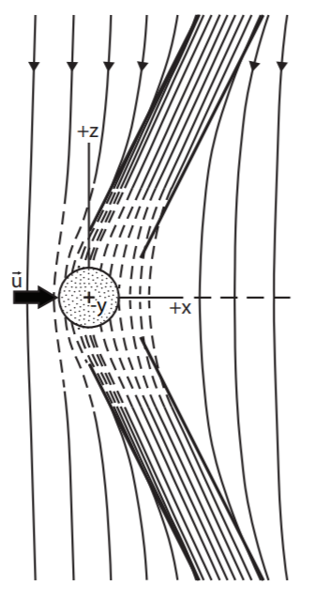
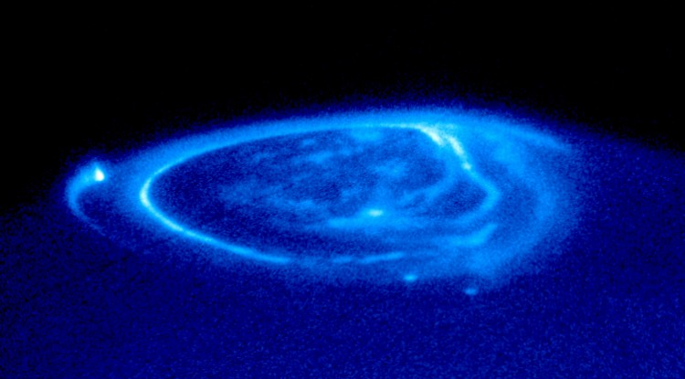
Dynamic moons as a source of auroral hiss
Near the moon, fresh ions are picked-up and accelerated from rest to bulk flow speed by E-field
Each accelerated ion reduces bulk flow speed by m_{i}u² → Drag force
Force balance requires transmission of J × B force → system of field-aligned currents
MHD disturbances mediated by Alfvén waves; electron beams excite plasma waves
Secondary effects: Alfvén wave reflection
B
J
Image Credit: J. Spencer
Clarke et al. (1996), Science

Slide 3
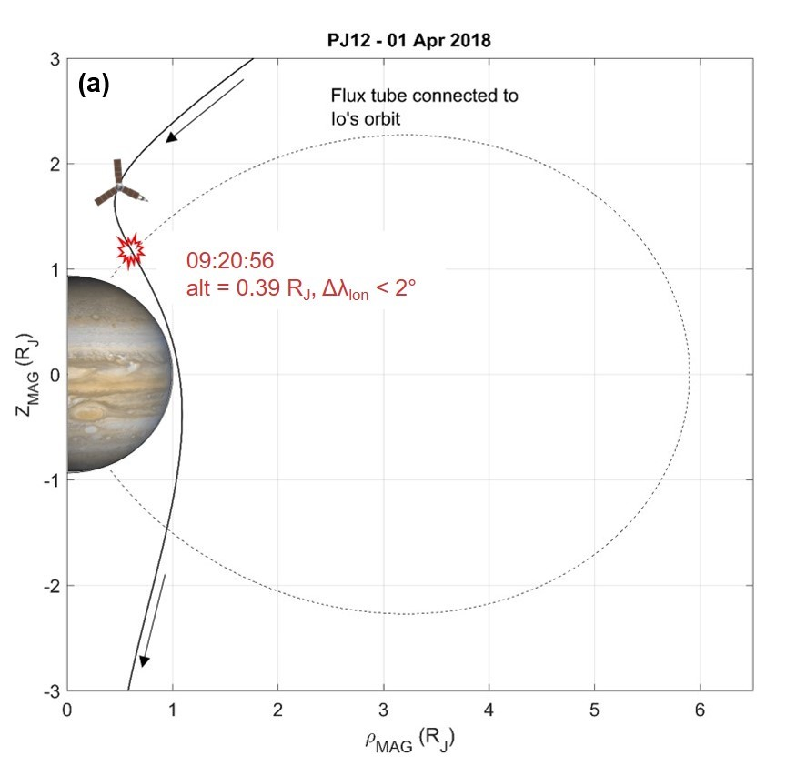
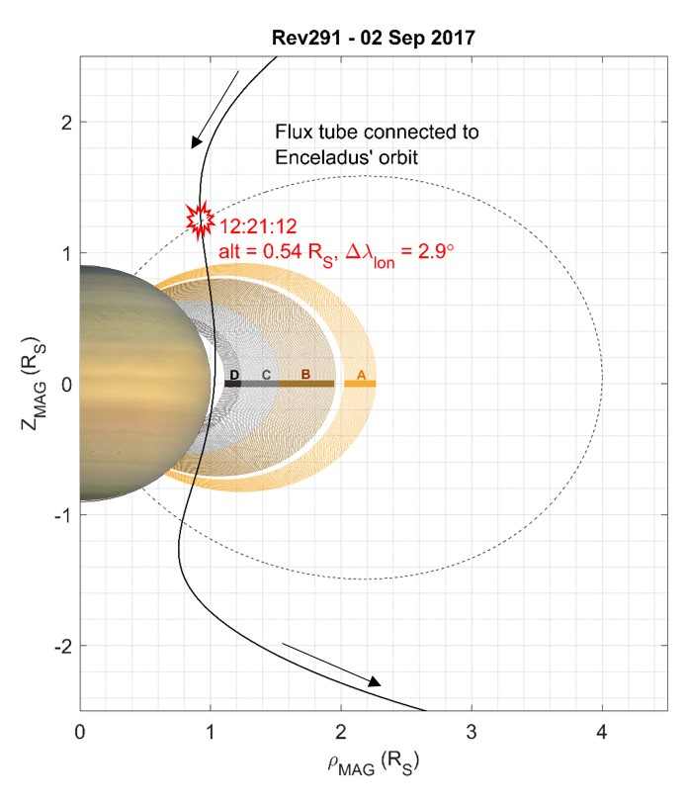
Juno and Cassini on satellite flux tubes
Main Alfvén Wing
(very likely)
Sulaiman et al., GRL, 2020
Sulaiman et al., GRL, 2018

Slide 4
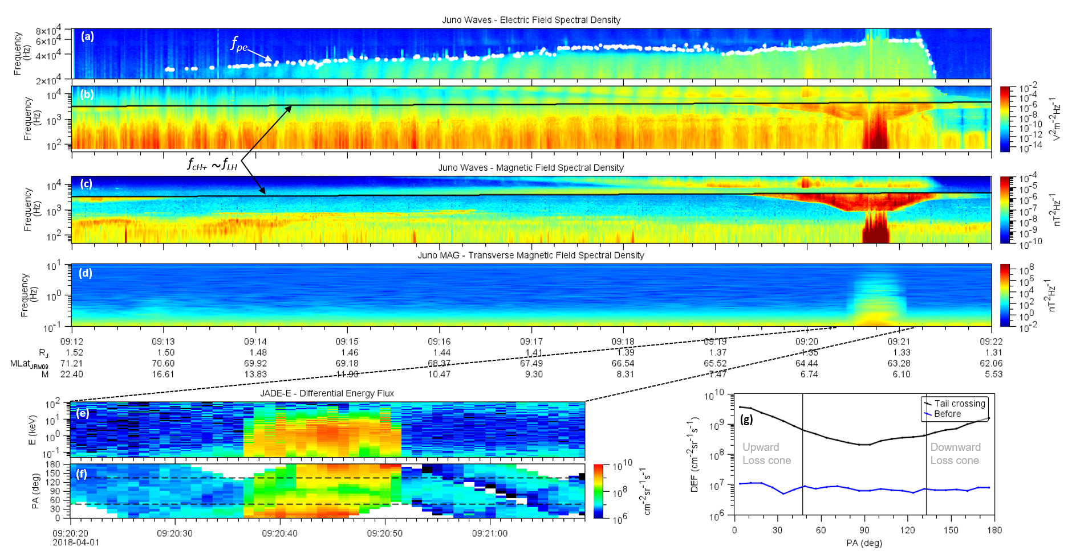
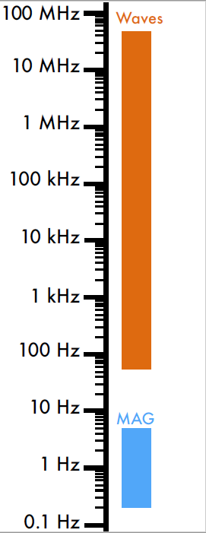
Fields and particles on Io’s Main Alfvén Wing
f_{ci}
f_{cH+}
A
l
f
v
é
n
f_{ci}
Sulaiman et al., GRL, 2020

Slide 5
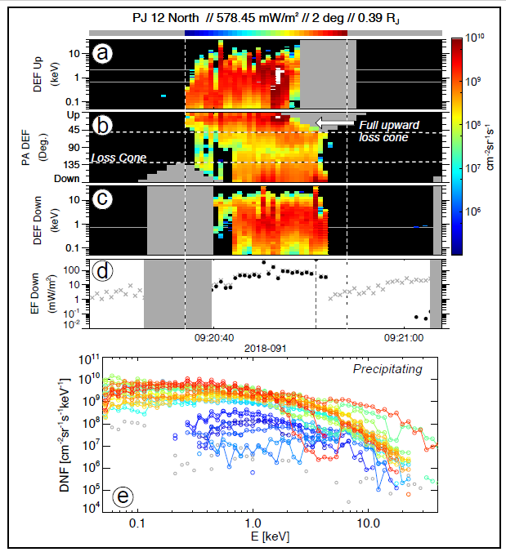
Fields and particles on Io’s Main Alfvén Wing
f_{ci}
f_{ci}
Szalay et al., GRL, 2020

Slide 6
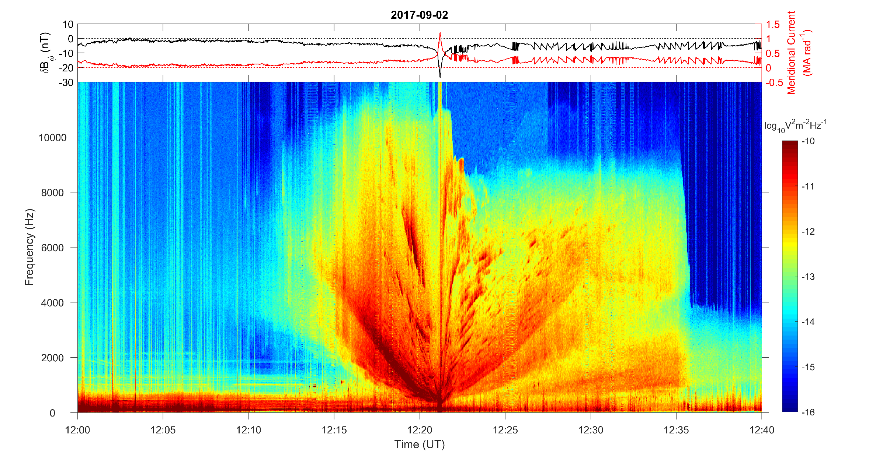
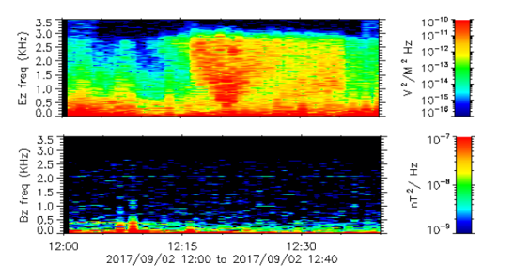
Fields on Enceladus’ Main Alfvén Wing
E-field
B-field
f_{cH+}
Sulaiman et al., GRL, 2018

Slide 7
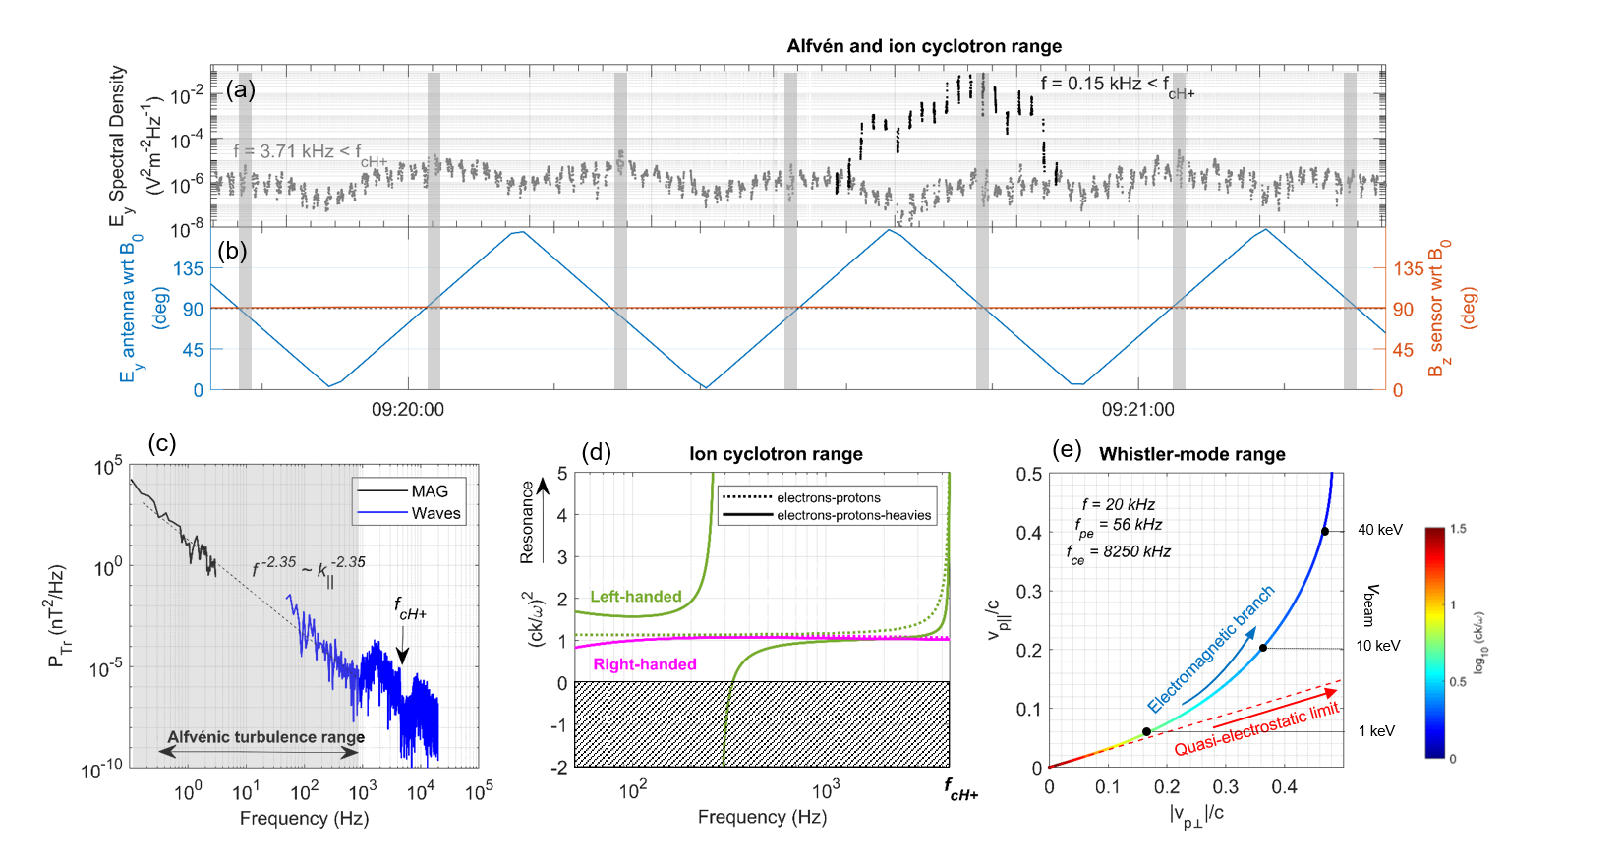
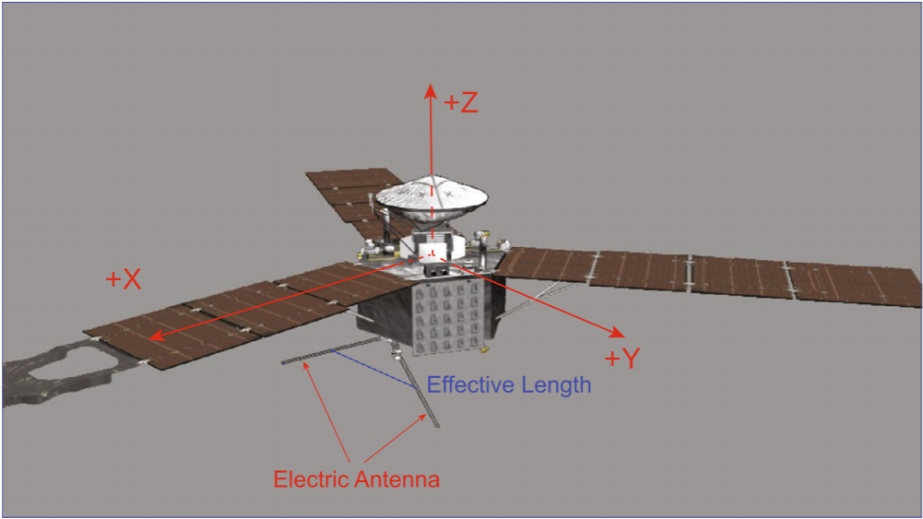
Alfvénic fluctuations Io’s Main Alfvén Wing
Transverse fluctuations consistent with Alfvén waves
Dispersion relation:
ω (=2πf) ~ ck∥
Alfvénic turbulence cascade and broadband, bi-directional electrons suggestive of stochastic acceleration (as opposed to parallel potential)
Sulaiman et al., GRL, 2020

Slide 8
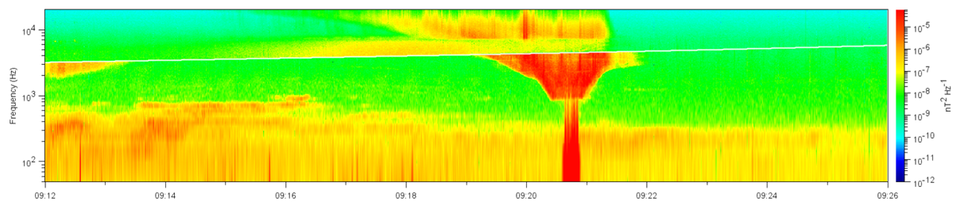

Ion cyclotron heating Io’s Main Alfvén Wing
f_{cH+}
Character of waves on frequency-time spectrogram is consistent with left-handed polarization:
  Resonance at f_{cH+}
Left-handed waves resonate with ions near the ion cyclotron frequency. A maximum ion cyclotron heating rate can be computed such that
Transverse heating → linked to proton conics
$$\frac{dW\text{⊥}}{dt}= S_{E}q^{2}{\left(m_{i}\right)}^{−1}=\sim 500 {eVs}^{−1}$$
Clark et al., GRL, under review

Slide 9
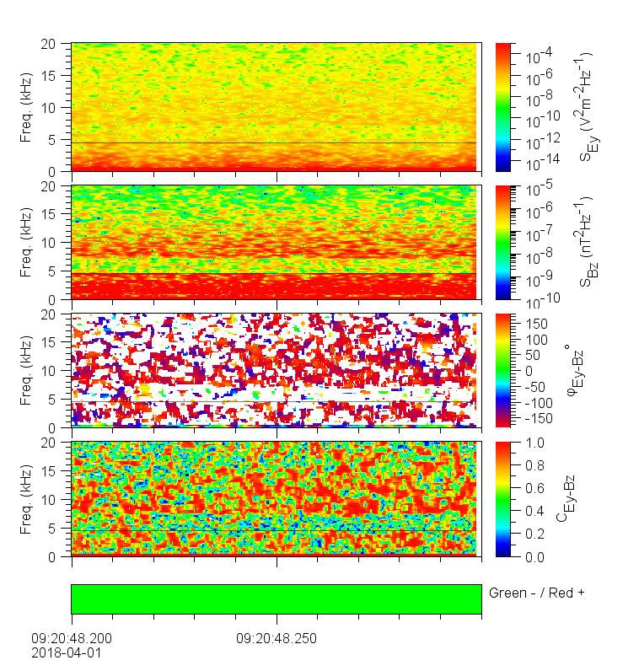
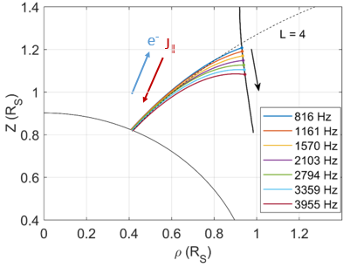
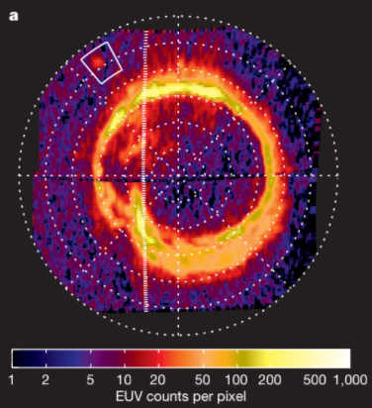
Where are the plasma waves coming from?
E-field
B-field
Enceladus
Ray-tracing identifies the source in the ionosphere therefore propagating upward from Saturn
Io
Poynting vector E × B/μ₀ consistent with energy propagating upward from Jupiter
Pryor+Rymer et al. (2011), Nature

Slide 10
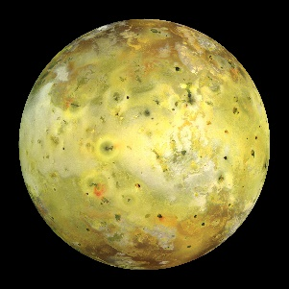
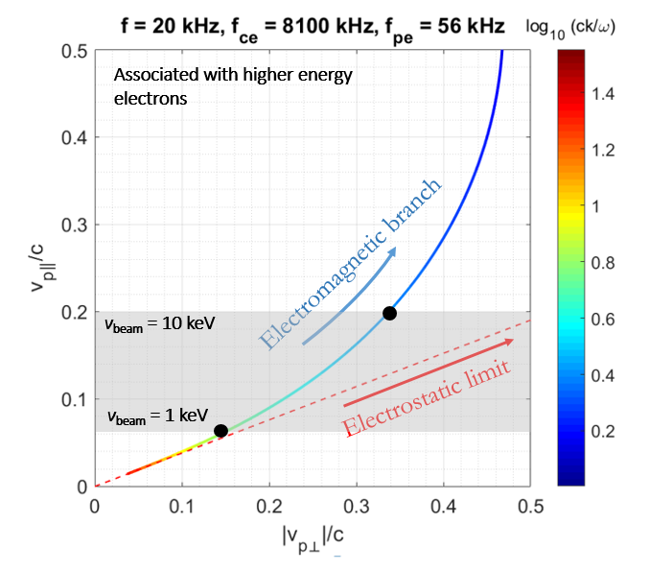

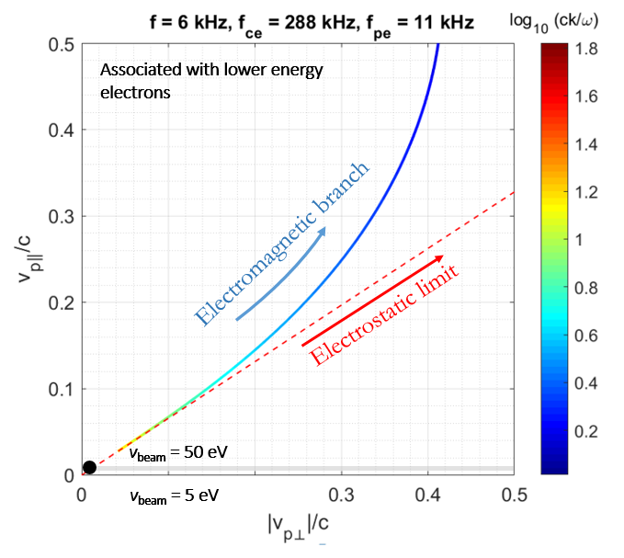
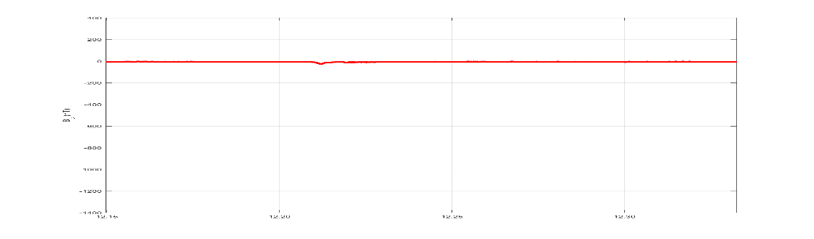
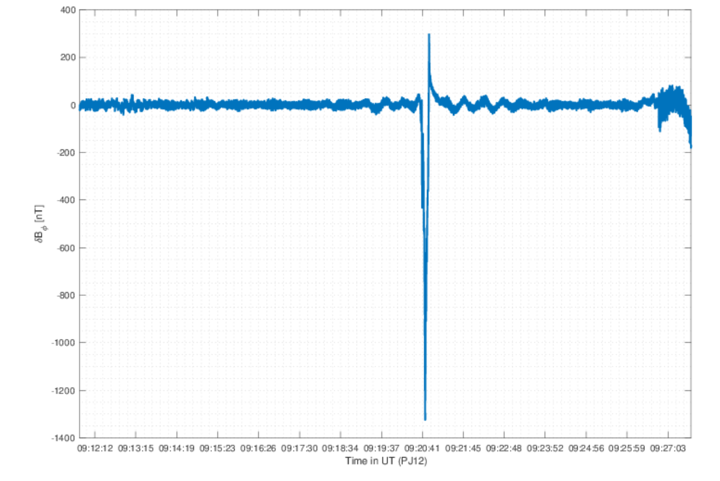
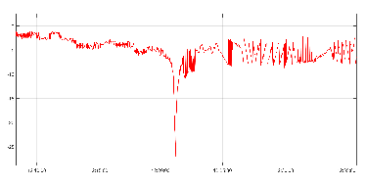
Why is Io electromagnetic? Why is Enceladus quasi-electrostatic?
-1400 to 400 nT
-1400 to 400 nT
δB_{Ф} at Enceladus crossing
δB_{Ф} at Io crossing

Slide 11
Conclusions
Active flux tubes connected to Io’s orbit have been sampled, revealing fields and particles signatures characteristic of auroral processes
  Alfvénic turbulence and broadband electrons consistent with stochastic acceleration
  Intense ion cyclotron heating associated with upward proton conics
  Electron beams unstable to the generation of whistler-mode auroral hiss
Io’s interaction with Jupiter significantly more powerful than Enceladus’ interaction with Saturn. Juno and Cassini in-situ data quantify this comparison:
  Plasma waves (EM vs ES waves)
  Particle energy (eV vs keV range)
  δB_{ϕ} size or field-aligned current strength
Future works
The large number of events enables us to investigate the following dependences: (i) Altitudinal (ii) Longitudinal separation (down-tail) (iii) Centrifugal latitude (iv) Satellite property (Io vs Europa vs Ganymede)
A proposed objective of the Juno extended mission is to target the Alfvén wing local to Io
Papers
Sulaiman et al. (2018), Enceladus auroral hiss emissions during Cassini’s Grand Finale, GRL
Gershman et al. (2019), Alfvénic fluctuations associated with Jupiter’s auroral emissions, GRL
Sulaiman et al. (2020), Wave-particle interactions associated with Io’s auroral footprint, Evidence of Alfvén, ion cyclotron, and whistler modes, GRL
Szalay et al. (2020), A new framework to explain changes in Io’s footprint tail electron fluxes, GRL
Clark et al. (under review), Energetic proton acceleration associated with Io’s footprint tail, GRL

