Slide 1
DEDRA on-board MOVE-III:
An in-situ detector to support space debris model validation
MASTER Modelling Workshop 2021
X.Oikonomidou, E. Karagiannis, M. Schlaak, A. Hacker, P. Pucknus, L. Pretsch, S. Iorgulescu
e-mail: xanthi.oikonomidou@esa.int

Slide 2
Presentation Outline
Munich Orbital Verification Experiment (MOVE)
Collaboration Framework
Background & Educational Aspects
Mission Concept
Mission Statement
Payload
Data Products
Orbit and Simulations
Orbit & Mission Parameters
MASTER Simulations
Conclusion

Slide 3
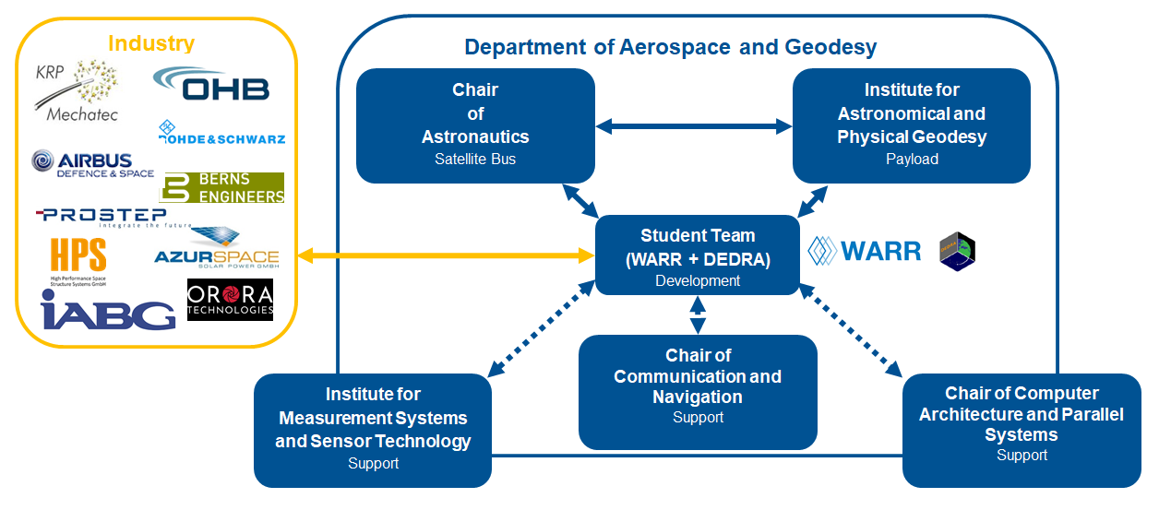
MOVE-III – Collaboration Framework
Technical University of Munich (TUM)
Time
Notes:
Explain what cubesats are

Slide 4
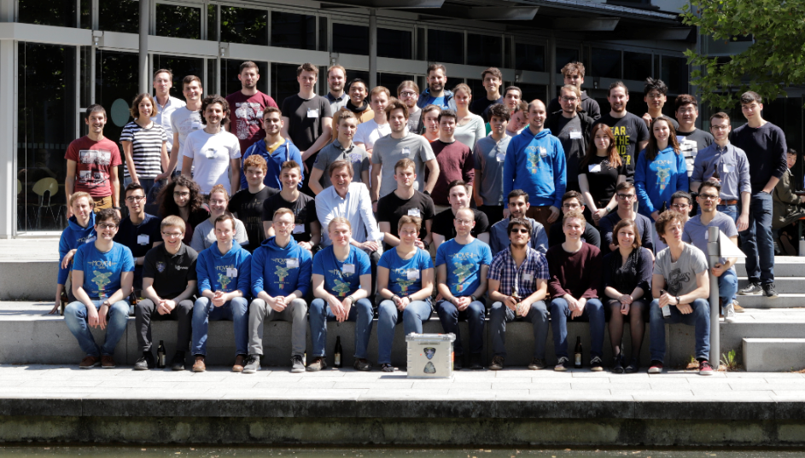
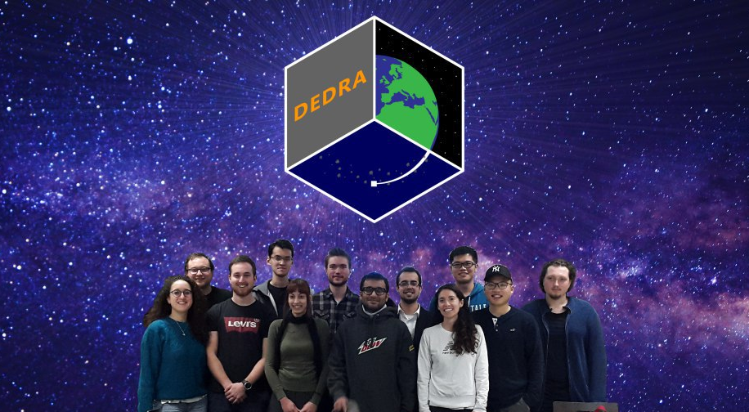
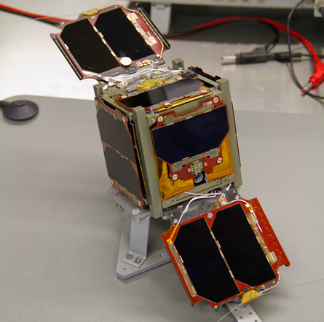
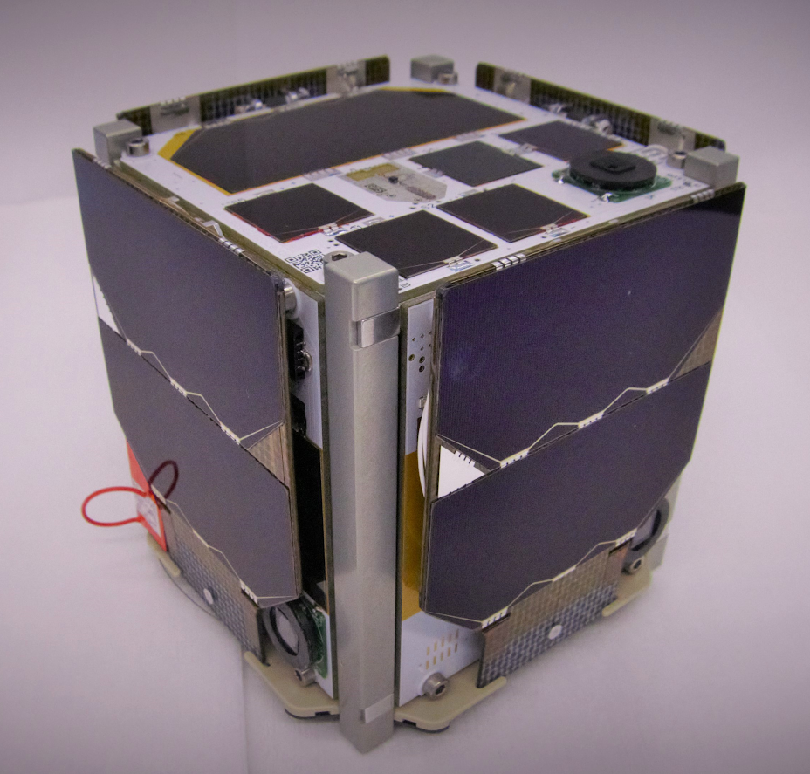
MOVE-III – Background & Educational Aspects
MOVE: Munich Orbital Verification Experiment
DEDRA: DEbris Density Retrieval & Analysis
Student group with main objective: the hands-on education of students in:
spacecraft design
qualification
testing
operation
First-MOVE
MOVE-II
MOVE-IIb
MOVE-III
?
2013
2018
2019
2020
2021
Time
Notes:
Explain what cubesats are

Slide 5
Presentation Outline
Munich Orbital Verification Experiment (MOVE)
Collaboration Framework
Background & Educational Aspects
Mission Concept
Mission Statement
Payload
Data Products
Orbit and Simulations
Orbit & Mission Parameters
MASTER Simulations
Conclusion

Slide 6
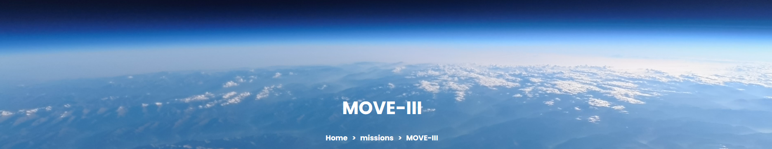
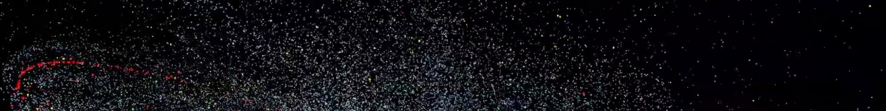
Mission Statement
MOVE-III is the first cross-institutional project of the new Faculty of Aerospace and Geodesy at the Technical University of Munich.
It shall conduct in-situ measurements of submillimetre space debris and micrometeoroid particles, making use of the Debris Density Retrieval and Analysis (DEDRA) sensor. The mission shall help to validate and improve the space debris models and contribute to the characterization of the space environment in low earth orbit.
Design, testing and operations shall be carried out as hands-on education for students of the Technical University of Munich under guidance and supervision from the Chair of Astronautics and the Institute for Astronomical and Physical Geodesy.

Slide 7
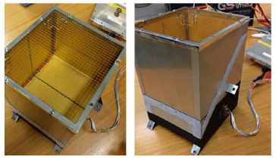
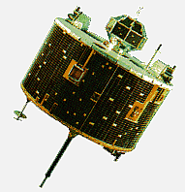
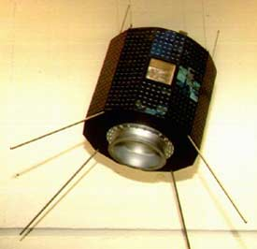
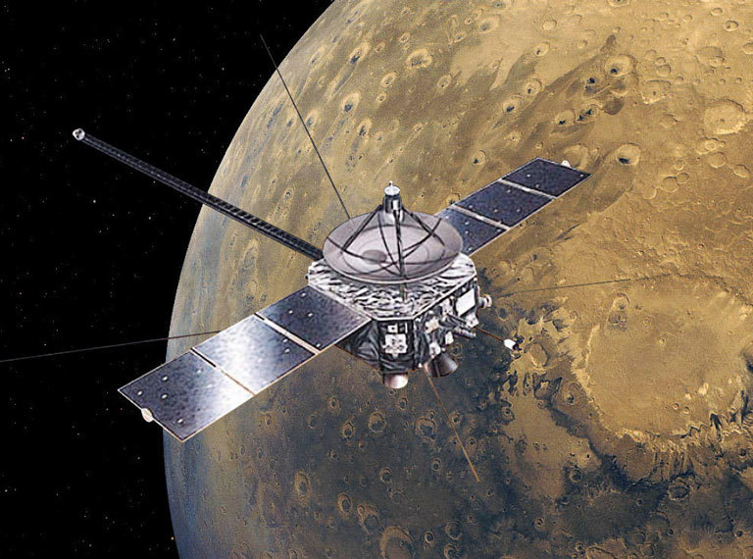
Payload – DEDRA
Heritage: Munich Dust Counter (MDC)
HITEN (MUSES-A) – 1990 to 1993
BREMSAT – 1994 to 1995
NOZOMI (PLANET-B) – 1998 to 2003

Slide 8
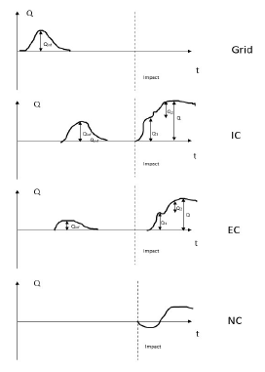
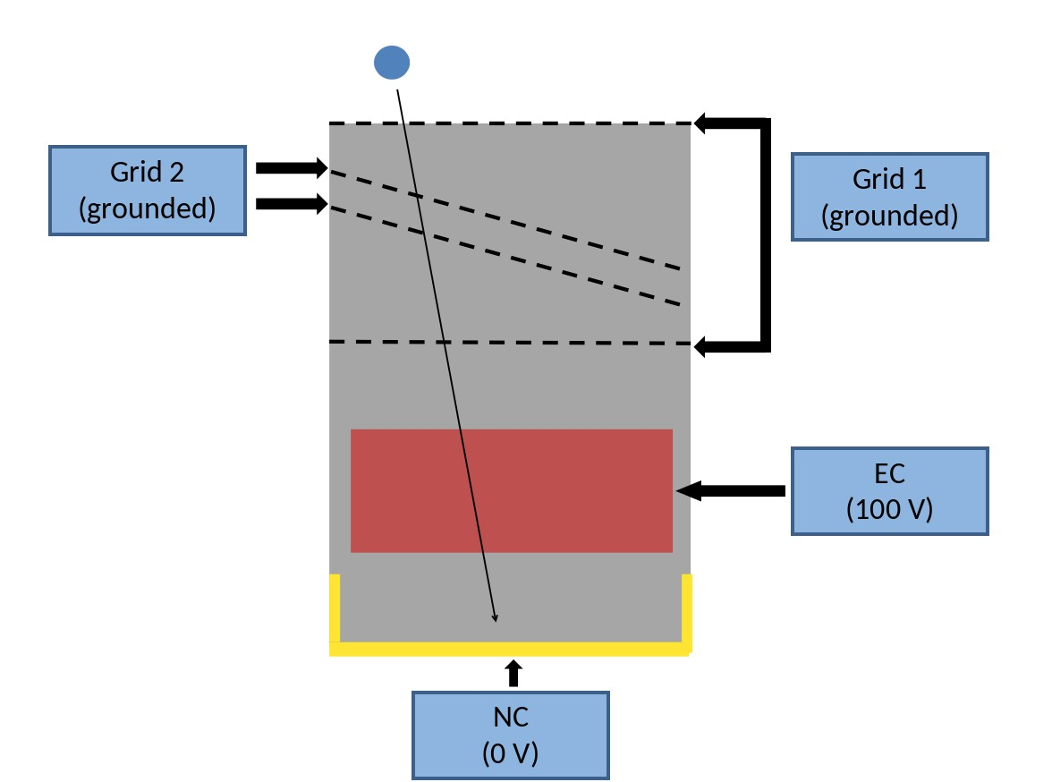
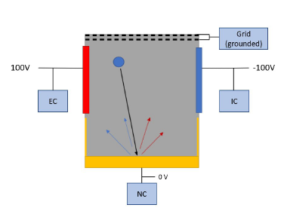
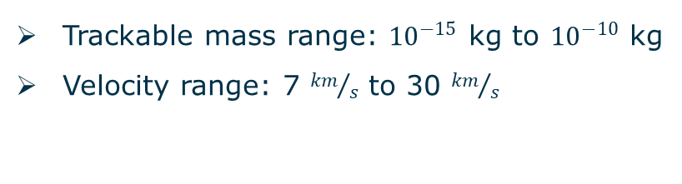
Payload – DEDRA
DEDRA is based on the MDC design and follows the same measurement principle
All electronic components are being re-designed
An advanced sensor design is proposed
Measurement Principle
& Sensor Design
Baseline Design
Advanced Sensor Design
Trackable mass range: ${10}^{−15}$ kg to ${10}^{−10}$ kg
Velocity range: 7 ${km}/s$ to 30 ${km}/s$

Slide 9
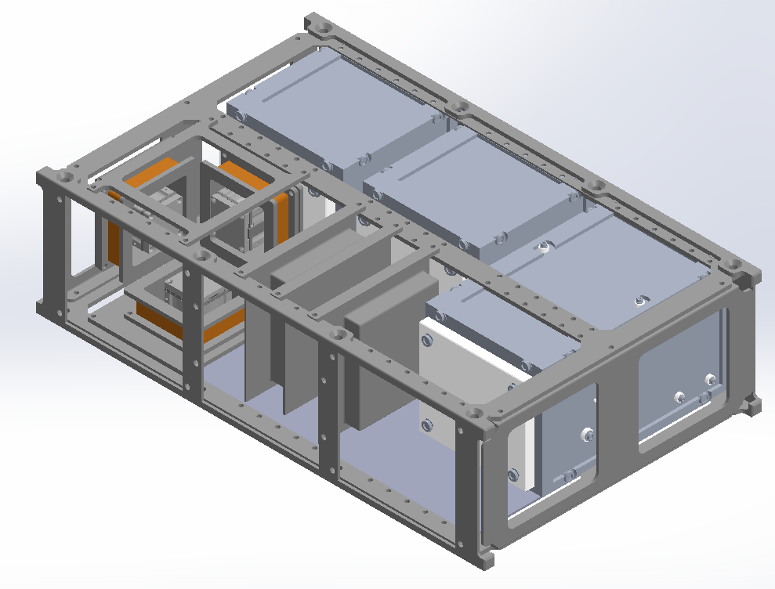
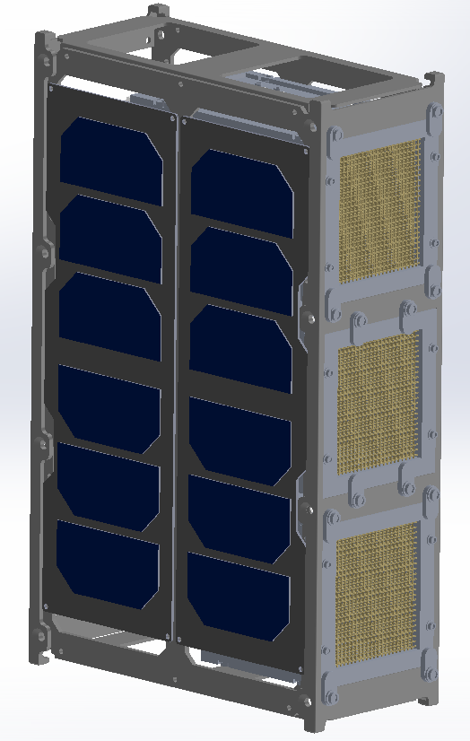
Payload – DEDRA
Mechanical Design & Sensor Configuration
Flight direction
10 cm
30 cm
20 cm

Slide 10
Data Products
Level-0
Calibration
Science Data Packet
Time of impact
Rise-time
Maximum voltage
Total number of impacts
Speed, mass, and rough declination of impactor
Product A:
Total Flux
Level-1A
Level-1B
Level-2A
Existing Statistics
Product B1:
SD vs meteoroids
Impactor Classification
Level-2B
Product B2:
SD sub-classes
Advanced Sensor Design
Velocity vector
Altitude and declination
Orbital elements
Product C:
Orbital Param. (II)

Slide 11
Presentation Outline
Munich Orbital Verification Experiment (MOVE)
Collaboration Framework
Background & Educational Aspects
Mission Concept
Mission Statement
Payload
Data Products
Orbit and Simulations
Orbit & Mission Parameters
MASTER Simulations
Conclusion

Slide 12
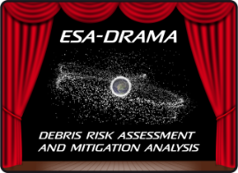
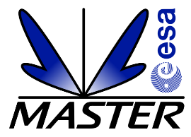
Orbit & Mission Parameters
Requirements
Mission lifetime > 1 year
Sun-synchronous orbit (~98°inclination)
High small space debris and meteoroid flux
Low flux of large objects
Compliance with space debris mitigation guidelines (de-orbiting within 25 years)
Low system complexity
Likely Orbit Range
500 – 600 km
OSCAR
ARES
MIDAS
Total of 125-215 impacts/year, depending on orbit & simulation year
Notes:
1 impact every three days

Slide 13
MASTER-8 Simulations
550 km, 2024-2025:
146 impacts: 114 meteoroids, 32 SD
78% meteoroids, 22% SD
600 km, 2024-2025:
202 impacts - 114 meteoroids, 88 SD
56% meteoroids, 43% SD
Notes:
How much percent are the meteoroids?

Slide 14
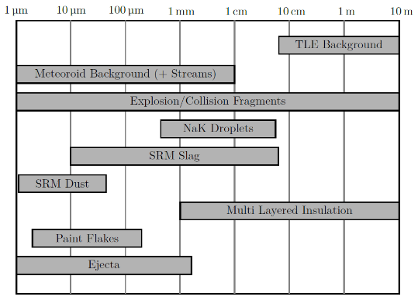
MASTER-8 Simulations
1
2
22% of total SD
69% of total SD
1-2% of total SD
4
5
2
3
1
Notes:
How much percent per source?

Slide 15
Presentation Outline
Munich Orbital Verification Experiment (MOVE)
Collaboration Framework
Background & Educational Aspects
Mission Concept
Mission Statement
Payload
Data Products
Orbit and Simulations
Orbit & Mission Parameters
MASTER Simulations
Conclusion

Slide 16
Conclusion
MOVE-III is a CubeSat project of the Technical University of Munich
MOVE-III aims at providing in-situ measurements of submillimeter space debris and meteoroids, in order to support and validate the current space debris models
DEDRA is the payload of MOVE-III. It is a plasma ionization sensor, which can provide the mass, the velocity and potentially (with the advanced design) the direction of the incoming particles.
MASTER predicts approximately 125-215 impacts within a year (for altitudes between 500 km and 600 km and simulations years between 2023-2027) on the three DEDRA sensors.

