Slide 1
Impact flux predictions with MASTER
A presentation for the ESA workshop
02.-04.03.2021
Maximilian Klaß, Gerhard Drolshagen, Robin Putzar, Detlef Koschny and Björn Poppe
Image credit: ESA

Slide 2
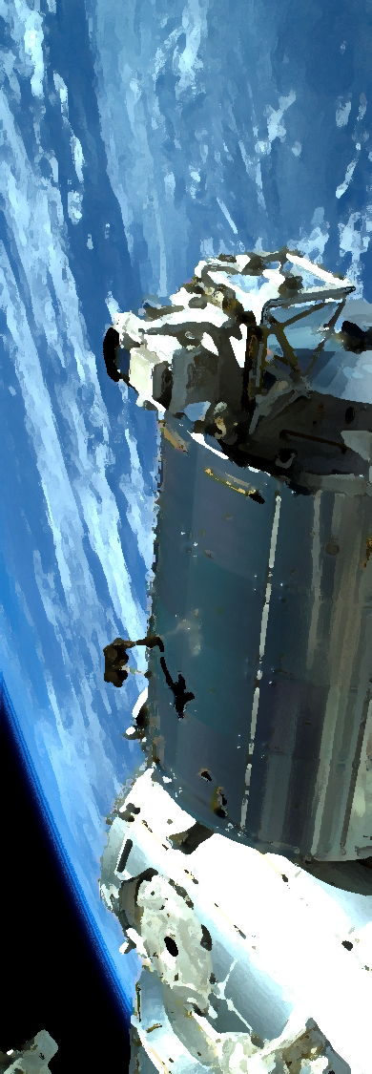
Table of contents
Background
Software
Geometrical Analysis
Non-Geometrical Analysis
Comparison with the impact survey
Conclusion

Slide 3
Background
The Columbus module, Image Credit: DLR

Slide 4
Background
Impact craters on the surface of the Columbus module

Slide 5
Background
Based on my work with MASTER during my bachelor thesis „Predictions of impact fluxes on the Columbus module of the ISS“
How frequent are meteoroid and debris impacts in the Near Earth Environment?
Goal: Compare flux predictions of different theoretical models (and with data from the impact survey)

Slide 6
Software
ESABASE2/debris was used for most flux calculations
Customization: mission, orbit, spacecraft and debris settings
Contains various flux models, e.g. Grün meteoroid model, ORDEM and (older) MASTER debris models
Also used the standalone MASTER software for the most up-to-date version

Slide 7
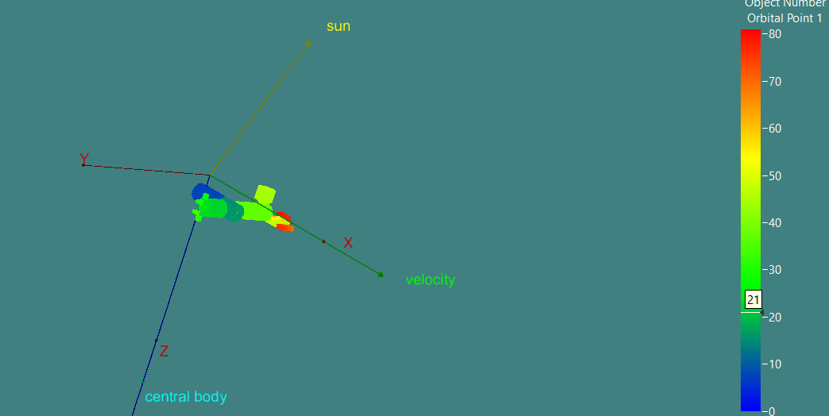
Geometrical Analysis
Figure 1: The geometry editor in ESABASE2/debris

Slide 8
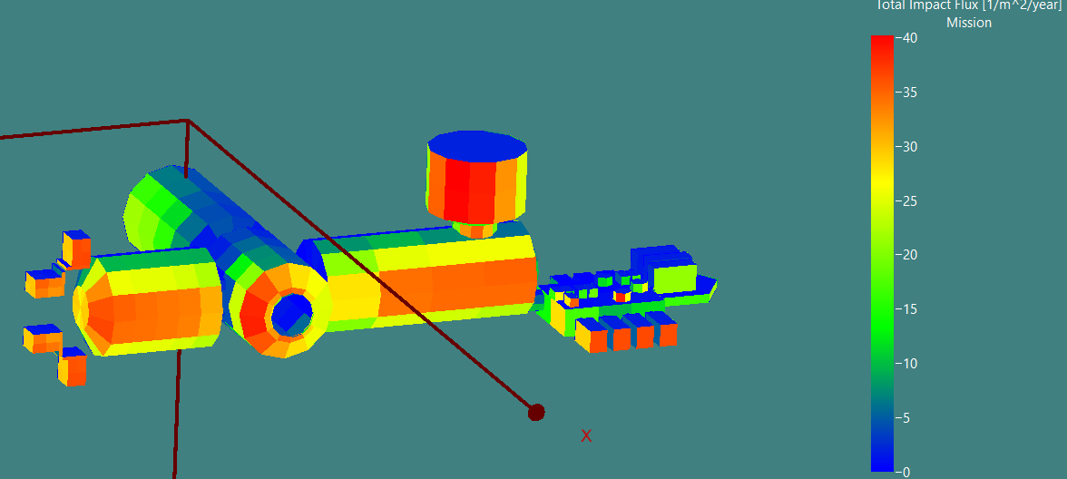
Geometrical Analysis
Figure 2: Debris flux /$m^{2}/year$ for the MASTER 2009 model, with 0.01 cm minimum particle diameter

Slide 9
Non-Geometrical Analysis
Square plate in Earth orbit with 1$m^{2}$ per side
Plate is oriented, with the surface normal pointing in flight direction
ESABASE2, as well as the MASTER standalone software were used

Slide 10
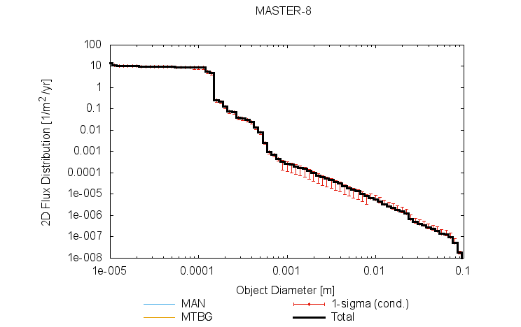
Non-Geometrical Analysis
Figure 3: Impact flux for the MASTER model for a RAM-oriented plate in ISS-like orbit

Slide 11
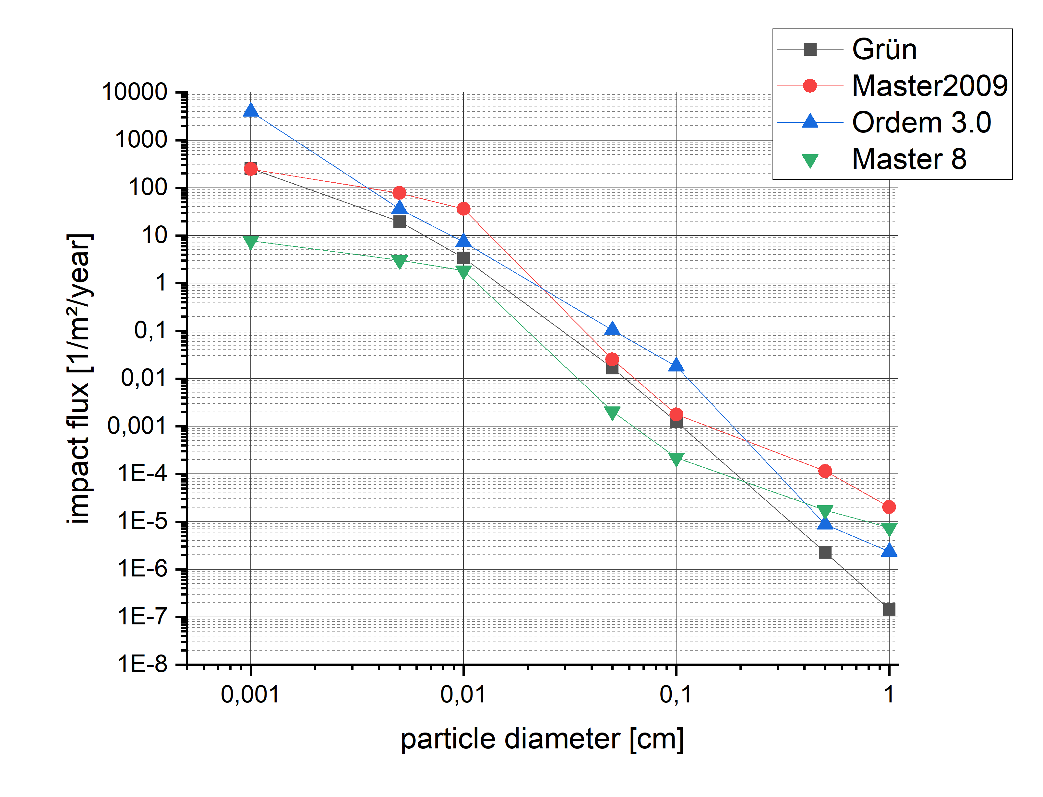
Non-Geometrical Analysis
Figure 4: Impact flux for the different space environment models for a RAM-oriented plate in ISS-like orbit

Slide 12
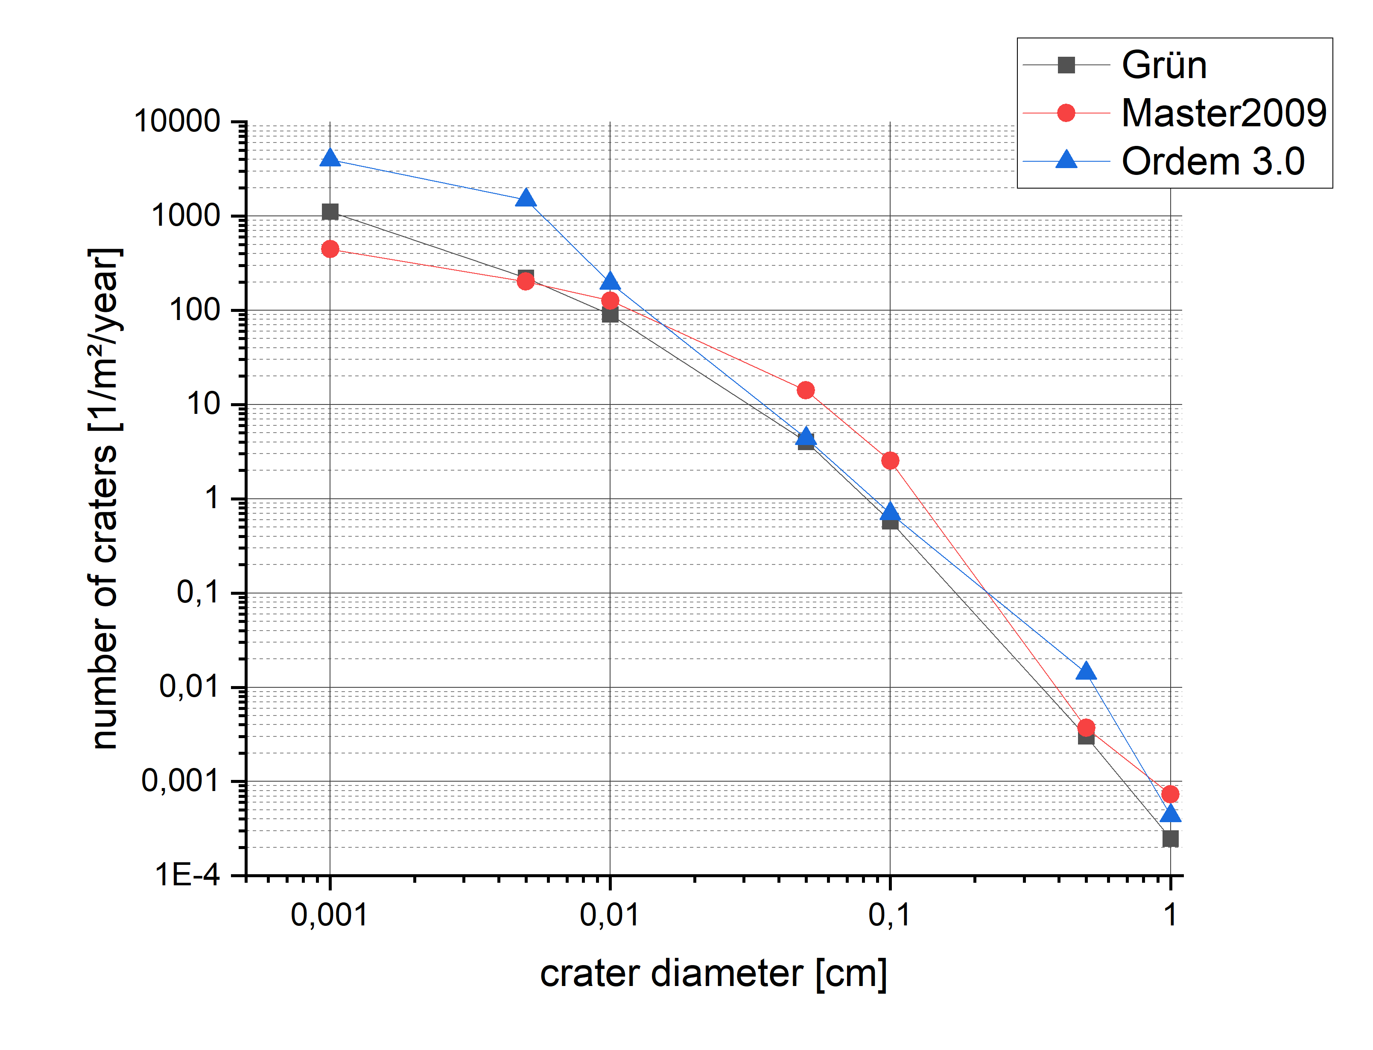
Non-Geometrical Analysis
Figure 5: Number of expected craters on the front facing surface of the RAM-oriented plate for different models

Slide 13
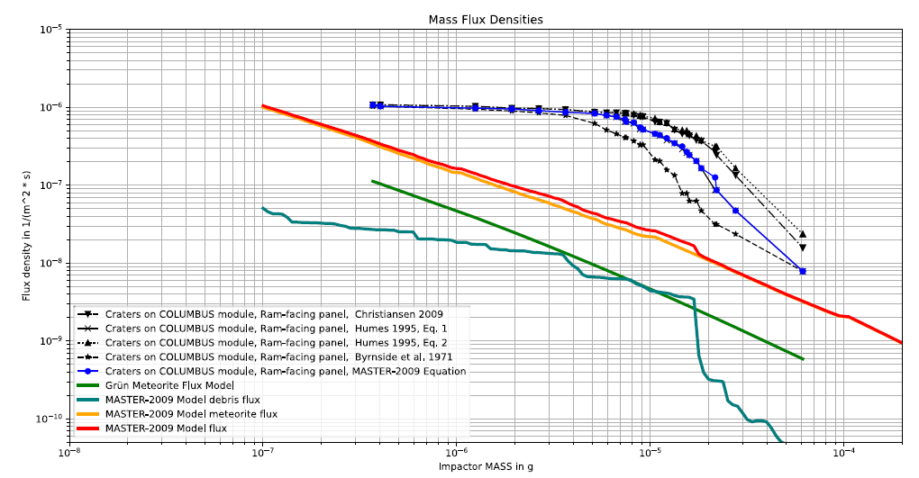
Comparison with impact survey data
Figure 6: Impact flux densities on a RAM-facing panel of the Columbus module. Source: Lee/Kellner

Slide 14
Conclusion
The story is not over: More impact survey data is going to be analysed
MASTER standalone provides an intuitive and handy GUI, however less features than ESABASE2/debris
Data can be easily visualized and/or exported to be analysed further
Integration into ESABASE2 would add useful functionality and make it easier to compare debris models

Slide 15
Thank you for your time!

