Slide 1
Internship presentation
MMOD modelling in an industrial context:
The use and application of MASTER
B. Zitouni, S. Gonzalez Garcia, R. Kast

Slide 2
Overview:
Overview
MMOD Assessment process by OHB:
Project needs
General MMOD Analysis process
Detailed MMOD Analysis methodology
MMOD Modelling
Master use and comparison M2009 vs M8 outcome
Connection to Systema (stenvi files)
Conclusion: open discussion
MM models change? Why? [Results are weirder in new MASTER]
New Stenvi file format?

Slide 3
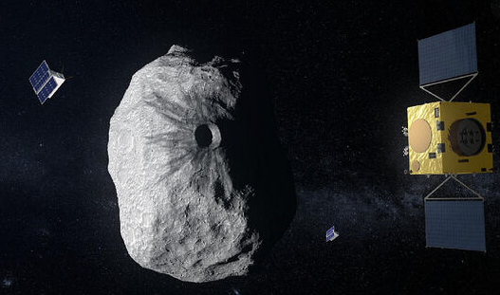
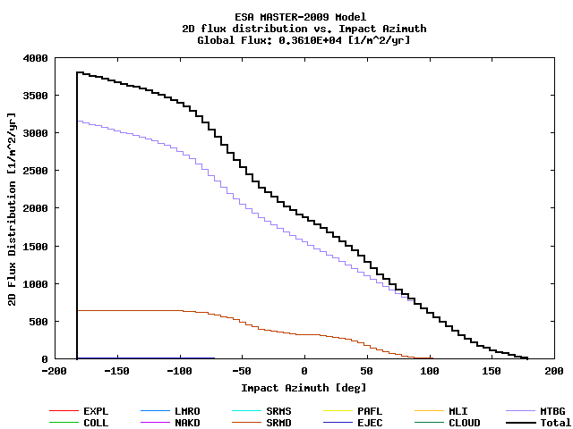
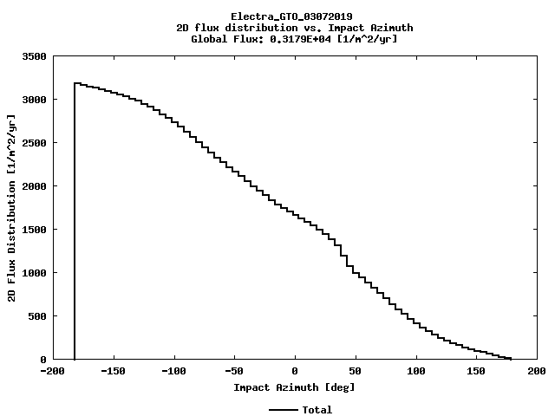
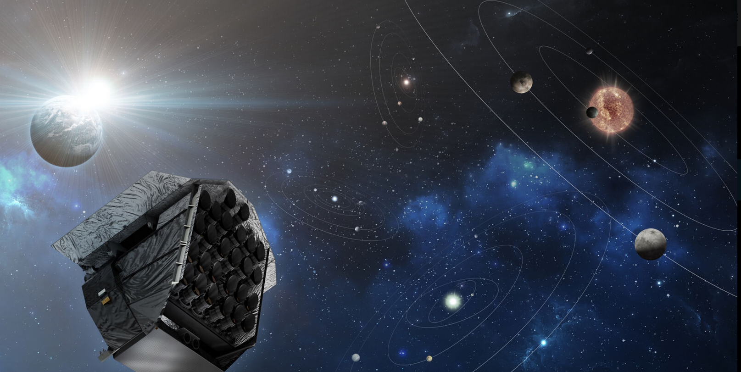
Project needs:
Modelling & Analysis Group
OHB variety of missions: LEO, MEO, GEO, Exploration. Needs to study several MMOD environment and not only one type
LEO: 2 Observation satellites + CO2M
MEO: Galileo first generation satellites
GEO: Telecommunication satellites (H2SAT, Electra –orbit raising-) + Scientific (MTG)
Exploration: Plato, HERA
Exploration
LEO
GEO
Project have specific needs for units or the whole satellite, to assess the PNF
Lagrange L3 =>

Slide 4
MMOD Analysis process:
Modelling & Analysis Group
Goal: check if the design is correct with regard of the studied subject
These types of environment analysis interact with several disciplines:
Design
Thermal
Materials
Mission definition (orbit + Environment)
Interactions in two directions:
Defining the analysis
Flowing the outputs to the impacted subsystems
Loop if analysis show a design flow
Inputs
Analysis
Results
Design: geometry STEP file
Thermal: simplified list
Materials: list with appropriate properties for the study
Mission definition:
Orbit:
altitude and latitude
Local time and season
Environment:
MM models
Manmade debris
STENVI Files
Implementation into model
Meshing
Mission and Environment definition
Numerical assessment
Ray-tracing
Surfaces orientation
Sufficient iterations for confidence in results
Results adapted to project needs
Comparison with requirements
Check if analysis too conservative
Identification of possible problems
New loops if necessary
PPT for intermediate results

Slide 5
MMOD Analysis Methodology
MMOD modelling in an industrial context (OHB)
Depending on the project state: PDR or CDR, we go more in details if needed
Simplified process at early satellites stages: « MASTER + EXCEL »
Define Environnement with MASTER
Load MASTER ouput file in our own Excel tool
Make a first assessement for surfaces, for different BLEs, at different angles
Provide a first PNP
Detailed assessment at advanced stages: “MASTER + SYSTEMA”
Defining the the meteoroids and orbital debris (M/OD) flux model from MASTER
Simplifying the spacecraft geometry within Systema
Computation of equipment vulnerability
Identifying structures and elements within the model
Defining the material parameters
Choosing the correct equations
Evaluating the Probability of No Penetration (PNP)

Slide 6
MMOD modelling: MASTER use and comparison
MMOD modelling in an industrial context (OHB)
Comparison between M2009 and M8
Target orbit
Performed for:
MASTER 2009
MASTER 8
Grün model – Grün distribution
Grün model – Taylor distribution
Divine-Staubach model (Grün distribution)
Divine-Staubach model (Taylor distribution)

Slide 7
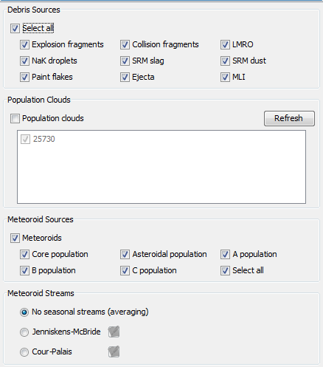
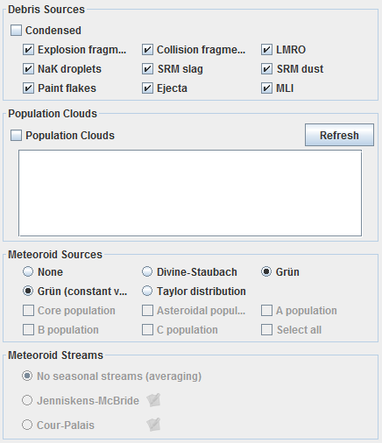
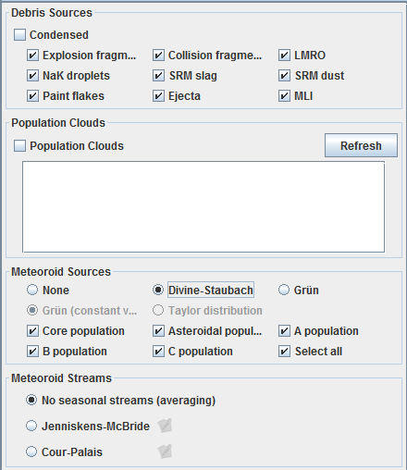
MMOD modelling in an industrial context (OHB)
First Comparison Analysis
Master 2009 | Master 8 Grün – Grün | Master 8 Divine-Staubach (Grün option)

Slide 8
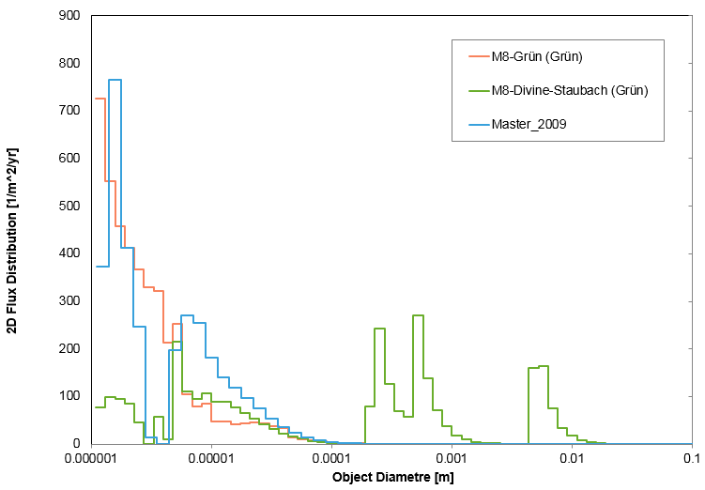
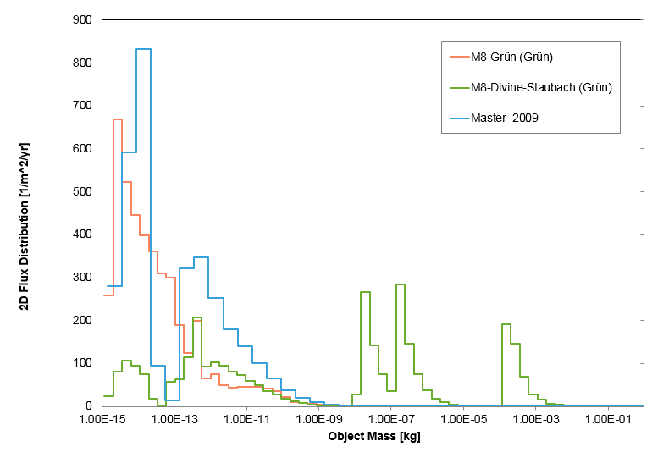
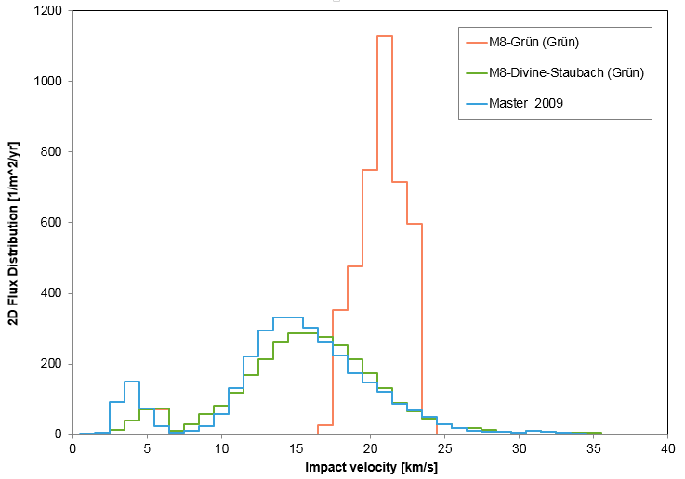
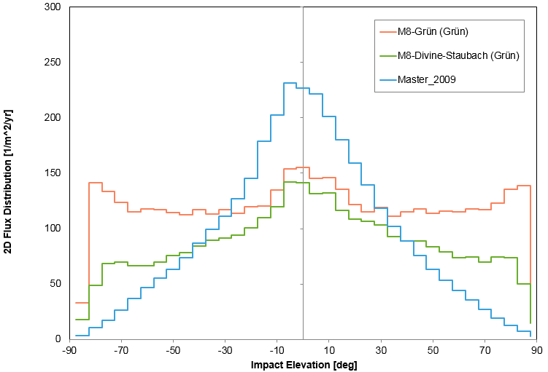
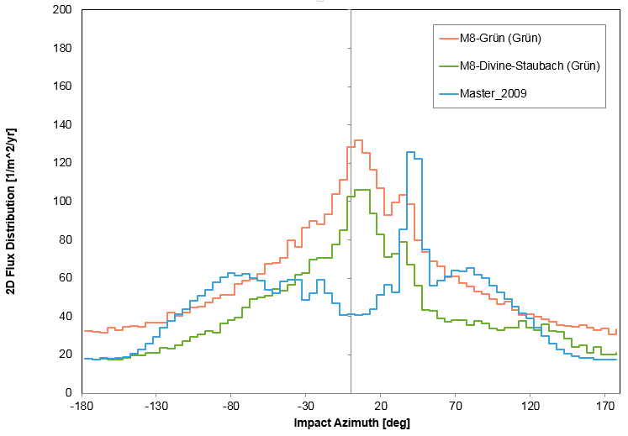
MMOD modelling in an industrial context (OHB)

Slide 9
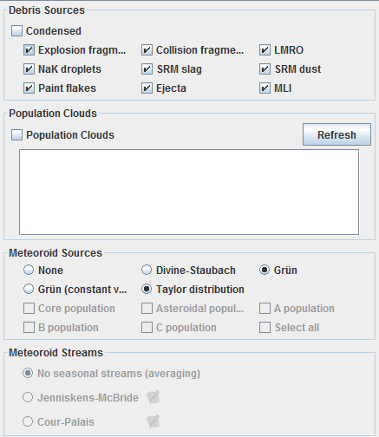
MMOD modelling in an industrial context (OHB)
Suggestions of change from ESOC
Master 8 Grün – Grün | Master 8 Grün – Taylor

Slide 10
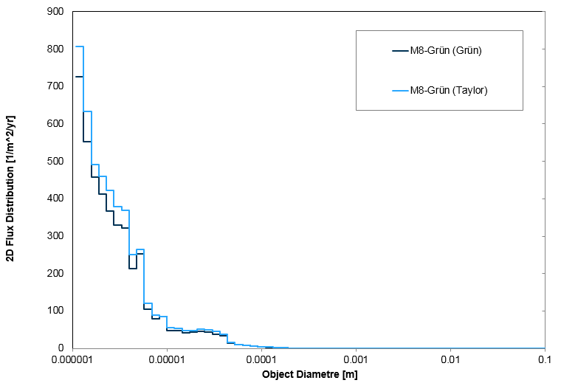
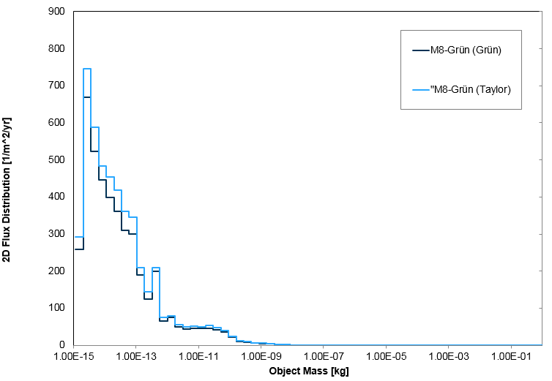
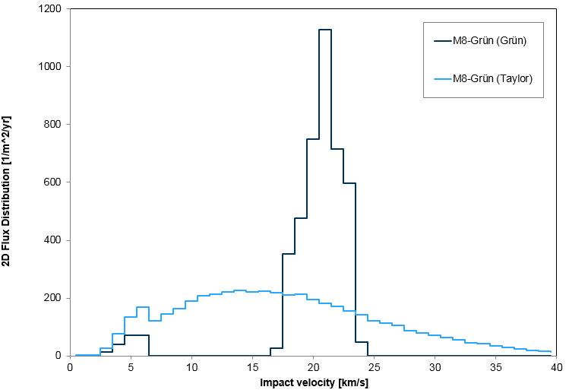
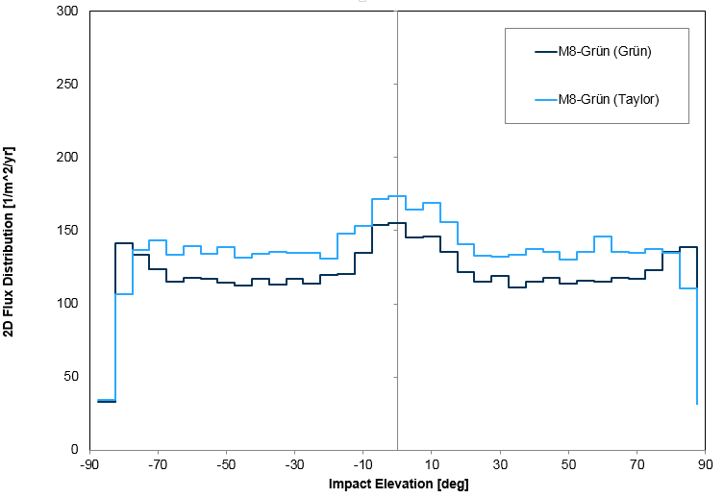
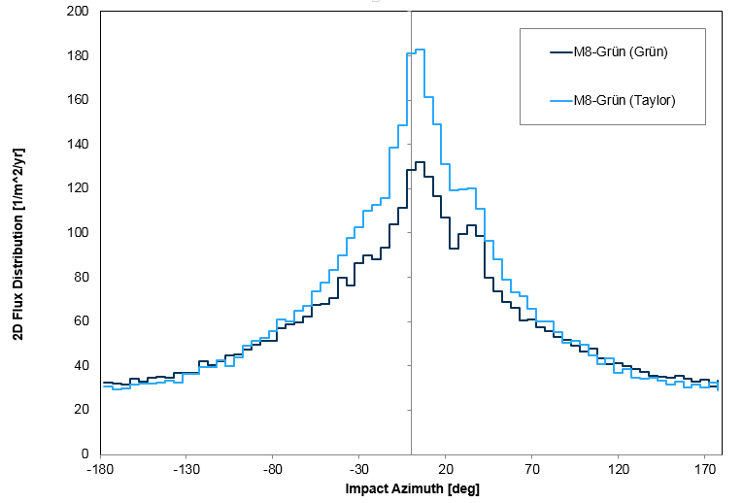
MMOD modelling in an industrial context (OHB)

Slide 11
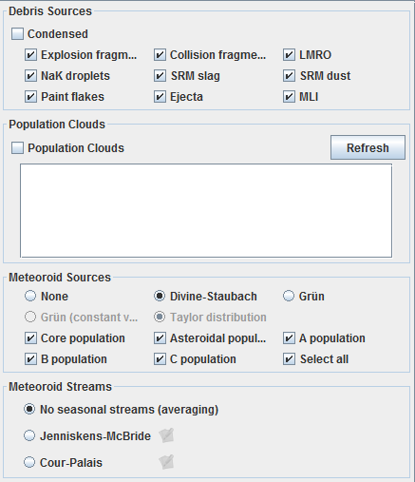
MMOD modelling in an industrial context (OHB)
Second Comparison Analysis
Master 2009 | Master 8 Grün – Taylor | Master 8 Divine-Staubach (Taylor option)

Slide 12
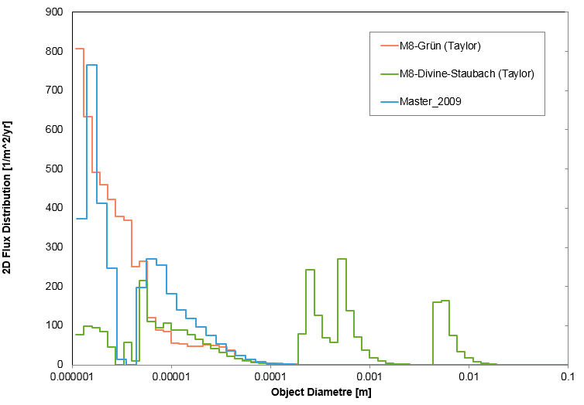
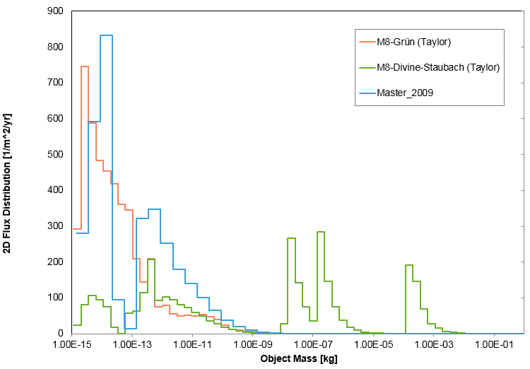
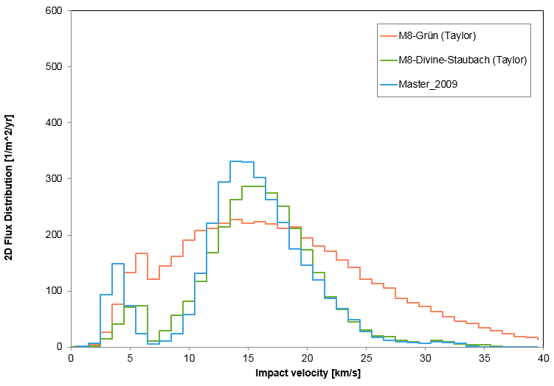
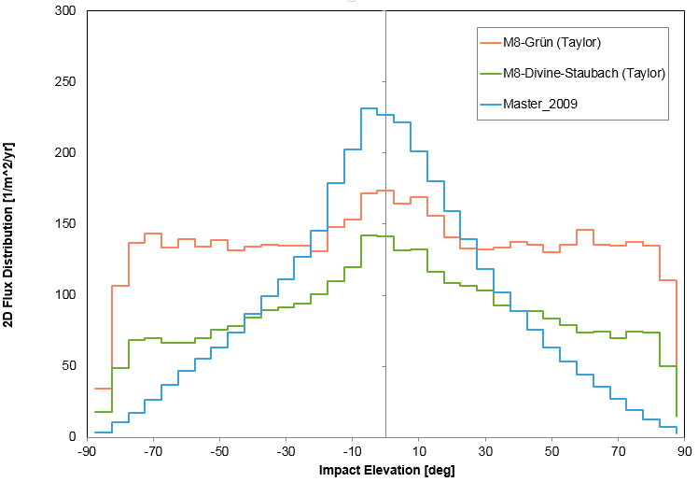
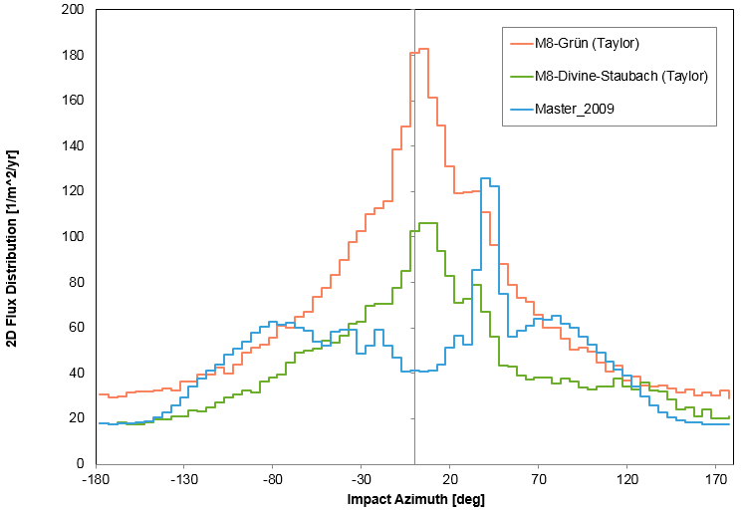
MMOD modelling in an industrial context (OHB)

Slide 13
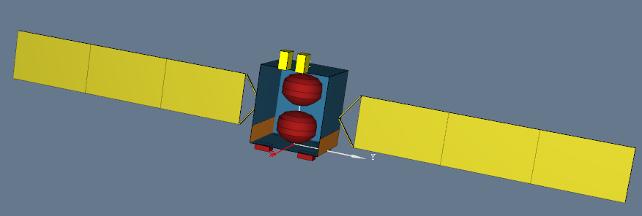
Impact risk assessment
MMOD modelling in an industrial context (OHB)
Risk of failure assessed by using:
Spacecraft information (geometry, trajectory…)
Ballistic limit equations (stablishing the failure criteria)
Directional collision fluxes derived from MMOD models
Measure of risk : Poisson statistics relations
$P_{imp}=1−e^{−Nimp} → PNF=e^{−Nimp}$
($N_{imp}=\left(flux\right) x \left(area\right) x (time)$)
Link with MASTER?

Slide 14
Link with MASTER: Stenvi files
MMOD modelling in an industrial context (OHB)
First difficulty: how to define the BIN?
#--------------------< Definition of the output spectrum >----------------------
# Bin Min Max
AZIMUTH 18 -180.0 180.0 Azimuth [deg]
ELEVATION 18 -90.0 90.0 Elevation [deg]
VELOCITY 2 0.5 20.5 Velocity [km/s]
DIAMETER 40 0.1E-04 0.1E+02 Diameter [m]
LATITUDE 1 0.0 360.0 Argument of True Latitude [deg]
DENSITY 200 0.0 5.0 Density [g/cm^3]
How the link with the “different years scenarios” is performed?
Stenvi only provides Lower border and Uppers Borders, averaged in time
Some information are lost afterwards in the simulation (exact distribution according to the particles sizes)

Slide 15
Conclusion: open discussions
MMOD modelling in an industrial context (OHB)
Micrometeoroids and Debris assessment
The use of MASTER 2009 is recommended until the MASTER 8 Divine-Staubach model patch is released and a more exhaustive investigation on the Grün model has been performed
An exchange with ESA/ESOC about the MASTER new version investigation was performed
The use of Grün model with Taylor distribution is recommended
Why change of the MM models? Not stable in new MASTER
Use of new orbits such as Lagrange Points, exploration… How reliable is the tool? Limitations?
Link with Systema: STENVI files, open for discussions
Some questions remains open: different years scenarios, averaged values, information lost later

