Slide 1
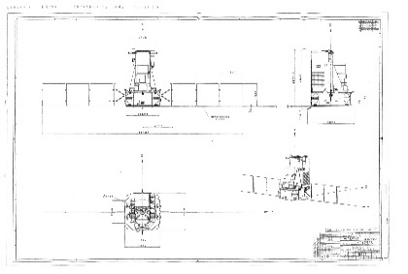
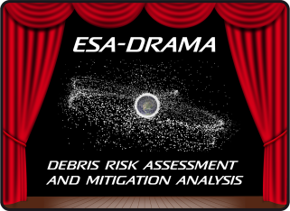
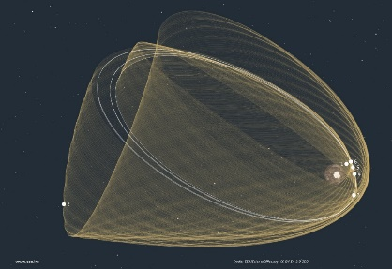
Use of MASTER and ARES for Operational Collision Avoidance Support Planning
Manoeuvre Threshold
& Strategy
Master Modelling Workshop 2021
March 3, 2021
Francesca Letizia | Sven Flegel | Klaus Merz ESA Space Debris Office
Notes:
2 min

Slide 2
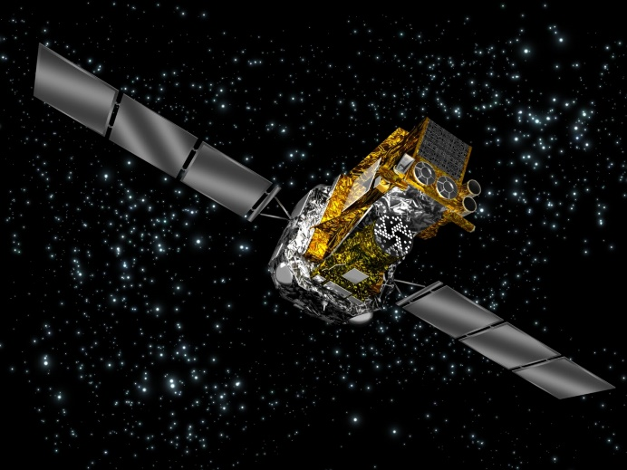
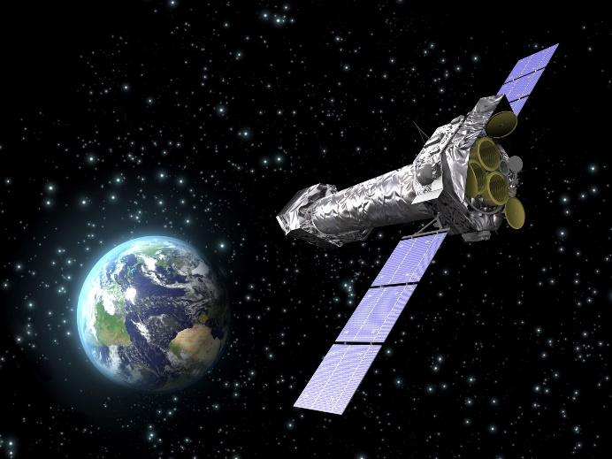
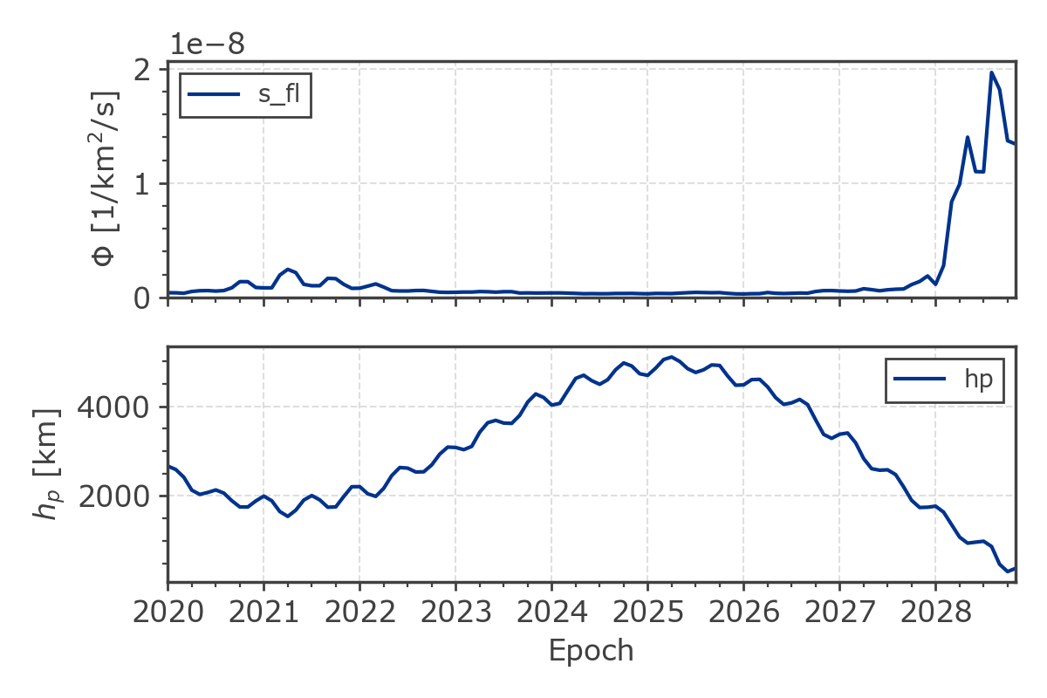
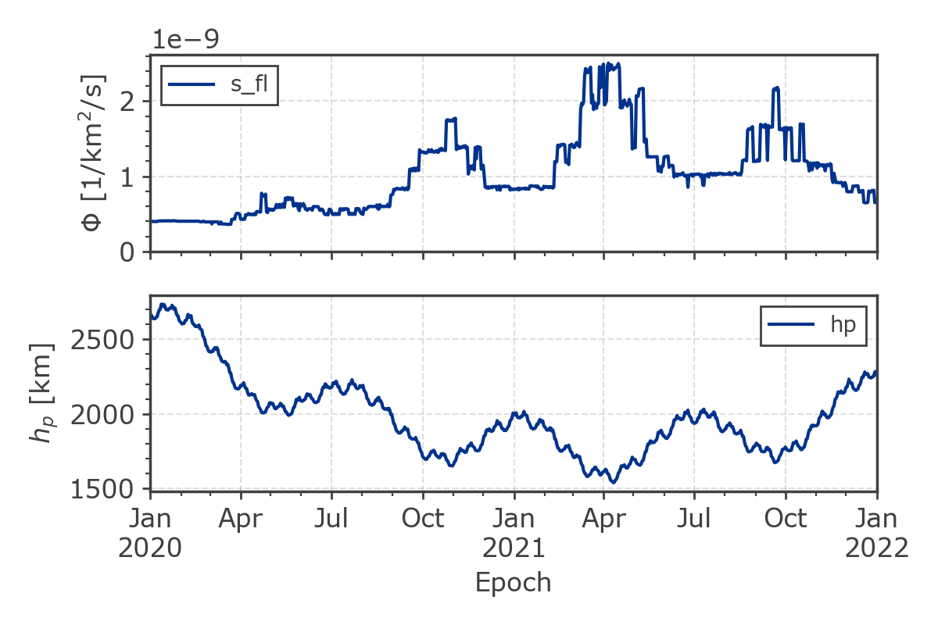
Collision Avoidance Analysis for HEO missions
Integral
LEO crossing Sept 2020-Nov 2021
XMM
GEO crossing mid 2020-mid 2029
GEO_{IADC}
Notes:
2 min

Slide 3
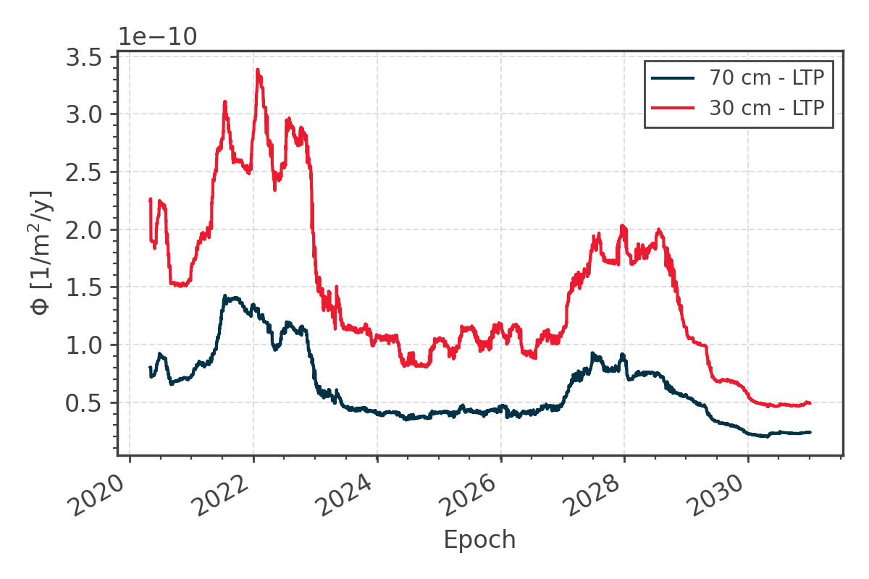
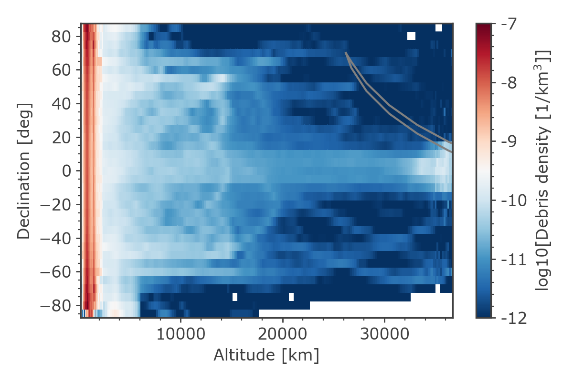
Flux analysis – Example: XMM
Python wrapper for analysis along given trajectory files
Interface to common orbit file types (e.g. OEM, NAPEOS files)
Output: plots + .csv file
Debris flux
30-70 cm cut-off for detectability in GEO
LTP – Long-Term Propagation
Notes:
=> Show flux starting 2021 (yellow, red; no history)

Slide 4
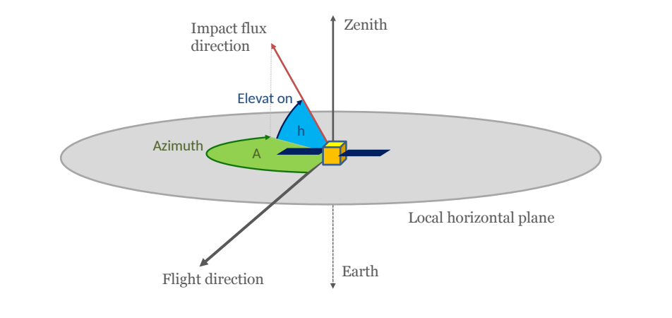
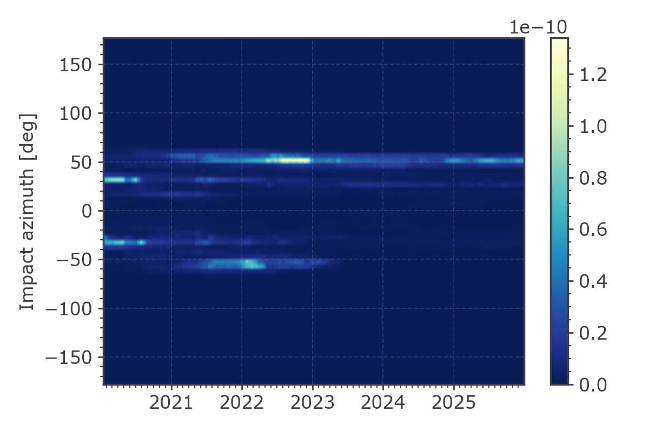
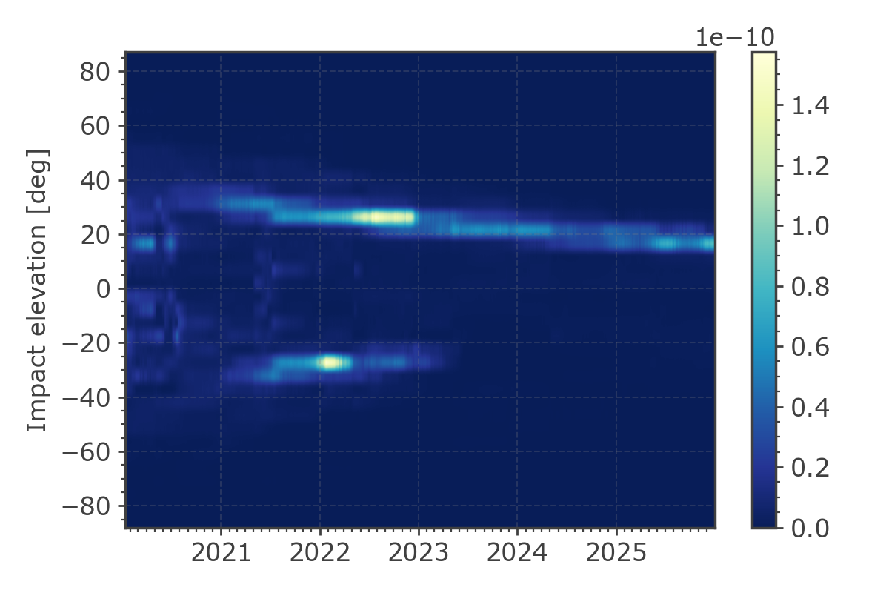
Flux analysis – Example: XMM
Preliminary encounter geometry characterisation in azimuth and elevation
Debris flux [1/m²/y]
Debris flux [1/m²/y]

Slide 5
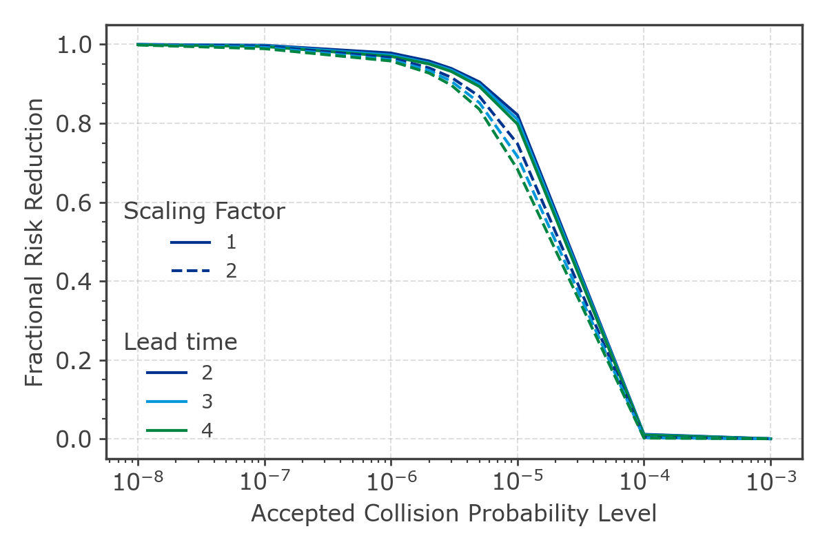
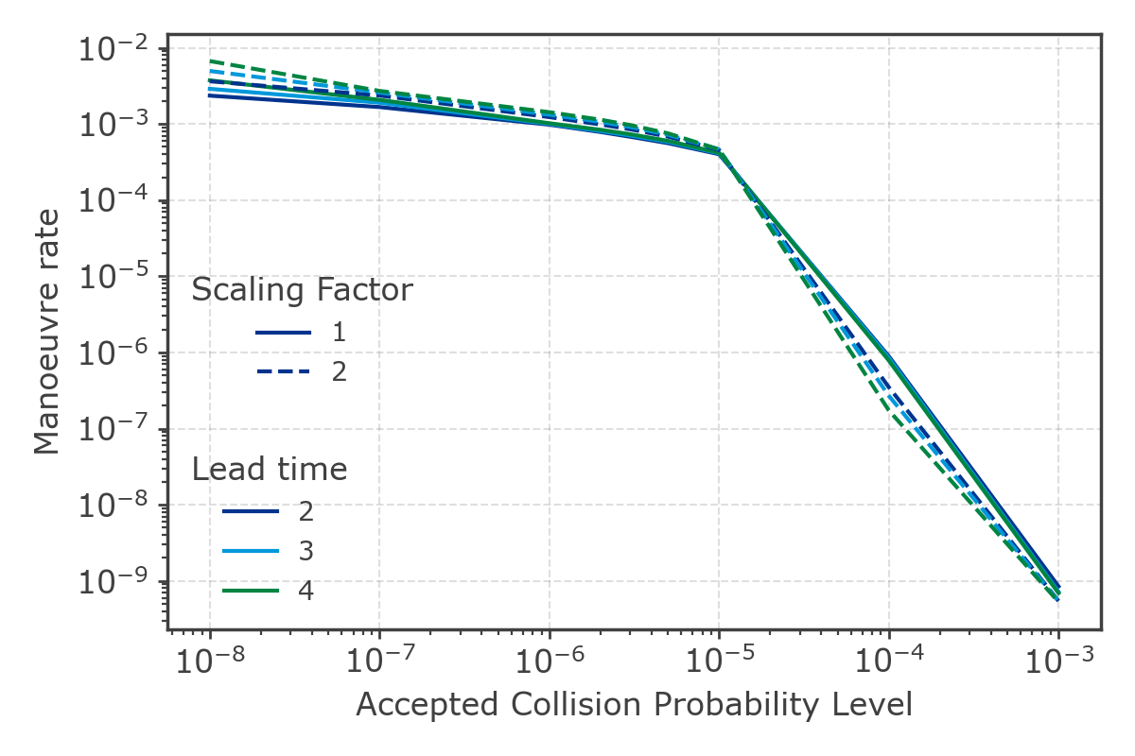
Collision probability & threshold definition
Next step: DRAMA/ARES analysis
Check on the mitigated risk through collision avoidance at the epoch of maximum flux
Parametric evaluation based on
Minimum debris size
Target covariance
Chaser covariance (i.e. scaling factor)
Lead time
Definition of a suitable reaction threshold and determination of the corresponding manoeuvre rate
XMM

Slide 6
Realistic Close Encounters
?
If manoeuvre (CAM) necessary:
How much Δv?
What kind of CAM? e.g. Hohmann
CAM schedule (e.g. time to TCA)
!
Require:
Target & chaser states + uncertainties
for likely close encounters
Notes:
2 min

Slide 7
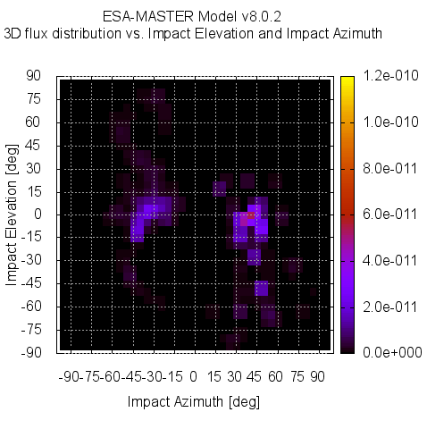
Realistic Close Encounters
Target orbit prediction (ESA flight dynamics team)
Chaser size threshold
heat maps
INTEGRAL
Notes:
2 min

Slide 8
Realistic Close Encounters
Target orbit prediction (ESA flight dynamics team)
Chaser size threshold
heat maps
INTEGRAL
Insight from 2-d heat maps
Likeliest impact properties
Caveat
Need to combine multiple heat maps for full picture
Likely target & chaser state not readily available
Likeliest per chaser category (e.g. orbit, size) not directly accessible
Notes:
2 min

Slide 9
Realistic Close Encounters
GEO chasers
MEO chasers
LEO chasers
Target orbit prediction (ESA flight dynamics team)
Chaser size threshold
cpe files
INTEGRAL
Notes:
2 min

Slide 10
Realistic Close Encounters
GEO chasers
MEO chasers
LEO chasers
Target orbit prediction (ESA flight dynamics team)
Chaser size threshold
cpe files
INTEGRAL
Notes:
2 min

Slide 11
Realistic Close Encounters
GEO chasers
MEO chasers
LEO chasers
Target orbit prediction (ESA flight dynamics team)
Chaser size threshold
cpe files
INTEGRAL
Insight
Chaser orbit (sma, inc, ecc)
Impact angle + Δv combination
Impact location (important for ecc > 0)
Postprocessing ➔ realistic & significant target & chaser states
Notes:
2 min

Slide 12
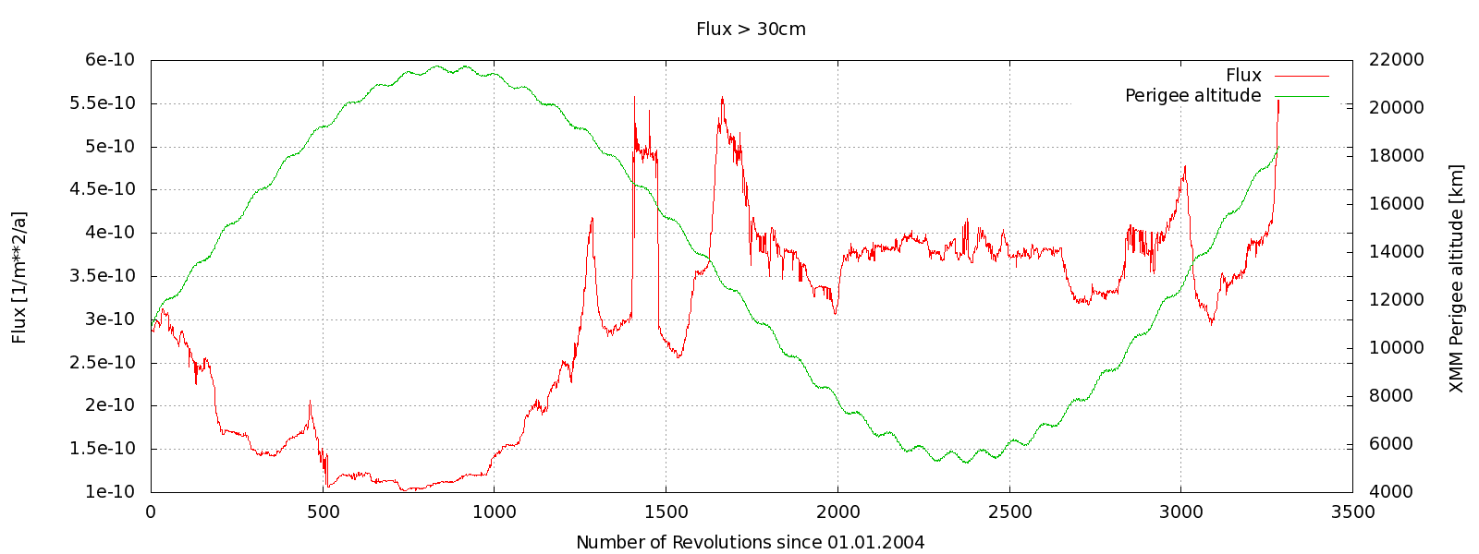
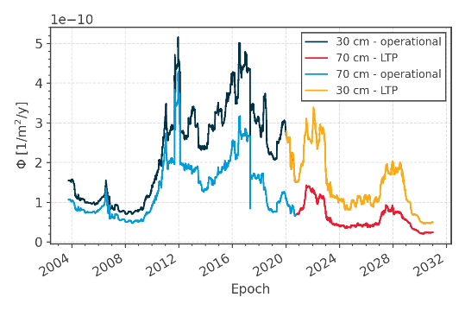
Outlook / Summary
Manual extract likeliest:
.. chaser per orbit (LEO/HEO/GEO)
.. impact location
Interfaces:
Python wrapper
Options to load a pre-computed trajectory (with standard orbit format)
Re-assessment for long-running missions can span over multiple model versions: More visibility of the changes in the reference populations
Rank | Target | Chaser

Slide 13
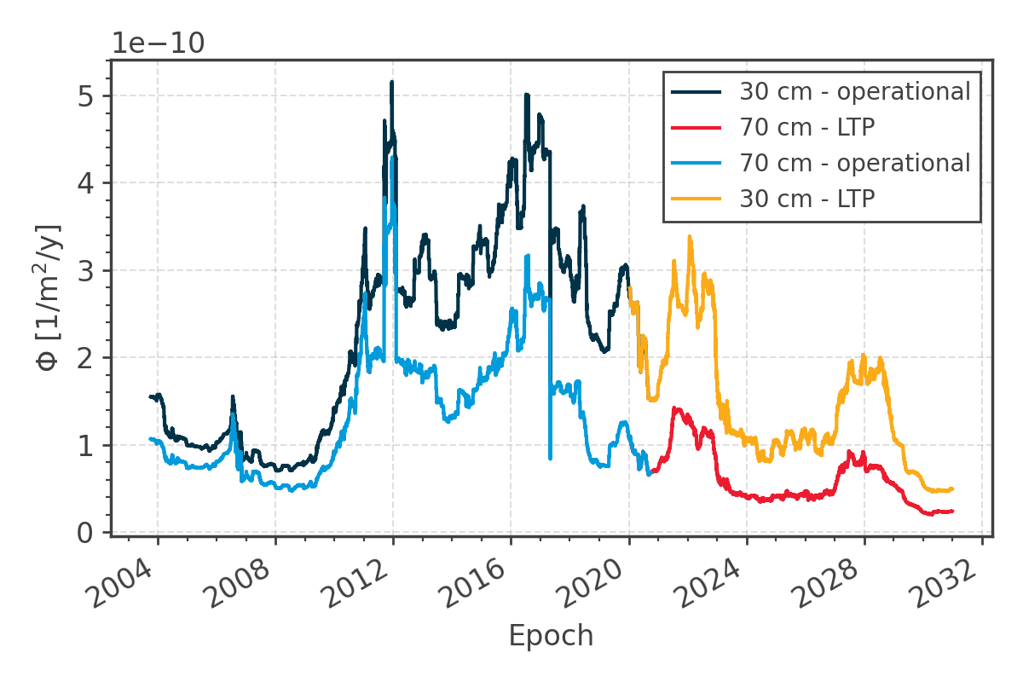
Comparison across MASTER versions
2012
2017
2022
GEO
MEO
GEO
MASTER-2009
Difference
MASTER-8

Slide 14
Use of MASTER and ARES for Operational Collision Avoidance Support Planning
Manoeuvre Threshold
& Strategy
Dr. Francesca Letizia | Dr. Sven K. Flegel | Dr. Klaus Merz ESA/ESOC Space Debris Office (OPS-SD) Robert-Bosch-Str. 5, 64293 Darmstadt, Germany francesca.letizia@esa.int | sven.flegel@esa.int | klaus.merz@esa.int http://www.esa.int/debris

