Slide 1
From Measurement to Uncertainties to Understanding
The MASTER population

Slide 2
Agenda
Brief History
Why providing uncertainties?
From measurement to uncertainties

Slide 3
Brief History
First approaches by NASA in 1994
Former ECSS standards
“Constant uncertainty factors of 0.33 to 3”
Rough estimation with no statistical evaluation of underlying data
No discrimination between visible and non-visible spectrum
No justified quantification!

Slide 4
Why providing uncertainties?
“Knowing what you don’t know has a higher value than ignoring the unknown.”
Safety factors in mission design
Indication for the quality of the model
Uncovering shortcomings as well as best applications of the model

Slide 5
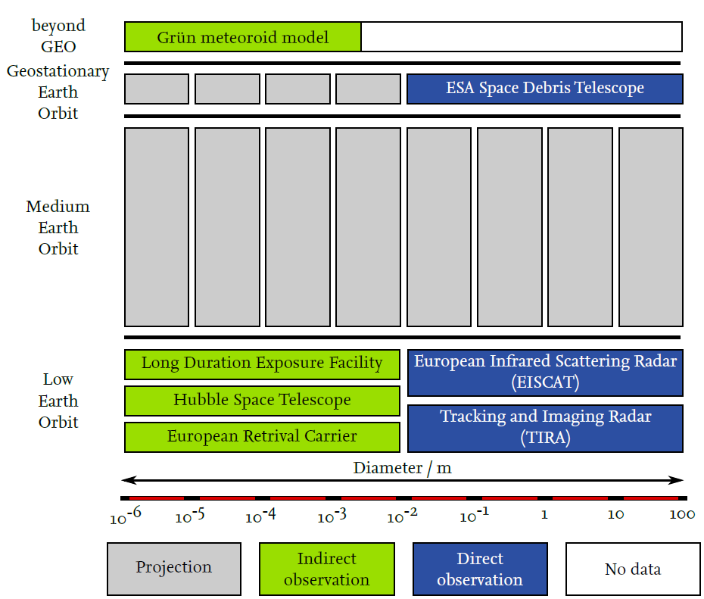
From measurement to uncertainties
Data used for uncertainty estimation
Uncertainties shall be:
Diameter dependent
Regime dependent
After validation of the historic population, uncertainties are derived based on statistical evaluation of the calibration results.

Slide 6
From measurement to uncertainties
Results obtained by sensors
$$ε=\frac{Measurement−Model}{Model}$$
“Error-ratio”
Results obtained by the model
“Error-ratio”:
Dimensionless key figure that quantifies the deviation
It allows to indicate nominal value at the MASTER output and error values as a factor of the nominal value
Measurement > Model: $ε$ > 0
Measurement < Model: $ε$ < 0
Model = 0: almost non-existent (< 0.3% of datasets), neglected
Measurement = Model: $ε$ = 0

Slide 7
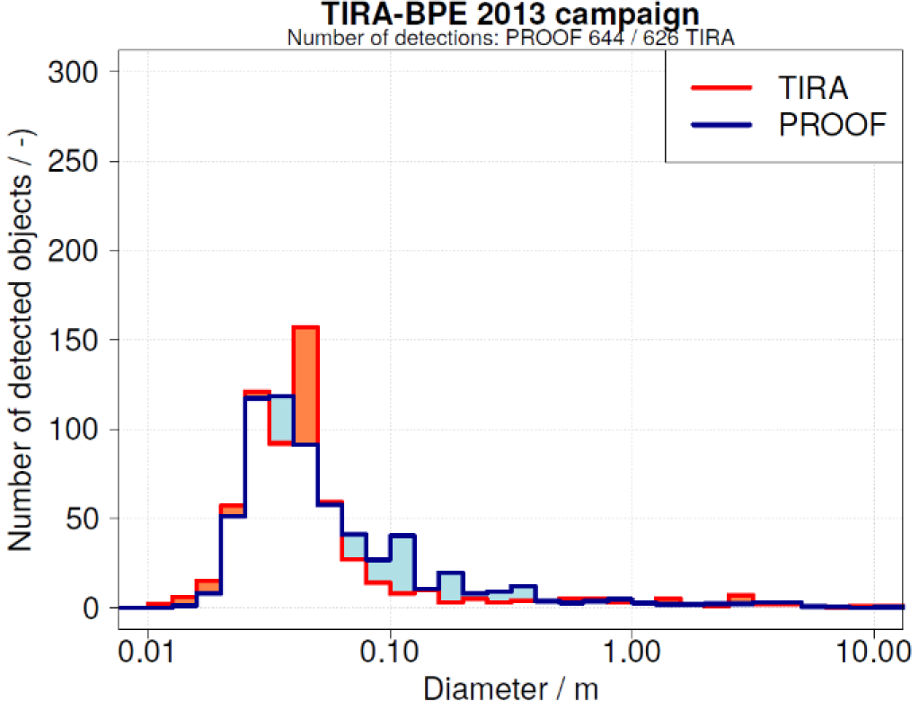
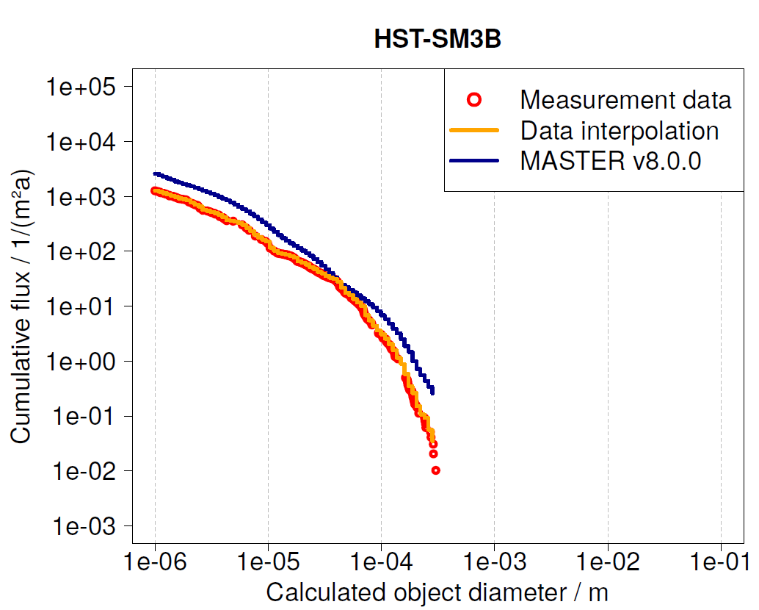
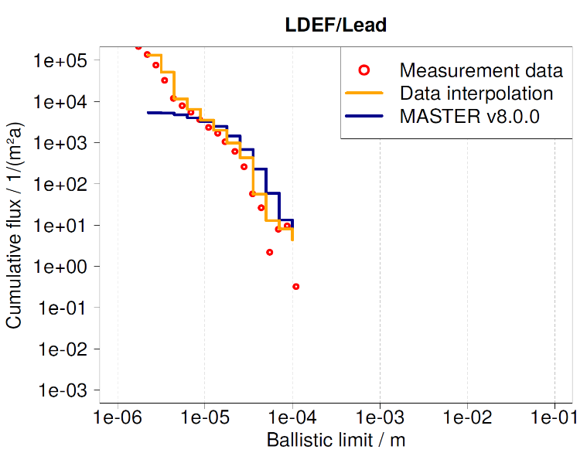
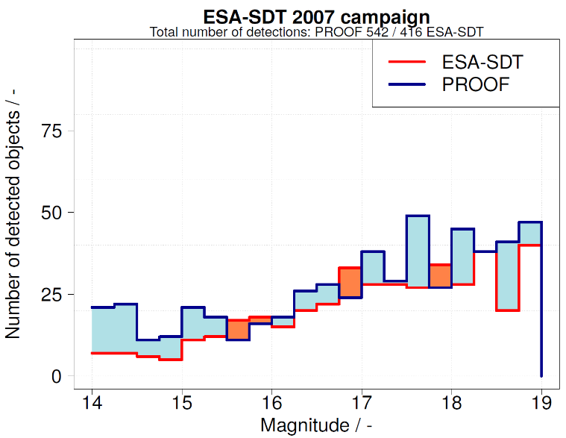
From measurement to uncertainties
Evaluation of size spectra of validation results
Blue: MASTER (Model)
Red: Sensor (Measurement)

Slide 8
From measurement to uncertainties
Weighting and data merging
Error-ratio calculated for each diameter bin
Differentiation of positive and negative error-ratios
Calculating mean error-ratios (positive and negative) for each diameter decade
Combining the mean error-ratios of all available validation campaigns into two distinct mean error-ratios (positive and negative).
decade
decade
decade

Slide 9
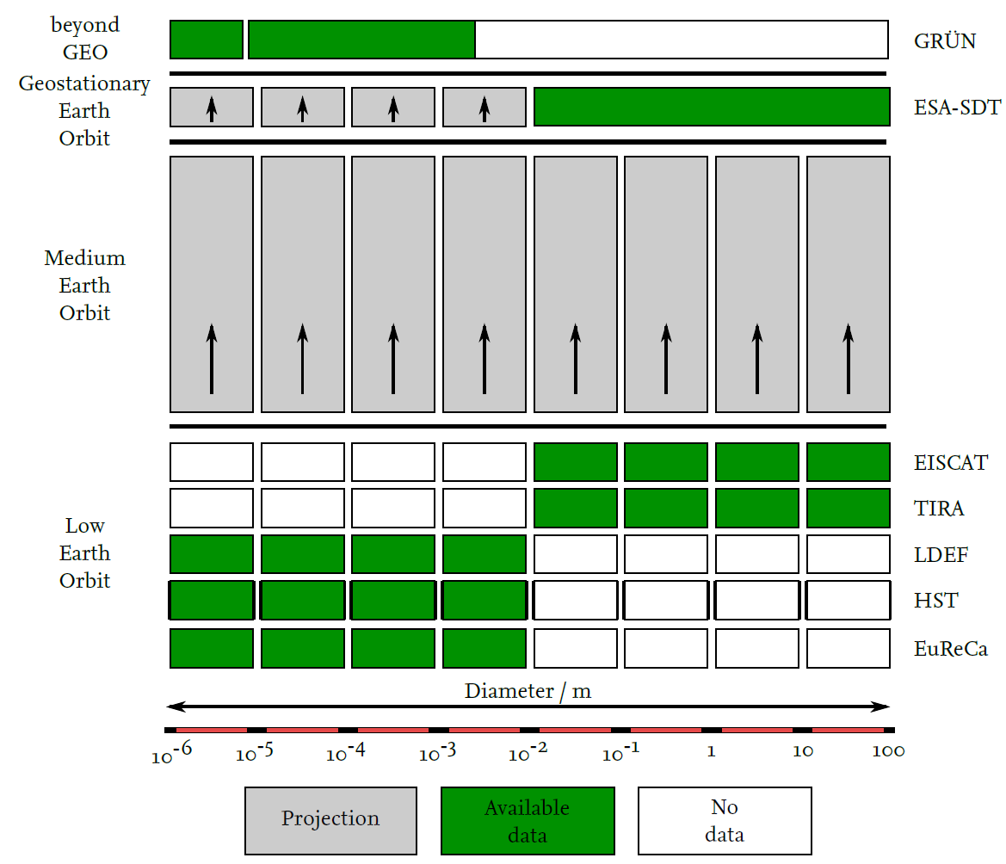
From measurement to uncertainties
Weighting and data merging
Error-ratio calculated for each diameter bin
Differentiation of positive and negative error-ratios
Calculating mean error-ratios (positive and negative) for each diameter decade
Combining the mean error-ratios of all available validation campaigns into two distinct mean error-ratios (positive and negative).

Slide 10
From measurement to uncertainties
Multiple campaigns
Multiple campaigns
Multiple campaigns
Inter- vs. Intra-sensor weighting
Weighting based on e.g.:
Diameter spectrum contribution
Sensor campaign age w.r.t. reference epoch
Number of detections
Data quality
…
Intra-sensor weighting
Sensor #1
Sensor #2
Sensor #3
Inter-sensor weighting
Diameter decade error-ratio

Slide 11
From measurement to uncertainties
Multiple campaigns
Multiple campaigns
Multiple campaigns
Inter- vs. Intra-sensor weighting
Weighting based on e.g.:
Diameter spectrum contribution
Sensor campaign age w.r.t. reference epoch
Number of detections
Data quality
…
Intra-sensor weighting
Sensor #1
Sensor #2
Sensor #3
Inter-sensor weighting
Diameter decade error-ratio
Assuming normal distribution* to obtain 1σ environment
* Currently under revision

Slide 12
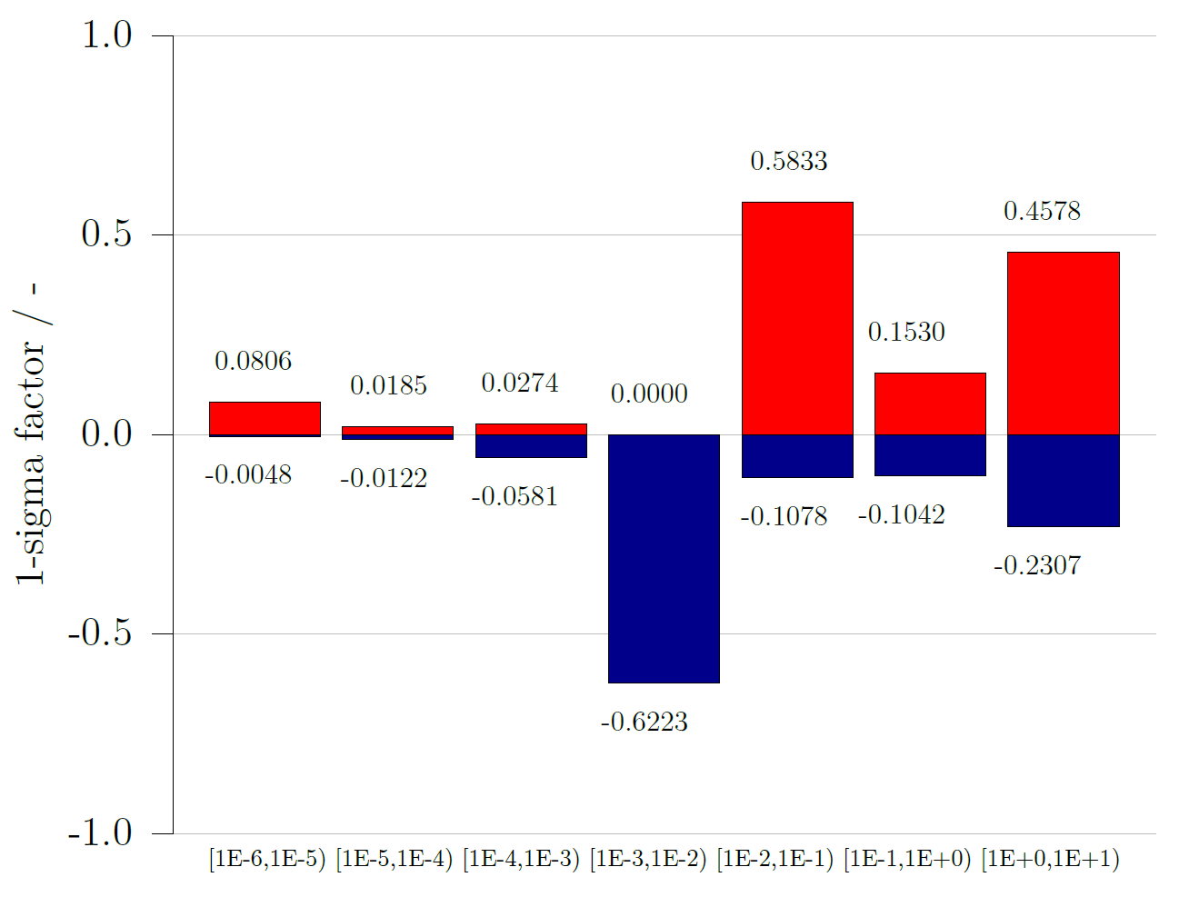
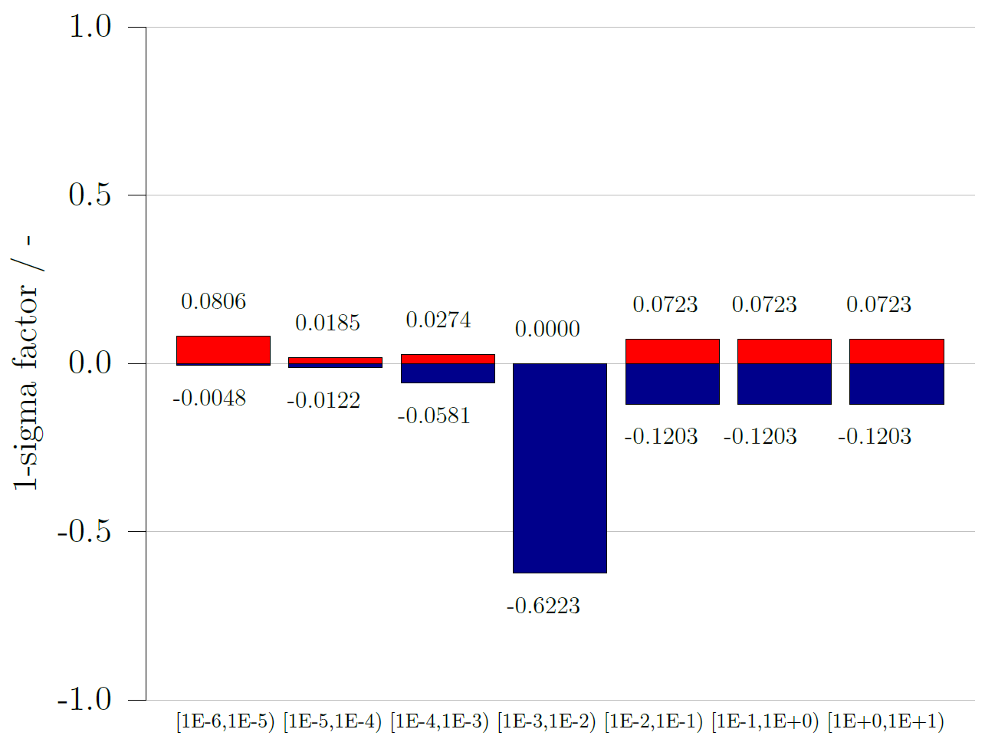
From measurement to uncertainties
LEO and MEO
GEO
Factors applied to nominal flux (and spatial density) output

Slide 13
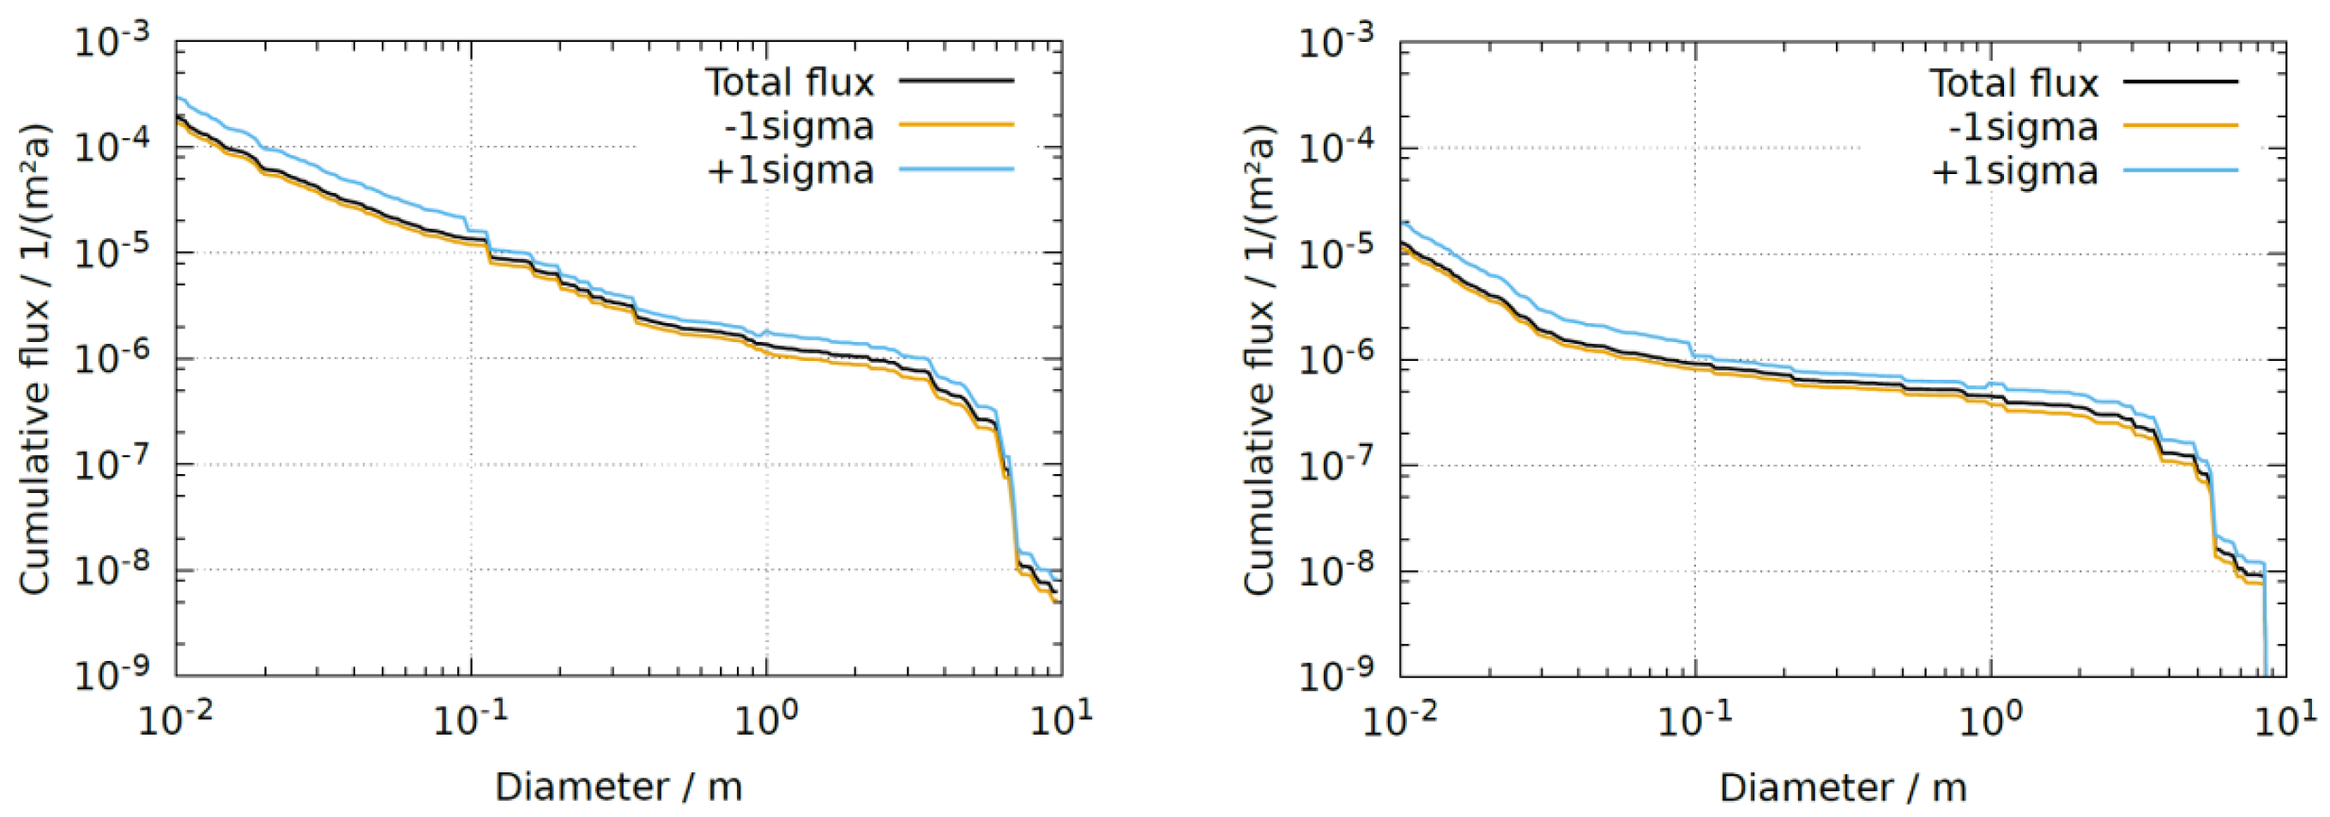
From measurement to uncertainties
SSO at 750 km
ISS orbit

Slide 14
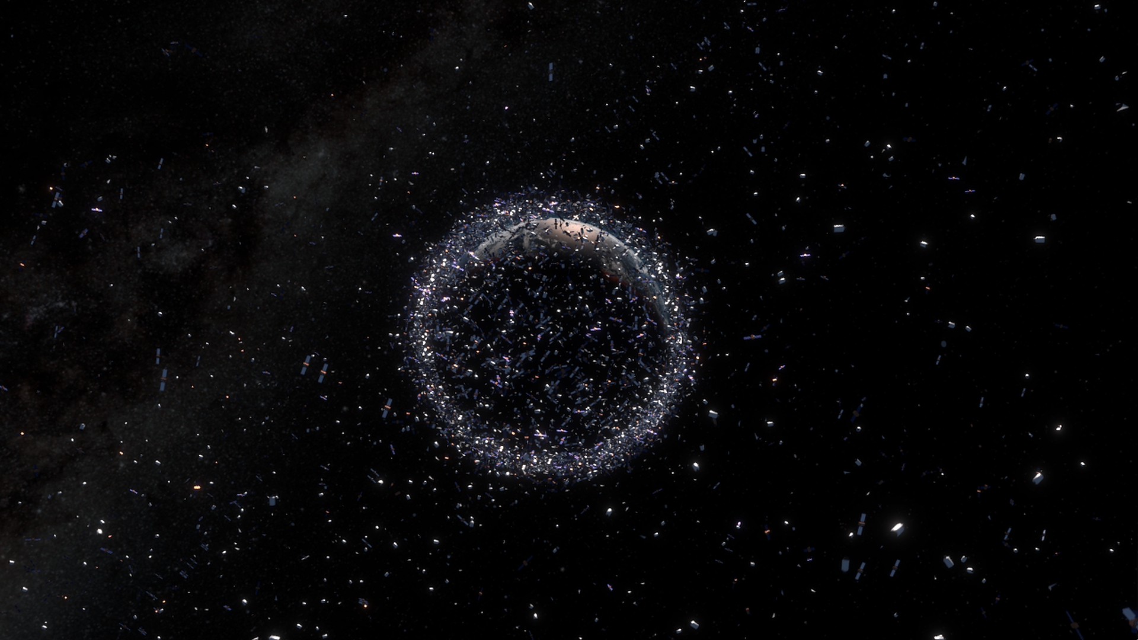
Thank you!
As of November 2020
Number of rocket launches since the start of the space age in 1957
About 5990 (excluding failures)
Number of satellites these rocket launches have placed into Earth orbit
About 10490
Number of these still in space
About 6090
Number of these still functioning
About 3300
Number of debris objects regularly tracked by Space Surveillance Networks and maintained in their catalogue
About 28290
Estimated number of break-ups, explosions, collisions, or anomalous events resulting in fragmentation
More than 550
Total mass of all space objects in Earth orbit
More than 9100 tons
Number of debris objects estimated by statistical models to be in orbit
34000 objects greater than 10 cm 900 000 objects from greater than 1 cm to 10 cm 128 million objects from greater than 1 mm to 1 cm
www.esa.int
www.esa.int – Space Debris by the Numbers

