Slide 1


UKPOP
Study funded by:
Future Space Population Study
From Measurements to Understanding: MASTER Modelling Workshop
2nd - 4th March 2021
Supported by:
Keiran McNally (kmcnally@gmvnsl.com)
Dr Hugh Lewis (hglewis@soton.ac.uk)
Alfredo M. Antón (amanton@gmvnsl.com)

Slide 2
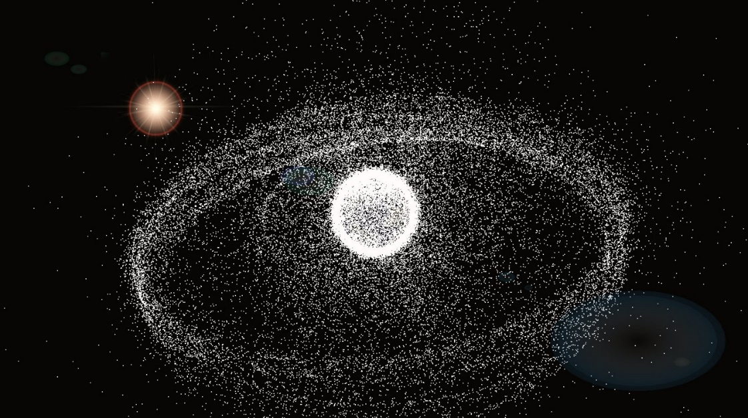
Objective
Examine the future space object population, using expected trends in the short, medium, and long term.
Credit: Dr Hugh G. Lewis
This research was funded by the UK Space Agency and Dstl, as part of the European Union Space Surveillance & Tracking (EUSST) project. Work was conducted under Grant Agreement 785257-2-3SST2016 and the H2020-SGA-Space-SST3-2016-2017 Horizon 2020 funding line.

Slide 3
Project Outline
Analysis of historical data to establish “realistic” future launch trends
Identification of appropriate initial population that includes object origin, mission and status
Propagation of population, combined with future launch trends to produce future populations at set epochs
2018
2023
2028
2043

Slide 4
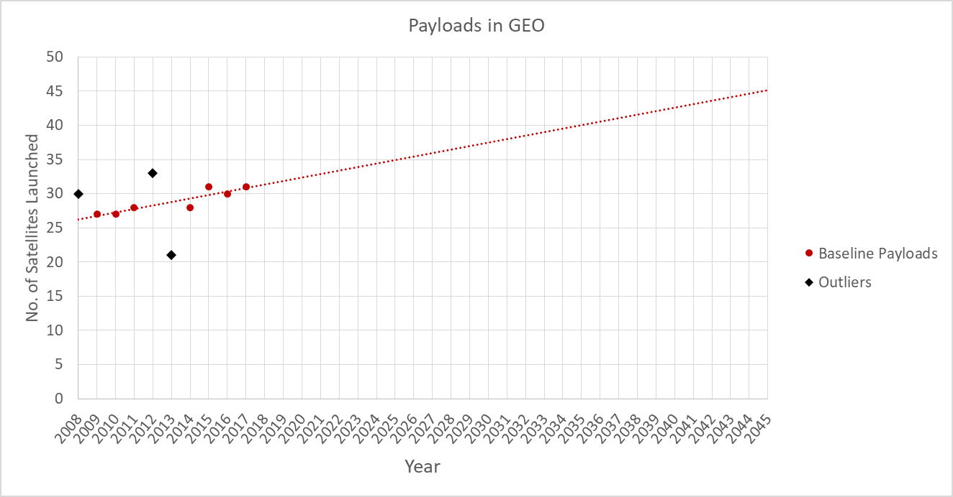
Launch Trends
Future launches split by orbital regime
Linear increase forecast for HEO and GEO
MEO managed by constellation
MEO Constellation | Total Size | Lifetime | Resupply Rate per Year
O3b | 16 | 10 | 2 (1.6)
Galileo | 24 | 12 | 2
GPS | 30 | 12 | 3 (2.5)
GLONASS | 24 | 10 | 3 (2.4)
BeiDou | 27 | 10 | 3 (2.7)
O3b mPower* | 7 | 10 | 1 (0.7)
 |  | TOTAL | 14

Slide 5
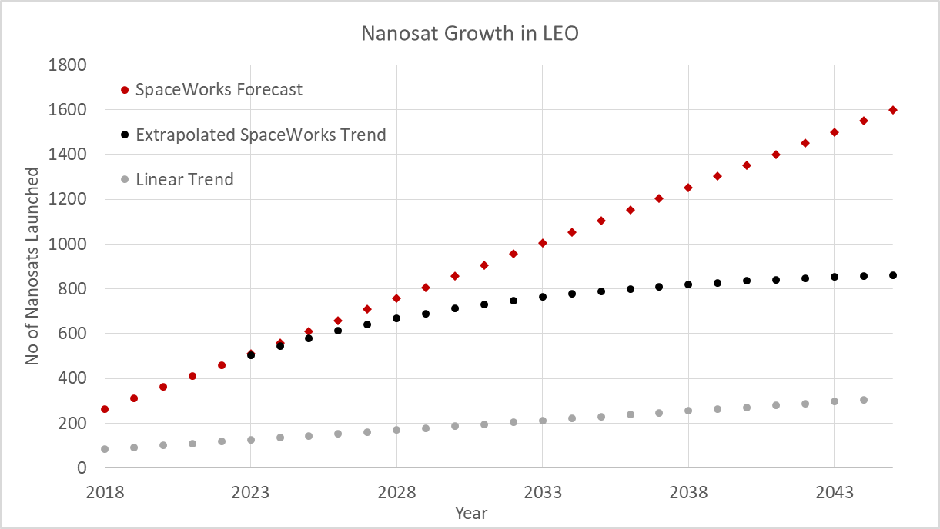
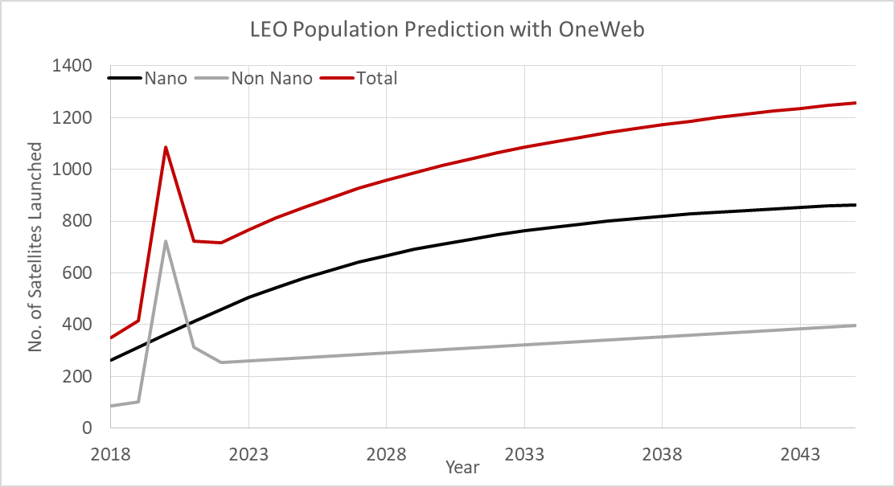
Launch Trends
LEO: Difficult to establish trends
  Nanosats
  Mega-Constellations
Saturating growth forecast for LEO Nanosats
OneWeb launches and resupply included in study
Linear increase for non-nanosats in LEO

Slide 6
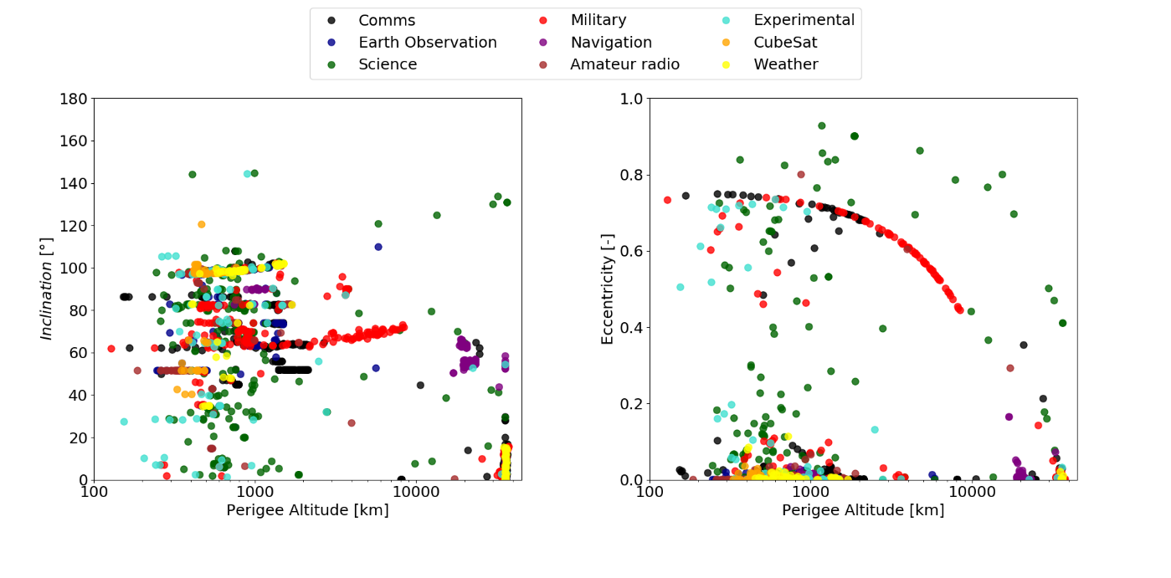
Initial Population
MASTER population used as input: No contextual information
Objects “matched” with TLE data to obtain object ID’s
  Allowed name/country/mission information to be retrieved
Minimum size requirements per regime:
LEO: ≥ 1cm
MEO: ≥ 5cm
GEO: ≥ 10cm
Other catalogues not suitable (e.g. 18th SPCS)

Slide 7
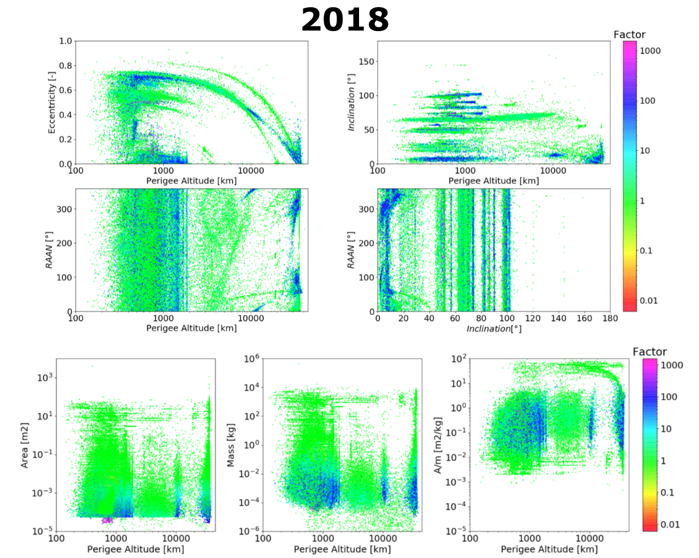
Initial Population
Matching done via orbital and physical comparison
  Sensible limits used when mass was not known
Possible missed matches:
  MASTER propagation
  Satellite manoeuvres
  Missing objects in MASTER
Initial population = MASTER + additional payloads

Slide 8
DAMAGE Overview
Debris Analysis and Monitoring Architecture to the Geosynchronous Environment
Originally designed to investigate the long-term evolution of the debris environment in High Earth Orbit
Researcher: Dr Hugh Lewis – University of Southampton
Used to support UK Space Agency’s role in IADC since 2004
Semi-analytic propagator, supported by:
  Breakup model, collision prediction algorithms
  Satellite failure model, constellation manager

Slide 9
Simulation Setup
Population with & without OneWeb to be simulated
Four scenarios considered
  No explosions, no OneWeb
  No explosions, with OneWeb
  With explosions, no OneWeb
  With explosions, with OneWeb
~110 Monte Carlo runs per scenario
  Allow analysis of stochastic effects considered (Collisions)
MASTER populations used as reference for comparisons

Slide 10
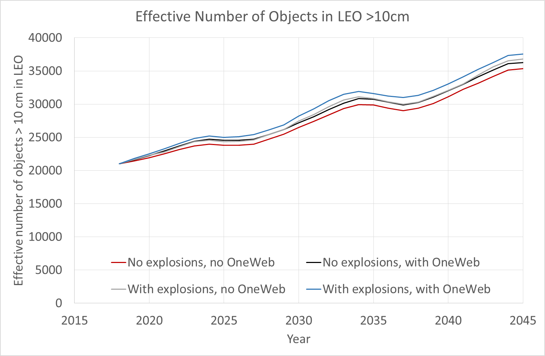
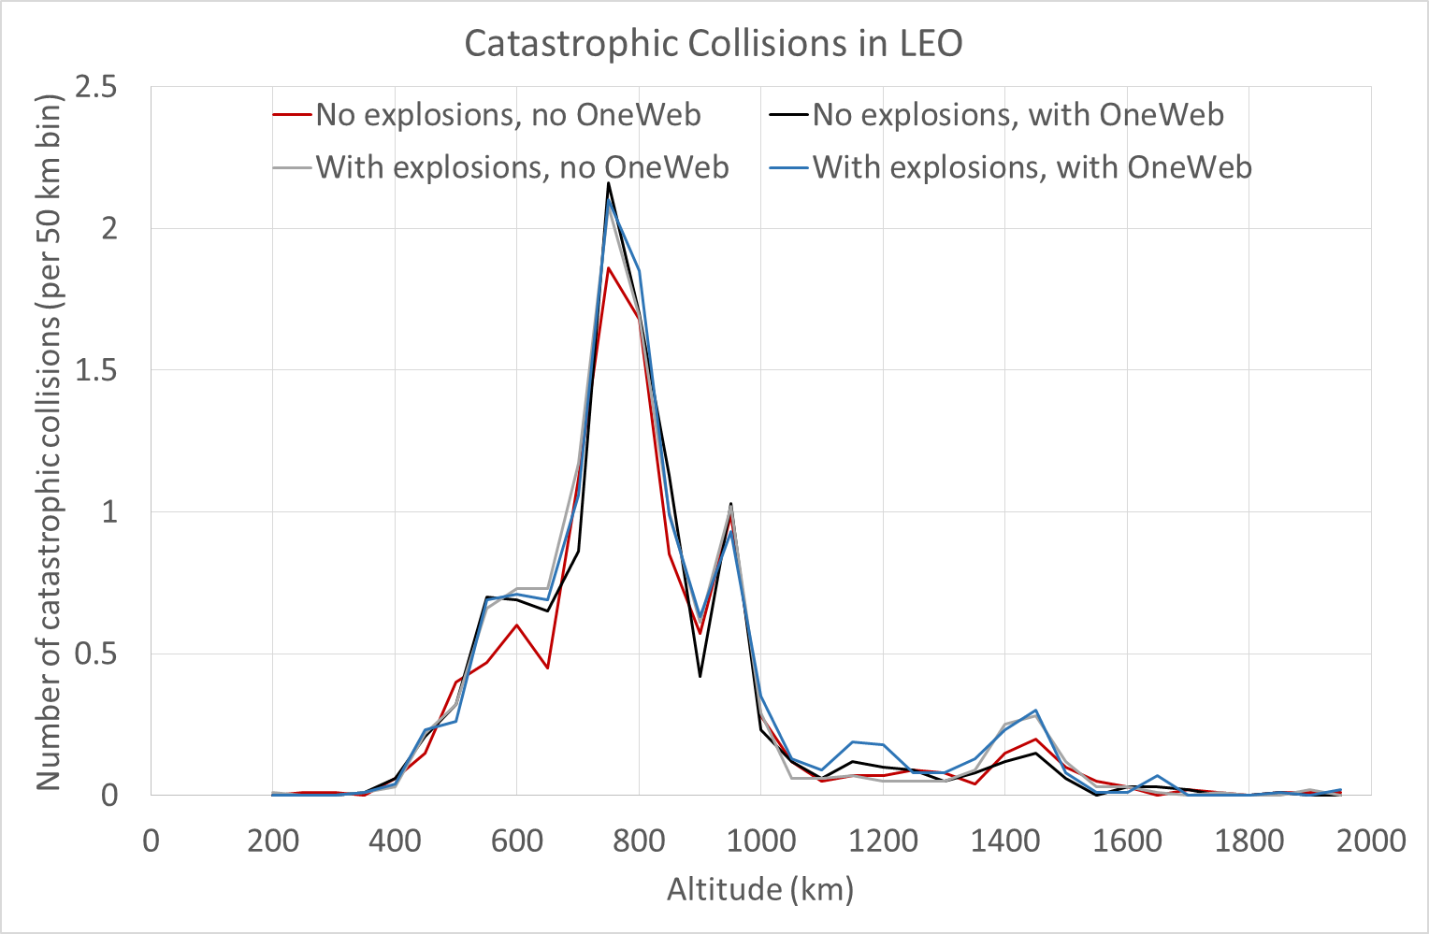
Results
Results taken from one representative Monte Carlo run
Visible increase in LEO objects from OneWeb
No noticeable increase in collisions from OneWeb
  High PMD success rate: 95%??
OneWeb

Slide 11
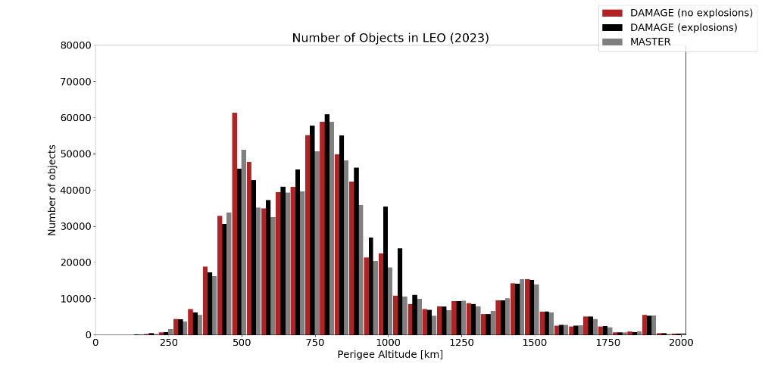
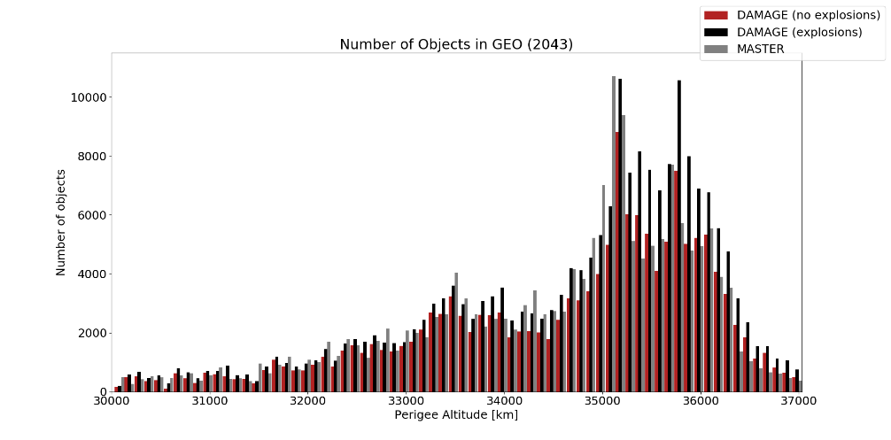
Results
Catastrophic Collision: March 2020
Short term:
  Good agreement with MASTER
  Local variations from collisions and explosions
Long term:
  Similar trend
  MASTER has more objects in GEO
  Collisions? Graveyard orbits?

Slide 12
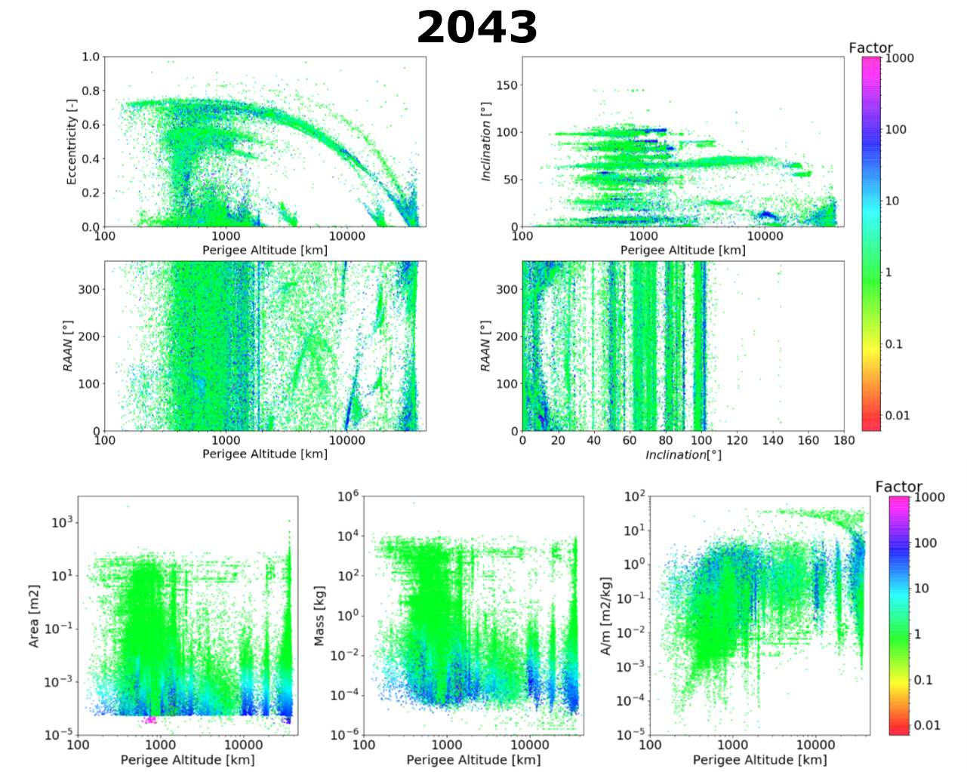
Results
Cubesats and nanosats

Slide 13
Conclusions
Lack of contextual information in MASTER
  Matching with TLEs was effective but not entirely successful
Difficult to foresee future launch traffic
  GEO communication market (dependant on LEO constellations)
  Mega-constellations (Starlink)
  Nano/CubeSat Market
PMD success of constellations? → Assumed 95% (realistic??)
Future active debris removal activities?

Slide 14
Keiran McNally (kmcnally@gmvnsl.com)
Dr Hugh G Lewis (hglewis@soton.ac.uk)
Alfredo Antón (amanton@gmvnsl.com)

