Slide 1
www.onera.fr
1

Slide 2
Determination and archiving of the electrostatic characteristics of the space materials at ONERA
L. Leclercq¹, S. Hess¹, P. Sarrailh¹, J.-F. Roussel¹, T. Paulmier¹, and M. Villemant¹
1 – ONERA – The French Aerospace Lab, Toulouse, France
Ce document est la propriété de l'ONERA. Il ne peut être communiqué à des tiers et/ou reproduit sans l'autorisation préalable écrite de l'ONERA, et son contenu ne peut être divulgué. This document and the information contained herin is proprietary information of ONERA and shall not be disclosed or reproduced without the prior authorization of ONERA.

Slide 3
CONTEXT: A lot of experiments at ONERA
SIRENE: Study of the surface and internal charge by electrons irradiation (LEO, MEO and GEO orbits)
COPHOS: Contamination
GEODUR: Study of the surface and internal charge by electrons irradiation (GEO orbits)
DEESSE: Secondary electron emission
Etc…
Need of efficient tools to treat/archive all the experimental data in order to characterize space materials

Slide 4
Global Material Data Base Ecosystem

Slide 5
COMPEX (Common Onera Material Parameter EXtractor)
INPUTS
OPTIMIZATION
Models
Internal and surface charging
Outgassing
Multi-models
Several types of models (ex: conductivity and potential)
Multi-data
Several sets of experimental
data
COMPEX 1.0 (Java)
Efficient for contamination
Less efficient for charging
Only 1 optimization method implemented
Experimental data
SIRENE
COPHOS
COMPEX 2.0 (Python)
Application to several models
Offer different optimization methods to get more accurate results
More efficiency and genericity
Material characteristics from database

Slide 6
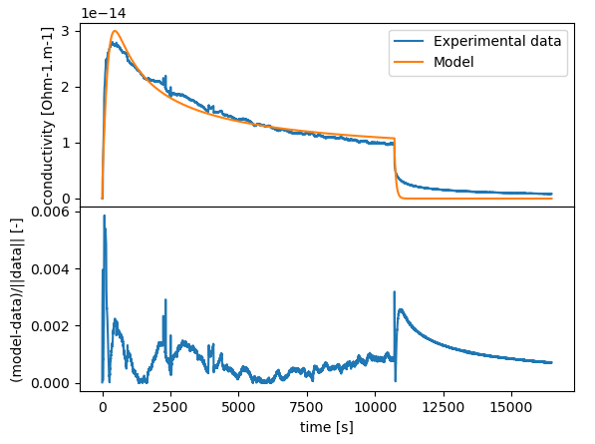
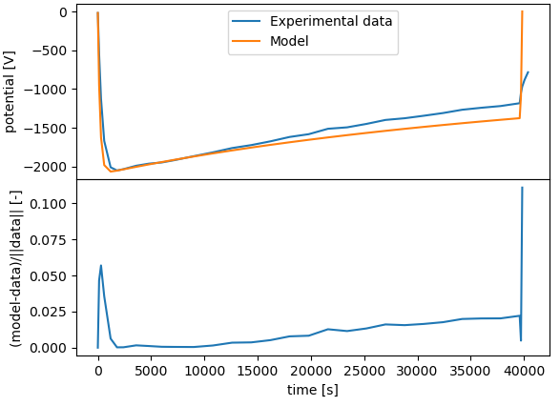
COMPEX (Common Onera Material Parameter EXtractor) Charging
COMPEX 1.0
One experimental data
One model
0D
No effects of E and T
COMPEX 2.0
Possibility to fit several experimental data
Possibility to couple models (conductivity and potential)
0D
Effects of E and T(Poole-Frenkel, Onsager)
Kapton - Potential
Teflon - Conductivity

Slide 7
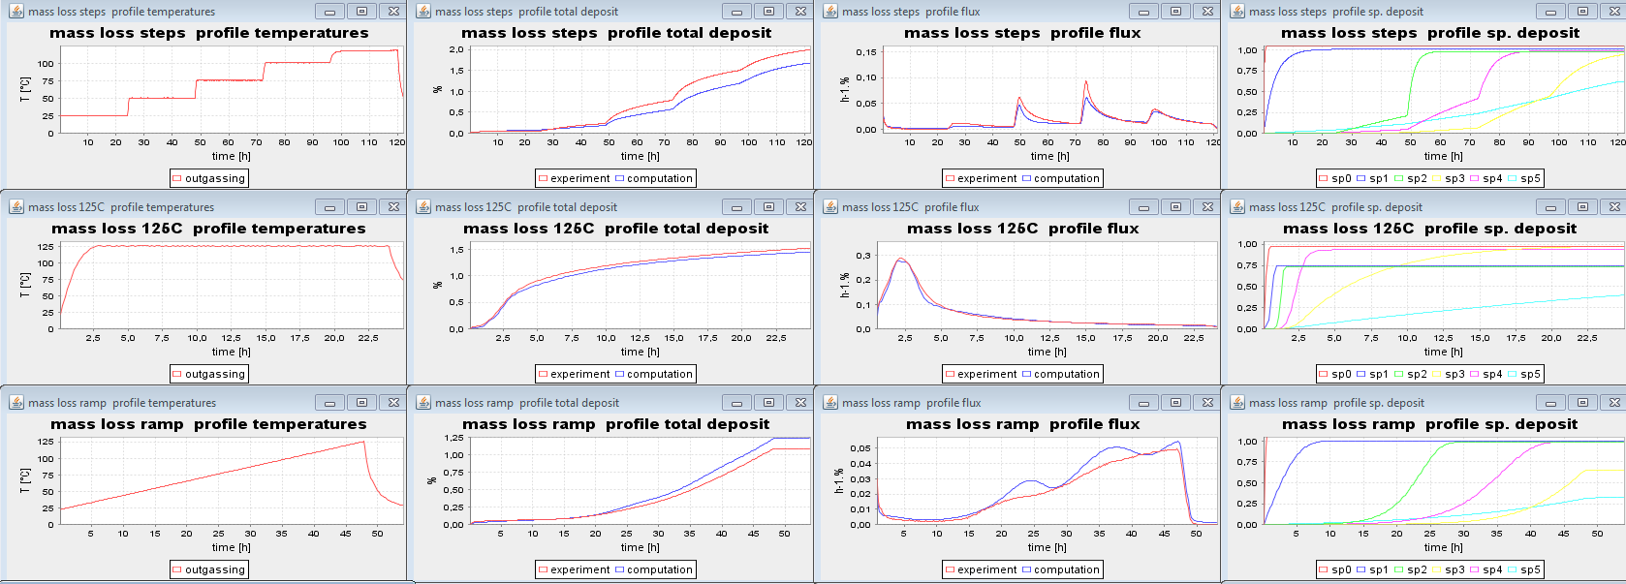
COMPEX (Common Onera Material Parameter EXtractor) Contamination
COMPEX 1.0
Modelling of total mass loss (TML) and deposit (CVCM) measured on microbalances (QCM) due to outgassing
Extraction of outgassing, sticking and reemission parameters
COMPEX 2.0
Processing of mass spectrometer (MS) data, TGA/MS and outgassing/MS
Modelling of QCM + MS data, species per species for their quantitative + chemical analysis
Notes:
Idée principale: COMPEX1 utilise les mesures de masse totale, pour COMPEX2 ça sera tous les canaux du spectro de masse (toutes les masses de 1 à 300 a.m.u. par ex)
Image = COMPEX 1, modélisation simultanée de 3 profils de température de dégazage différents (3 lignes)

Slide 8
Global Material Data Base Ecosystem

Slide 9
ChaMISEn (Characterization of Material Interactions with Space Environments)
What?
A database gathering :
Material charcteristics
Raw measurements from experiments
Physical models
Optimization tools
Simulation tools
+ Keep links between each element (who produced what, how and using which tools?)
Why?
ONERA performs many experiments/characterizations each year
Need to keep track of it, and of all their relevant details
Need to extract the most of it
Need to provide an easy access to each bit of information

Slide 10
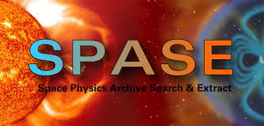
ChaMISEn (Characterization of Material Interactions with Space Environments)
How?
Need of an efficient but versatile data model
based on the SPASE data model used for space environment
efficient, maintained by major agencies and academic institutions worldwide
used as metadata descriptor for ESA’s ODI and CDF format
common handling by Spacecraft-Environment interaction simulation codes
Simple and complete handling of heterogeneous data
Simple and robust data relation handling

Slide 11
Prototype client: ChaMISEn Desktop
View of a set of material characteristics
Who and what? Datamodel id & keywords
model
measurement
value (may be non scalar, bounded,…)

Slide 12
Prototype client: ChaMISEn Desktop
Model description: simple but complete (allow automated I/O check)
Inputs
Outputs

Slide 13
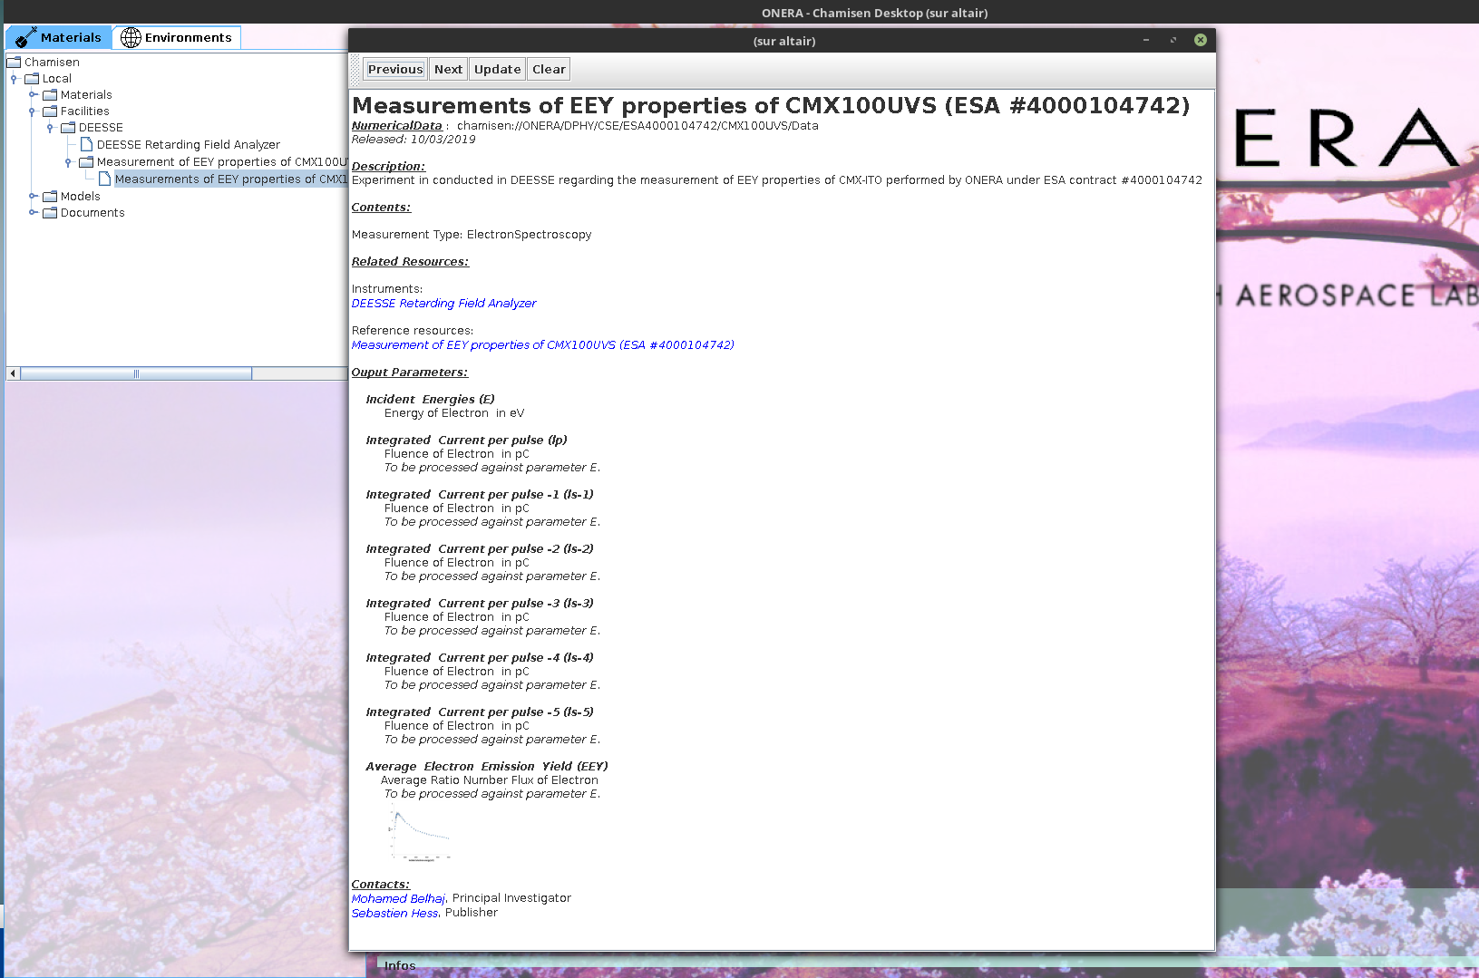
Prototype client: ChaMISEn Desktop
Measurement description: descriptive and documented
Links toward experiment,…
Field description

Slide 14
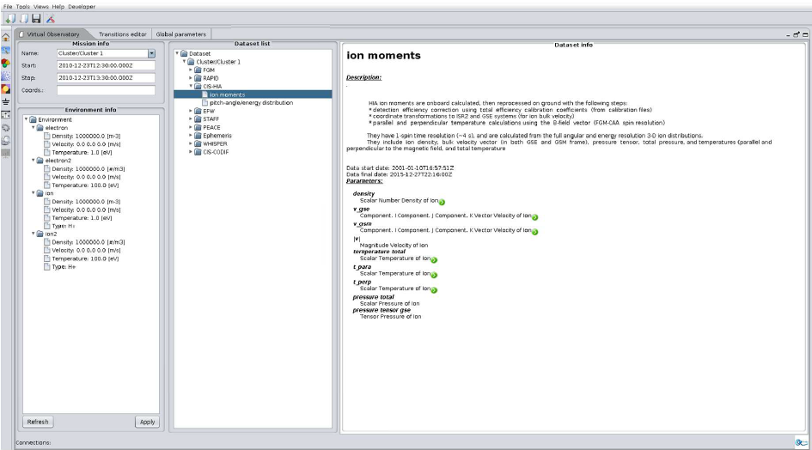
SPIS can already upload space environment from database
Europlanet RI: Space environment data base manager in SPIS to import environment and export results.

Slide 15
Open Source database framework https://w3.onera.fr/spacecraft_charging/fr/home
Specification document already available online https://w3.onera.fr/spacecraft_charging/fr/chamisen
Database framework ChaMISEn available soon (open source)
Europlanet: beta version by the end of the month

Slide 16
Conclusion
Many various experiments to characterize space materials and their interaction with the spatial environment (Contamination, surface and internal charge etc…)
Complete framework of data processing
COMPEX to characterize space materials
Developing of a database to gather the experiment and simulation results, and to use as inputs for models/simulations (SPIS, COMOVA, THEMIS)
Database framework will be available for users

