Slide 1
SPINE Website survey results
Fabrice Cipriani and Grégoire Deprez
ESA ESTEC
07/06/2021

Slide 2
Web / SPINE survey rationale / goals
New website , new look, new features (e.g. SPIS code hosting)
Website : needed relooking, information re-organisation, provide easy access to information and facilitate interactions within the SPINE community
Survey was covering :
Website sections organisation
Contribution to website sections
Participation to WG
Contributions to bug tracking / bug corrections
Contribution to the spis code / gitlab
We are interested to hear your direct feedback !

Slide 3
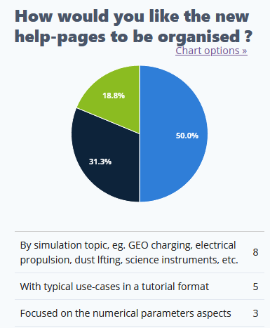
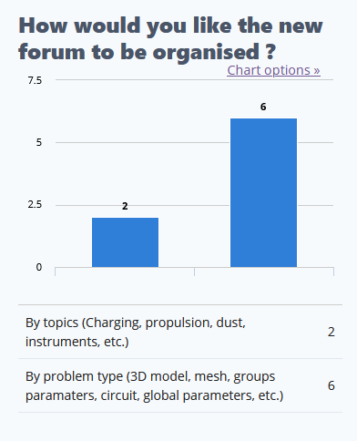
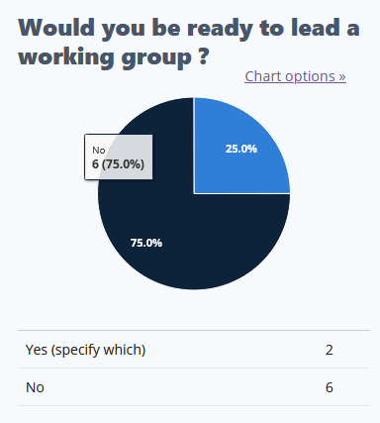

Slide 4
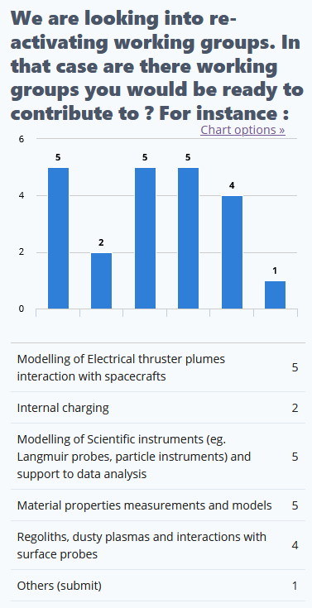
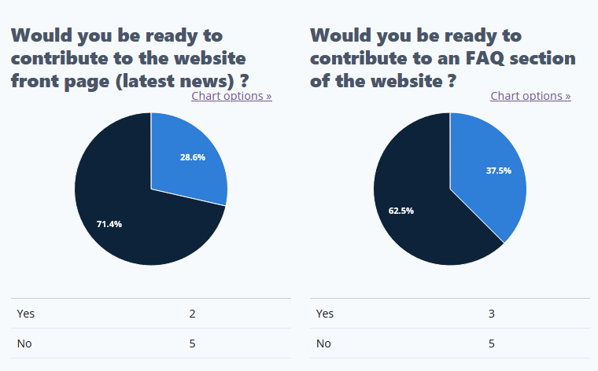

Slide 5
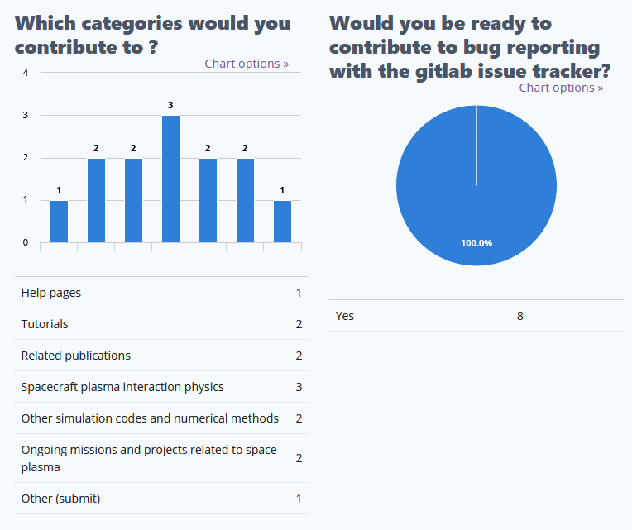

Slide 6
