Slide 1
SPIS Modelling of spacecraft surface contamination due to FEEP thrusters
28th SPINE workshop (2021)
M. Villemant¹, S. Hess¹ and P. Sarrailh¹
1 - ONERA - The French Aerospace Lab, 31055 Toulouse Cedex, France

Slide 2
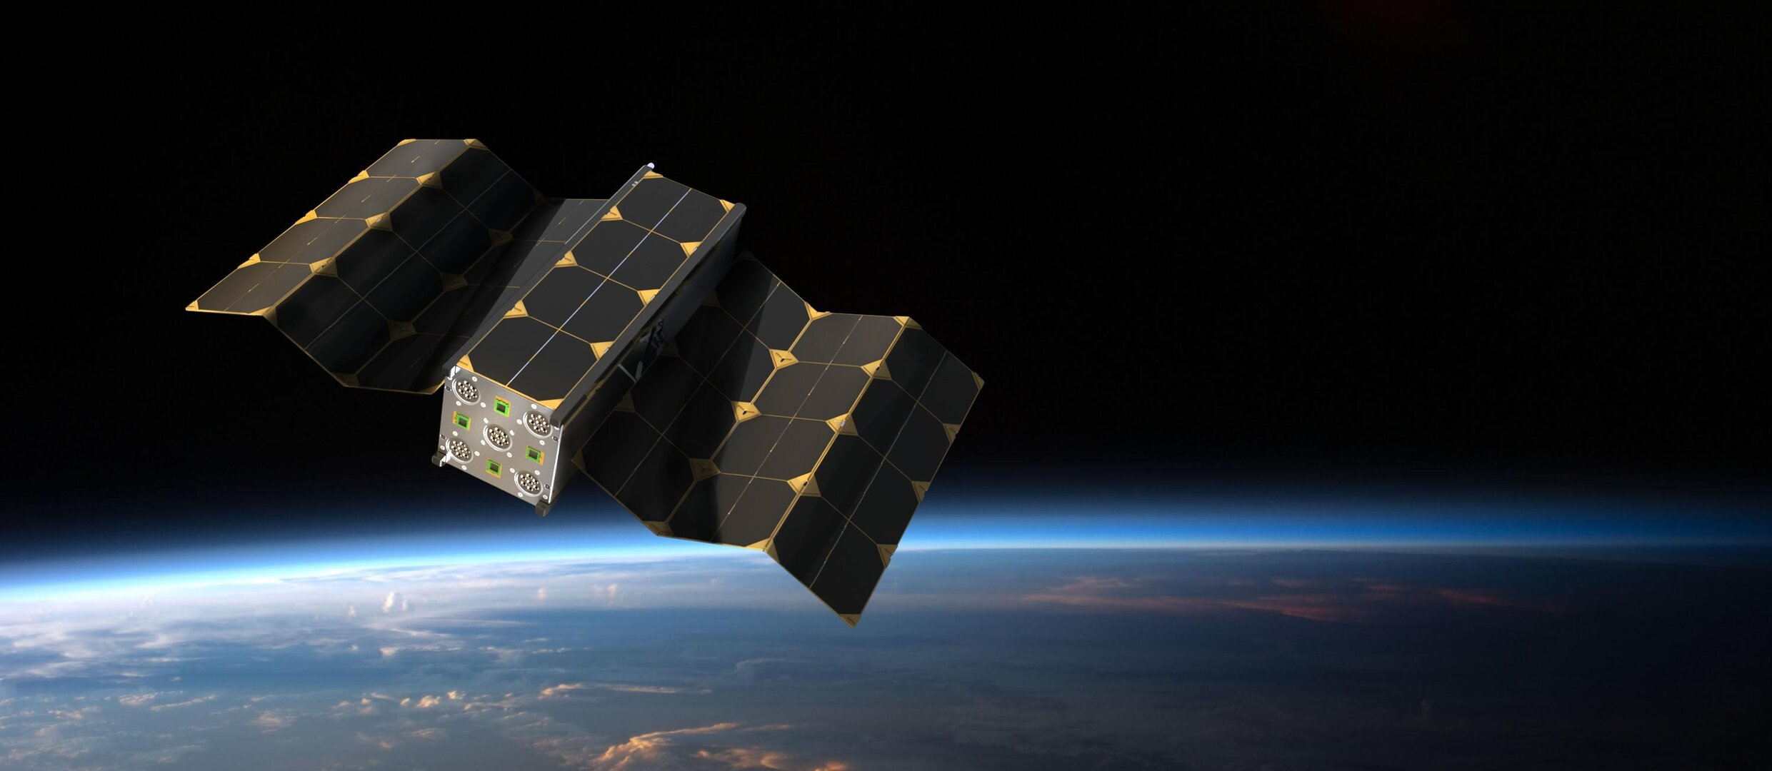
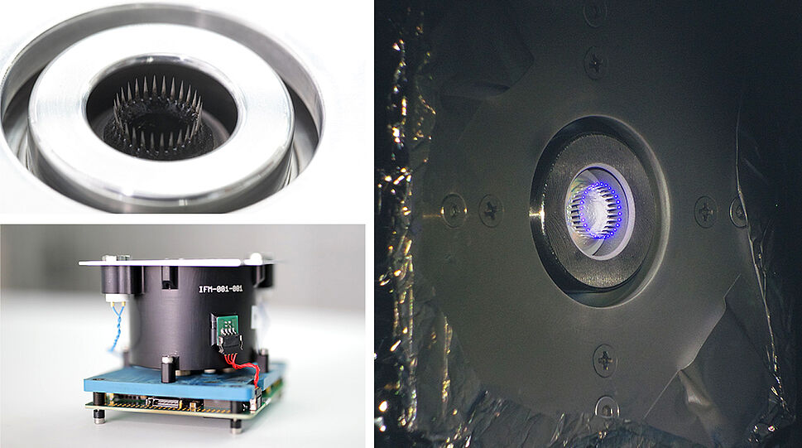
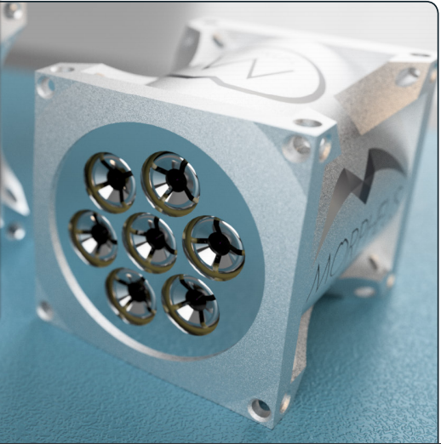
On the use of Field Emission Electric Propulsion (FEEP)
Propulsion for nanosatellites and nanosatellites constellations.
Very precise satellite attitude contrôle (scientific missions)
Enpulsion: More than 130 thrusters sold of which 50 are already propelling satellites [1].
Specific impulse | 1600-8000 s
Thrust | 0.1-1.0 mN
Total thruster mass (wet mass with PPU) | 1 kg – 4 kg
Total power supply | 10 - 100 W
Figure 1 : Example of nanosatellite using FEEP thrusters (Morpheus space, artist view)
Very high specific impulse
Droplets emission
High compactness
Low thrust
Low mass
FEEP is an emerging electric propulsion technology with already a real success with new-space industry and space agencies
Figure 2 : Enpulsion FEEP thruster (Nano)
Figure 3 : Morpheus FEEP thruster

Slide 3
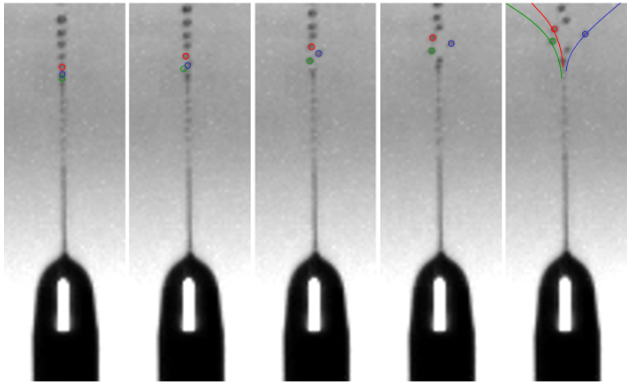
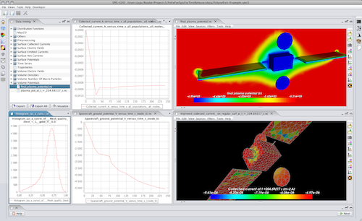
Problematic of droplet emission and presentation plan
Satellite surface contamination by droplets
FEEP ⇒ use of liquid metal ⇒ satellite surface metallization (solar panels, optics, etc.)
What is the impact of FEEP droplet emission on spacecraft cleanliness?
Figure 4 : Example of droplet emitted from a FEEP thruster
Need for simulation of droplet satellite body interaction
⇒ Implementation in SPIS software : SPIS-LISA
Implementation in SPIS and validation with experimental data
Presentation of a realistic case simulation: LISA mission
Conclusion on SPIS-LISA development and further studies
Figure 5 : SPIS software interface

Slide 4
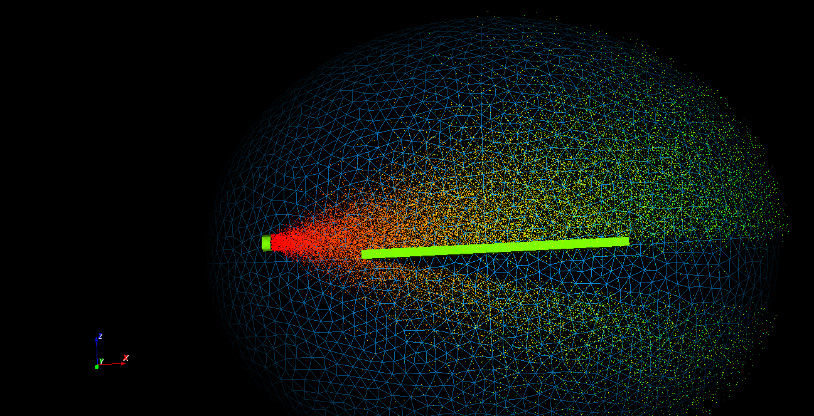
Implementation in SPIS and validation of code by comparison with experimental data

Slide 5
Droplets evolution and interactions with spacecraft body and environment
Droplets charging
Droplets
Surface contamination
Droplets bouncing
Complex interaction between droplet populations, spacecraft body and environment
Droplets splitting
Interaction with the environment
Evaporation
Neutrals
Surface contamination
Ionization
Need to take these phenomena into account in satellites simulations
Surface contamination
Charge exchange ions
Surface charging
Surface erosion

Slide 6
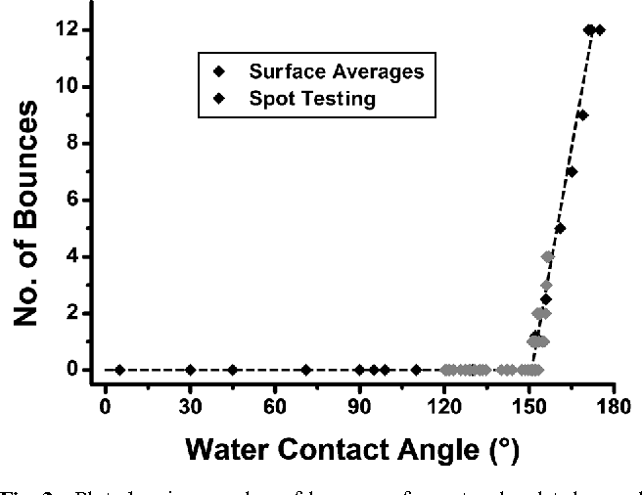
SPIS new developments
FEEP model:
Fitting model based on experimental parameters
Molecular contamination
$$ΔT$$
$$S=\left\{\begin{aligned}&1 \\ &0.5−\left(T−T_{0}\right)∗{∆T}^{−1} \\ &0\end{aligned}\begin{matrix}T<T_{0}−0.5∆T \\ T>T_{0}+{0.5}/∆T\end{matrix}\right.$$
$$\left\{\begin{aligned}Particles \left(ions and droplet\right)emission velocity : v=\sqrt{\frac{qΦ_{a}}{m}} \\ Total emitted current : I=\frac{{\left(\frac{φ_{e}}{φ_{on}}−1\right)}^{−β}}{Z} \\ Masse fraction of droplet: η={\left(\frac{I}{I_{c}}\right)}^{α}\frac{\left.f(T\right)}{φ_{e}} \\ f\left(T\right)=\frac{1.04}{2}−\frac{1.04\operatorname{atan}\left(T−562K\right)}{π} \\ α=1−2β \end{aligned}\right.$$
$$T_{0}$$
Droplet bouncing on surface
$$S=1−\exp\left(−\frac{STK}{γ.{\left(1Å\right)}^{2}}\right)$$
For LMIS thruster:
$β=115$
$I_{c}=6.0 μA$
$Z=2.5 MΩ$
$φ_{a}=5000 V$
$φ_{on}=1000 V$
$φ_{e}=5000 V$
Equivalent model for electrospray thruster

Slide 7
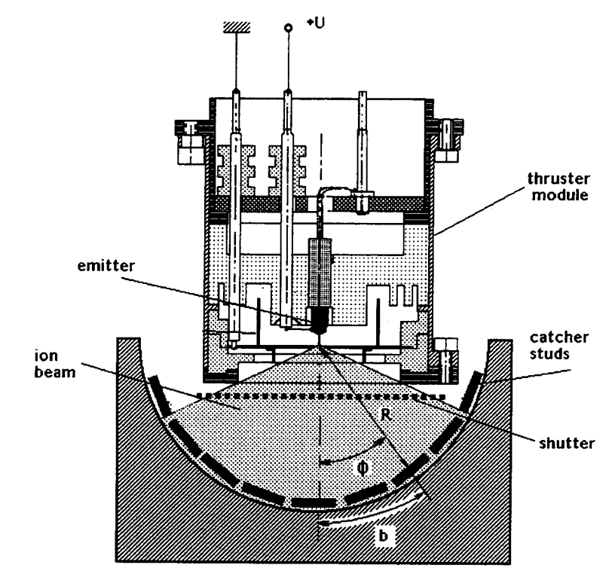
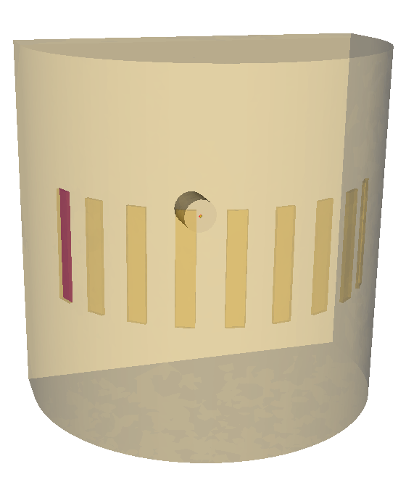
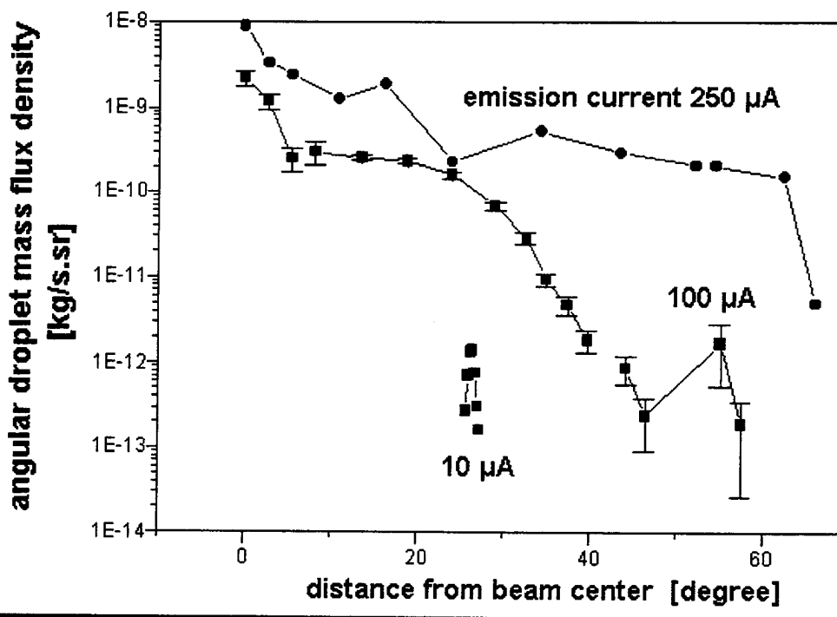
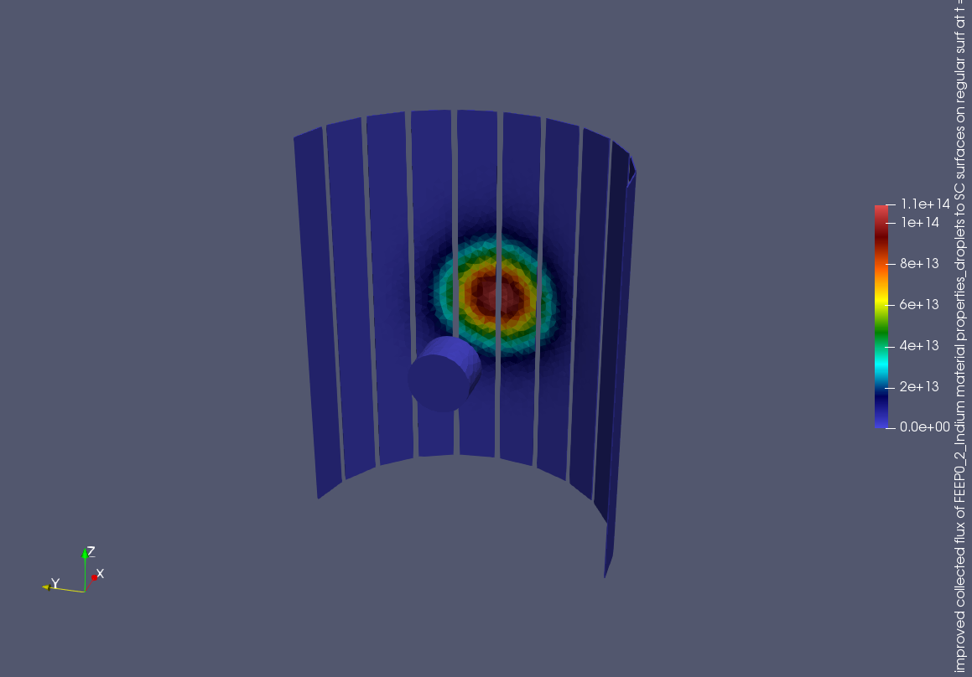
Validation with experimental data
Droplet emission with experimental data from ESA: comparison of droplet flux collected in front of FEEP
$$<m_{d}> =3.8×{10}^{−18}kg$$
$$Γ_{d}\left(θ=0°\right)=1.1×{10}^{14} m^{−2}.s^{−1}$$
$$Γ_{d}\left(θ=30°\right)=1.0×{10}^{13} m^{−2}.s^{−1}$$
$$S=5.0 mm^{2}$$
$$K=\frac{S⋅〈m_{d}〉}{Ω}=3.8⋅{10}^{−23}kg.m^{2}.sr^{−1}$$
$$Q=K⋅Γ$$
$Ω =\frac{2π}{12}=0,5 sr$
Good correlation between experimental data and simulation
$$Q_{d,m}\left(θ=0°\right)=4.18×{10}^{−9} kg.sr^{−1}.s^{−1}$$
$$Q_{d,exp}\left(θ=0°\right)=1.1×{10}^{−9} kg.sr^{−1}.s^{−1}$$
$$Q_{d,m}\left(θ=30°\right)=3.8×{10}^{−10}kg.sr^{−1}.s^{−1}$$
$$Q_{d,exp}\left(θ=30°\right)=9.0×{10}^{−11}kg.sr^{−1}.s^{−1}$$

Slide 8
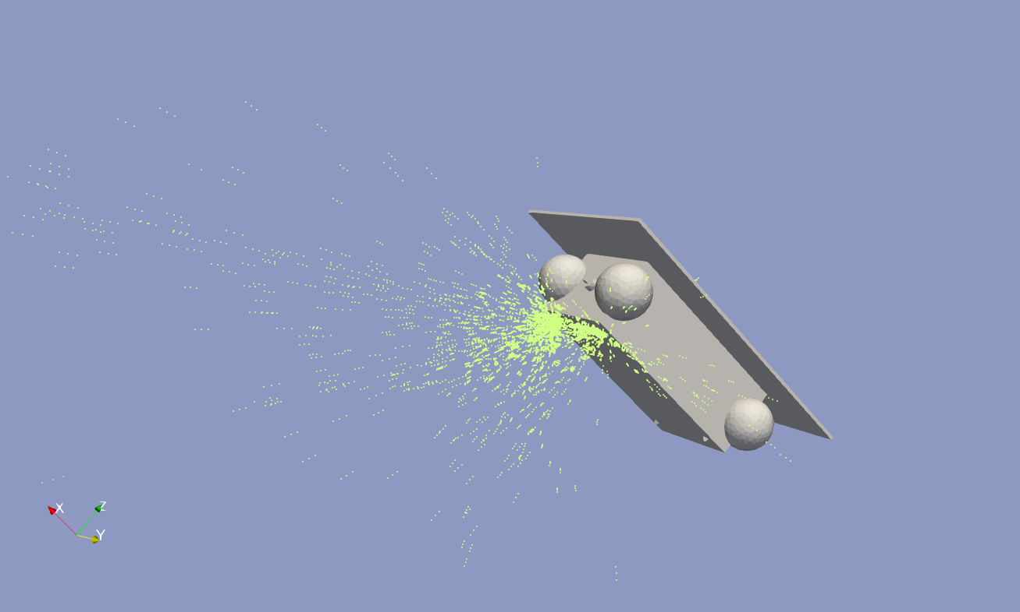
Results of SPIS simulation of LISA spacecraft in worst case situation

Slide 9
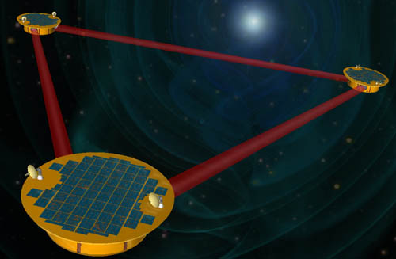
Realistic case : LISA mission
LISA : Laser Interferometer Space Antenna
2.5 million km
IR laser Interferometry
Figure 6 : Artist view of LISA functionning
Gravitationnal waves
Creation of a gravitational interferometer by linking with infrared laser beam three satellites separated by 2.5 million kilometer at Lagrange 1 point.
Need for very precise attitude control
Need for autonomy on a long mission duration
Need for assessment of FEEP use impact on satellite cleanliness
Use of FEEP thrusters

Slide 10
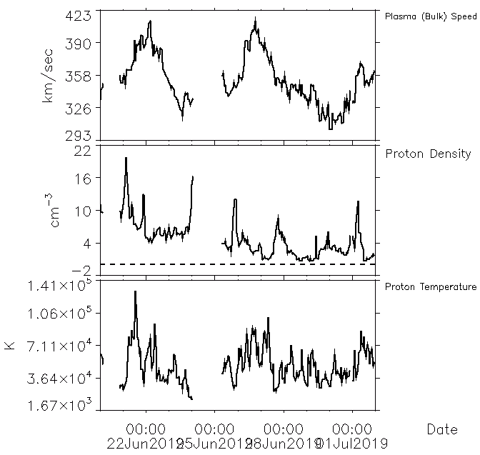
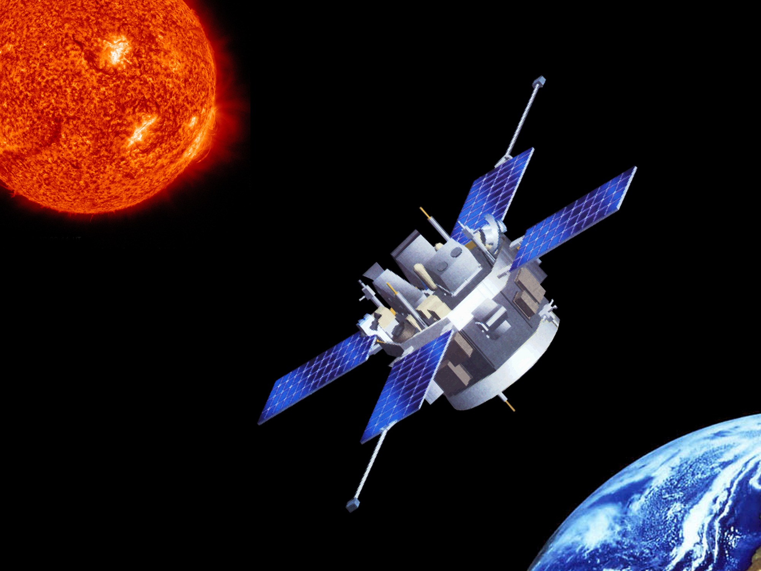
Initialisation of SPIS LISA simulation : Environment
ACE mission data used for having informations on environment
Figure 8 : Artist view of ACE mission (NASA)
Environment conditions at Lagrange L1 point:
Solar wind considered as neutral
$n_{e}=n_{p}≃{10}^{5}cm^{−3}$
$T_{p}=T_{e}≃5.3×{10}^{4}K=4,8 eV$
$V_{e}=V_{i}≃350 km/s$
Figure 7 : Measured data at L1 point by ACE mission (NASA)

Slide 11
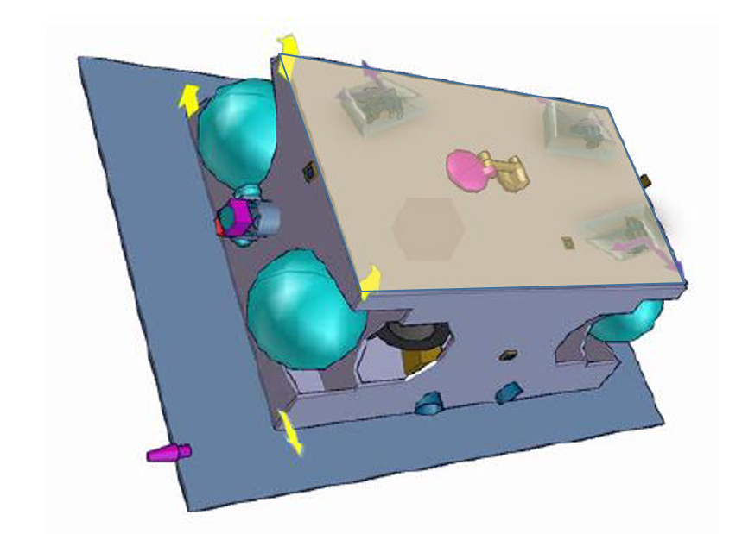
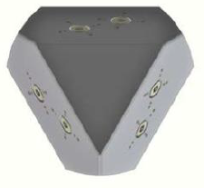
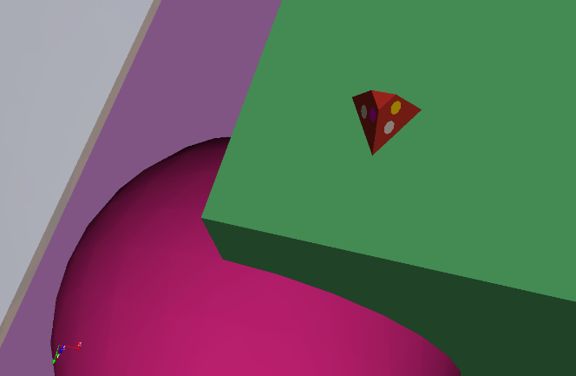
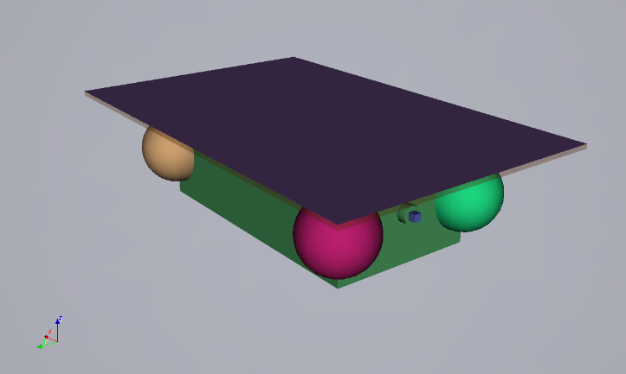
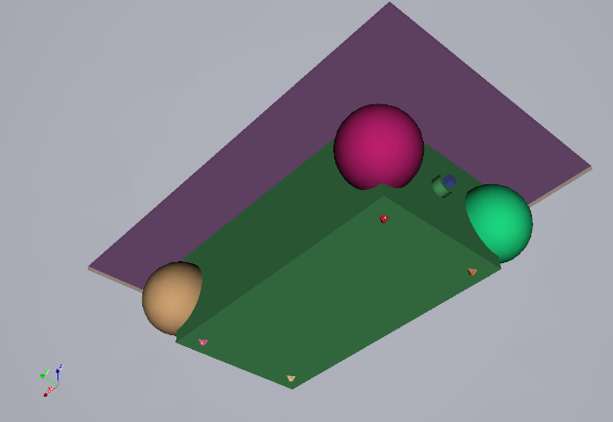
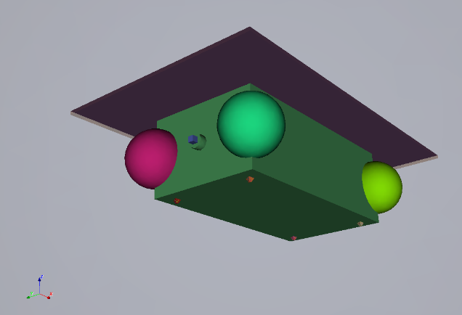
Initialisation of SPIS LISA simulation : Geometry
LISA geometry derived from latest geometry obtained from ESA
Total of 24 FEEP thrusters installed on LISA spacecraft (12 nominals and 12 spares)
Figure 9 : ESA model of LISA spacecraft
Figure 11 : FEEP thrusters spots on LISA geometry (ESA)
Figure 12 : FEEP thrusters spots on LISA geometry (SPIS geometry)
Figure 10 : SPIS geometry of LISA

Slide 12
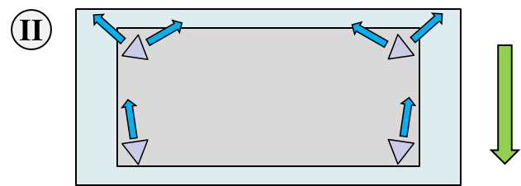
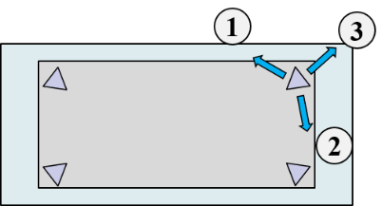
Initialisation of SPIS LISA simulation : thrusters firing configuration
A total of 28 configurations have been considered:
(2 Environment conditions) x (14 thrusters configurations)
Figure 14 : LISA geometry (ESA)
Focus on the result of worst case simulation:
Figure 14 : LISA modelling in II configuration
$$n_{e}=n_{i} [m^{−3}]$$ | $$T_{e}=T_{i}[eV]$$ | $$v_{e}=v_{i}\left[\frac{km}{s}\right]$$ | Configuration
$${10}^{7}$$ | $$30$$ | 1000 | II
Figure 13 : FEEP thrusters spots on LISA geometry (SPIS geometry)

Slide 13
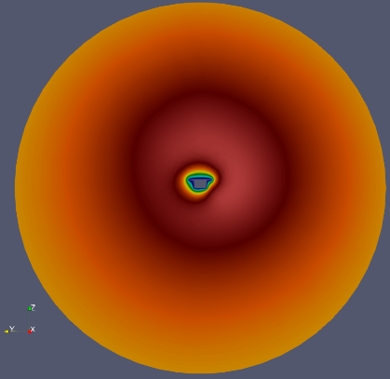
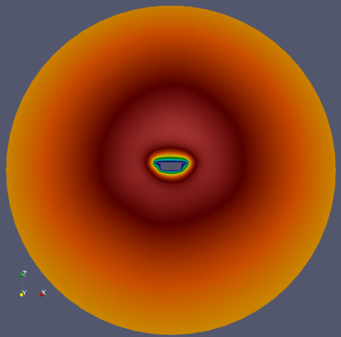
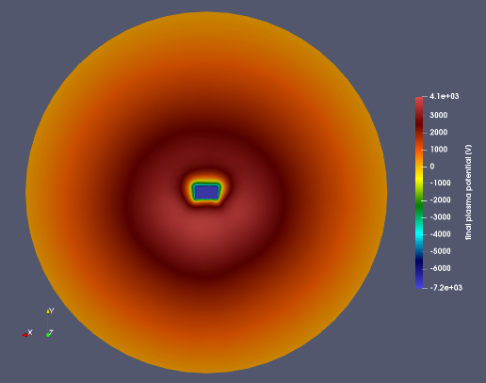
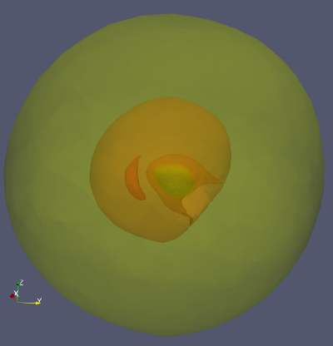
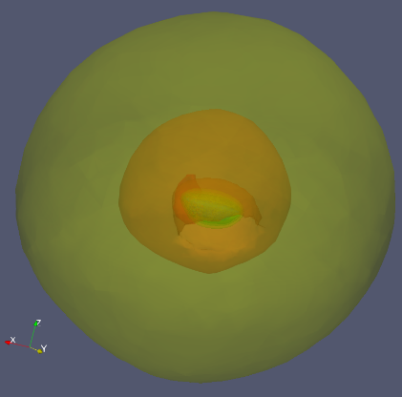
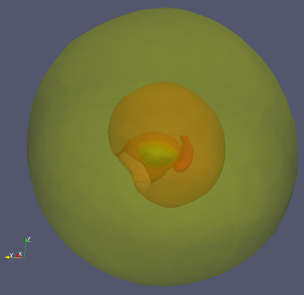
Global characteristics of the plasma around the spacecraft : plasma potential
Very high potential around the spacecraft mainly due to the use of field emission cathode : high energy electrons (1 keV) that are not attracted enough by environment ions to neutralize them.
Figure 16 : Plasma potential around the satellite at $t_{f}=3.0 s$ (left: normal to X axis, center: normal to Y axis, right: right: normal to Z axis)
Figure 17 : Plasma potential contour around the spacecraft (from darker to brighter: 4000 V, 3500 V, 3000 V, 2500 V, 2000 V, 1500 V, 1000 V)

Slide 14
Population of emitted particles around the spacecraft
Droplets density
Ions In⁺ density
Droplets bouncing particles density
Density contour for $n=1.0⋅10^{7}m^{−3}$
First simulation results shows a potential contamination of spacecraft surface

Slide 15
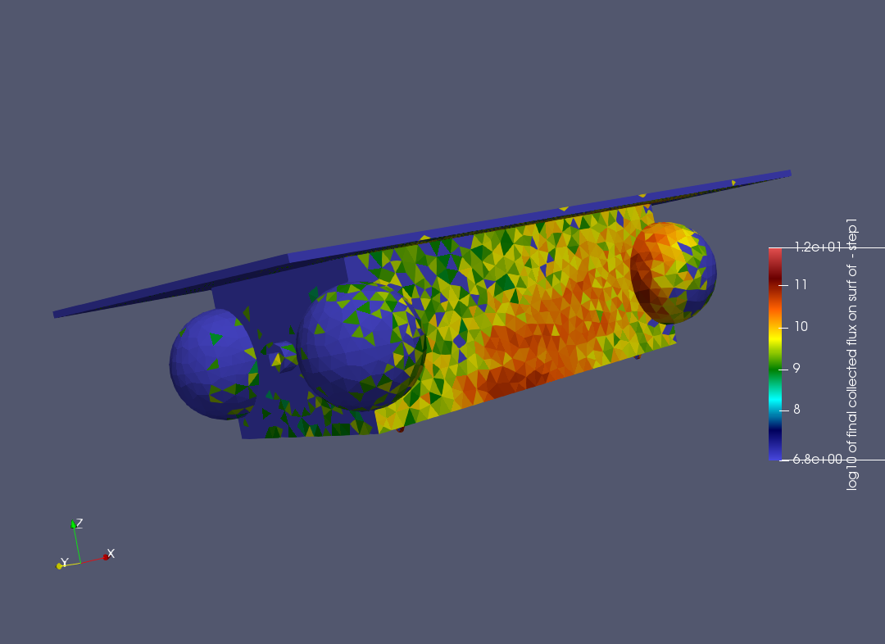
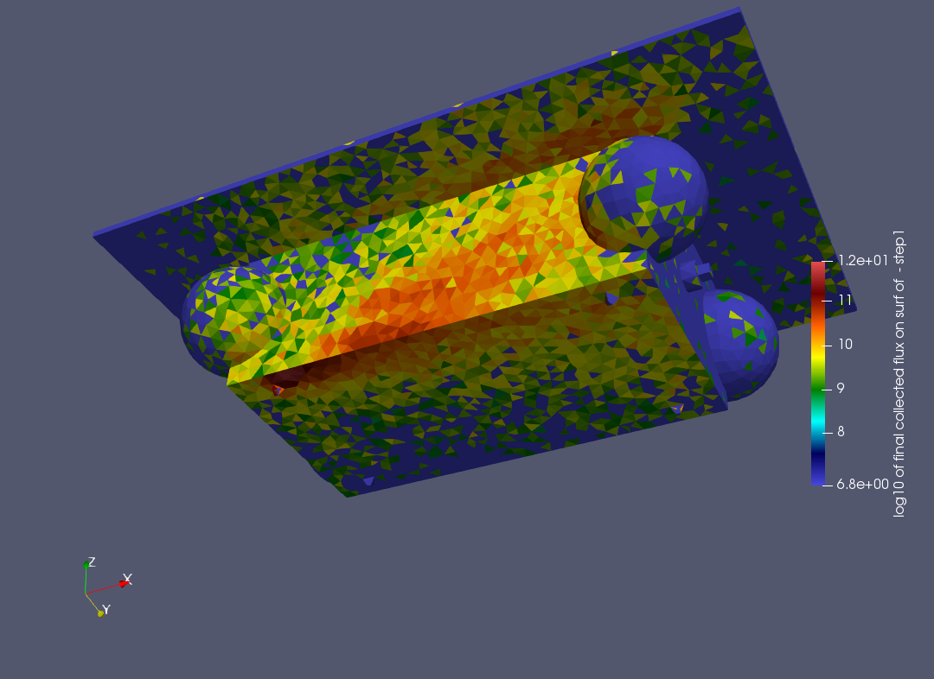
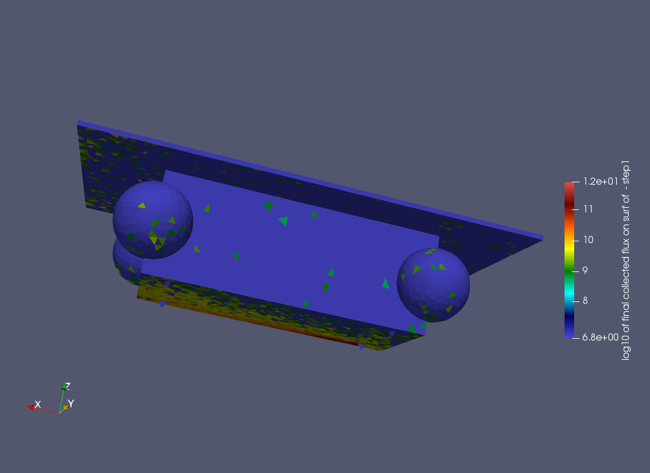
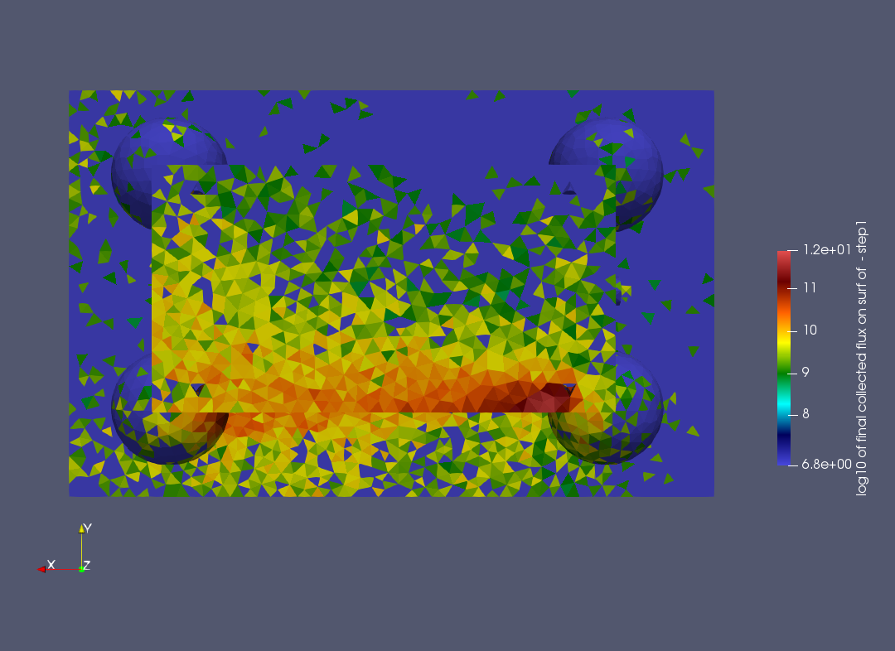
Contamination of particles on surface
There is a visible risk of LISA surface contamination due to droplets. Especially on surface upholding the optics.

Slide 16
Conclusion and further study

Slide 17
Conclusion and further studies
New version of SPIS software allows taking into account the use of FEEP thrusters, droplets dynamic and their interaction with spacecraft body.
SPIS-LISA software validation shows good correlation with the studied experimental data
This new version of SPIS allows making a first estimation of the impact of FEEP thrusters on spacecraft surface cleanliness
However, it is clear that a more detailed validation of SPIS-LISA should be performed to strengthen the validity of its results.
Further studies:
Thorough study on interaction between emitted droplets and spacecraft surface materials
Thorough comparison between on ground test of micro-thruster and SPIS simulation to improve SPIS-LISA validation
Comparison of SPIS-LISA simulation with inflight data of FEEP-equipped satellites

Slide 18
Literature Review
[1] An Austrian Success Story: ENPULSION launches new thruster product family, October 2020.
[2] M. Fehringer, F. Rüdenauer, et W. Steiger, « Ultra-Precise Indium Thruster », Austrian Research Centre Seibersdorf, Austrian Research Centre Seibersdorf, Austria, ESA Report, juin 1998.
[3] J. Roussel, T. Tondu, J. Mateo-Velez, E. Chesta, S. D’Escrivan, et L. Perraud, « Modeling of FEEP Plume Effects on MICROSCOPE Spacecraft », IEEE Transactions on Plasma Science, vol. 36, no 5, p. 2378‑2386, oct. 2008, doi: 10.1109/TPS.2008.2002541.
[4] « CHARACTERIZATION OF COLLOID THRUSTER BEAMS », th International Electric Propulsion Conference, p. 6, 2005.

