Slide 1
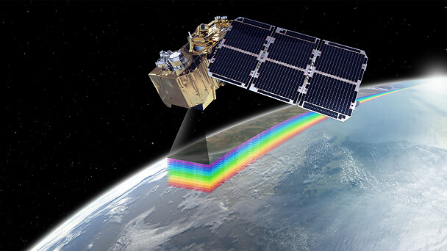
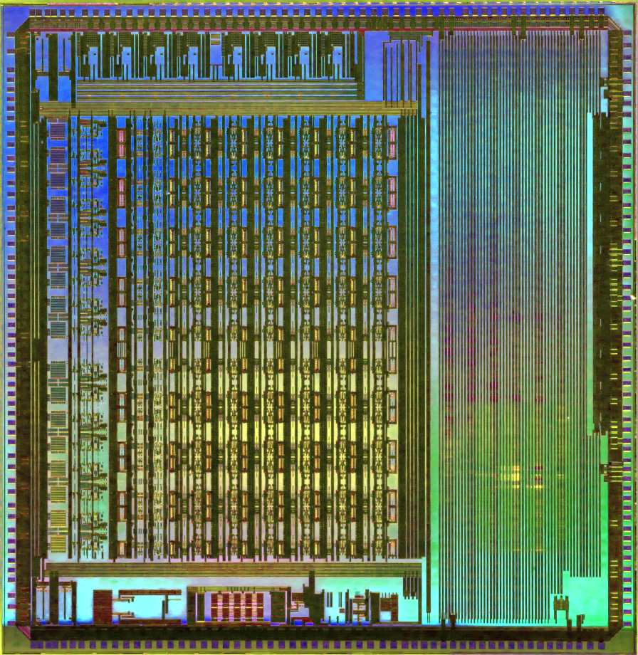
NIRCA MkII IR Image Sensor Readout and Controller ASIC
AMICSA 2022, Madrid, Spain
NIRCA MkII
Custom cell-, circuit- and system- design of ICs for space applications
Torbjørn Østmoe, torbjorn.ostmoe@ideas.no
Integrated Detector Electronics AS (IDEAS), Oslo, Norway
Copernicus Sentinel-2A, Courtesy of Airbus

Slide 2
NIRCA MkII provides A/D conversion and control for IR sensors using a single IC

Slide 3
IR system using NIRCA MkII
Sensor examples
Sensor: FPA + ROIC
NIRCA MkII
Master Controller (FPGA)
Flex cable
HgCdTe/InGaAs
Microbolometer array

Slide 4
NIRCA MkII Applications
Earth observation
Astrophysics
Terrestrial

Slide 5
Benefits of NIRCA MkII
Reduce SWaP
NIRCA MkII bare die area: 1 cm²
Power consumption < 2 W
This reduces costs
Withstands harsh environments
Radiation hardness (SEE/TID)
Operating temperature -40ºC to +85ºC
1 cm
1 cm

Slide 6
Example: NIRCA MkII in system
Adjustable frequency/delay/duty
ASIC configuration
ASIC control
ASIC state/status read
Sequencer programming
Sensor
Flexible waveforms
Debug (internal sig)
NIRCA MkII ASIC
FPGA
Sensor clock
Std. SPI modes
Shift register
DOUT
SPI
SPI
Control (RST, INT,…)
Signal about ASIC/sensor states
IRQ
Control
SPI / Serial
Read status/serial
React to status
React to interrupts
PIRQ
Status (FV, LV, ERR)
DIN
Low noise
Programmable voltage
TX
IDEAS provides RX IP (VHDL)
Supply/References
AOUT
IDEAS RX IP
AC or DC coupling
Source synchronous
With/without TX clock
Multiple frame types
Many data sources (ADC, DIN, REGs)
Stream capability
CRC
Pixel array
Direct connection
7 pF input capacitance
Fully-/pseudo-differential
Adjustable sample point
Wide common-mode range
Store images
Ethernet / CameraLink
Analog out
AIN
Clock
Clock
≤ 15 MHz from FPGA or other source
Proximity sensor

Slide 7
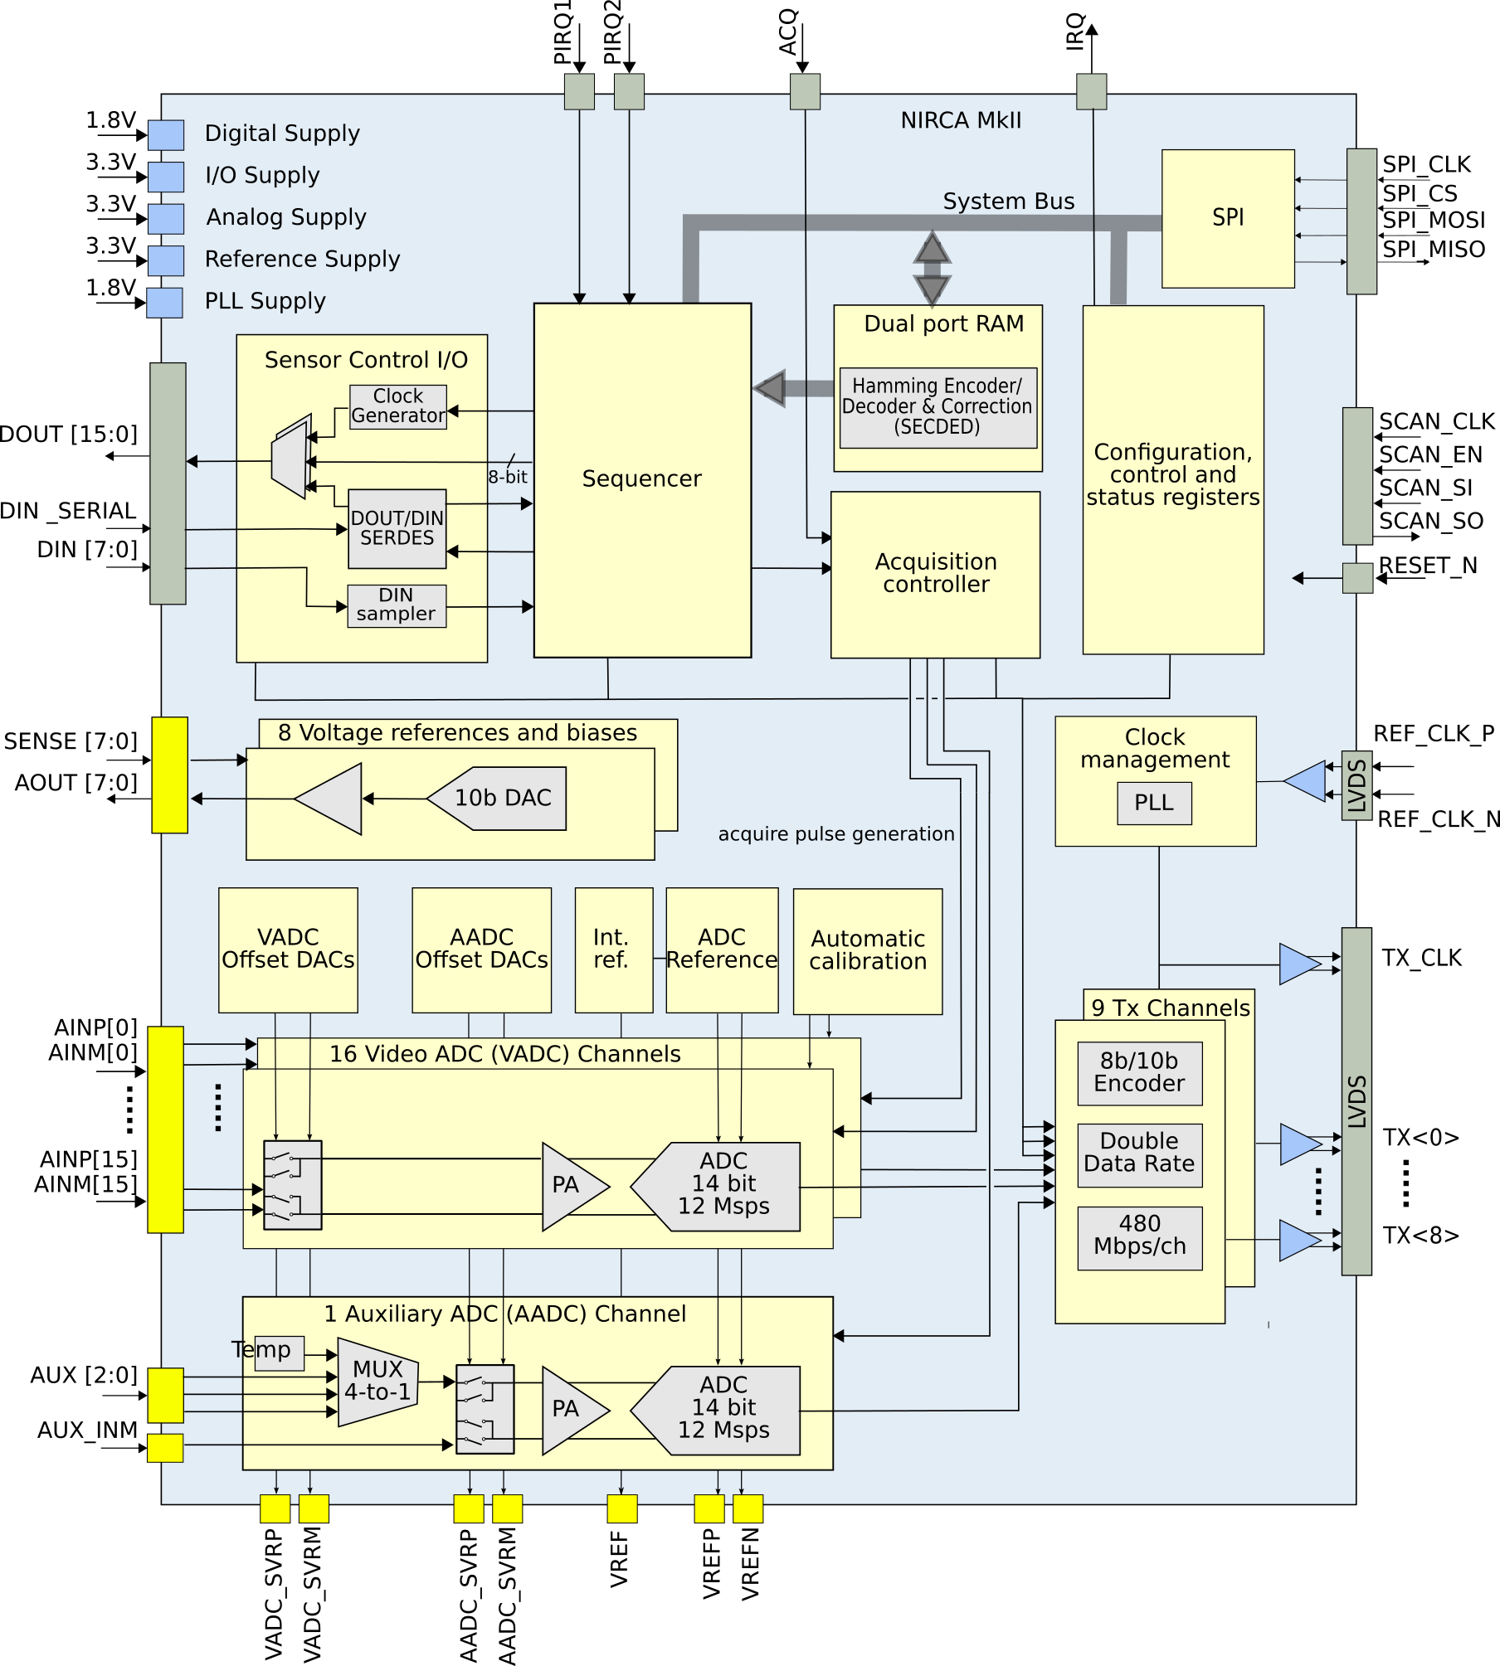
NIRCA MkII Block Diagram and Features
17 ADCs digitizing sensor data at 12 Msps
8 adjustable voltage references (0 – 3 V)
I/O interface for sensor control, monitoring and sample time adjustment
Programmable sequencer
Instruction RAM with single error correction, double error detection (SECDED)
ACQ capable of a wide variety of acquisition modes
9 LVDS links TX<0:8> with 8b/10b encoding exporting data to the FPGA at 480 Mbps/link double rate
SPI interface for communication
Radiation hardened against SEE and TID
16
16

Slide 8
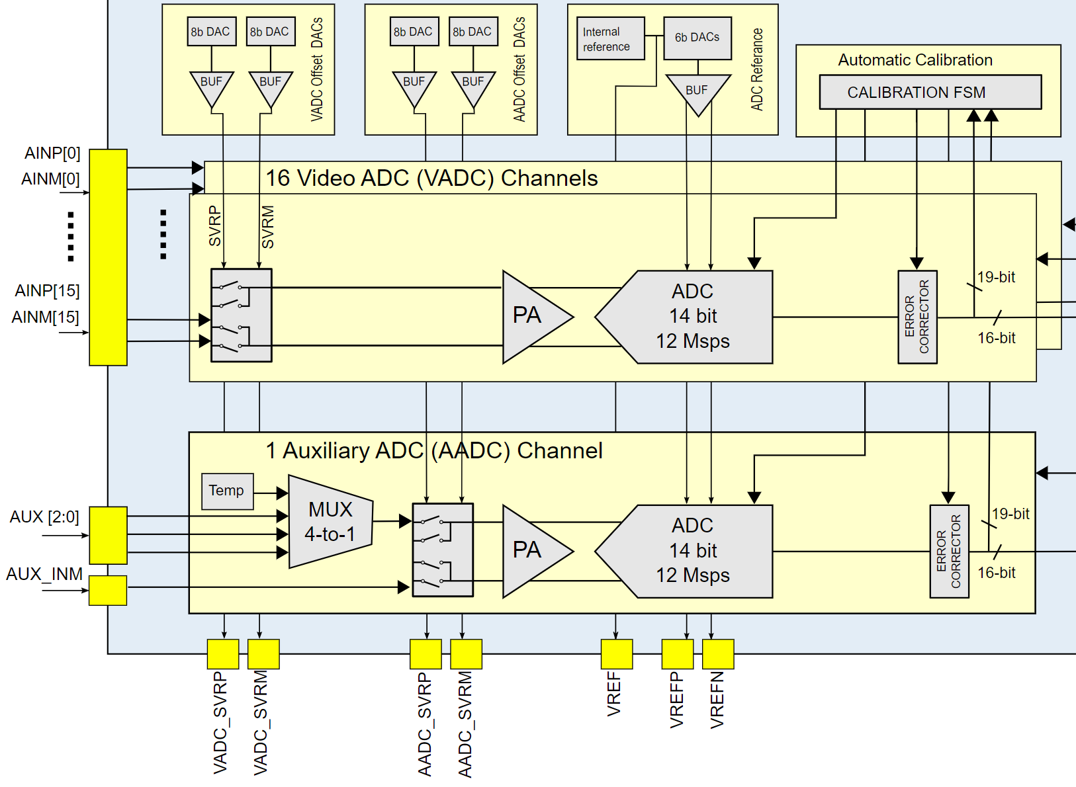
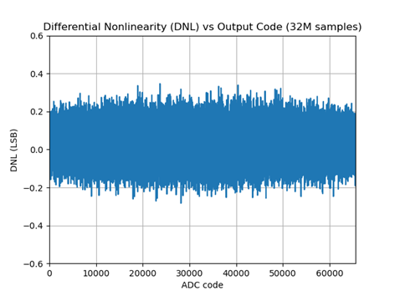
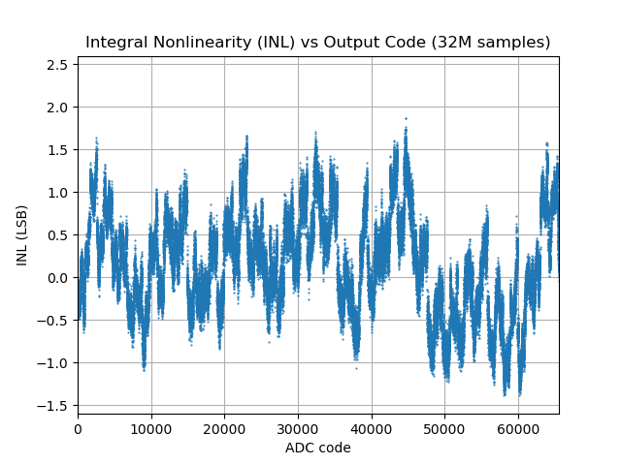
Analog front-end
Preamp + pipeline ADC architecture
Supports fully- and pseudo differential mode
16 Video ADCs + 1 Auxiliary ADC
16-bit ADCs with 12 Msps
14-bit if frame/line valid are sent upstream
Programmable offset and gain
Gain: x1, x1.14, x1.33, x1.6, x2, x2.67, x4, and x8
Range:$± 0.125$ V$to ±2$ V
Automatic calibration of capacitor mismatch
16
16
Typical values with gain x1 and 16-bit ADC mode.
Parameter | Measured
Equivalent input noise (ENI) | 3.0 LSB_{rms}
Differential non-linearity (DNL) | (-0.32, +0.35) LSB
Integral non-linearity (INL) | (-2.4, +1.5) LSB

Slide 9
Sequencer
Automating the control sequences
Microcontroller-like instruction set
21 instructions:
Control: CALL, JUMP, LOOP, …
Data management: LOAD, LDTEMP, MOVTEMP, …
Data flow: TXVAL, TXBR, …
State management: WAIT (COMPARE / IRQ)
Can be used in combination with flags as SYNC and ACQUIRE
Handling of IRQ inputs and outputs

Slide 10
Using the NIRCA MkII sequencer
NM2 assembly program
@start:
NOOP 0
LOAD DOR 0b00000001
LOAD NLC 5 # Call next function 5+1 times
CALL @f_func1
LOAD DOR 0b00000000
WAIT 2 # Stops: wait for unused condition
LOOP @start
@f_func1:
A LOAD DOR 0b00000011
LOAD DOR 0b00000111
LOOPR @f_func1 # LC = LC - 1
Simple NIRCA program generating a waveform using functions, instructions and the ACQUIRE-flag
Configuration
ACQ triggered by sequencer (A-flag in @f_func1) VADC_0 enabled sample sent on TX

Slide 11
Example use case: Sensor with Frame and Data valid
Sensor
Sends frame/
line valid=1 to DIN
Line valid high
Line valid low
1. Reset & integration phase
Resets sensor
Integration time
Start of frame
Data sent on TX
WAIT for line-valid
End of frame
2. Frame and data/line-valid sequence
NIRCA MkII
Software

Slide 12
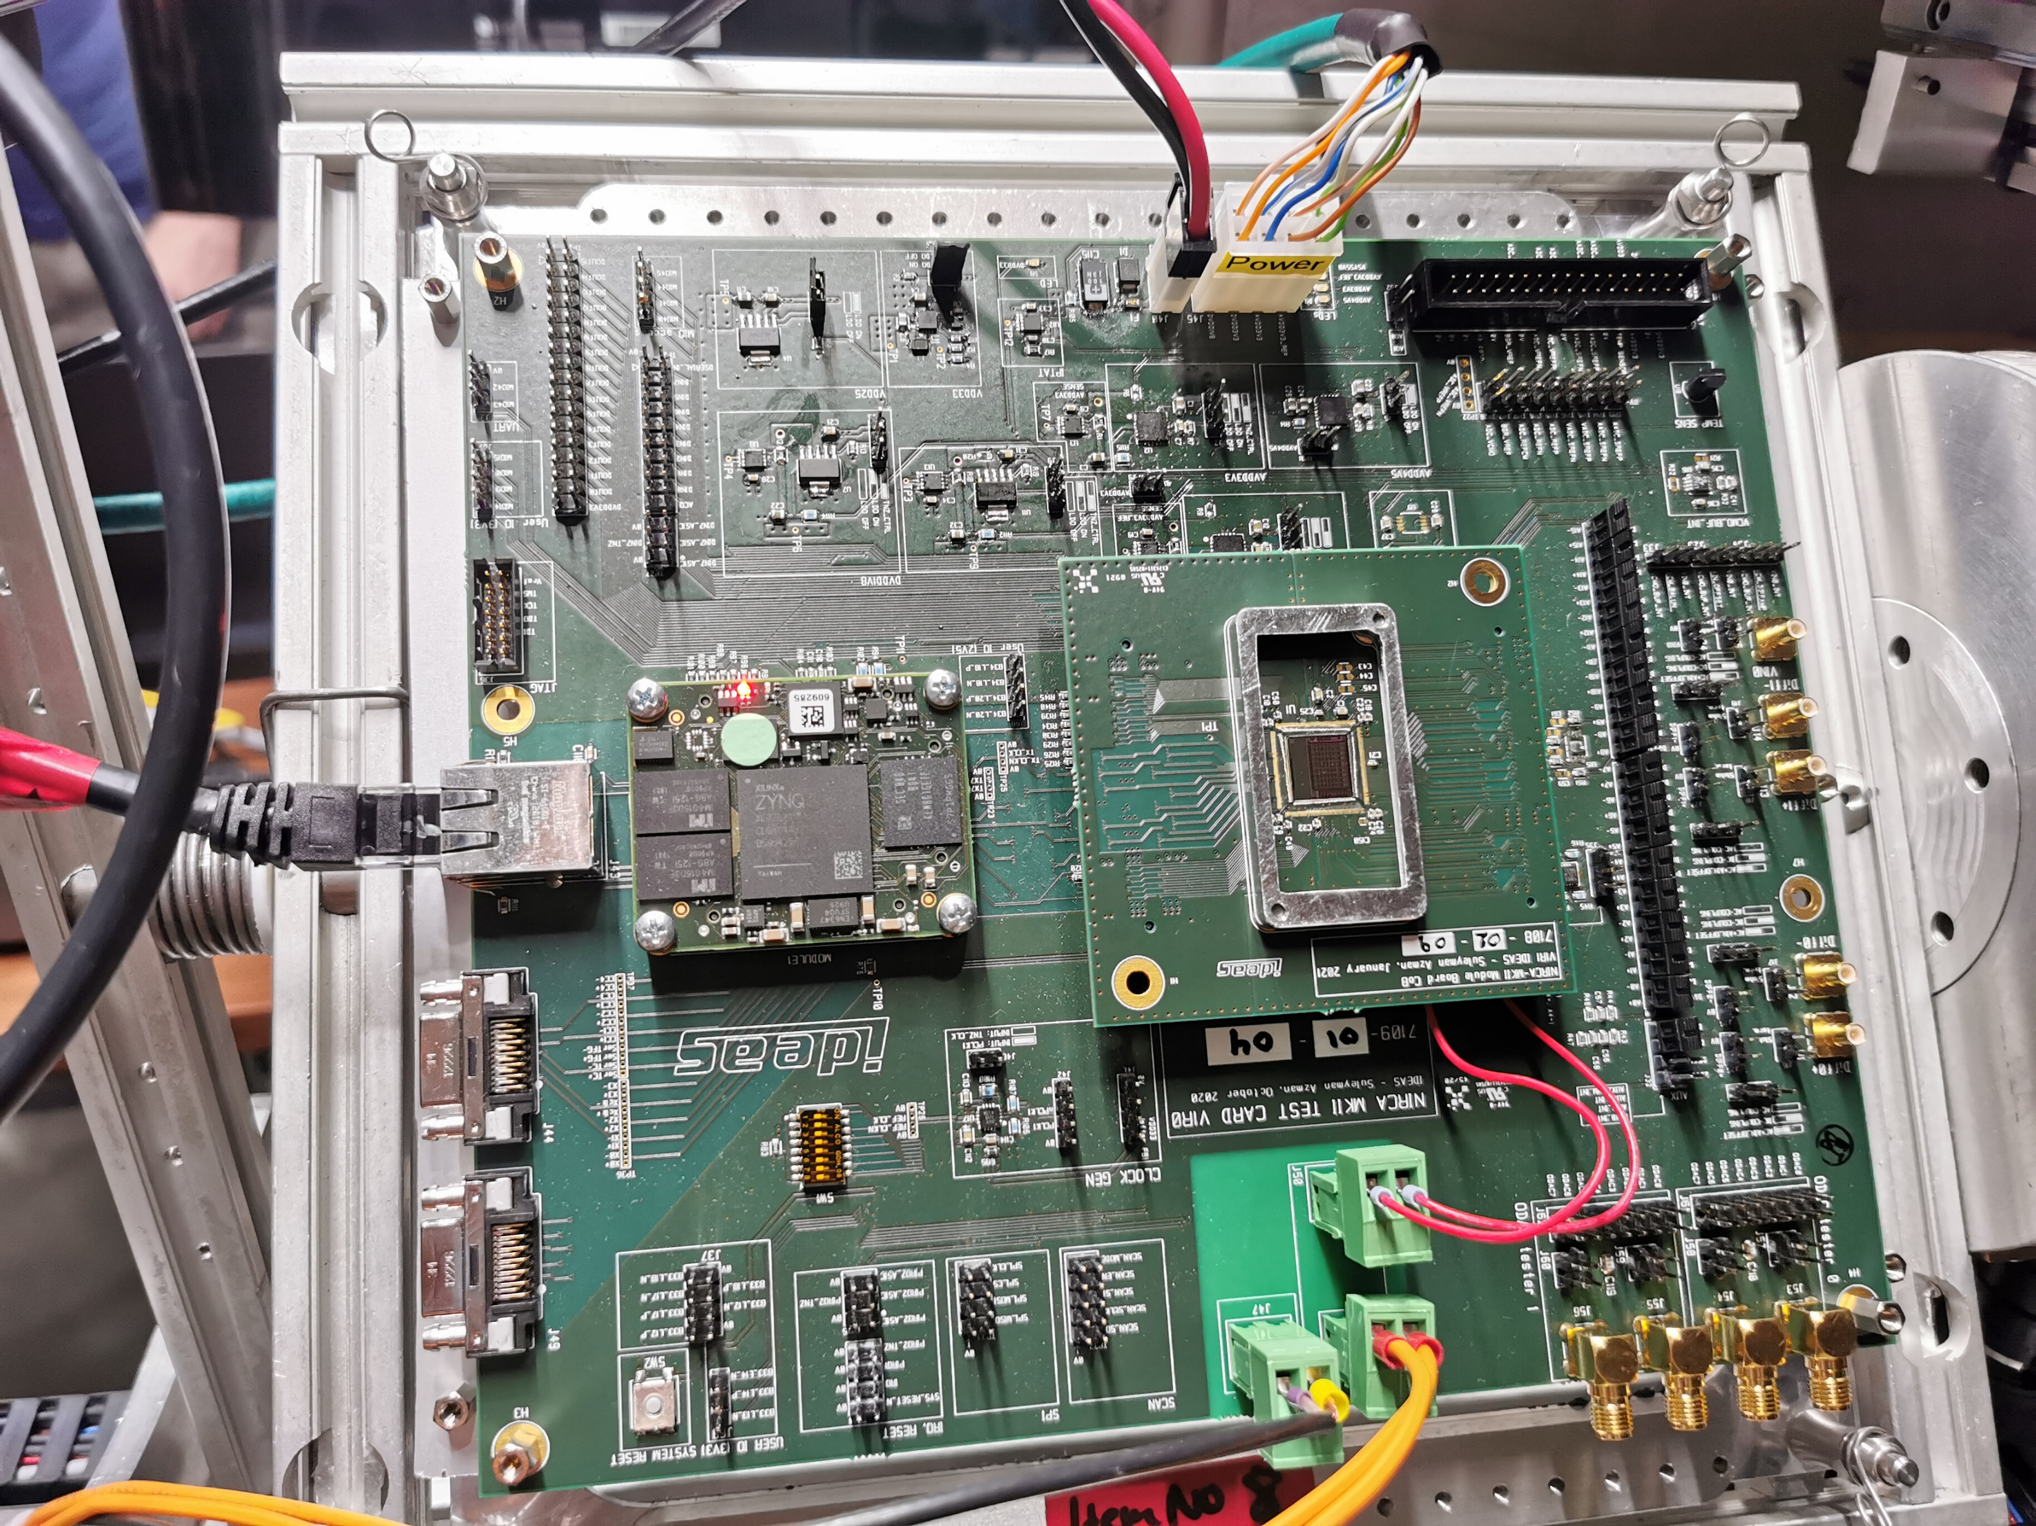
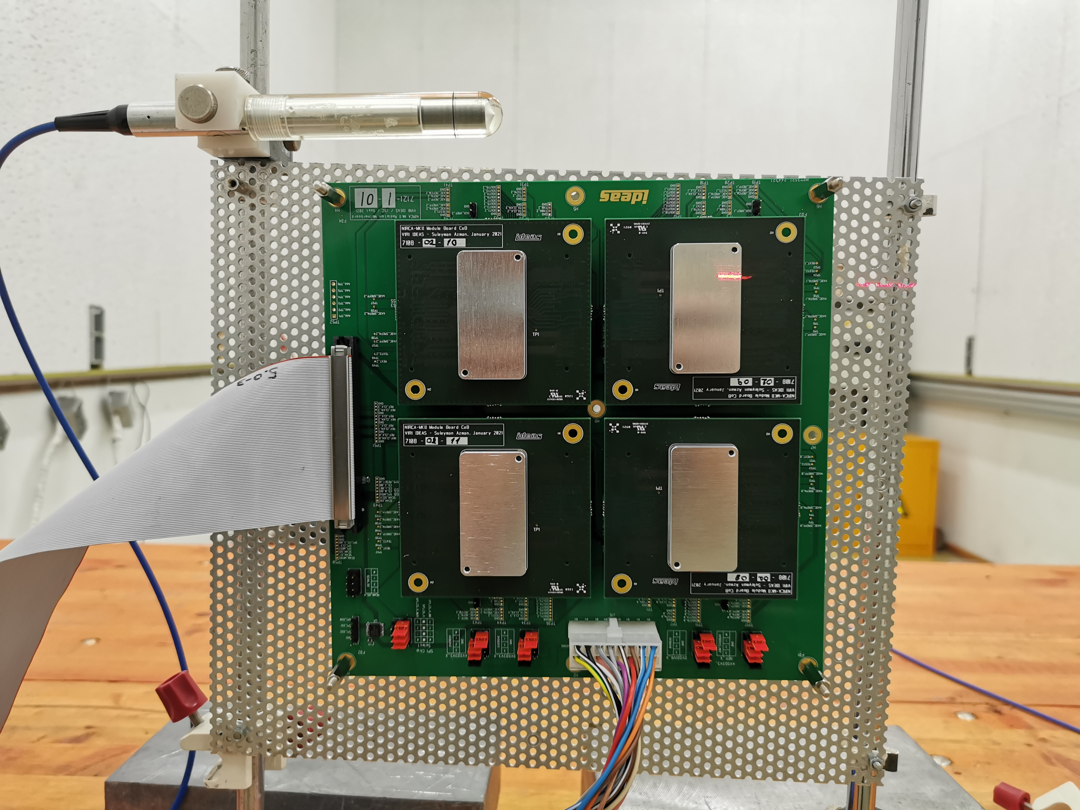
Radiation testing
SEL tolerance up to LET = 71.1 MeVcm²/mg
No SEU in configuration registers below LET < 16.1 MeVcm²/mg, few SEUs above
SECDED implementation of the RAM works
27 krad (low dose rate) + 85 krad (high dose rate)
No TID induced drift on DNL, INL, noise, offset/gain errors and max frequency
Drift in voltage references/ODACs about -0.5 %
SEE
TID

Slide 13
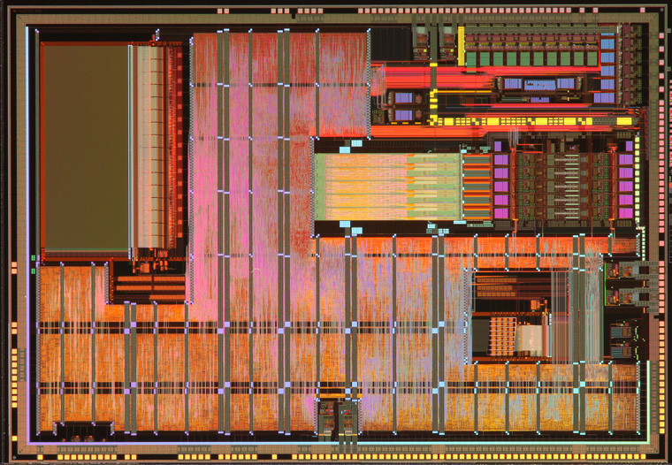
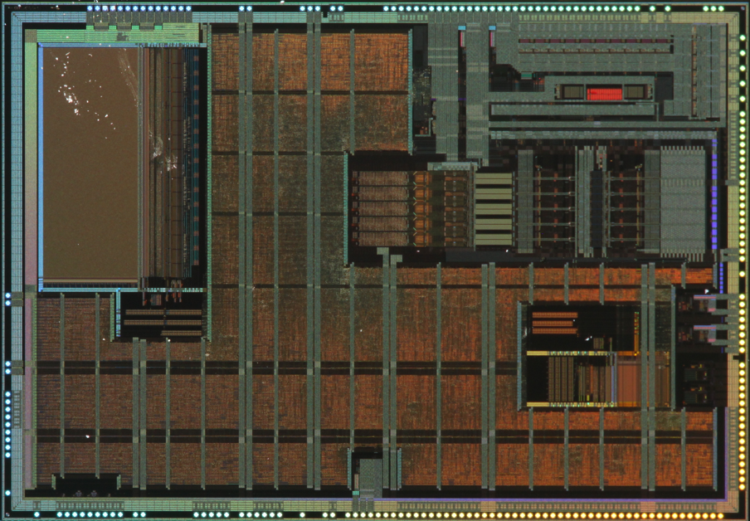
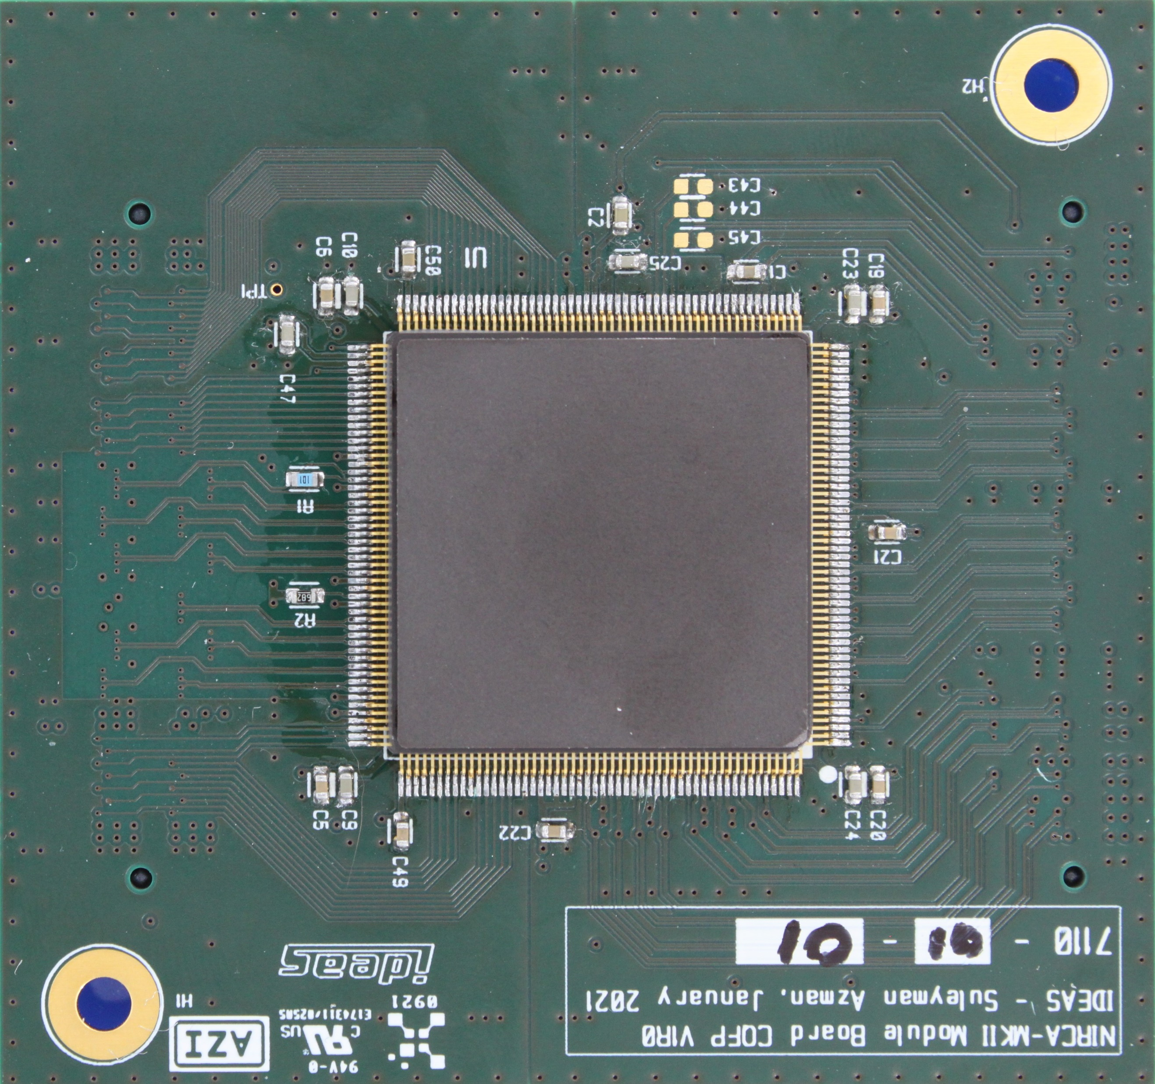
NIRCA – Roadmap
2015 2017 2020 2023
NIRCA 1
NIRCA 1.1
NIRCA MkII
NIRCA MkII Design iteration & Qualification
NIRCA MkII Further development
NIRCA MkII is validated, radiation tested and packaged
Samples are available
Funding for further development is secured from ESA

Slide 14
NIRCA – Next steps
Make qualification platform Q4 2022
NIRCA MkII design iteration available Q2 2023
Space qualified packaging Q2 2023
Procure engineering models Q2 2023
Available for customers too
Radiation testing for qualification Q3 2023
Space qualification Q1 2024
Flight models will be available
Collaborate with users!

Slide 15
Contact
Project Manager - Amir Hasanbegovic: amir.hasanbegovic@ideas.no
Presenter - Torbjørn Østmoe: torbjorn.ostmoe@ideas.no
Special Apps/Ops/Env
Radiation Detectors
Image Sensors
IC Designer/Supplier

