Slide 1
Radiation Hardened Versatile 14-bit SAR adc
Laurent Berti

Slide 2
Outline
Original ADC
Analog mux 8:2
Comparator improvement (offset, speed and input equivalent noise)
ADC core improvement
Conclusion

Slide 3
Original ADC
10-bit SAR ADC single ended
Silicon proven
Single capacitor bank, no split capacitor architecture
1024 unit-capacitors of 25 fF (min. value comes from the PCell of the PDK)
Low enough sampling noise (kT/C) for 16-bit resolution
DAC matching equivalent to a 14-bit DNL
Goal
Transform the original ADC into a 14-bit versatile ADC without losing the benefit of the silicon proven
Implementation strategy
The root architecture and design must be kept

Slide 4
Outline
Original ADC
Analog mux 8:2
Comparator improvement (offset, speed and input equivalent noise)
ADC core improvement
Conclusion

Slide 5
Analog mux 8:2
Analog MUX 8:2 added in front of ADC
Useful for low frequency sensor application: 1 ADC to monitor till up to 8 sensors in single ended mode or 4 in differential mode
Possibility to isolate the input from the sampling capacitor (25pF)
Zin > 24 kOhms
Possibility to amplify the signal up to 12dB

Slide 6
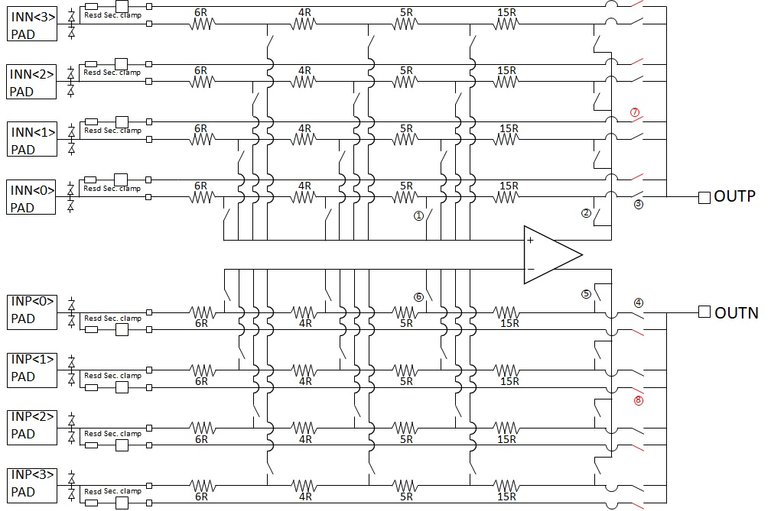
Analog mux 8:2
Bypass possible
Switches 1, 3, 4 and 6: no DC current
Switches 2 and 5: DC current but not in ADC signal path
Sizing of the switches driven only by settling time consideration and SA (i.e. min. size)
No gain error
No distortion
No secondary ESD protection needed for the amplifying path => no gain error due to ESD resistor

Slide 7
Outline
Original ADC
Analog mux 8:2
Comparator improvement (offset, speed and input equivalent noise)
ADC core improvement
Conclusion

Slide 8
Comparator improvement
Architecture maintained, only resizing
Auto-zeroing
During tracking phase
Use switched Miller compensation
Min. retention offset correction: 30 µs
Max. settling time 14-bit: 600ns
PM > 60º
Max delay FS to 1 LSB for 14-bit: 100ns
Max input-referred noise at 125ºC: 35µVrms
SET filter
Auto zeroing cap

Slide 9
Outline
Original ADC
Analog mux 8:2
Comparator improvement (offset, speed and input equivalent noise)
ADC core improvement
Conclusion

Slide 10
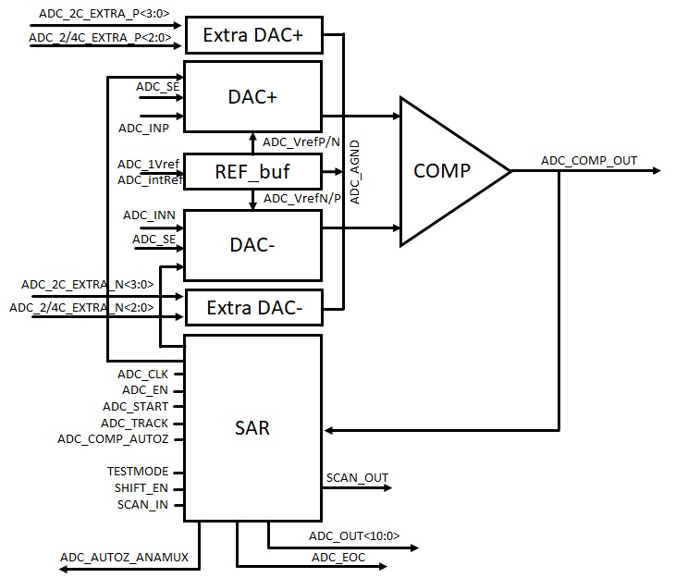
ADC core improvement
Added 4 items
Internal voltage reference (Bypass possible)
Second DAC for the differential mode
1-bit to the FSM
Extra DAC in parallel with the original DAC to extend the resolution
Original ADC

Slide 11
ADC core improvement
Goal of the extra DAC: increase the resolution from 11-bit to 14-bit
The DAC uses the charge sharing principle between the different capacitor
Sampling: Q_{C_S} = (VIN-AGND) * 2048 * C where C is the unit capacitor of the DAC
End of conversion: Q_{C_E} = Q_{C_S} => V_{IN_comp} = [(AGND-VIN) * 2048 * C + 1024 * C * VREFP/N + 512 * C * VREFP/N ....]/(2048*C) Q_{C_LSB} = (VREFP – VREFN) * C
AGND = (VREFP-VREFN)/2
1024C
512C
256C
4C
2C
C
C
Comparator
VIN
AGND

Slide 12
ADC core improvement
Adding 3 bits resolution means dividing the LSB charge (Q_{C_LSB}) by 8
Add a capacitor of C/2, C/4 and C/8.... not possible
The unit cap C is already at minimum value (MiM cap of 12.5 fF)
Use of MoM cap is not suitable for matching (MoM can’t match with MiM)
Arranging unit capacitor in series is not suitable due to floating node or leaky path
Add a unit capacitor and divide the reference in 8 intervals of (VREFP-VREFN)/8
It means Q_{C_LSB} become C * (VrefP-VrefN)/8
Easy to implement thanks to a resistive divider. High resistor value is possible because the sampling frequency is low and the capacitor is small (1 unit cap)

Slide 13
ADC core improvement
Add 2 capacitors of 2 C and of 4 C in the extra DACs
Added for dithering purpose
Input signal is sampled on the bottom plate of all the capacitors connected to the mid-range reference
A first conversion where the 2 extra capacitors stay connected to the mid-reference
Input signal is sampled on the bottom plate of all the capacitors connected to the mid-range reference
A second conversion (with the same sampled value) where the 2 extra capacitors are connected to VREFP. Equivalent to add an offset of 6*(VREFP-VREFN)/2048
A third conversion (on the same sampled value) where the 2 extra capacitors are connected to VREFN. Equivalent to substract an offset of 6*(VREFP-VREFN)/2048
Use the averaged value of the 3 conversions for the output code....

Slide 14
ADC core improvement

Slide 15
Outline
Original ADC
Analog mux 8:2
Comparator improvement (offset, speed and input equivalent noise)
ADC core improvement
Conclusion

Slide 16
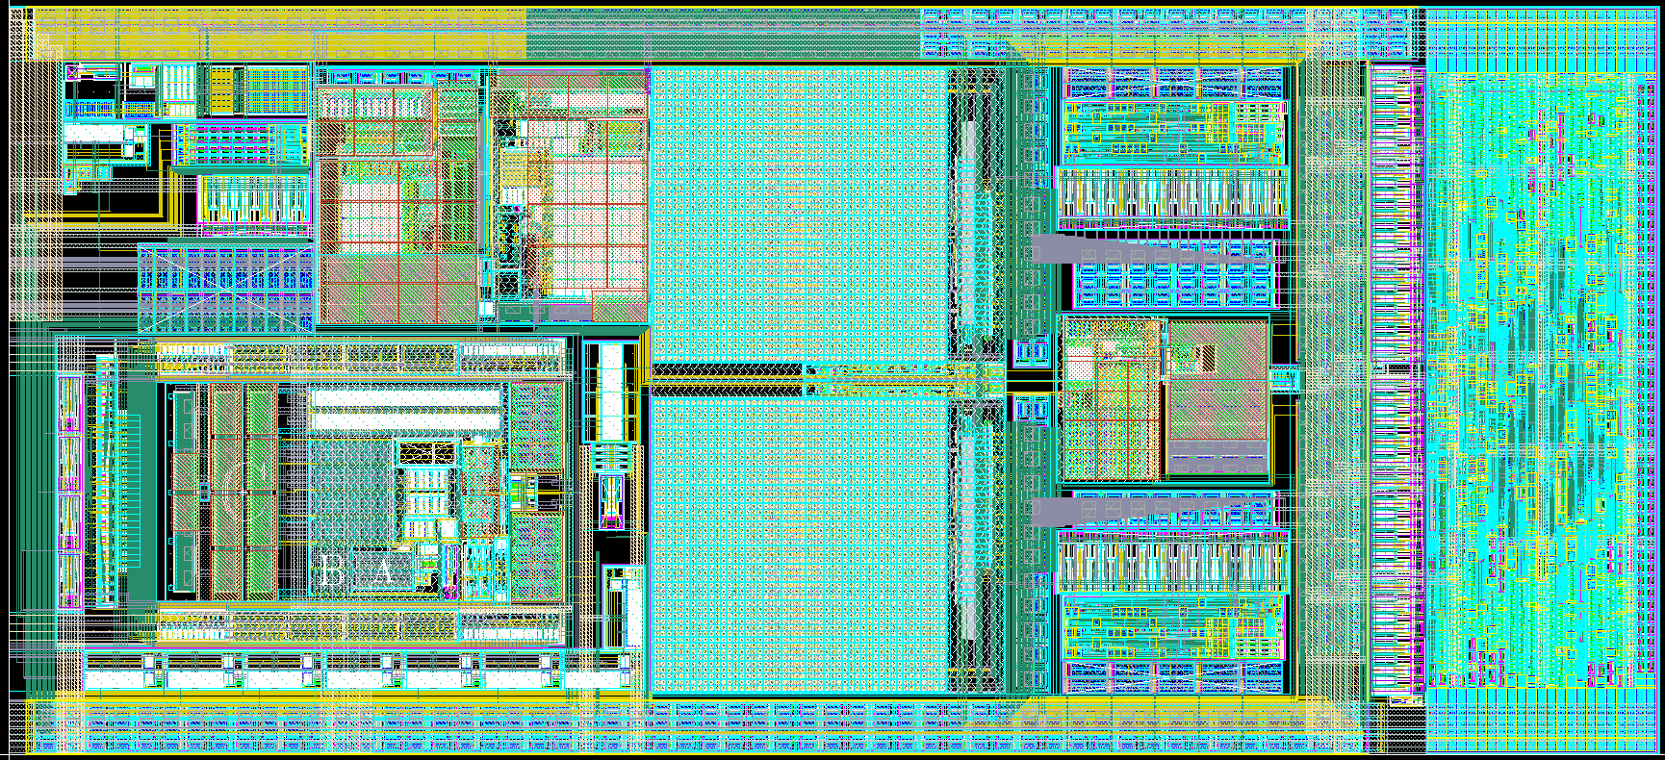
Conclusion
Starting from silicon proven 10-bit ADC:
Add 3 optional bit
Add analog MUX
Add internal reference
All these improvements can be bypassed

