Slide 1


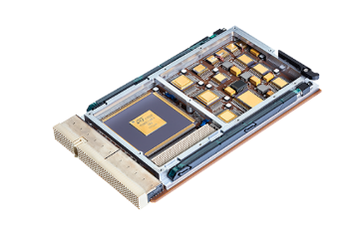

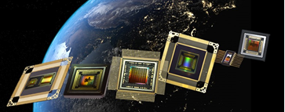
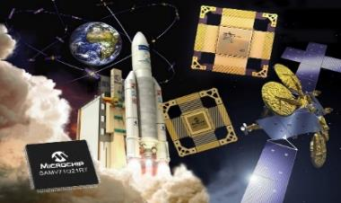
Space Qualified European Ethernet PHY 100Mb/1Gb
Solution Provider for Deterministic Networks and Modular Avionics
Aerospace & Defense
AMICSA
June 2022
Notes:
My thoughts are to tell a story…
Climate change concerns driving electrification
Electrification driving investment by traditional players and VC/ Startups
Our CEM’s don’t have bandwidth to get to the new startups - need your help
We have anchor products ideally positioned to help customer pivot to support this megatrend
Example products – block diagrams
Call to action
Mike Sorrentino set up the Sockeye meeting with CACI in the metro area and our CEM in Eastern Canada is setting up a meeting for me with Barry Devine to work out a coverage plan for A&D he does not have the bandwidth for.
Things are already different…

Slide 2





Microchip ADG France
Aerospace and Defense Product Line
Design
Committed to High Reliability and Long-Term Supply
  Delivering aerospace ICs for more than 30 years
  Strong flight heritage in space and avionics applications
  Leverage from automotive solutions for “new space” challenges: volume, cost and time to market
Major Product Focus
  ASICs
  Processors and microcontrollers
  Communication interfaces and memories
Long-term Cooperation with European Agencies:
  ESA, CNES, DGA, DLR …
Internal Qualified Supply Chain
  DLA/ESCC: Wafer lot to qualified parts (France)
  DLA: Assembly line (Thailand)
Microchip Nantes - France
Microchip Nantes - France
Foundry
Probe
Microchip Rousset - France
Assembly
Test
Microchip MMT - Thailand
Microchip MMT - Thailand

Slide 3




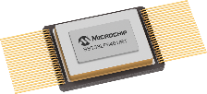






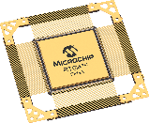
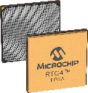
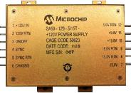
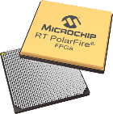
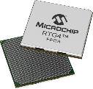
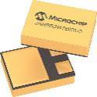




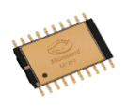
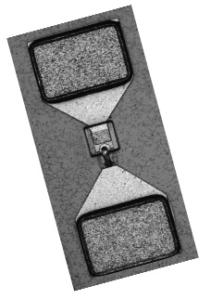



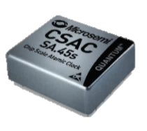




Microchip Space Portfolio
MPUs and MCUs
8-bit AVR
32-bit SPARC V8 and arm M3 & M7
GNSS SoC
Communication Interface & memories
SpaceWire, Ethernet, CAN
SRAM
NVM memories
FPGAs
RT PolarFire
RTG4
RT ProASIC3
RTAX, RTSX-SU
Power Solutions
Rad-hard JANS Diodes, Bi-Polar Small Signal Transistors
Rad-hard Isolated DC-DC Converter Modules
Custom Power Supplies 2 W to > 5 KW
Point of Load Hybrid Solutions
Electromechanical Relays
Mixed Signal Integrated Circuits
Telemetry and Motor Control Space System Managers
Power Supply protection
RF Products
Packaged and Chip Si and GaAs RF Diodes,
SAW filters,
Packaged and bare die GaN and GaAs MMICs
GaN on SiC HEMT transistors.
Timing solutions & Oscillators
Ovenized Quartz Oscillators
Hybrid Voltage Controlled &
Temperature Compensated Crystal Oscillators
Cesium Clocks
Chip Scale Atomic Clock (CSAC)

Slide 4


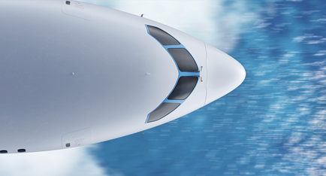



































TTTech Group - Truly Global
Automotive
Aerospace & Space
Off-Highway
Industrial & IoT
Android & Services
Global Reach:
2300+ employees
20 locations/sites
in 14 countries
headquartered in Austria

Slide 5
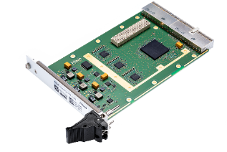
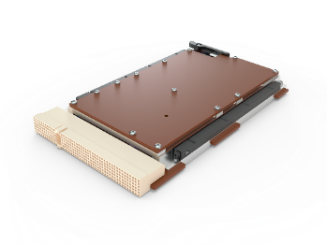

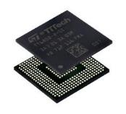
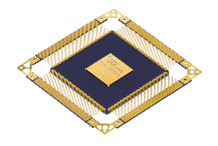
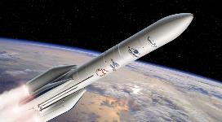




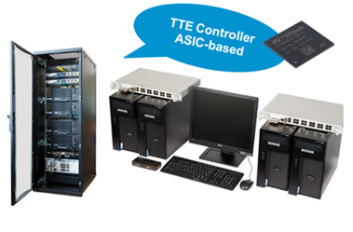
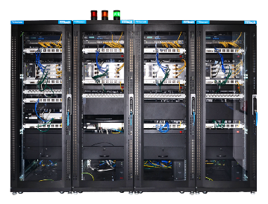



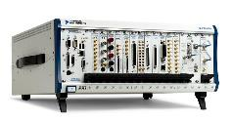

TTEthernet Products
TTE Equipment
              ^{TTE}End System Space 3U cPCI (EDU, PROTO, FLIGHT)
              ^{TTE}Switch Space 3U cPCI (EDU, PROTO, FLIGHT)
TTE Components
              ^{TTE}Controller HiRel (PBGA400, AEC-Q100)
              ^{TTE}Controller Space (CQFP352, QML-V)
TTE Software (tools & embedded) - Building Blocks
              ^{TTE}Tools Development Suite
              ^{TTE}Verify and ^{TTE}Analyze Verification Tools
^{TTE}Plan
^{TTE}Build
^{TTE}Verify
^{TTE}Analyze
TTE Development, Testing & Integration - Building Blocks
              ^{TTE}Development Systems Linux / VxWorks 653
              ^{TTE}Testing Systems
              ^{TTE}Testbed
^{TTE}Development Systems
^{TTE}Testing Systems
^{TTE}Testbed

Slide 6


Ethernet for Avionics Networks
Ethernet is becoming a more common standard in modern spacecrafts
Most used technology for local networks
Used in automotive, industrial control and aircraft avionics
Flexible, plug & play
High data rates
Open cross-industry standard (IEEE 802.3) with multiple providers
Connectivity: works with any commercial laptop
Enabler of more Ethernet in Space – component qualification

Slide 7


TTEthernet for Spacecraft Network Systems
TTEthernet for high-reliable deterministic Ethernet for safety-critical systems
Protocol on top of standard Ethernet
Network devices synchronized autonomously via dedicated sync frames
Redundancy, network fault management, diagnostics data reporting - abstracted fully by the network
Used on Ariane 6 and as Gateway backbone

Slide 8
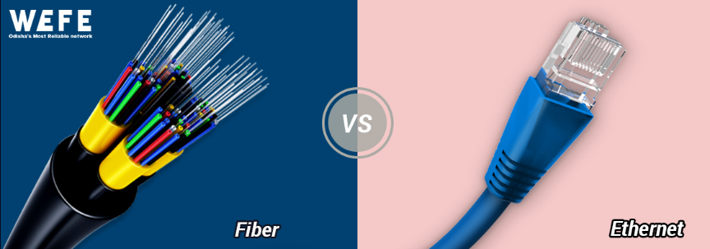
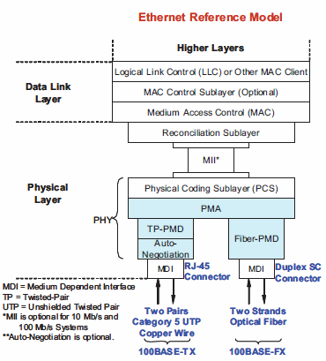
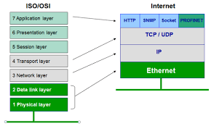
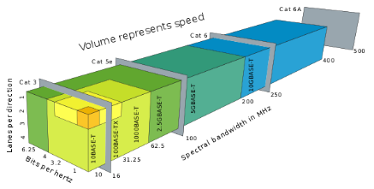
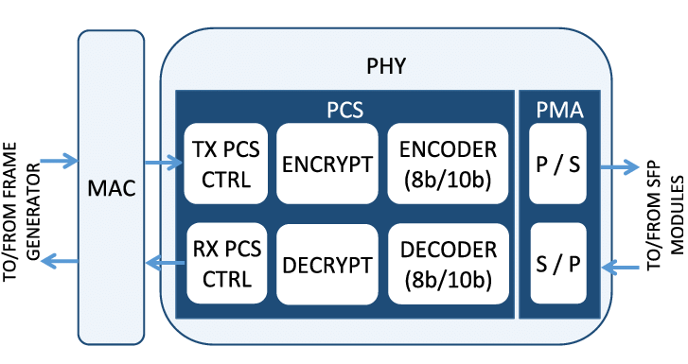
What is Ethernet PHY ?
&
Fiber
Copper
BASE-X / BASE-FX
BASE-T / BASE-TX
MAC layer builds the Ethernet packets transmitted to the PHY.
PHY includes the PCS and PMA (Physical Medium Attachment) sublayers.
  ENCRYPT and DECRYPT modules perform the format preserving encryption/decryption of 8b/10b symbols at the PCS sublayer.
  P/S and S/P modules are Parallel to Serial and Serial to Parallel modules, that transmit and receive the bitstream from the optical link.

Slide 9
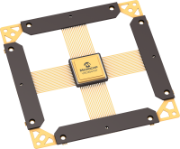


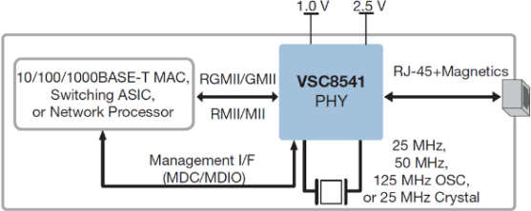
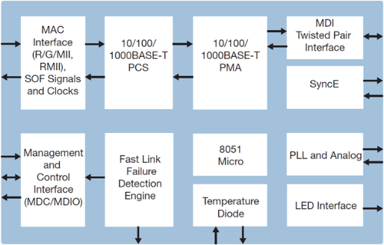
VSC8541RT
Rad Tolerant Fast/Gigabit Ethernet PHY
Samples & Flight Models available
ESCC Detail Specification No. 9405/020
10/100/1000BASE-T Ethernet copper transceiver (IEEE 802.3ab compliant)
RGMII/GMII/MII/RMII MAC interface
Synchronous Ethernet and IEEE 1588 Start of Frame identification
Patented line driver with low EMI voltage mode
Wake-on-LAN
Supports clocking from 25 MHz crystal or 25/50/125 MHz oscillator
Host-free configurability through hardware strapping
Best-in-Class power consumption
Extended temperature range -55°C to 125°C
CQFP68 and VQFN68 packages
Ceramic CQFP68
Plastic QFN68
Radiation
TID 100krad(Si) SEL immune up to 78MeV.cm2/mg

Slide 10
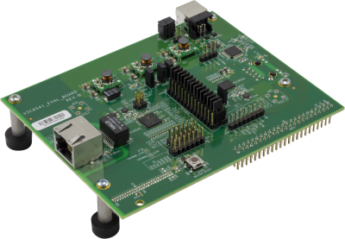
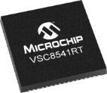
COTS to Radiation Tolerant devices
Start from industrial/automotive products
Same mask set Same functionality Same development tools | Easy access via commercial eval kit Free tool chain & libraries Same pin out as commercial device | Easy access via commercial eval kit Free tool chain & libraries Same pin out as commercial device
Hardening of critical parameters
Process tuning for no Single Event Latch-up at least up to 62 MeV.cm²/mg @ Tmax Total Ionizing Dose – Specific screening & Lot selection (>50Krad) Radiation report including SEU full characterization
Scalable solutions
Space Grade Ceramic: QML qualification & screening equivalent Minimum Ordering Quantity of 5 units |  | Hirel Plastic (HP): 3-Temp screening + Ext. Visual Inspection Minimum Ordering Quantity > 200 units

Slide 11
VSC8541RT Radiation Results
Tests supported by CNES (Centre National d’Etudes Spatiales)
Single Event Latchup – SEL
  Performed under worst case conditions (Vcc_{max} & 125°C)
  In accordance with ESCC25100 and MIL STD 883/Mil PRF 38535 standards
  Single Event Latch-Up LET threshold is higher than 78 MeV.cm²/mg
Single Event Upset – SEU
  SEFI conditions as well as Hard and Soft reset occurrence characterized
  Weibull curves and MTBF tables available for the different SEFI conditions
  No Power Off/On sequence was needed to restart the device after a link loss
Total Ionizing Dose – TID
  Performed according to MIL STD 883 TM1019 & ESCC22900 standards
  27 parts remained inside the specification limits after test read-out at 100krad(Si) on parametrical parameters and no functional deviation was observed
Radiation report available upon request

Slide 12
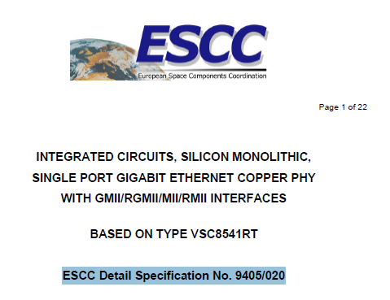
VSC8541RT Qualification Results
Goal is to demonstrate high reliability and ability to withstand user environmental constraints
Qualification is based on:
  Technology Qualification
  Product Qualification for space applications
Technology Qualification
  Qualified with projected lifetime at 110°C higher than 15 years
Product Qualification for Space applications
  Successfully qualified on 3 successive assembly lots
  All tests passed successfully : HBM & CDM ESD, Electrical latch Up, Life test, Assembly/Packaging reliability tests, Construction analysis and Irradiation tests
VSC8541RT fully qualified and Qualification Package available upon request
Part of European Preferred Part List => ESCC Detail Specification No. 9405/020

Slide 13
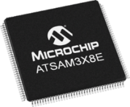
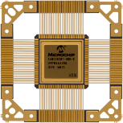
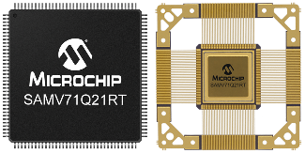
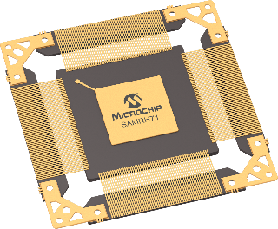

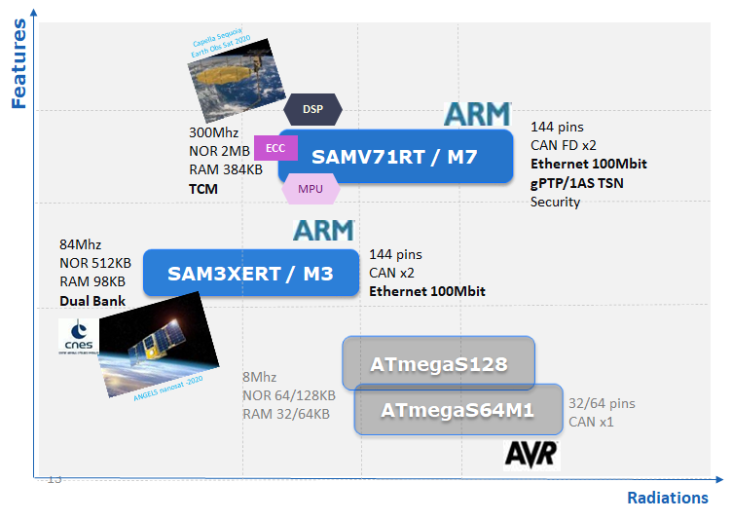



SoC w Embedded Ethernet for Space
Rad Tolerant µC
Rad Hardened processor
ARM Cortex M7 SoC w TCM/MPU & DSP capabilities
>200DMIPS, 1MB SRAM w ECC, 128KB Flash w ECC
Spw, 1553, CAN FD, 100Mbit Ethernet gPTP/1AS TSN
Ready for Spacewire to Ethernet Gateway
Radiations
TID 150krad (Flash limited to 20krad) SEL immune up to 62 MeV SEU LET >20Mev.cm2/mg (Xsection <10-9 cm2/word)
Radiations
TID 30krad SEL immune up to 62.5 MeV
CQFP256
BGA625
SpaceWire
SpaceWire

Slide 14
Ethernet for Space - Looking forward
Supporting European space industry & agencies towards more Ethernet solutions
Targeting new RT/RHBD Ethernet devices for Space
  Ethernet PHY
    SGMII, FX & 10Gbit
  Ethernet Switch
    1 to 10Gbit (w/wo TSN)
  Ethernet SoC
    Gbit ARM MCU & MPU
    Gbit embedded IP for FPGA

Slide 15
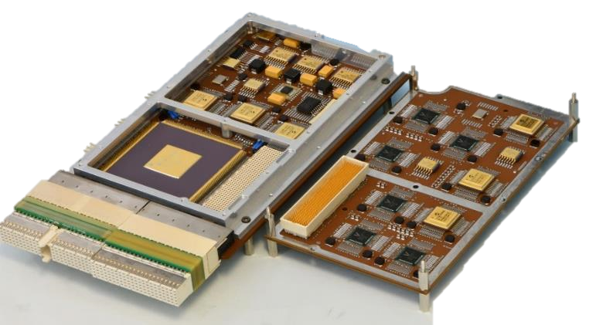
TTEthernet® Equipment for Gateway as Reference Design with VSC8541RT
Switch or network interface card (SONIC)
^{TTE}Switch: interconnection of several nodes
^{TTE}End System: ability for host computer to connect to TTEthernet
Main components
  ^{TTE}Controller: Main functional block for TTEthernet, contributing to all high-level functions
  VSC8541RT PHY: Translation of MII to MDI signals (100/1000 BASE-T) to provide connectivity to the function of the ^{TTE}Controller
SONIC-Switch (Baseboard and Mezzanine)
SONIC-End System (Baseboard)
PHY
(ceramic)
PHY
(plastic)
^{TTE}Controller
(ceramic)
PHY
(ceramic)
Internal I/F
Connection
PHY
(plastic)
External I/F
Connector
SONIC Elegant Bread Board (EBB) used for development tests

Slide 16
SONIC Architecture and Main Functions
Modular design concept to provide flexibility, easy integration and maintenance for different use cases
SONIC supports multiple network lanes for fault-tolerant computer architectures
Main Functions
^{TTE}End System Use-Case
Main Functions
^{TTE}Switch Use-Case
Networking
(BE, RC, TT)
SONIC-ES Board
PBA incl. TTE-Controller, PHYs, Peripherals
Frame
Networking
(BE, RC, TT)
Network configuration
Driver
SONIC-SW Board
PBA incl. TTE-Controller, PHYs, Peripherals
Frame
Synchronization
End System firmware
Synchronization
Switch firmware
Monitoring + commanding
Monitoring + commanding
Testing and debugging
Testing and debugging
SONIC End System (3 ports)
SONIC Switch (12 Ports)

Slide 17
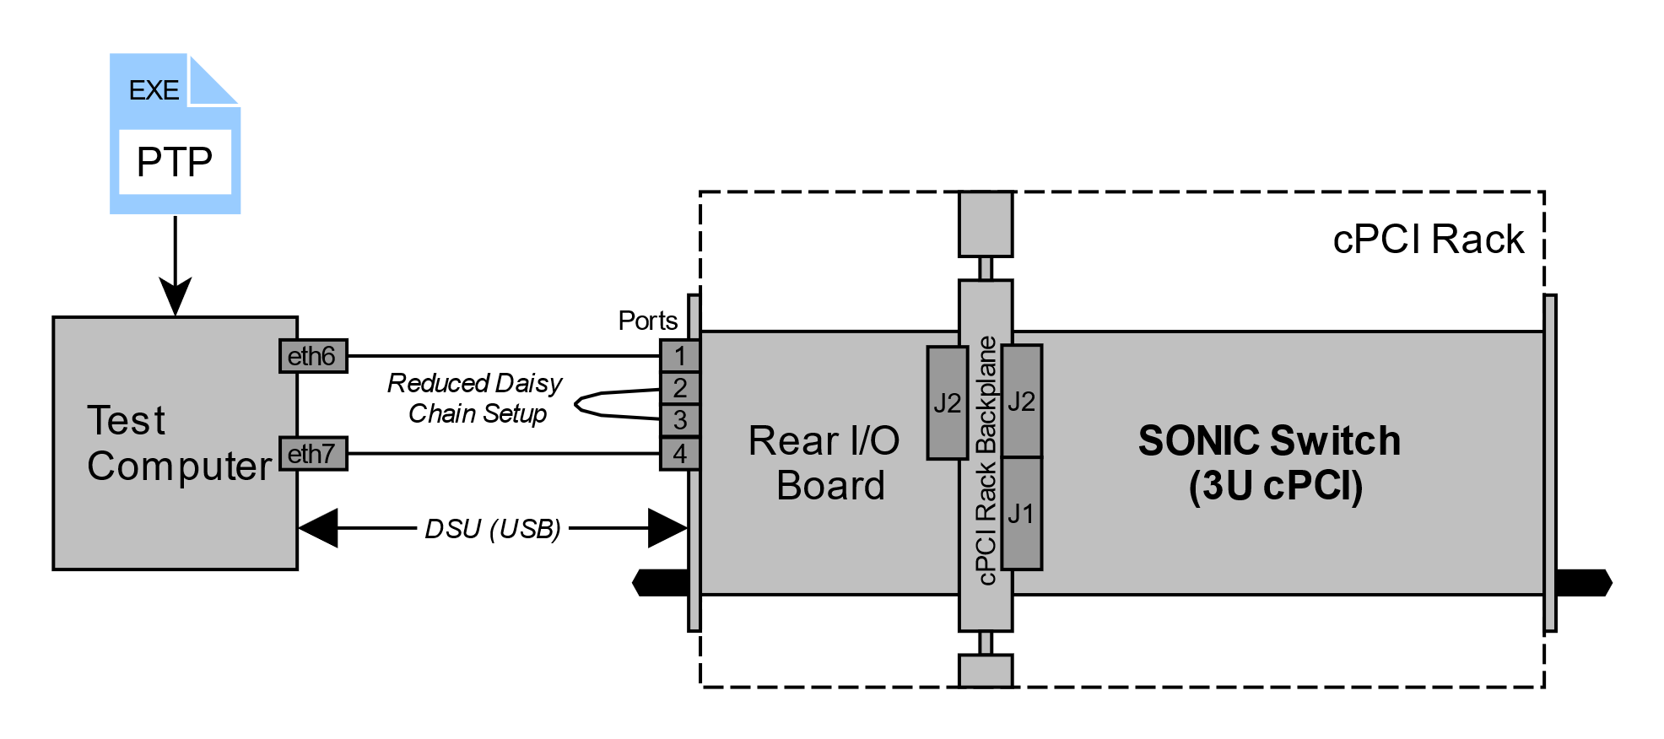
VSC8541RT Performance Validation
Objective
Functional validation and performance measurements as a part of component qualification
Link speed: 1Gbit/s
Tests performed on Development Model (DM) and Elegant Bread Board (EBB)
Switch ID | SONIC Switch Model | TTE-Controller | PHYs (Baseboard) | PHYs (Mezzanine)
SW1 | DM | plastic | plastic | plastic
SW2 | EBB | ceramic | plastic | plastic
SW3 | EBB | ceramic | ceramic | plastic
Overview of SONIC Switch models used for performance tests
Test Setup
Ports 2-3 daisy chained
Performance test script (PTP) running on Host CPU
Throughput measured via Wireshark and recorded via the test script (log-file)
Dropped frames counted and recorded (log-file)
SONIC Switch performance test setup with reduced daisy chain

Slide 18
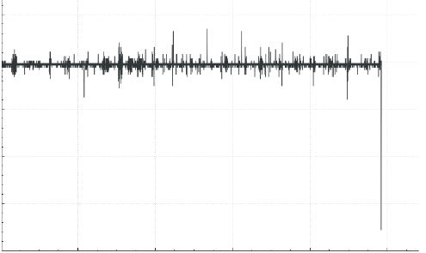
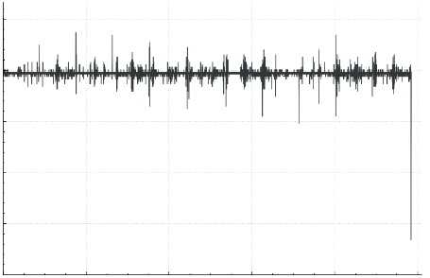
VSC8541RT Performance Validation
SW1 (DM)
Data: Wireshark
SW2 (EBB)
Data: Wireshark
Test Results
Successful tests for
  Different SONIC Models (DM/EBB)
  TTE-Controller and PHY configurations (plastic/ceramic)
1Gbit/s throughput successfully demonstrated
No dropped frames
1,25∙10⁶
1,25∙10⁶
1,00∙10⁶
1,00∙10⁶
0,75∙10⁶
0,75∙10⁶
Throughput, kBit/s
Throughput, kBit/s
0,50∙10⁶
0,50∙10⁶
0,25∙10⁶
0,25∙10⁶
0
0
2
4
6
8
10
0
0
2
4
6
8
10
Time, s
Time, s
SW3 (EBB)
Data: Log-File (Script)
Details
Data: Log-File (Script)
100kBit/s
Throughput results for different SONIC Switch configurations

Slide 19

Conclusion
Ethernet PHY successfully qualified
TTE-Controller (TTTech) and VSC8541RT (Microchip) – key components for high-speed deterministic Ethernet avionics networks for future spacecrafts
Reference design based on high-profile human space flight Gateway equipment
Thank you & please visit us at our
exhibition booths to learn more about chip and board-level solutions for dependable avionics

Slide 20
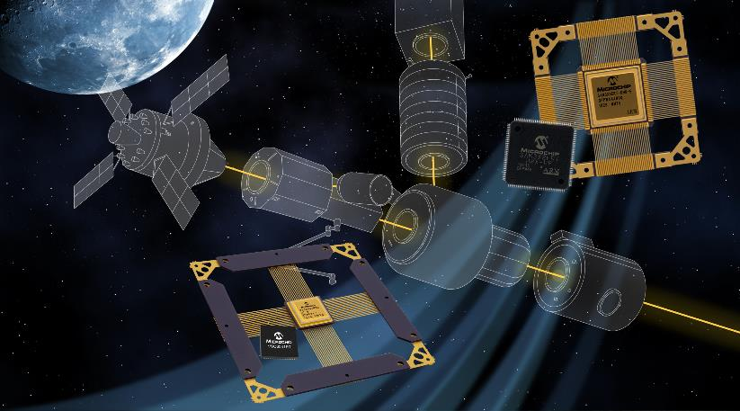
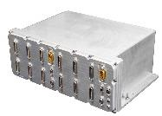
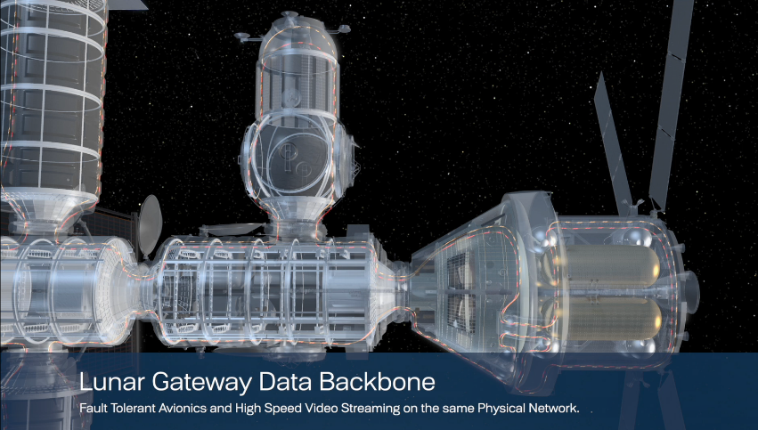
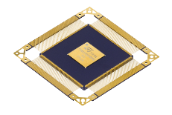

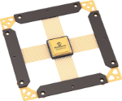
Thank You

Slide 21
VSC8541RT ordering codes
VSC8541 Evaluation Kit
VSC8541RT Part Numbering
TID wafer lot data available for QML-V eq. under specific request
Tool | Part Number
VSC8541 Evaluation Board | VSC8541EV
Part Number | Package | Interface | Ethernet Bandwidth | Quality Flow
VSC8541WZBRT-E | CQFP68 | GMII / RGMII / MII / RMII | 10/100/1000Mbps | Engineering Sample
VSC8541WZBRT-MQ |  |  |  | QML-Q Equivalent
 |  |  |  | QML-V Equivalent
VSC8541WZBRT-SV |  | GMII / RGMII / MII / RMII | 10/100/1000Mbps | QML-V Equivalent
VSC8541XMVRT-HP | VQFN68 | GMII / RGMII / MII / RMII | 10/100/1000Mbps | Hirel Plastic (HP)

Slide 22
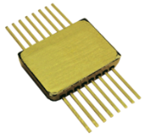
VSC8541RT Reference Clocks
App Note AN3503: Reference Clocks from Vectron for VSC8541RT Radiation Tolerant Ethernet Transceiver
1403
Microchip Part Number | Quality Level | REF Clock Frequency (MHz) | Oscillator Specification | Oscillator Model Number | Oscillator Supply Voltage(V) | TID (krad)
VSC8541WZBRT-E | Prototype (-E) | 25 | OS-68338/PX-709 | PX-709-0025-25M0000000 | 3.3 | 100
VSC8541WZBRT-MQ | QML_Q | 25 | OS-68338/PX-709 | PX-709-0026-25M0000000 | 3.3 | 100
VSC8541WZBRT-SV | QML_V | 25 | OS-68338/PX-709 | PX-709-0027-25M0000000 | 3.3 | 100
VSC8541XMVRT-HP | Hirel Plastic (-HP) | 25 | OS-68338/PX-709 | PX-709-0028-25M0000000 | 3.3 | 100
VSC8541WZBRT-E | Prototype (-E) | 50 | OS-68338/PX-709 | PX-709-0029-50M0000000 | 3.3 | 100
VSC8541WZBRT-MQ | QML_Q | 50 | OS-68338/PX-709 | PX-709-0309-50M0000000 | 3.3 | 100
VSC8541WZBRT-SV | QML_V | 50 | OS-68338/PX-709 | PX-709-0031-50M0000000 | 3.3 | 100
VSC8541XMVRT-HP | Hirel Plastic (-HP) | 50 | OS-68338/PX-709 | PX-709-0032-50M0000000 | 3.3 | 100
VSC8541WZBRT-E | Prototype (-E) | 125 | DOC204900 | 1403D125M0000CX | 2.5 | 100
VSC8541WZBRT-MQ | QML_Q | 125 | DOC204900 | 1403B125M0000CE | 2.5 | 100
VSC8541WZBRT-SV | QML_V | 125 | DOC204900 | 1403R125M0000CS | 2.5 | 100
VSC8541XMVRT-HP | Hirel Plastic (-HP) | 125 | DOC204900 | 1403C125M0000CB | 2.5 | 100

