Slide 1
A multi-fidelity simulation framework for atmospheric re-entering bodies
02.12.2021 - ATD3 2021 Workshop
Morgado, F., Peddakotla, S., Fossati, M.

Slide 2
Outline
Destructive re-entry: not only a modelling problem
A multi-fidelity approach
Geometry, inertia and meshing
Low-fidelity methods and assumptions
High-fidelity methods
Validation on proximal spheres separation
Demonstration on a ATV-like fragmentation process
Outlook and references

Slide 3
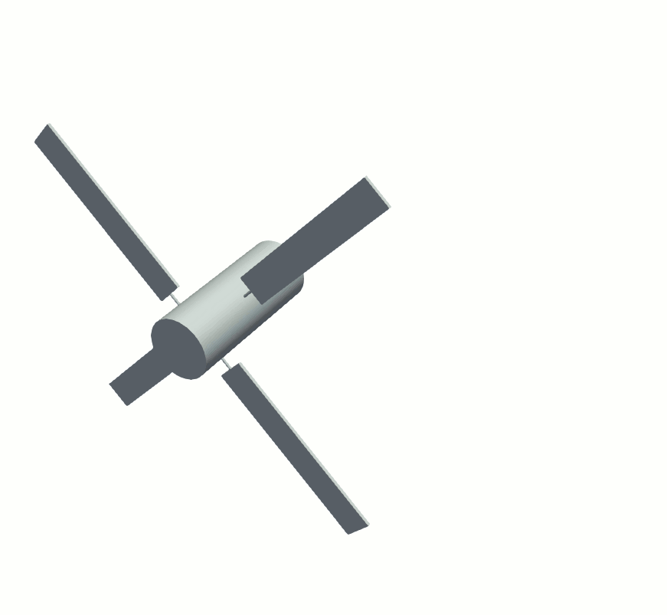
Destructive re-entry: not only a modelling problem
Unsteady and multi-disciplinary
Not much flight test data available
Difficult to replicate in experimental facilities
High-degree of uncertainty on the demise outcome
Accuracy vs computational cost
A trade-off between computational effort and modelling accuracy is needed to mitigate the uncertainty and in turn the ground impact risk

Slide 4
A Multi-fidelity approach: rationale
Low-fidelity re-entry
modelling
Multi-fidelity
switch
Q1. How much can uncertainty in the destructive re-entry be reduced by increasing the accuracy of the models in a targeted manner?
Surface meshing
update (Lo-Fi)
[
]
Surface+volume meshing
and adaptation (HiFi-CFD)
Surface meshing
(HiFi-CSD)
HiFi CFD solution
(pre-fragmentation)
Surface mesh
mapping
Q2. How is the increased accuracy in simulating the break-up process affecting the dynamics of the fragments?
Peridynamics solution
HiFi CFD solution
(post-fragmentation)
Re-meshing
(HiFi-CFD)

Slide 5
A Multi-fidelity approach: TITAN† high-level workflow
† TITAN (from TransatmospherIc flighT simulAtioN) is a Python code developed from his predecessor FOSTRAD.
It is a simulation tool built on modules from SMART-flidyn (fight dynamics) and SMART-gmi (geometry, meshing and inertia) libraries
Start
Geometry + inertia
Trajectory (6dof)
Aerothermodynamics
NO
YES
Ablation model
Fragmentation

Slide 6
Workflow and models
Low-fidelity models
Local panel inclination methods
Altitude trigger for break up
0D thermal model
Fidelity switch
Low fidelity
High Fidelity
High-fidelity aerothermodynamics library
Rarefied regime: DSMC Sparta (upcoming)
Slip regime: SU2-NEMO
Continuum: SU2-NEMO
High-fidelity structural codes library
Peridigm
Identification of wet surfaces
Automatic Grid generation
Call HiFi solver
Aerodynamic solution
Assess grid convergence
Adapt Grid and interpolate solution
Aerothermodynamic solution
Compute Loads
Multi-fidelity aerothermodynamics workflow

Slide 7
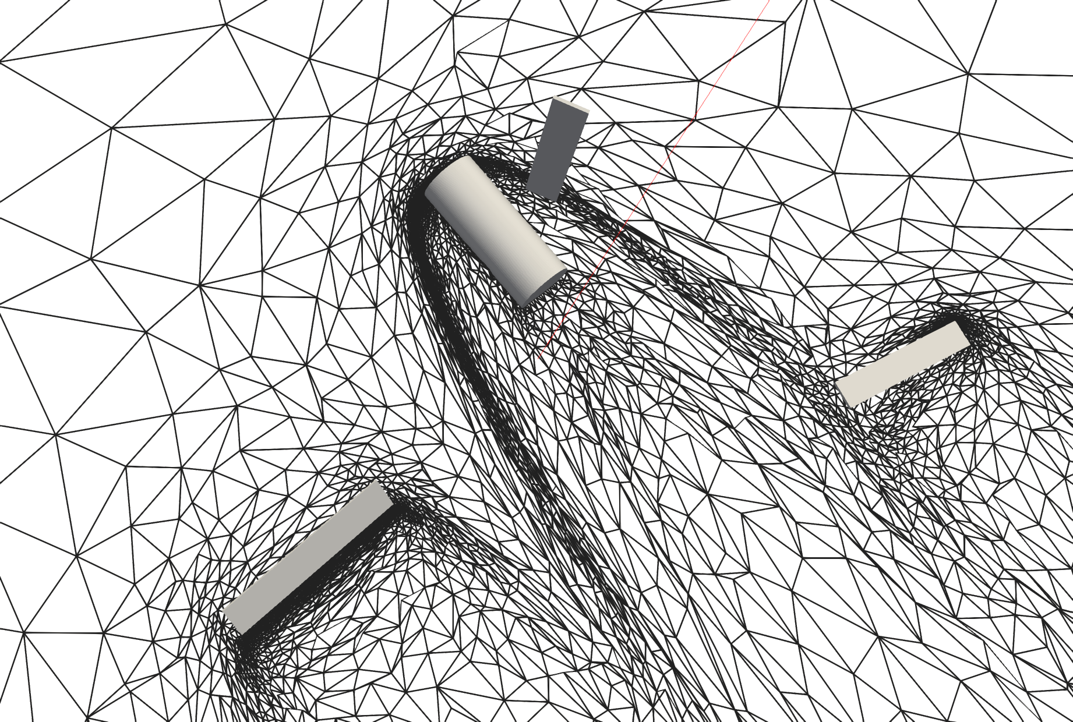
Geometry, inertia and meshing
Any spacecraft made by a combination of faceted primitives: as complex as they need to be
Primitives can be indestructible elements and destructible joints
Joints can be of any complex shape (faceted)
Components’ relation is determined by their geometrical arrangement and joints
Gmsh¹ is employed for automatic meshing and for inertia properties calculation
INRIA-AMG² is adopted for CFD/DSMC mesh optimization
¹ https://gitlab.onelab.info/gmsh/gmsh
² https://pages.saclay.inria.fr/adrien.loseille/index.php?page=softwares

Slide 8
Low-fidelity aerothermodynamics
Back-face culling algorithm
(triangle rasterization)
Check which faces are wet
Aerodynamic Computation
Modified Newtonian theory
Schaaf and Chambre theory*
Continuum
Free-molecular
Aerothermodynamic Computation
Van Driest† and SCARAB‡
Schaaf and Chambre theory*
Local-radius based
bridging function​
† Van Driest, E. (1956). The problem of aerodynamicheating. Aeronautical Engineering Review, pages 26–41
‡ Koppenwallner, G., Fritsche, B., Lips, T., and Klinkrad, H. (2005). Scarab-a multi-disciplinary code for destruction analysis of space-craft during re-entry. In Fifth European Symposium on Aerothermodynamics for Space Vehicles, volume 563, page 281.
* Samuel Albert Schaaf and Paul L Chambré. Flow of rarefied gases. Number 8. Princeton University Press, 1961.

Slide 9
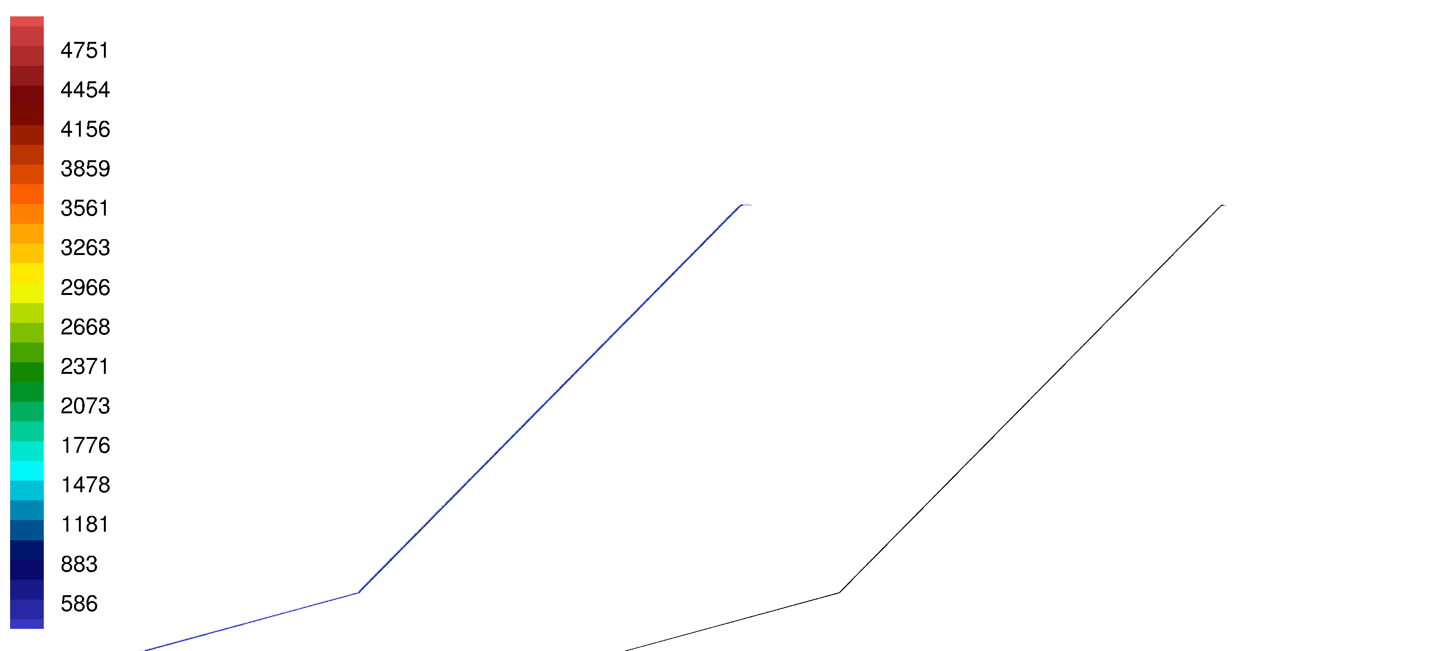
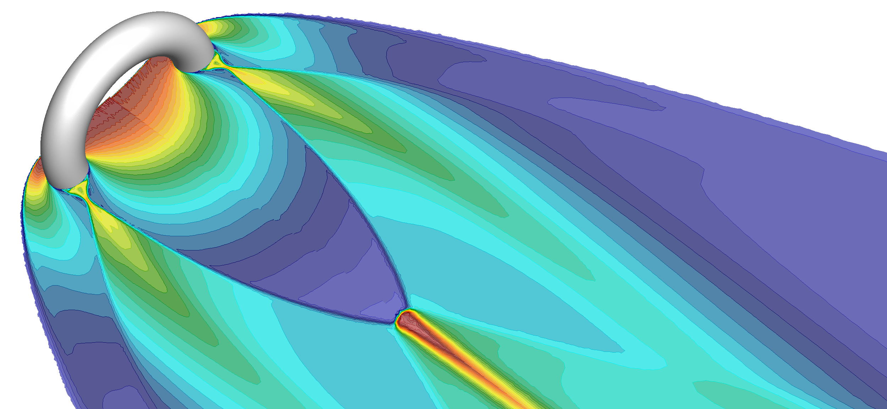
High-fidelity open-source CFD: SU2-NEMO
Multi-species and finite-rate chemistry with Mutation++ library
Multi-temperature model for thermal nonequilibrium
From continuum to slip regime
Unstructured-adaptive FV formulation
Collaborative effort between U. of Strathclyde, Stanford, VKI and U. of Arizona
https://github.com/su2code/SU2
Mach 9 flow over a 5-45 ramp.
Temperature contours [K] (left); Numerical Schlieren (right)
Toroidal ballute. Thermally (rhs) vs calorically perfect (lhs).
Temperature contours.

Slide 10
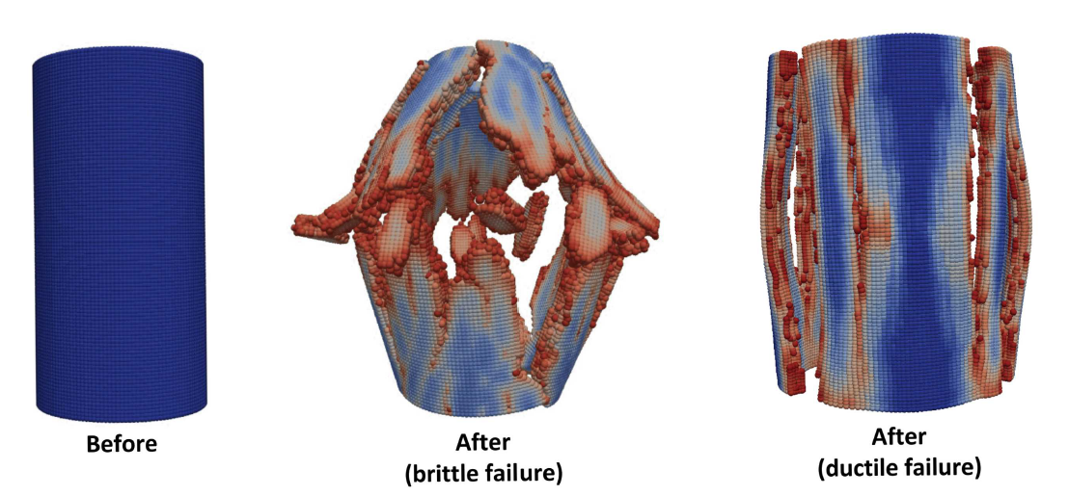
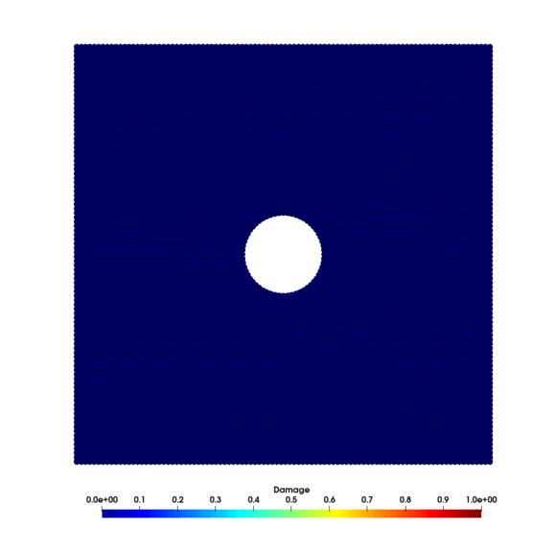
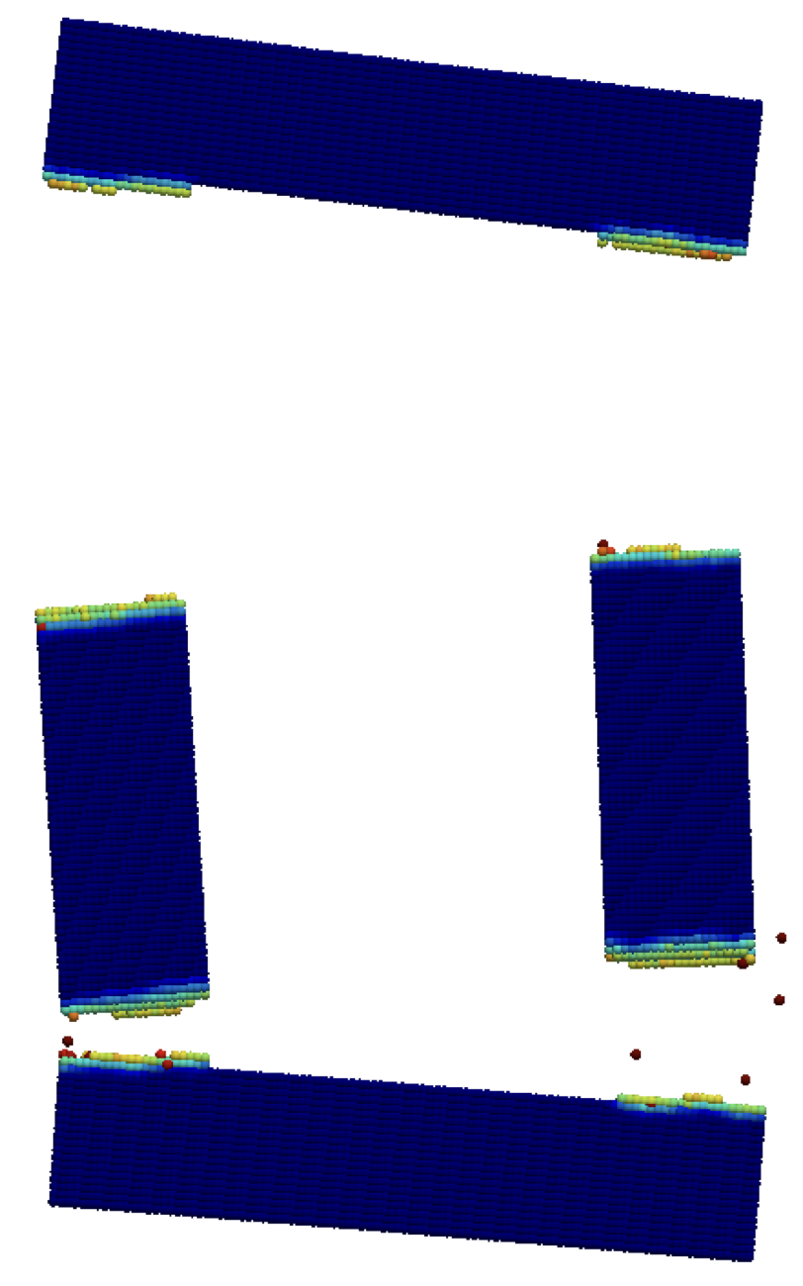
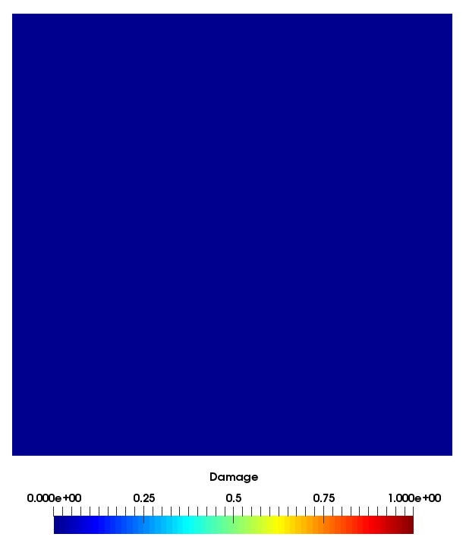
High-fidelity CSD: Peridigm
Peridynamics is continuum mechanics formulation
Peridigm is an open-source computational peridynamics code developed at Sandia National Laboratories
Capability to simulate brittle, ductile and composite materials
https://github.com/peridigm/peridigm
Crack initiation and propagation due to localized stresses (left), Crack initiation resulting in multiple fragments due to uni-axial tensile load (center), Dynamic crack propagation on a pre-cracked flat plate (right)

Slide 11
Two-spheres separation
Quasi-steady approach to high-fidelity simulation of fragments separation
Validate the approach with experimental tests†
Avg. Nº of cells after adaptation 700,000
Mach | 4
Density [kg/m³] | 0.07
Pressure [Pa] | 1,400
P/P∞
† Laurence, S., Parziale, N., & Deiterding, R. (2012). Dynamical separation of spherical bodies in supersonic flow. Journal of Fluid Mechanics, 713, 159-182. doi:10.1017/jfm.2012.453

Slide 12
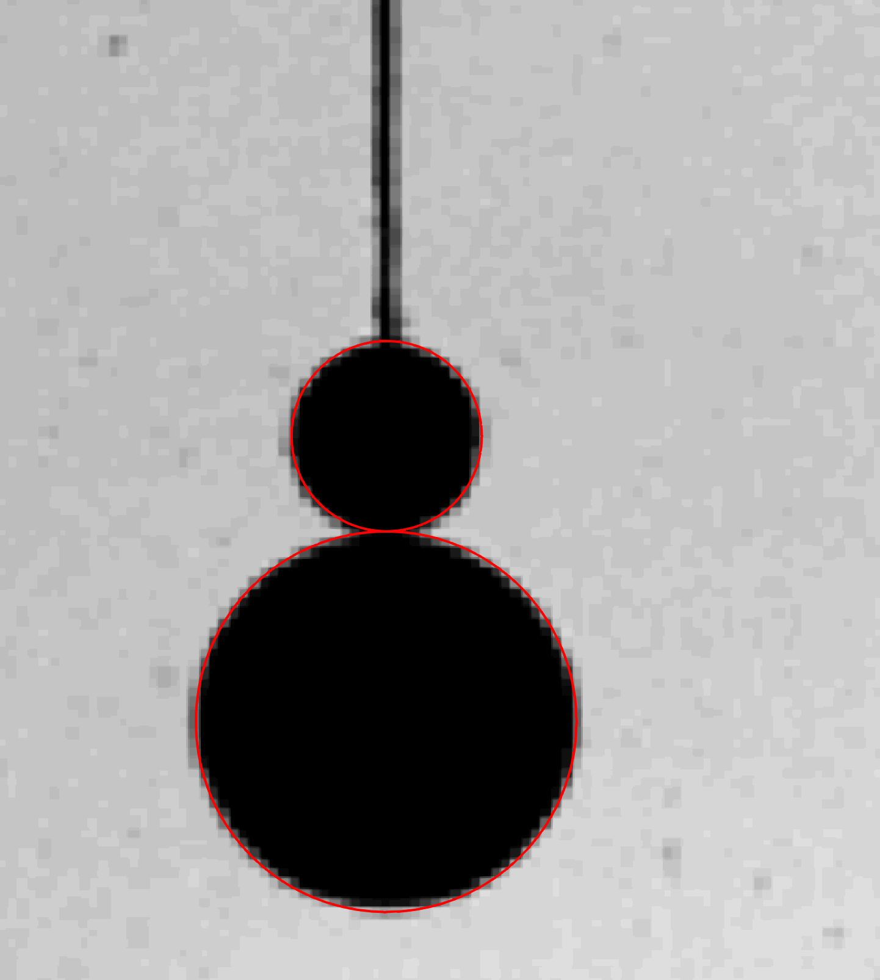
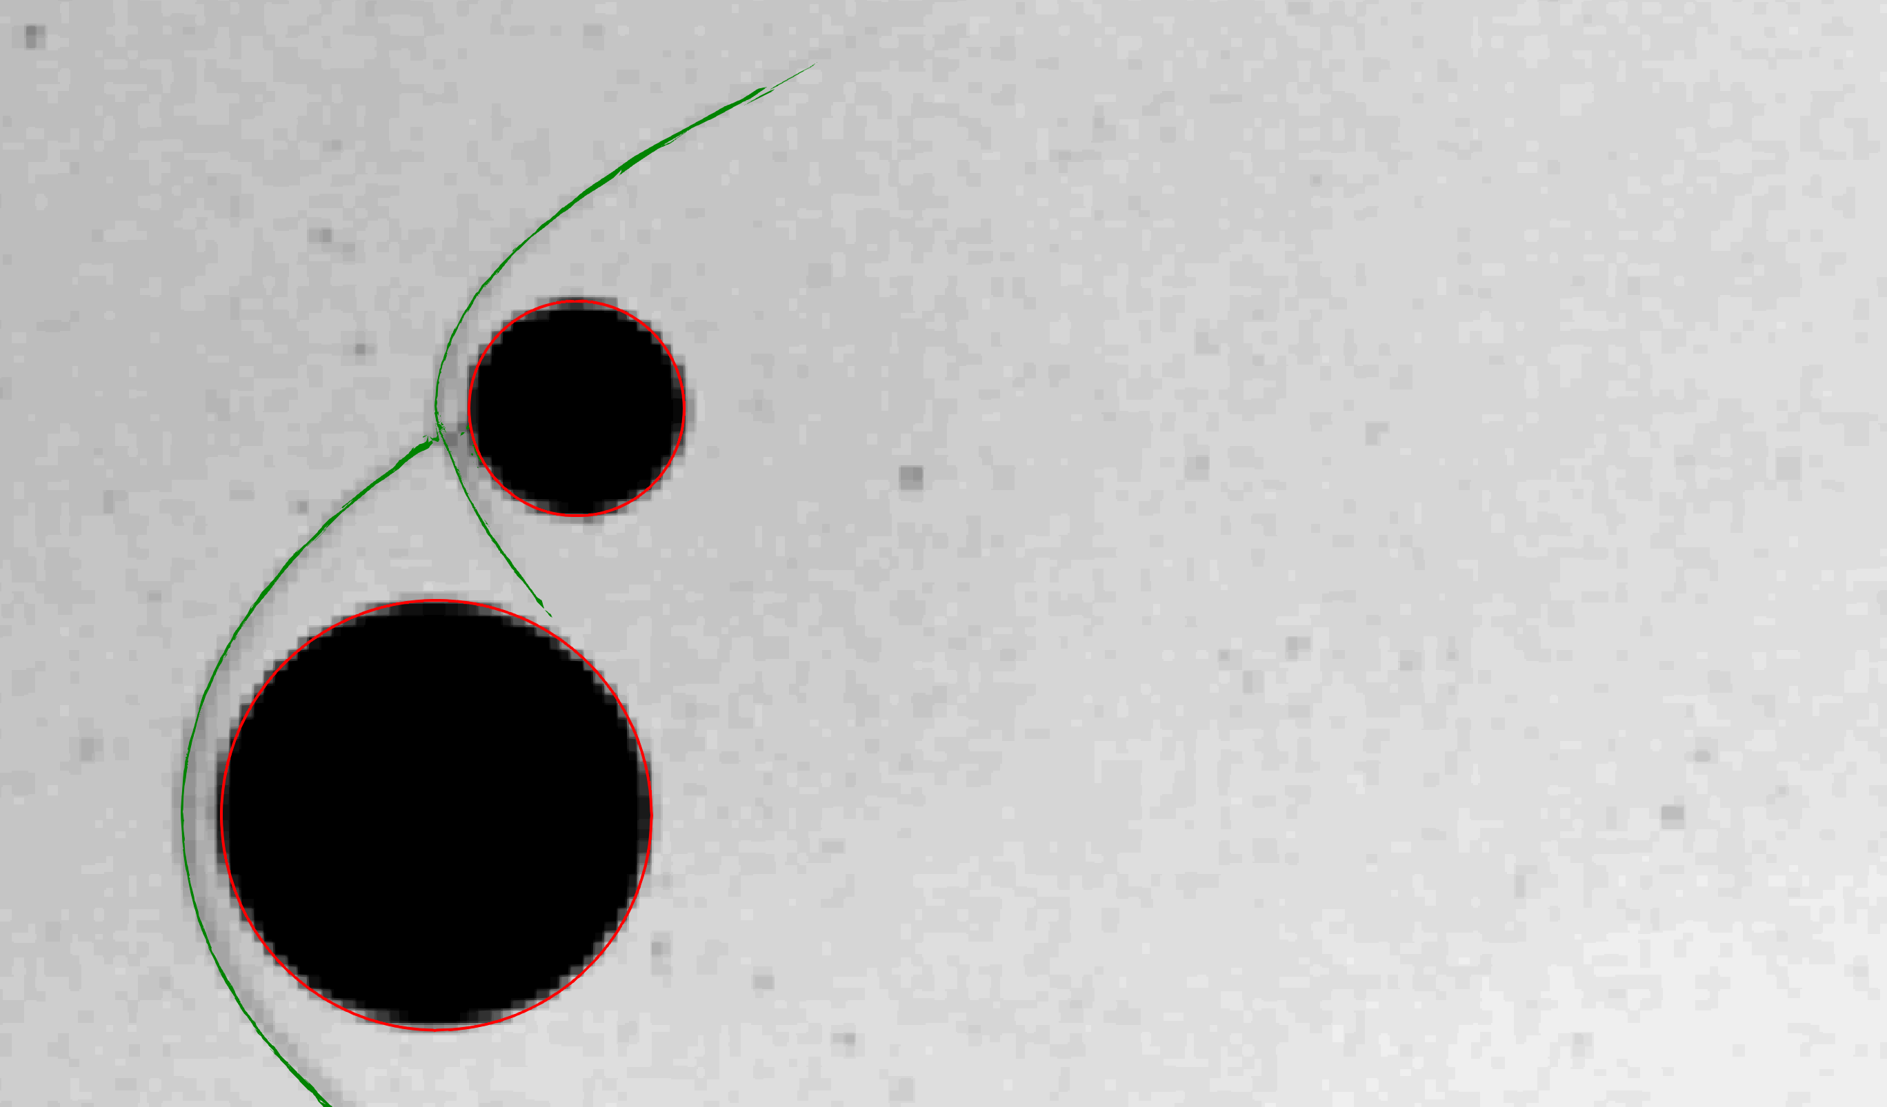
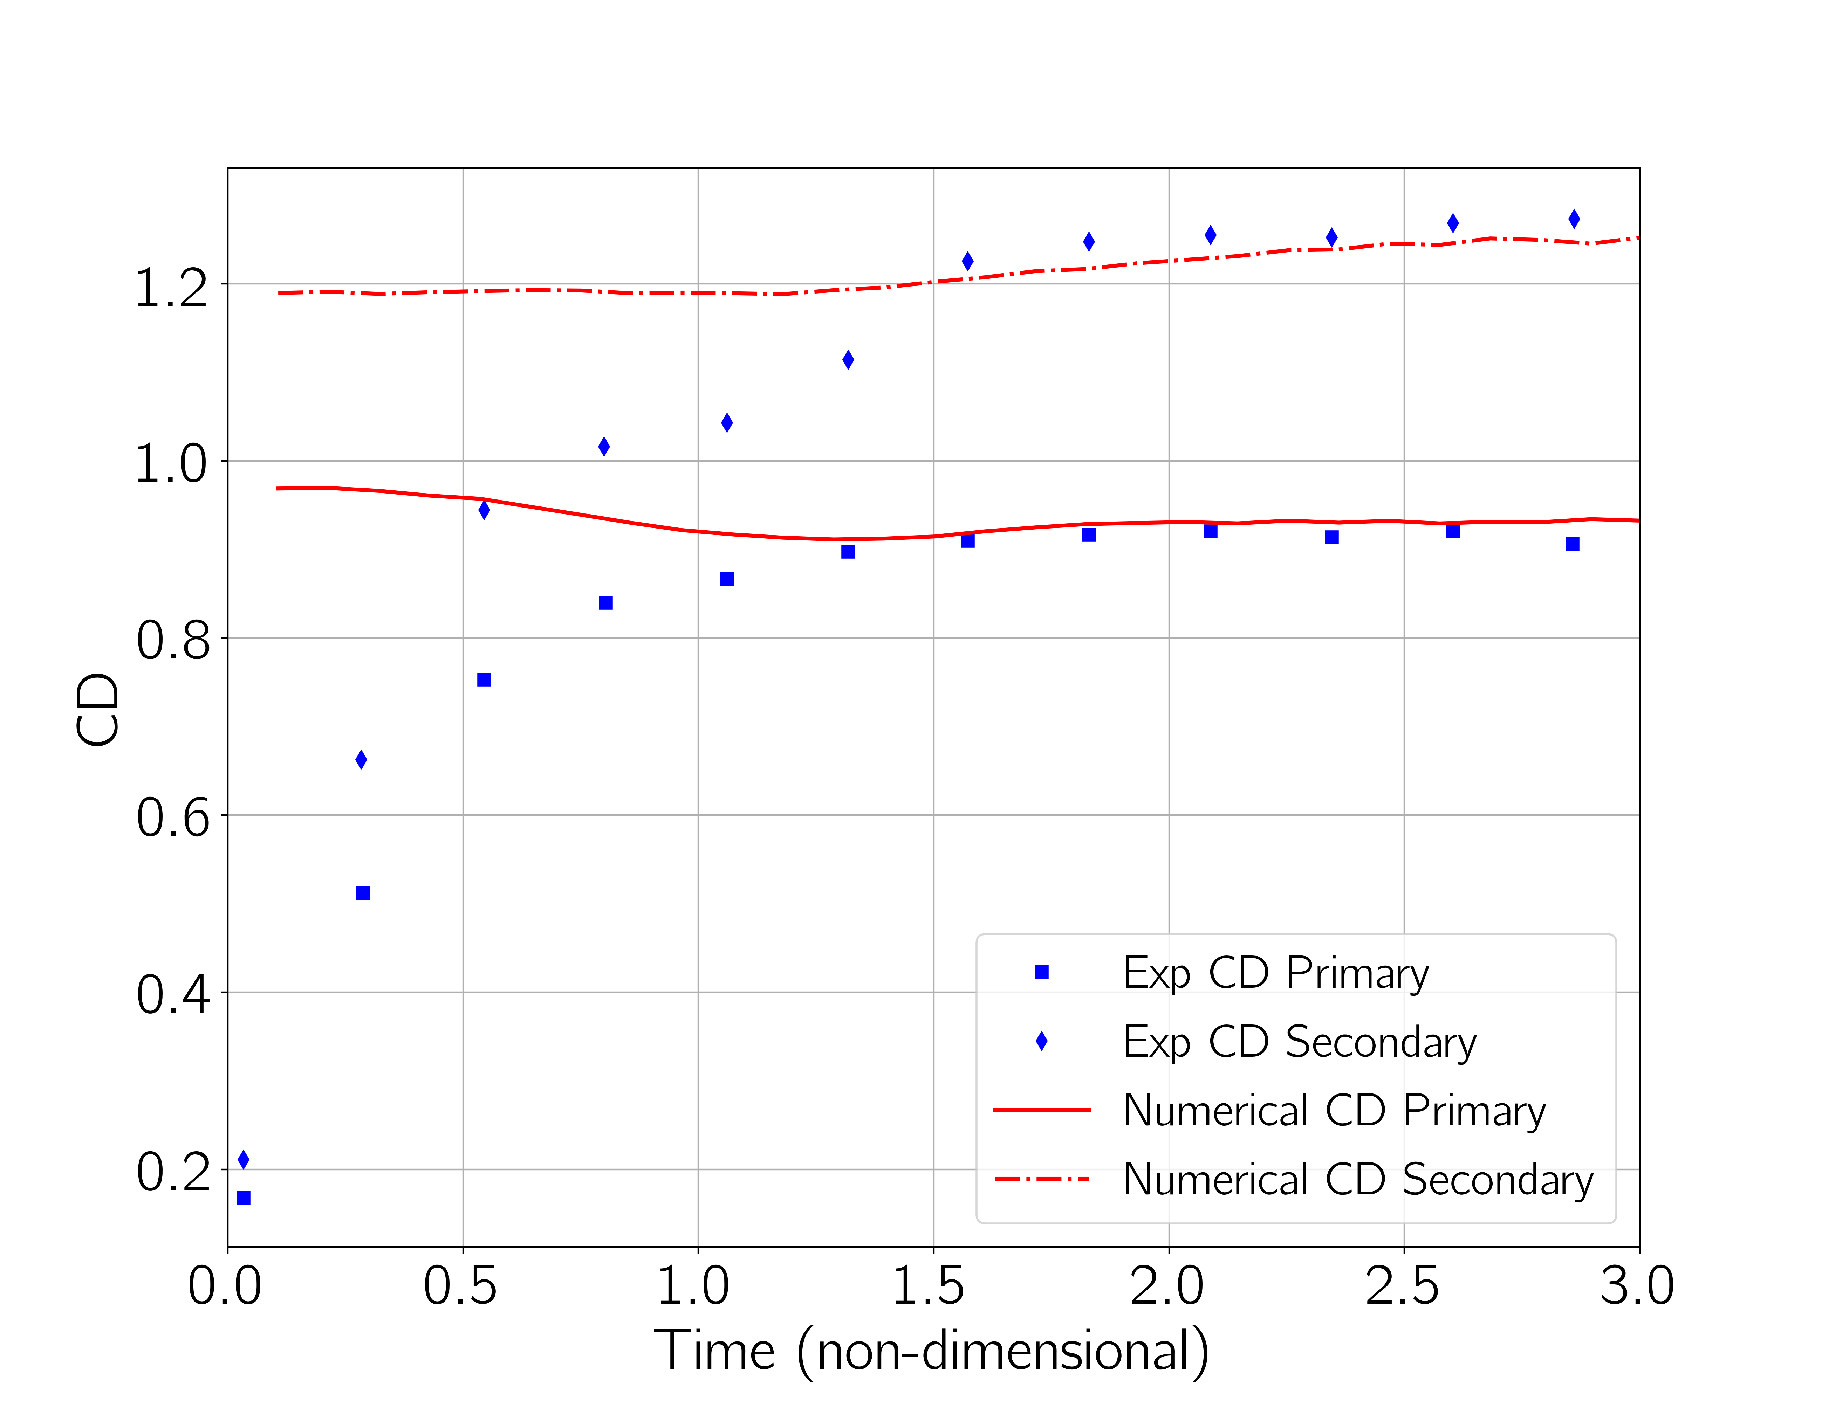
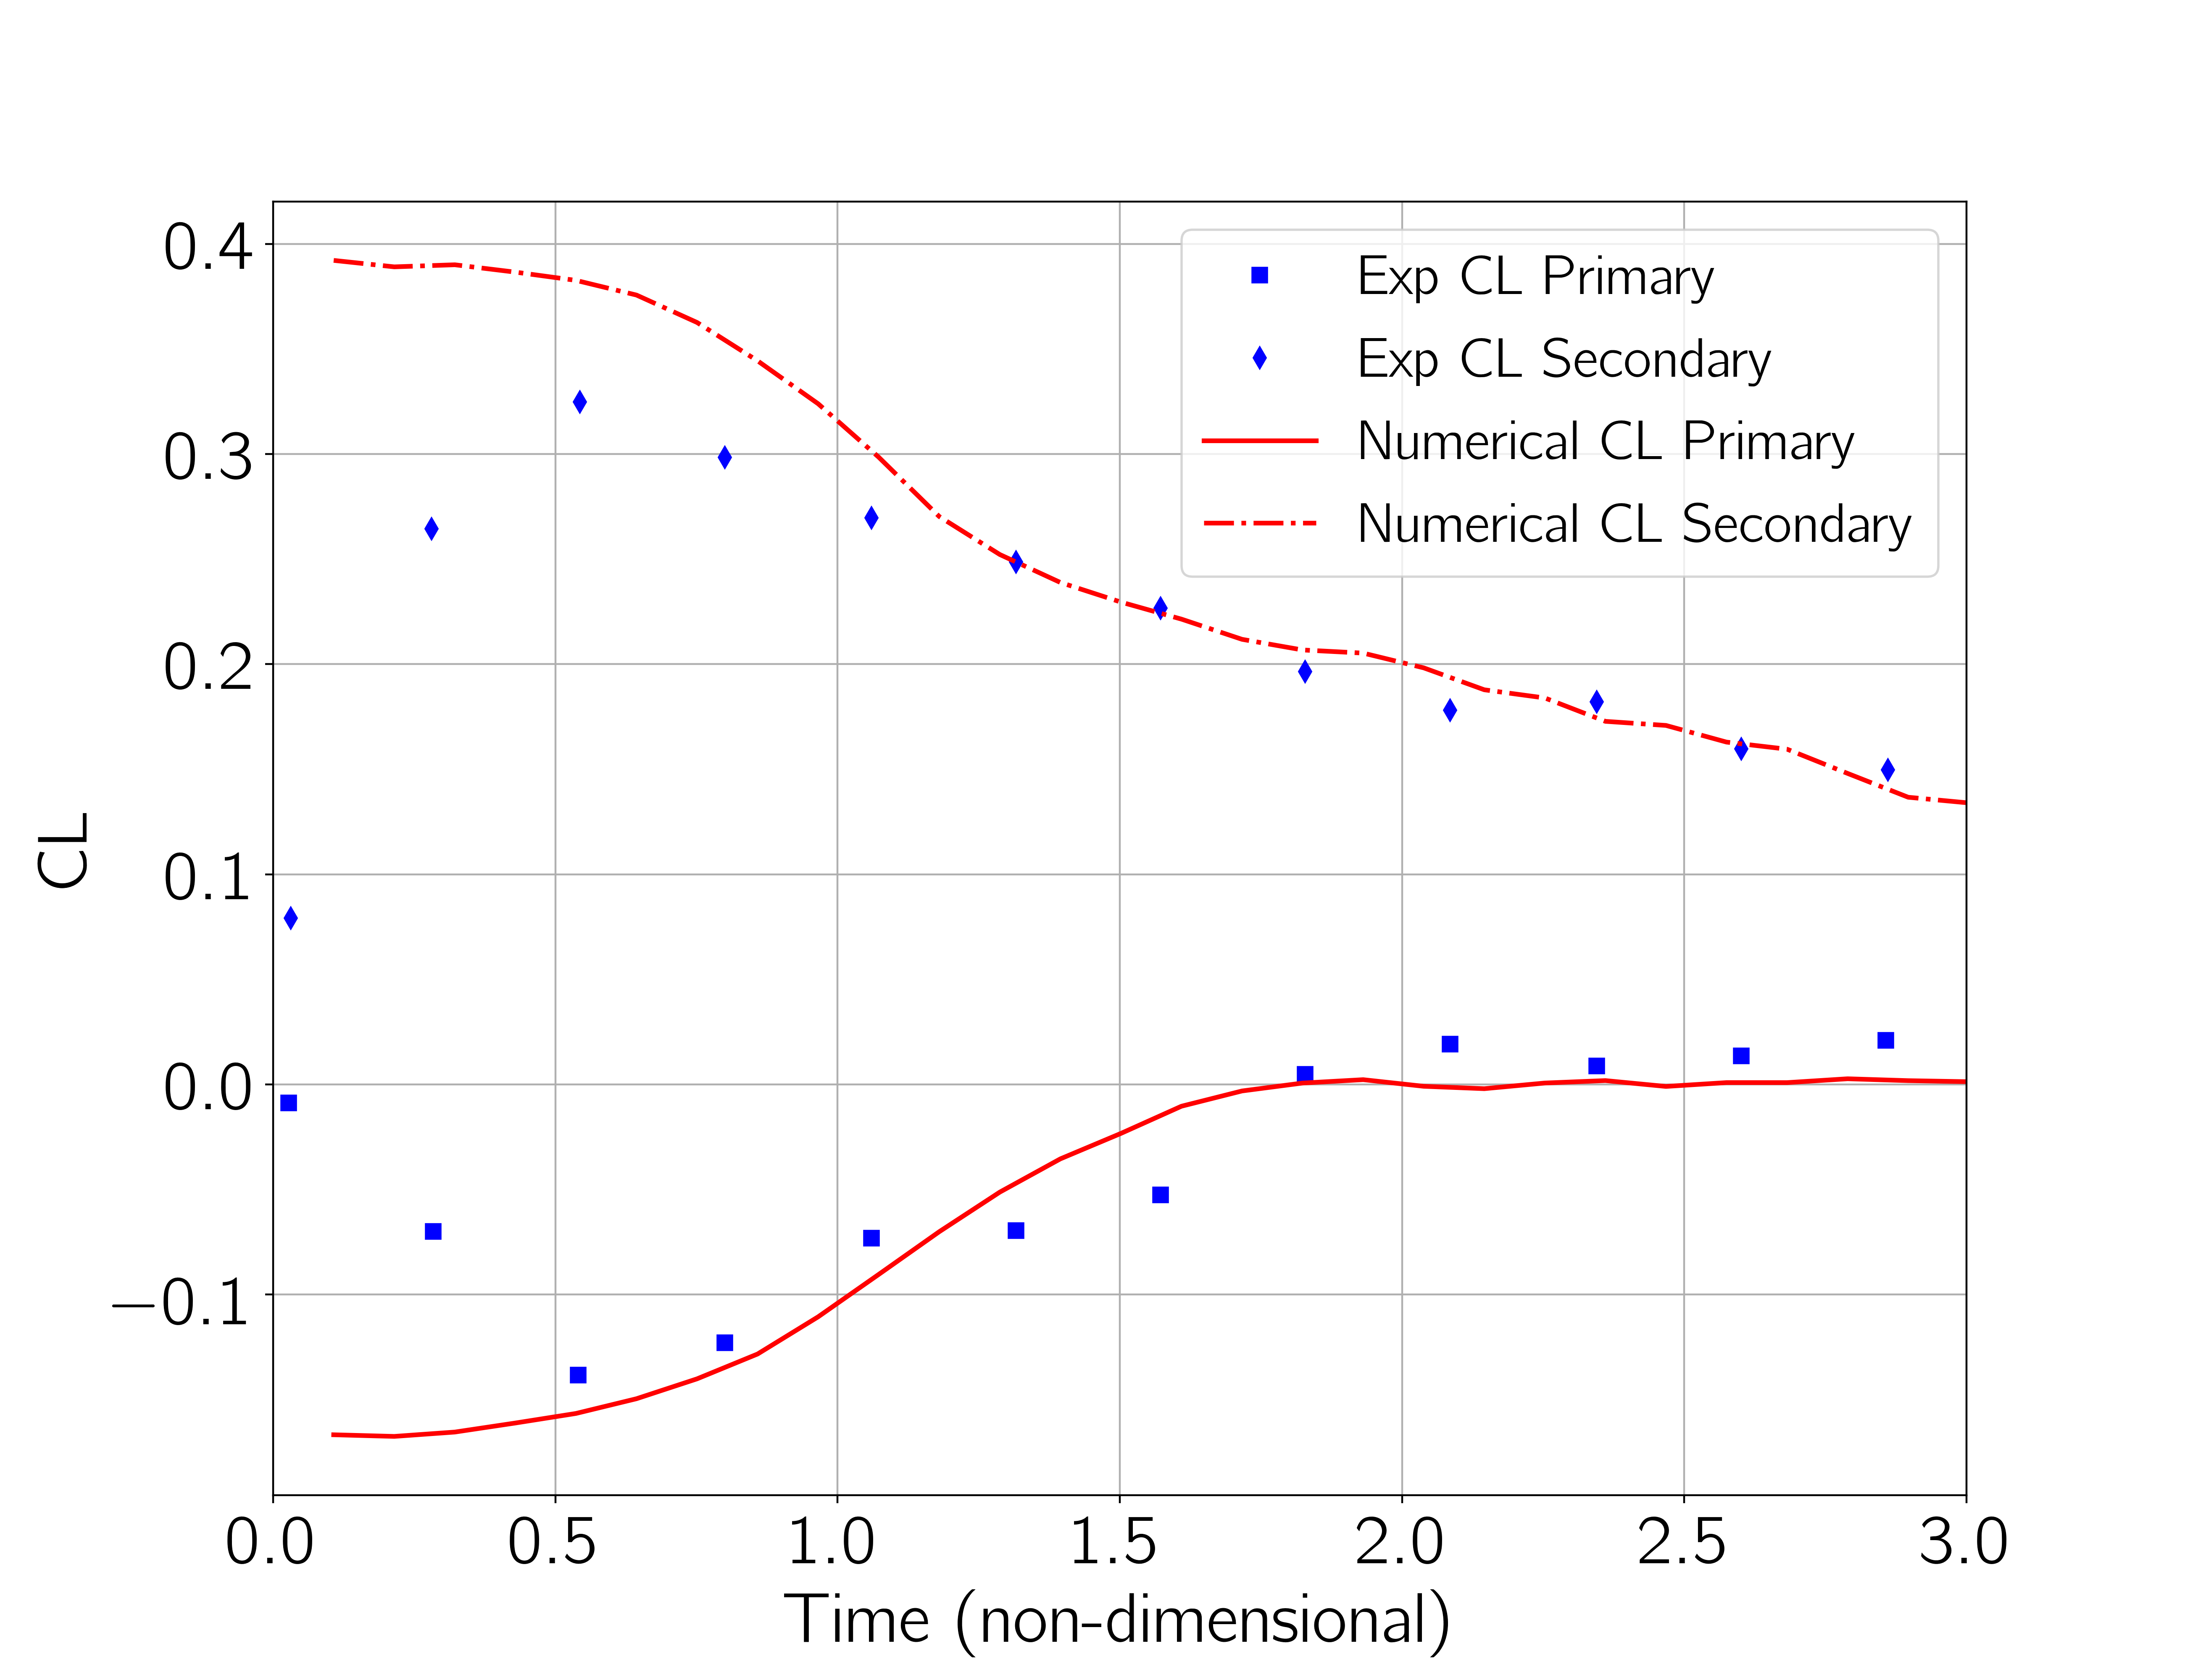
Two-spheres separation: position and forces
Time = 0
Time = 1.5
Two spheres are released from an arrangement as shown on the left
Aerodynamic coefficients are evaluated as the two spheres move away one from the other
An initial transient is present in the experiments after the release of the spheres
Colored lines on the Schlieren show numerical predictions

Slide 13
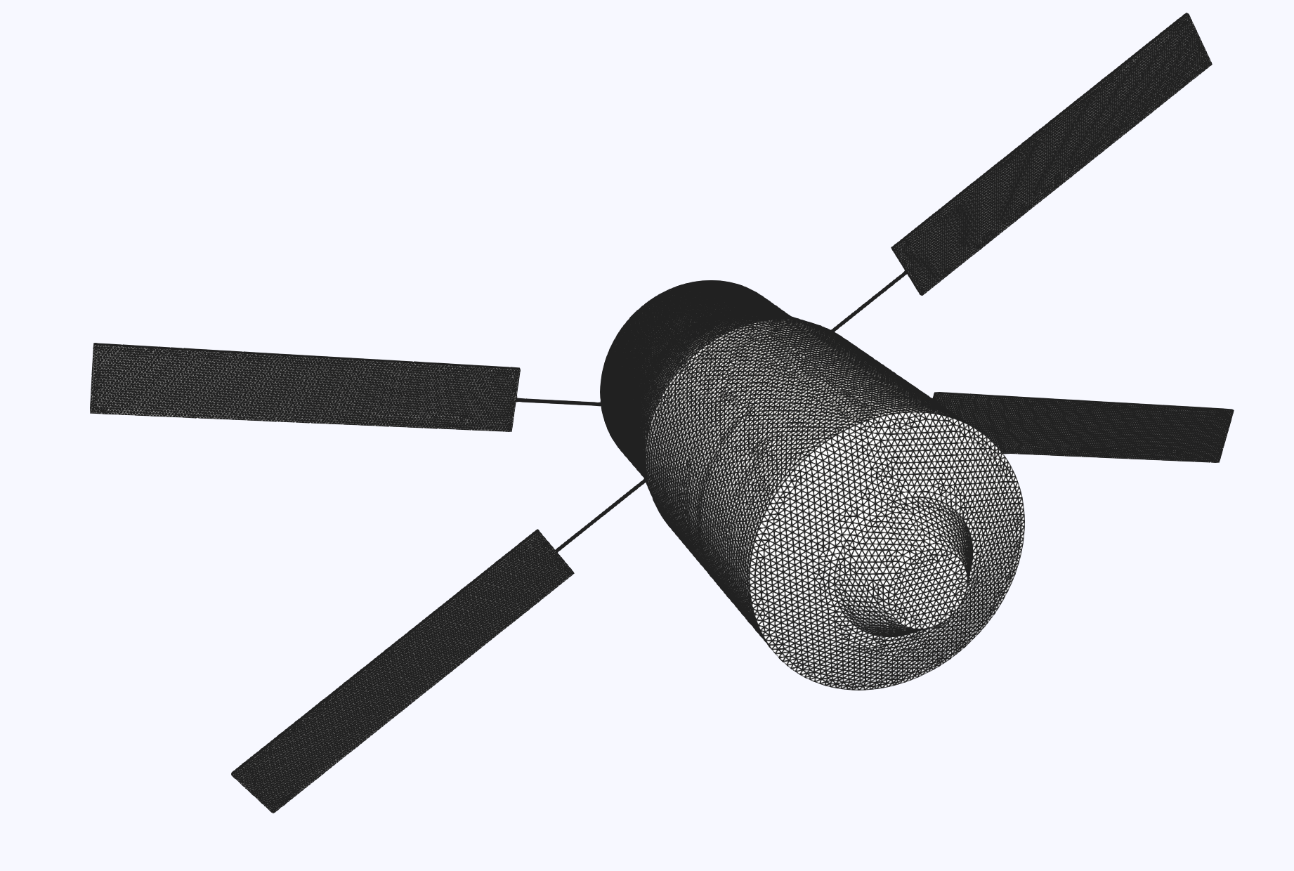
ATV cargo-inspired fragmentation process
Idealized test case to compare low- and multi-fidelity solutions
Fragmentation triggered by altitude
Relative Velocity [km/s] | 7.57
Relative Flight Path Angle [deg] | -1.45
Latitude [deg] | -40
Longitude [deg] | 207
Heading angle [deg] | 78
Surface mesh [N_{el}] | 160k
Geometric data courtesy from ESA

Slide 14
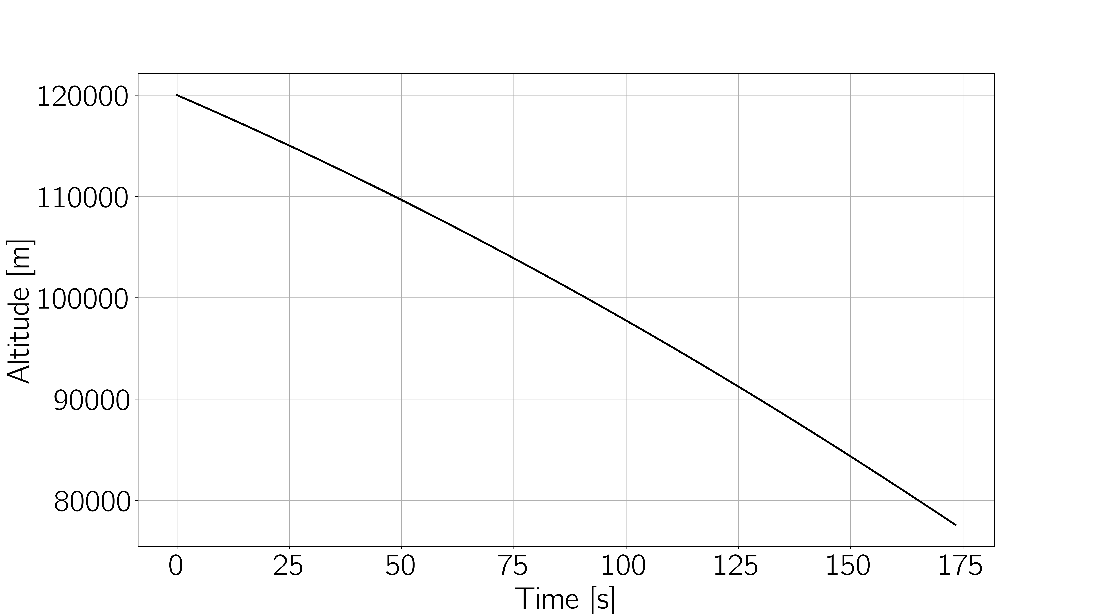
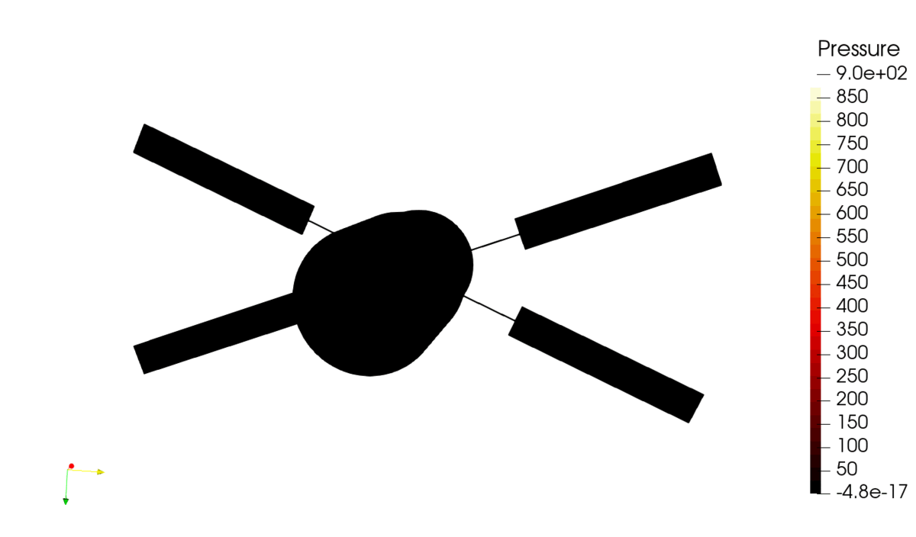
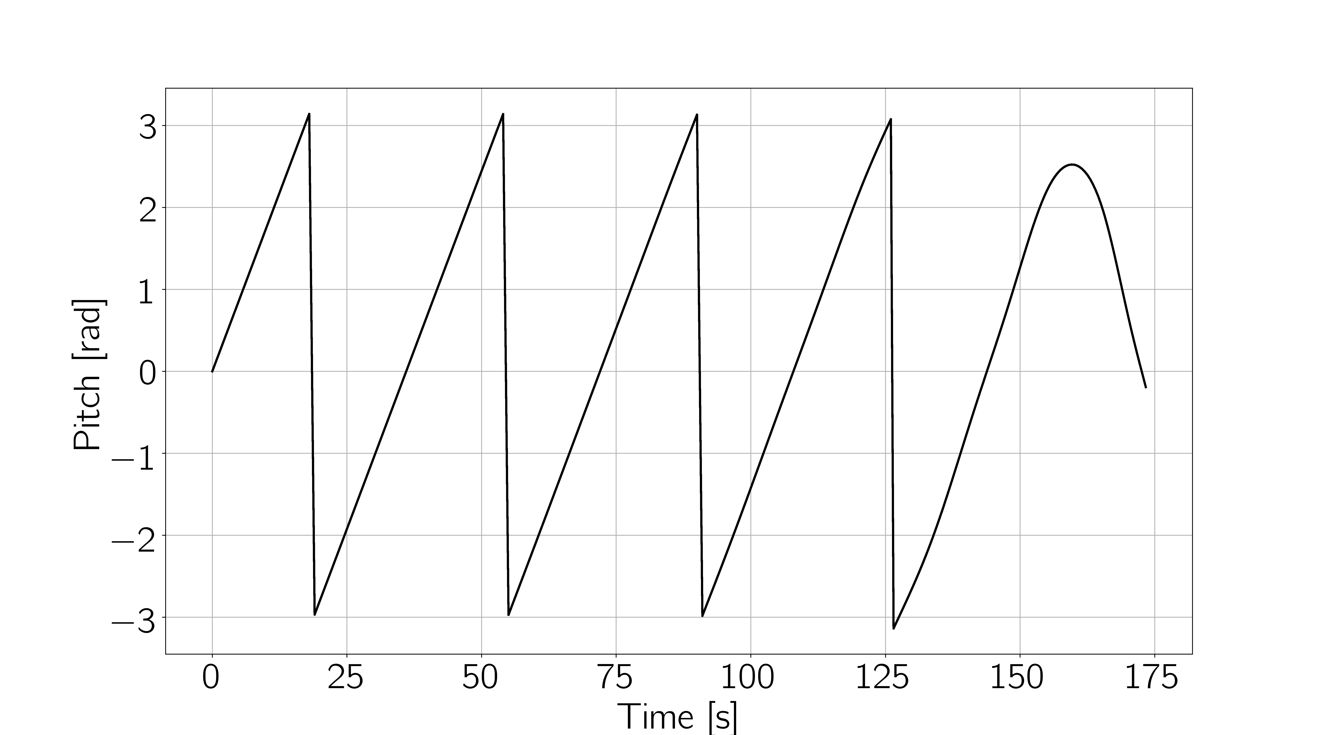
ATV cargo-inspired fragmentation process
Body dynamics during reentry. Pressure contours [Pa]
Low-fidelity simulation of re-entry and fragmentation from 120km to 77km
Independent dynamics of fragments after fragmentation
Simulated time = 173.4s, variable Δt = [1s – 0.01s]

Slide 15
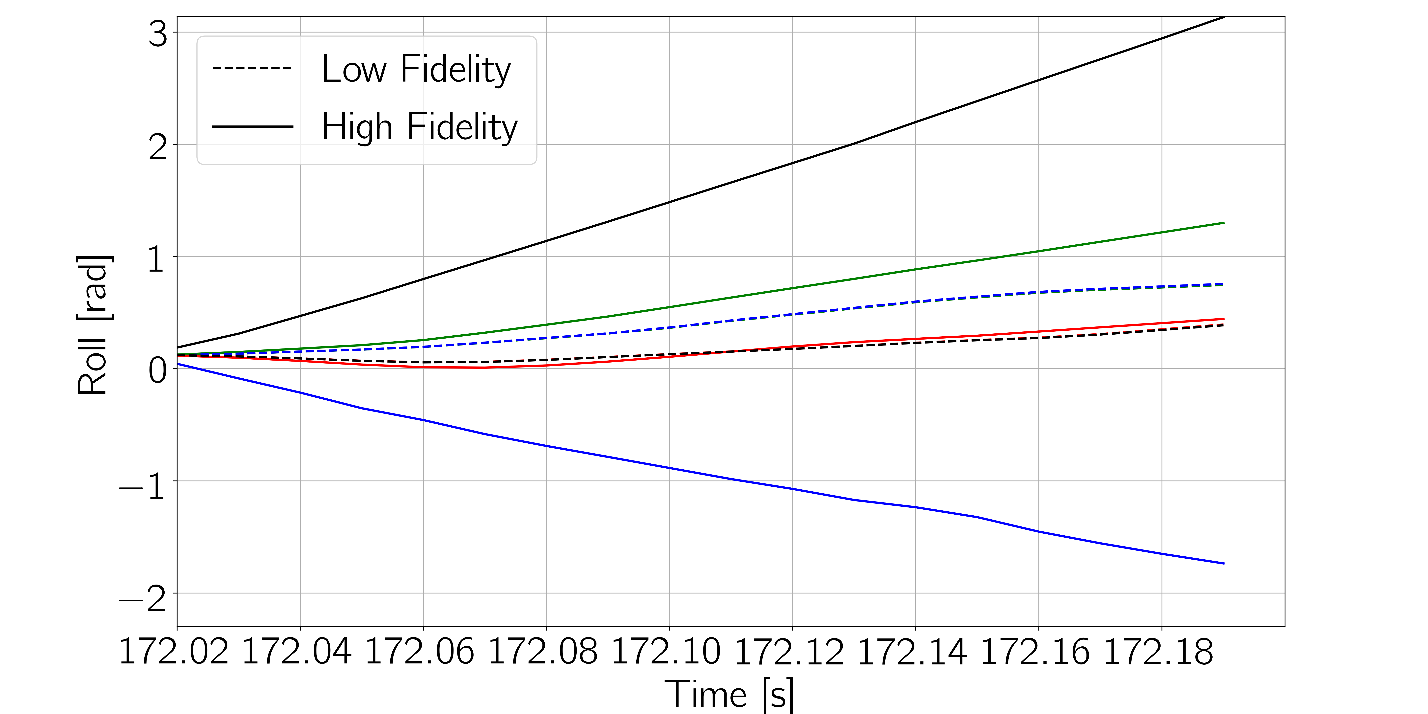
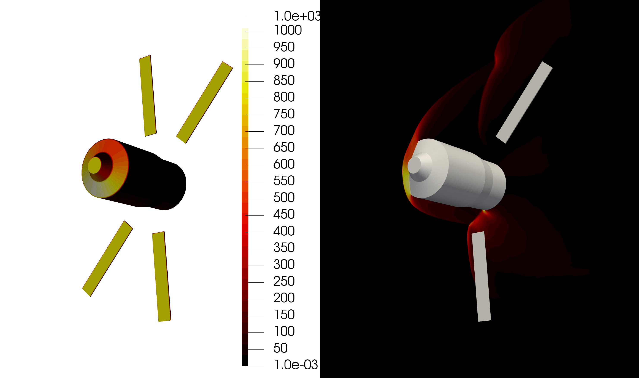
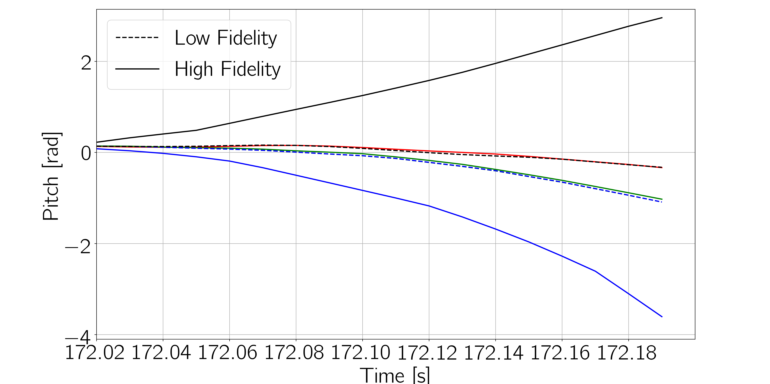
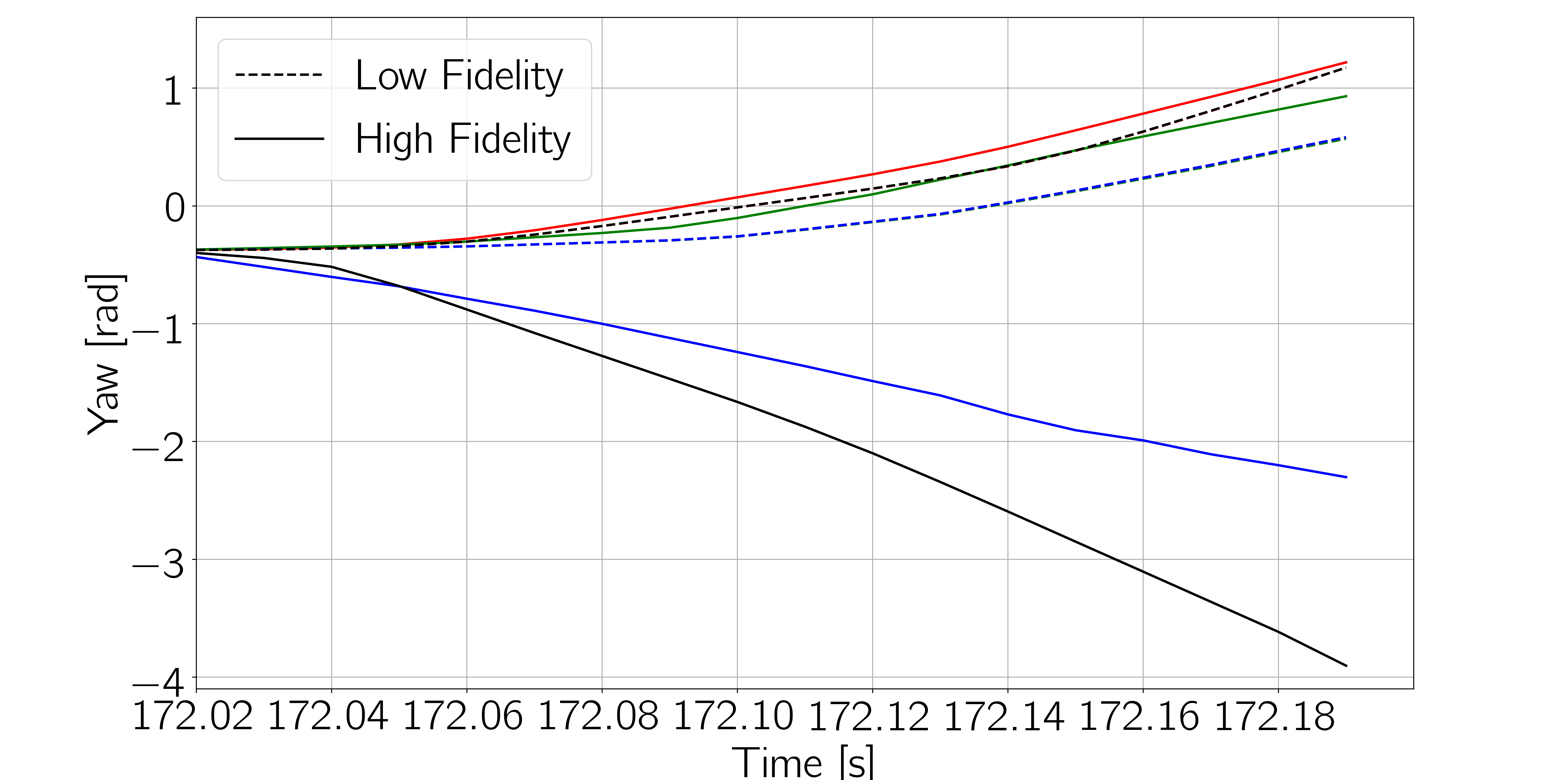
ATV cargo-inspired fragmentation process
Fragments dynamics after fragmentation. Low-fidelity (left), high-fidelity (right). Pressure contours [Pa]

Slide 16
Outlook
Thorough validation through available data and more complex test cases (i.e. more components and more fragments)
Automatic determination of fidelity switches
Integration with DSMC SPARTA
Integration of ESTIMATE material library
Implementation of a low-fidelity fragmentation model
Introduction of data-driven reduced order modelling
Release of TITAN v2022.1 (code name: blizzard), SMART-flidyn and SMART-gmi on: https://github.com/strath-ace. June 2022.

Slide 17
Acknowledgements
This work has been supported by the following grants:
Multi-disciplinary modelling of the aerothemodynamically-induced fragmentation of re- entering bodies (MIDGARD). ESA Contract No. 4000130436/20/NL/MH/ac, 2020-2023
STARDUST-R: The Asteroid and Space Debris Network Reloaded. H2020 Marie Sklodowska Curie grant 813644
The authors acknowledge the comments and inputs from:
Prof. T. Magin, Von Karman Institute for Fluid Dynamics
Dr. Cristina DePersis, ESA
Dr. Guillermo Ortega, ESA
Dr. Adrien Loseille, INRIA

Slide 18
References
Peddakotla, S.A., Minisci, E., Vasile, M., and Fossati, M. (2021). A Novel Approach for the Accurate Simulation of Re-entry Fragmentation. 72nd International Astronautical Congress. Dubai, UAE, November.
Maier, W., Needles, J.T., Garbacz, C., Morgado, F., Alonso, J.J. and Fossati, M. (2021) SU2-NEMO: An Open-Source Framework for High-Mach Nonequilibrium Multi-species Flows. Aerospace, 8(7), 193. https://doi.org/10.3390/aerospace8070193.
Garbacz, C., Maier, T., Alonso, J.J., Scoggins, J.B., Magin, T., Economon, T. and Fossati, M. (2021). Numerical study of nonequilibrium shock interference patterns over hypersonic vehicles. AIAA Journal. https://doi.org/10.2514/1.J060470.
Upcoming:
Morgado, F., Peddakotla, S.A., Garbacz, C. and Fossati, M. (2022) Multifidelity Approach for Aerodynamic Modelling and Simulation of Uncontrolled Atmospheric Destructive Entry. AIAA Scitech Forum and Exposition, San Diego (CA), US, January.

