Slide 1

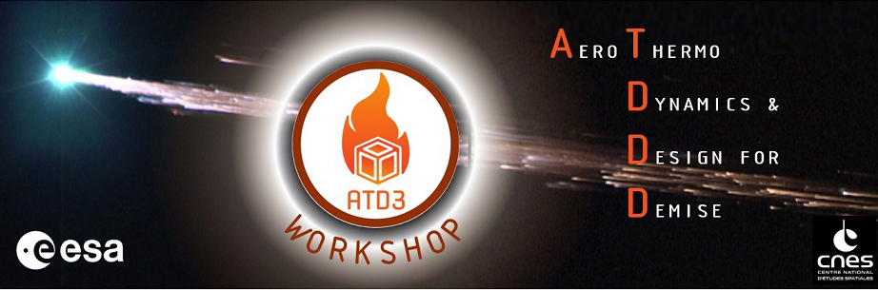
ATD3 Workshop 2021
SATELLITE REENTRY UNCERTAINTY QUANTIFICATION AND SENSITIVITY ANALYSIS USING THE OBJECT-ORIENTED CODE DEBRISK
P. Van Hauwaert⁽¹⁾ , J. Annaloro⁽²⁾, J.M. Papy⁽¹⁾, T. Martinez⁽¹⁾, S. Galera⁽³⁾, M. Spel⁽¹⁾ , E. Constant⁽¹⁾, A. Bellucci⁽²⁾, P. Omaly⁽²⁾
⁽¹⁾R.TECH, ⁽²⁾CNES, ⁽³⁾ALTRAN
RTECH-ING-PRES-211201-3051-RTECH
Notes:
Joint work between CNES and RTECH
Already presented at IAASS2021
How the variation of numerical parameters influence the results

Slide 2

Agenda
ATD3 2021 - SATELLITE REENTRY UNCERTAINTY QUANTIFICATION AND SENSITIVITY ANALYSIS USING THE OBJECT-ORIENTED CODE DEBRISK
Context (the need to evaluate the survivability of debris) and the DEBRISK software
Uncertainty modelling and numerical method
Uncertainty quantification and sensitivity analysis:
  Comparison between « automated » and « manual » fragmentation models
Uncertainty reduction:
  Fragmentation altitude
  Heat rate in the continuum regime
  Low speed drag multiplier
Impact of the maximum acceptable energy threshold on the results
Conclusions
Notes:
Only mention the bold titles:
2 kinds of frag models

Slide 3
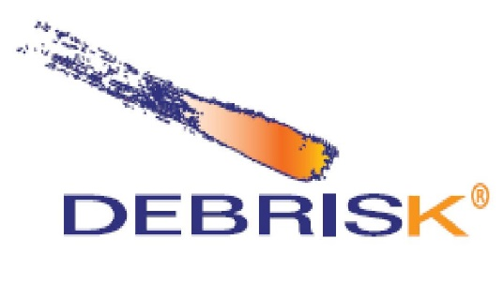
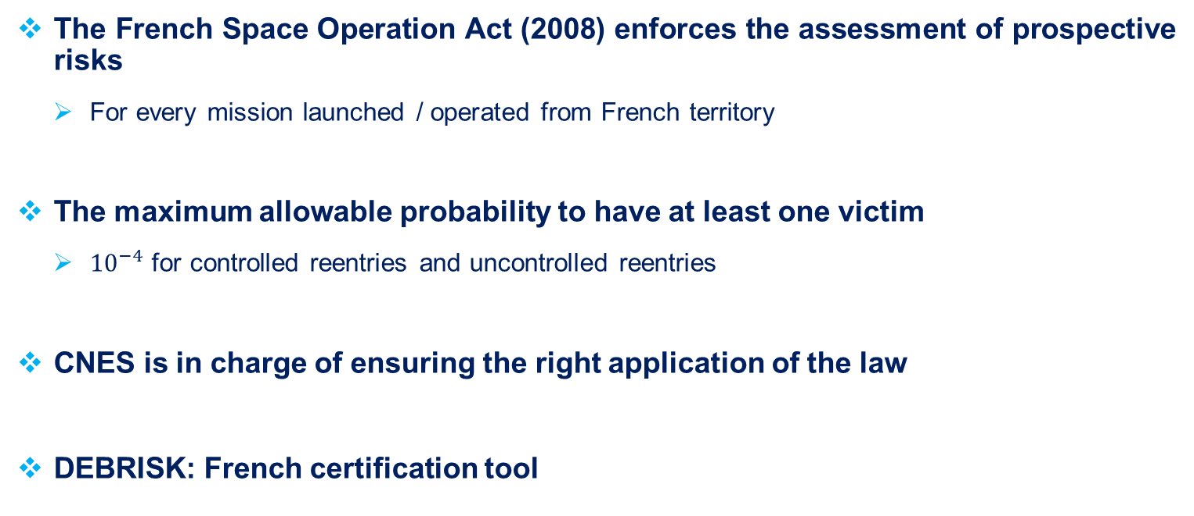
Context
ATD3 2021 - SATELLITE REENTRY UNCERTAINTY QUANTIFICATION AND SENSITIVITY ANALYSIS USING THE OBJECT-ORIENTED CODE DEBRISK
  The French Space Operation Act (2008) enforces the assessment of prospective risks
    For every mission launched / operated from French territory
  The maximum allowable probability to have at least one victim
    ${10}^{−4}$ for controlled reentries and uncontrolled reentries
  CNES is in charge of ensuring the right application of the law
  DEBRISK: French certification tool
Notes:
With the french space operating act decided in 2008, for every mission launched or operated from the french territory, The maximum allowable probability to have at least one victim shall be to 1e-4 at maximum for any reentry
CNES in charge of the right application of the laws: thanks to DEBRISK tool

Slide 4
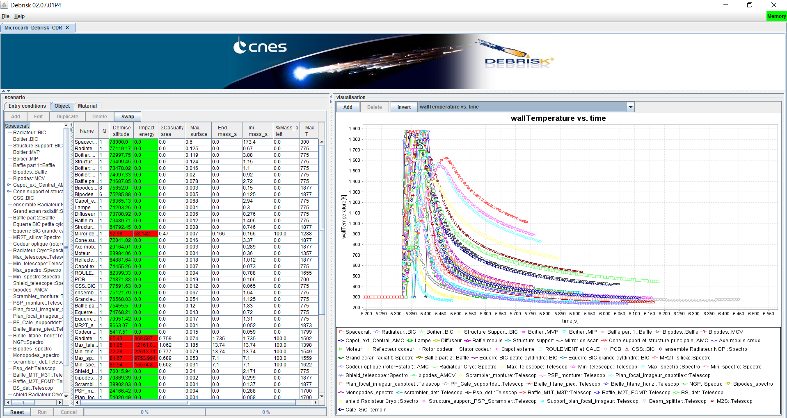
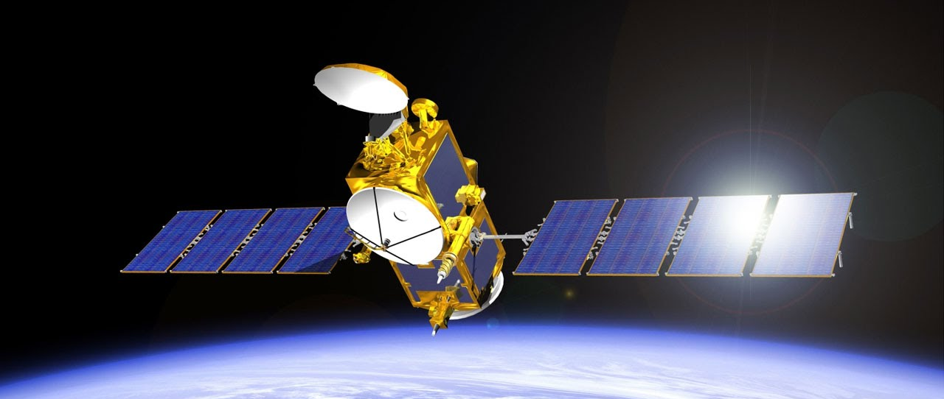
DEBRISK
ATD3 2021 - SATELLITE REENTRY UNCERTAINTY QUANTIFICATION AND SENSITIVITY ANALYSIS USING THE OBJECT-ORIENTED CODE DEBRISK
DEBRISK: French certification tool
  Provided to the aerospace companies and operators
  Designed to perform survivability analysis of fragments of space vehicles during their atmospheric reentry
  Based on an object-oriented approach
  Since 2015, CNES is working on reducing uncertainties in the physical models
  Non-linearity of the models + uncertainties => deterministic approach adequate ? Uncertainty quantification / sensitivity analysis needed !
Notes:
French certification tool
Provided to the aerospace companies and operators
Designed to perform survivability analysis of fragments of space vehicles during their atmospheric reentry
Based on an object-oriented approach :
Bottom left sat is modelled: GS -> plate. Main body : box. simple shape embedded for the rest and so on..
Since 2015, CNES is working on reducing uncertainties in the physical models
Because of Non-linearity of the models + uncertainties => It is legitimate to ask if a deterministic approach adequate ? Uncertainty quantification / sensitivity analysis needed !

Slide 5
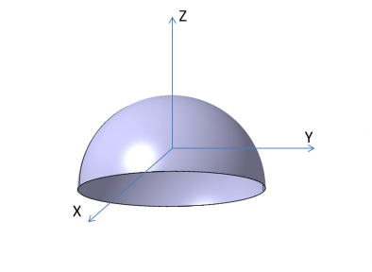
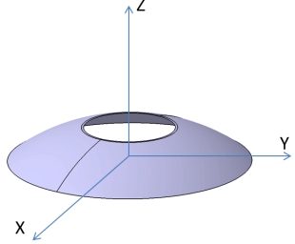
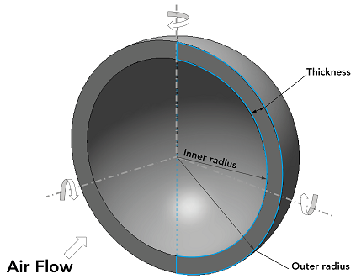
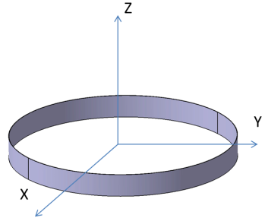
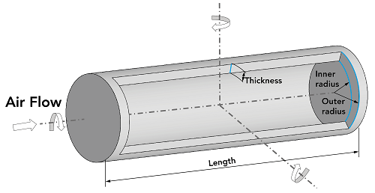
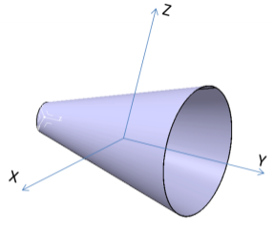
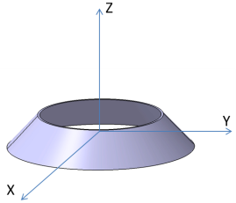
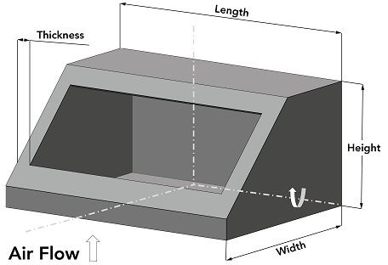
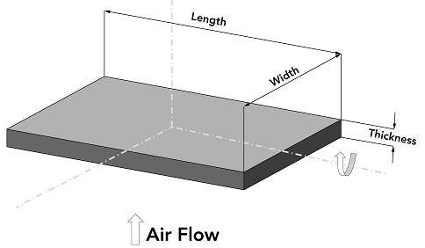
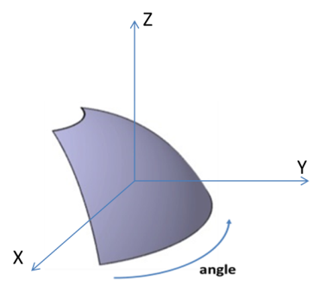
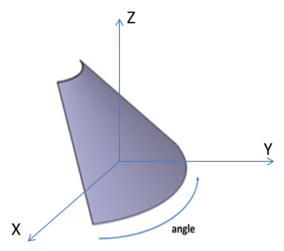
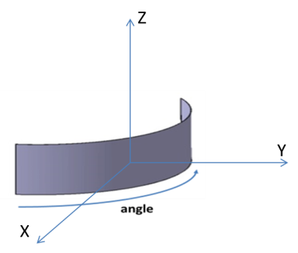
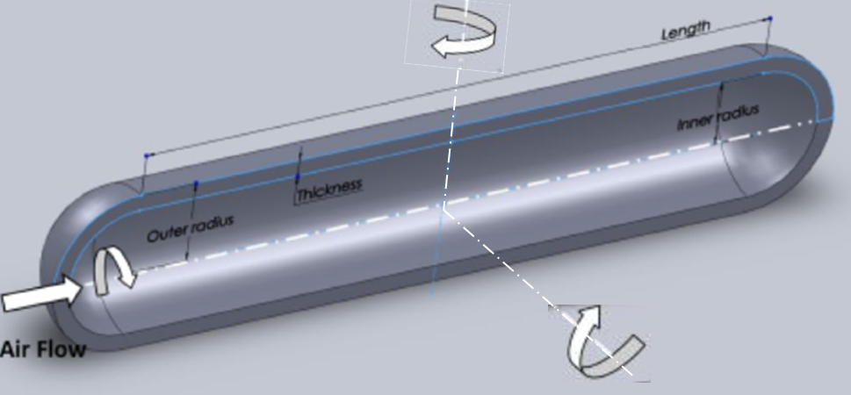
DEBRISK v3: New features
IAASS2021 - SATELLITE REENTRY UNCERTAINTY QUANTIFICATION AND SENSITIVITY ANALYSIS USING THE OBJECT-ORIENTED CODE DEBRISK
13 topologies are now available
All backed up by CFD computations

Slide 6
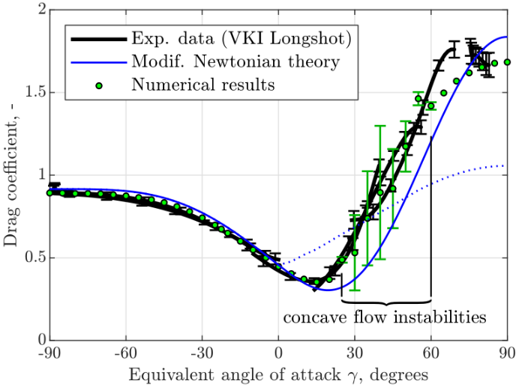
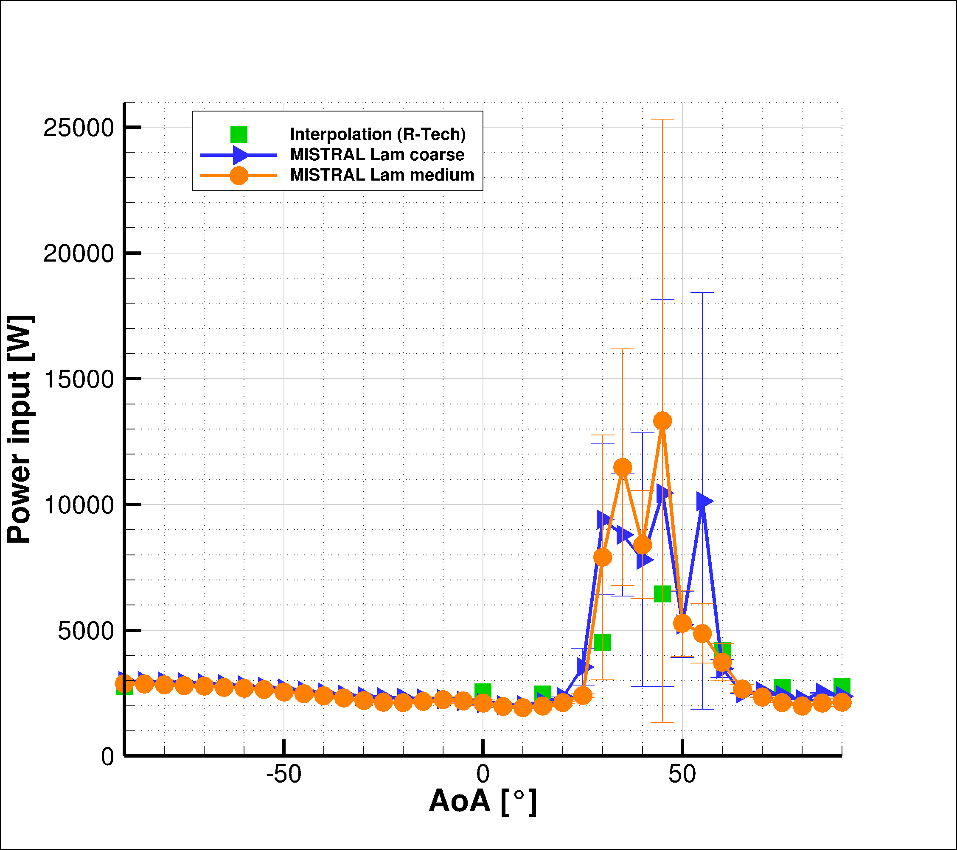
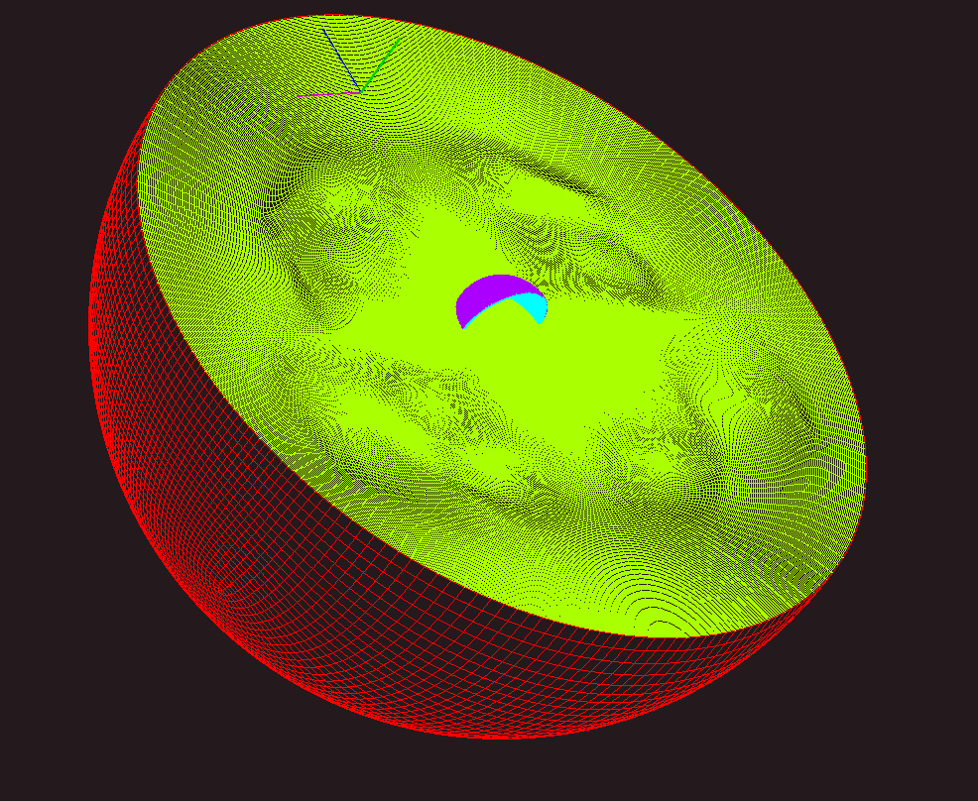
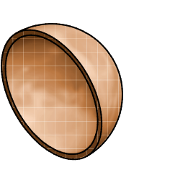
DEBRISK v3: New features
IAASS2021 - SATELLITE REENTRY UNCERTAINTY QUANTIFICATION AND SENSITIVITY ANALYSIS USING THE OBJECT-ORIENTED CODE DEBRISK
Complete review of the aerothermodynamics part for the hypersonic regime
The Klett’s methodology is discarded
The aerothermodynamics of DEBRISK is based on more than 3000 CFD/DSMC computations (MISTRAL code)
Validated through experimental tests (Longshot at VKI and T-117 at TSAGI)

Slide 7
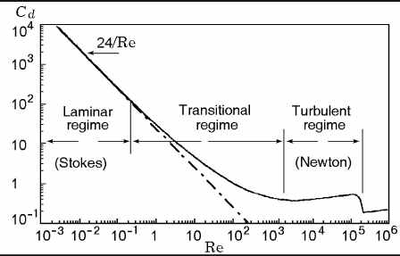
DEBRISK v3: New features
IAASS2021 - SATELLITE REENTRY UNCERTAINTY QUANTIFICATION AND SENSITIVITY ANALYSIS USING THE OBJECT-ORIENTED CODE DEBRISK
Complete review of the aerothermodynamics part for the subsonic regime
Taking into account the evolution of the drag coefficient as a function of Mach and Reynolds

Slide 8
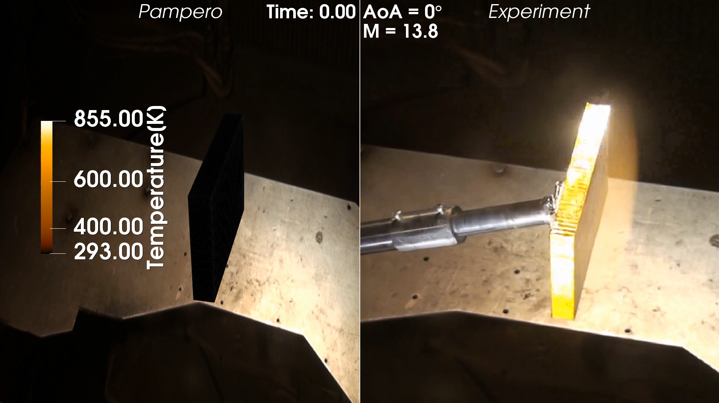
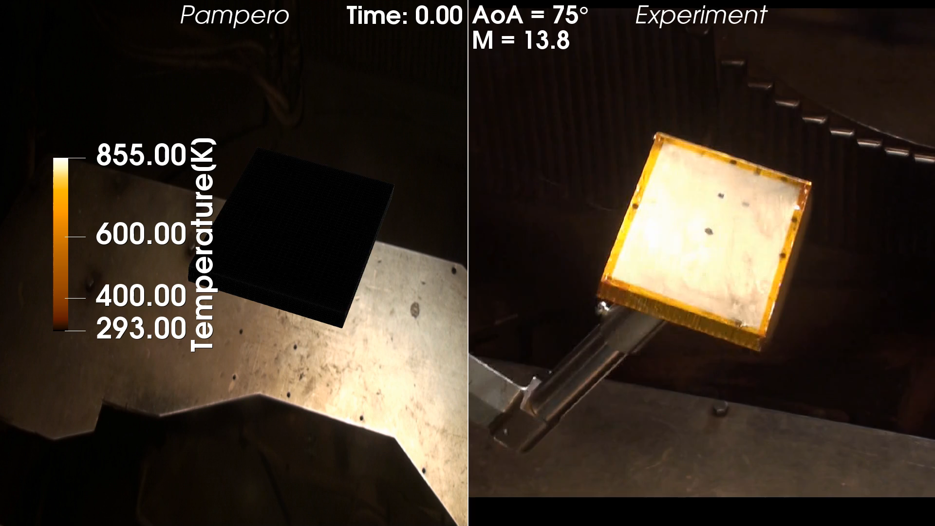
DEBRISK v3: New features
IAASS2021 - SATELLITE REENTRY UNCERTAINTY QUANTIFICATION AND SENSITIVITY ANALYSIS USING THE OBJECT-ORIENTED CODE DEBRISK
The break-up altitude is no longer generic (usually 78 km)
The break-up altitude is now specific to each satellite via a thermal criteria calibrated by destructive tests on Aluminum honeycomb panels at TSAGI

Slide 9
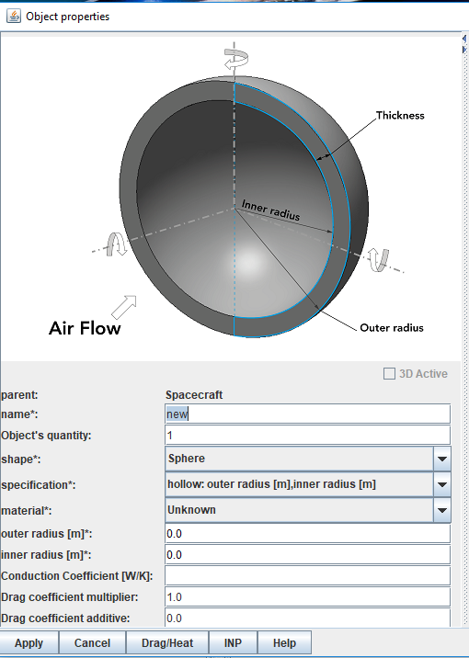
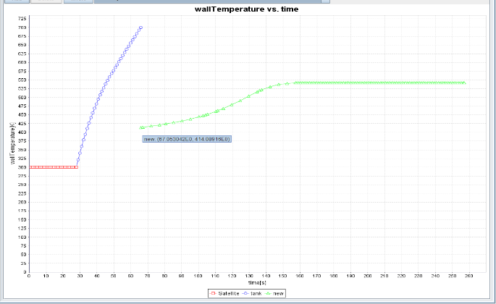
DEBRISK v3: New features
IAASS2021 - SATELLITE REENTRY UNCERTAINTY QUANTIFICATION AND SENSITIVITY ANALYSIS USING THE OBJECT-ORIENTED CODE DEBRISK
Thermal model improved by adding heat transfers between two objects
PCDU birth around 400 K
PCDU
Satellite external structure

Slide 10
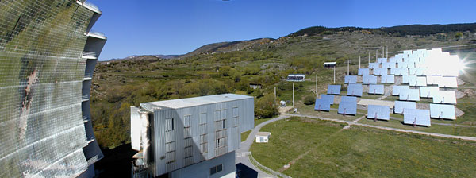
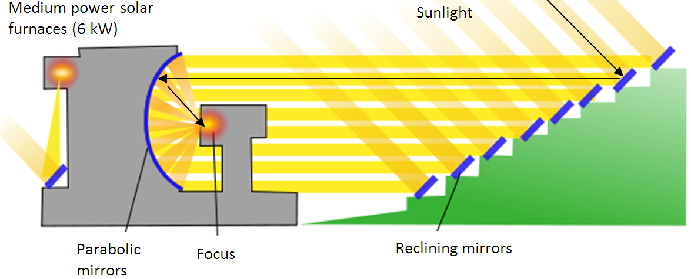
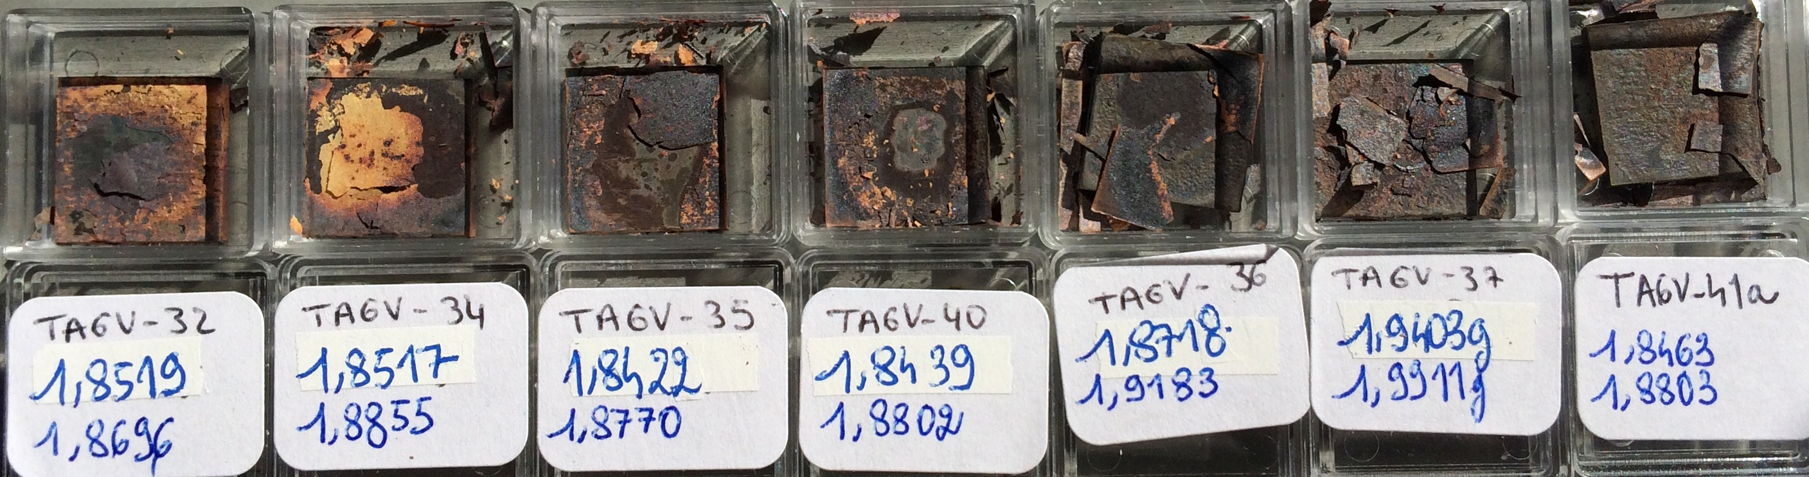
DEBRISK v3: New features
IAASS2021 - SATELLITE REENTRY UNCERTAINTY QUANTIFICATION AND SENSITIVITY ANALYSIS USING THE OBJECT-ORIENTED CODE DEBRISK
Complete review of the emissivity values by taking into account oxidation effects
Currently in an harmonization phase with ESA for the ESTIMATE Database

Slide 11
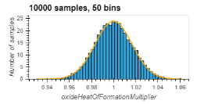
Uncertainty modeling
ATD3 2021 - SATELLITE REENTRY UNCERTAINTY QUANTIFICATION AND SENSITIVITY ANALYSIS USING THE OBJECT-ORIENTED CODE DEBRISK
30+ uncertainties modelled, see paper
Defined through analytical distributions: Uniform (U), Normal (N), etc
Monte Carlo Sampling
key | description
epsilonMultiplierAllButTi | U[0.85;1.05]
epsilonMultiplierTi | U[0.75;1.1]
fragmentationAltitude | U[68000;88000] (m)
lowSpeedDragMultiplierDebriskV2Satellite | U[0.2;1.8]
massMultiplier | U[0.8;1.2]
multiplicativeDragCoeffCont | N[1;0.06]
multiplicativeDragCoeffFM | N[1;0.06]
qcwMultiplier | N[1.035;0.224595]
qfmMultiplier | U[0.95;1.05]
Table: Distribution of 9 selected uncertainties
Fig: Comparison between Monte Carlo sampling and analytical formulations
Notes:
30+ uncertainties modelled, see paper
Defined through analytical distributions: Uniform (U), Normal (N), etc
Describe Monte Carlo Sampling:
In order to obtain results
Selected parameter at random among for every single parameter
Debrisk is run
Repeat 10000 times
Results : UQ and sensitivity analysis
Parameter useful to understand the rest of the presentation

Slide 12
Numerical methods
ATD3 2021 - SATELLITE REENTRY UNCERTAINTY QUANTIFICATION AND SENSITIVITY ANALYSIS USING THE OBJECT-ORIENTED CODE DEBRISK
Monte Carlo approach. Motivations :
  Large (30+) number uncertainties
  DEBRISK simulation : a few minutes for a satellite with 100 fragments
  Simplicity of tool chain (DUQ) at the expense of a large number of simulations.
Toolchain : « DUQ » (DEBRISK Uncertainty Quantification) python API
  500,000 DEBRISK simulations per day per user on the “HAL” (CNES supercomputer)
  On-the-fly post processing and Indices computation (Spearman, etc) : uncertainties quantification & sensitivity analysis.
  A total of 10 millions simulations carried out for the study
Notes:
reason why we use the MC approach
Large number of param
Fast simulation and easy to //
=> we wanted to have a simple method at the expense of large number of simulation
=> DUQ python api

Slide 13
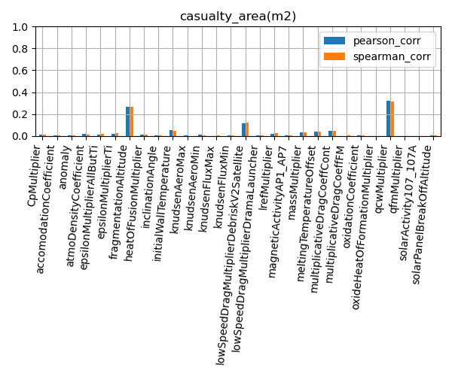
CA & Indices
ATD3 2021 - SATELLITE REENTRY UNCERTAINTY QUANTIFICATION AND SENSITIVITY ANALYSIS USING THE OBJECT-ORIENTED CODE DEBRISK
CA : « casualty area » : related to the sum of the surface of falling fragments reaching the ground with an energy significant enough to endanger the life of a human being
Ranking indices : Used to quantify the ranking (sensitivity analysis) of the parameters over the CA
Fig: CA indices. Manual fragmentation. A3
Notes:
We will be looking at the results in term of CA
Hight index value ⬄ large impact of the how the value of he CA is changing.

Slide 14
Satellites and fragmentation models
ATD3 2021 - SATELLITE REENTRY UNCERTAINTY QUANTIFICATION AND SENSITIVITY ANALYSIS USING THE OBJECT-ORIENTED CODE DEBRISK
Satellite | number of components | Initial mass (kg) | Ballistic coefficient (kg/m2) | Inclination angle (°)
A1 | 57 | 300 | 35 | 89.95
A2 | 108 | 170 | 78 | 98
A3 | 135 | 160 | 57 | 98
Fig: 3 satellites used for the study
« Automated » fragmentation: breakup trigger with panels reaching the degradation temperature of the adhesives/glue which fix the external aluminum faces sheets to the honeycomb.
  Recommended if the external structure of the satellite is mainly made of honeycomb/aluminum sandwich panels
« Manual » fragmentation: breakup trigger at fixed attitude
  Recommended in the other cases
Notes:
3 different kinds of sat with different kind of ….
Automated : the break up is triggered by the panel reaching the degradation temperature of the glue that is fixing them to the satellite
Manuel : fix fragmentation altitude
2 fragmentation models because we have (at least) 2 different kind of satellite

Slide 15
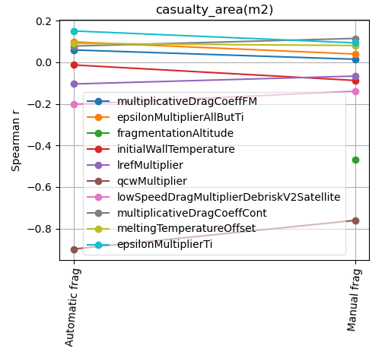
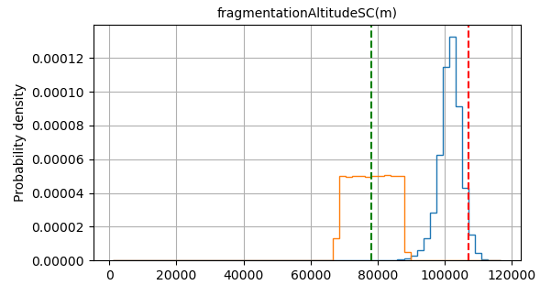
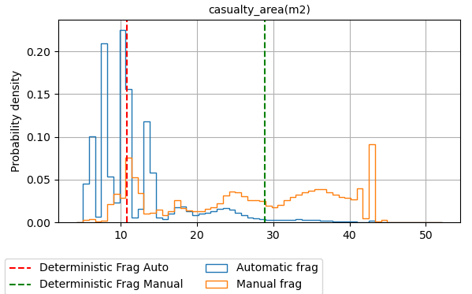
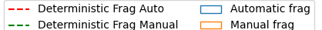
« Automated » vs « Manual »
ATD3 2021 - SATELLITE REENTRY UNCERTAINTY QUANTIFICATION AND SENSITIVITY ANALYSIS USING THE OBJECT-ORIENTED CODE DEBRISK
Manual fragmentation : fragmentationAltitude = U[68km, 88km]
Large differences in fragmentation altitude for « automated » : ~20km higher
Large differences in CA : both distribution and deterministic case: CA > x2 depending on the S/C
Manual vs automated : ranking order of most significant uncertainty ~identical except for initialWallTemperature and multiplicativeDragCoeffCont
Fig: PDF of the fragmentation altitude for A3.
Fig: PDF of the CA for A2 spacecraft.
Fig: Variation of Spearman index between the 2 fragmentation models. A2
Notes:
Manual : input
Auto : output
20km : realease earlier : CA smaller, up to 2 times =>
IT DOES MATTER to select the right frag model depending on the type of SAT
sensitivity analysis: fig on right:
abs value: how much the parameter impact the value of the CA
sign : in which direction it impact the value of the CA
ranking about the same except :
frag altitude
wall temperature
mutiplicative drag in the cont regime
same order for
qcw
frag altitude
low speed drag coeff multiplier

Slide 16
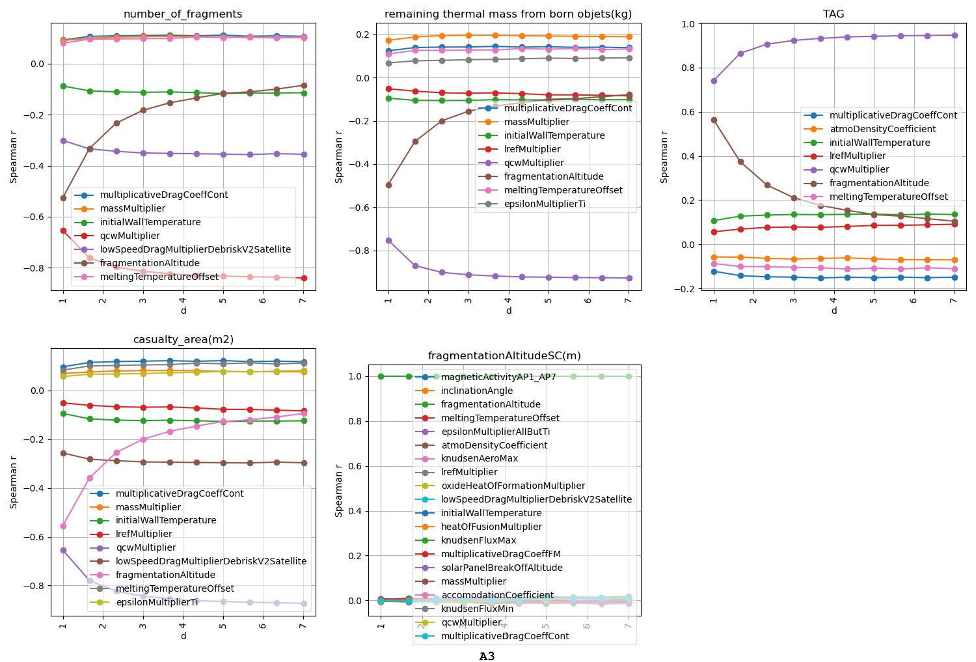
Uncertainty reduction : fragmentation altitude
ATD3 2021 - SATELLITE REENTRY UNCERTAINTY QUANTIFICATION AND SENSITIVITY ANALYSIS USING THE OBJECT-ORIENTED CODE DEBRISK
How much the reduction in fragmentation altitude uncertainty shall be so that it is not a parameter that has a large sensitivity on the value of the CA ?
Manual fragmentation : reduction « d » in fragmentationAltitude = 78km +/- (10km / d)
  ranking order of the other main uncertainty parameters are unchanged.
  qcwMultiplier (heat in the continuum regime) becomes the dominant parameter
Fig: Variation of Spearman index with a reduction of fragmentation altitude. A3
Notes:
Uncertainties reduction
How much a reduction in fragmentation altitude uncertainty shall be, so that it does not impact the value of the CA in a significant way ?
manual fragmentation : model with uniform of half amplitude 10km.
reduction : half amplitude 10km/ d. d>=1
d=5 => 2km is arguably the answer

Slide 17
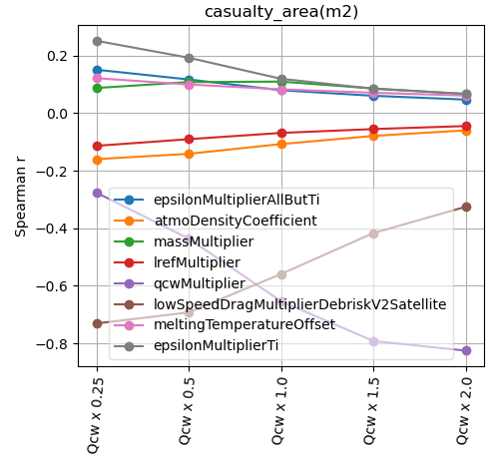
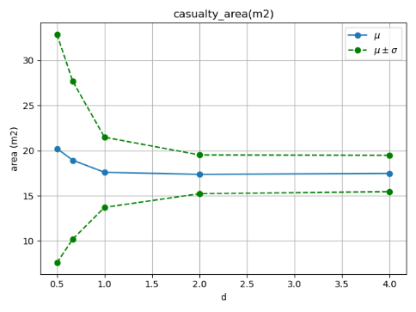
Uncertainty reduction : heat rate in the continuum regime
ATD3 2021 - SATELLITE REENTRY UNCERTAINTY QUANTIFICATION AND SENSITIVITY ANALYSIS USING THE OBJECT-ORIENTED CODE DEBRISK
qcwMultiplier = Norm[mu = 1.035, sigma = 0.224595 / d]
The decrease in standard deviation for the CA is getting lower between x0.25 and x0.5 => not relevant to investigate further uncertainty reductions below.
lowSpeedDragMultiplier becomes dominant.
Even a large (d=4) reduction for the qcwMultiplier is not enough so that the absolute value of the index is reduced significantly.
Fig: Variation of the statistics of the CA with a reduction of qcwMultiplier. A3.
Fig: Variation of Spearman index with a reduction of qcwMultiplier. A3
Notes:
Same question for the heat rate in cont regime
Modeled by Norm law and standard deviation : sigma
simulate a decease in uncertainty: decreasing sigma, dividing by "d" >= 1
left side : decrease of CA: std of the CA reach a plateau : no incentive to decrease the value further (d=2) without accounting for other reductions, cause no confidence in the results
right side : eventually the low speed drag multiplier because the dominant sensitivity parameter

Slide 18
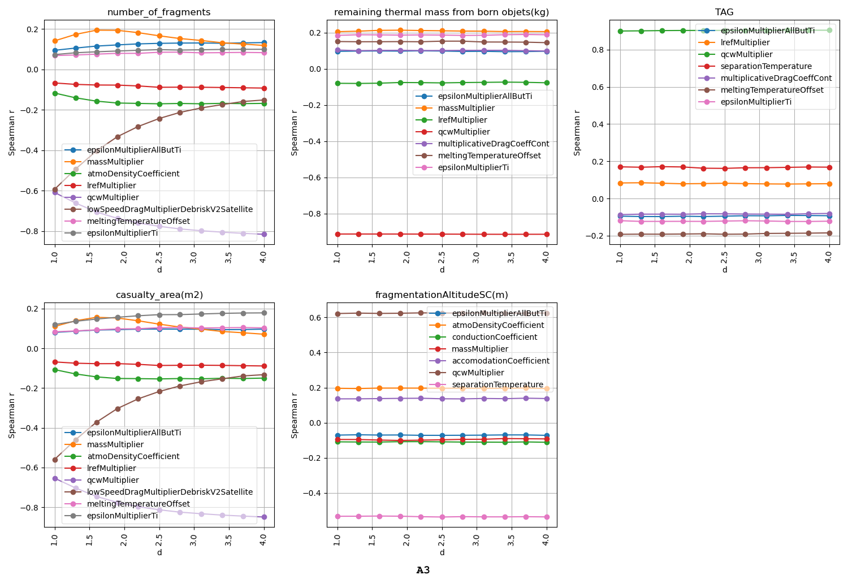
Uncertainty reduction : low speed drag coefficient
ATD3 2021 - SATELLITE REENTRY UNCERTAINTY QUANTIFICATION AND SENSITIVITY ANALYSIS USING THE OBJECT-ORIENTED CODE DEBRISK
lowSpeedDragMultiplierDebriskV2Satellite = U[1 – 0.8 / d, 1 +0.8 /d ]
d=1 : U[0.2, 1.8]
d=4 : U[0.8, 1.2] corresponds to a value where the low speed multiplier does not have a large influence anymore for A3. But depend on S/C.
Recent improvements to DEBRISK will reduced the uncertainty in the range U[0.8:1.2].
Fig: Variation of Spearman index with a reduction of low-speed coefficient. A3
Notes:
same question for low speed drag coefficient.
when switching from d=1 to d=4 : reduce +/- 80% to +/-20% => reaching the desired value

Slide 19
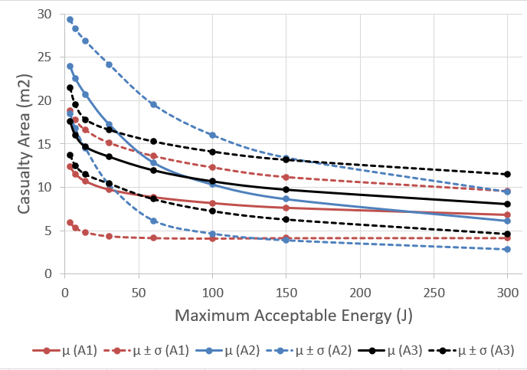
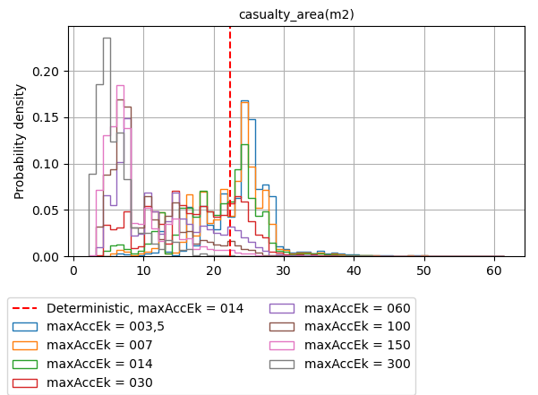
Impact of the maximum acceptable energy threshold (1/2)
ATD3 2021 - SATELLITE REENTRY UNCERTAINTY QUANTIFICATION AND SENSITIVITY ANALYSIS USING THE OBJECT-ORIENTED CODE DEBRISK
Objects above the maximum acceptable energy threshold are accounted for in the computation of the CA.
It is not an uncertainty parameter but a choice.
A minimum value of 0J should have been used but 3.5J is selected instead for numerical stability reason => model any impacting objects contributing to the CA
The effect of the reduction is most significant between 3.5J and 60J.
Variation of CA and the 1-sigma confidence interval with the maximum acceptable energy
Fig: PDF of the CA for various maximum acceptable energy. A2
Notes:
lets have a look at the impact of the maximum acceptable energy threshold on the results
any objects that have a Ek higher that that threshold will be accounted for in the value of the CA.
It is a choice.
Investigate value from min to 300J (energy of some bullet )
analysis for 3 S/C :
left : min -> 60J : decrease up to factor 2
right : also visible on the PDF distribution

Slide 20
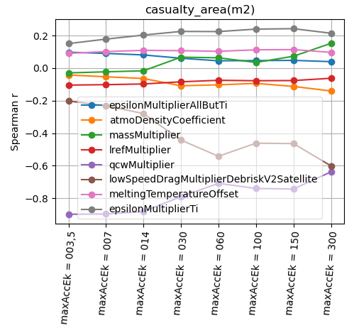
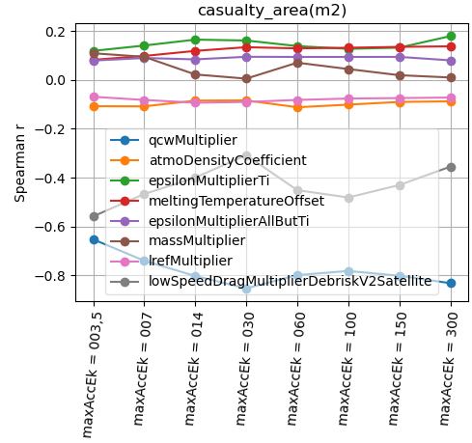
Impact of the maximum acceptable energy threshold (2/2)
ATD3 2021 - SATELLITE REENTRY UNCERTAINTY QUANTIFICATION AND SENSITIVITY ANALYSIS USING THE OBJECT-ORIENTED CODE DEBRISK
Ranking : low-speed drag multiplier & qcwMultiplier vary significantly
Competition between: “phenomena associated with the terminal kinetic energy” and “phenomena associated with thermal ablation”.
With a higher threshold for the maximum acceptable energy : decreasing the uncertainties over the low-speed drag coefficient multiplier will decrease the global uncertainties over the CA.
Fig: Variation of Spearman index with the maximum acceptance energy. A2
Fig: Variation of Spearman index with the maximum acceptance energy. A3
Notes:
with the variation of that threshold, the heat rate multiplier in the continuum regime and the low speed drag multiplier vary significantly
It sounds like there is a competition between: “phenomena associated with the terminal kinetic energy” and “phenomena associated with thermal ablation”.
With a higher threshold for the maximum acceptable energy : decreasing the uncertainties over the low-speed drag coefficient multiplier will decrease the global uncertainties over the CA.

Slide 21
Conclusions
ATD3 2021 - SATELLITE REENTRY UNCERTAINTY QUANTIFICATION AND SENSITIVITY ANALYSIS USING THE OBJECT-ORIENTED CODE DEBRISK
With the methods developed : It takes less than 1 day to carry out full uncertainty quantification and sensitivity analysis using DEBRISK => results with confidence interval.
Fragmentation altitude, the heat rate in the continuum regime and the low-speed drag coefficient : have the most impact on the results. A reduction in uncertainties => increase in confidence of the results. But depends on the scenario
In order for those uncertainties to have their index magnitude reduced significatively: the 3 studied spacecrafts show that it shall be reduced to U[76, 88] km for the fragmentation altitude, to U[0.8;1.2] for the low speed drag coefficient multiplier and to a std of 0.055 for the qcwMultiplier (even if it is not always enough).
Changes in the maximum acceptable energy threshold can change the value of the CA by more than a factor 2 when going from 14J to 60J but that depends on the spacecraft.
Large differences on the CA are observed, when comparing the two fragmentation models. This highlights the significance of choosing the appropriate model depending on the satellite.
Other variations have been investigated but are not presented in this work, e.g.: the type of atmosphere model, the orbit type (circular vs eccentric), the gravitation model and the angle of inclination of the mission.
As a by-product of the current study some major stability improvements for DEBRISK have been proposed for implementation in the final release of DEBRISK V3
NB: most conclusions assume that the current models actually are representative of how a satellite demise, but this topic is not discussed here.
Notes:
To conclude:
we developed method to carry out UQ and sensitivity analysis for any debrisk simulation. And result can be made available within a day.
we …
we …

Slide 22

ATD3 2021 - SATELLITE REENTRY UNCERTAINTY QUANTIFICATION AND SENSITIVITY ANALYSIS USING THE OBJECT-ORIENTED CODE DEBRISK
This activity was supported by CNES under the contract n°200753

