Slide 1
ATD3 Workshop 2021
Numerical and Experimental Validation of Spacecraft Demise during Atmospheric Re-entry
T.Martinez⁽¹⁾, G.Brives⁽¹⁾, E. Constant⁽¹⁾, M. Spel⁽¹⁾, L. Walpot⁽²⁾, J. Lachaud⁽³⁾, M. Balat-Pichelin⁽⁴⁾, P. Reulet⁽⁵⁾, A. Bultel⁽⁶⁾, B. Helber⁽⁷⁾
⁽¹⁾R.TECH, ⁽²⁾ESA, ⁽³⁾Univ. of Bordeaux, ⁽⁴⁾CNRS-PROMES, ⁽⁵⁾ONERA, ⁽⁶⁾CNRS-CORIA, ⁽⁷⁾VKI

Slide 2
Agenda
Introduction
Experimental campaigns
Material properties characterisation
Shear stress testing in Re-entry environment
Numerical modelling and rebuilding
Mistral-PATO coupling strategy
PAMPERO reduced models

Slide 3
Introduction
Objectives
Advance the knowledge of space debris degradation during their re-entry
Strengthen the predictive capabilities of the high-fidelity and spacecraft-oriented numerical tools currently in use
Rebuild numerically the data measured in high-enthalpy facilities and reactors operated at representative flight conditions
Reduce the risk of casualties from uncontrolled re-entry by reducing the amount of debris surviving re-entry
Approach
Various materials will be tested and analysed encompassing: CFRP, Haynes 25, steel AISI 304L
A comprehensive experimental database will provide insight into degradation and fragmentation processes and enrich the current ESA ESTIMATE database
Cost-effective, multi-physics, multi-scale, high-fidelity numerical codes of various accuracy will be extensively used and evaluated with respect to the measurements and enhanced to predict the sample degradation

Slide 4
Project organisation
GSTP
&
Head : P. Reulet
Expertise : Thermal properties identification for composite degradation at high heating
Head : M. Spel
Expertise : Development of Re-entry simulation tools, high-fidelity hypersonic simulation, Design for Demise
Sub-contractor : J. Lachaud
Expertise: Expert in porous ablative materials, initiated development of PATO tool at NASA, will provide guidance for flow/porous-material coupling
Head : A. Bultel
Expertise : Modelling and simulation of the chemical kinetics of atomic and molecular plasmas
Head : M. Balat-Pichelin
Expertise : Material characterization for Space and Energy applications
Head : O. Chazot
Expertise : Modelling, simulation and experimental validation of atmospheric entry flows and thermal protection systems

Slide 5
Experimental campaigns

Slide 6
Experimental campains
Metallic alloys characterisation
Materials: Haynes 25 From Haynes International and AISI 304L from Goodfellow
Contributor : CNRS-PROMES
Tests : Oxidation testing in MESOX facility. Emissivity testing in MEDIASE facility
Samples’ size :
- 15 x 15 x 2 mm³ for oxidation studies
- 25mm and 40mm diameter, thickness 2mm for emissvity studies
 | Haynes 25 | AISI 304L
Composition (%) | Coª(51)-Ni(10)-Cr(20)-W(15)-Fe(3)-Mn(1.5)-Si(0.4)-C(0.1) | Ni(10.5)-Cr(20)-Mn(2)-Si(0.75)-Fe(balance) C(0.03)-S(0.03)-P(0.045)-N(0.1)
Density (g.cm⁻³) | 9.07 | 7.89
Melting point (K) | 1600 – 1680 | 1505 – 1530
Application | Combustion chamber of the 400 N Hydrazine thruster (Ariane 5) | Various

Slide 7
Facilities and measurements
PROMES Facilities for metallic alloys characterisation :
 | MEDIASE | MESOX | Microstructural Characterisation
Facility specification | - Pressure : 10⁻⁵ Pa to 1atm 900 K < T < 2600 K | Pressure: 100 to 5000 Pa T increase +100K/s, Tmax 2600K | Scanning Electron Microscopy X-Ray diffraction Raman spectroscopy(if needed) Optical profilometry (if possible)
Property measured | Emissivity measurements : Spectral directional emissivity Normal spectral emissivity Total hemispherical emissivity | Oxidized state record (Video) Activation Energy for Arrhenius law Oxidation Kinetic law | Morphology crystallography and chemical composition chemical composition of the extreme surface (if needed) surface roughness (if possible)
Sample | Pre-oxidized and virgin | Virgin | Oxidized

Slide 8
Experimental campains
CFRP characterisation
Materials: CFRP from MECANO ID (Toulouse France)
Contributor : ONERA
Measurements : Physical degradation quantities(mass loss rate, decomposition reaction, reaction enthalpies etc..), Optical surface properties, Thermophysical properties
 | CFRP
Fiber | HexForce® G0803 Satin 5H
Resin | HexFlow® RTM6
Volume Fiber ratio | 57%
Sample thickness | 3mm (11 plies) and 4mm (14 plies)

Slide 9
Facilities and measurements
ONERA Facilities for the CFRP characterisation :
 | Mettler Toledo TGA/DSC3+ with Adethec toolbox | HR-TGA | BLADE | Bruker-Equinox Lambda 1050
Facility specification | - Max Temp. 1100°C Air/N2 Atmosphere | Temperature up to 1500°C Heating rate from 5°C/min to 1500°C/min Helium Atmosphere | LT : 20 – 80°C HT : 60 – 600°C | Ambient Temperature
Property measured | Arrhenius model for thermo-chemical reactions : Resin pyrolysis Char oxidation Fiber oxidation | Mass loss rate at high heating rates -> Arrhenius model | 3 thermal conductivities k_{x} , k_{y} , k_{z} Specific heat | IR emissivity UV/near-IR absoptivity
Sample | Virgin | Virgin | Virgin Degraded | Virgin Degraded

Slide 10
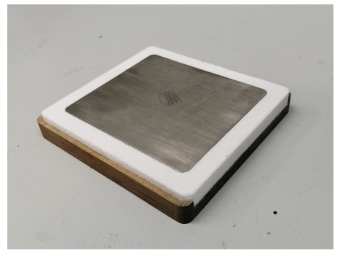
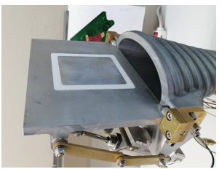
Experimental campains
Shear stress testing
Materials: Haynes 25, AISI 304L and CFRP
Contributor : von Karman Institute
Tests : Shear stess testing in high enthalpy flow with new semi-ellitptical nozzle in Plasmatron facility
Objective : Enrich data on the effect of shear flow on oxidation and delamination of oxide layers and CFRP sheets.
Samples: 90 x 90 x 4 mm³ plate glued in an alumina frame for adiabatic wall condition towards the water cooled sample holder

Slide 11
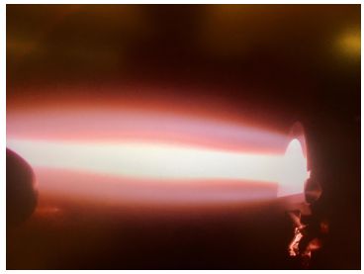
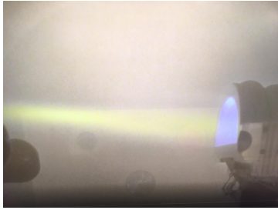
Experimental campains
Shear stress testing
Test | Material | Mass flow (g/s) | AoA (°)
1 | CFRP 1 | 6 | 0
2 | CFRP 1 | 16 | 20
3 | CFRP 3 | 16 | 20
4 | Haynes 25 | 16 | 20
6 | SS 304L | 16 | 20
6 | To Be defined | TBD | TBD
5g/s
Preliminary test matrix
Sample measurements:
Surface Temperature
Emissivity
Surface state evolution
Mass before and after
12g/s

Slide 12
Numerical modelling and rebuilding

Slide 13
Numerical modelling
Mistral-PATO coupling strategy
MISTRAL
PATO
R.Tech in-house CFD tool
Thermochemical Non-equilibrium Navier-Stokes Solver
Multi-dimensional (2D/axi/3D)
Finite volume structured multi-block
Open source In-depth material response
toolbox based on OpenFOAM
Multiphase porous reactive materials
Internal decomposition (pyrolysis, vaporization)
Gas-gas and gas-solid chemical reaction
Gas species transport (convection, diffusion)
Solid morphology evolution (internal density change, surface ablation)

Slide 14
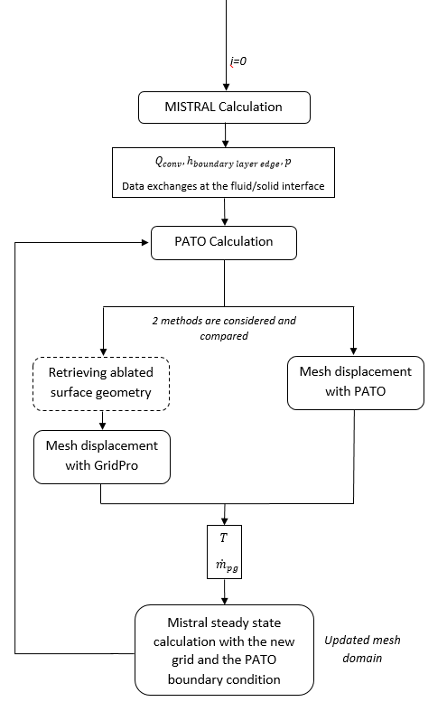
Numerical modelling
Mistral-PATO coupling strategy
Objectives:
• Validate the implementation of the physico-chemical models (Metallic models developed by CORIA implemented in PATO)
• Validate the implementation of the coupling algorithms
• Compute surface recession and deformation
• Compare with the high-enthalpy facility measurements
• Evaluate uncertainty (physico-chemical models’ equations and parameters)
• Adjust the modelling parameters within meaningful range
• Assess high-fidelity model performances and derive reduced models

Slide 15
Numerical modelling
PAMPERO reduced models
Objectives:
Determine the parameters to be correlated
Review the correlation parameter theoretical dependences, adjust and correct them
Implement the correlations in PAMPERO code
Compute flow and heating environment in a wind-tunnel with PAMPERO
Compare the solutions of PAMPERO and MISTRAL-PATO
Validate the correlations with the experiments
Apply PAMPERO tool on trajectory cases to study the modelling effect on the demisablity
PAMPERO computations for its validation (wind-tunnel mode)
Material | CFRP | Haynes 25 | AISI 304L | TBD
Number of runs | 1 | 1 | 1 | 1
PAMPERO trajectory computational matrix.
Material | CFRP | Haynes 25 | AISI 304L | TBD
Number of runs | 10 | 10 | 10 | 10
4 EIP altitudes (100, 90, 80, 70, 60 km) and 2 attitudes (0° and 90°)

Slide 16
Future Work
Perform testing for material characterisation (PROMES + ONERA) => Samples received, tests to be started during this month
Manufacturing of the flat plate heat flux probe at VKI => measure cold wall heat flux for test conditions
Perform testing for flat plates (CFRP, Haynes 25, AISI 304L) => Plasmatron to be ready current January/February
Implement material properties in PATO. Develop and implement Metallic model => From Coria and PROMES outputs
Investigate and compare mesh movement with PATO to remeshing from GridPro => Currently working on it
Communication between codes and full simulation
Rebuilt of VKI experiment with MISTRAL-PATO coupled tool
Implementation of simplified models in PAMPERO and comparison to high-fidelity simulation end experiment

Slide 17
Thank you all for you attention !
Contact :
thomas.martinez@rtech.fr
gauthier.brives@rtech.fr
eddy.constant@rtech.fr
martin.spel@rtech.fr

