Slide 1

Emission Spectroscopy of Low Density Air Shock Tube Flows Above 10 km/s
Tobias Hermann, Peter Collen, Alex Glenn, Tamara Sopek, Matthew McGlivray, and Luca di Mare
Oxford Thermofluids Institute,
University of Oxford
16/09/2022, 9th International Workshop on Radiation of High Temperature Gases for Space Missions, Santa Maria, Azores, Portugal

Slide 2
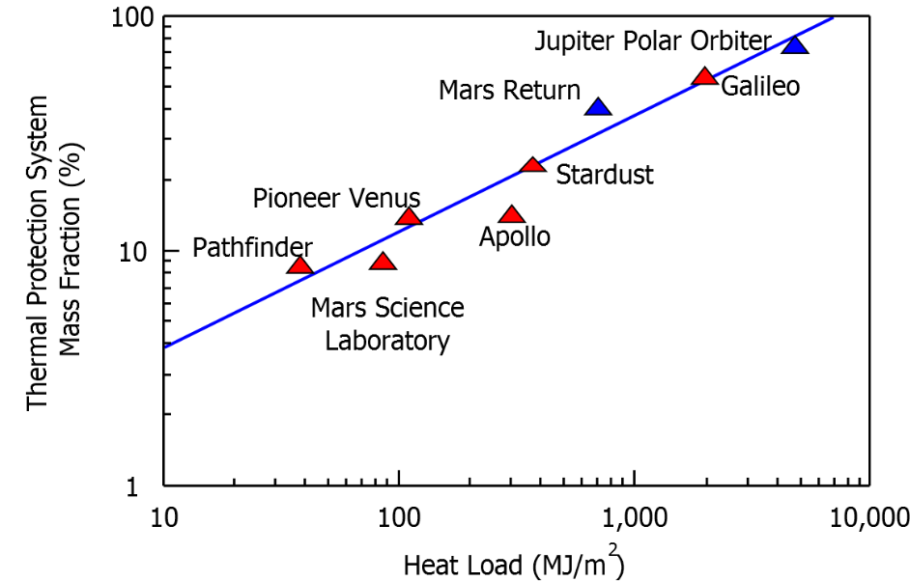
Atmospheric Re-entry and Heat Shields
Large kinetic energy of flight transferred into internal energy of the gas in front of the capsule
  Results in very high gas temperatures (>10.000 K)
  Extreme re-entry conditions lead to large heat flux
Protection by decomposing heat shield : Many missions are impossible due to too large heat shield mass
Large uncertainties in the prediction of the flowfield
  Non-equilibrium chemistry
  Emission and absorption of radiation
  Coupling between flow and heat shield
  Convective heat flux (25% uncertainty)[1]
  Radiative heat flux (80% uncertainty) [2]
Dragon V2 capsule [SpaceX].
[1] Brandis and Johnston, AIAA Thermophysics conference, 2014.
[2] Johnston et al., JSR, 2013.
TPS mass fraction of exploration missions [M. McGilvray]

Slide 3
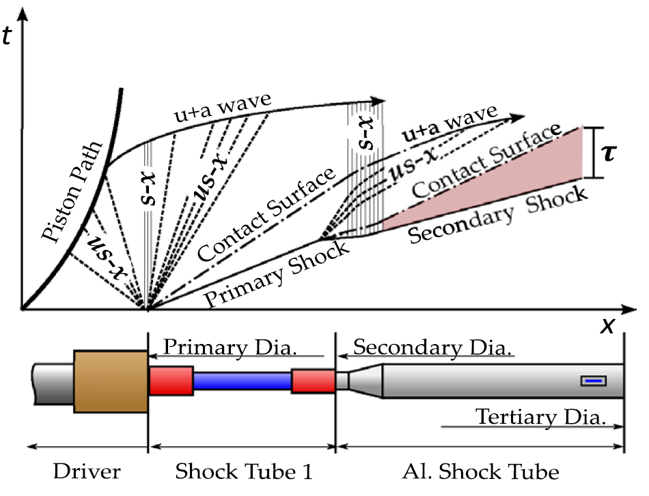
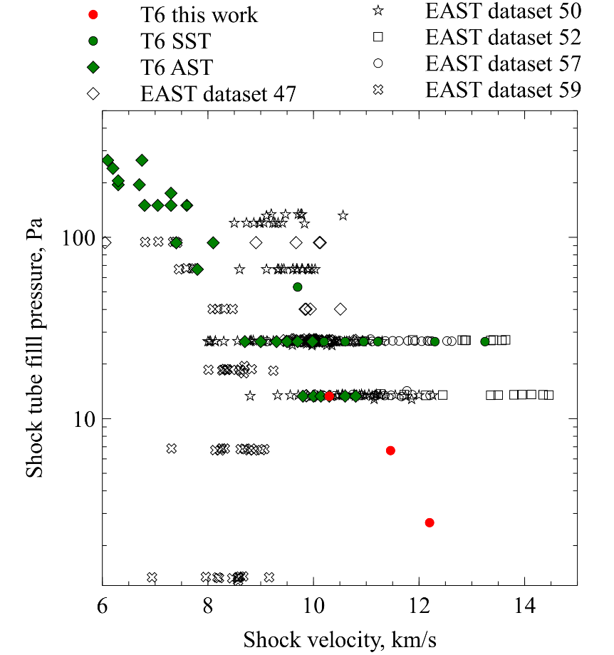
Shock Tube Testing and Flow Conditions
Testing in T6 Aluminium shock tube mode
Area change to achieve 225mm diameter at window location
Use of secondary driver (10 kPa Helium)
Synthetic air used as test gas
Shot number | Fill pressure, Pa | Shock velocity, km/s
221 | 13.3 | 10.30
229 | 6.67 | 11.26
231 | 2.67 | 12.31
Collen et al. “Development and commissioning of the T6 Stalker Tunnel” ExiF 2021

Slide 4
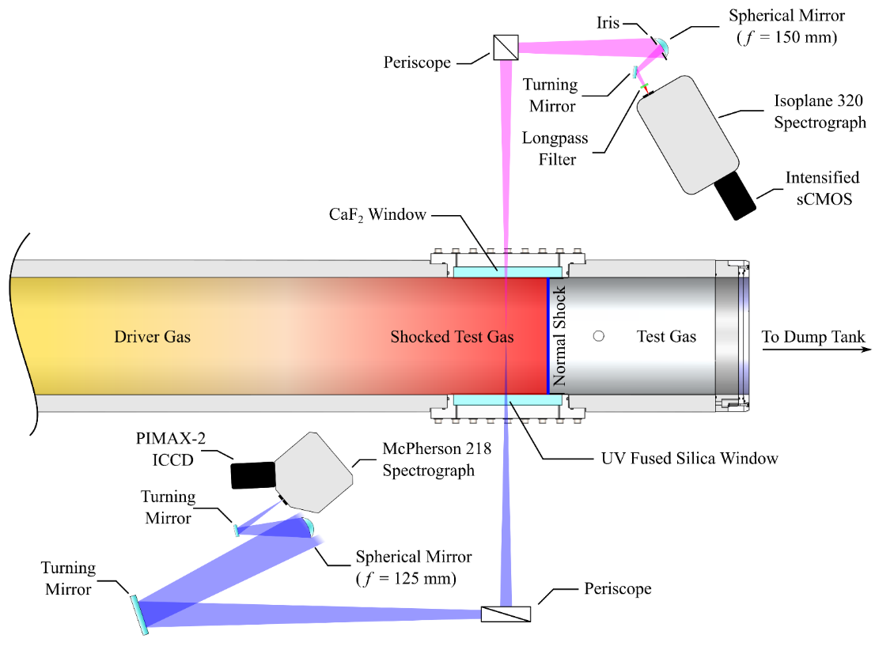
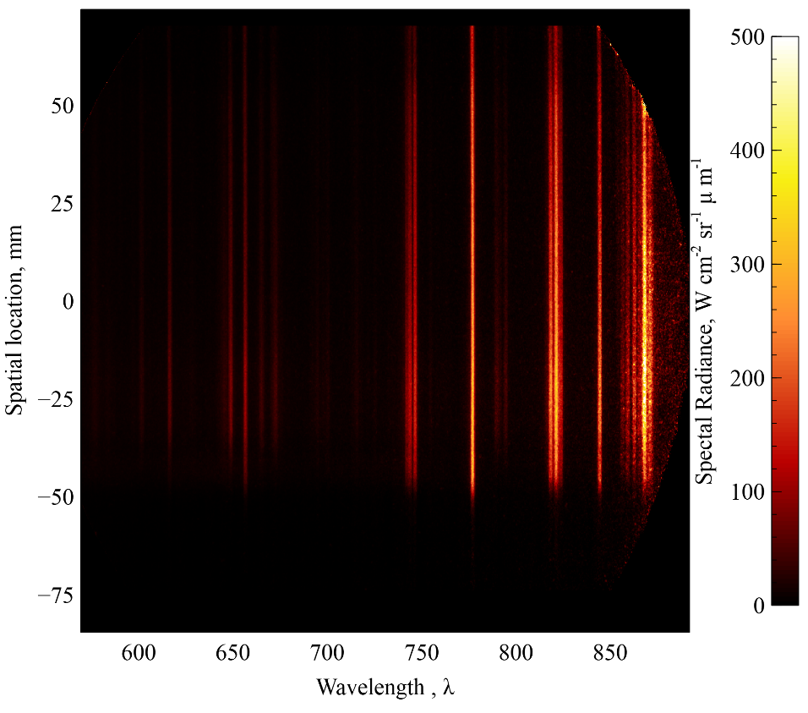
Emission Spectroscopic Setup
Calibration for absolute radiance using integrating sphere
Characterisation of instrument functions
  Spatial: Derivative of integrating sphere edge (FWHM_{G}=0.7 mm, FWHM_{L}=0.5 mm)
  Spectral: Mercury lamp with thin lines (FWHM_{G}=1.25 nm, FWHM_{L}=0.009 nm)
Exposure time of 0.5 μs
Atomic radiation dominates
Glenn et al. “Comparison of Equilibrium Radiation between Shock Tube and Plasma Torch Spectroscopy for Atmospheric Pressure Air, RHTG 2022”
Calibrated spatially resolved spectrum of shot 221.

Slide 5
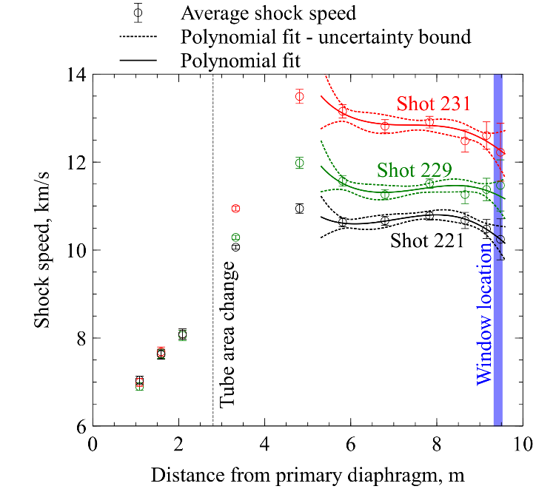
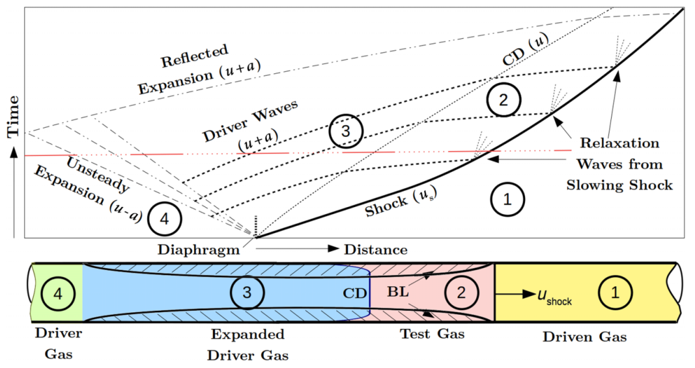
Analysis using Simulation Tools
Shock speed analysis using Monte-Carlo approach with polynomial fit
CEA equilibrium simulation using nominal shock speed at window location – shock speed uncertainty analysis for upper and lower boundary
LASTA simulation using equilibrium gas composition: Spatial evolution behind shock
Poshax simulation using nominal shock speed at window location (Park 93 rates): Non-eq. region
NEQAIR 15.0 used with Boltzmann and flux limited QSS population distribution and spatial and spectral smearing functions
Spectrum cumulated between 680 – 850 nm
Satchell et al. “Analytical Method of Evaluating Nonuniformities in Shock Tube Flows: Theory and Development”, AIAAJ 2022

Slide 6
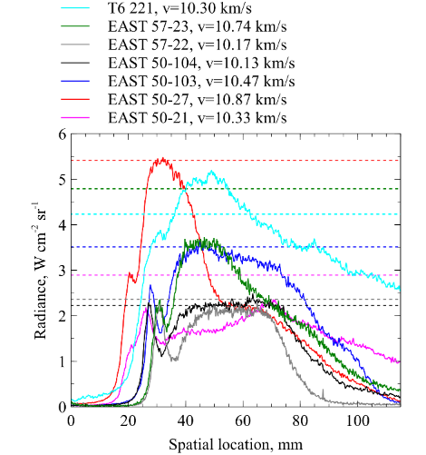
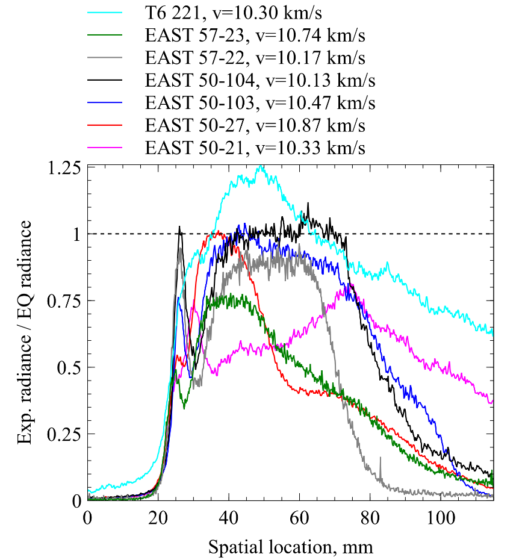
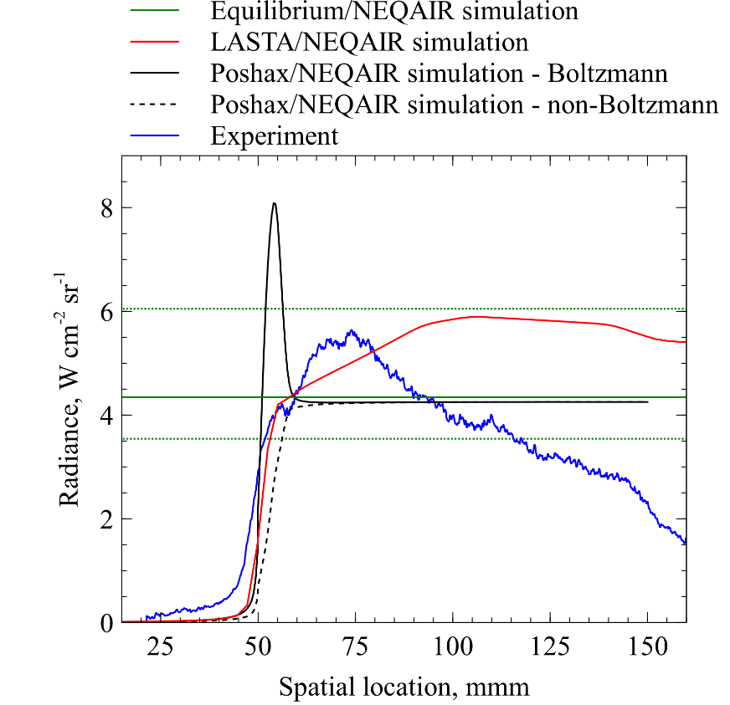
Results – 13.3Pa, 10.30 km/s
Comparison to simulations and to comparable EAST datasets (at 13.3 Pa)
Reasonable agreement with LASTA – however, drop of radiation after 25mm
Similar spatial features between T6 and EAST 57-23, 50-27
Nonequilibrium region far from Boltzmann distribution
Non-Boltzmann distribution does not adequately cover double peak
No significant molecular radiation is observed in the non-eq. region

Slide 7
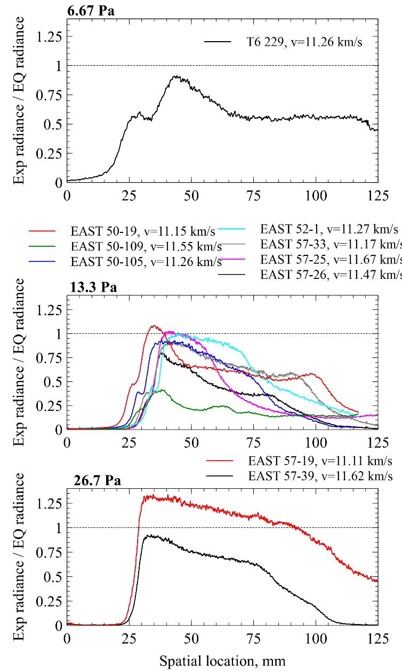
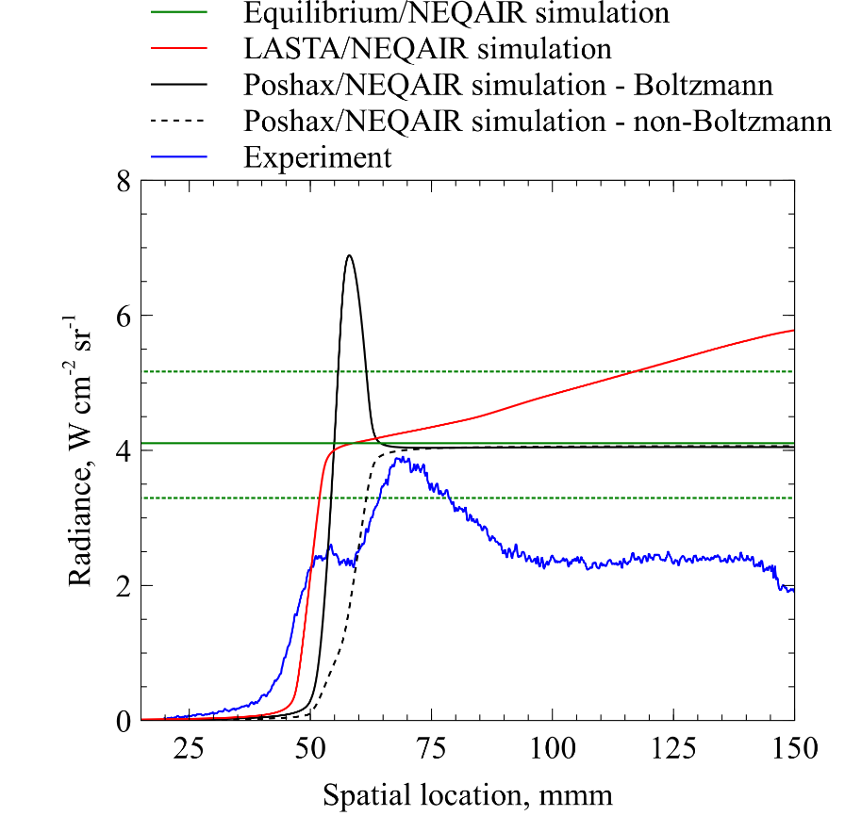
Results – 6.67 Pa, 11.26 km/s
Plateaued radiance region below equilibrium uncertainty
  Potential mismatch due to large boundary layers or driver gas mixing
Double peak non-equilibrium region more pronounced at lower pressure
Neither Boltzmann nor non-Boltzmann models capture non-eq. rise

Slide 8
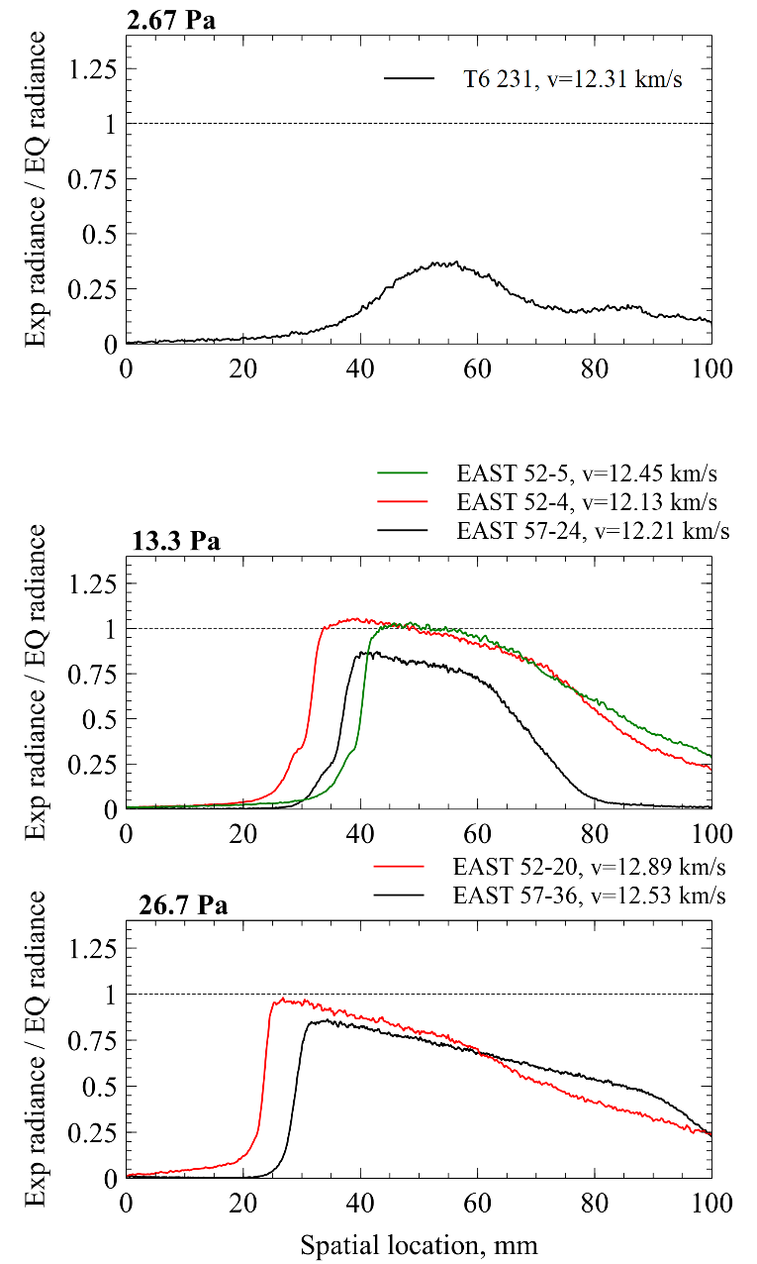
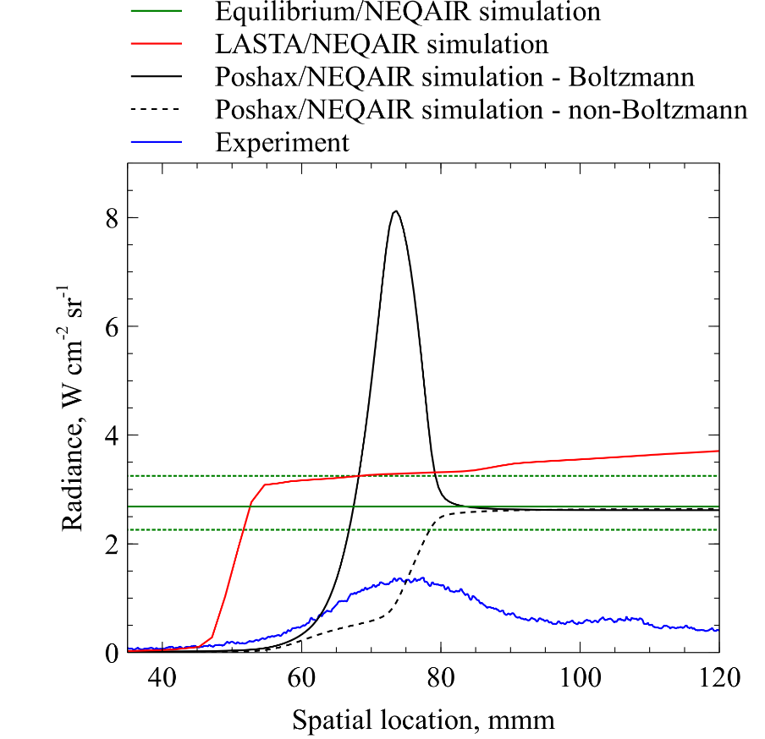
Results – 2.67 Pa, 12.31 km/s
Non-equilibrium region strongly elongated at lower pressure
Radiation intensity far below uncertainty boundary
Both Poshax simulation fail to reproduce non-equilibrium

Slide 9
Conclusions
Shock tube measurements carried out at low pressures in T6 Aluminium shock tube facility
  Between 10.3 and 12.3 km/s
Optical emission spectroscopy carried out in the VIS/NIR spectral regions
Comparison to EAST data at similar shock velocities/pressures where possible
Simulation using LASTA, Poshax, and CEA
Agreement in absolute radiance for higher pressure experiments
Mismatch in absolute radiance for low pressure conditions – possible boundary layer influence, premature mixing with driver gas
Current simulation tools do not adequately reproduce measurement data
  Spectral analysis methods needed to deduce thermochemical state from spectral data

